Slide 1
Week 11 Assignment Figures
Margaret Oneil
BIOL-398-05/S17
Department of Biology
Loyola Marymount University

Slide 2
Without blank correction
ANOVA | WT
p < 0.05 | 2599 (42%)
p < 0.01 | 1726 (27.9%)
p < 0.001 | 1015 (16.4%)
p < 0.0001 | 573 (9.3%)
B & H p < 0.05 | 1936 (31.3%)
Bonferroni p < 0.05 | 302 (4.9%)

Slide 3
With blank correction
ANOVA | WT
p < 0.05 | 2528 (40.8%)
p < 0.01 | 1652 (26.7%)
p < 0.001 | 919 (14.8%)
p < 0.0001 | 496 (8%)
B & H p < 0.05 | 1822 (29.4%)
Bonferroni p < 0.05 | 248 (4%)

Slide 4
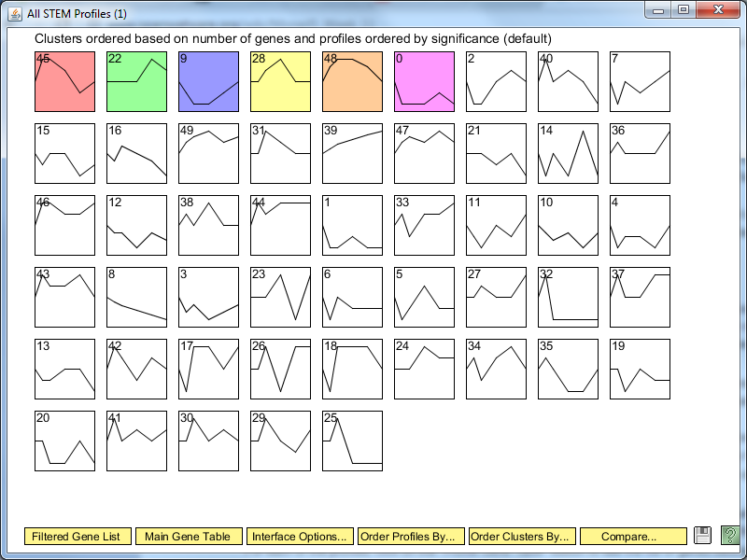
All profiles

Slide 5
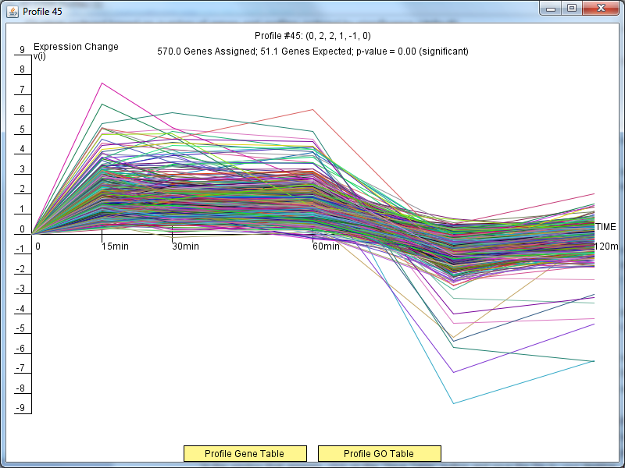
Profile 45

Slide 6
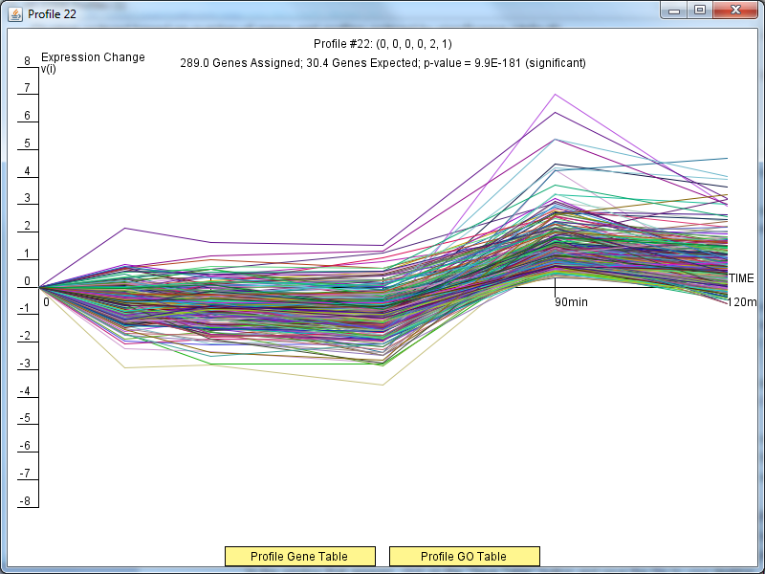
Profile 22

Slide 7
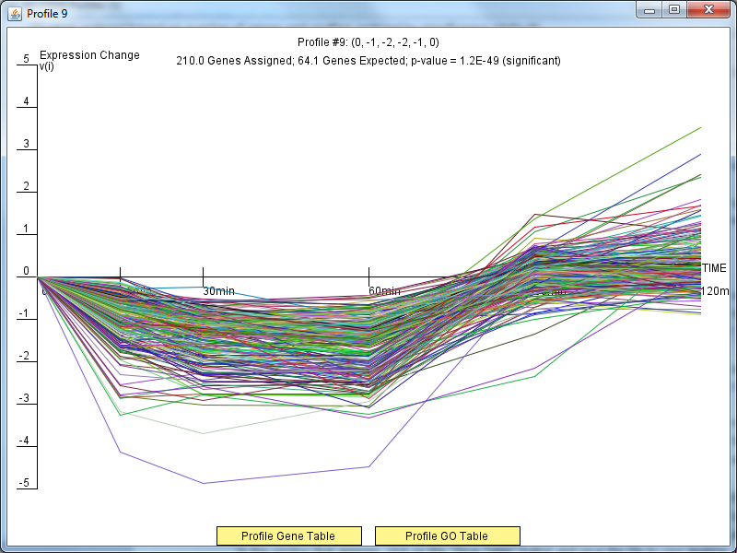
Profile 09

Slide 8
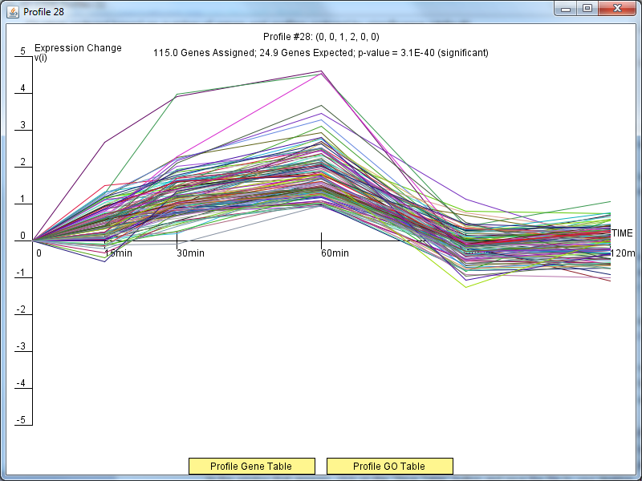
Profile 28

Slide 9
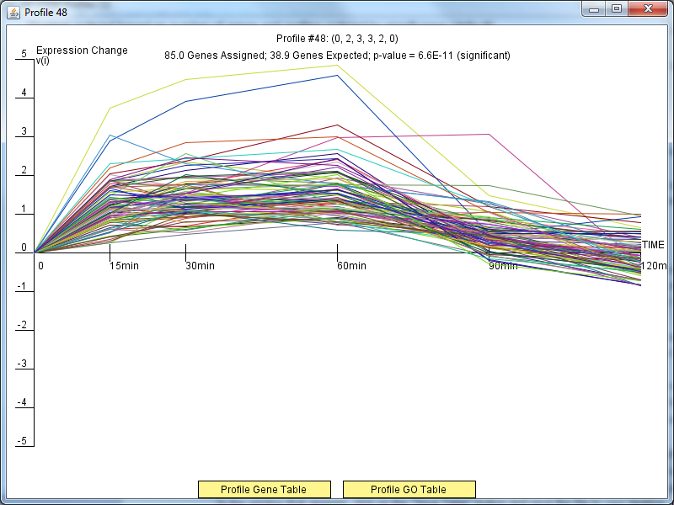
Profile 48

Slide 10
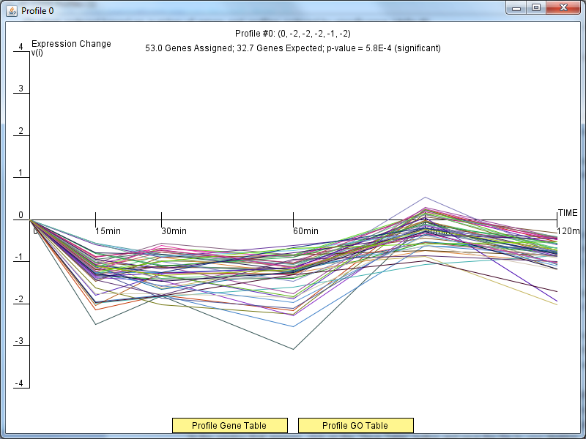
Profile 0

