Slide 1
Modeling Oxygen Consumption and Carbon Dioxide Production in Saccharomyces cervisiae
Paul Magnano and Jim McDonald
Loyola Marymount University
BIOL 398-03/MATH 388-01
Seaver 202
February 28, 2013

Slide 2
Outline
Purpose and Significance of our model
State Variables Used
Explanations of Terms Used
System of Differential Equations
Parameters Required for Simulation
Output of Simulation/Graphs
Discussion of Results
Possible Future Directions

Slide 3
Outline
Purpose and Significance of our model
State Variables Used
Explanations of Terms Used
System of Differential Equations
Parameters Required for Simulation
Output of Simulation/Graphs
Discussion of Results
Possible Future Directions

Slide 4
Purpose of our Model
ter Schure et al. measured the oxygen consumption and carbon dioxide production of Saccharomyces cervisiae in their paper on nitrogen metabolism.
The class chemostat model did not account for these two variables.
Our goal was to develop a model that will predict the oxygen consumption and carbon dioxide production of Saccharomyces cervisiae within the chemostat.
Our model would allow us to observe the changes in oxygen consumption and carbon dioxide production when other state variables were changed.

Slide 5
Significance of the Model
Saccharomyces cervisiae consume oxygen for metabolic purposes and give off carbon dioxide as a result.
The ratio of these two processes make up the respiratory quotient (RQ).
The ter Schure paper showed that the respiratory quotient stayed relatively constant.
The RQ remained constant above 44 mM of ammonium concentration because both the O₂ consumption and CO₂ production were in a steady state.

Slide 6
Significance of the Model
We wanted to develop an equation that modeled ter Schure’s data.
This model was developed with the goal of achieving steady states in O₂ consumption and CO₂ production.
The model we developed showed an initial increase in O₂ consumption which led to an initial increase in CO₂ production, then over time both variables achieved steady states.
We were able to develop a model that allowed us to observe the behaviors in O₂ consumption and CO₂ production by Saccharomyces cervisiae.

Slide 7
Outline
Purpose and Significance of our model
State Variables Used
Explanations of Terms Used
System of Differential Equations
Parameters Required for Simulation
Output of Simulation/Graphs
Discussion of Results
Possible Future Directions

Slide 8
Explanation of State Variables
Nitrogen level: dependant on -> feed rate, outflow rate, consumption by yeast
Carbon: dependant on -> feed rate, outflow rate, consumption by yeast
Yeast: dependant on -> nutrient levels, outflow rate
Oxygen: dependant on -> feed rate, outflow rate, consumption by yeast
Carbon Dioxide: dependant on -> production by yeast, outflow rate

Slide 9
Outline
Purpose and Significance of our model
State Variables Used
Explanations of Terms Used
System of Differential Equations
Parameters Required for Simulation
Output of Simulation/Graphs
Discussion of Results
Possible Future Directions

Slide 10
Explanation of Terms Used in Equations
c1: Nitrogen
c2: Carbon
y: Yeast
o: Oxygen
x: Carbon Dioxide
u: Feed Rate of Nitrogen
u2: Feed Rate of Carbon
u3: Feed Rate of Oxygen
K: Nutrient Saturation Rate Constant
q: Rate Constant for Nutrient In/Outflow
r: Net Growth Rate
V: Nutrient Consumption Rate Constant

Slide 11
Outline
Purpose and Significance of our model
State Variables Used
Explanations of Terms Used
System of Differential Equations
Parameters Required for Simulation
Output of Simulation/Graphs
Discussion of Results
Possible Future Directions

Slide 12
Equations Used in the Model
Nitrogen:
dc1dt=q*u- q*c1 -((y*c1*V)/(K+c1))*(c2/(c2+K))
Carbon:
dc2dt=q*u2 - q*c2 -((y*c1*V)/(K+c1))*(c2/(c2+K))
Yeast Population:
dydt = (y*r)*(V*c1)/(K+c1)*(c2/(c2+K))*(o/(o+K)) - q*y
Oxygen:
dodt = q*u3 - q*o – ((y*o*V)/(K+o))
Carbon Dioxide:
dxdt = ((y*o*V)/(K+o)) - q*x

Slide 13
Outline
Purpose and Significance of our model
State Variables Used
Explanations of Terms Used
System of Differential Equations
Parameters Required for Simulation
Output of Simulation/Graphs
Discussion of Results
Possible Future Directions

Slide 14
Explanation of Required Parameters
Nutrient Saturation Rate Constant -> amount of nutrient that saturates the cell
Rate Constant for Nutrient In/Outflow -> rate of flow in and out of Chemostat
Net Growth Rate -> birth rate of yeast – death rate of yeast
Nutrient Consumption Rate Constant -> amount of nutrient that is consumed by cell
Feed Rate of Nitrogen -> rate that nitrogen flows in
Feed Rate of Carbon -> rate that carbon flows in
Feed Rate of Oxygen -> rate that oxygen flows in

Slide 15
Outline
Purpose and Significance of our model
State Variables Used
Explanations of Terms Used
System of Differential Equations
Parameters Required for Simulation
Output of Simulation/Graphs
Discussion of Results
Possible Future Directions

Slide 16
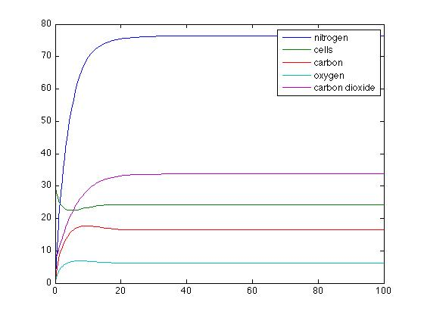
Graph of our Initial Simulation
t0 =0
t1 =100
c0 = 0
N0 = 30
c20 = 0
x0 = 0
o0 = 8
q = 0.2
u = 120
r = 1.0
K = 5
V = 0.5
u2 = 60
u3 = 40
Concentration
Time

Slide 17
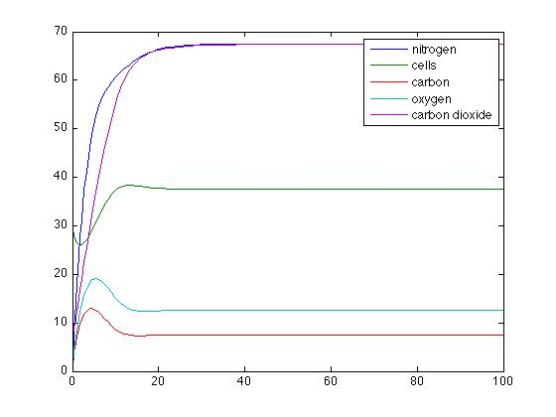
Inflow/Outflow Rate was Increased
t0 = 0
t1 = 100
c0 = 0
N0 = 30
c20 = 0
x0 = 0
o0 = 8
q = 0.5
u = 120
r = 1.0
K = 5
V = 0.5
u2 = 60
u3 = 40
Concentration
Time

Slide 18
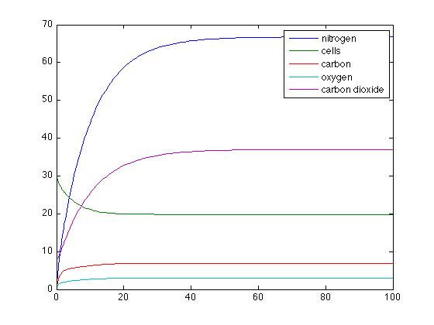
Inflow/Outflow Rate was Decreased
t0 = 0
t1 = 100
c0 = 0
N0 = 30
c20 = 0
x0 = 0
o0 = 8
q = 0.1
u = 120
r = 1.0
K = 5
V = 0.5
u2 = 60
u3 = 40
Concentration
Time

Slide 19
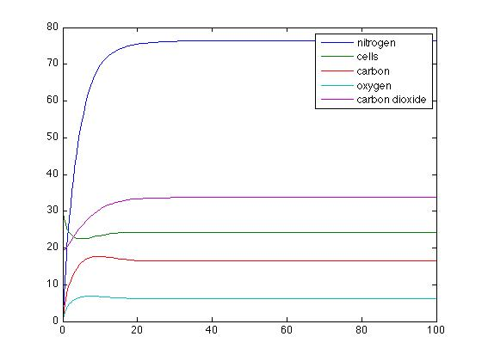
Initial O₂ Concentration was Increased
t0 = 0
t1 = 100
c0 = 0
N0 = 30
c20 = 0
x0 = 0
o0 = 20
q = 0.2
u = 120
r = 1.0
K = 5
V = 0.5
u2 = 60
u3 = 40
Concentration
Time

Slide 20
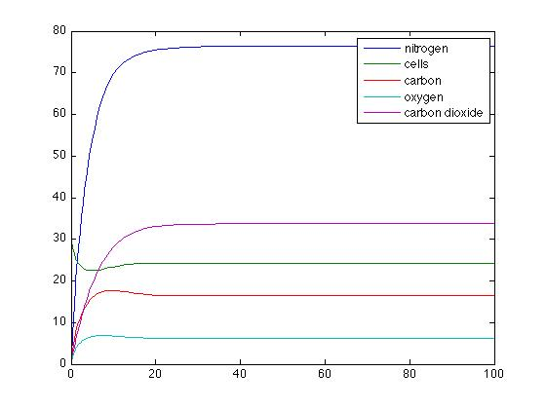
Initial O₂ Concentration was Decreased
t0 = 0
t1 = 100
c0 = 0
N0 = 30
c20 = 0
x0 = 0
o0 = 2
q = 0.2
u = 120
r = 1.0
K = 5
V = 0.5
u2 = 60
u3 = 40
Concentration
Time

Slide 21
Results of Simulation
The general trend of each simulation in our model:
As oxygen was fed into the chemostat the oxygen consumption increased, resulting in an initial increase in carbon dioxide production.
After an amount of time both the O2 consumption and CO2 production leveled off into a steady state (the time and amount were dependent on the value of the other variables).

Slide 22
Outline
Purpose and Significance of our model
State Variables Used
Explanations of Terms Used
System of Differential Equations
Parameters Required for Simulation
Output of Simulation/Graphs
Discussion of Results
Possible Future Directions

Slide 23
Discussion of Results
ter Schure et al. found that oxygen consumption and carbon dioxide production achieve steady states quickly in the chemostat when aerobic conditions are present.
Our equations modeled the O₂ consumption and CO₂ production when the yeast is performing aerobic metabolism.
Similar to the ter Schure paper, our model produced steady states in both O₂ consumption CO₂ shortly after initial increases.

Slide 24
Discussion of Results
The graphs from our model showed a similar trend to the graphs in the ter Schure paper above 44 mM ammonia concentration.
We formulated new equations for a model that accounted for the steady states achieved in O₂ consumption and CO₂ production.
Our model reflected the data and graphs present in the ter Schure paper.

Slide 25
Outline
Purpose and Significance of our model
State Variables Used
Explanations of Terms Used
System of Differential Equations
Parameters Required for Simulation
Output of Simulation/Graphs
Discussion of Results
Possible Future Directions

Slide 26
Possible Future Directions
Our model accounts for CO2 production in aerobic metabolism. A possible future direction would be to compare CO2 production between aerobic and anaerobic metabolism.
We could also compare the growth rates of Saccharomyces cervisiae between the two types of metabolism.

Slide 27
Summary
Model’s Purpose and Significance
State Variables Explained
All Terms Used Explained
Differential Equations We Modeled
Parameters Explained
Observed Simulation Outputs and Graphs
Results Discussed
Looked at Future Directions

Slide 28
References
ter Schure, Eelko G. et al. "The Concentration of Ammonia Regulates Nitrogen Metabolism in Saccharomyces Cerevisiae." Journal of Bacteriology 177.22 (1995): 6672-675.

