Slide 1
Integrins, Cell and Tissue Mechanics, Intro to Biomaterials
2/19/15
Lecture 7, ChE 575

Slide 2
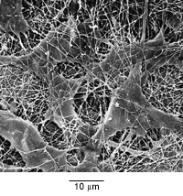
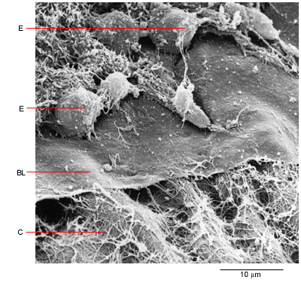
Natural Cell Microenvironment: ECM
PROTEINS AND SUGARS
Fibroblasts in connective tissue
Molecular Biology of the Cell
Epithelial, basal lamina, connective tissue
Molecular Biology of the Cell

Slide 3
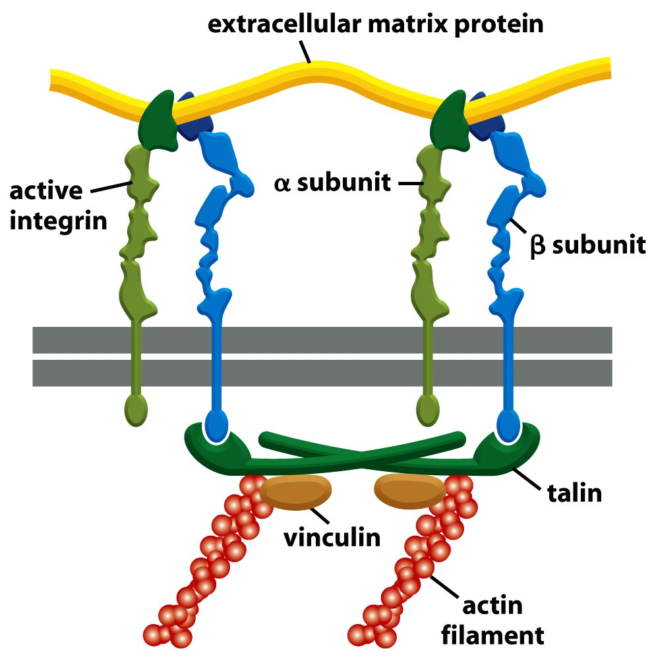
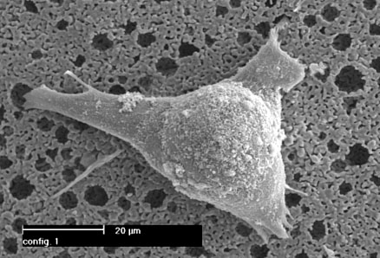
Integrin Structure

Slide 4
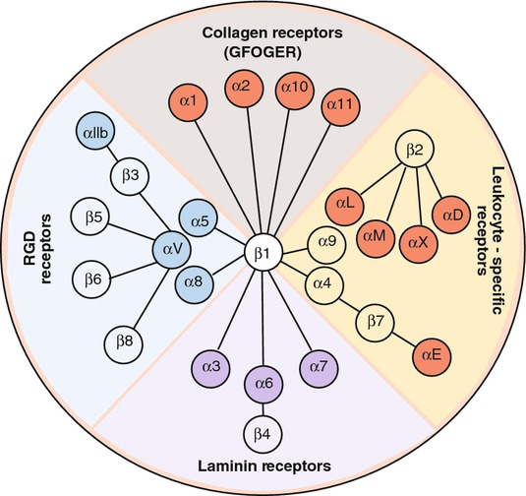
Many different heterodimers of integrins
Heterodimers are specific to the ECM proteins in tissue: matching cell type to tissue
8 betas, 18 alphas = 24 combinations (even though 8x18 = 144)

Slide 5
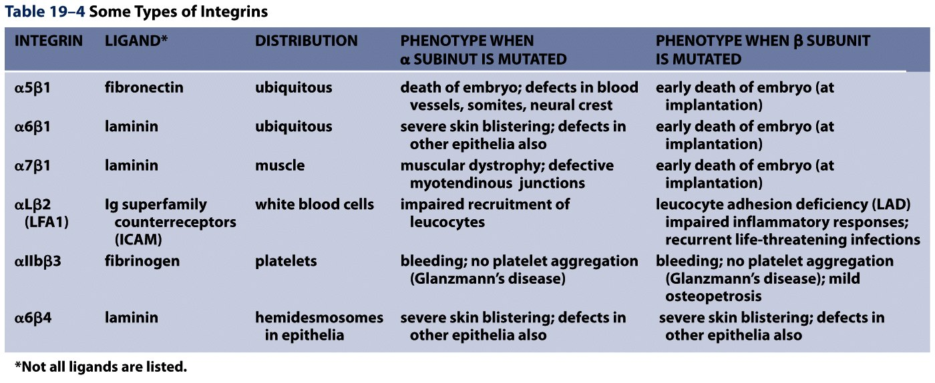
Not all cells express all integrin pairs!
Differential expression of integrins helps isolate cell types to different tissue areas
Epithelia: attach to laminin.
  Carcinoma (epithelial cancer) cells: begin to express fibronectin and collagen-binding integrins, so they can invade the surrounding tissue and metastasize.
Tissue engineered material: coat these with proteins that will ONLY BIND the cells you want there!

Slide 6
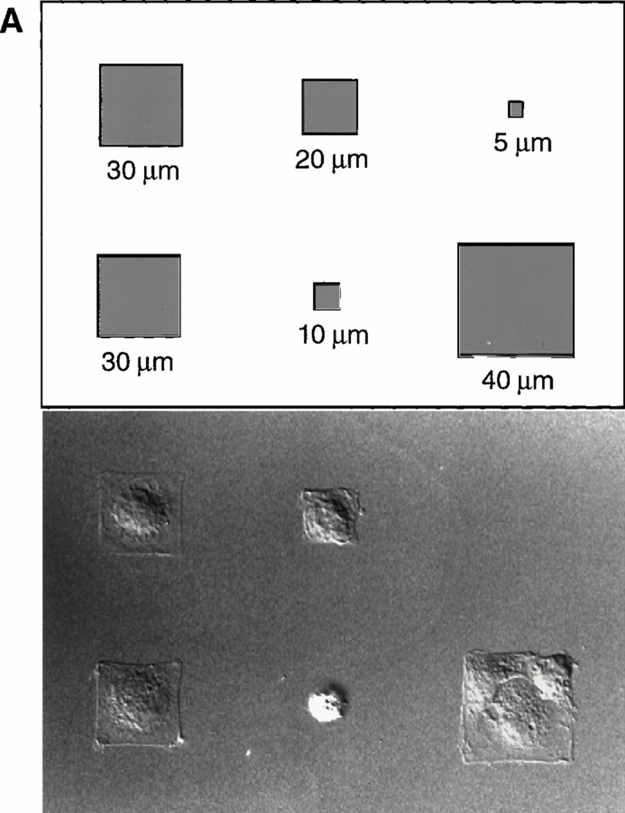
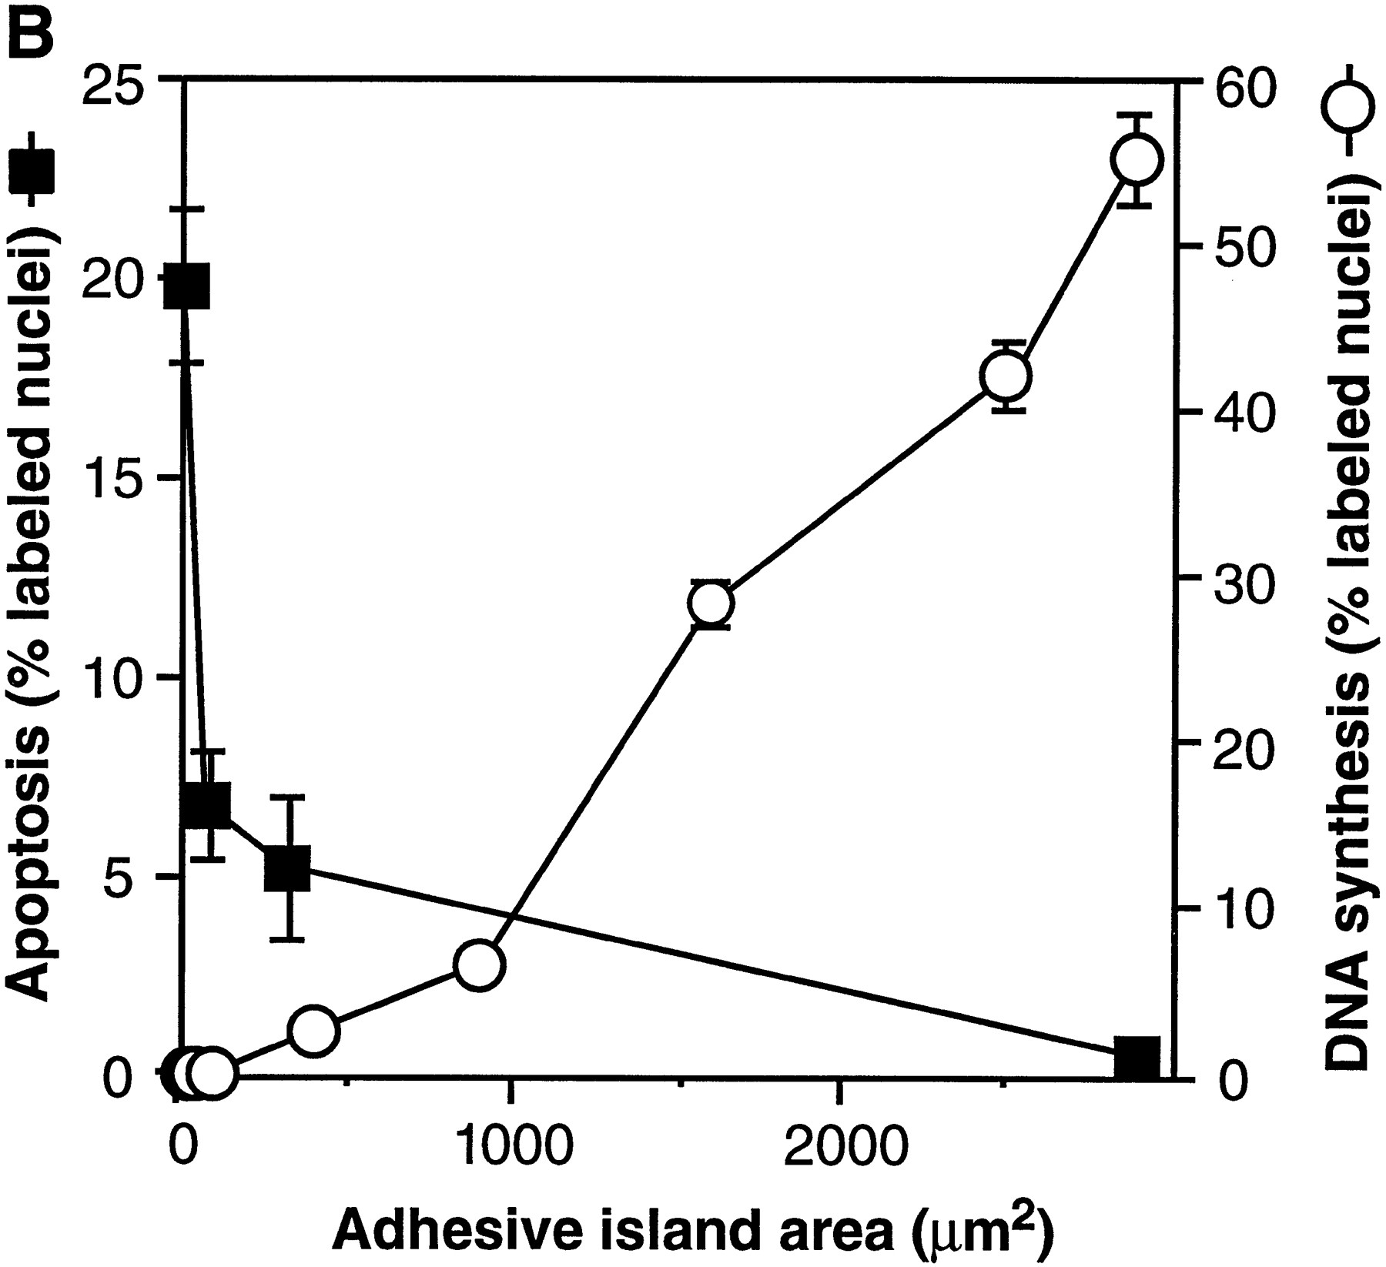
Most Cells Need to Adhere and Spread to Survive
Geometric Control of Cell Life and Death
Christopher S. Chen, et al.
Science 276, 1425 (1997);

Slide 7
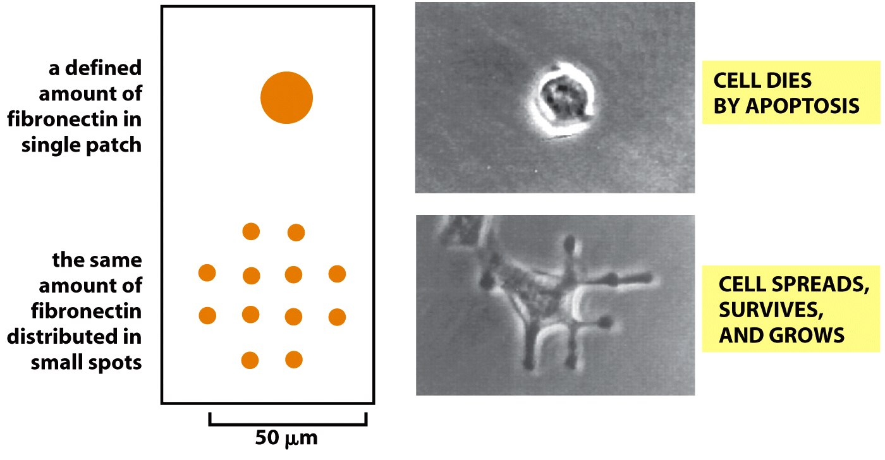
This effect not from “# of integrin bonds”
“anoikis”

Slide 8
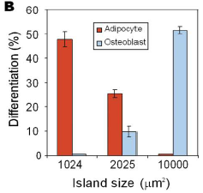
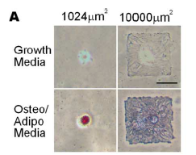
Next Paper Review:
Stem Cell Differentiation by controlling size of adhesion sites
McBeath et al., Dev Cell, 2004

Slide 9
Cell and Tissue Mechanics

Slide 10
Introduction to Biomaterials

Slide 11
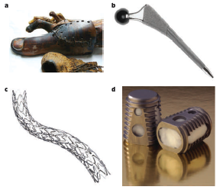
History of biomaterials
Biomaterials range from prosthetics, to stents, to implantable scaffolds
“Classes” of biomaterials we’ll go through:
  Synthetic, Bioinert
  Synthetic, Bioactive/Bioinstructive
  Natural, Bioderived Polymers
Biomaterials developed, at least initially, for tissue engineering
Huebesch and Mooney, Nature, 2009

Slide 12
Choice:
1. Do you want a biomaterial that the body ignores?
2: or a material that is responsive to, or instructive toward the body?

Slide 13
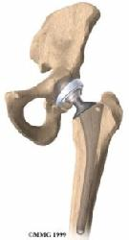
If 1: Bioinert materials
Purposes:
1) do not entice an immune response once implanted into the body.
2) Have incredible mechanical toughness withstand physiological loading
3) Long lasting in the body (won’t degrade over time)
Applications:
1) Skeletal tissue prosthesis (hip, knee replacement)
2) Vascular stents, heart valves
3) Tooth caps, replacements, other dental applications

Slide 14
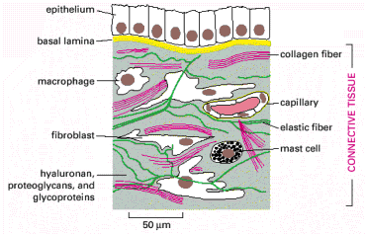
If 2: Natural biopolymers
Taken straight from body: are native proteins found in the ECM
Fibrous, instructive, soft (in bulk): the opposite of bioinert examples
Regulate cell function, act as a physical scaffold, can be remodeled by cells
Not very controllable (lumped parameters)
Images taken from Molecular Biology of the Cell
Examples: Type I Collagen, Fibrin, Matrigel

Slide 15
Newer option: Functionalize inert surfaces with cell instructions

Slide 16
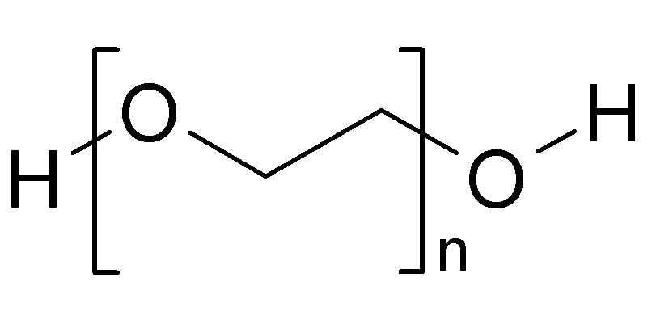
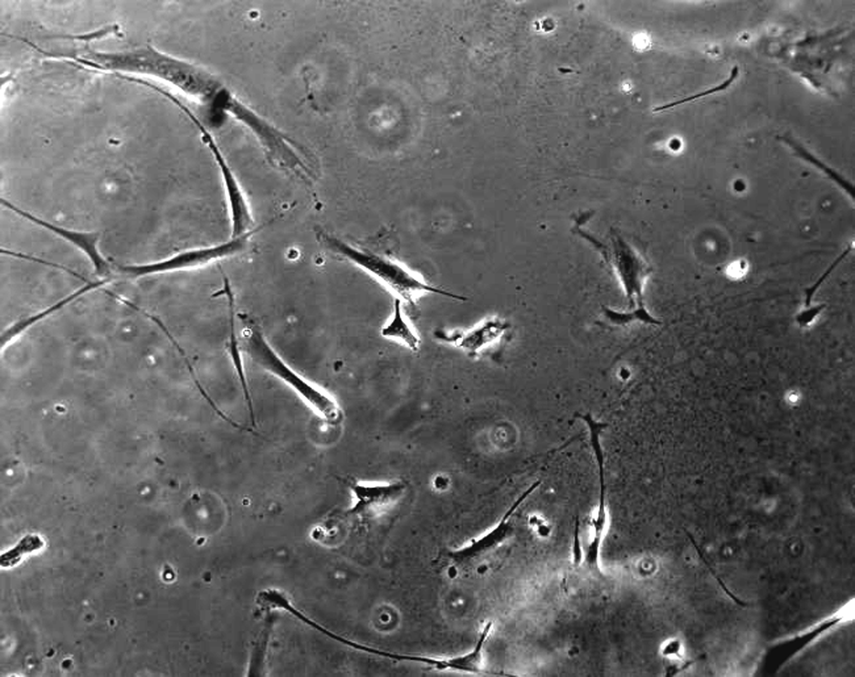
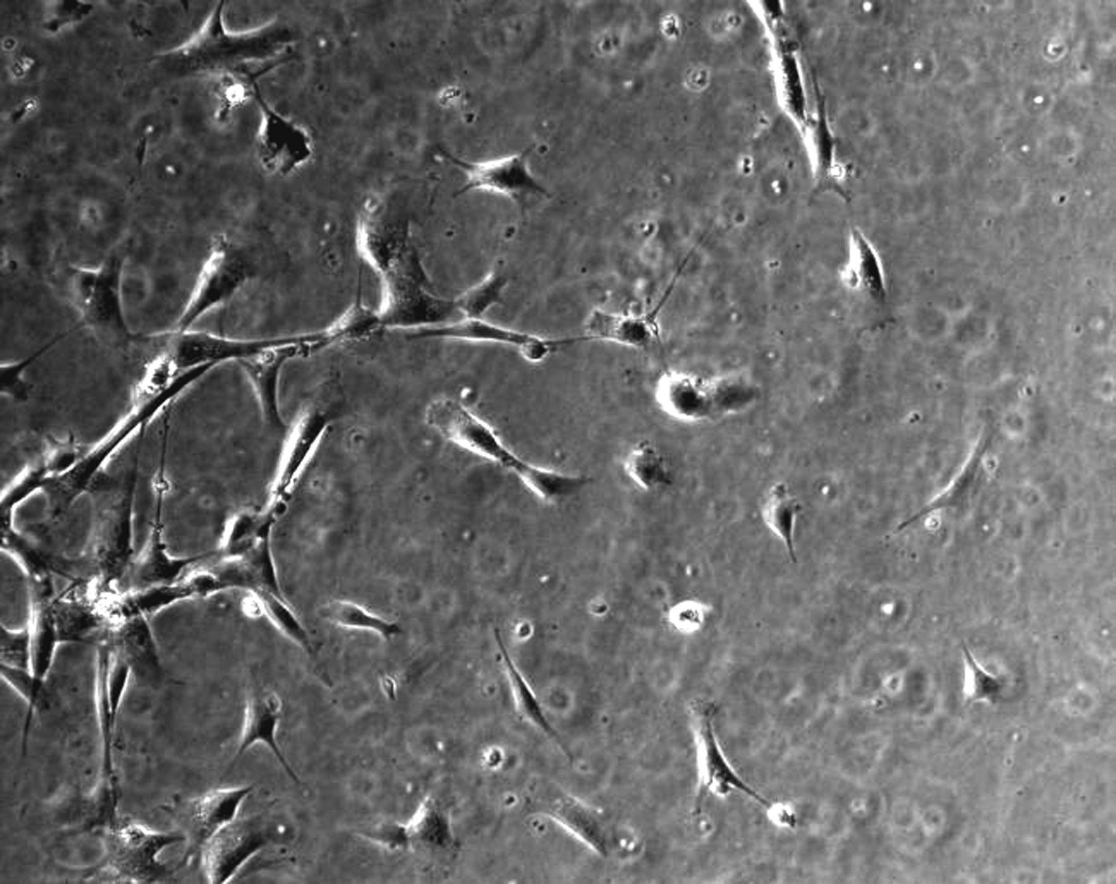
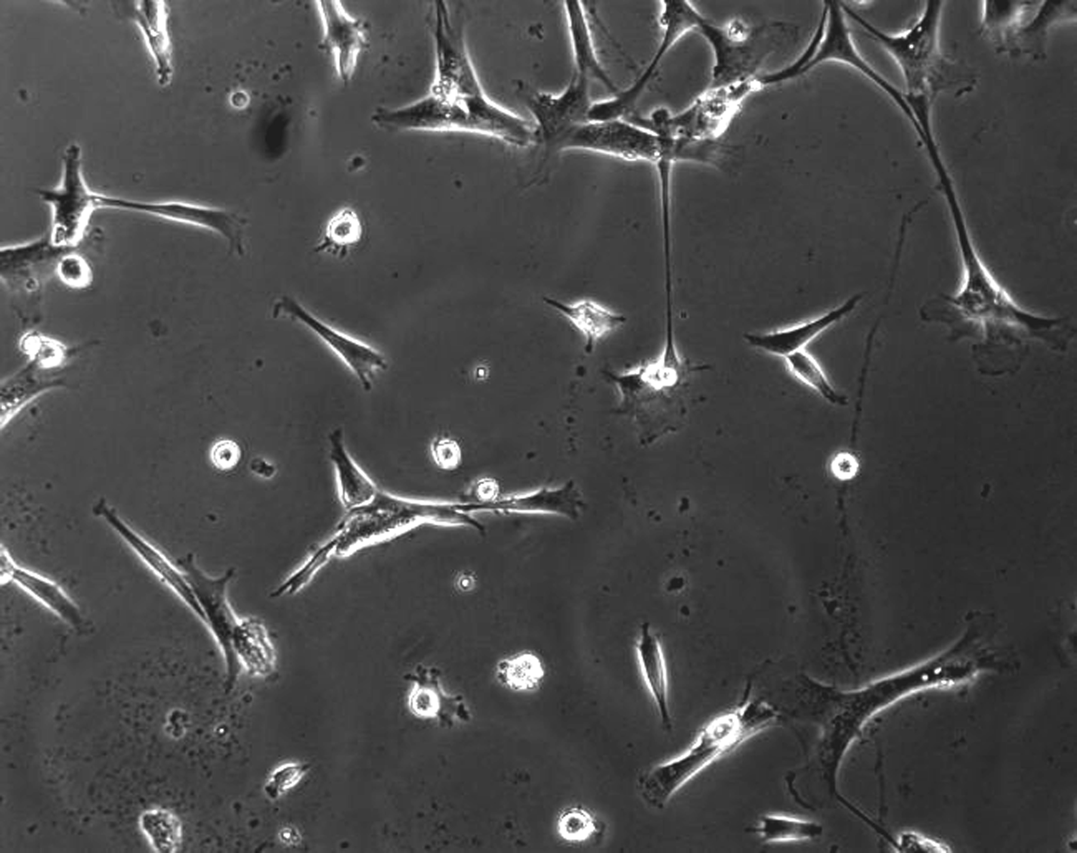
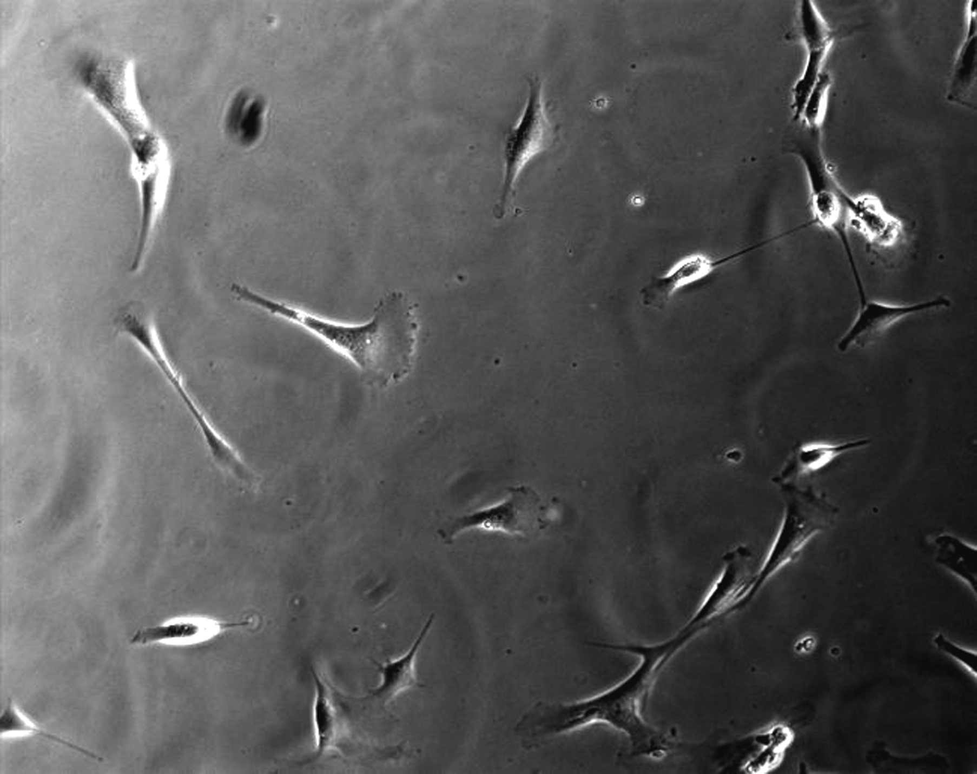
1: Regulate Cell Adhesion
Attack amines, thiols on proteins, or biotinylate them
No treatment
Type I Collagen
RGDS
Hydrophilic surface, so no protein will stick
Fibronectin
KQAGDV

Slide 17
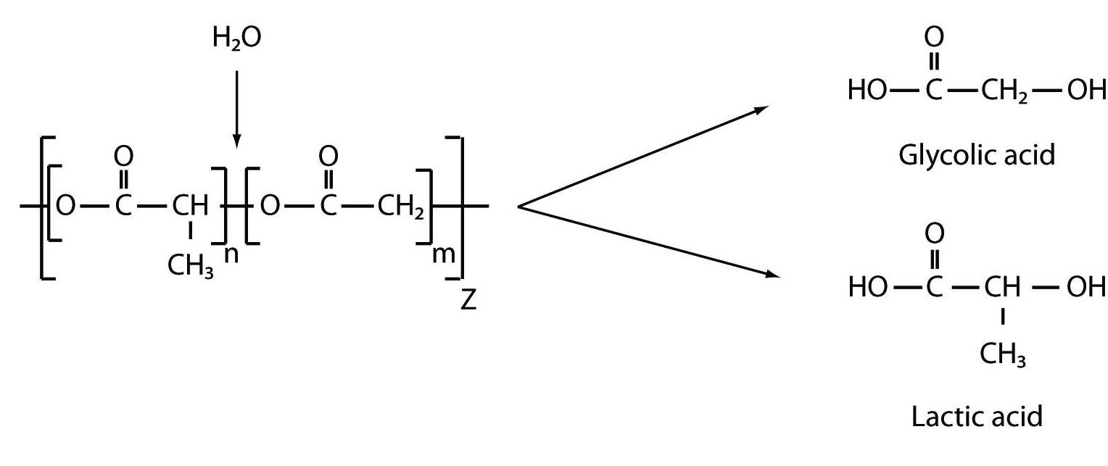
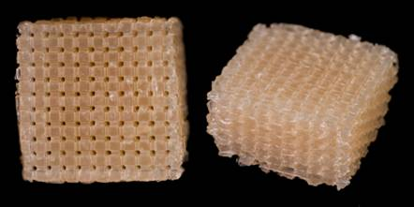
2: Regulate bio-degradation
Purposes:
Temporary space holder for tissue replacement
Not entirely bioinert – meant to degrade away while being replace by native tissue in vivo
Typically adhesive to ECM proteins and, therefore, cells
Tune biodegradation to match body’s kinetics (rate of tissue production/replacement)
Degradation typically hydrolytic (ester groups)
Unstable.
Degradation half life, in months
100% PGA
50-50 blend
100% PLA
% PLA in PLGA blend
Applications:
Both Hard and Soft tissue repair
where vascularization is needed

Slide 18
Thoughts, Perspectives
There’s a biomaterial out there for every need, only a subset mentioned here.
Establish design criteria from biological purpose
Some are easier than others to modify – so justify your choice!
Some are cheaper than others – so justify your choice!

