Slide 1

Synthetic Biology Open Language
By 何明浩 李荣蓬

Slide 2
Outline
Definition and overview.
Background knowledge.
Core model in SBOL.
Examples.
Other issues to mention.

Slide 3
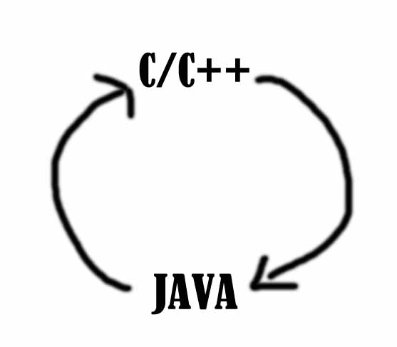
Part1 Definition and overview
What is SBOlanguage
English?

Slide 4
Similar, but not really.
The official definition of SBOL is :
Synthetic Biology Open Language (SBOL) is a software standard for the electronic exchange of specifications and descriptions of genetic parts, devices, modules, systems, and engineered genomes.
My Understanding for you to get the idea is :
SBOL is an abstraction in the conception level that you can imitate what DNA, genomes, cells do, what’s more, you can not only imitate the DNA’s behaviors but also create new guys following nature’s simple but beautiful rules.
SBOL is a language for you to use.

Slide 5
History of SB?L
There once were many language standard to describe the DNA behaviors. But they can not communicate with each other, this is not acceptable and SBOL came out in 2008 , ending this situation in some way.
SBOL
It is first developed by some scientists in MIT and got support from Microsoft. Now it is widely accepted and it is also abelian with many other softwares such as DNA2.0’s gene designer. It has three main platforms: Java, C++, Python. Newest version:1.1.0.

Slide 6
Part2 Background knowledge
Biobricks
UML
-Unified Modeling Language
XML
-Extensible Markup Language
RFC
-Request for comments
RDF
-Resource Description Framework
You don’t have to make so many definitions clear now, we are just going to see what do they mean indeed.

Slide 7
Part3 Core of the Models in SBOL

Slide 8
The four main classes and some elements in SBOL are:
DnaSequence
Dnacomponent
Collection
SequenceAnotation
Also, you can create your own elements but they are ”optional” in some way and can not be read by other scientists unless they have been ac

Slide 9

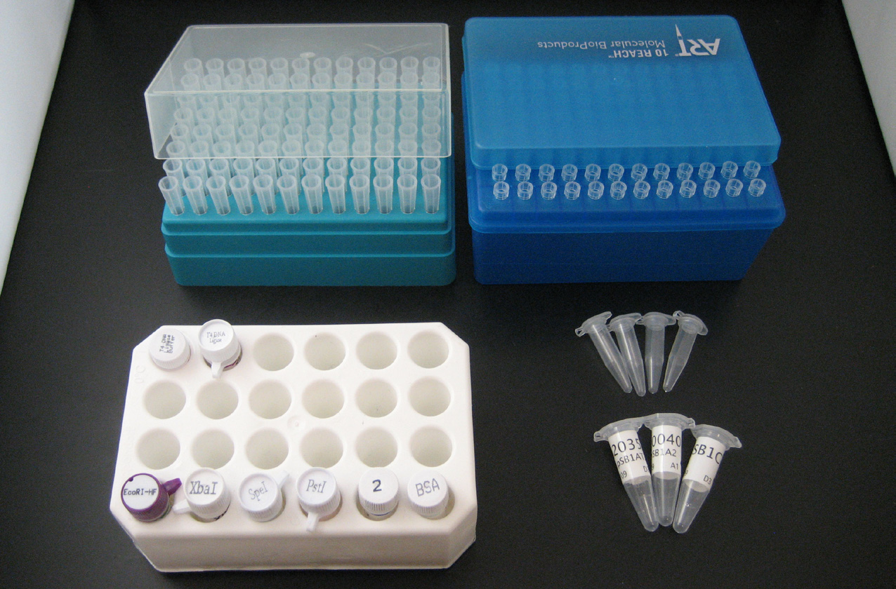
With this structure supported, people can create their own DNA Sequence, use others’ components to do their own tasks.
You can combine the bricks, cut off the bricks ,select the bricks you want and get the information you need . What’s more, you can predict what your molecules can do without working in the lab!
Pictures resource:
BioBrick™ Assembly Manual
http://www-computer.org/computers-internet

Slide 10
Part3 UML(classes)
Unified Modeling Language (UML) is a standardized general-purpose modeling language in the field of object-oriented software engineering. UML includes a set of graphic notation techniques to create visual models of object-oriented software-intensive systems.
http://en.wikipedia.org/wiki/Unified_Modeling_Language

Slide 11
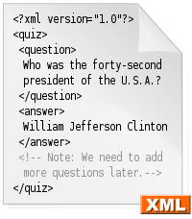
Part3 XML
Extensible Markup Language (XML) is a markup language that defines a set of rules for encoding documents in a format that is both human-readable and machine-readable. http://en.wikipedia.org/wiki/XML

Slide 12
Part3 RDF and RFC (not KFC)
The Resource Description Framework (RDF) is a family of World Wide Web Consortium (W3C) specifications originally designed as a metadata data model.
In computer network engineering, a Request for Comments (RFC) is a memorandum published by the Internet Engineering Task Force (IETF) describing methods, behaviors, research, or innovations applicable to the working of the Internet and Internet-connected systems.
This is why it’s reusable and open to develop.

Slide 13
Part4 Examples
Know the structure, example1 :
Annotated Composite DnaComponent BBa_I0462
In Figure above, the BioBrick™ part BBa_I0462, a DnaComponent, is depicted with annotations of three DnaComponents: a ribosome binding site (BBa_B0034), the coding sequence for LuxR (BBa_C0062), and a double terminator BBa_B0015. In Figure below,the same DnaComponent is described using pseudocode as an example of SBOL:Core:model as text.
LuxR家族调控蛋白是一类在革兰氏阴性细菌群体感应中起重要作用的调控蛋白,它们参与由酰基高丝氨酸内酯介导的多种生物学过程,调控细菌生物发光、质粒转移、生物膜形成以及多种胞外酶、毒力因子和次生代谢产物的合成。

Slide 14
The pseudocode in SBOL
DnaComponent [
uri: http://partsregistry.org/Part:BBa_I0462
displayId: BBa_I0462
name: I0462
description: LuxR protein generator
annotations:
Link to the file

Slide 15
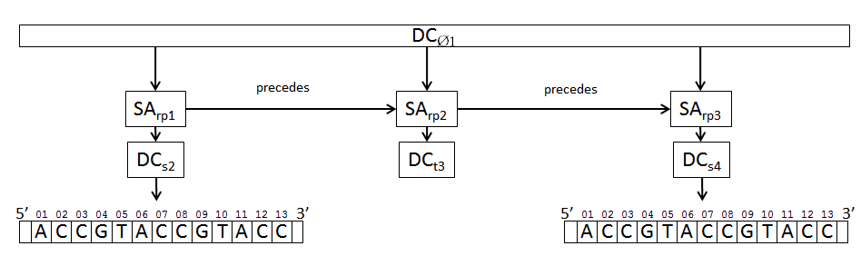
Get planned ,Partially Realized Design Template , example2:
The design template for DnaComponent DCØ1 specifies that at least three DnaComponents must be present in this design. Their ordering is constrained, DCs2 precedes DCt3 and DCt3 precedes DCs4. In this template the DCs2 and DCs4 already have a DnaSequence specified, however DCt3 does not, instead it specifies a type which it must me constrained to. Therefore, the DCt3 component can be filled in to match the type constraint later.

Slide 16
DnaSequence of subComponent on the minus strand, example3:
The SequenceAnnotation’s (SApos1) strand is specified as ‘-‘, the subComponent’s (DCs2) DnaSequence (DS1) is the reverse-complement of the parent DnaComponent’s (DCs1) sequence (DS2) in the annotated region.

Slide 17
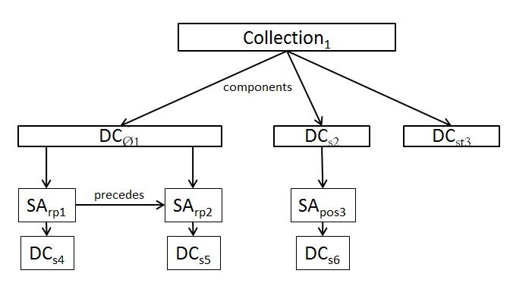
About the collection
To provide an organizational container for multiple DnaComponent instances, we provide the Collection class. The example in Figure 11 shows a Collection with multiple DnaComponents grouped together and ready to be shared between software applications.
Collection is a set with specific property or for specific usage. Its elements is grouped so that they can be shared and reused much more easily.

Slide 18
Part5 Other issues to mention
Operation details ( for C++ funs). (example: how to add collection)
The RFC rules, MUST, OPTIONAL and more,example.
Reference:
http://www.sbolstandard.org/
Official Introduction:SBOL V1.1.0 PDF format
Introduction to RFC Authors
an optional extension of SBOL: Provisional BioBrick Language

Slide 19
Q&A
Thanks

