Slide 1
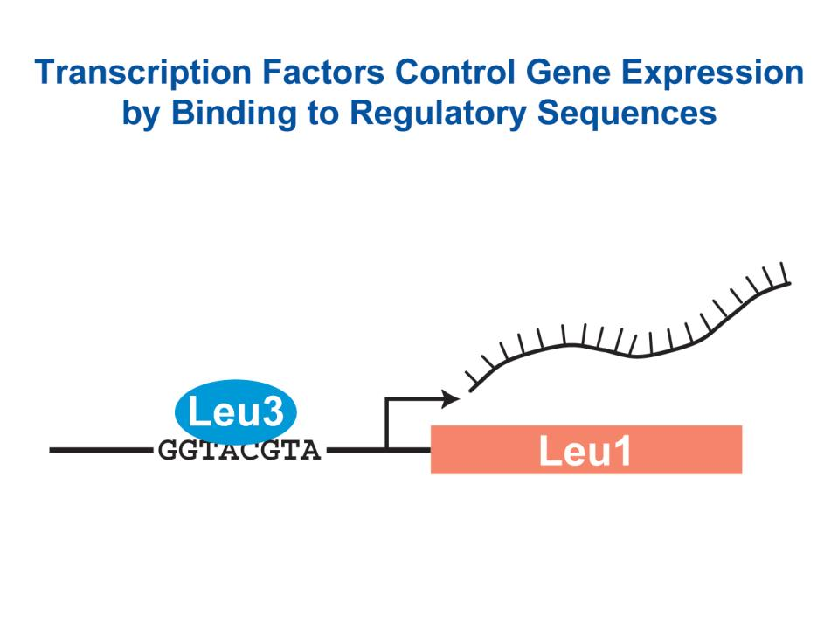
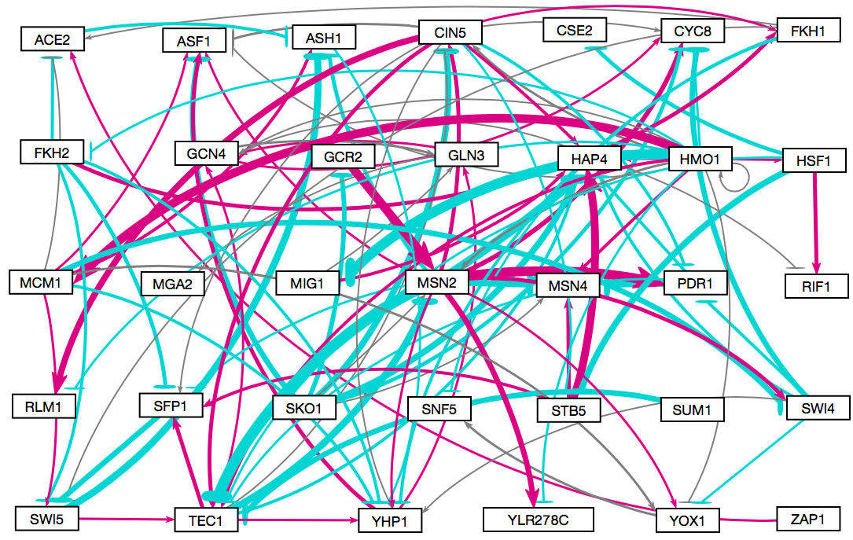
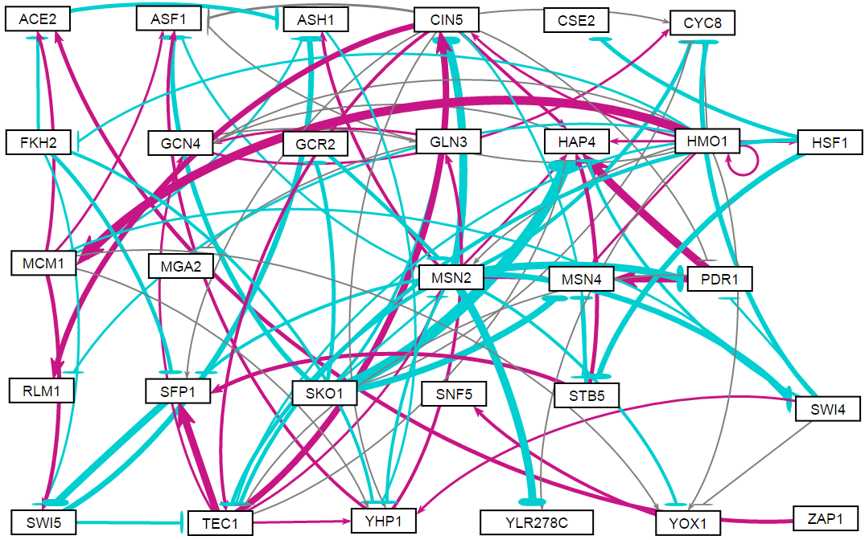
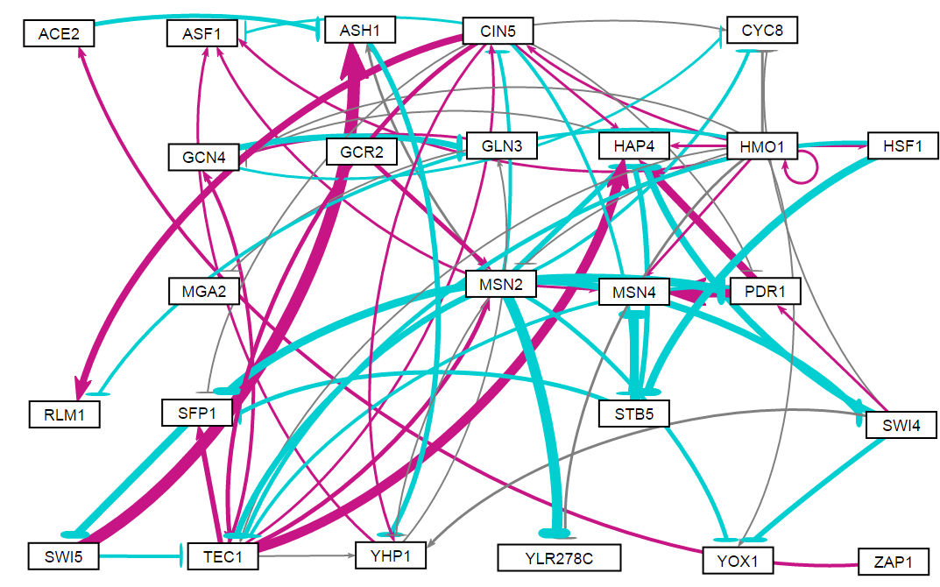
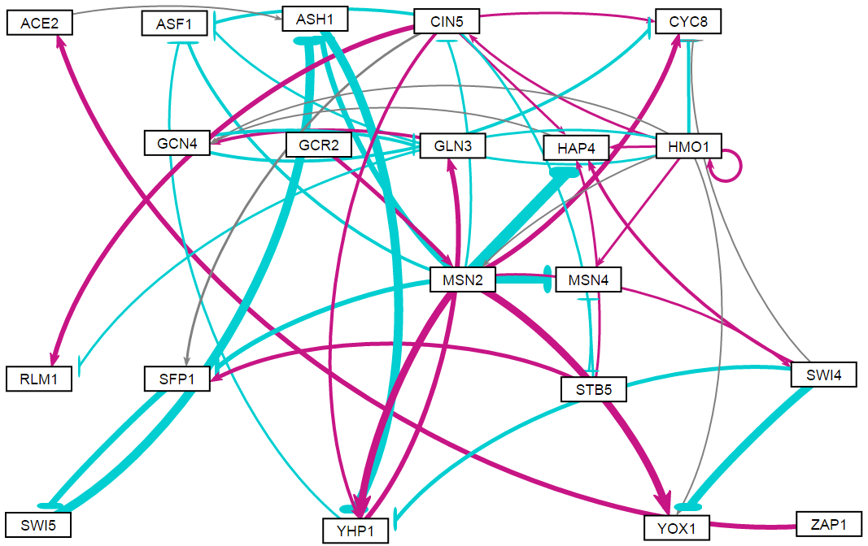
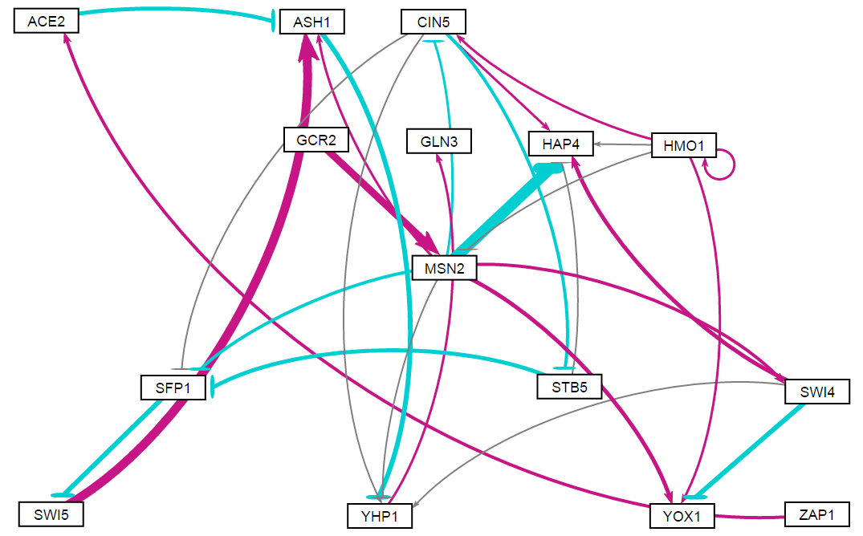
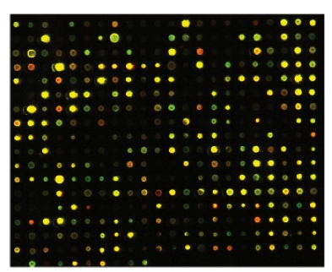
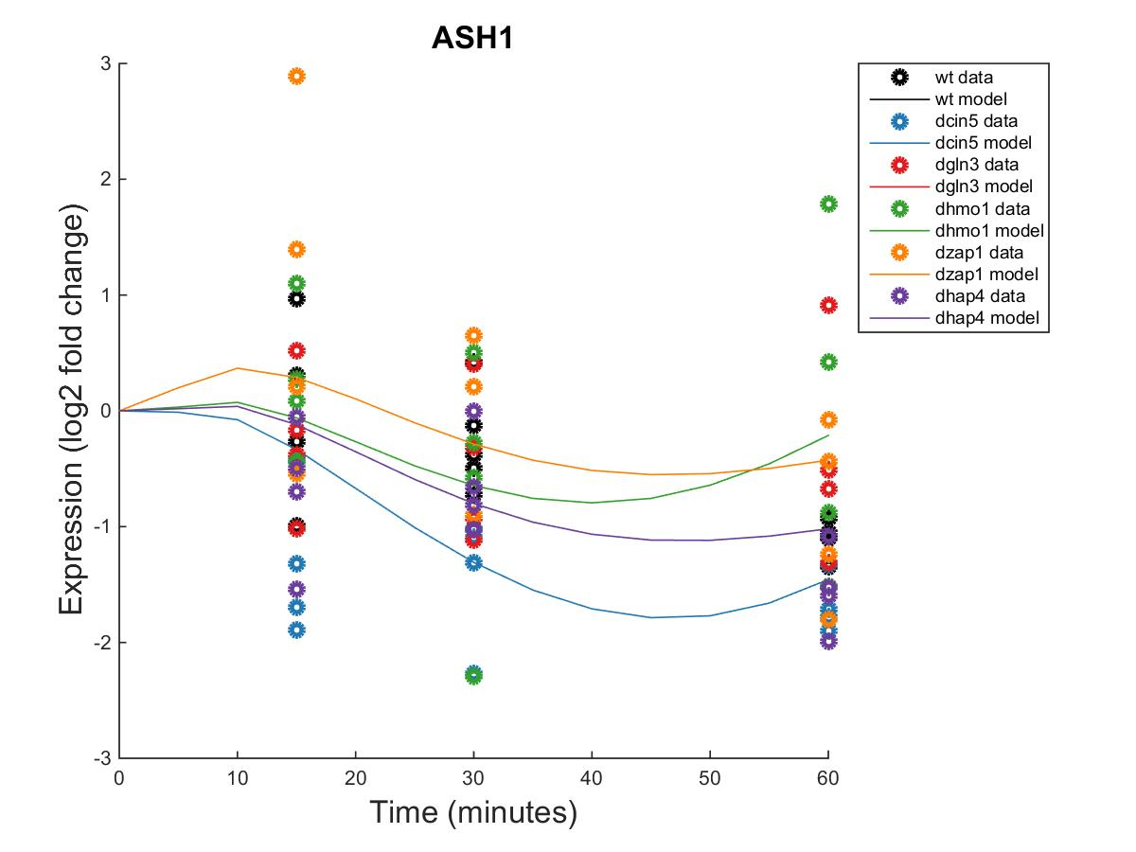
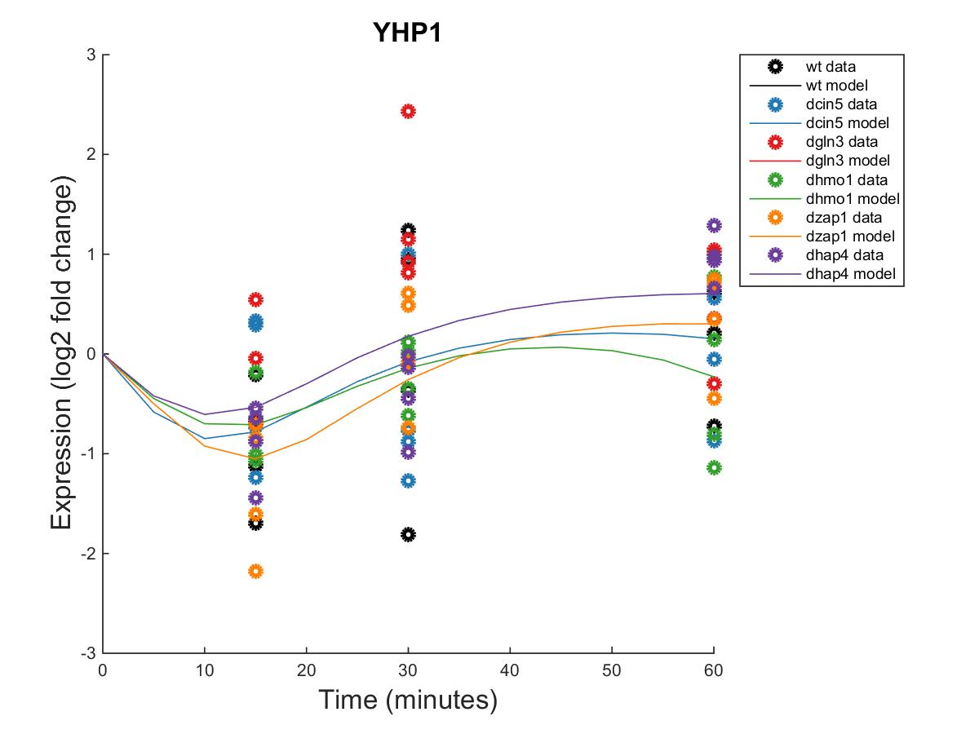
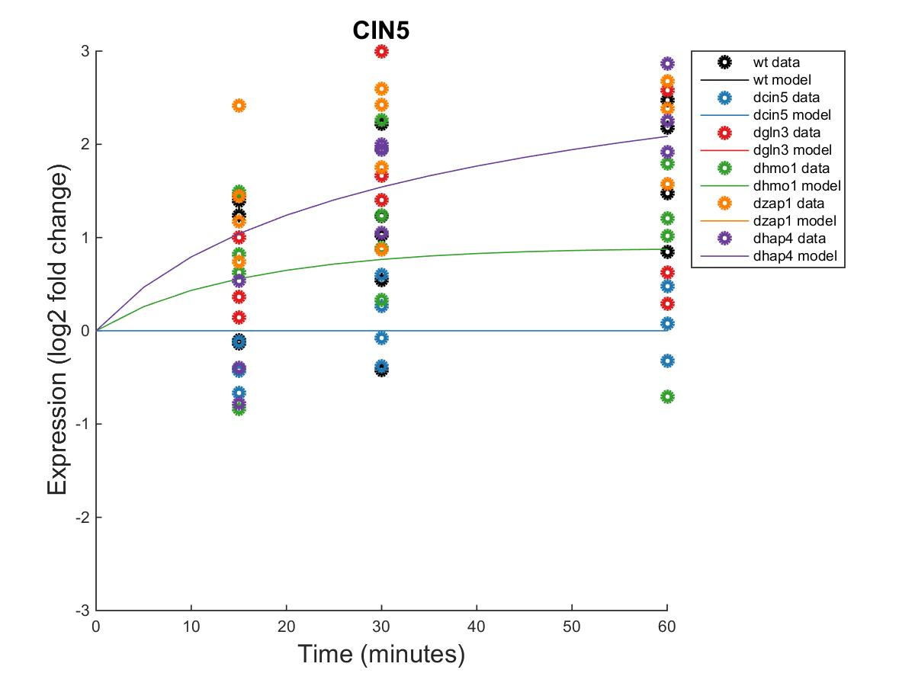
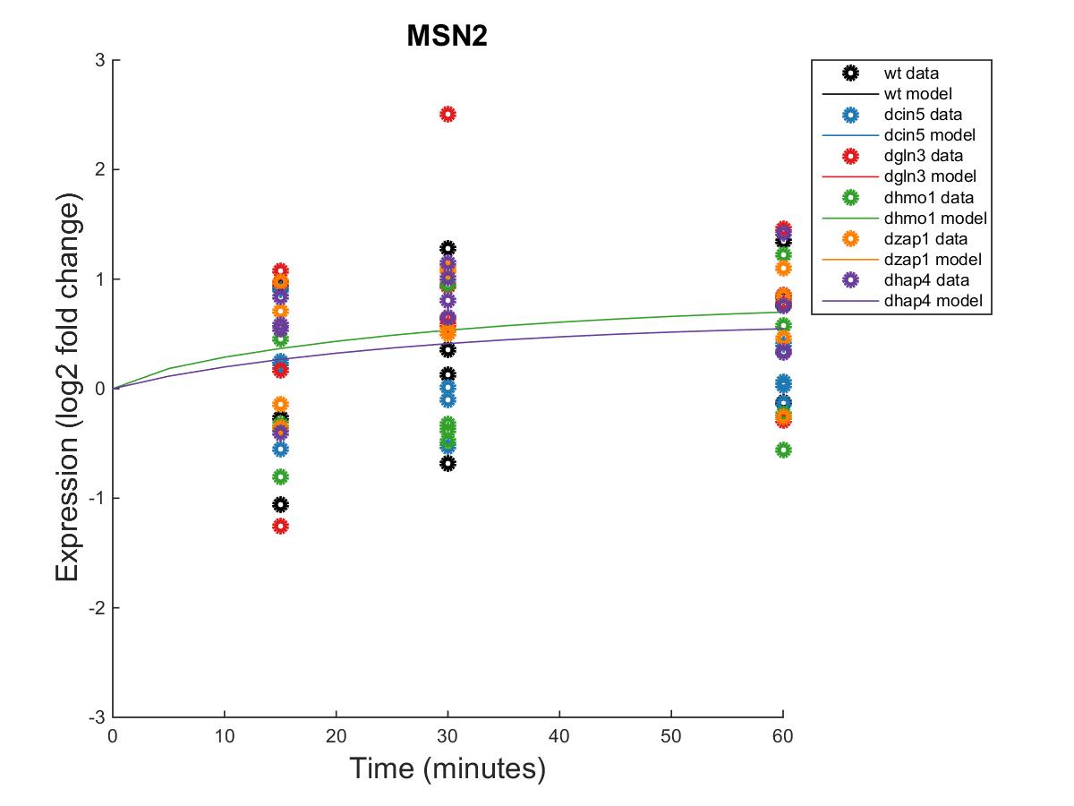
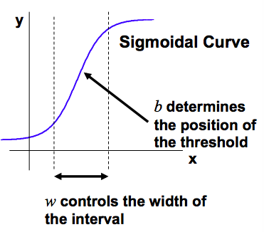
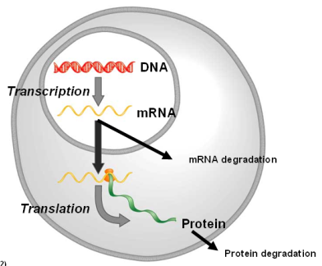
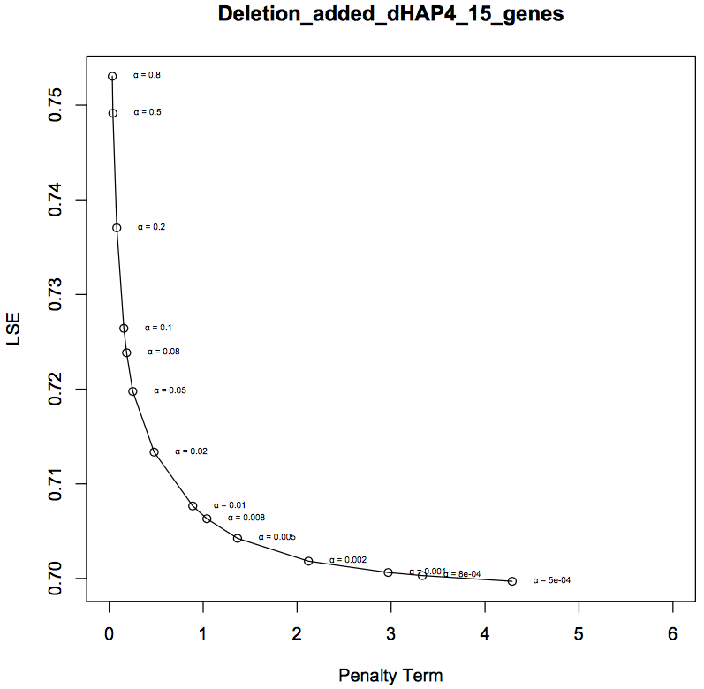
Evaluating Hap4’s Role in the Gene Regulatory Network that Controls the Response to Cold Shock in Saccharomyces cerevisiae using GRNmap
K. Grace Johnson¹, Margaret J. O’Neil², Kam D. Dahlquist², and Ben G. Fitzpatrick³
¹Department of Chemistry and Biochemistry, ²Department of Biology, ³Department of Mathematics
Loyola Marymount University, 1 LMU Drive, Los Angeles, CA 90045 USA
Transcription Factors Control Gene Expression by Binding to Regulatory DNA Sequences Upstream of Genes
Network size comparison
Activators increase gene expression.
Repressors decrease gene expression.
Transcription factors are themselves proteins that are encoded by genes.
A gene regulatory network (GRN) consists of a set of transcription factors that regulate the level of expression of a set of target genes, which can include other transcription factors.
The dynamics of a GRN is how the expression of genes in the network change over time.
Yeast Respond to the Environmental Stress of Cold Shock by Changing Gene Expression
34 genes, 102 edges
30 genes, 90 edges
25 genes, 68 edges
20 genes, 46 edges
15 genes, 28 edges
However, little is known about which transcription factors regulate this response.
The Dahlquist lab has studied the global transcriptional response to cold shock using DNA microarrays, which measure the level of mRNA expression for all 6000 genes in yeast.
We have collected expression data from the wild type strain and five transcription factor deletion strains (Δcin5, Δgln3, Δhmo1, Δzap1, Δhap4 ) before cold shock and after 15, 30, and 60 minutes of cold shock at 13°C.
We are using mathematical modeling to determine the relative influence of each transcription factor in the GRN that controls the cold shock response.
Degree distribution charts
Individual gene plots for the most interesting genes
Microarray at 60 minutes after cold shock
dHAP4 Strain Microarray Data was used to Create a Family of GRNs
A modified ANOVA of the DNA microarray data of the strain deleted for the Hap4 transcription factor showed that 1794 genes had a log₂ fold change significantly different than zero at any of the time points.
Significant genes were submitted to the YEASTRACT database, which returned their transcription factor regulators in order of significance.
Again using YEASTRACT, a family of several gene regulatory networks was created by starting from the 34 most significant regulators and paring down to 15.
Networks of this size are called “medium-scale” because they represent only a small subset of the approximately 250 transcription factors in the yeast genome.
For Each Gene in the Network, a Nonlinear Differential Equation Determines the Rate at Which the Gene is Expressed
(Transcribed and Translated)
MSE’s and ANOVA p values for the most interesting genes
The model, called GRNmap (Gene Regulatory Network modeling and parameter estimation) was implemented in MATLAB.
The MATLAB code and executable are available under an open source license at https://github.com/kdahlquist/GRNmap/.
LSE/Min LSE Table
Conclusions and Future Directions
Each gene has a differential equation that models the change in expression over time.
We use a sigmoidal model for each differential equation
  P_{i} is mRNA production rate for gene i
  d_{i} is the mRNA degradation rate for gene i
  w is weight term, determining the level of activation or repression of j on i
  b is a unique threshold for each gene
The production rate (P_{i} ), weight (w ), and threshold (b) values were estimated from DNA microarray data using a penalized least squares approach.
Network size | 15 genes | 20 genes | 25 genes | 30 genes | 34 genes
LSE | 0.706 | 0.702 | 0.705 | 0.752 | 0.793
Minimum theoretical LSE | 0.485 | 0.478 | 0.490 | 0.533 | 0.547
Ratio | 1.455 | 1.469 | 1.439 | 1.411 | 1.451
Parameter comparison charts (w, b, P’s)
Which size network seems to best model the data (based on a comparison of LSE)? --- size of network seems to make little difference on the ratio between LSE and min theoretical LSE – as a general trend the LSE does increase, meaning is gets harder to fit the data as more data as added, but this was expected. The ratio shows that the model performs consistently for a range of network sizes
Which genes are modeled the best (based on individual gene plots, the MSE’s and how that relates to the ANOVA, significant or not significant)
E represents the error between estimated values and microarray data values.
(Freeman, 2002)
L-curve Analysis of dHAP4 networks revealed the ideal alpha value to be 0.002
Choosing the best alpha value is best done through iteration.
Functionality was added to the GRNmap code that ran forward estimations of the same network using several alpha values.
For each alpha value ranging from 0.0005 to 0.8, the Least Squares Error (LSE) was plotted against the penalty term.
The best alpha is one that minimizes both the LSE and the penalty term, and therefore lies near the “elbow” of the L-curve.
Acknowledgments
For their work on the GRNmap code, we would like to thank Juan S. Carrillo, Trixie A. Roque, Nicholas A. Rohacz, and Katrina Sherbina. We thank Nicole A. Anguiano and Anindita Varshneya for their work on GRNsight visualization. Microarray data was collected by Cybele Arsan, Wesley Citti, Kevin Entzminger, Andrew Herman, Heather King, Lauren Kubeck, Stephanie Kuelbs, Elizabeth Liu, Matthew Mejia, Kenny Rodriguez, Olivia Sakhon, and Alondra Vega. Partial funding for this project was provided by NSF-RUI 0921038.
References
Dahlquist, Kam., Fitzpatrick, Ben., Camacho, Erika., Entzminger, Stephanie., Wanner, Nathan. (2015). Parameter estimation for gene regulatory networks from microarray data: cold shock response in Saccharomyces cerevisiae. Submitted.
Freeman, S. (2002). Biological science (First ed.). Prentice Hall.
GRNmap. (n.d.). Retrieved March 6, 2016, from https://github.com/kdahlquist/GRNmap/.
GRNsight. (n.d.). Retrieved March 6, 2016, from http://dondi.github.io/GRNsight/.
Dário Abdulrehman, Pedro T. Monteiro, Miguel C. Teixeira, Nuno P. Mira, Artur B. Lourenço, Sandra C. dos Santos, Tânia R. Cabrito, Alexandre P. Francisco, Sara C. Madeira, Ricardo S. Aires, Arlindo L. Oliveira, Isabel Sá-Correia, Ana T. Freitas (2011). YEASTRACT: providing a programmatic access to curated transcriptional regulatory associations in Saccharomyces cerevisiae through a web services interface Nucl. Acids Res., 39: D136-D140, Oxford University Press.

Slide 2
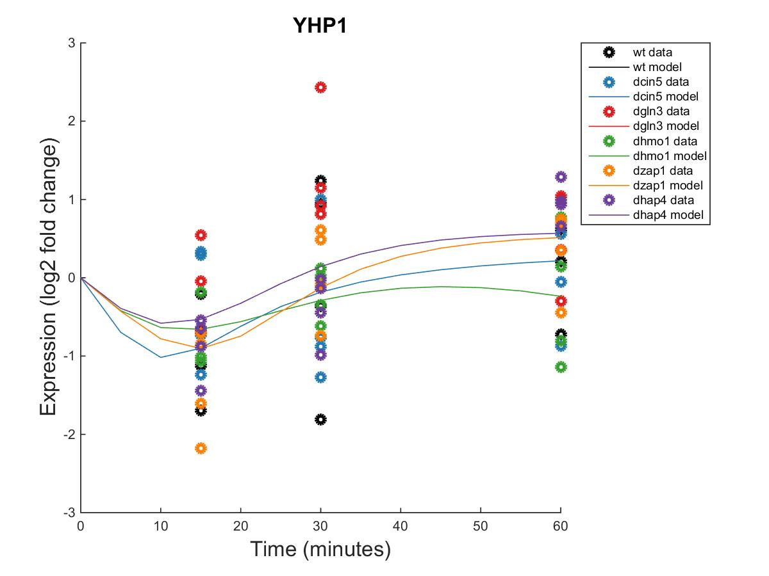
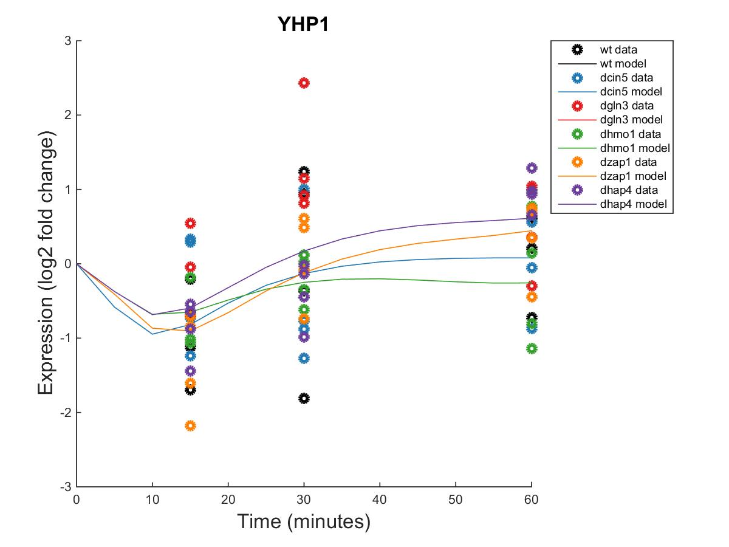
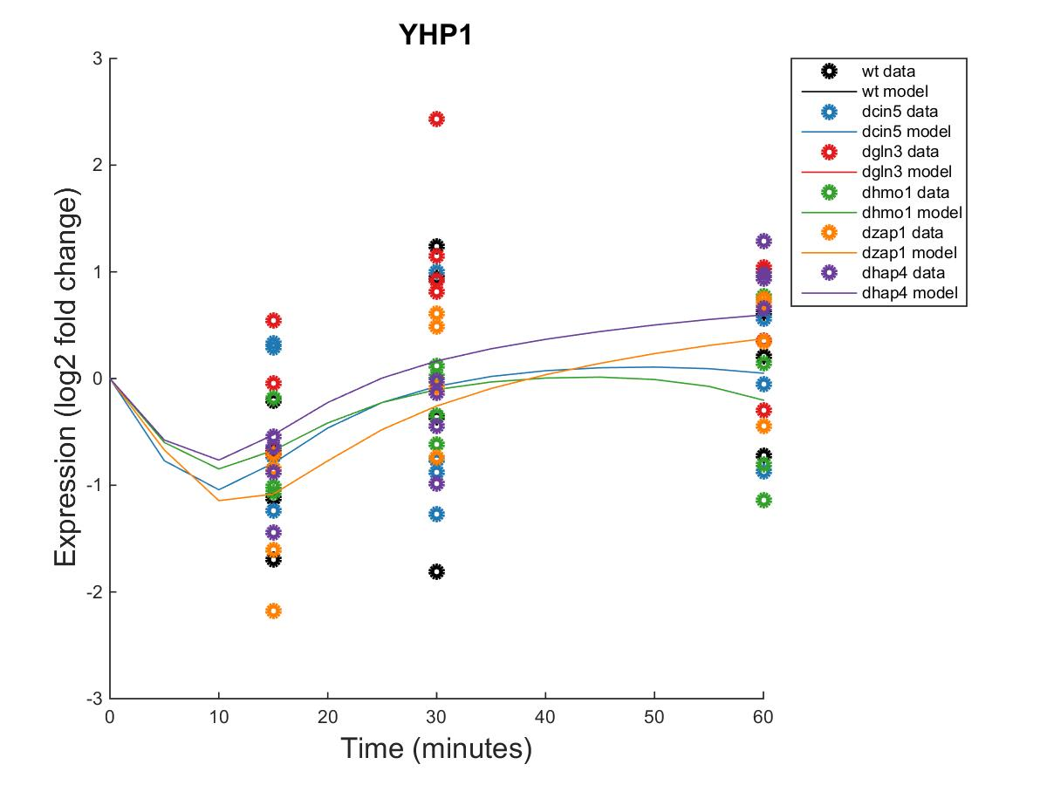

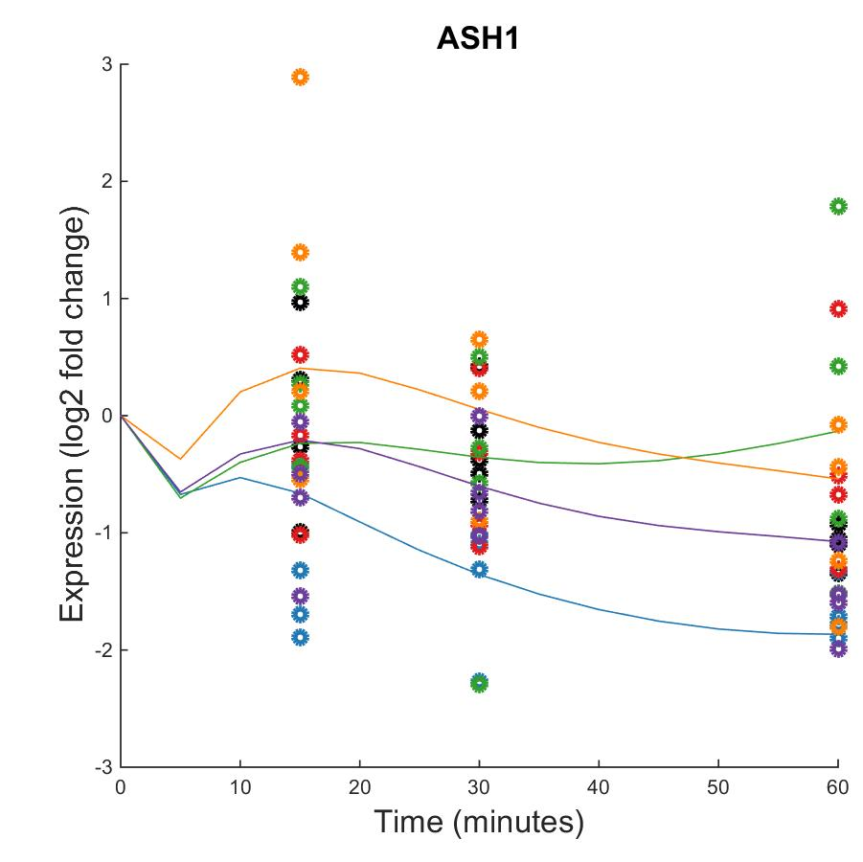
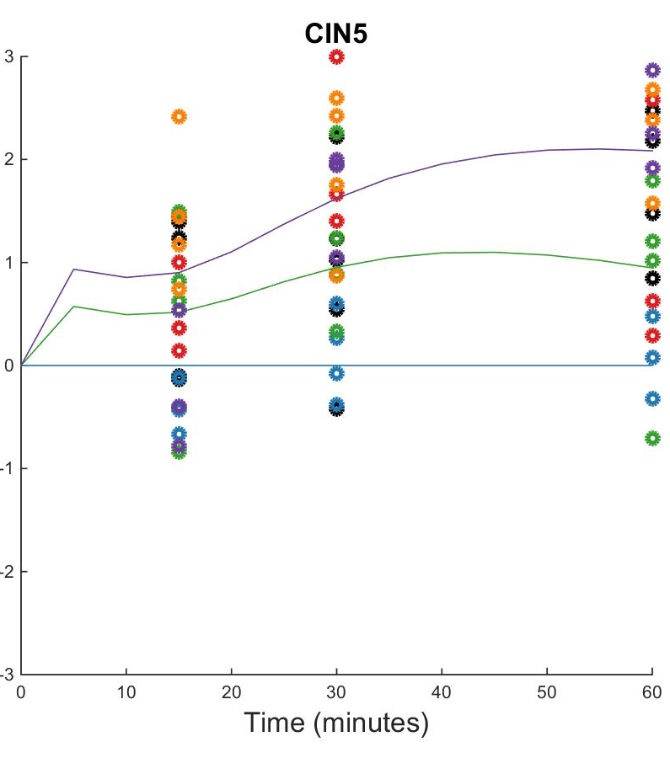
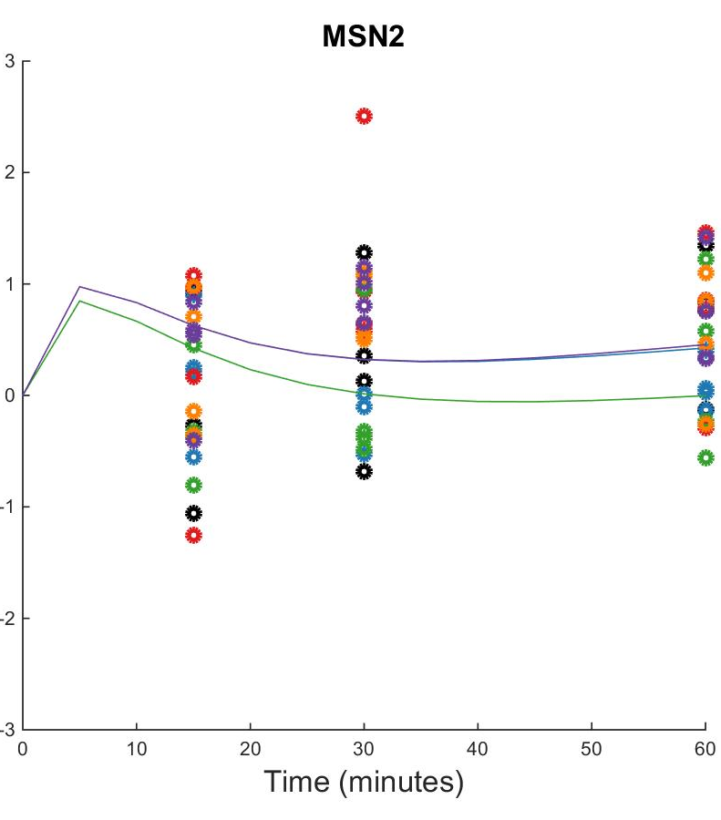
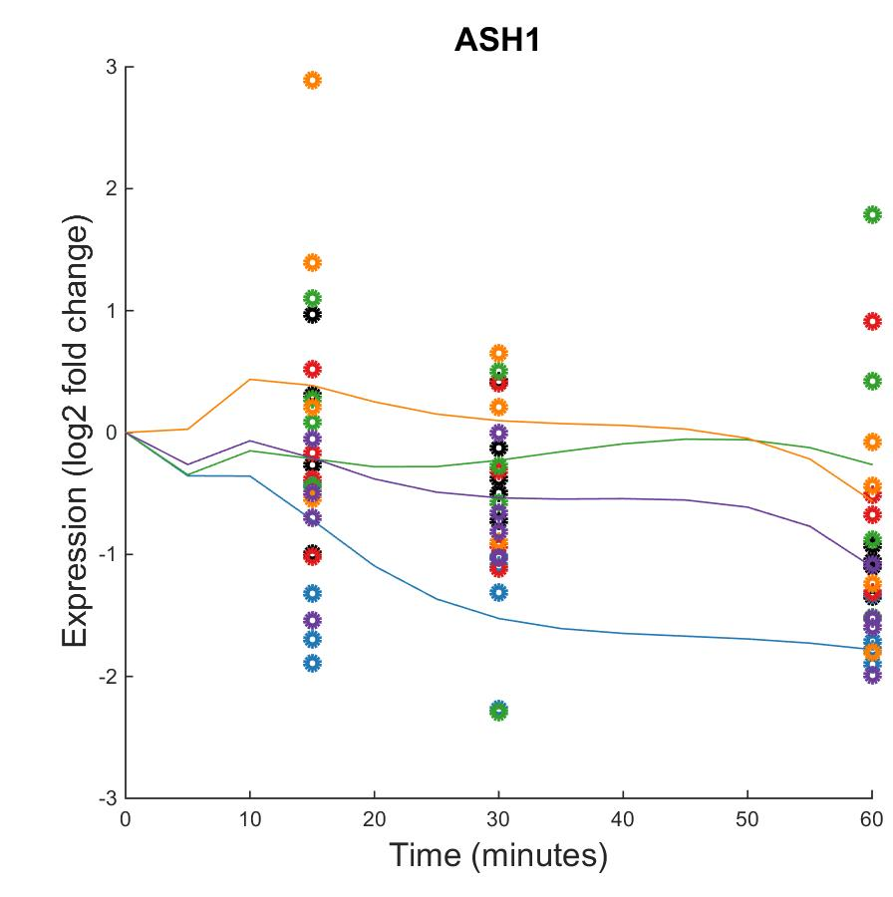

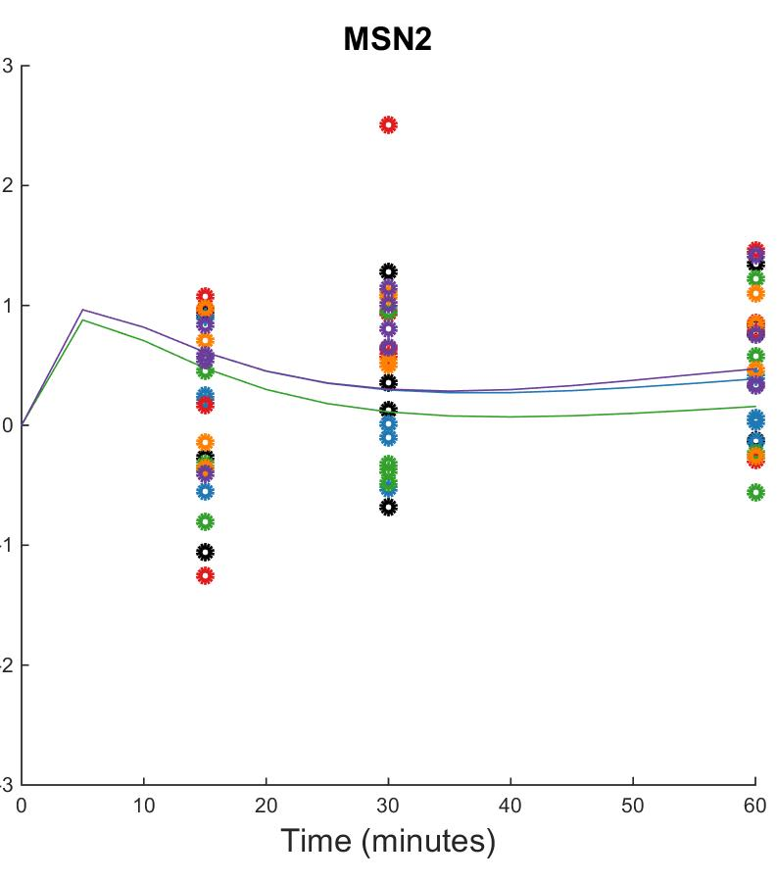
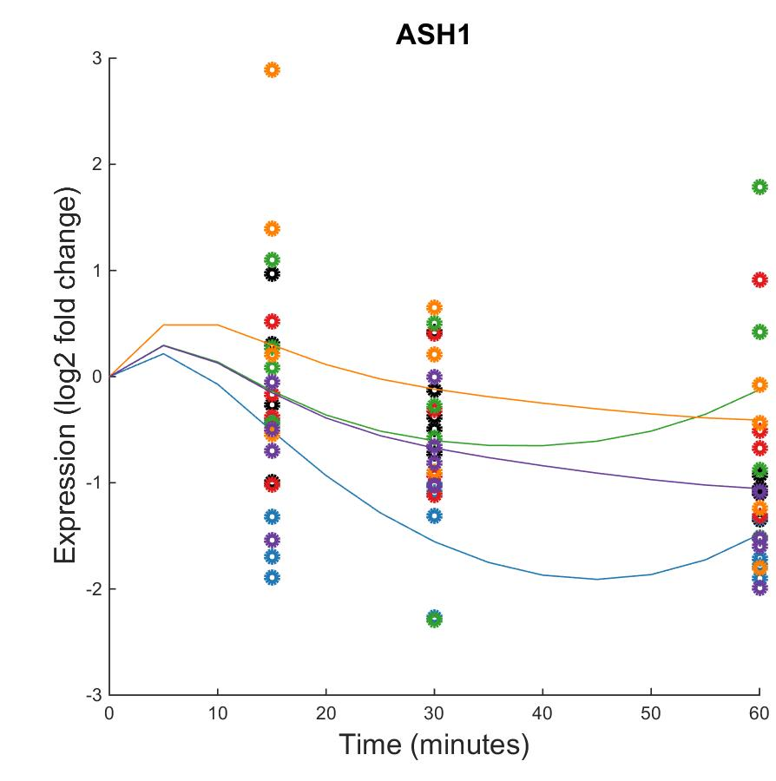

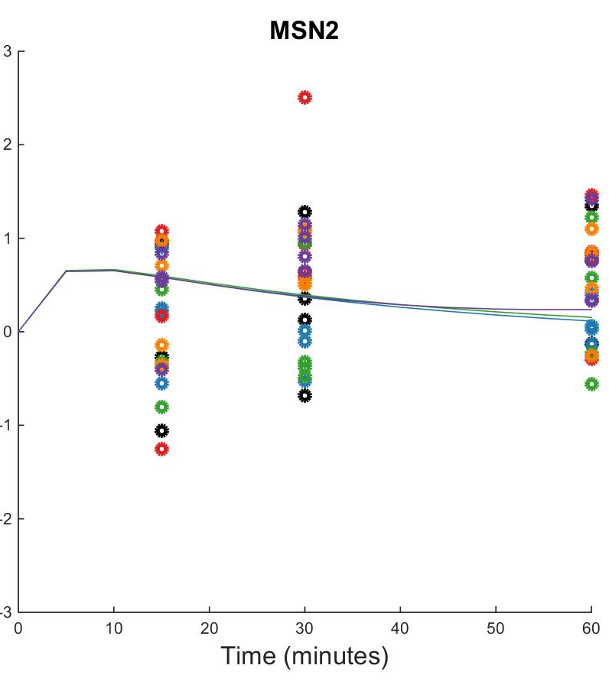
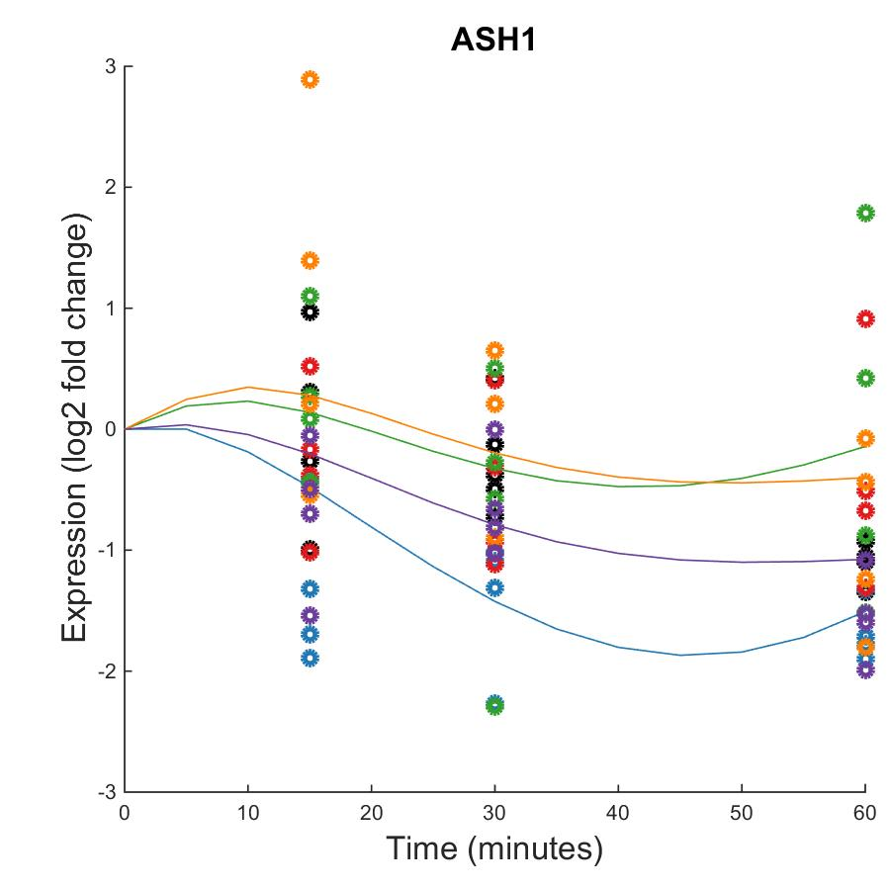

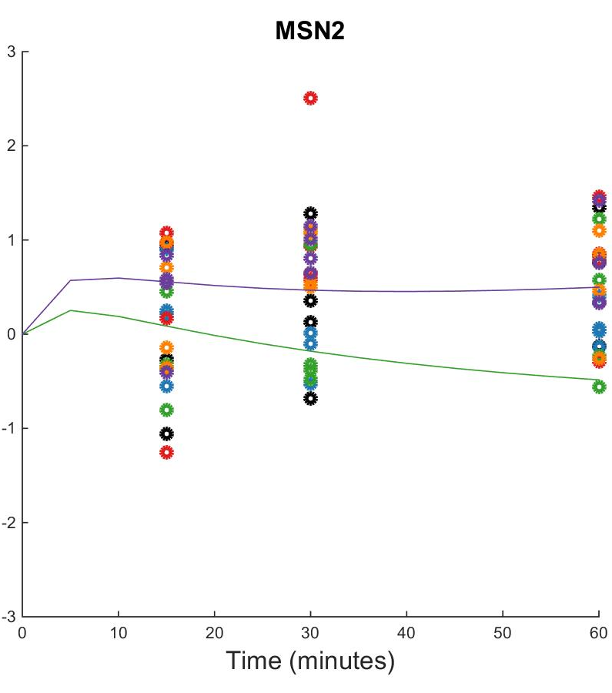
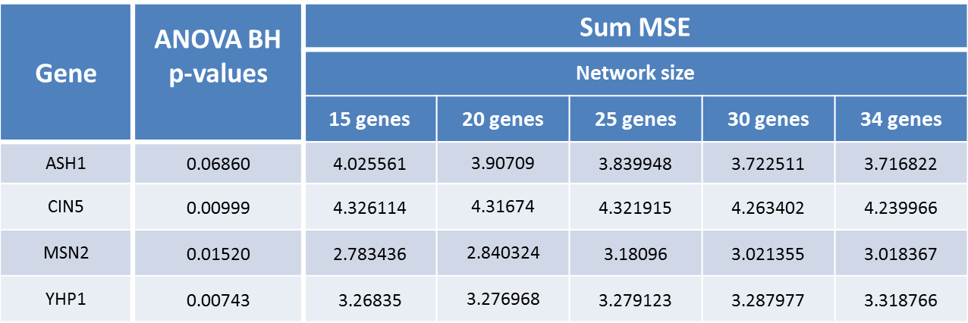
Evaluating Hap4’s Role in the Gene Regulatory Network that Controls the Response to Cold Shock in Saccharomyces cerevisiae using GRNmap
K. Grace Johnson¹, Margaret J. O’Neil², Kam D. Dahlquist², and Ben G. Fitzpatrick³
¹Department of Chemistry and Biochemistry, ²Department of Biology, ³Department of Mathematics
Loyola Marymount University, 1 LMU Drive, Los Angeles, CA 90045 USA
Transcription Factors Control Gene Expression by Binding to Regulatory DNA Sequences Upstream of Genes
Network size comparison
Activators increase gene expression.
Repressors decrease gene expression.
Transcription factors are themselves proteins that are encoded by genes.
A gene regulatory network (GRN) consists of a set of transcription factors that regulate the level of expression of a set of target genes, which can include other transcription factors.
The dynamics of a GRN is how the expression of genes in the network change over time.
Yeast Respond to the Environmental Stress of Cold Shock by Changing Gene Expression
34 genes, 102 edges
30 genes, 90 edges
25 genes, 68 edges
20 genes, 46 edges
15 genes, 28 edges
However, little is known about which transcription factors regulate this response.
The Dahlquist lab has studied the global transcriptional response to cold shock using DNA microarrays, which measure the level of mRNA expression for all 6000 genes in yeast.
We have collected expression data from the wild type strain and five transcription factor deletion strains (Δcin5, Δgln3, Δhmo1, Δzap1, Δhap4 ) before cold shock and after 15, 30, and 60 minutes of cold shock at 13°C.
We are using mathematical modeling to determine the relative influence of each transcription factor in the GRN that controls the cold shock response.
YHP1 is modeled well in all five networks, ASH1, CIN5 and MSN2 are modeled best by the smaller networks
Microarray at 60 minutes after cold shock
dHAP4 Strain Microarray Data was used to Create a Family of GRNs
A modified ANOVA of the DNA microarray data of the strain deleted for the Hap4 transcription factor showed that 1794 genes had a log₂ fold change significantly different than zero at any of the time points.
Significant genes were submitted to the YEASTRACT database, which returned their transcription factor regulators in order of significance.
Again using YEASTRACT, a family of several gene regulatory networks was created by starting from the 34 most significant regulators and paring down to 15.
Networks of this size are called “medium-scale” because they represent only a small subset of the approximately 250 transcription factors in the yeast genome.
MSE’s and ANOVA p values for the most interesting genes
For Each Gene in the Network, a Nonlinear Differential Equation Determines the Rate at Which the Gene is Expressed
(Transcribed and Translated)
The model, called GRNmap (Gene Regulatory Network modeling and parameter estimation) was implemented in MATLAB.
The MATLAB code and executable are available under an open source license at https://github.com/kdahlquist/GRNmap/.
LSE/Min LSE Table
Conclusions and Future Directions
Each gene has a differential equation that models the change in expression over time.
We use a sigmoidal model for each differential equation
  P_{i} is mRNA production rate for gene i
  d_{i} is the mRNA degradation rate for gene i
  w is weight term, determining the level of activation or repression of j on i
  b is a unique threshold for each gene
The production rate (P_{i} ), weight (w ), and threshold (b) values were estimated from DNA microarray data using a penalized least squares approach.
Network size | 15 genes | 20 genes | 25 genes | 30 genes | 34 genes
LSE | 0.706 | 0.688 | 0.705 | 0.752 | 0.793
Minimum theoretical LSE | 0.485 | 0.478 | 0.490 | 0.533 | 0.547
Ratio | 1.455 | 1.440 | 1.439 | 1.411 | 1.451
Which size network seems to best model the data (based on a comparison of LSE)? --- size of network seems to make little difference on the ratio between LSE and min theoretical LSE – as a general trend the LSE does increase, meaning is gets harder to fit the data as more data as added, but this was expected. The ratio shows that the model performs consistently for a range of network sizes
Which genes are modeled the best (based on individual gene plots, the MSE’s and how that relates to the ANOVA, significant or not significant)
Notes
  20 gene network has the overall smallest LSE
  Stuff about gene plots as network gets bigger
Parameter comparison charts (w, b, P’s)
E represents the error between estimated values and microarray data values.
(Freeman, 2002)
L-curve Analysis of dHAP4 networks revealed the ideal alpha value to be 0.002
Choosing the best alpha value is best done through iteration.
Functionality was added to the GRNmap code that ran forward estimations of the same network using several alpha values.
For each alpha value ranging from 0.0005 to 0.8, the Least Squares Error (LSE) was plotted against the penalty term.
The best alpha is one that minimizes both the LSE and the penalty term, and therefore lies near the “elbow” of the L-curve.
Acknowledgments
For their work on the GRNmap code, we would like to thank Juan S. Carrillo, Trixie A. Roque, Nicholas A. Rohacz, and Katrina Sherbina. We thank Nicole A. Anguiano and Anindita Varshneya for their work on GRNsight visualization. Microarray data was collected by Cybele Arsan, Wesley Citti, Kevin Entzminger, Andrew Herman, Heather King, Lauren Kubeck, Stephanie Kuelbs, Elizabeth Liu, Matthew Mejia, Kenny Rodriguez, Olivia Sakhon, and Alondra Vega. Partial funding for this project was provided by NSF-RUI 0921038.
References
Dahlquist, Kam., Fitzpatrick, Ben., Camacho, Erika., Entzminger, Stephanie., Wanner, Nathan. (2015). Parameter estimation for gene regulatory networks from microarray data: cold shock response in Saccharomyces cerevisiae. Submitted.
Freeman, S. (2002). Biological science (First ed.). Prentice Hall.
GRNmap. (n.d.). Retrieved March 6, 2016, from https://github.com/kdahlquist/GRNmap/.
GRNsight. (n.d.). Retrieved March 6, 2016, from http://dondi.github.io/GRNsight/.
Dário Abdulrehman, Pedro T. Monteiro, Miguel C. Teixeira, Nuno P. Mira, Artur B. Lourenço, Sandra C. dos Santos, Tânia R. Cabrito, Alexandre P. Francisco, Sara C. Madeira, Ricardo S. Aires, Arlindo L. Oliveira, Isabel Sá-Correia, Ana T. Freitas (2011). YEASTRACT: providing a programmatic access to curated transcriptional regulatory associations in Saccharomyces cerevisiae through a web services interface Nucl. Acids Res., 39: D136-D140, Oxford University Press.

Slide 3
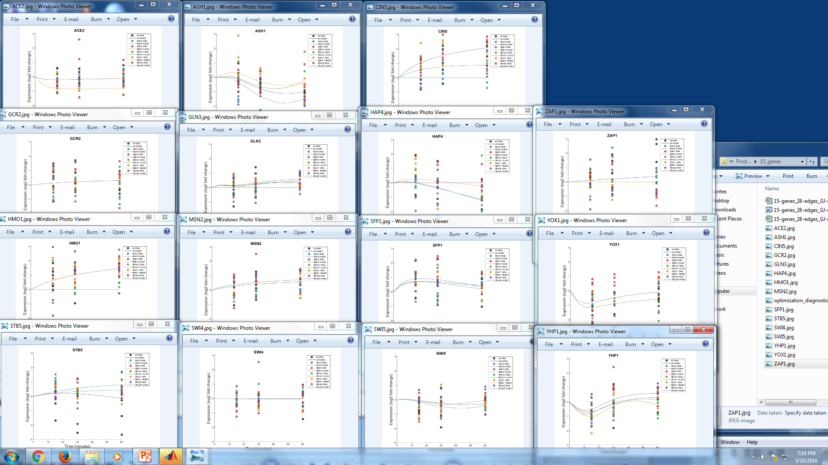
15 genes

Slide 4
20 genes

Slide 5
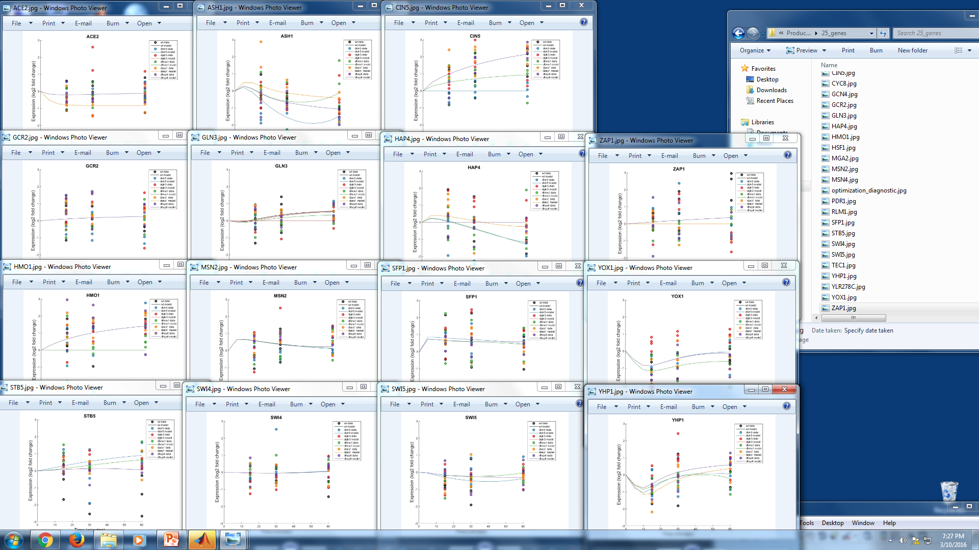
25 genes

Slide 6
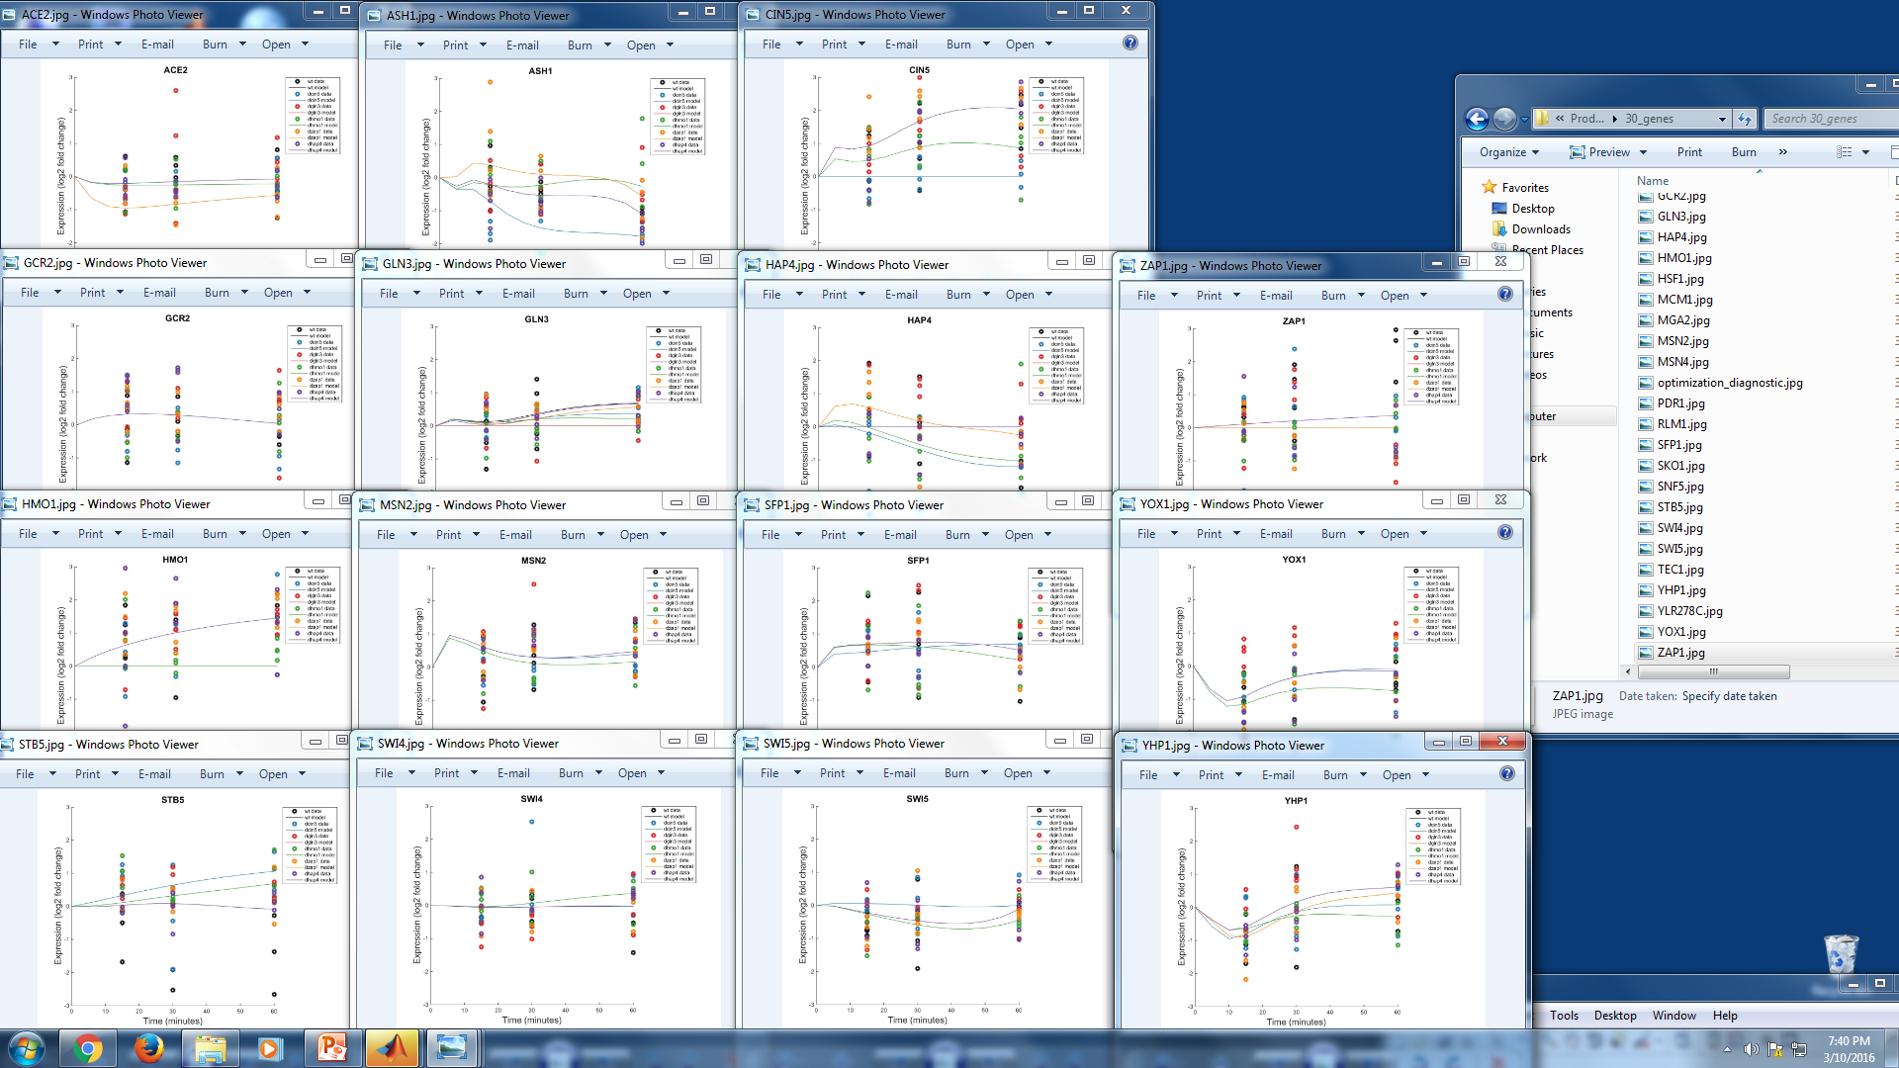
30 genes

Slide 7
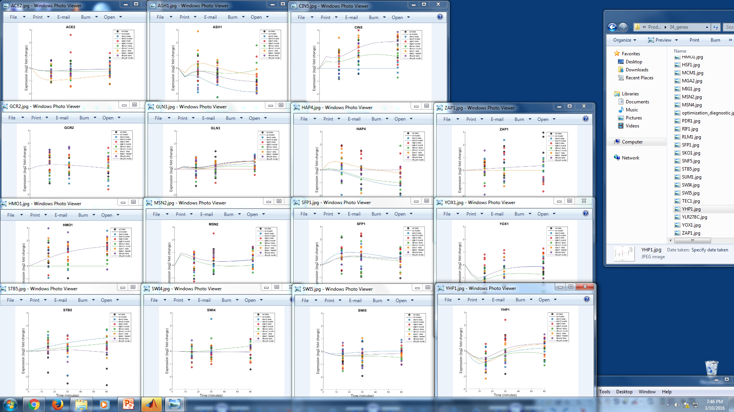
34 genes

Slide 8
Gene | ANOVA BH p-values | Sum MSE
 |  | Network size
 |  | 15 genes | 20 genes | 25 genes | 30 genes | 34 genes
ASH1 | 0.06860 | 4.025561 | 3.90709 | 3.839948 | 3.722511 | 3.716822
CIN5 | 0.00999 | 4.326114 | 4.31674 | 4.321915 | 4.263402 | 4.239966
MSN2 | 0.01520 | 2.783436 | 2.840324 | 3.18096 | 3.021355 | 3.018367
YHP1 | 0.00743 | 3.26835 | 3.276968 | 3.279123 | 3.287977 | 3.318766

