Slide 1
The Concentration of Ammonia Regulates Nitrogen Metabolism in Saccharomyces cerevisiae
ter Schure, E.G., Sillje, H.H.W., Verkleij, A.J., Boonstra, J., and Verrips, C.T. (1995) Journal of Bacteriology 177: 6672-6675.
Kara Dismuke | Kristen Horstmann
Department of Biology
Loyola Marymount University
BIOL 398-04 | Dahlquist, Fitzpatrick
Thursday March 5, 2015
Notes:
Saccharomycs cerevisiae= type of yeast (makes beer….cerevisea….cerveza)
ideal model for systems biology
small genome- 6,000 genes
extensive data available
molecular genetic tools available
Nitrogen metabolism- go over definition

Slide 2
Outline
Central Nitrogen Metabolism in S. cerevisiae
Establish theoretical approach for modeling concentrations of:
  Alpha-ketoglutarate
  Glutamate
  Glutamine
Steady-state shown in graphical results
  Compare & observe trends for 3 amino acids

Slide 3
Purpose
The purpose of this Journal Club is to develop a theoretical model to represent nitrogen metabolism and the effects of changing various parameters and to compare our results to the experimental results found in ter Schure’s paper, The Concentration of Ammonia Regulates Nitrogen Metabolism in Saccharomyces cerevisiae.

Slide 4
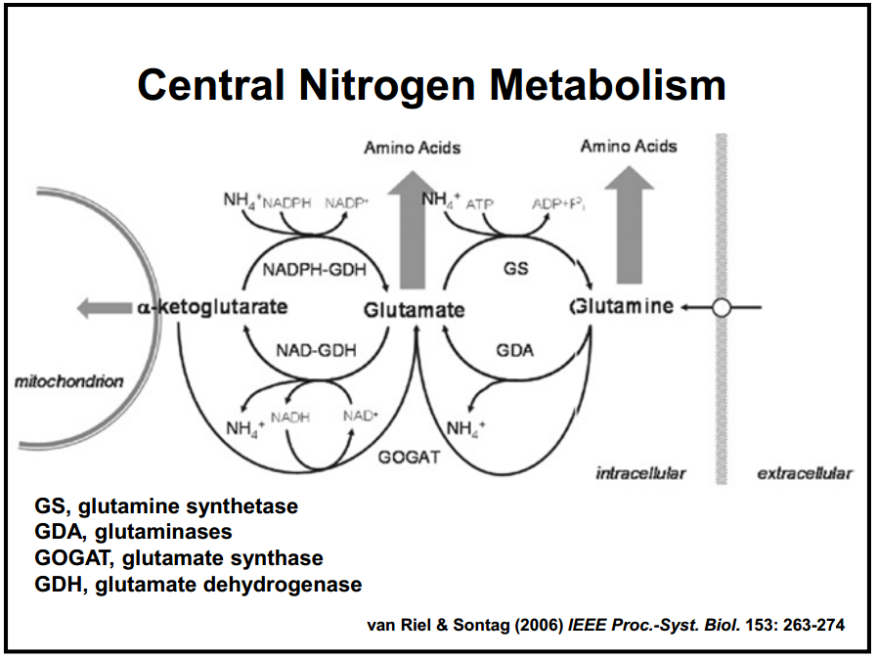
Background
Nitrogen is essential for all organisms
  Ammonia incorporation
Conversions catalyzed by enzymes
Assimilation of nitrogen
  Enzyme reactions
Glutamate: central role
Notes:
Nitrogen is essential:
Nitrogen enters through plants, fungi but mainly bacteria & archaea and reduces it to ammonia
Ammonia incorporation: Ammonium is incorporated into organic molecules by glutamate dehydrogenase and glutamine synthase
Conversions catalyzed by enzymes: Most conversions between organic & inorganic nitrogen= catalyzed by bacterial and archaeal enzymes
Assimilation of nitrogen: achieved through metabolic conversions between 3 amino acids
Enzyme reactions: Involve substrate and product
Glutamate: central role in mammalian nitrogen flow
Nitrogen donor
Nitrogen acceptor
Metabolic pathway: when the product of 1 reaction becomes the substrate for the next reaction

Slide 5
Variables & Equations
State Variables
a: alpha-ketoglutarate
b: glutamate
c: glutamine
Systems of Differential Equations
Notes:
Amino acids
Explain significance of model
Michaelis-Menten
assumes equations are at equilibrium
assumes total amount of enzymes are conserved
da/dt…change in concentration of AK over time…dependent on concentrations of itself, gutatmine, glutatmate as well as the parameters of the equations AK is involved in
Same idea

Slide 6
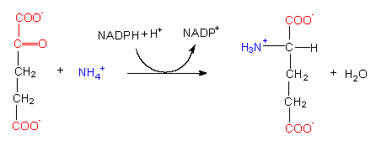
Parameters
Glutamate Dehydrogenase:
Reverse:
r₁
alpha-ketoglutarate glutamate
r₋₁
glutamate alpha-ketoglutarate
https://s10.lite.msu.edu/res/msu/botonl/b_online/e19/19e.htm
Notes:
Enzymes: NADPH, etc.

Slide 7
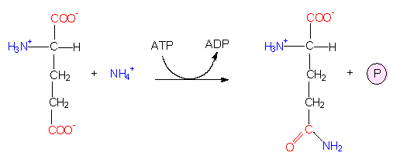
Parameters
Glutamate Synthetase:
Reverse:
r₂
glutamate glutamine
r₋₂
glutamine glutamate
https://s10.lite.msu.edu/res/msu/botonl/b_online/e19/19e.htm

Slide 8
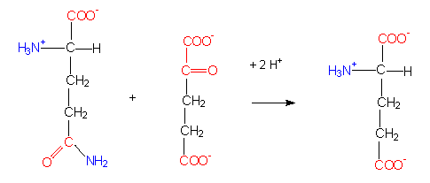
Parameters
Glutamate Synthase:
r₃
alpha-ketoglutarate + glutamine 2glutamate
2
2
https://s10.lite.msu.edu/res/msu/botonl/b_online/e19/19e.htm

Slide 9
Analysis of Steady-State
Partial derivatives= 0
  Steady state/dynamic equilibrium
Our Simulation Results
  Run 1: steady at approx. 1sec
  Run 2: steady at approx. 1.5sec
  Note: a, b, c = 1
  Note: Carried out to 3 seconds (.1sec intervals)
Notes:
Partial deriv= 0 (dynamic equilibrium…remains constant over time, but work is still being carried out)
were the process maintaining the system to cease, the conditions would not remain
no more nitrogen
enzymes stop working to convert substrates to products

Slide 10
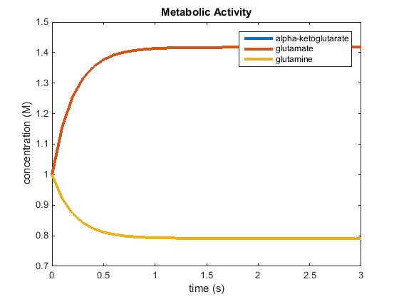
Simulation: Run 1
Note: For Run 1, all parameters were set to 1.
Notes:
Enzymes
Equilibrium= states that the system wants to stay in

Slide 11
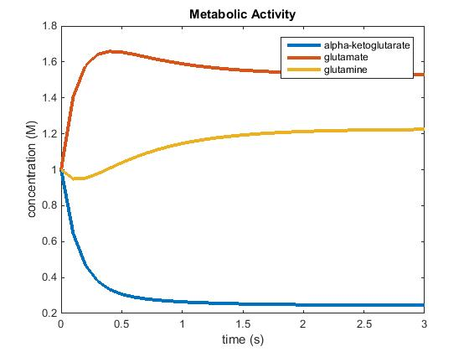
Simulation: Run 2
Note: For Run 2, all parameters were set to 1 except for r₁ which was set to 5.

Slide 12
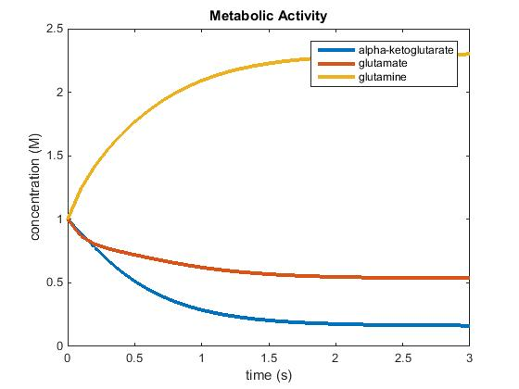
Simulation: Run 3
Note: For Run 3, all parameters were set to 1- except r₂ which was set to 5.
Notes:
Bigger font for textboxes?

Slide 13
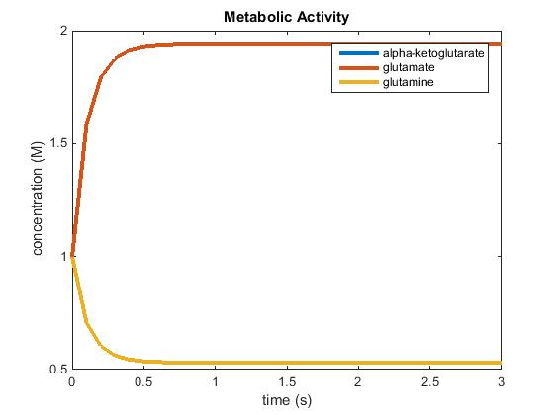
Simulation: Run 4
Note: For Run 3, all parameters were set to 1- except r₃ which was set to 5.

Slide 14
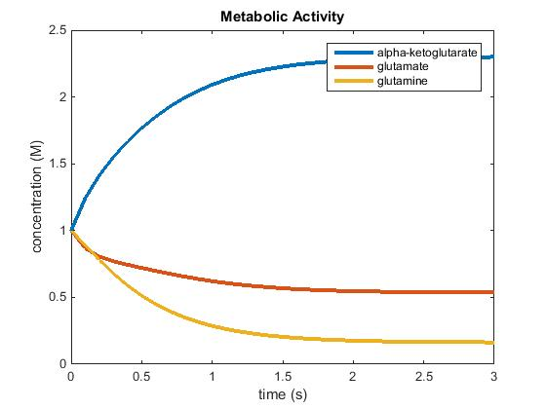
Simulation: Run 5
Note: For Run 2, all parameters were set to 1- except r₋₁ which was set to 5.

Slide 15
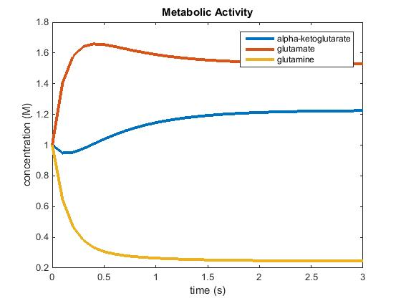
Simulation: Run 6
Note: For Run 3, all parameters were set to 1- except r₋₂ which was set to 5.

Slide 16
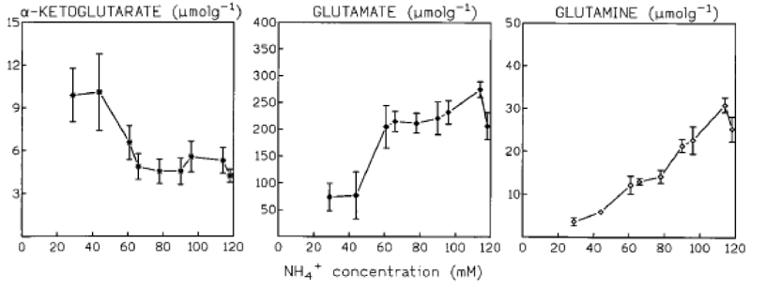
Results & Discussion
Trends amongst 3 amino acids
Note different axes
Theoretical vs. experimental
Notes:
Notice trends
Note different x axes, but also note we know, as time increases, ammonia concentration increase

Slide 17
Conclusion
Central Nitrogen Metabolism in S. cerevisiae depends on the 3 amino acids discussed
Using theoretical approach, our models reached equilibrium for the following:
  Alpha-ketoglutarate
  Glutamate
  Glutamine
Noting as time increases ammonia concentration increases, we observed trends when we compared our results to those found in the ter Schure paper

Slide 18
Final Question
"If the ammonia concentration is the regulator, this may imply that S. cerevisiae has an ammonia sensor which could be a two-component sensing system for nitrogen…"
What do you make of this sentence? What could these two components be?
Notes:
Glucose (fixed concentration)
Ammonia concentration (changes levels of intercellular metabolites like AK, glutamine, glutamate)

Slide 19
References
Van Riel & Sontag (2006) IEEE Proc.-Syst. Biol. 153: 263-274
https://s10.lite.msu.edu/res/msu/botonl/b_online/e19/19e.htm
http://www-plb.ucdavis.edu/courses/bis/105/RecordedLectures/NMetabMP3.ppt
ter Schure, E.G., Sillje, H.H.W., Verkleij, A.J., Boonstra, J., and Verrips, C.T. (1995) Journal of Bacteriology 177: 6672-6675.
Notes:
Any questions?

