Slide 1
Darwin’s Surprise Why are evolutionary biologists bringing back extinct deadly viruses?
Michael Specter
The New Yorker
December 3, 2007
Presented by
Patrick Wu
20.385 Advanced Topics in Synthetic Biology
May 10, 2011

Slide 2
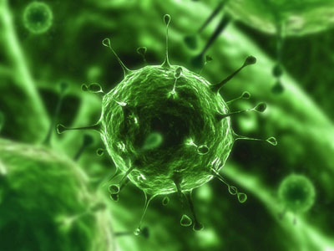
Background of Viruses
Genetic material within protein capsid
Non-living parasite (requires host)
Viruses pose greatest threat to humanity
Infectious and deadly
Retroviruses can alter human genome
http://static.howstuffworks.com/gif/light-virus-1.jpg

Slide 3

Connecting Retroviruses and Humans
Eight percent of human genome endogenous retroviruses – “junk DNA”
Unable to be reactivated, harmless
Specter, Michael. Darwin’s Surprise. The New Yorker

Slide 4

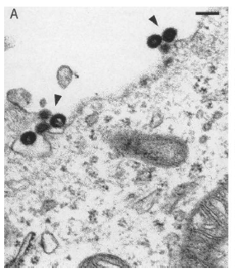
Thierry Heidmann
Reconstructed HERV-K from known sequenced copies of human provirus (2006)
Demonstrated viral activity when inserted to human 293T cell line
Dewannieux M, et al. Identification of an Infectious Progenitor for the Multiple-Copy HERV-K Human Endogenous Retroelements. Genome Res. 2006 Dec;16(12):1548-56. Epub 2006 Oct 31.

Slide 5

Reconstructing Viruses
Advanced genetic manipulation and DNA technology
Inherent safety issue
Jurassic Park (2003)

Slide 6
So why investigate ancient retroviruses?
Study modern retroviruses (such as HIV)
New field – paleovirology – study ancient viruses
Understand impact of modern diseases
Study human evolution
Viruses insert DNA into germ cell genomes, passed on to future generations
Investigate development of certain human characteristics
Trace evolutionary closeness to primates and other animals

Slide 7
Significance of Provirus in Human DNA
8% “junk DNA” suggests major evolutionary role of viruses
Suggests previous retroviral attacks in human evolutionary history before HIV
Understanding of there viruses may aid in development of HIV treatments

Slide 8
Origins of Modern Placenta
Endogenous retroviruses previously thought to be always harmful
Syncytium cells between mother and fetus found to contain retroviruses
Found in healthy baboons, mice, cats, and humans
Syncytin protein causes of fusion of placenta cells as well as retroviral latching onto cells
Suggests evolution of placenta due to endogenous retroviruses

Slide 9
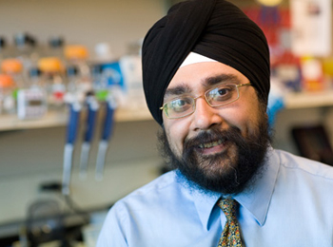
Harmit Malik
Sought to understand human susceptibility to viruses
Recreated Pan troglodytes endogenous retrovirus (PtERV) virus found in chimpanzees and gorillas but not humans
Found that human TRIM5a provides resistance to PtERV, but monkey version provides resistance to HIV and not to PtERV

Slide 10
Harmit Malik
Infected human cells modified with chimp TRIM5a gene separately with PtERV and HIV
Found no resistance to PtERV, resistance to HIV
Evolutionary divergence of function of TRIM5a gene between humans and chimps
Potential for new drug therapy involving chimp TRIM5a gene

Slide 11

Aris Katzourakis
Lentiviruses previously never been found in animal genomes
Katzourakis discovered first endogenous lentivirus in European rabbit (2007)
“Rabbit endogenous lentivirus type K” (RELIK)
Possibility for small animal model for studying evolution and impact of HIV if virus is reconstructed

Slide 12
New developments in HIV drugs
Koronis Pharmaceuticals – KP1212
Accelerates viral rate of mutation
Accumulation of mutations causes error catastrophe and viral death
Target endogenous retroviral signals
Produced in response to HIV infection
Possible new type of vaccine

Slide 13

Summary
Retroviruses shown to have significant role in human evolution
Study of retrovirology thus important
Better understanding of viral pathology
Leads to advances in treatments for HIV and other retroviruses
Inherent benefits from directly studying reconstructed ancient viruses
http://velica.deviantart.com/art/Retrovirus-101941516

