Slide 1
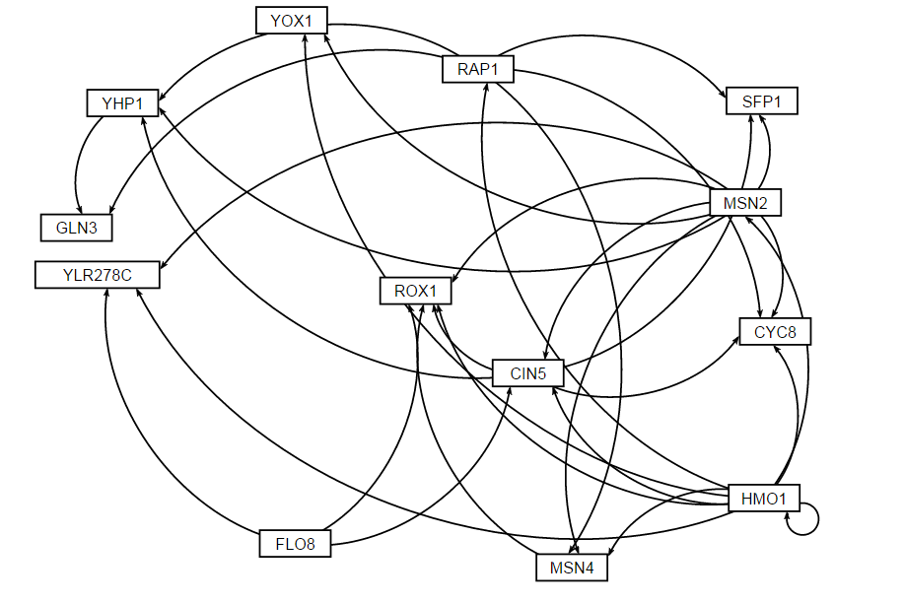
Gene regulatory Network HMO1_profile43

Slide 2
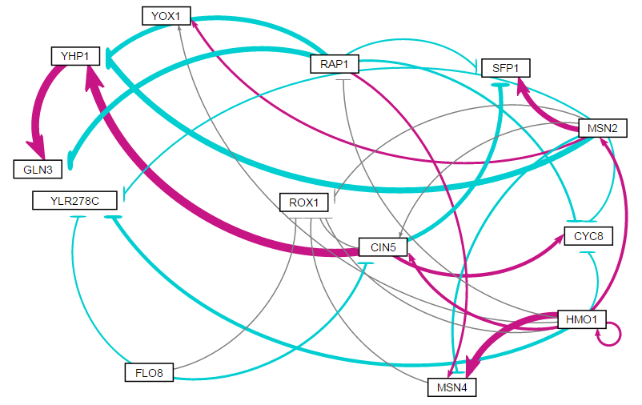
Estimated b: weighted network

Slide 3
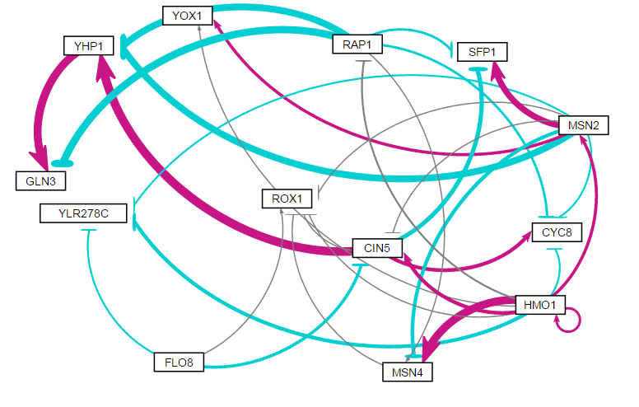
Fixed b: weighted network

