Slide 1
Biology Group Presentation
November 24, 2009

Slide 2
WHO?
Target Consumer:
High school student with mathematical skills, discretionary time and a keen sense of curiosity
OR
Biologists with very specific, high end needs
OR
Experimental geneticists
OR
Clinical geneticists

Slide 3
Goal 1:
To make edit / add features to Trait-o-matic based on our bio stream research that make it more research friendly and increase its utility

Slide 4
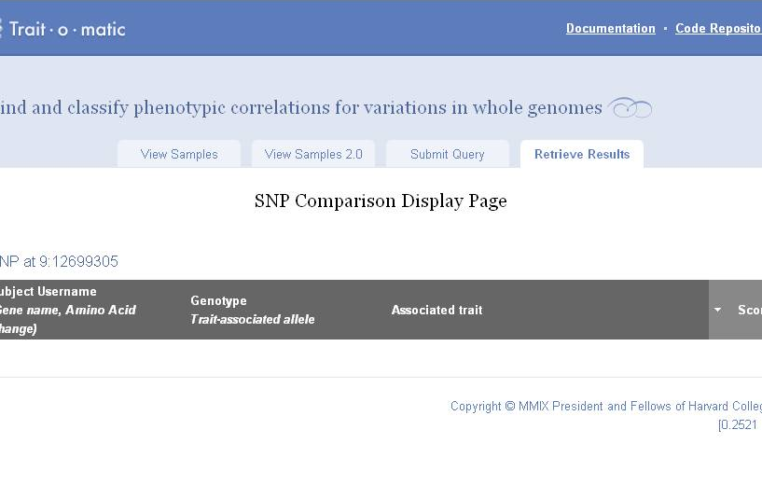
Example 1

Slide 5
Example 2

Slide 6
Example 3
Way to combine human phenome project, environment, genotype and Trait-o-matic in a consistent, usable way

Slide 7
Example 4
If goal is to truly model epitasis, you need to understand all protein-protein interactions

Slide 8
Example 5

Slide 9
Goal 2:
Provide test case details

Slide 10
Step 1
Verify single SNP associations using a linear model, coding blue, intermediate and brown as 1, 2 and 3 quantitatively
Code SNP genotypes as 0,1,2 minor alleles
Which SNP shows the largest effect—what is the Beta (compare with existing study results)

Slide 11
Step 2
Check for existing linkage disequilibrium to toss out non-significant SNPs (QUESTION: WHY?)
Perform SNP analysis to exclude markers in strong LD (compare to study where, they were able to exclude 13 SNPs in strong LD from the OCA2-HERC2 region)
Perform prediction modeling using various models
Chi-Square Goodness of Fit Test to determine which model is best

Slide 12
Culled from literature

Slide 13
Culled from literature, cont’d

Slide 14
Goal 3:
Find actual test data

Slide 15
Steps taken thus far
Contacted for data:
Manfred Kayser, Professor of Forensic Molecular Biology at Erasmus University Rotterdam
Mark Shriver, Associate Professor of Biological Anthropology at Penn State
NCI re: Cancer Genetic Markers of Susceptibility (CGEMS) project
research program involving genome-wide association studies (GWASs)
created a database for common inherited genetic variants (2,300 people, 555,000 SNPs)
can query the data by gene name, chromosome region, range of base pairs, individual SNP, or P value
Worst case scenario: use PGP 10!

Slide 16
Response 1 – Author of one of our papers
Dear Ridhi, the procedure to get access to the data is as such that you have to provide a research proposal to the management team of the Rotterdam Study and they will than discuss it in one of their next meetings. Please let me know if you are willing to do this and I put you in contact with a relevant person. Note that such procedure normally is done for scientific requests with certain expectations, hence it may be a bit over the top for a normal student project. Cheers manfred

Slide 17
Response 2 – NCI
Hi Ridhi, You have to either find a PI to do it for you or see if your institution could register you as a PI in institution's eRA common account in order to access dbGaP data. This is how dbGaP is setup, there is no other around. Regards, Luning Hao

