Slide 1
Drug Delivery “Vectors” nanoparticles, bacteria, and viruses
Bobby Wei
Stanford iGEM 08-09

Slide 2

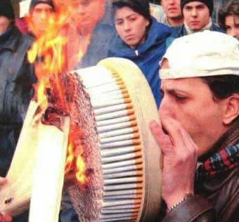
Problem? Cancer. Enough said.

Slide 3
Bacteria-Mediated Delivery of Nanoparticles and cargo into cells
Feasible mechanism: use of biotin and streptavidin proteins to attach cargo to benign bacteria
Streptavidin has one of the strongest non-covalent interactions known to chemistry with the vitamin biotin
Biotin is a water-soluble B-complex vitamin that can be easily added to antibodies
Biotinylated antibodies latch onto receptor proteins on a bacteria’s surface and also bind to streptavidin-coated nanobots
Basis behind immunoprecipitation

Slide 4
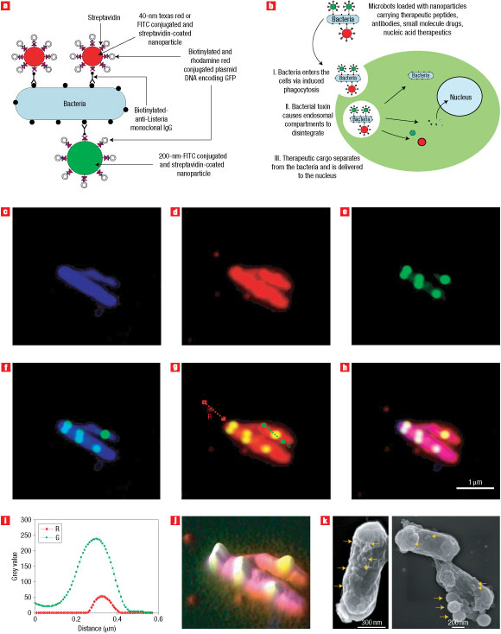
In a nutshell: Stick cargo onto bacteria, and then let endocytosis occur

Slide 5
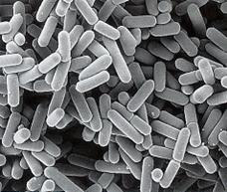
Another example: Bioengineering Bacteria for Drug delivery
Osel (based in Santa Clara) turns Lactobacillus into a local drug factory for prevention of HIV infection
Mechanism: Using bacteria type endogenous to body to express desired genes

Slide 6
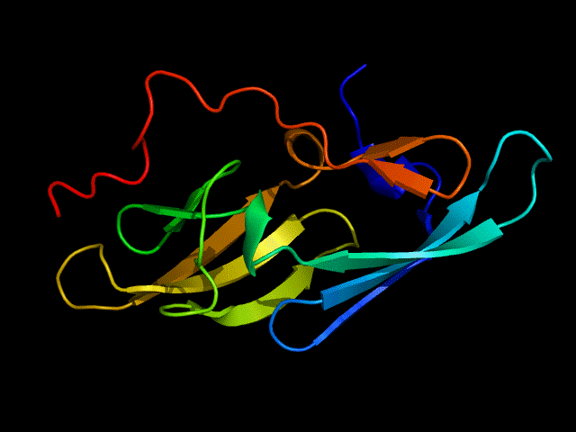
“Baterial therapeutics”
What Osel does: Lactobacillus is the most common bacteria that dwells in the vaginal tract of women. Osel bioengineered it to deliver Cyano-virin N, a potent inhibitor of HIV, to mucosal surfaces
Lactobacillus was altered to express CV-N at potent enough levels to block HIV infection

Slide 7
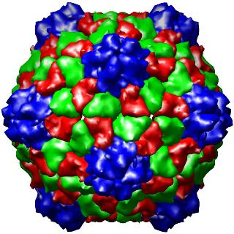
Plant Virus particles as oral drug delivery vehicle
Cow Pea Mosaic Virus (CPMV) is a favorite for researchers; benign and easy to mass-produce
CPMV nanoparticles (just the protein shell) can pass through the digestive system intact, and into the bloodstream

Slide 8
After ingestion CPMV nanoparticles found widely distributed throughout animals’ bodies
Mechanism
Attach tumor-targeting molecules (signal peptides) to surface and encapsulate drugs in the interior
Advantages:
Stability
Enclosed space doesn’t leak
Ease of manufacture
Ability to target cells
Ability to carry therapeutic cargo
Ingestion
Alleviate side effects of chemotherapy

Slide 9
frontiers of synthetic biology: nanocages and gels
Karen Wooley of WashU constructed a molecular cage surrounding a polymer core
Remove core and line reactive chemical groups on the inside and outside, and you have a virus-mimicking nanocage
Can carry drugs and target cancer cells like viruses
Advantages
Personalization
Ability to create synthetic systems instead of relying on existing virus
Chemical groups you attach to the inside and outside control the hydrophillicity of that surface
Solves the problem of water-insoluble anti-cancer drugs

Slide 10
Solutions (difficulty assessed based on limited lab knowledge)
Umm…: We could engineer a synthetic particle of our own design and of novel composition that mimics the properties of a bacterial or viral vector
Less insane: We could recreate and improve upon the nanocage model
Feasible: We could create a new nano-particle that targets a lesser-known type of virus or tumor
Almost underachieving: We could mooch off of Dr. Smolke’s work with “intelligent molecules that seek and destroy diseased cells.”

