Slide 1
Unit 5
Medical Biotechnology II

Slide 2
Lesson 1
Introduction: movie “Contagion”
Discussion: Is this movie realistic with regards to how diseases in spread, how governments respond, and the availability of vaccines?
http://www.movie2k.to/Contagion-watch-movie-1033665.html

Slide 3
Lesson 2
Infectious
Classification, transmission, prevention
Lecture; Read and study powerpoint
Work with a partner and develop review questions
Whole class discussion of review questions.
Gram Stain Lab: Normal Flora
Case Study: Childbed fever

Slide 4
Infectious Disease Classification
Epidemiology: the study of when and where diseases occur and how they are transmitted.
Pathology: The study of disease
Etiology: The study of the cause of a disease
Infection: Colonization of the body by pathogens
Disease: An abnormal state in which the body is not functioning normally.

Slide 5
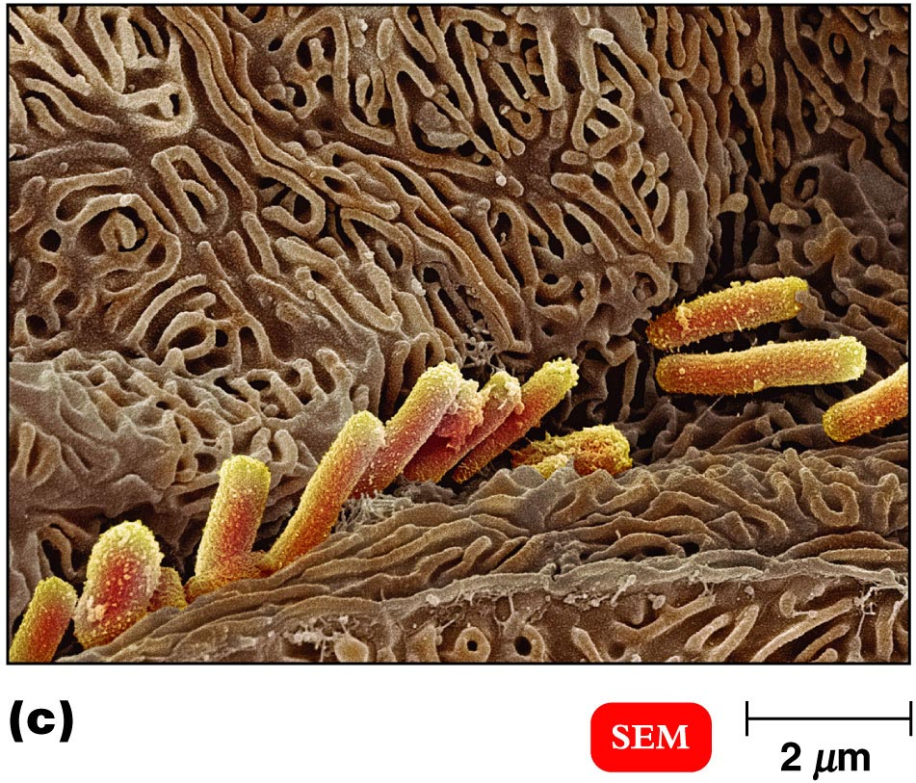
Infectious Disease Classification
Normal Flora and the Host
Normal Flora or Normal Microbiota: The normal bacteria found in or on your body; mostly nonpathogenic
Normal flora can become pathogenic when it colonizes areas of the body that it is not normally found in; ex. E. coli in the bladder instead of the intestines.

Slide 6
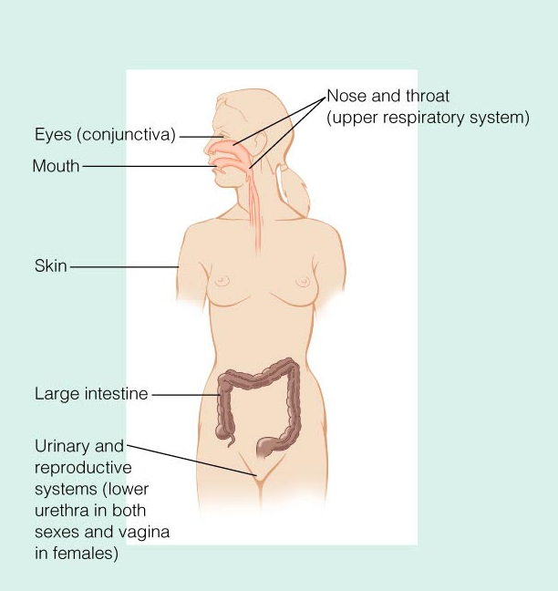
Infectious Disease Classification
Normal Microbiota and the Host
Locations of normal microbiota on and in the human body.

Slide 7

Infectious Disease Classification
Where does normal flora come from?
Environment, family members etc.
Fetus in the uterus is germ free.
At birth, Lactobacilli from the vagina colonize the baby’s digestive tract.

Slide 8



Infectious Disease Classification
Transient Flora and the Host
Transient Flora: Bacterial changes of normal flora due to seasonal changes (temperatures, etc.) or age and activity.

Slide 9
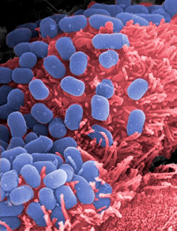
Infectious Disease Classification
Can normal flora benefit the host?
Microbial antagonism: how microbes inhibit the growth of other microbes, usually by competition (e.g. bacteriocins).
Bacteriocins: chemicals produced by bacteria to inhibit the growth of other bacteria (normal flora produce a lot of this).
Probiotics are live microbes applied to or ingested into the body, intended to exert a beneficial effect.

Slide 10
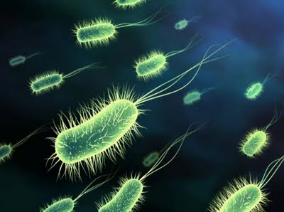
Infectious Disease Classification
Symbiosis
Symbiotic relationship: organisms living in a close, intimate relationship with each other.
Commensalism, one organism is benefited and the other is unaffected. (Normal flora).
Mutualism, both organisms benefit. (Normal flora).
Parasitism, one organism benefits at the expense of the other. (Infectious disease)

Slide 11
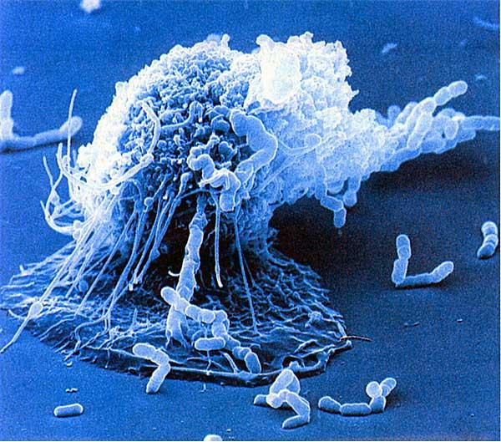
Infectious Disease Classification
Pathogen
A pathogen or infectious agent is a biological agent that causes disease or illness to its host.
The term is used for agents that disrupt the normal physiology of a cell, fungus, animal or plant.
A pathogen can be viral, bacterial, fungal, or a prion.
A “primary pathogen” is defined as an organism capable of causing disease in a healthy person with a normal immune response.
A “secondary pathogen” is an infectious agent that causes a disease that follows the initial infections.

Slide 12
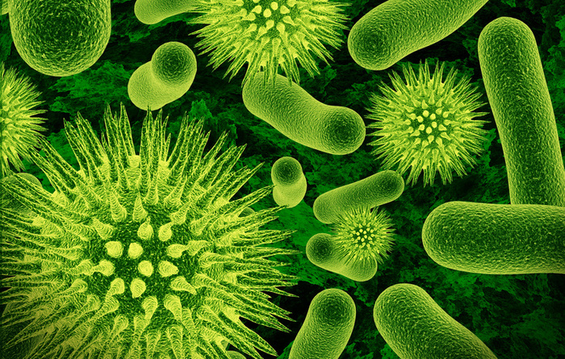
Infectious Disease Classification
Opportunistic Pathogen
Opportunistic Pathogen : Potential pathogenic organisms that do not ordinarily cause disease in the normal habitat of a healthy person.
When these organisms get into an area where they are not normally found and cause disease.
All normal flora are have the capacity to be an opportunist in a compromised host (one without normal immune response).

Slide 13
Transmission Infectious Disease
Reservoirs of Infection
For a disease to perpetuate itself, there must be a continual source of disease. This continual source is referred to as the reservoir.
Reservoirs are classified as either human, animal or nonliving.

Slide 14
Transmission Infectious Disease
Reservoirs of Infection
Reservoirs of infection are continual sources of infection.
Human — AIDS, gonorrhea
Carriers may have inapparent infections or latent diseases.
Animal
Zoonoses. Diseases that occur primarily in animals. Example Rabies, Lyme disease, toxoplasmosis, influenza
Nonliving —
Soil: Botulism, tetanus
Water: Cholera

Slide 15
Transmission Infectious Disease
Contact transmission.
1. Direct contact: Person to person transmission by physical contact. This includes touching, kissing and sexual intercourse.
2. Indirect contact Disease is transmitted from a nonliving object (fomite) to a host.
- Fomites may include eating utensils, toys, towels, door
knobs, etc.
3. Droplet transmission. Mucous droplets from coughs sneezes laughing or talking. Droplet travels less than one meter from the reservoir to host.
- Example Whooping cough, Influenza, the Common Cold.

Slide 16

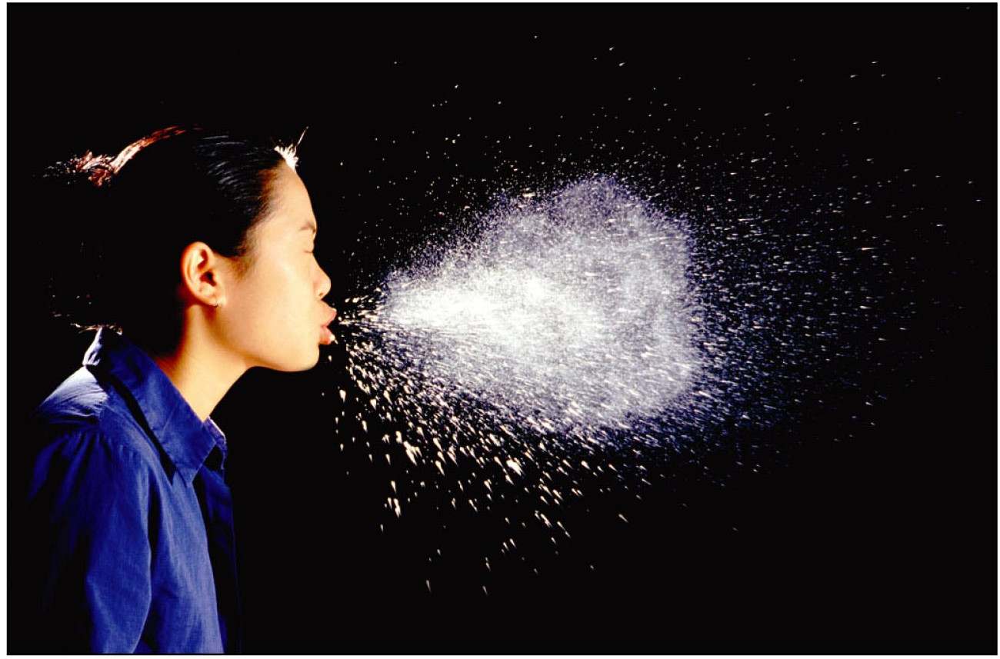
Transmission Infectious Disease

Slide 17
Transmission Infectious Disease
Vehicle: Transmission by an inanimate reservoir
- Food: E. coli gastroenteritis (fecal/oral)
- Water: Cholera (fecal/oral)
- Airborne: Anthrax
Vectors: Arthropods, especially fleas, ticks, and mosquitoes.
- Plague, Lyme disease

Slide 18
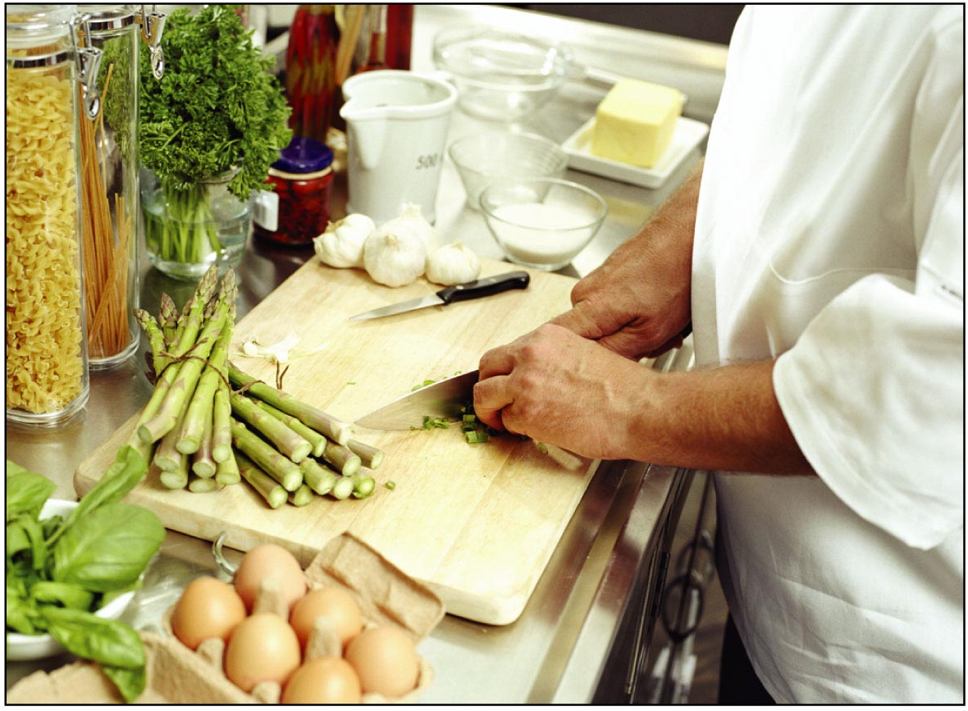
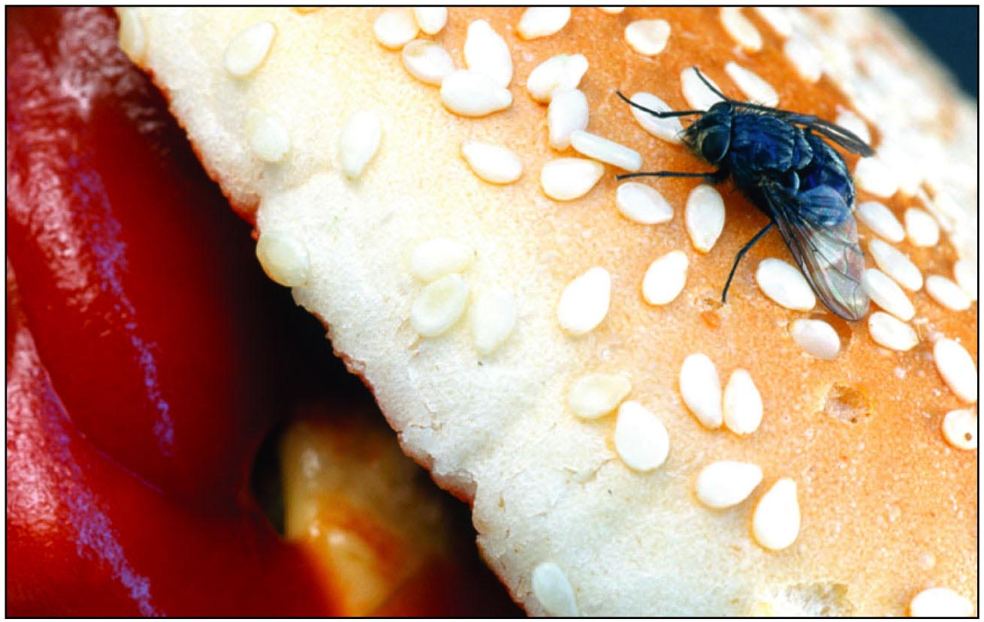
Transmission Infectious Disease

Slide 19
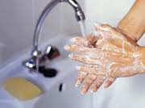
Prevention
Vaccines
Antimicrobial drugs
Handwashing
Sanitation of fomites and water supplies
Prepare and store food properly
Control pests (insects and rodents)
Quarantine

Slide 20
Lesson 3
Part 1 – Stages of Infection
Read powerpoint online
Work with a partner to develop review questions.
Whole class discussion questions.
Read article about stages of infection, traditional medical tests, and molecular biology tests used to diagnose.
Part 2 – Epidemiology
Read SARS time line (Refer to handout)
What types of activities occur during an epidemic
Read powerpoint online.
Write a one paragraph description of the important elements in an epidemiological investigation.
View video –SARS The True Story
Class discussion

Slide 21
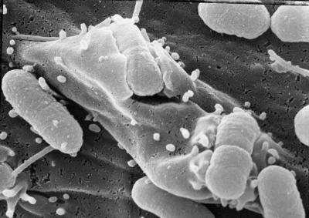
Stages of Infection
How Infectious Agents Cause Disease
Production of poisons, such as toxins and enzymes, that destroy cells and tissues.
Direct invasion and destruction of host cells.
Triggering responses from the host’s immune system leading to disease signs and symptoms.

Slide 22
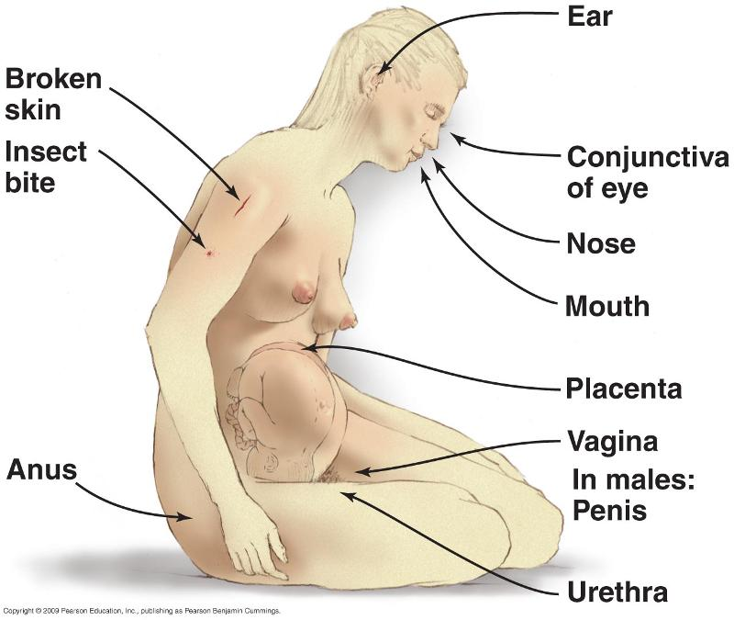
Stages of Infection
1. Entry of Pathogen
Portal of Entry →
2. Colonization
Usually at the site of entry
3. Incubation Period
Asymptomatic period
Between the initial contact with the microbe and the appearance of the first symptoms

Slide 23
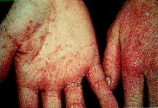
Stages of Infection
4. Prodromal Symptoms
Initial Symptoms
5. Invasive period
Increasing Severity of Symptoms
Fever
Inflammation and Swelling
Tissue Damage
Infection May Spread to Other Sites
Acme

Slide 24
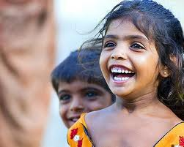
Stages of Infection
Decline of Infection
- Improvement in symptoms
7. Convalescence

Slide 25
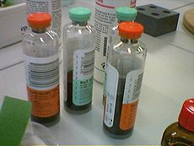
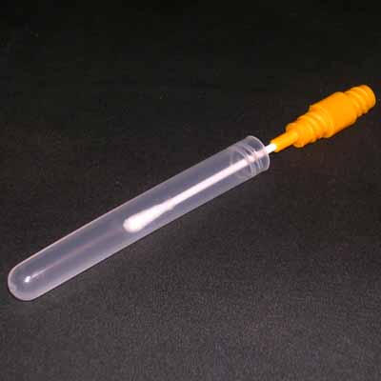
Diagnostic Tests- Traditional
Isolation of Pathogens from Clinical Specimens
If a physician suspects a bacterial infection, samples of infected body fluids or tissues are collected from the patient.
Samples may include blood, spinal fluid, pus, sputum, urine, or feces.
A swab may be used to sample the infected area.

Slide 26
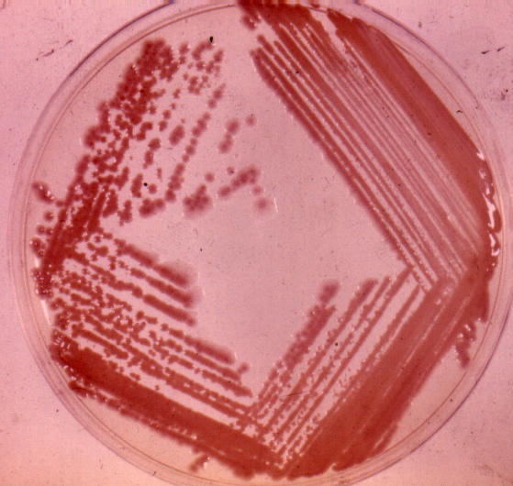
Diagnostic Tests - Traditional
Isolation of Pathogens from Clinical Specimens
The swab is then inoculated onto the surface of an agar plate or put into a tube of liquid medium.
The bacteria is grown and isolated.

Slide 27
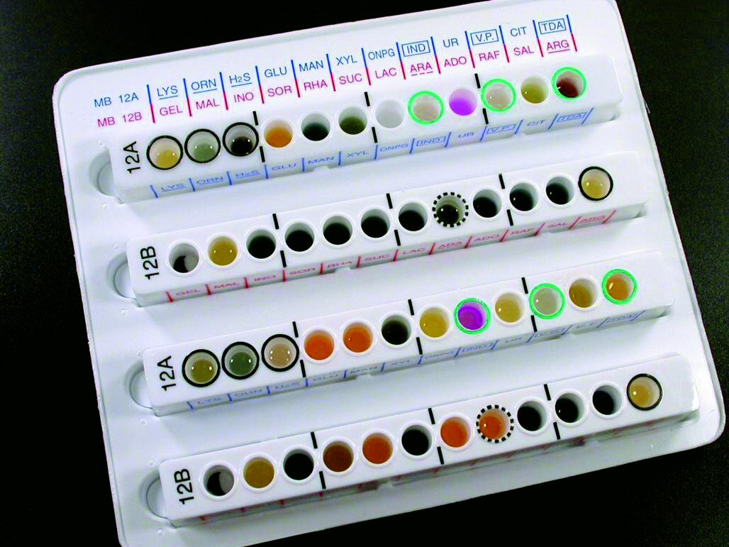
Diagnostic Tests-Traditional
Isolation of Pathogens from Clinical Specimens
The bacteria is identified by growth dependent rapid identification systems.
These systems contain a battery of biochemical tests.

Slide 28
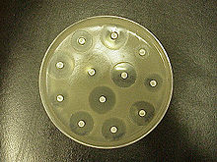
Diagnostic Tests-Traditional
Isolation of Pathogen from Clinical Specimen
Identified pathogens are then tested for sensitivity to antimicrobial agents.
Drug sensitivity testing guides antimicrobial therapy for the patient.
Small wafers with antibiotics are placed on a plate of bacteria. Large zones of no bacterial growth indicated antimicrobial sensitivity.

Slide 29
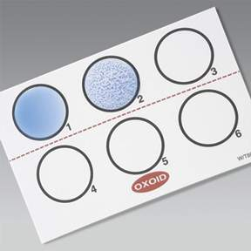
Diagnostic Tests- Traditional
Serology Tests for Antibody or Antigen (Bacterial & Viral)
The agglutination of antigen coated or antibody coated latex beads with a complimentary antibody or antigen is a typical method of rapid diagnosis.
Blood serum from the patient is used in this test.
If , for example, a patient has antibody to a particular infectious agent, the antibody will bind to the antigen coated latex beads.
The suspension becomes visibly clumped. http://www.youtube.com/watch?v=hRzOwSTkF0s
(first 3 min)

Slide 30
Diagnostic Tests- ELISA
Enzyme Linked Immunoassay (viruses)-ELISA
A target antigen is bound to a solid phase such as the plastic on a microplate.
A patient’s blood serum is added to the microplate.
Antibody in the serum will bind to the antigen.
The well in the plate is washed with an enzyme tagged antihuman antibody which binds to the patient antibody.
A substrate for the enzyme is added and a color reaction occurs .

Slide 31
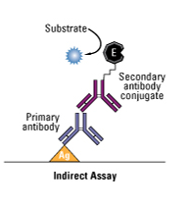
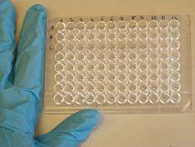
Diagnostic Tests- ELISA
Microplate Antibody/antigen/
Enzyme complex

Slide 32
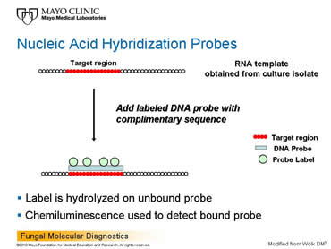
Molecular Diagnostic Tests
Nucleic Acid Hybridization
To identify a bacteria or virus, a species specific nucleic acid probe is needed.
Probes are a single strand of DNA with a sequence unique and complimentary to the gene of interest.
If a clinical specimen contains the microorganism of interest, the probe will bind to the microorganism’s gene DNA sequence.
The double stranded DNA is detected because the probe is labeled with a radioactive, fluorescent, or enzyme tag.

Slide 33
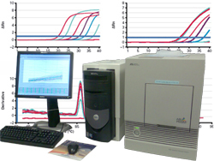
Molecular Diagnostic Tests
PCR
There are PCR tests available to extract DNA or RNA from bacteria or viruses.
The PCR method uses species specific primers for targeted DNA or cDNA.
The DNA is then amplified.
Detection of the gene sequence can be done by gel electrophoresis.
An alternative to electrophoresis is the use of PCR machines with precision optics monitors.
The primer has a fluorescent label and the monitor plots the uptake of the primer. If the primer has been used, this indicates the presence of the microorganism.

Slide 34
Epidemiology
In investigating an outbreak, speed is essential, but getting the right answer is essential, too. To satisfy both requirements, epidemiologists approach investigations systematically, using the following 10 steps:
Prepare for field work
Establish the existence of an outbreak
Verify the diagnosis
Define and identify cases
Describe and orient the data in terms of time, place, and person
Develop hypotheses
Evaluate hypotheses
Refine hypotheses and carry out additional studies
Implement control and prevention measures
Communicate findings
The steps are presented here in conceptual order. In practice, however, several may be done at the same time, or they may be done in a different order. For example, control measures should be implemented as soon as the source and mode of transmission are known, which may be early or late in any particular outbreak investigation.

Slide 35
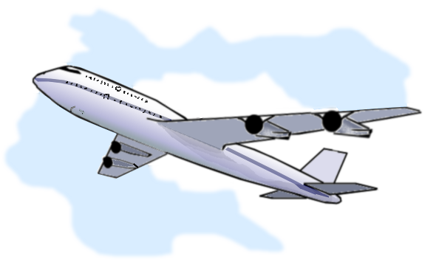
Epidemiology
Step 1: Prepare for Field Work
Before leaving for the field:
Research the disease and gather the supplies/ equipment needed
Make necessary administrative and personal arrangements for such things as travel.
Consult with all parties to determine your role in the investigation and who your local contacts will be.

Slide 36
Epidemiology
Step 2: Establish the Existence of an Outbreak
Verify that a suspected outbreak is indeed a real outbreak.
Some of the cases will be associated with a true outbreak with a common cause, some will be unrelated cases of the same disease, and others will turn out to be unrelated cases of similar but unrelated diseases.
Before you can decide whether an outbreak exists (i.e., whether the observed number of cases exceeds the expected number), you must first determine the expected number of cases for the area in the given time frame.

Slide 37
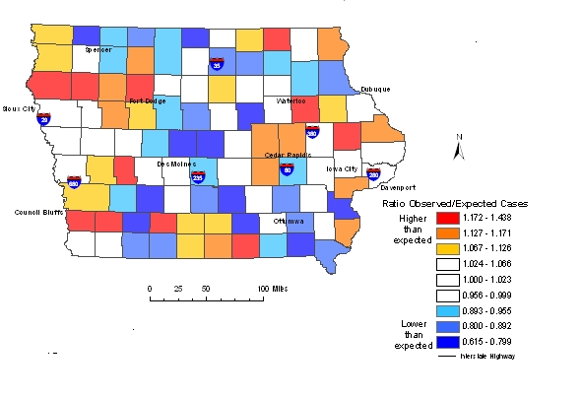
Epidemiology

Slide 38
Epidemiology
Dx
Step 3: Verify the Diagnosis
In addition to verifying the existence of an outbreak early in the investigation, you must also identify as accurately as possible the specific nature of the disease.
Goals in verifying the diagnosis are two-fold.
- First, ensure that the problem has been properly diagnosed—that it really is what it has been reported to be.
- Second, for outbreaks involving infectious or toxic-chemical agents, be certain that the increase in diagnosed cases is not the result of a mistake in the laboratory.

Slide 39
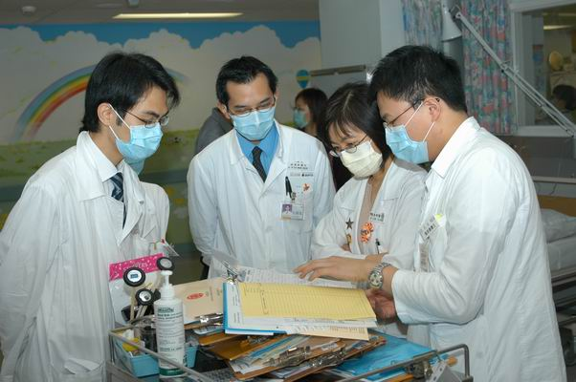
Epidemiology
Step 4: Define and Identify Cases
Establish a case definition. Your next task as an investigator is to establish a case definition, or a standard set of criteria for deciding whether, in this investigation, a person should be classified as having the disease or health condition under study. A case definition usually includes four components:
clinical information about the disease,
characteristics about the people who are affected,
information about the location or place, and
a specification of time during which the outbreak occurred.

Slide 40
Epidemiology
Step 5: Describe and Orient the Data in Terms of Time, Place, and Person
After data collection, characterize an outbreak by time, place, and person. This step may be performed several times during the course of an outbreak. Characterizing an outbreak by these variables is called descriptive epidemiology,
This step is critical
- First, by becoming familiar with the data, you can learn what information is reliable and what is not.
- Second, you provide a comprehensive description of an outbreak by showing its trend over time, its geographic extent (place), and the populations (people) affected by the disease. This description lets you begin to assess the outbreak in light of what is known about the disease and to develop causal hypotheses.

Slide 41
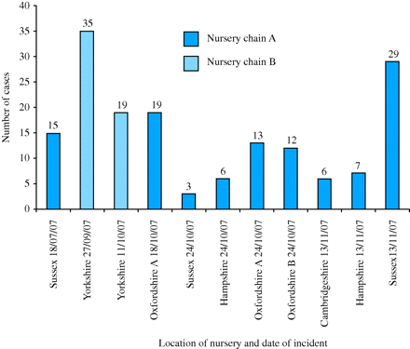
Epidemiology (descriptive)

Slide 42

Epidemiology
Step 6: Develop Hypotheses
In real life, we begin to generate hypotheses to explain why and how the outbreak occurred when we first learn about the problem. But at this point in an investigation, after you have interviewed some affected people, spoken with other health officials in the community, and characterized the outbreak by time, place, and person, your hypotheses will be sharpened and more accurately focused.
The hypotheses should address the source of the agent, the mode (vehicle or vector) of transmission, and the exposures that caused the disease. Also, the hypotheses should be proposed in a way that can be tested.

Slide 43
Epidemiology
Step 7: Evaluate Hypotheses
The next step is to evaluate the credibility of your hypotheses. There are two approaches you can use, depending on the nature of your data: 1) comparison of the hypotheses with the established facts and 2) analytic epidemiology, which allows you to test your hypotheses with cohort and case control studies.

Slide 44
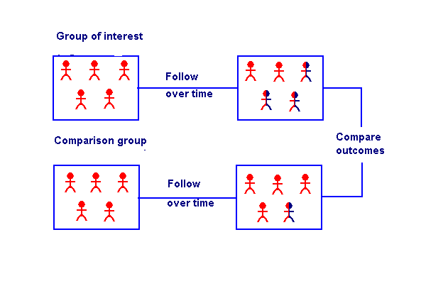
Epidemiology (cohort study)

Slide 45
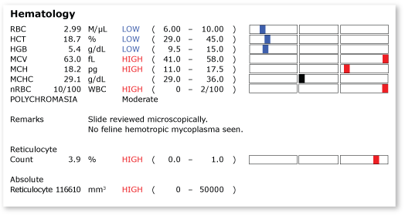
Epidemiology
Step 8: Refine Hypotheses and Carry Out Additional Studies
Additional epidemiological studies When analytic epidemiological studies do not confirm your hypotheses, you need to reconsider your hypotheses and look for new vehicles or modes of transmission. This is the time to meet with case-patients to look for common links and to visit their homes to look at the products on their shelves.
Also, confirmation from laboratory findings can be valuable.

Slide 46
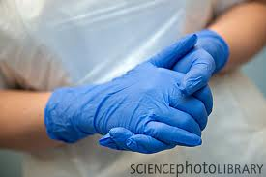
Epidemiology
Step 9: Implementing Control and Prevention Measures
Even though implementing control and prevention measures is listed as Step 9, in a real investigation you should do this as soon as possible.
Control measures, which can be implemented early if you know the source of an outbreak, should be aimed at specific links in the chain of infection, the agent, the source, or the reservoir.

Slide 47

Epidemiology
Step 10: Communicate Findings
Your final task in an investigation is to communicate your findings to others who need to know. This communication usually takes two forms: 1) an oral briefing for local health authorities and 2) a written report

Slide 48
Epidemiology
SARS – The True Story http://www.youtube.com/watch?v=MXPaee0uEQM
Case study: SARS

Slide 49
Lesson 4
Origin of SARs and evolution of the virus
Work in groups of 4. Read powerpoint and web articles about origin of SARS virus and viral evolution.
Discuss and respond to questions.
Write a short essay explaining how natural selection occurred with the SARS virus.

Slide 50
Origin of SARS & Evolution
Visit the following websites for the origin of SARS:
http://www.abc.net.au/science/features/sars/default.htm
http://learn.genetics.utah.edu/archive/sars/index.html

Slide 51
Origin of SARS and Evolution
Visit the following websites for the evolution of SARS:
http://www.smartplanet.com/blog/science-scope/study-shows-how-swiftly-infectious-viruses-evolve/12136
http://www.scientificamerican.com/article.cfm?id=sars-evolution-traced
http://learn.genetics.utah.edu/archive/sars/index.html

Slide 52
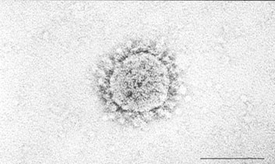
Identification of SARS virus
6 weeks after the outbreak of SARS, CDC identified the SARS virus as a coronavirus via electron microscopy.
http://www.smithsonianmag.com/science-nature/Stopping_a_Scourge.html
This is what they saw:

Slide 53
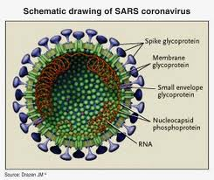
Identification of SARS virus
Coronavirus
Are single stranded RNA viruses
Replicate in the cytoplasm of the host cell.
Spherical 60- 220 nm in size.
Contain club shaped glycoproteins on their surfaces. The virus looks like it has a crown.
Largest genome of any RNA viruses; 29,700 base pairs.

Slide 54
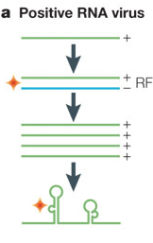
Identification of SARS virus
Replication
The plus strand RNA enters the cytoplasm.
Only RNA polymerase is translated directly from the virus genome to protein.
RNA polymerase makes a negative RNA strand.
Negative RNA strand is a template to make monocistronic (only codons for protein) m RNA that is used in translation.

Slide 55
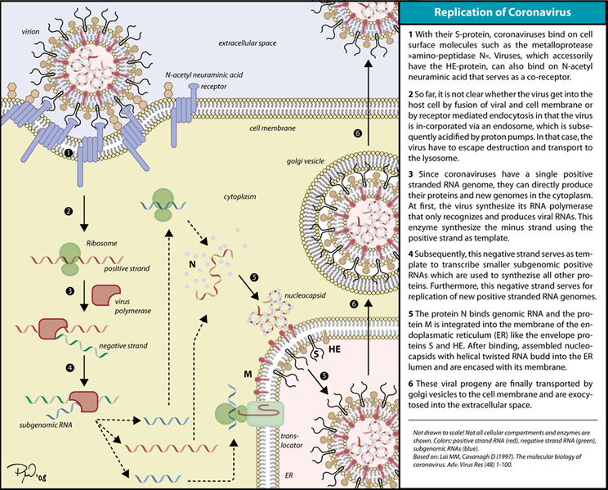

Slide 56
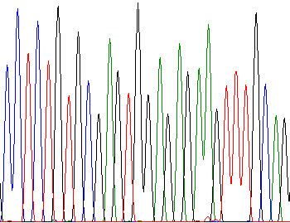
Identification of SARS virus
The second step in identification of the virus was to discover the DNA sequence of the virus.
Three months after the outbreak, Canada’s Michael Smith Genome Sciences Center in British Columbia sequenced the SARS coronavirus.
The DNA sequence is located in GenBank.
http://www.msfhr.org/news/features/2009/03/speed_demons

Slide 57
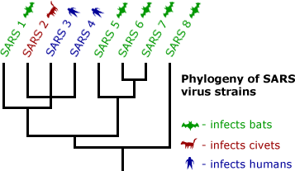
Identification of SARS virus
Bioinformatics
DNA isolates were taken from SARS virus and compared to DNA isolates from other coronaviruses and other strains of SARS viruses.
By comparing SNP (single nucleotide polymorphism) among the DNA isolates, researchers were able to classify the virus and create a phylogenetic tree.
Researchers also discovered that four proteins were responsible for pathogenesis of SARS: spike (S) protein; small envelope (E) protein; membrane (M) protein; and nucleocaspid (N) protein.

Slide 58
Patient Diagnostics -SARS
The DNA sequencing and research led to two frequently used tests to help diagnose SARS in patients.
RTPCR – Real Time Reverse Transcriptase PCR
ELISA – Enzyme linked immunoassay

Slide 59
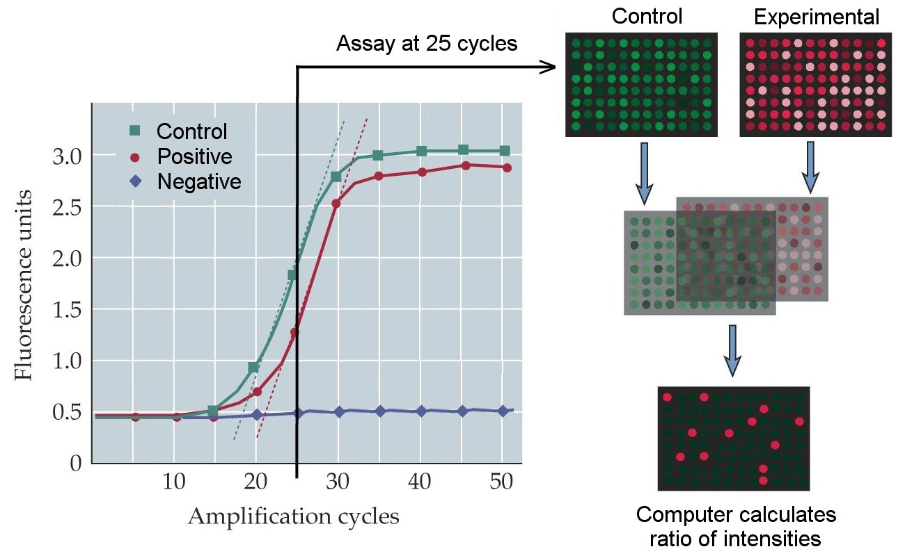
Patient Diagnostics
RTPCR
Enables researchers to quantify amplification reactions in real time.
A specialized thermo cycler with a laser scan beams light through the PCR tube.
The PCR product is labeled with a fluorescent tag.
The amount of fluorescent light produced after each cycle is printed on a computer readout.
This allows for quantification of the number of PCR products produced after each cycle.
For diagnosis of SARs, patient tissues and body fluids can be used directly. The primers used in the test are specific for cDNA made from the viral genome.
http://www.youtube.com/watch?v=kvQWKcMdyS4

Slide 60
Patient Diagnosis
ELISA
The SARS antigen is bound to a microplate.
The patient’s blood serum with SARS antibodies is introduced.
The patient SARs antibody binds to the SARS antigen.
A second antibody with an enzyme attached combines with the SARS antibody/antigen complex.
When a substrate is added,t he well in the microplate turns color with a positive reaction .
http://highered.mcgraw-hill.com/sites/0072556781/student_view0/chapter33/animation_quiz_1.html.

Slide 61
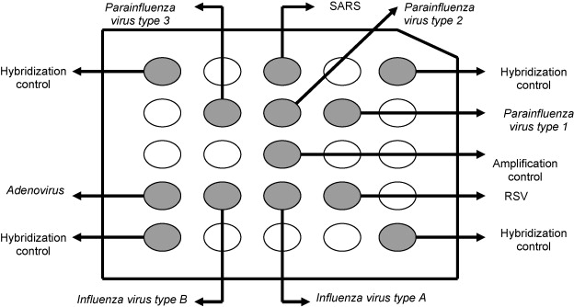
Patient Diagnostics
ViroChip
A DNA microarray test system called ViroChip enables doctors to screen for the type of virus present in a patient, if they do not know the virus type.
A ViroChip has 22,000 DNA sequences on it and identifies a variety of different viruses.
http://www.nytimes.com/2008/10/07/health/research/07conv.html

Slide 62
Lesson 5
Immunology
Work in groups of 4.
Read powerpoint, discuss, and respond to questions.
Complete chart of immune responses.
Whole class discussion of responses.
Write a 5 minute commercial or skit about the immune system.
Present skit or commercial.

Slide 63
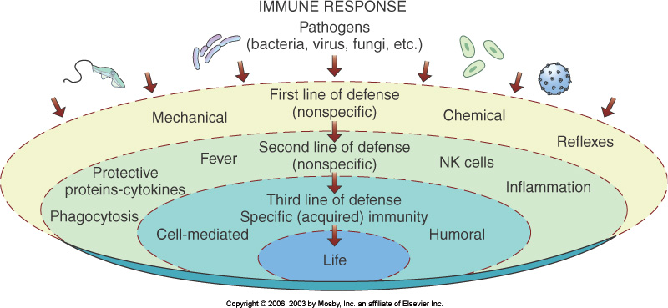
Immunology
Two types of immunity
Innate or Non-specific Immunity
Adaptive or Acquired Immunity

Slide 64
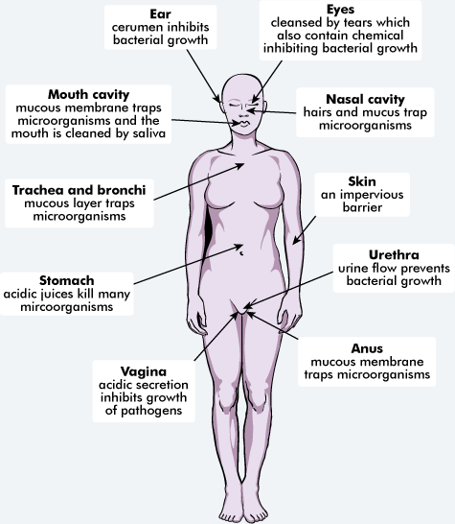
Immunology
3 Lines of Defense in immunity
Barriers at body surfaces (innate)
Intact skin and mucous membranes
Infection fighting tears and saliva.
Normal bacterial flora outcompete pathogens.
Flushing effects of tears, urination, diarrhea.

Slide 65
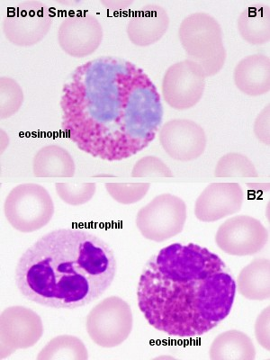
Immunology
3 Lines of Defense
Non-specific Responses (Innate)
Inflammation
a. Fast acting white blood cells; neutrophils, basophils, eosinophils.
b. Macrophages
c. Complement proteins and other infection fighting substances.
2. Organs with phagocytic functions i.e. lymph nodes.

Slide 66
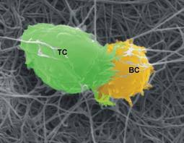
Immunology
3 Lines of Defense
Immune Responses (Adaptive or Specific)
T cells and B cells
Communication signals and chemical weapons ( antibodies, complement proteins etc.)

Slide 67
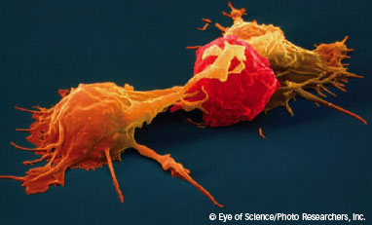
Innate or Non –Specific Immunity
Innate Immunity – Non specific responses
Innate immunity is a non specific attack against any cell or particle that is not self.
Antimicrobial agents
Phagocytic cells
Nonphagocytic cells
Natural killer cells →
Inflammation and Fever

Slide 68
Innate or Non-Specific Immunity
Innate - Antimicrobial agents
Antimicrobial agents are chemicals or molecules that act to deter or destroy microorganisms. Some of them act in conjunction with physical barriers.
There are 3 types:
Interferon
Interleukins
Complement

Slide 69
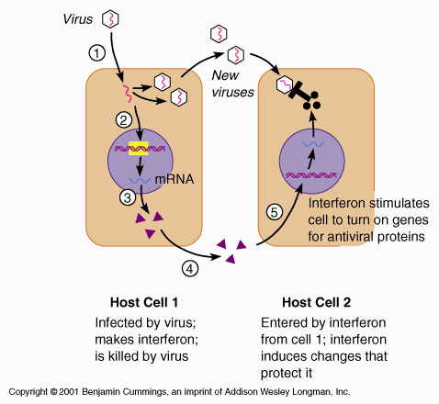
Innate or Non-specific Immunity
Interferon
Interferons are a large group of proteins that acts as signals both during innate and adaptive immune responses.
Interferon is produced early in viral infections by a cell.
The interferon will not keep the cell from viral infection but it is released and warns other cells to synthesize antiviral cell surface proteins.
http://www.youtube.com/watch?v=3qFu6Fv4cJk&feature=related

Slide 70
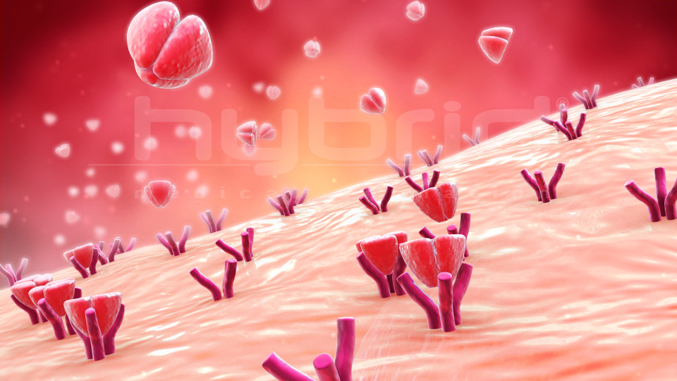
Innate or Non-specific Immunity
Interleukins
Interleukins are another class of proteins which are produced by cells of the immune system.
Tumor necrosis factor (TNF) , a type of interleukin, stimulates cells to create an inflammatory response.
TNF cells can also kill tumor cells.

Slide 71
Innate or Non-specific Immumity
Complement: a family of 20 different proteins.
Found in blood serum and protect the body from infection.
Works together with other components of the innate and adaptive immune systems.
Generally, complement is inactive.
In the presence of an antigen, complement becomes activated.

Slide 72
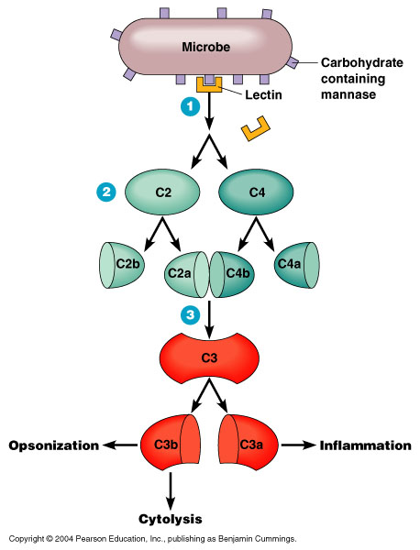
Innate or Non-specific Immunity
Complement
Complement is activated in 4 general and non specific ways.:
Some complement proteins coat the surface of a pathogen so phagocytes can engulf them.
Other complement proteins lyse the cell wall of microorganisms
Other complement proteins trigger the release of histamine which increases inflammation by dilating blood vessels and increasing capillary permeability.
Some complement proteins attract lymphocytes.
http://highered.mcgraw-hill.com/sites/0072556781/student_view0/chapter31/animation_quiz_1.html

Slide 73
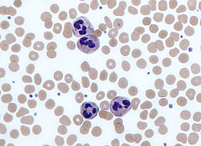
Innate or Non-specific Immunity
Innate – Phagocytic Cells
Sometimes an infectious agent avoids physical barriers and antimicrobial agents in the body.
A 3rd line of defense is available.
Phagocytic cells engulf microorganisms in digestive vacuoles and break down cells.
Phagocytic cells contain many enzymes: lysozyme to breakdown peptidoglycan, proteases to break down proteins, nucleases to break down DNA and RNA, and lipases to break down lipids.

Slide 74
Innate or Non-specific Immunity
Phagocytic Cells
There are 2 types of phagocytic cells:
Stationary phagocytes – reside along blood vessel walls and in connective tissue
Wandering phagocytes – circulate in the blood.
Both types are made in the bone marrow

Slide 75
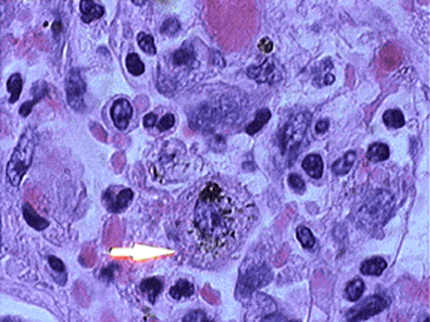
Innate or Non-specific Immunity
Stationary phagocytes
Macrophages are large phagocytic cells.
Made in the bone marrow, they circulate in the blood for a few days and are called monocytes at this stage.
Monocytes are released into connective tissue and are now referred to as macrophages.
Macrophages are scavenger cells. They engulf:
Microorganisms
Dead body cells
Cancer cells
Cells infected with viruses.
The life span of a macrophage is from a few months to many years.
http://www.youtube.com/watch?v=m6qJ69wcSnc

Slide 76
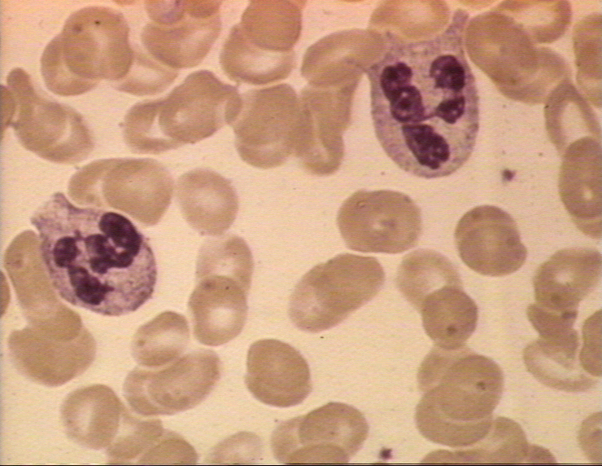
Innate or Non-specific Immunity
Wandering Phagocytes
Wandering phagocytes are white blood cells called monocytes and neutrophils.
There are 4,000-6,000 neutrophils/mm3 of blood. They account for 65% of all white cells.
In a bacterial infection, neutrophil numbers can double.
Neutrophils are mobile. They can squeeze through capillaries and into cells; they can enter the spinal column to fight meningitis.
http://hippocampusbiology.blogspot.com/2009/03/bacteria-can-run-but-they-cant-hide.html

Slide 77
Innate or Non-Specific Immunity
Innate – Nonphagocytic Cells
Eosinophils – White blood cells that secrete enzymes that attack parasitic worms; reside in blood.
Basophils - White blood cells that contain heparin (stops blood from clotting) and histamine (vasodilator which promotes blood flow to tissues). Play a role in inflammation and allgergies. Reside in blood.
Mast Cell - Cells residing in many tissues that contain heparin and histamine. Look like basophils but come from different cell line. Important in inflammation.

Slide 78



Innate or Non Specific Immunity
Eosinophil
Basophil →
Mast Cell

Slide 79

Innate or Non-specific Immunity
Innate – Natural Killer Cells
Are not phagocytic.
Are a white blood cell called a lymphocytes
Attach to cell surfaces and produce enzymes that destroy antibody covered cells that have been infected with microorganisms or viruses.
Also able to destroy cancer cells.
http://www.youtube.com/watch?v=HNP1EAYLhOs

Slide 80

Innate or Non-specific Immunity
Innate – Inflammation
Inflammatory response is a major component of the innate immune system.
In inflammation:
1. When tissue is injured or microorganisms enter the tissue, mast cells release chemicals called histamine.

Slide 81

Innate or Non-specific Immunity
Inflammation
The chemicals spark the mobilization of various defenses.
Histamine induces blood vessels to dilate and increases blood flow to the injured tissue.
Blood plasma leaks out of the blood vessels to the affected tissues.
Phagocytic cells squeeze out of the blood vessels and migrate to the tissue.
Increased blood flow, fluid, and cells produce redness, heat, and swelling of tissues.

Slide 82

Innate of Non-specific Immunity
Inflammation
The major results of inflammation is to disinfect and clean injured tissue.
Phagocytic cells engulf bacteria and body cells killed by them.
Many phagocytic cells die in this process and they are engulfed and digested.
Pus that accumulates at the injury site consists of dead cells and fluid from leaking capillaries.

Slide 83

Innate or Non-specific Immunity
Inflammation
Inflammation helps prevent the spread of infection to surrounding tissues.
Clotting factors and platelets pass into the tissues from the blood and form local clots to seal off the infected region.
The damaged tissue begins to repair. http://www.sumanasinc.com/webcontent/animations/content/inflammatory.html

Slide 84

Innate or Non-specific Immunity
Innate- Fever
During some infections, fever occurs.
Fever is induced by toxins released by microorganisms.
The increase in body temperature:
Kills some microorganisms.
Increases inflammation.
Stimulates phagocytic activity.
Stimulates adaptive (acquired) immune response.
Reduces iron concentration in blood and limits amount of iron available to microorganisms.

Slide 85
Adaptive or Acquired Immunity
Adaptive immunity is a complex set of interactions that is highly specific against one type of antigen.
Whereas innate immunity reacts to a variety of pathogens, adaptive immunity must be primed by the presence of an antigen.
Adaptive immunity either attacks a specific antigenic invader directly or it produces antibodies.
There are two types of adaptive immunity:
Cell mediated immunity
Humoral immunity

Slide 86

Adaptive or Acquire Immunity
Cell mediated immunity involves a type of lymphocyte called a T (thymus) cell. T cells work against infections caused by fungus and protozoans. Also, they are important in eliminating cancer cells.
Humoral immunity involves a type of lymphocyte called a B cell. B cells protect against viruses and bacteria in body fluids by producing antibodies.

Slide 87

Adaptive or Acquired Immunity
Both T cells and B cells originate from stem cells in the bone marrow.
B cells continue to mature in the bone marrow.
T cells are carried from the bone marrow to the thymus gland to become specialized.
Both T cells and B cells have the ability to recognize self from antigen.

Slide 88

Adaptive or Acquired Immunity
Cell Mediated Immunity
T cells after maturation are moved to the lymphatic system.
T cells are primarily involved in attacking cells directly.
While T cells are maturing, they develop the ability to recognize specific antigens (Non-self)
For T cells to go into action, they need the antigen presented to them.

Slide 89

Adaptive or Acquire Immunity
Cell mediated immunity
All cells have surface glycoproteins call the Major Histocompatibilty Complex (MHC).
In humans, the MHC is called HLA (human leukocyte antigen).
These classes of molecules mark our cells as self.
Invading cells have an MHC and this marks them as foreign.

Slide 90

Adaptive or Acquire Immunity
Cell mediated immunity
Cells like macrophages recognize foreign (MHC) cells and ingest them.
Macrophages(or other cells) then display antigenic fragments from the microorganism on their cell surfaces.
Macrophages displaying antigens are called antigen presenting cells (APC).
T cells bind to the macrophage/antigen complex and this activates the T cell.
T cells will then proliferate and carry out their functions.

Slide 91

Adaptive or Acquire Immunity
Cell mediated immunity
There are 2 types of T cells:
CD8 or cytotoxic T cells
CD4 or helper T cells

Slide 92

Adaptive or Acquire Immunity
Cell mediated immunity
CD8 cells
CD8 cells respond to foreign antigens on the cell’s surface by binding to the antigenic MHC on the invading cells and directly killing them.
CD8 cells release perforin, a protein that creates pores on the invading cells membrane. Water and ions flow into the cells and the cell lyses.
Cancer cells, foreign cells from a transplant or graft, pathogen infected cells, and virus infected cells are targeted by CD8 cells.
http://www.theimmunology.com/animations/Cytotoxic.T.Cell.htm

Slide 93

Adaptive or Acquired Immunity

Slide 94

Adaptive or Acquired Immunity
Cell mediated immunity
CD4 cells
CD4 cells that have been activated by an APC secrete cytokines, a protein that stimulates other lymphocytes.
If B cells have contacted an antigen, the signal from the CD4 cell differentiates the B cell into an antibody producing cell.
CD4 cells also play a role in stimulating CD8 cells to proliferate.
http://highered.mcgraw-hill.com/sites/0072507470/student_view0/chapter22/animation__t-cell_dependent_antigens__quiz_2_.html

Slide 95
Adaptive or Acquired Immunity
Humoral Immunity
B cells are involved in humoral immunity.
B cells produce antibody. The antibody produced by a B cell is specific for a particular antigen.
There are two types of B cells:
Plasma Cells
Memory Cells

Slide 96

Adaptive or Acquired Immunity
Humoral immunity
Plasma Cells
A plasma cell encounters an antigen and secretes a specific antibody.
Plasma cells are activated when they encounter an antigen and are stimulated by helper T cells.
Plasma cells can produce more than 10 million antibodies in an hour.

Slide 97

Adaptive or Acquired Immunity
Humoral immunity
Memory Cells
Not all activated B cells become plasma cells.
Some become memory cells and produce small amounts of antibody after an infection has been eliminated.
If the same microorganism is encountered again, the memory cells change to plasma cells and begin producing antibody.
This enables the immune system to attack rapidly and aggressively if there is re-infection.
http://highered.mcgraw-hill.com/sites/0072495855/student_view0/chapter24/animation__the_immune_response.html

Slide 98

Adaptive or Acquire Immunity
Antibodies
Antibody structure and function
Disposal of antibody/antigen complex.

Slide 99

Adaptive or Acquired Immunity
Antibody structure and function
Antigens that elicit an antibody response are typically a protein or polysaccharide surface component of microbes.
The antibody does not bind to the total antigen.
A small accessible portion of antigen called an epitope or antigenic determinant is available for binding to the antibody.
A single antigen has several epitopes and each epitope binds to a different antibody.

Slide 100

Adaptive or Acquired Immunity
Antibody structure and function.
Antibodies are globular serum proteins called immunoglobulins.
There are two antigen binding sites for specific epitopes on an antibody.
Each antibody consists of 4 polypeptide chains. 2 identical heavy chains and 2 identical light chains.

Slide 101
Adaptive or Acquired Immunity
Antibody Structure and Function
At the 2 tips of the antibody are variable regions (on light and heavy chains).
The amino acid sequence varies from antibody to antibody.
The variable region gives the antibody specificity for an antigen.
The binding of the epitope and the binding site is similar to an enzyme substrate reaction.

Slide 102
Adaptive or Acquired Immunity
Antibody structure and function
The tail of the antibody is formed by the constant region.
The constant region is responsible for distribution of the antibody within the body and for mechanisms that mediate the disposal of the antibody/antigen complex.
There are 5 types of heavy chain constant regions: IgA, IgG, IgM, IgD, and IgE.

Slide 103


Slide 104
Adaptive or Acquire Immunity
Disposal antibody/antigen complex
The binding of antibody to antigen creates complexes that must be disposed.
Three types of disposal
Neutralization/Opsonization
Agglutination/ Precipitation
Complement fixation

Slide 105


Slide 106
Adaptive or Acquire Immunity
Disposal antibody/antigen complex
Neutralization/Opsonization
In neutralization, the antibody binds to the antigen.
The microbe covered in antibodies is phagocytized by macrophages.
Opsonization is similar to neutralization. Compounds called opsins bind to antibody/antigen complexes and this enhances the ability of the macrophage to phagocytize the microorganism

Slide 107


Slide 108
Adaptive or Acquired Immunity
Disposal antibody/antigen complex
Agglutination
Agglutination is possible because antibodies have 2 antigen binding sites.
One site can attach to one bacteria and the second site can attach to a second bacteria.
When thousands of antibodies behave in this way, a clumping of the microorganisms occurs.
Precipitation is similar to agglutination as clumping occurs.
In precipitation, the antigens cross link and form a precipitate.
Both processes are followed by macrophage phagocytosis.

Slide 109


Slide 110

Adaptive or Acquired Immunity
Disposal antibody/antigen complex
Complement Fixation
Antibody/antigen complexes activate a complement cascade.
Complement consists of 20 proteins and in the cascade one type of complement triggers the production of the next type in a series of reactions.
Completion of the complement cascade results in lysis of viruses and pathogenic cells or opsonization.
http://highered.mcgraw-hill.com/sites/0072556781/student_view0/chapter31/animation_quiz_1.html

Slide 111

Lesson 6
ELISA Lab – SARS virus
Conduct ELISA test.
Write lab report
Refer to your handouts

Slide 112
Lesson 6
Vaccines
Read article: How do vaccines work?
Discussion: How is this related to discussion of immune system
Lecture- Types of vaccines (biotechnology)
Whole class review with questions of vaccine types.
Video: Mothers who do not vaccinate their children.
Read and review article on causal relationships between vaccines and adverse effects.
Discussion: Should childhood vaccination be mandatory?

Slide 113
Lesson 5
Vaccines

Slide 114
Vaccines
How do vaccines work?
http://www.healthychildren.org/English/safety-prevention/immunizations/pages/How-do-Vaccines-Work.aspx?nfstatus=401&nftoken=00000000-0000-0000-0000-000000000000&nfstatusdescription=ERROR%3a+No+local+token
http://www.historyofvaccines.org/content/how-vaccines-work

Slide 115

Vaccines
Vaccination has proven effective against fighting diseases caused by microorganisms.
Infectious disease is one of the major causes of death worldwide. 60% of children worldwide under the age of 4 die from infectious disease.
The world’s first vaccine was made by Edward Jenner in 1796. He discovered that the live cowpox virus could be used to immunize patients against smallpox.

Slide 116

Vaccines
Vaccines
Vaccines are parts of a pathogen or whole organisms that are given to humans or animals by mouth or by injection to stimulate the immune system.
When people or animals are vaccinated, the immune system recognizes the vaccine as antigen and produces antibodies and memory B cells.

Slide 117

Vaccines
Vaccines
Four major strategies are used to make vaccines:
Subunit vaccines
Attenuated vaccines
Inactivated (killed) vaccines
DNA vaccines

Slide 118

Vaccines
Vaccines
Subunit vaccines
Subunit vaccines are made by injecting portions of viral or bacterial structures, usually proteins or lipids from the microbe, to which the immune system responds.
EX: Vaccines for hepatitis B, anthrax, tetanus, and meningococcal disease.
http://library.thinkquest.org/20994/data/task8-2.html

Slide 119

Vaccines
Vaccines
Attenuated vaccines
Attenuated vaccines involve using live bacteria or viruses that have been weakened (attenuated) by aging or alteration of growth conditions.
Attenuation prevents replication after the vaccine is introduced into the recipient.
EX: Vaccines for MMR, tuberculosis, cholera, Saban polio, and chickenpox.

Slide 120

Vaccines
Vaccines
Inactivated vaccines
The pathogen is killed and the dead microorganism is used for the vaccine.
EX. Vaccines for rabies, influenza, DPT, and Salk polio.

Slide 121

Vaccines

Slide 122

Vaccines
Vaccines
DNA Vaccines
DNA vaccines have demonstrated that injecting small pieces of DNA from a microbe create an antibody response.
DNA vaccines are composed of bacterial plasmids. Expression plasmids used in DNA-based vaccination normally contain two units: the antigen expression unit, followed by antigen-encoding and polyadenylation sequences and the production unit that is composed of bacterial sequences necessary for plamid amplification and selection
DNA vaccines for HIV and malaria are in clinical trials.

Slide 123
Vaccines
Vaccines
http://www.pbs.org/wgbh/pages/frontline/teach/vaccine/
Pros and cons of vaccination
http://www.hrsa.gov/vaccinecompensation/adverseeffects.pdf
Causality vaccines

