Slide 1
Engineering Transcription Factors with Novel DNA-Binding Specificity using Comparative Genomics
Tasha A. Desai, Dmitry A. Rodionov, Mikhail S. Gelfand, Eric J. Alm, and Christopher V. Rao
Alvin Chen
20.385
April 14, 2010

Slide 2
Comparative Genomics
Study of the relationship of genome structure and function across different species
Uses information based on selection patterns to help understand functions of genes and evolutionary processes that act on genomes
Can comparative genomics inform the design of bacterial transcription factors?

Slide 3
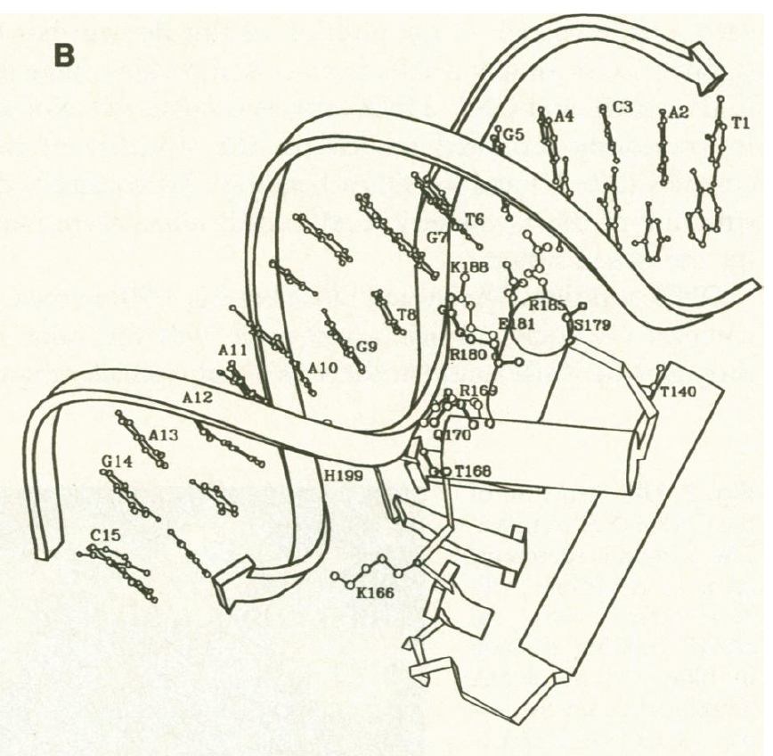
cAMP Receptor Protein (CRP)
CRP binds cAMP, causing a conformational change which allows it to bind to various promoters, including the lac operon
Previous study shows that small number of AA’s can determine specificity of CRP
Predicted that Arg180/ Glu181/Arg185 make direct contact with DNA bases in major groove in E. coli CRP
Schultz et al., Science, (1991) 253(5023): 1004

Slide 4
Overview
Tested correlations between residue identity and target DNA-binding sequence determined from previous study (wanted to figure out binding patterns)
Generated eight variants of E. Coli CRP and tested whether they could bind to cognate operator sequence
All variants were mutated at Arg180/Glu181/Arg185 triad of CRP
Operator mutated in lacZ promoter
LacZ was fused to GFP so that fluorescence could be used as a readout of promoter activity

Slide 5
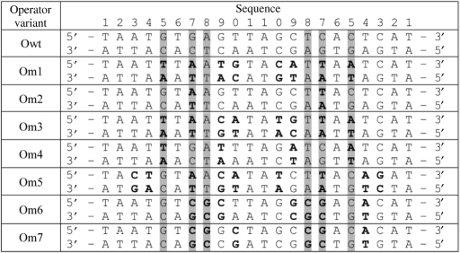
Operator Site Mutations
Bolded bases denote mutations
Shaded columns denote bases that make direct contact to side chains in WT CRP
Arg180 contacts G5, Glu181 contacts C5, Arg185 contacts G7/T8

Slide 6
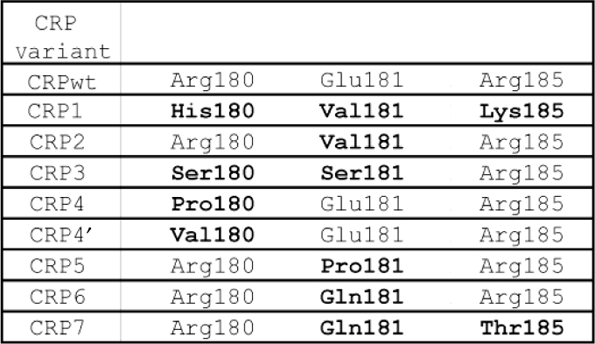
CRP Mutations
Bolded residues denote mutations
CRP4 and CRP4’ predicted to bind same Om4 site

Slide 7
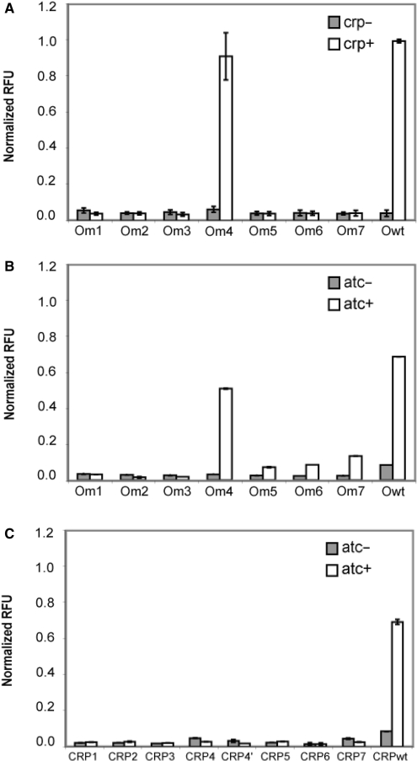
No Promiscuous Operator Binding (except for Om4)
All reporters in crp+ strains with mutated operators inactive except for Om4
Om4 only mutated at position 5 (G -> T) for bases that directly interact with CRP
All promoters in crp- strains inactive

Slide 8
Analysis of Inducible CRP Expression on Mutated Operators
All reporters inactive in absence of atc
Om4 and WT reporters were active
Weak expression for Om5, Om6, and Om7 (no explanation given)

Slide 9
CRP Mutants are Incapable of Activating Wild-Type Reporter
Ectopically expressed CRP was tested with the wild-type operator
None of the CRP variants were able to activate wild-type reporter

Slide 10
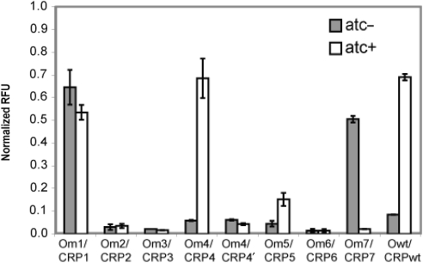
Four of Eight Mutants Can Activate Their Cognate Operator (sort of…)
CRP1 – Strong activation in atc- and atc+ (most severe changes)
CRP4 able to bind to Om4 and activate reporter in dose-dependent manner
CRP7 activates Om7 only in absence of inducer
CRP5 weakly activates reporter (25% of wild-type level)

Slide 11
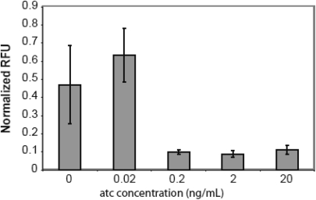
Dose Response of CRP7/Om7 Pairing
CRP7-Om7 combination is active only at low levels of atc
Moderate decrease (25%) in cell density at higher atc concentrations
Suggests some level of toxicity due to CRP7/Om7 pairing

Slide 12
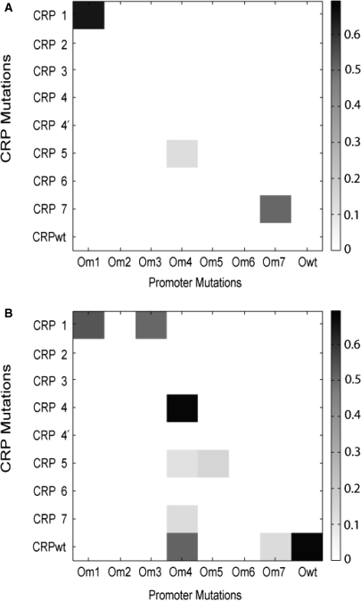
Analysis of Pairing CRP & Operator Mutations (atc-)
Strong activation by CRP6/Om7 pair
Weak activation by CRP5/Om4 pair
Non-specific mutations in Om6 prevent CRP6 and CRP7 from binding

Slide 13
Analysis of Pairing CRP & Operator Mutations (atc+)
CRP1 able to activate Om1 and Om3 (non-specific interaction has effect on affinity)
Om4 activated by CRP4/CRPwt (strong) and CRP5/CRP7 (weak)
CRP5 can weakly activate Om4 in + and – atc conditions

Slide 14
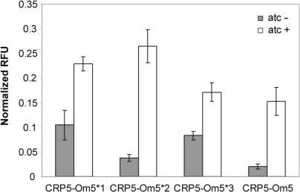
Optimization by Genetic Screening
Randomized the middle six positions of Om5
Found three variants with increased activity
Result doesn’t approach wild-type levels, but demonstrates that computational designs can be improved

Slide 15
Key Assumptions
Mode of binding is identical with the CRP family of regulators
If CRP binds to operator, it will activate transcription
Limited cross-talk between species

Slide 16
Concerns - Uh oh!
Need to proofread figures and text! (for example, mistakes in fig. 5A and caption of fig. 6)
Conditions questionable – grew strains in glucose
Should show protein levels and binding affinity/specificity by protein footprinting
Need to have possible explanations for unexpected behavior
Paper goes overboard in proclaiming its success (at most just 1 of 8 mutants successful)

Slide 17
Significance
Comparative genomics is a possibly useful tool for transcription factor engineering
Can possibly use mutual information between transcription factors and DNA-binding site to inform protein engineering
Our understanding of simple protein-DNA interaction is limited (CRP7/Om7)
Bases that do not contact CRP can have impact in binding affinity
Possible to create orthogonal pathways with small number of mutations

Slide 18
Design of Genetic Networks with Specified Functions by Evolution in silico
Paul Francois and Vincent Hakim
Alvin Chen
20.385
April 14, 2010

Slide 19
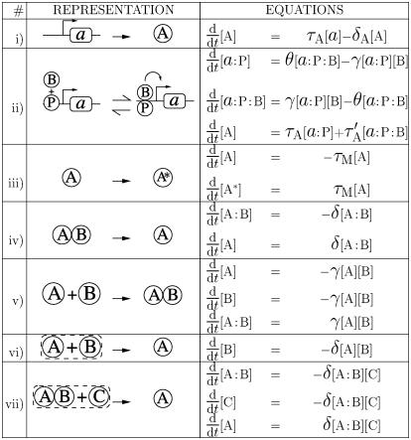
List of Possible Reactions

Slide 20
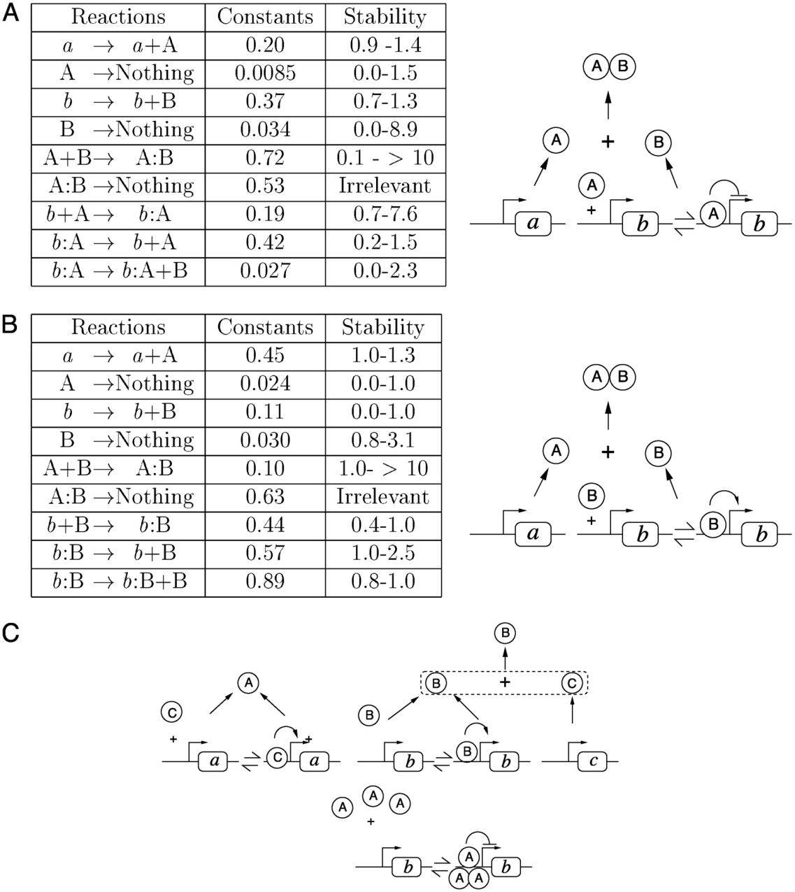
Three Obtained Bistable Switches

Slide 21
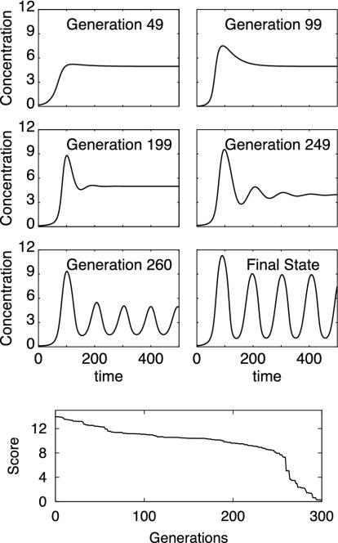
Evolutionary Process Leads to Development of Oscillatory Network

Slide 24
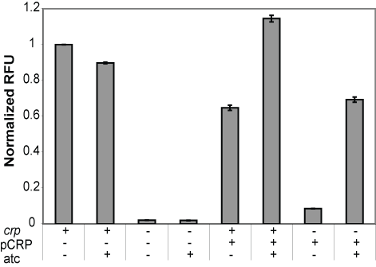
Reporter System Works
In wild type cells, lacZ-gfp reporter is active; inactive for crp-
pCRP can complement crp- background when induced by atc
Surprisingly, in presence of atc, moderate inhibition of expression occurred
Notes:
Not important to include

