Slide 1
Introduction to Tissue Engineering
ChemEng 590B: Tissue Engineering
Lecture 1
January 22nd, 2013

Slide 2
FIRST THING. PRE-COURSE QUIZ!
Take a pre-course quiz handout. You have 5-10min to complete.
When finished, hand to a neighbor for in-class grading.

Slide 3
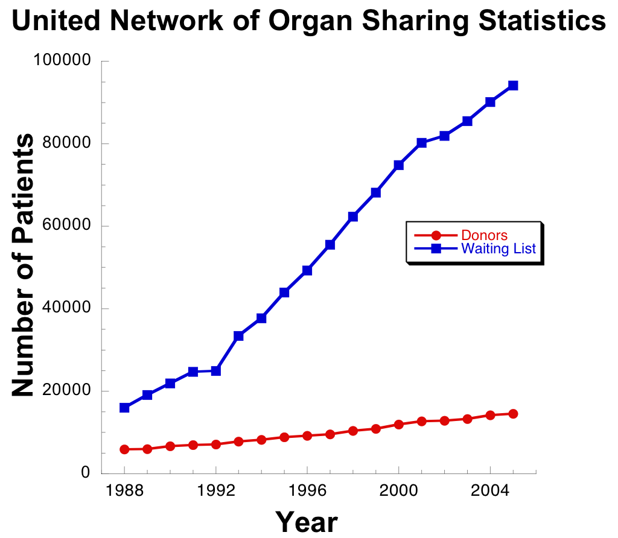
Tissue Engineering Seeks to Provide Replacement Tissues
Current lack of organ donors to meet rising demand of transplants
Each year, 40 to 90 million hospital days are attributed to the treatment of tissue and organ failure in the United States.
$400 billion per year is estimated as the total national health care cost for the 8 million or so procedures performed on patients suffering end-stage organ failure or tissue loss within the US.
Critical problems for tissue engineering
  Vascularization
  Cell Delivery
  3. Mechanical mismatch

Slide 4
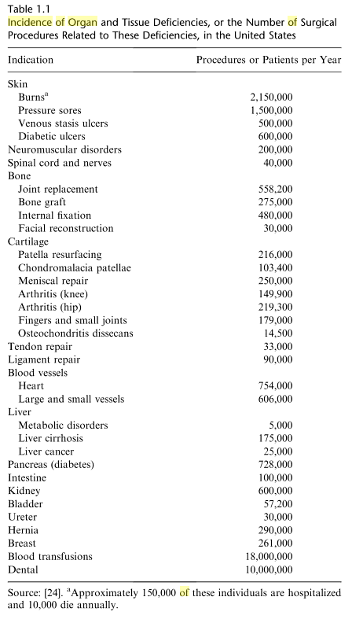
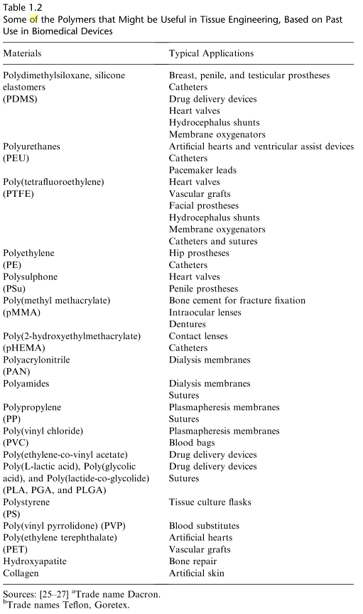

Slide 5
Tissue Replacement Strategy

Slide 6
Wound Healing: Strategies
To start: a critically sized defect that cannot autonomously repair

Slide 7
Wound Healing: Strategies
A) Inject cells (from patient or donor), cells will make new bone
If cells are not from patient, big problems with immune rejection
  Xenograft: different species. Allograft: different person, same species.
If cells are from patient, do they have enough? Of the right type? Stem cells?
  Autograft: tissue from another part of same body
Will cells survive the injection?
How do you package them into a very large defect?

Slide 8
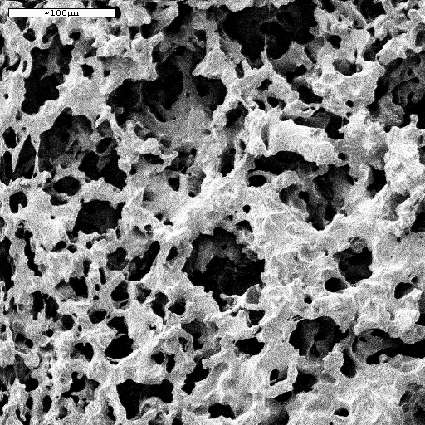
Wound Healing: Strategies
B) Add scaffold, entice cells to migrate in and repair
Scaffold needs to be permissive to cells and nutrients, but not entice immune response
  Properties to entice cell of interest, block out others
Scaffold must be mechanically appropriate
Is patient in traction during healing?
Does patient have enough healthy cells?

Slide 9
Wound Healing: Strategies
C) Add cells and scaffold, scaffold replaced over time
All the issues of cell-only and scaffold only implantation w.r.t. immune response
Scaffold must be degradable over a specific time period???

Slide 10
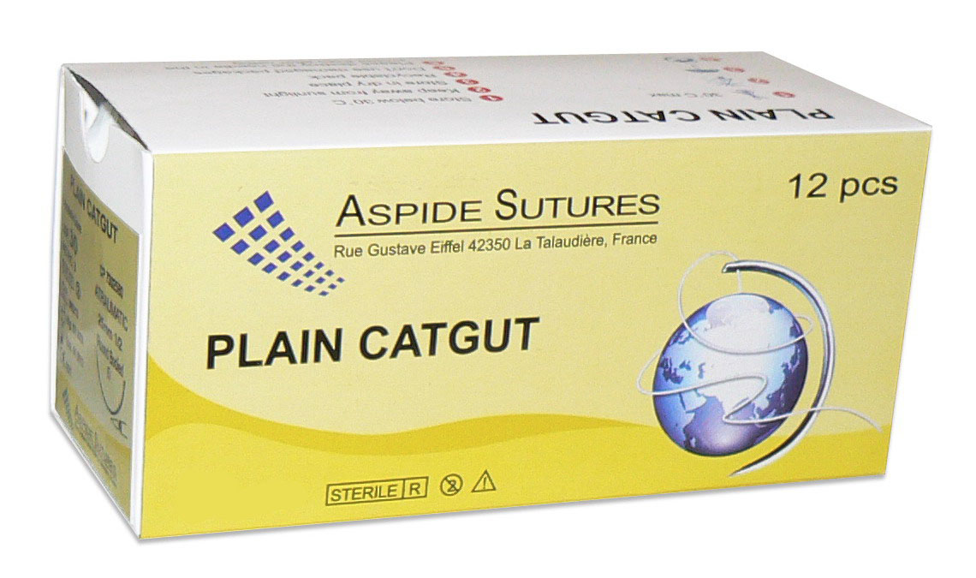
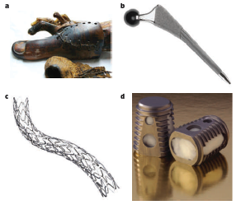
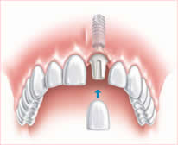
Tissue Engineered Solutions
Historically: Bio-inert materials to replace structural units of body
Resorbable sutures, 600 BC
Dental implants
Huebsch and Mooney, Nature, 2009
Posted on website

Slide 11
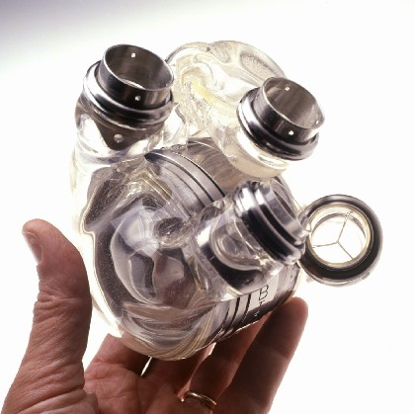
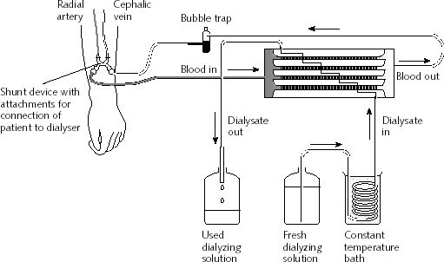
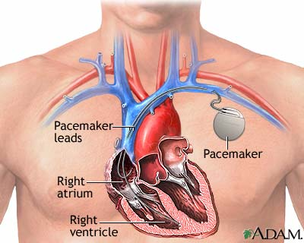
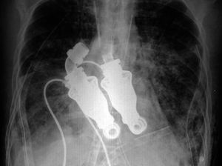
Machines to replace biological tissue function
AbioCore artificial heart
Ex vivo dialysis
“beatless” artificial heart
Texas Heart Institute

Slide 12
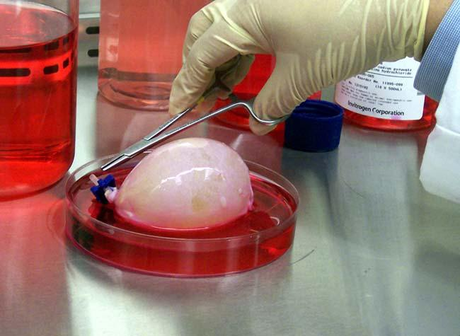
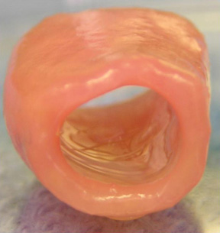
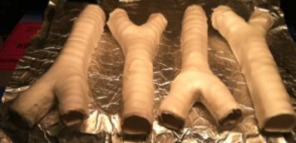
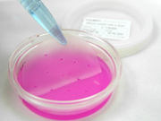
Engineered Biological Tissue
Trachea, Fauza, Children’s Hospital Boston
Nanofiber Solutions
Engineered bladder, tony attala
Skin grafts

Slide 13
SYLLABUS OVERVIEW
Course Outcomes
To understand the growing need for tissue replacements, the evolution of the field of Tissue Engineering, where it originated, and perspectives on the future of the field and potential impacts on society.
To understand extracellular matrix and the chemical and physical properties of biomaterials can guide cell survival, adhesion, migration, and differentiation.
To use quantitative engineering approaches to understand and design engineered tissues.
Develop skills in scientific writing, information dissemination/presentation, literature review, and collaboration through a grant-writing project.
Learn to create a wiki page and present a novel tissue engineering tool or device.
Instructor
Professor Shelly Peyton
Chemical Engineering Department
speyton@ecs.umass.edu
154D Goessmann Laboratory
Telephone: 545-1133
Office hours: Tuesdays 2-4pm
Course Logistics
Lectures are scheduled on Tuesdays and Thursdays, 4-5:15PM, LGRC A201
Textbooks and Other Materials
The required textbook for this class is:
Tissue Engineering: by Saltzman, Oxford University Press (2004)
Other textbooks that might be helpful as references (and are available at the Library) are:
Molecular Biology of the Cell, by Alberts et al. SEVERAL READINGS COME FROM THIS TEXT
Biology for Engineers, by Johnson
Molecular Cell Biology by Lodish et al.
Principles of Polymer Chemistry by Flory

Slide 14
Note on Textbooks
Most of class (12 of 17 lectures) will follow (though not in order) the Tissue Engineering book by Saltzman.
Lectures outside of book will follow research papers, since book can’t cover everything that I think is interesting or updated since 2004. Papers will be posted online.
A few lectures will also take information from MBOC (5th edition). This is not required reading, but you might find it very helpful if your biology background is weak, so I will list the relevant chapters covered at lecture. MBOC (4th edition) is on reserve at the library. 5th edition is available via 5-college.
Class website! http://openwetware.org/wiki/ChemEng_590B

Slide 15
SYLLABUS, CONT.
Assignments
Readings: It is critical that you keep up with the reading assignments, as class lectures will give overviews of the reading with an additional focus on recent advances in the field of bioengineering. Readings come from Tissue Engineering and current literature (research papers).
Wiki Pages: Each class member will research one topical area of tissue engineering, create a wiki page on that topic, and do a short research presentation in class. http://openwetware.org/wiki/590B_Wikis.
Research Project: There will be a group research project consisting of writing an NIH-style grant, and a research presentation.
Examinations
There will be a total of three exams during the semester including the final exam. Schedule below.
Grading
This course will NOT BE CURVED. Numerical grades will be assigned for each homework assignment, examination, and project. Your final grade will be computed based on your performance in all aspects of the course with weights as follows :
Research Project 35%
Wiki Pages & Presentation 20%
Exam 1 15%
Exam 2 15%
Exam 3 (Final) 15%
Academic Honesty
Each student is responsible for all individual assignments. The University policy on academic honesty will be strictly enforced. The details of this policy as well as examples of violations are outlined in the “Undergraduate Rights and Responsibilities” document. Further information can be found at http://www.umass.edu/dean_students/codeofconduct/acadhonesty/

Slide 16
Note on Grading
Research Project 35%
Wiki Pages & Presentation 20%
Exam 1 15%
Exam 2 15%
Exam 3 (Final) 15%
COURSE IS NOT CURVED! Extra credit wiki pages can help you boost your grade.

Slide 17
Wiki Pages
Create a Wiki page giving a thorough description, with references, of your tissue engineering device, company, or leader in the field.
Post at http://openwetware.org/wiki/590B_Wikis.
  You will need to “sign up” at http://openwetware.org/wiki/OpenWetWare:How_to_join
Pages created in 2012 are at http://openwetware.org/wiki/2012_Wiki_Pages
  Walk through a sample page: http://openwetware.org/wiki/Glucose_Sensors
Wiki page + presentation = 20% of final grade (10% each)

Slide 18
Mini Research Presentation
(from Wiki Pages Assignment)
Give a 10min presentation on a tissue engineered device, with another 5-10min for questions.
  Discuss the following items
    The human health problem or need that initiated the design of the device.
    Potential market for the device (how many patients could it serve, what is the economic impact?)
    The scientific literature leading up to the design (i.e. what role did initial scientists have in coming up with the idea.)
    The partners involved (academic institution, VCs, industry)
    Evolution of the device and its implementation
    Role of animal studies and clinical trials
    Reasons for its success or failure (both successful and unsuccessful examples desirable!)
    You will need to identify 1-2 papers that support your presentation to post on your WikiPage.
Topics for presentation have already been assigned a date. You can sign up for any one you like, but the dates are fixed.
Any exams and homeworks that occur after these presentations will include material from the additional reading and talk!
Check your plagiarism beforehand with TurnItIn: http://www.library.umass.edu/services/plagiarism-prevention/

Slide 19
Wiki Pages, Presentation Sign Up Sheet and Topics

Slide 20
Course website
http://openwetware.org/wiki/ChemEng_590B

Slide 21
Schedule, Tentative
Lecture # | Date | Topic | Reading | Assignments
1 | 22-Jan | Intro to Tissue Engineering
2 | 24-Jan | Review of Cell Biology
3 | 29-Jan | Organs and Organ Systems
4 | 31-Jan | Mesenchymal and Tissue-Specific Stem Cells
5 | 5-Feb | Embryonic and Reprogrammed Stem Cells
6 | 7-Feb | The ECM, Cell Adhesion, and Integrins
7 | 12-Feb | Intro to Biomaterials |  | EXAM 1 HANDED OUT IN CLASS
 | 14-Feb | No Class, Exam 1 Due |  | EXAM 1 DUE
 | 19-Feb | No class - Tuesday schedule followed (pres day)
8 | 21-Feb | Introduction to NIH Research Projects | NIH GPG | HAND OUT EXAMPLE GRANTS
 | 26-Feb | No Class, Prof. Peyton in DC
9 | 28-Feb | Cell migration and the cytoskeleton + haptotaxis
 | 5-Mar | No class - MCB seminar
10 | 7-Mar | Diffusion models of cell migration + chemotaxis
11 | 12-Mar | Cell and Tissue Mechanics, mechanical properties of biomaterials |  | EXAM 2 HANDED OUT IN CLASS
 | 14-Mar | No Class, Exam 2 Due |  | EXAM 2 DUE
 | 19-Mar | No class - Spring Break
 | 21-Mar | No class - Spring Break
12 | 26-Mar | mechanotransduction and tensegrity
13 | 28-Mar | durotaxis
14 | 2-Apr | Grant Review Day |  | Grant reviews due
15 | 4-Apr | Imaging, Optics
 | 9-Apr | No Class, Prof. Peyton in DC
16 | 11-Apr | The Immune System
17 | 16-Apr | drug and cell delivery
 | 18-Apr | Research Project presentations | groups 1-2 | Full Paper grant proposals due
 | 23-Apr | research project presentations | groups 3-4
 | 25-Apr | research project presentations | groups 5-6 | FINAL EXAM HANDED OUT IN CLASS
 | 30-Apr | No Class, Final Exam Due |  | FINAL EXAM DUE

