Slide 1

Towards synthetic biological approaches to resource utilization on space missions
Menezes AA, Cumbers J, Hogan JA, Arkin AP.
Presented by Marianne Lintz
May 6, 2015
http://www.lagerquist.com/daycamp/NCS_Drive/Cub%20Scout%20Resources/Clip%20Art/spaceship%20sideways.JPG

Slide 2

Innovation & space exploration
Space exploration is important and informative
Manned missions must be optimized for
  Risk
  Cost
  Success
New technology must address needs put forward by NASA
  Fuel, food, and waste management
  Manufacturing
  Therapeutics
  Radiation sensing/detection
http://www.logodesignlove.com/images/bad/nasa-logo-meatball.jpg

Slide 3
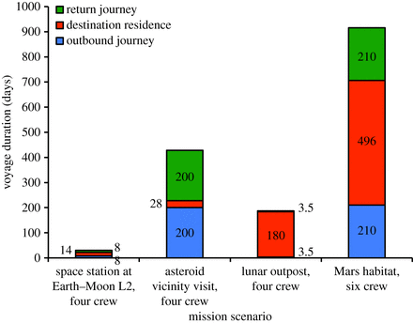
‘Space synthetic biology’ has potential to address critical space exploration needs
Current/future research compared to equivalent aerospace technologies
Approach based on
  Identification of endpoints
  Review of production costs in terms of launch mass or usable life
  Proposal of feasible biological techniques
Four main missions to address:
  Space station
  Asteroid
  Mars
  Moon
Notes:
All missions return voyages/4 person except for mars; moon and mars selected based on residence length→greatest need for optimization

Slide 4
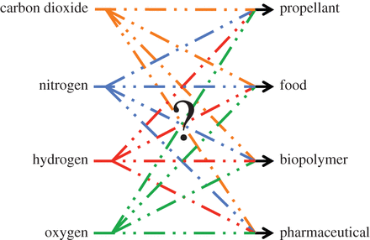
Transition from input to output using organisms is a major concern
Different inputs available for Mars vs. Moon
Outputs to generate
  Biopolymers
  Food
  Fuel
  Pharmaceuticals
Potentially utilize chain of organisms to produce inputs for other organisms

Slide 5
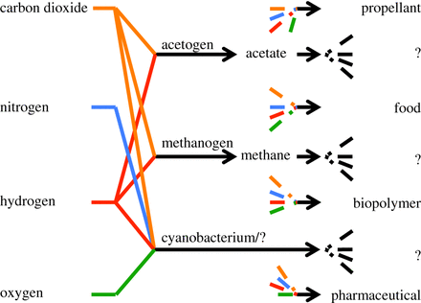
Transition from input to output using organisms is a major concern
Different inputs available for Mars vs. Moon
Outputs to generate
  Biopolymers
  Food
  Fuel
  Pharmaceuticals
Potentially utilize chain of organisms to produce inputs for other organisms

Slide 6
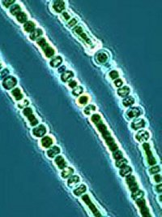
Synthetic biology improvements to propellants
Carbon-based fuels examined closely
  Nitrous oxide–hydrocarbon
  Methane–oxygen (methanogens in bioreactors)
Near-future synthetic biology improvements expected to focus on minimizing nutrient use or improving bioreactor recycling (directed evolution, etc.)
Can also develop bioreactor for nitrous oxide–hydrocarbon
  Utilize methanogens or cyanobacteria
  Enhance ethane production/bypass acetate intermediate
  Increase ethylene production (alternative hydrocarbon)
http://www.abc.net.au/science/news/img/environment/cyanobacteria220805.jpg
Notes:
Density higher than hydrogen, which requires specialized combustion apparatus
Organisms cannot produce toxic compounds, and other fuel processes are too complex
Focus on these rather than on productivity
Acetate requires hydrogen delivery
Vanadium nitrogenase

Slide 7
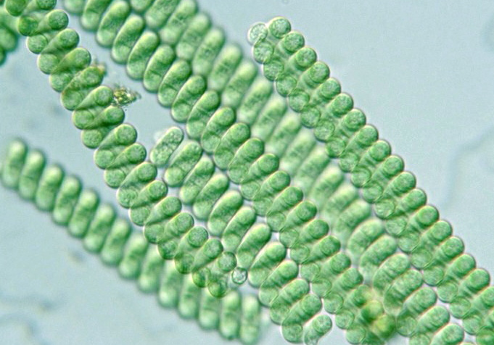
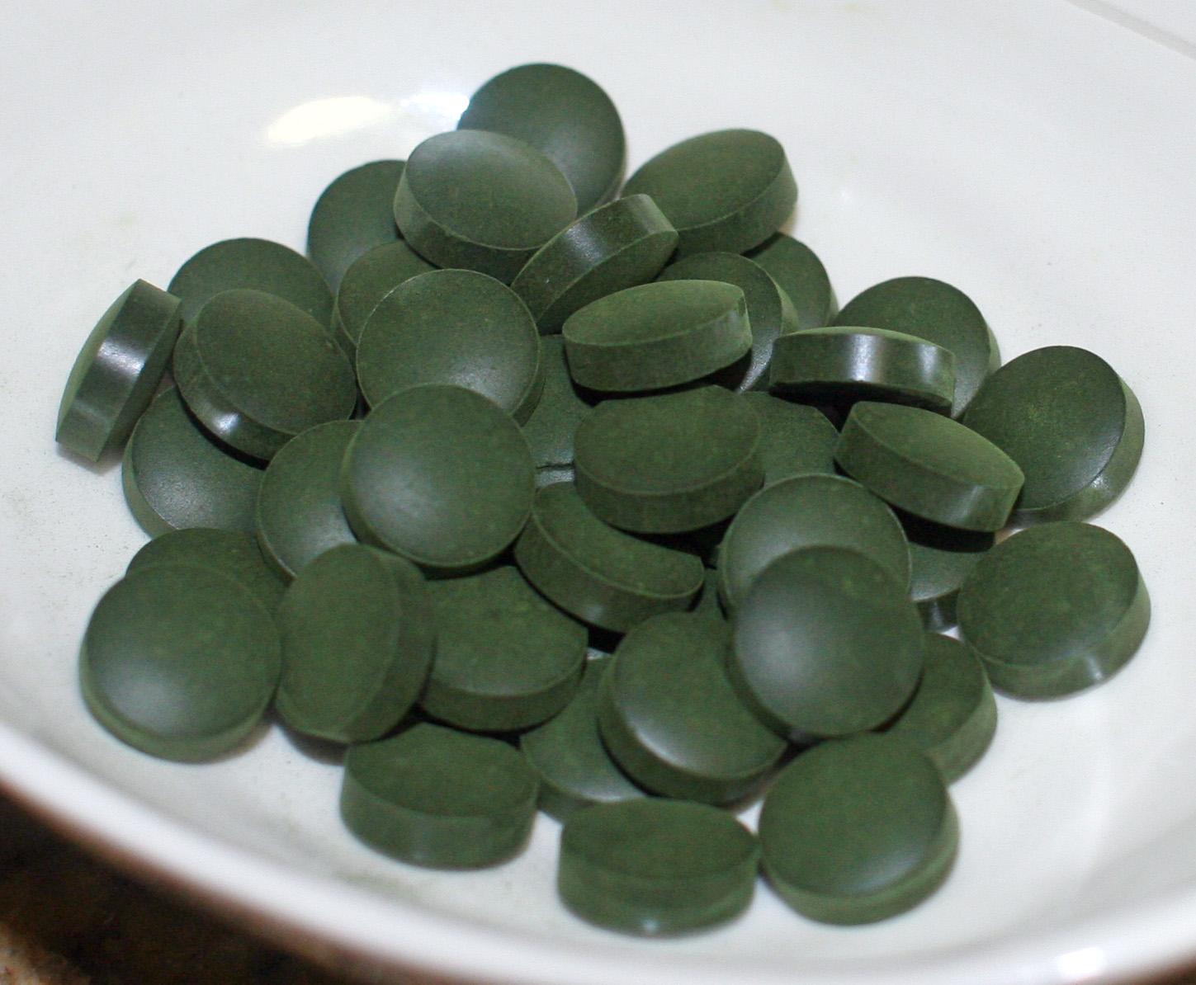
Synthetic biology improvements to food
Estimates based on vegetarian/mixed unpackaged wet-food
Autotrophs are chief food- and glucose-producing options
  Photosynthetic bacteria, plants
  Primary requirements readily available
  Spirulina → main competitive option to space farms
Synthetic biology improvements focus on
  Increasing Spirulina productivity
  Improving cyanobacterial C0₂ fixation
  Enhancing flavors/textures of resulting food supplies
http://www.societywellness.com/wp/wp-content/uploads/2015/03/Spirulina.jpg
http://upload.wikimedia.org/wikipedia/commons/b/b2/Spirulina_tablets.jpg
Notes:
Nutritionally rich Arthrospira platensis and Arthrospira maxima (together forming the supplement Spirulina)

Slide 8
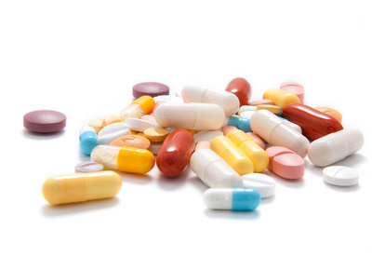
Synthetic biology improvements to pharmaceuticals
Current solution is to launch small unmanned spacecraft to restock supplies → very impractical
Synthetic biology can be used to manufacture targets
  Acetaminophen production in E. coli by modifying chorismate pathway
  Not space compatible, but possibly implementable in autotrophs
  Start from protected, inactive bacteria
Even with losses, still very beneficial
  Manufacturing time is estimated to be on the order of days
  Low concentrations of active ingredient required
  Crew can now be largely independent from resupply crafts
http://www.zirbus.com/pharmaceuticals.jpg

Slide 9
Assumptions and suggestions
Key assumptions
  Validity of previous work
  Clear need/demand
  Complete nutrient extraction/recycling from terrain
  Similar bioreactor productivities for different environments
Suggestions
  Publish a review paper
  Separate the material into 2 or more individual papers

Slide 10
Conclusions and significance
Current and future synthetic biology research has the potential to greatly optimize manned space missions, specifically those to the Moon or Mars
  Small change → large effect
  Improve safety, cost, and chance for success
  Applicable to such needs as food, fuel, and therapeutics production
Future work
  Elaborating on one specific proposed solution in detail
  Testing designs in simulated lunar and Martian atmospheric conditions
  Examining symbiotic communities rather than individual organisms

Slide 11

Thank you!
http://th09.deviantart.net/fs70/PRE/i/2013/046/3/d/space_the_final_frontier_by_unusualsuspex-d5v0h8m.jpg

