Slide 1
Fundaments of Cell Biology
Kristen Lee
9/23/2009

Slide 2
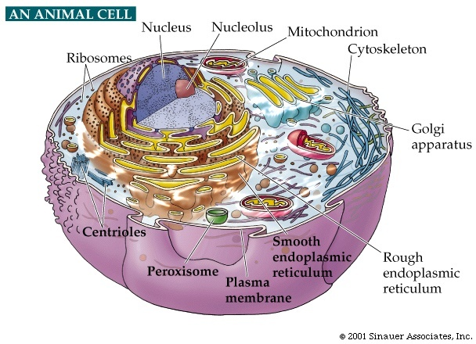
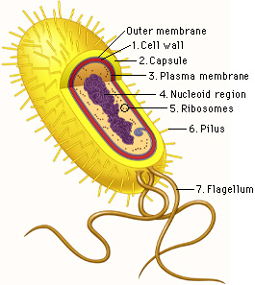
Background
Prokaryotes
Eukaryotes
Bacteria
Small & simple
No bound nucleus
Animals, plants, yeast, etc.
Complex metabolism
Nucleus is in membrane-bound compartment
1-10um
10-100um
Biology 2960 Computer Laboratory, Washington University
http://www.nslc.wustl.edu/courses/Bio2960/labs/04Microscopy/ProCell2.jpg
1/09/08. Chasin and Mowshowitz, Department of Biological Sciences, Columbia University
http://www.columbia.edu/cu/biology/courses/c2005/lectures/lec1_08.pdf

Slide 3
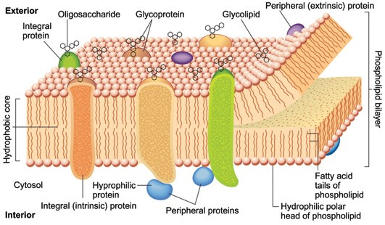
Cell Membrane
Plasma Membrane Structure
  Phospholipid bilayer, proteins, cholesterol
  Functions:
Selective Barrier
Membrane Transport
  Transporters, Channels
Vesicular transport
Cell-cell interactions
  Oligosaccharides,
    Glycoproteins/lipids
Royal Society of Chemistry
http://www.rsc.org/education/teachers/learnnet/cfb/cells.htm

Slide 4
Cytoskeleton
Cytoskeleton Type | Diameter | Structure
Microfilaments / Actin Filaments | 5-9 nm | Helical
-resist tension, maintaining cell shape, cell-to- X junctions, transduction, cytokinesis
Intermediate filaments | 10 nm | Rope-like
-mechanical stability, anchor organelles, support nuclear envelope
Microtubules | 25 nm | Hollow cylindrical
-rigid, intracellular transport, axoneme of cilia and flagella, component of mitotic spindle, MTOC, centrioles

Slide 5
Protein and Lipid Production
Gene Expression: transcription and translation
Rough ER- studded with ribosomes, folds proteins
Golgi Apparatus- packages/modifies proteins/lipids in vesicles for transport to final destination
Smooth ER- synthesize lipids and steroids, metabolize carbohydrates, regulate Ca concentration

Slide 6
Endomembrane System
Peroxisome- oxidative enzymes metabolize fatty acids, transports proteins
Endosome- sort material that is endocytosed
Lysosome- degrade cytoplasmic unwanteds
Energy
Mitochondria- generate most ATP in cells (cell respiration chain, Krebs cycle)

Slide 7
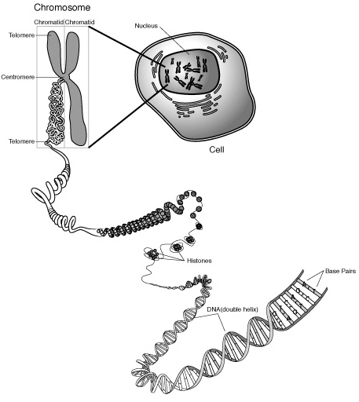
Nucleus
Mitotic
Higher order structures:
DNA + histone protein → Chromatin
→ Chromosome
46 total chromosomes
2 sex chromosomes (X/Y)
22 pairs of autosomal chromosomes
Sister chromatids=2x 1 chromosome
National Human Genome Research Institute
http://www.genome.gov/Pages/Hyperion/DIR/VIP/Glossary/Illustration/chromosome.cfm?key=chromosome

Slide 8
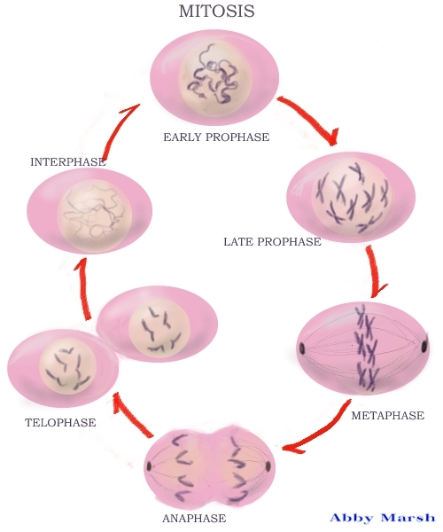
Cellular Reproduction
INTERPHASE (genetic material replicates)
MITOSIS
  Prophase (chromatin condenses)
  Prometaphase (nuclear envelope disassembles, mitotic spindle attaches to chromosomes)
  Metaphase (chromosomes align across metaphase plate)
  Anaphase (sister chromatids separate)
  Telophase (clean-up, reorganization CYTOKINESIS (cleavage furrow)
http://www.dartmouth.edu/~cbbc/courses/bio4/bio4-1997/02-theCell.html

