Slide 1
A comprehensive gene regulatory network for the diauxic shift in saccharomyces cerevisiae
Geistlinger, L., Csaba, G., Dirmeier, S., Küffner, R., and Zimmer, R.
Kevin McGee and Natalie Williams
Biology Department, Loyola Marymount University
June 3, 2015

Slide 2
Outline
Background: Diauxic shift & comparison of our research with the article
Generation of the yeast GRN and the diauxic shift GRN
Analysis of the GRN constructed from SGD, YEASTRACT, and Herrgard et al.
Summary
Implications

Slide 3
Background
Knowledge of which conditions regulation occurs and the effect on expression for a gene were requirements for construction of their GRN.
Goal: propose model for large-scale GRNs with a comprehensive model for transcriptional regulation of diauxic shift in yeast
Diauxic shift: when yeast cells switch from fermentation to aerobic respiration with the TCA cycle
Notes:
Many resources with available GRNs contain simple interactions and do not characterize them by the condition the cell is in.

Slide 4
Comparison
This study wants to distinguish which genes change expression when the cell is under a specific condition
Cold shock vs. diauxic shift
Construction of GRN
Microarray + databases vs. studies and other resources
Testing of the GRN
ODE to model the dynamics vs. qualitative works to model the dynamics

Slide 5
Outline
Background: Diauxic shift & comparison of our research with the article
Generation of the yeast GRN and the diauxic shift GRN
Analysis of the GRN constructed from SGD, YEASTRACT, and Herrgard et al.
Summary
Implications

Slide 6
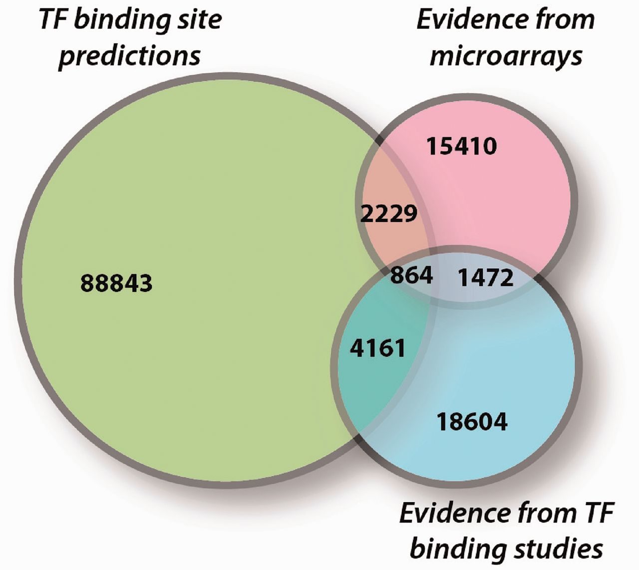
The yeast GRN: Figure 1
A combination of direct and indirect evidence provided “high” or “low” confidence in the noted regulations
Resources:
Saccharomyces Genome Database (SGD)
YEASTRACT
Herrgard et al.
Notes:
Direct: transcription factor physically binding to the promoter region of the target gene
Indirect: analysis of the fold change from expression studies as a result of a transcription factor perturbation
SGD: provided summary paragraphs on genes with different aspects of transcriptional regulation
YEASTRACT: transcriptional regulation with gene interactions represented in binary TF-TG format; doesn’t provide context as to which conditions GRIs take place
Herrgard et al.: each interaction is classified (act/repress), assigned a nutrient-based context (extra vs. intracellular), and described by boolean rule (IF SIGNAL & TF, then TG)

Slide 7
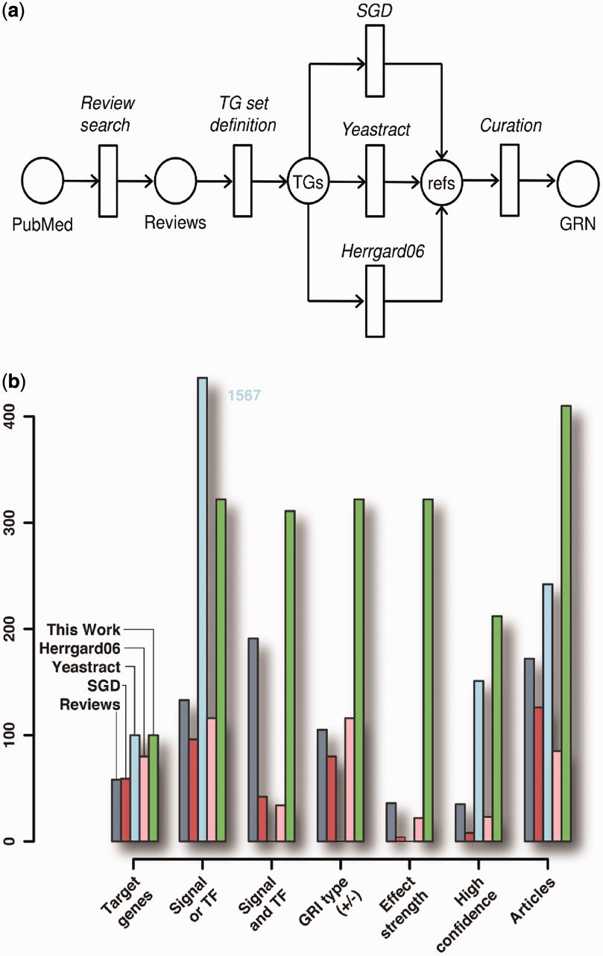
Diauxic Shift GRN: Figure 2
Figure 2 shows the approach used when curating the GRN that controls diauxic shift
Notes:
Used current reviews on regulation of diauxic shift to define a set of target genes
Searched the three previously mentioned databases/resources for TF and regulatory information
Compilation of all resources to obtain the GRN

Slide 8
Diauxic Shift GRN
Petri net models were used to represent the information available in the literature
The input of transcriptional transition was defined as a signal or a transcription factor
The target gene expression was identified as the output by modeling the fold change in its transcription.
Notes:
Petri net models: graphical and mathematical models & are applied to biochemical processes
Signals: intracellular or extracellular molecules, nutritional compositions, environmental and experimental conditions
TFs: up or down-regulated in states of “weak”, “medium”, or “strong”

Slide 9
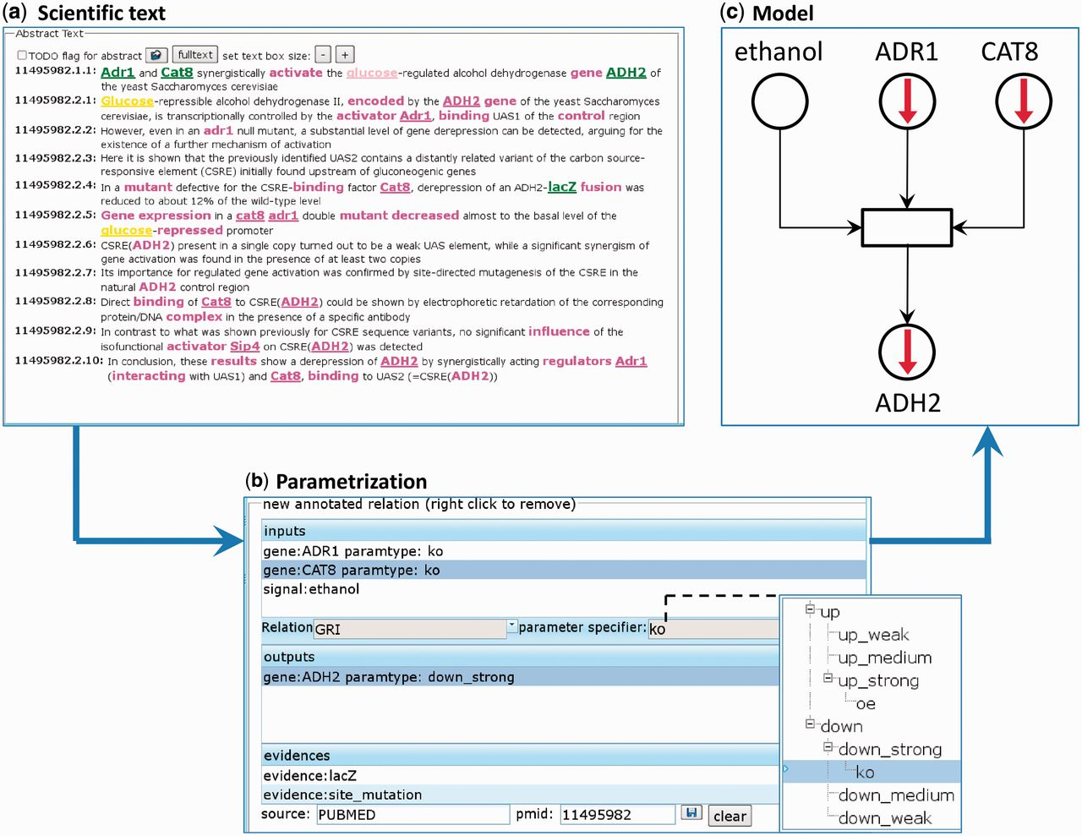
Diauxic Shift GRN: Figure 3
Figure 3 is a screenshot of the software RelAnn used to transform literature knowledge to a Petri net transition.
Notes:
Three principles of RelAnn: pre-index biological entities from the literature, simple click-based annotations to relate terms to each other, and represent relations as Petri net transitions

Slide 10
Outline
Background: Diauxic shift & comparison of our research with the article
Generation of the yeast GRN and the diauxic shift GRN
Analysis of the GRN constructed from SGD, YEASTRACT, and Herrgard et al.
Summary
Implications

Slide 11
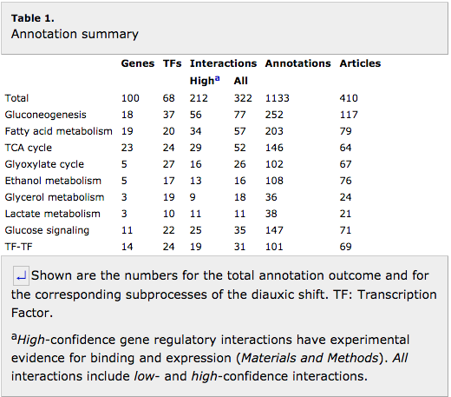
Results: Table 1. Annotation summary
Table 1 shows that 322 total interactions involved in the diauxic shift were seen in their GRN. It also categorizes the interactions by the subprocesses involved in this metabolic shift.
Notes:
In estimating the completeness of their network, a first order Hill equation was used. It was estimated that the GRN was 71% complete and that additional resources and information would only increase the network size slightly.

Slide 12
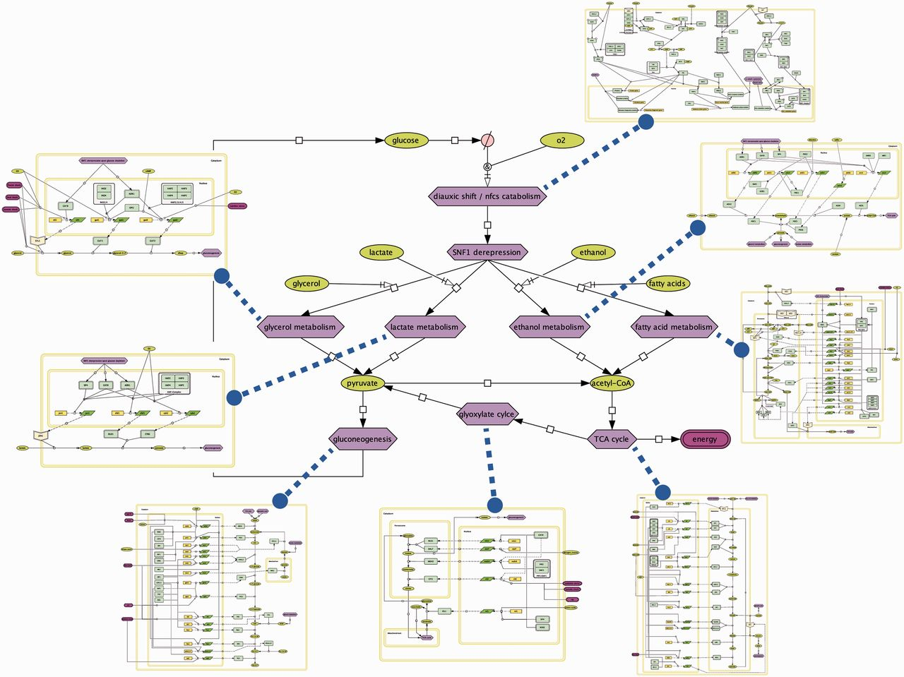
Results: Figure 4
Figure 4 is the Petri net representation of the interactions visualized in flowcharts of the subprocesses of the diauxic shift with CellDesigner.

Slide 13
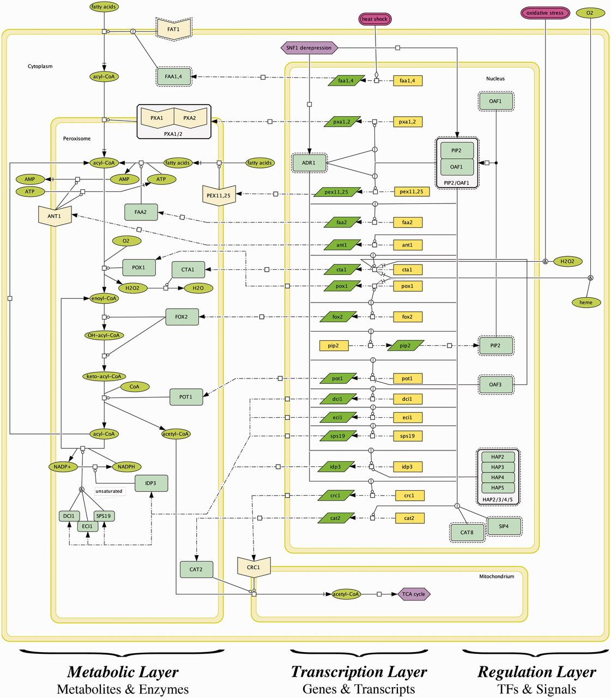
Results: Figure 5
Figure 5 is an example of the flowchart of one of the subprocesses of diauxic shift.
Regulation
Light green: TFs
Green & purple ellipses: signals
Transcription
Yellow: transcription genes
Green rhomboids: transcripts
Metabolic
Light green: translated enzymes
Green ellipses: substrates & products
Blue hexagons: subprocesses

Slide 14
Results: General Comparison
Improved three aspects of representation of interactions:
Context Definition
Effect
Detailed the regulatory effect type and strength
Evidence reliability
High – contains both binding and expression evidence (66% interactions had this classification)
Low – contains one of the criterion
SGD | YEASTRACT | Herrgard et al. | Geistlinger et al.
44% | N/A | 29% | >96%
Notes:
Context: determination of the conditions under which a regulation is enabled
Not available on YEASTRACT because it does not provide context as to when these interactions take place
Effect: type = activation or repression and then weak, medium, strong effects on expression
Evidence: judges how reliable the evidence for these regulatory interactions are

Slide 15
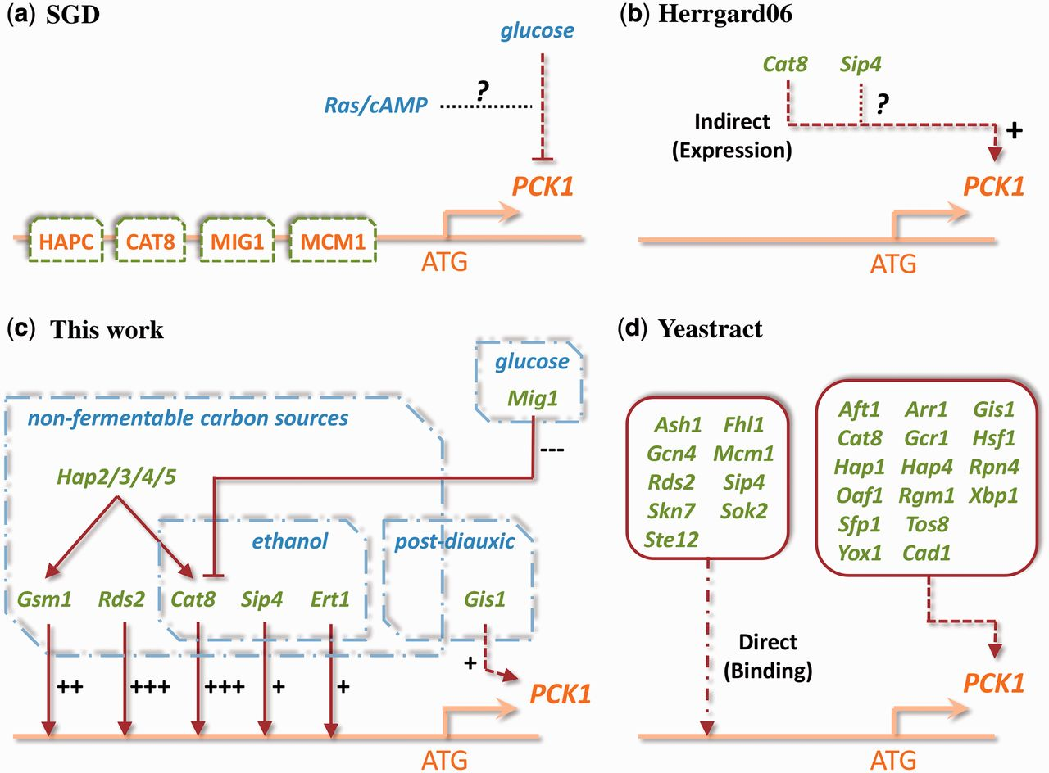
Result: Figure 6. PCK1 example
Figure 6 compares all the information each resource provided as well as what this study achieved in producing through their GRN when analyzing PCK1.
Notes:
Upstream the binding sites for these regulators are seen as well as a glucose-repressor signal from cAMP (SGD)
Known expression evidence shows that Cat8 activates PCK1, but there are no annotations for Sig4
This work assigns context to interactions through classification of activator/repressor and effect (weak, medium, strong) for each regulator
Lists various direct and indirect effects with no context; combined evidence provides either strong or weak confidence

Slide 16
Outline
Background: Diauxic shift & comparison of our research with the article
Generation of the yeast GRN and the diauxic shift GRN
Analysis of the GRN constructed from SGD, YEASTRACT, and Herrgard et al.
Summary
Implications

Slide 17
Summary
Questions addressed by searching for diauxic shift information:
Do existing resources already fully characterize the regulation of a given process?
If not, how can such a comprehensive characterization be achieved?
Which level of granularity is best suited to represent the volume and detail of the available heterogeneous information?

Slide 18
Summary
Do existing resources already fully characterize the regulation of a given process?
SGD summarizes regulatory impacts such as extra- and intracellular signals
YEASTRACT provides binary gene regulatory interactions from binding and expression data
Herrgard et al. contains transcriptional data of metabolic genes

Slide 19
Summary
2. If not, how can such a comprehensive characterization be
achieved?
A hierarchical approach was used to:
Compile a set of relevant genes
Integrate the regulatory information from databases, and
Complement the interactions by collecting information from the literature

Slide 20
Summary
3. Which level of granularity is best suited to represent the
volume and detail of the available heterogeneous
information?
Representing the regulatory interactions through qualitative characterization (see Figure 4 or 5)

Slide 21
Outline
Background: Diauxic shift & comparison of our research with the article
Generation of the yeast GRN and the diauxic shift GRN
Analysis of the GRN constructed from SGD, YEASTRACT, and Herrgard et al.
Summary
Implications

Slide 22
implications
Model can be tested to see if annotated behavior agrees with observed behavior of these regulatory interactions
This GRN has 300+ regulations, including combinatorial control, that can:
Allow for network-based approaches for interpreting expression data
Provide interactive maps and modules integrated into the annotation system
Be the starting point to annotate and incorporate other processes

Slide 23
References
Geistlinger, L., Csaba, G., Dirmeier, S., Kϋffner, R., and Zimmer, R. (2013). A comprehensive gene regulatory network for the diauxic shift in Saccharomyces cerevisiae. Nucleic acids research, 41, 8452-8463.

Slide 24
acknowledgments
Dr. Dahlquist
Dr. Fitzpatrick
Dondi
Fellow researchers and supporters of this dream

