Slide 1
ANOVA Within Strain P-values
ANOVA | WILD-TYPE | DCIN5 | DGLN3 | DHAP4 | DSWI4
p < 0.05 | 2377 (38.41%) | 1995 (32.23%) | 1856 (30.00%) | 2387 (38.57%) | 2583 (41.74%)
p < 0.01 | 1531 (24.74%) | 1157 (18.69%) | 1007 (16.27%) | 1489 (24.06%) | 1679 (27.13%)
p < 0.001 | 850 (13.73%) | 566 (9.15%) | 398 (6.43%) | 679 (10.97%) | 869 (14.04%)
p < 0.0001 | 449 (7.25%) | 280 (4.52%) | 121 (1.96%) | 240 (3.88%) | 446 (7.21%)
B&H p < 0.05 | 1673 (31.88%) | 1117 (18.05%) | 889 (14.36%) | 1615 (20.09%) | 1855 (29.97)
Bonferroni p < 0.05 | 226 (3.65%) | 109 (1.76%) | 20 (0.32%) | 61 (0.99%) | 179 (2.89%)

Slide 2
 | Cold Shock |  | Recovery
t test | t₁₅ | t₃₀ | t₆₀ | t₉₀ | t₁₂₀
Average Log Fold Change > 0.25 and p < 0.05 | 582 (9.4%) | 865(14.0%) | 933(15.1%) | 439(7.1%) | 230(3.7%)
Average Log Fold Change < -0.25 and p < 0.05 | 486(7.9%) | 717(11.6%) | 867(14.0%) | 309(5.0%) | 247(4.0%)
Total p < 0.05 | 1075(17.4%) | 1587(25.6%) | 1814(29.3%) | 749(12.1%) | 509(8.2%)
Total B & H p < 0.05 | 0(0%) | 85(1.4%) | 0(0%) | 0(0%) | 1(0.016%)
Total Bonferroni p < 0.05 | 1(0.016%) | 0(0%) | 0(0%) | 1(0.016%) | 0(0%)

Slide 3
 | Cold Shock |  | Recovery
t test | t₁₅ | t₃₀ | t₆₀ | t₉₀ | T₁₂₀
WILD TYPE | 1075(17.4%) | 1587(25.6%) | 1814(29.3%) | 749(12.1%) | 509(8.2%)
DCIN5 | 1393 (22.5%) | 756(12.2%) | 1250(30.2%) | 634(10.2%) | 351(5.6%)
DGLN3 | 1027(16.6%) | 1622(26.2%) | 628(10.1%) | 558(9.0%) | 403(6.5%)
DHAP4 | 1197(19.3%) | 1772(28.6%) | 2006(32.4%) | 234(3.7%) | 515(8.3%)
DSWI4 | N/A | 1497(24.2%) | 1757(28.4%) | 1075(17.4%) | 705(11.4%)

Slide 4
Between Strain ANOVA Comparison Results
Comparison | p < 0.05 | B&H p <0.05
wt vs. dCIN5 | 563 | 4
wt vs. dGLN3 | 720 | 36
wt vs. dHAP4 | 640 | 23
wt vs. dHMO1 | 556 | 5
wt vs. ZAP1 | 553 | 31
wt vs. S. par | 1498 | 703

Slide 5
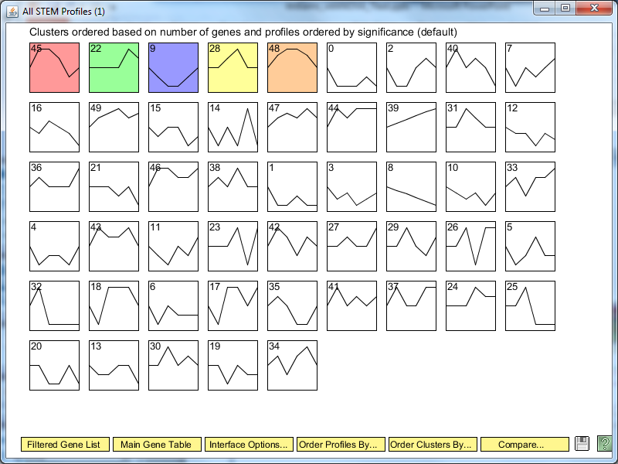

Slide 6
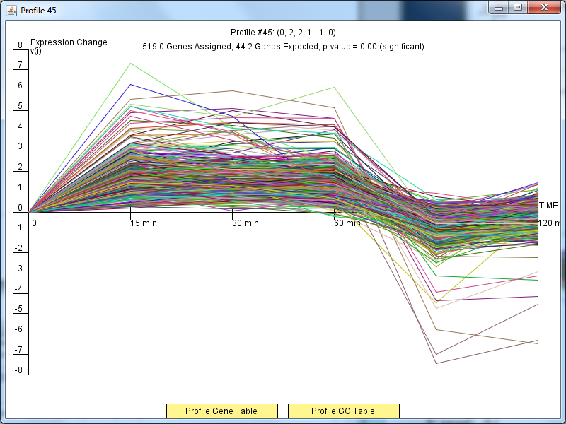

Slide 7
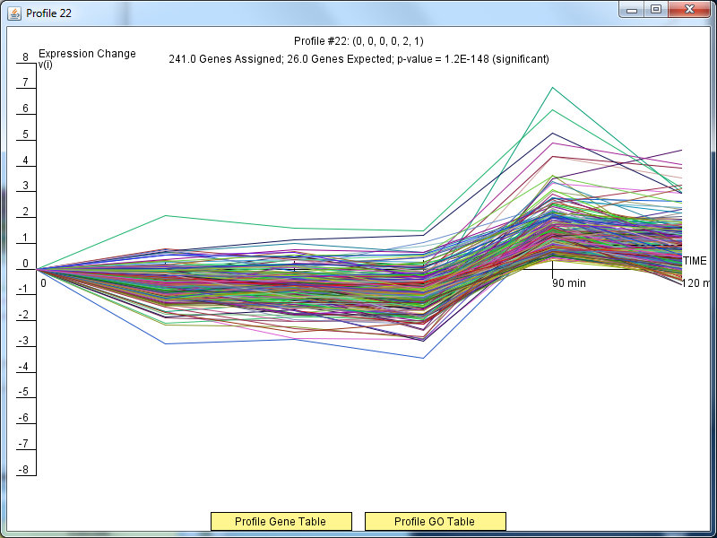

Slide 8
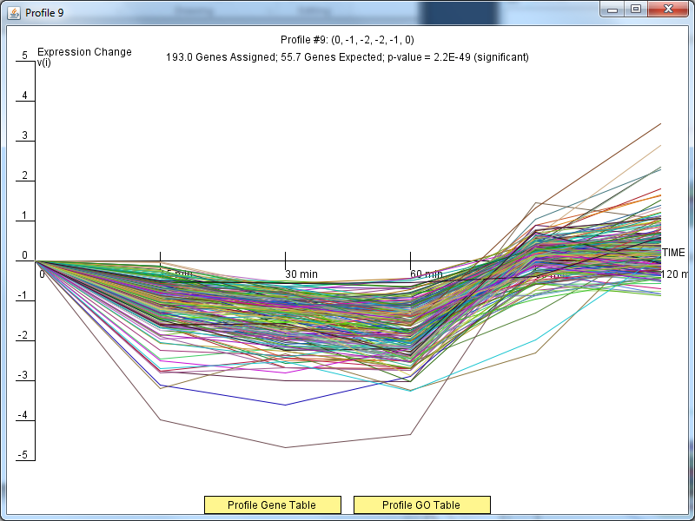

Slide 9
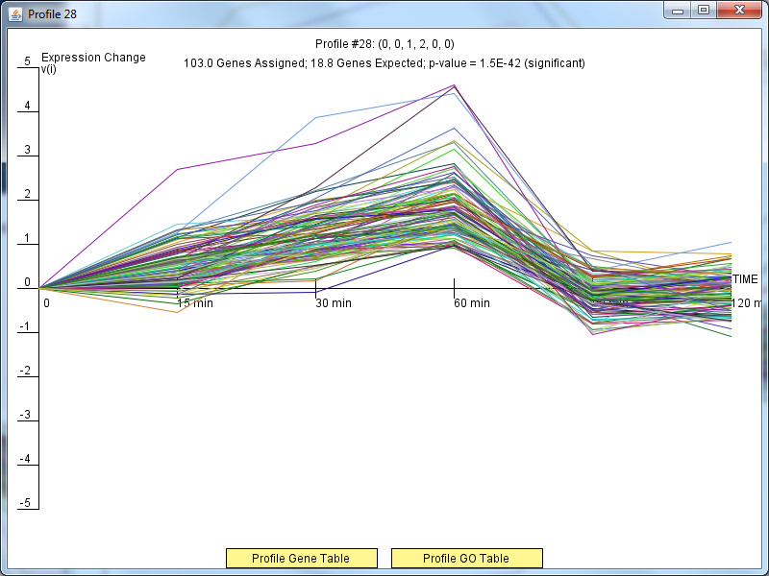

Slide 10
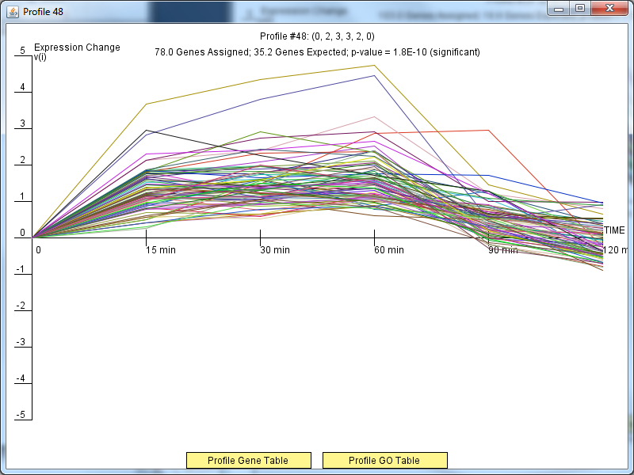

Slide 11
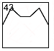
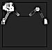
Kittens made from Profile #45

