Slide 1
Versant Branched-DNA assay
Label probes +
Alkaline phophatase
Pre-amplifier
probe
Amplifier
probes
Target probe
HIV RNA (from lysed particles)
Capture probe
Opaque 96-well
# of RNA strands is proportional to chemiluminescence intensity from
alkaline phosphatase reaction

Slide 2
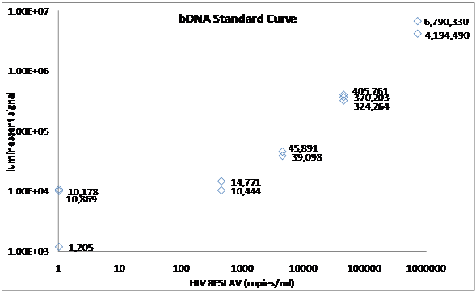
Wave80’s Versant Branched-DNA assay
A ~ 734,000 cp/mL
B ~ 45,000 cp/mL
E ~ 90 copies/mL
C ~ 4,500 copies/mL
Neg. control
D ~ 450 copies/mL
Reliable detection threshold ~ 450 copies HIV RNA/mL

Slide 3
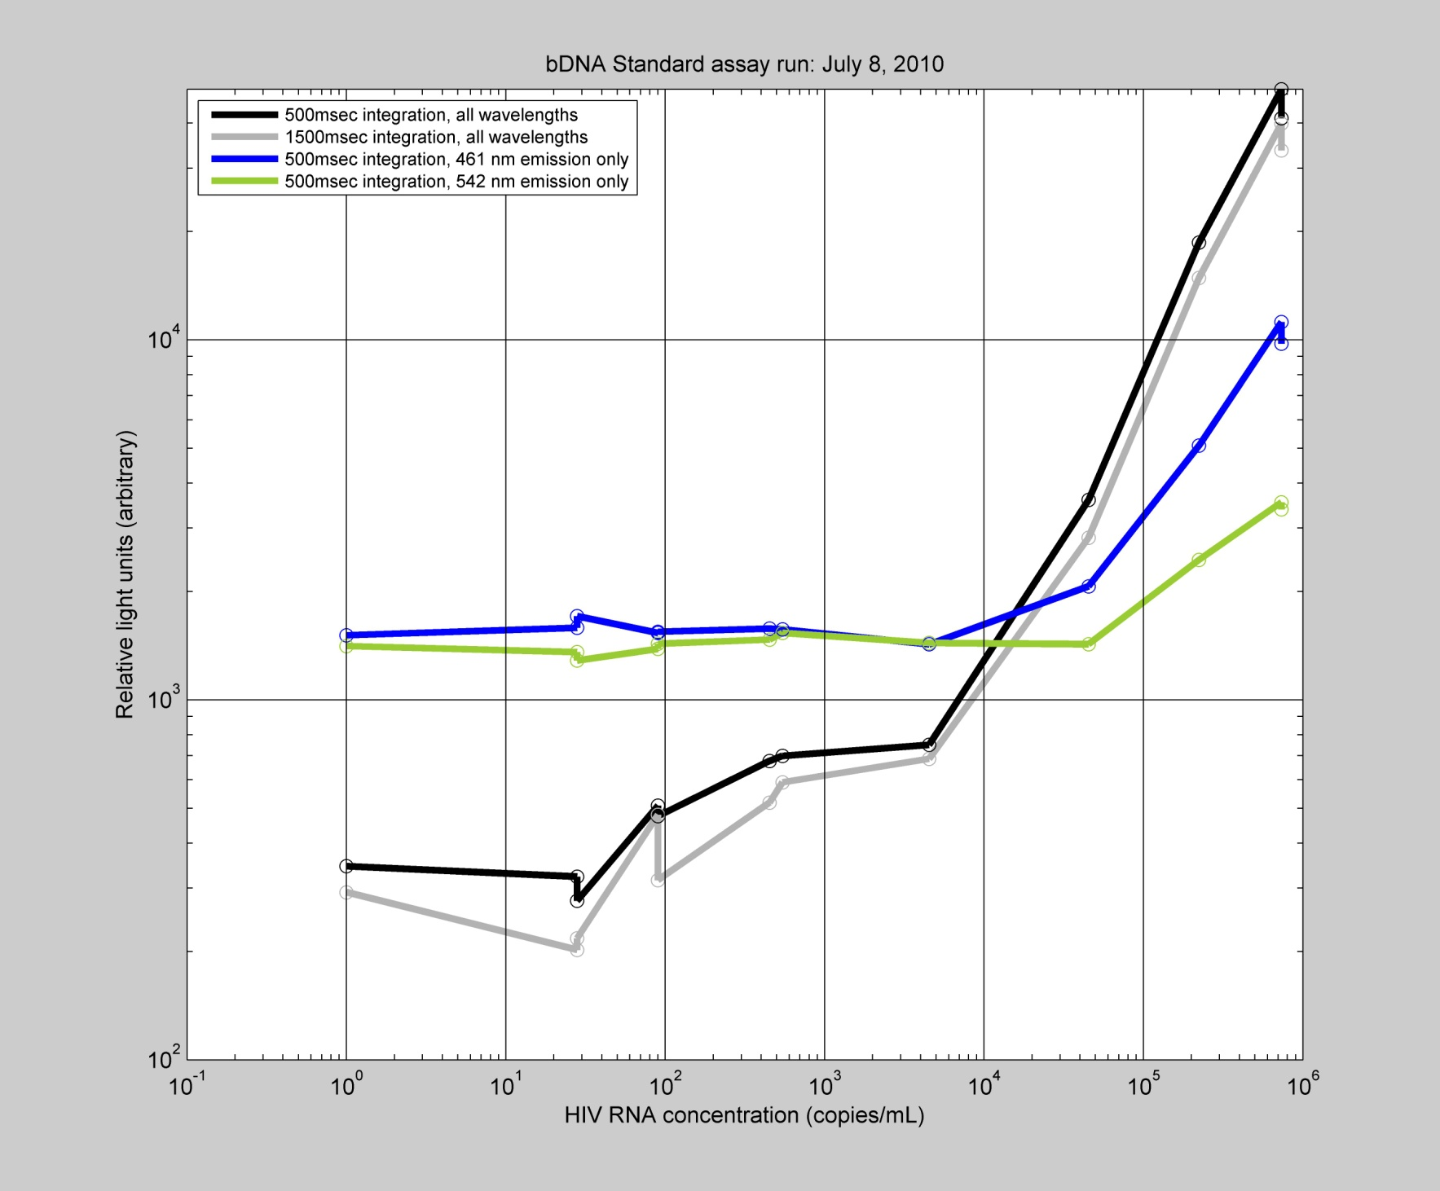
Our b-DNA assay has lower sensitivity than Wave80
A
Hi
B
C
Lo
D
C ~ 4,500 copies/mL
Neg. ctrl
E
F
Plate reader either has lower sensitivity / dynamic range, or we could have
overall RNA breakdown

