Slide 1
Acclimation of Saccharomyces cerevisiae to Low Temperature: A Chemostat-based Transcriptome Analysis
Tai, S. L., Daran-Lapujade, P., Walsh, M. C., Pronk, J. T., & Daran, J. M. (2007). Acclimation of Saccharomyces cerevisiae to low temperature: a chemostat-based transcriptome analysis. Molecular biology of the cell, 18(12), 5100-5112.
Lauren Kelly and Cameron Rehmani Seraji
Department of Biology
Loyola Marymount University
BIOL 398-05/MATH 388-01
March 30, 2017
Notes:
Cameron

Slide 2
Outline
Background Information
Goal of the Present Study
Methods and Procedures
In chemostat based cultures, nutrient limitation affected the transcriptional regulation of genes at low temperatures.
Comparing this chemostat study to other batch culture studies revealed inconsistent gene expression.
Is the environmental stress response (ESR) an obligatory response to growth at low temperatures?
Notes:
Cameron

Slide 3
Outline
Background Information
Goal of the Present Study
Methods and Procedures
In chemostat based cultures, nutrient limitation affected the transcriptional regulation of genes at low temperatures.
Comparing this chemostat study to other batch culture studies revealed inconsistent gene expression.
Is the environmental stress response (ESR) an obligatory response to growth at low temperatures?
Notes:
Cameron

Slide 4
Background Information
Temperature fluctuations are an evitable environmental factor that affects all organisms.
Sudden exposure to environmental changes will trigger a dynamic stress-response called adaptation.
Prolonged exposure to nonlethal stimuli leads to acclimation.
Chemostat cultures allow for accurate control of specific growth rate, independent of other culture conditions.
Ms2p/msn4p has been previously suggested to be a transcriptional factor in cold temperature.
Notes:
Cameron

Slide 5
Outline
Background Information
Goal of the Present Study
Methods and Procedures
In chemostat based cultures, nutrient limitation affected the transcriptional regulation of genes at low temperatures.
Comparing this chemostat study to other batch culture studies revealed inconsistent gene expression.
Is the environmental stress response (ESR) an obligatory response to growth at low temperatures?
Notes:
Cameron

Slide 6
Goals of the Present Study
Tai et al. (2007) aimed to investigate steady-state, acclimatized growth of S. cerevisiae at colder temperatures.
Emphasized transcriptional regulation of the genome.
They compared their chemostat culture results with those from previous studies in batch cultures and demonstrated the differences between the two.
They also aimed to further describe the role of ESR genes at low-temperature in chemostat cultures.
Notes:
Cameron

Slide 7
Outline
Background Information
Goal of the Present Study
Methods and Procedures
In chemostat based cultures, nutrient limitation affected the transcriptional regulation of genes at low temperatures.
Comparing this chemostat study to other batch culture studies revealed inconsistent gene expression.
Is the environmental stress response (ESR) an obligatory response to growth at low temperatures?
Notes:
Cameron

Slide 8
Methods and Procedures
S. cerevisiae strain: CEN.PK113-7D (MATa)
Grown in a chemostat culture (D = 0.03 h⁻¹)
Four Growth Conditions:
12°C, glucose-limited
12°C, ammonium-limited
30°C, glucose-limited
30°C, ammonium-limited
Utilized various analytical methods and microarray analysis and compared their data to other S. cerevisiae low-temperature transcriptome datasets.
Notes:
Cameron

Slide 9
Outline
Background Information
Goal of the Present Study
Methods and Procedures
In chemostat based cultures, nutrient limitation affected the transcriptional regulation of genes at low temperatures.
Comparing this chemostat study to other batch culture studies revealed inconsistent gene expression.
Is the environmental stress response (ESR) an obligatory response to growth at low temperatures?
Notes:
Cameron

Slide 10
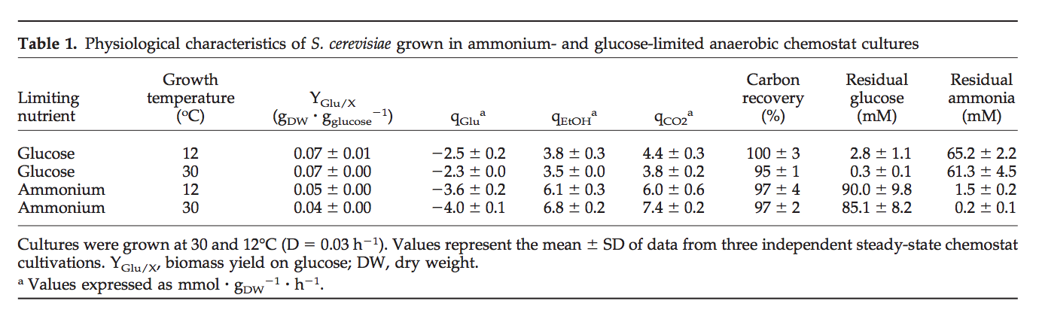
Growth-Efficiency Was Not Affected by Growth Temperature
Biomass was similar at both temperatures in both nutrient conditions.
In the 12°C cultures, the residual concentrations of glucose and ammonia were higher than the 30°C cultures.
Residual nutrient concentration is temperature dependent.
Notes:
Implication: The residual concentrations of growth-limiting nutrients glucose and ammonium was higher in the 12C media versus the 30C media. The higher degree of substrate saturation of the membrane transporters for these nutrients is likely part of the reason for their reduced capacity in 12C.
Cameron

Slide 11
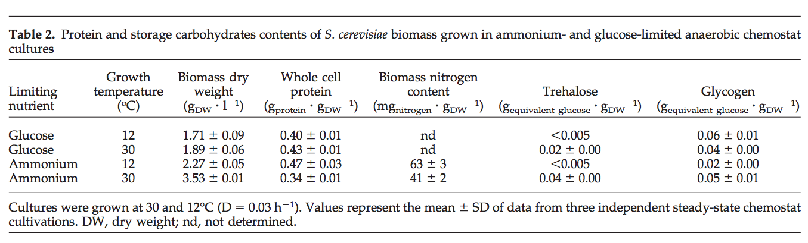
Less S. cerevisiae Growth on Glucose-Limited Media
There was more yeast growth on the ammonium-limited media.
Amount of trehalose was equal in the 12°C media and slightly higher in the 30°C ammonium-limited media.
Overall, yields and fermentation rates were similar in all growth conditions.
This indicates that the growth temperature did not affect the growth efficiency.
Notes:
Implication: There was a larger nitrogen content than protein content and this may have been due to an increased rRNA level. The increase of the rRNA level at low temperatures was supported by increased transcript levels of the genes that encode for polymerase 1 and 33 genes involved in RNA processing.
Cameron

Slide 12
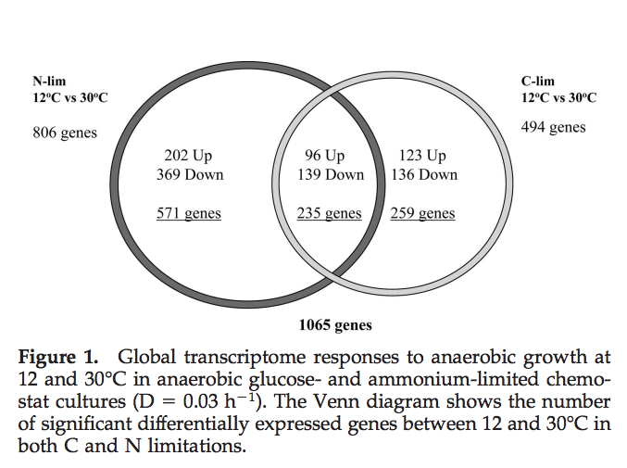
Higher Transcription Levels in Ammonium-limited Cultures
Of the 1065 genes, 644 genes were down-regulated and 421 up-regulated genes.
235 genes showed a consistent down-regulation and up-regulation in the glucose-limited and ammonium-limited conditions
Notes:
Implication:The temperature response showed a strong context dependency with respect to the nutrient limitation regime. The temperature-responsive genes were screened for enrichment of specific functional categories in order to identify the regulatory networks involved in the acclimation of S. cerevisiae to low temperature.
Cameron

Slide 13
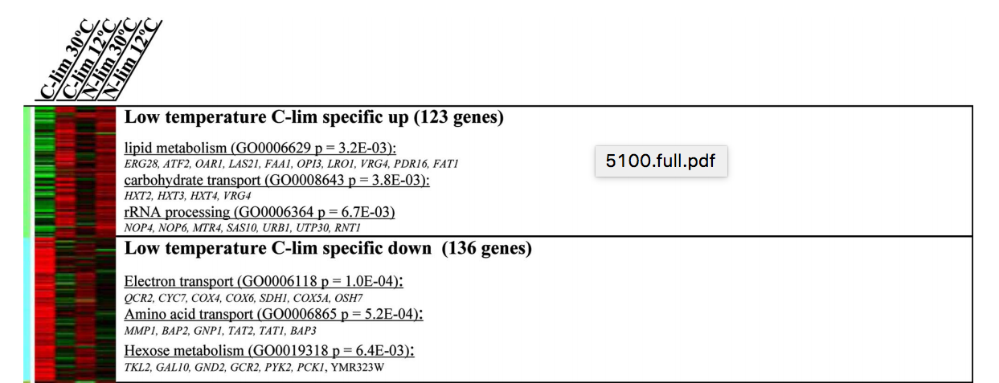
More Genes Were Induced in the Glucose-Limited Cultures
Temperature-responsive genes were screened for enrichment of specific functional categories.
C-lim cultures showed the most activity in these categories
Notes:
In Figure 2, a Heat Map was used to identify regulatory networks involved in the acclimation of the yeast to low temperature.
In this first section of Figure 2, the glucose (C-lim) cultures showed the most activity in these regulatory networks, as highlighted by the yellow boxes.
Implication:
lauren

Slide 14

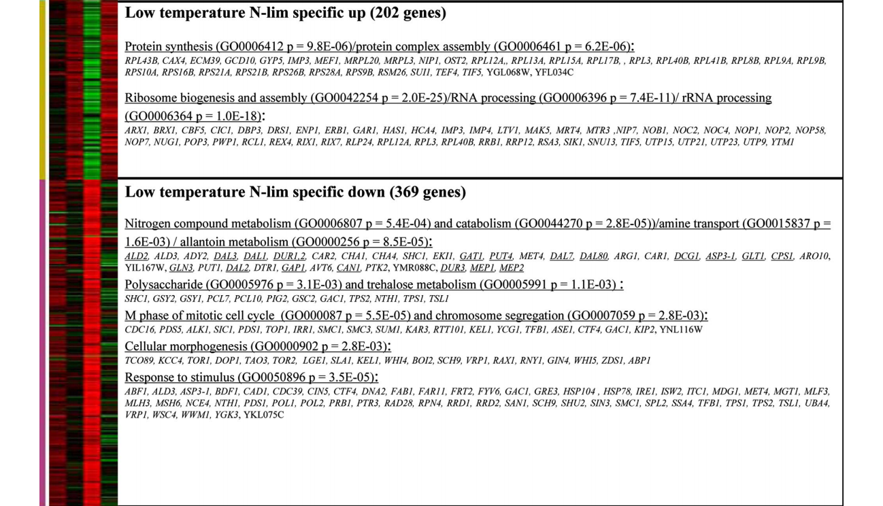
Greater Transcriptional Regulation in N-Lim
S. cerevisiae in N-lim cultures showed stronger transcriptional regulation in these categories.
Notes:
In this middle section of Figure 2, the ammonium-limited (N-lim) cultures showed the most regulation activity in these networks, also highlighted by the yellow boxes.
Implication:
lauren

Slide 15
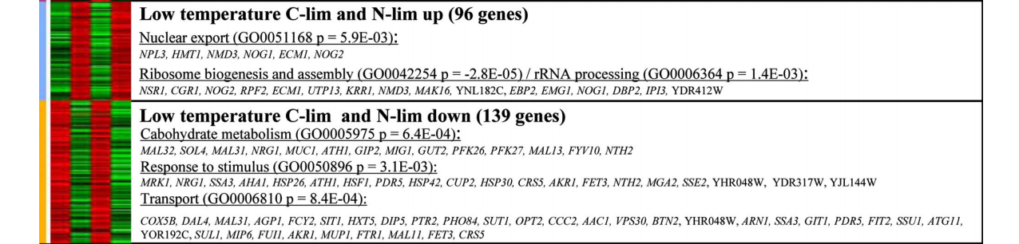
Strong Transcriptional Regulation in Both N-Lim and C-Lim
C-lim and N-lim cultures showed similar regulation trends in nuclear export, ribosome biogenesis/assembly, carbohydrate metabolism, and other categories.
Notes:
In this last section of Figure 2, the C-lim and N-lim cultures display similar transcriptional regulation in these networks.
Specifically, Carbohydrate metabolism is downregulated in both N-lim and C-lim, ties back to table 1. Less carbohydrates are metabolized, which leads to a higher residual nutrient concentration at lower temperatures
Implication:
lauren

Slide 16
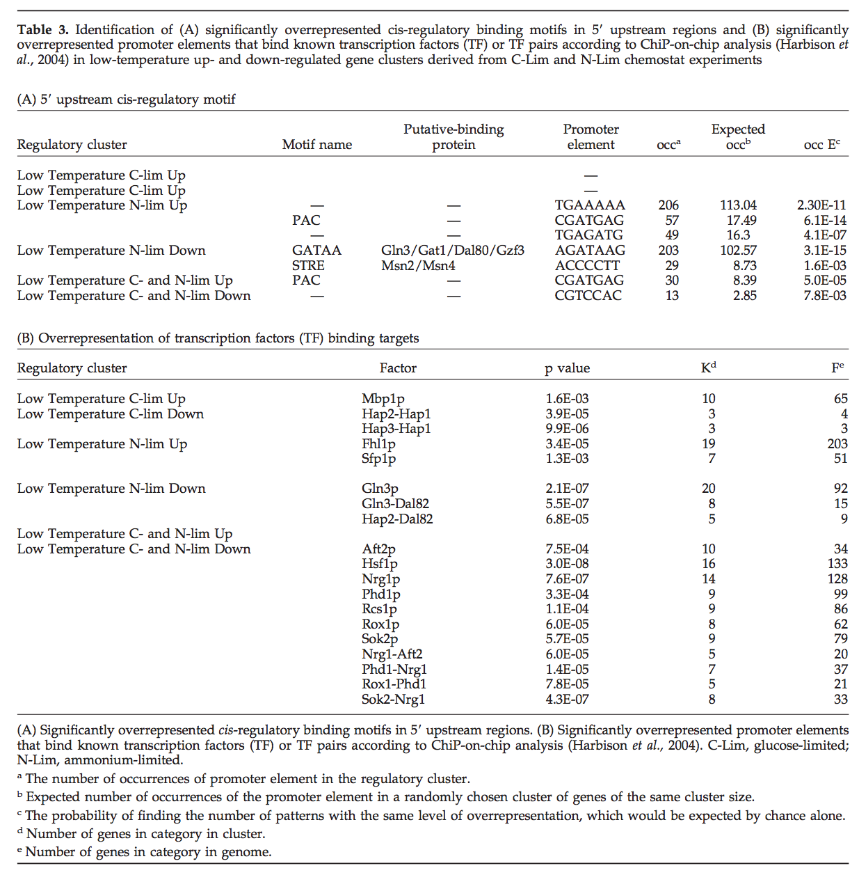
Overall, More Transcription Factors were Overrepresented
Table 3
There were significantly overrepresented cis-regulatory binding motif in the 5’ upstream regions.
There were significantly overrepresented promoter elements that bind known transcription factors or transcription factor pairs according to the ChiP-on-chip analysis.
Notes:
Implication: These results are consistent with glycogen and trehalose biosynthesis genes being induced by stress resulting from a sudden change to low growth temperature. This indicates that cells are able to physiologically adapt to low temperature. This adaptation leads to the up-regulation of storage carbohydrate synthesis receding. However, the exact physiological relevance of storage carbohydrate metabolism during adaptation to low temperatures is unclear.
lauren

Slide 17
Outline
Background Information
Goal of the Present Study
Methods and Procedures
In chemostat based cultures, nutrient limitation affected the transcriptional regulation of genes at low temperatures.
Comparing this chemostat study to other batch culture studies revealed inconsistent gene expression.
Is the environmental stress response (ESR) an obligatory response to growth at low temperatures?
Notes:
Cameron

Slide 18
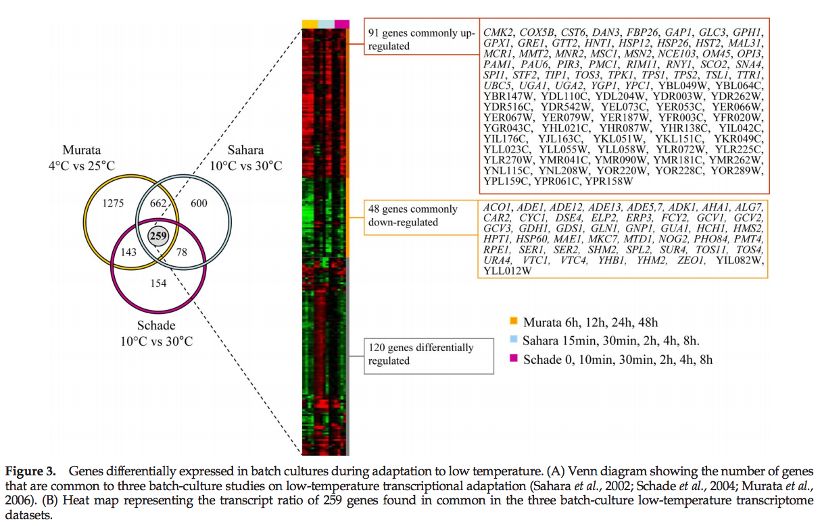
259 Genes Found in Common in Three Batch-Culture Studies
Venn diagram compares the genes from the three different batch culture studies.
Responses of genes was not consistent.
The heat map shows the transcript ratio of the 259 genes found in common.
Notes:
Implication: The fact that these three studies used batch-cultures may have been the reason that the genes did not have consistent responses. Other variables besides low temperature, such as low specific growth rate, can cause transcriptional responses.
Cameron

Slide 19
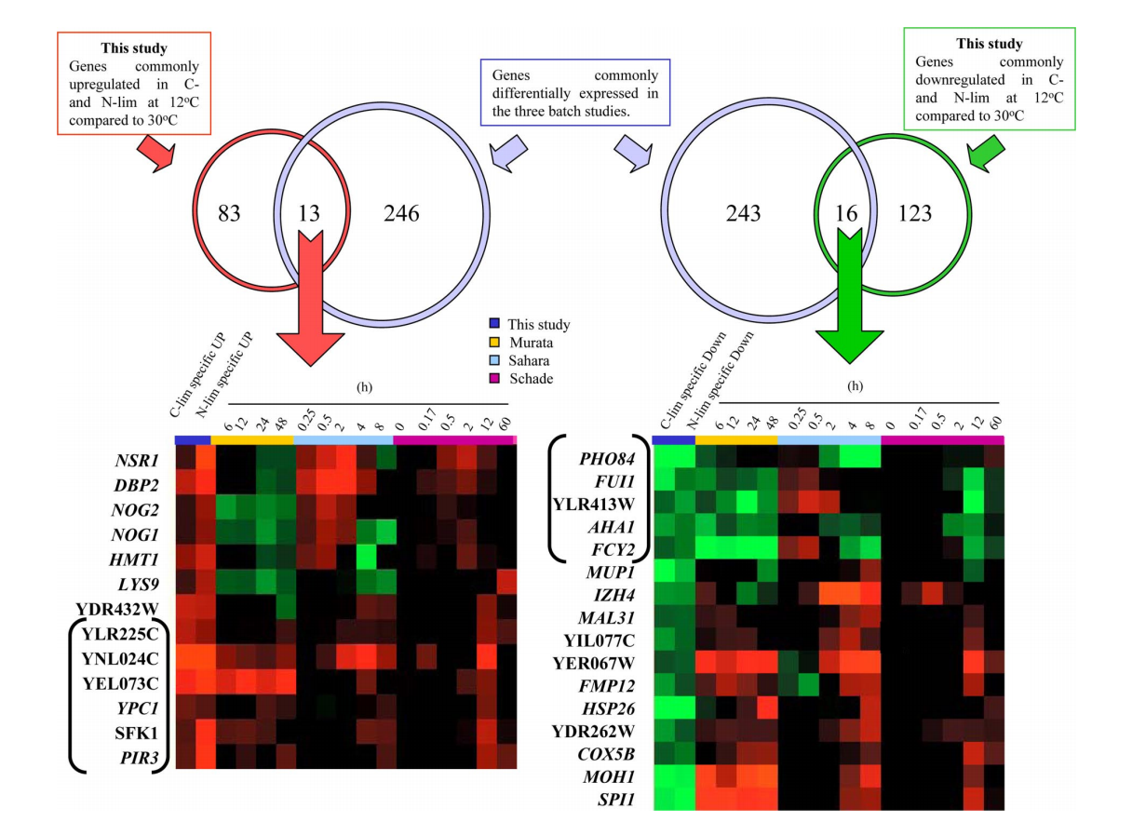
11 Genes Show Consistent Regulation
Three genes that were consistently up-regulated are involved in lipid metabolism.
SFK1, YPC1, and YEL073C
Three genes that were consistently down-regulated encode transporters.
Notes:
This figure incorporates data from this study and from the other three batch studies. In the Venn diagram on the left, there were 13 genes that were up-regulated in both the batch culture and chemostat based datasets. In the Venn diagram on the right, there were 16 genes that were down-regulated in both the batch culture and the chemostat based datasets. All together, only 11 genes (in brackets) showed a consistent pattern of regulation in all four situations
Three of the genes that were consistently up-regulated at low temp (SFK1, YPC1, and YEL073C) are involved in lipid metabolism. Each gene encodes a specific process or protein that is important in maintaining the cell membrane at low temperatures.
Three other genes that were consistently down-regulated at low temp (paper did not say which ones) encode transporters. Transport is also affected by modification of the membrane fluidity as a result of low temperatures
Implication: Genes that were consistently up- or down-regulated in both the batch cultures and the chemostat cultures coded for crucial cell functions
Cameron

Slide 20
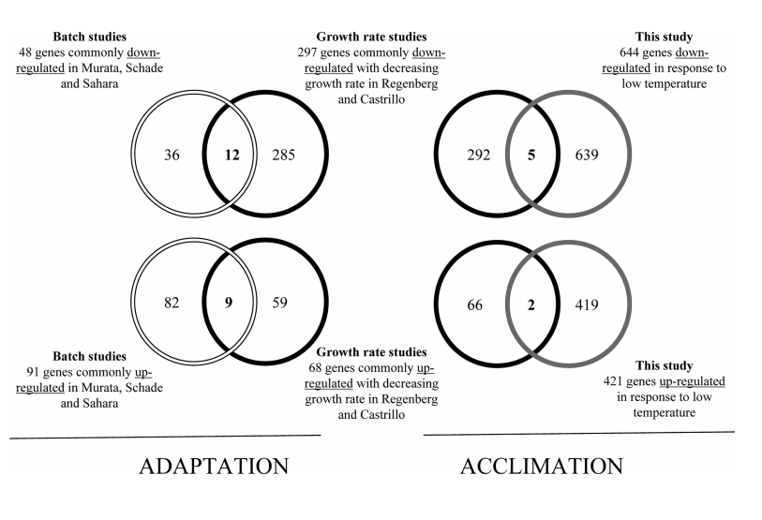
More Genes Regulated in Chemostat-Cultures
Genes were taken from Castrillo et al (2007) and Regenberg et al (2006).
25% of low-temperature down-regulated genes had altered transcript levels.
10% of the low-temperature up-regulated genes had altered transcript levels.
Notes:
Implication: The up-regulated and down-regulated genes that had altered transcript levels are likely to have been primarily related to specific growth rate rather than temperature. This figure also shows that there are overlaps with growth rate and that other gene changes are involved.
Cameron

Slide 21
Outline
Background Information
Goal of the Present Study
Methods and Procedures
In chemostat based cultures, nutrient limitation affected the transcriptional regulation of genes at low temperatures.
Comparing this chemostat study to other batch culture studies revealed inconsistent gene expression.
Is the environmental stress response (ESR) an obligatory response to growth at low temperatures?
Notes:
lauren

Slide 22
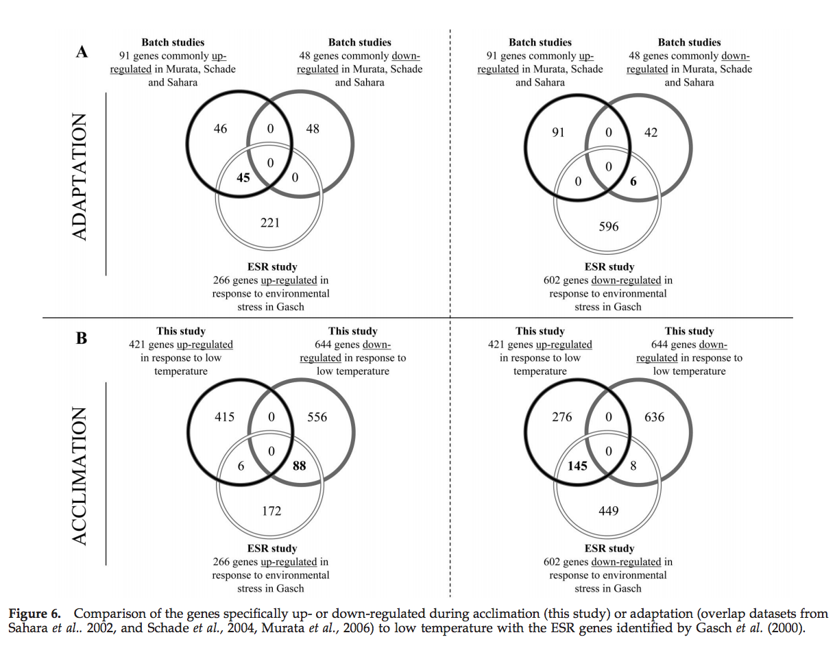
Extensive Overlap between the ESR Genes and the Genes in the Batch-Cultures
50% of consistently low-temperature up-regulated genes and 13% of low-temperature down-regulated genes found in the batch-culture studies were found in the ESR genes from Gasch et al. (2000)
Proposed that the ESR mechanism becomes induced with the growth temperature is decreased.
Notes:
A set of ESR genes defined by Gasch et at. (2000) was compared with sets of genes that were consistently up- or down regulated at low temperature in the batch cultures. 50% of the consistently low temperature up-regulated genes and 13% of low temperature down-regulated genes in the batch-cultures studies could be linked to ESR
Implication: Based only on the batch culture studies, there appears to be a strong overlap between low temperatures and the ESR.
lauren

Slide 23
Comparison of Gene Regulation in the Gasch et al. (2000) and the Chemostat Cultures
233 genes up-regulated and down-regulated in the study by Gasch et al. (2000) had an opposite transcriptional response in the low-temperature chemostat cultures.
Notes:
A similar comparison was done with the ESR genes and the 1065 genes that showed a different transcript level at low temperatures in the chemostat cultures. Only 14 genes showed a consistent response between low temperature and ESR. Several ESR genes showed an opposite transcriptional response in the low temperature chemostat cultures, which suggests reduced stress at low temperatures.
Implication: These results demonstrate that ESR is not the main response to low temperature, but rather occurs during adaptation upon sudden exposure to new environments. When cells are acclimated, as in the chemostat, it appears to not be interpreted as a stressful situation that would necessitate the ESR.
lauren

Slide 24
Chemostat Cultures Offer a New Perspective on Transcriptional Regulation at Low Temperatures
Genes that were consistently up- or down-regulated in both the batch cultures and the chemostat cultures coded for crucial cell functions
Prior studies had different results because they used batch-cultures and Tai et al. (2007) used chemostat-cultures.
ESR is not the main response to low temperatures.
Transcriptional responses to low-temperature and low specific growth rate can be dissected by the use of chemostat cultures.
Notes:
lauren

Slide 25
Works Cited
Tai, S. L., Daran-Lapujade, P., Walsh, M. C., Pronk, J. T., & Daran, J. M. (2007). Acclimation of Saccharomyces cerevisiae to low temperature: a chemostat-based transcriptome analysis. Molecular biology of the cell, 18(12), 5100-5112.
Notes:
Lauren

Slide 26

Acknowledgments
Dr. Kam Dahlquist
Dr. Ben Fitzpatrick
LMU Department of Biology
LMU Department of Mathematics
Notes:
Lauren

