Slide 1
Running GRNmap to analyze S. cerevisiae and S. paradoxus’ response to cold shock
Natalie Williams
Biology Department
Loyola Marymount Unviersity
May 26, 2015

Slide 2
Outline
Estimated b seemed to have sharper effects, seen in the output graphs.
Changing the threshold (b) value altered the normalized weights of specific target-regulator interactions.
Estimation of b values also resulted in changes in the magnitudes of influence for each interaction.

Slide 3
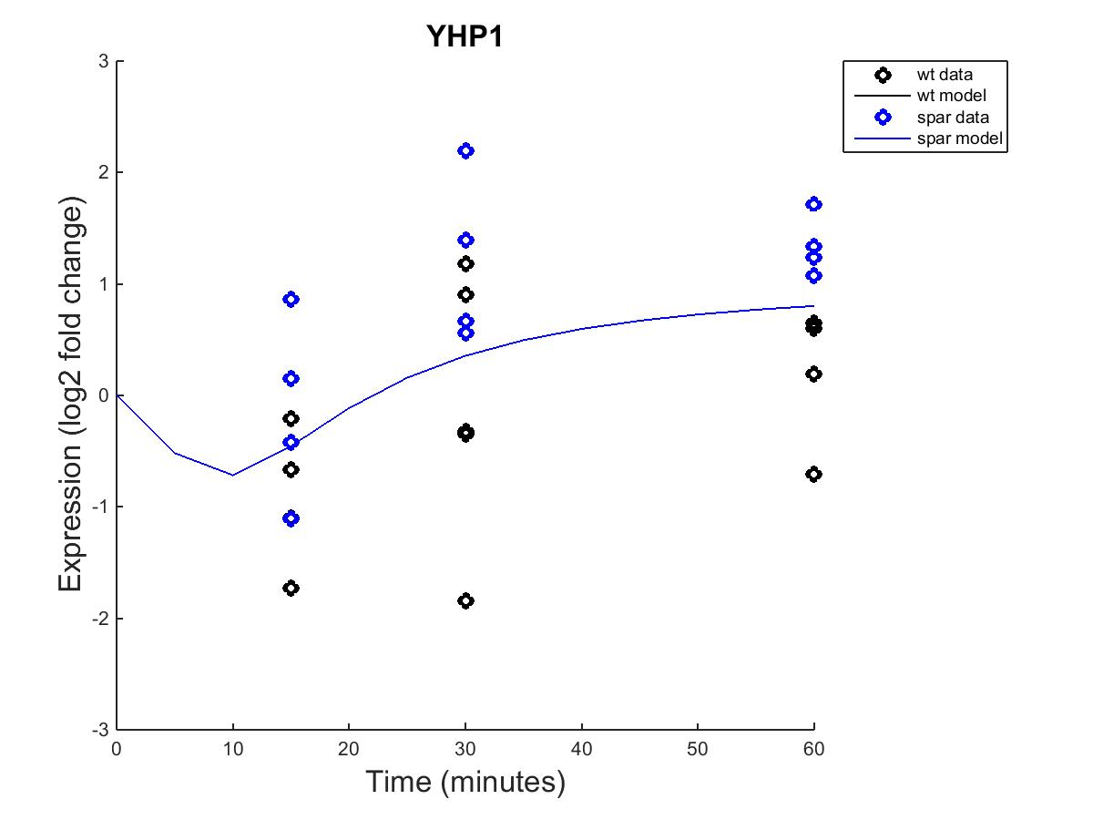
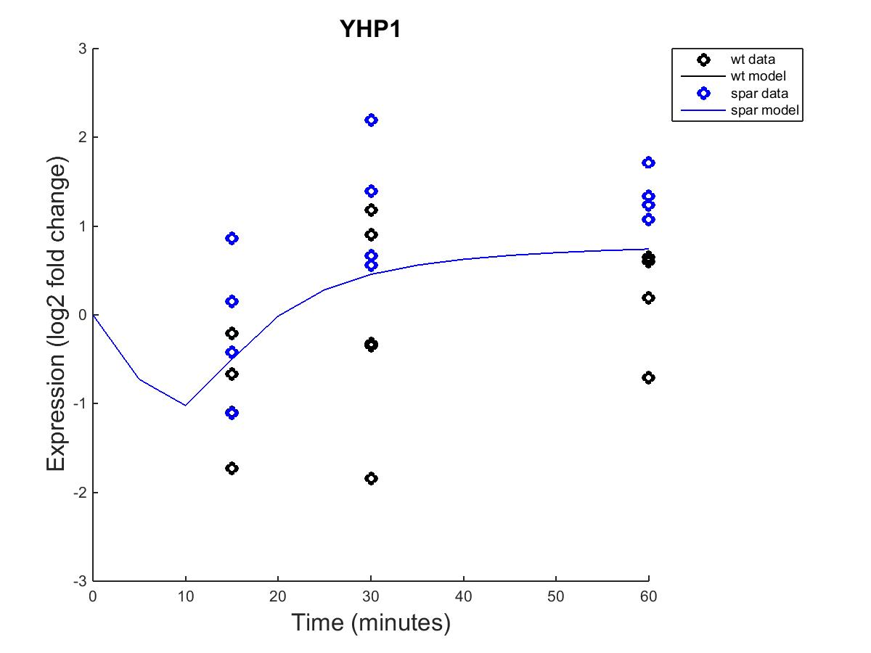
YHP1
Fixed b
Estimated b

Slide 4
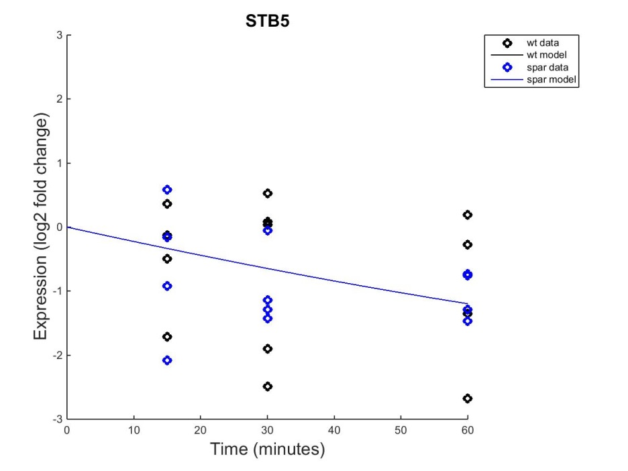
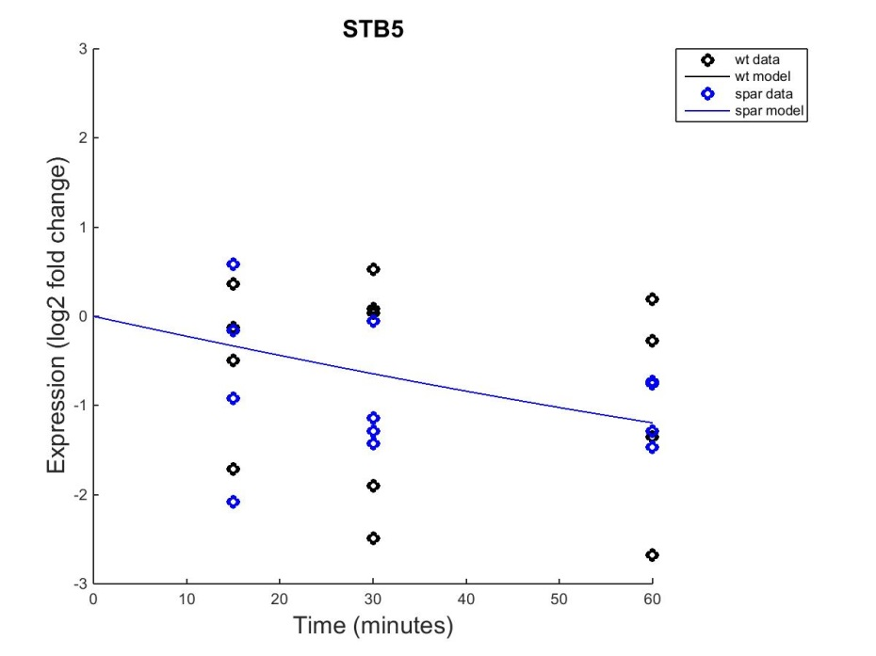
STB5
Fixed b
Estimated b

Slide 5
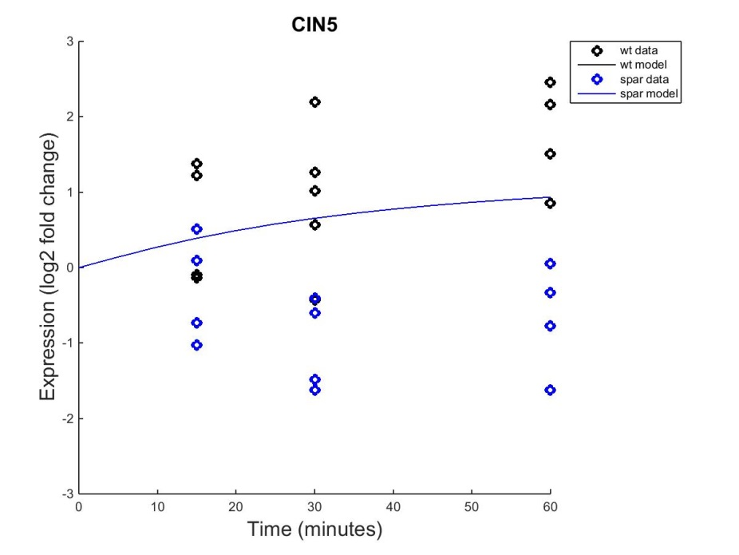
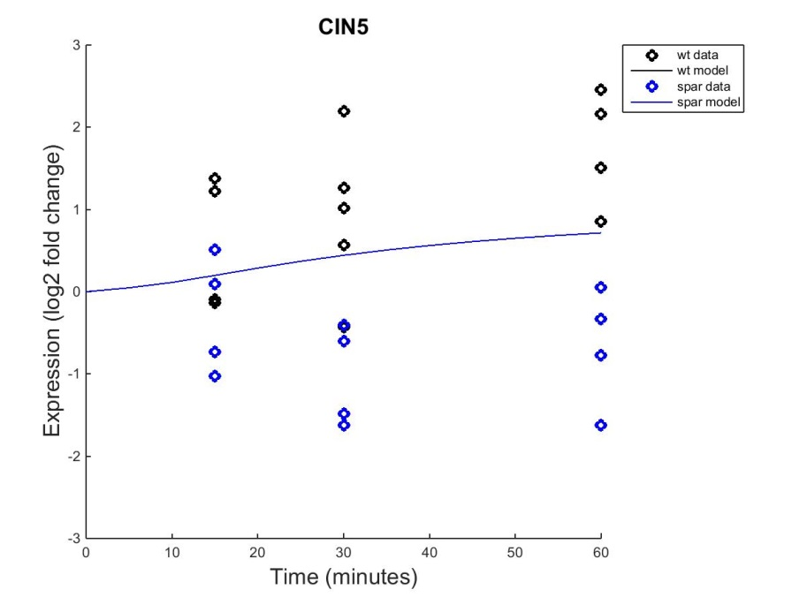
CIN5
Fixed b
Estimated b

Slide 6
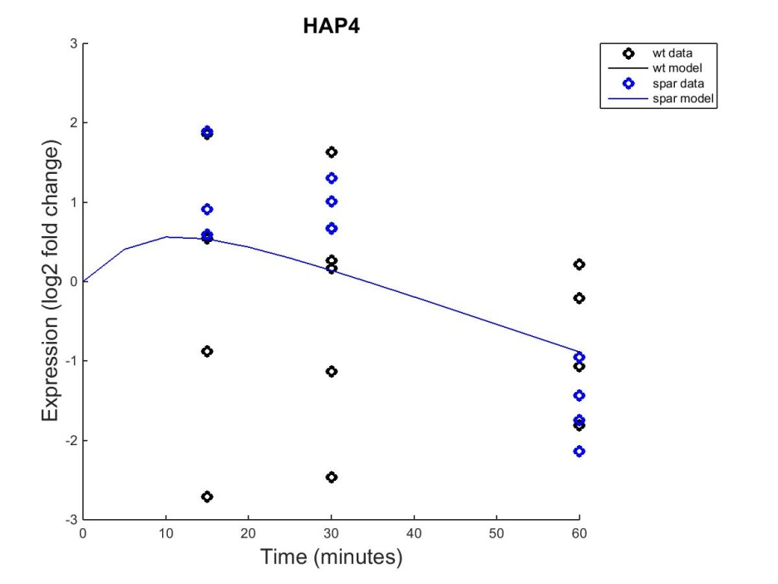

HAP4
Fixed b
Estimated b

Slide 7
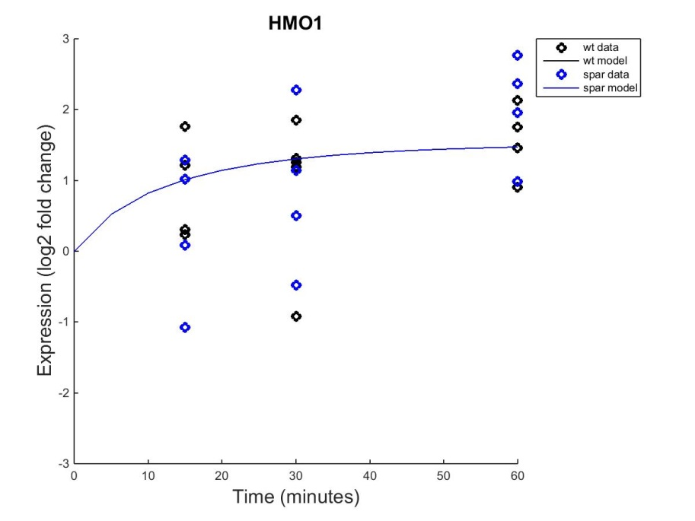

HMO1
Fixed b
Estimated b

Slide 8
Outline
Estimated b seemed to have sharper effects, seen in the output graphs.
Changing the threshold value (b) altered the normalized weights of specific target-regulator interactions.
Estimation of b values also resulted in changes in the magnitudes of influence for each interaction.

Slide 9
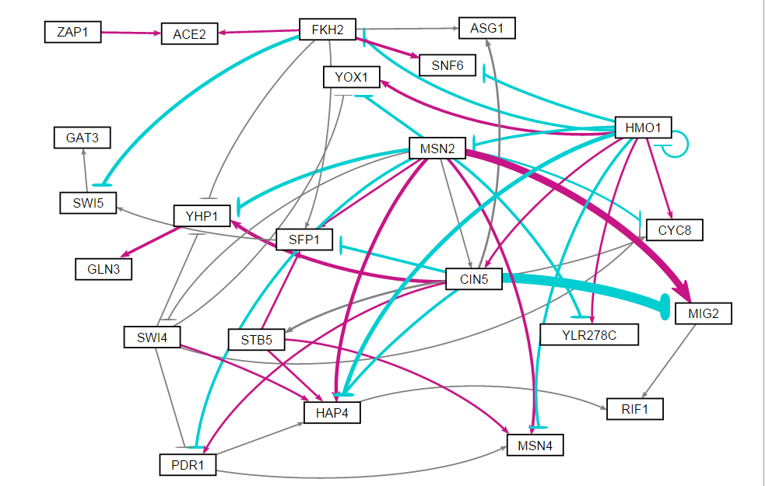
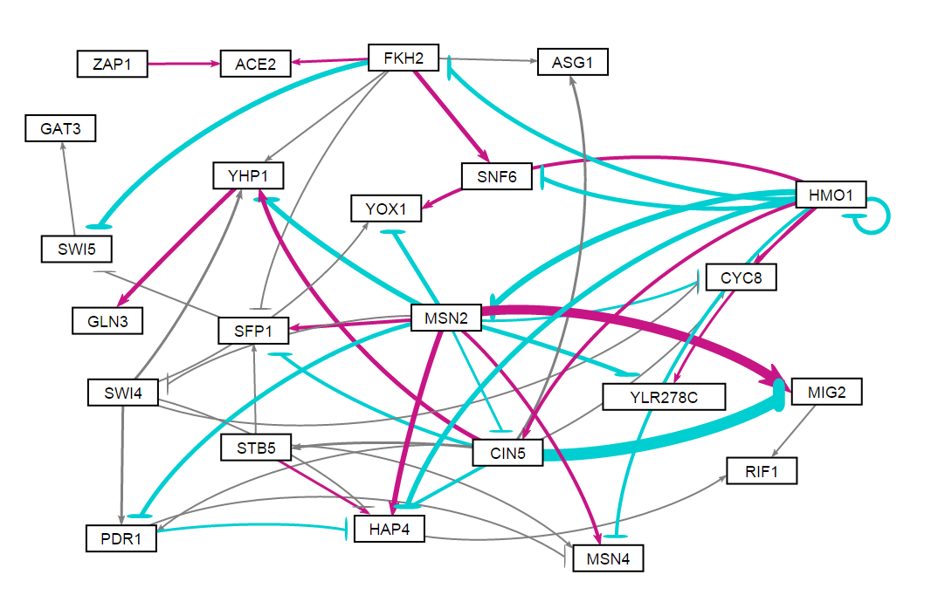
For this GRN, the b value impacts the optimized weights, seen when they normalized and then visualized in GRNSight.
Estimated b
Fixed b
Notes:
These are not from the input files being run separately
- MATLAB gave red error messages after the individual strains had be run through it

Slide 10
Outline
Estimated b seemed to have sharper effects, seen in the output graphs.
Changing the threshold value (b) altered the normalized weights of specific target-regulator interactions.
Estimation of b values also resulted in changes in the magnitudes of influence for each interaction.

Slide 11
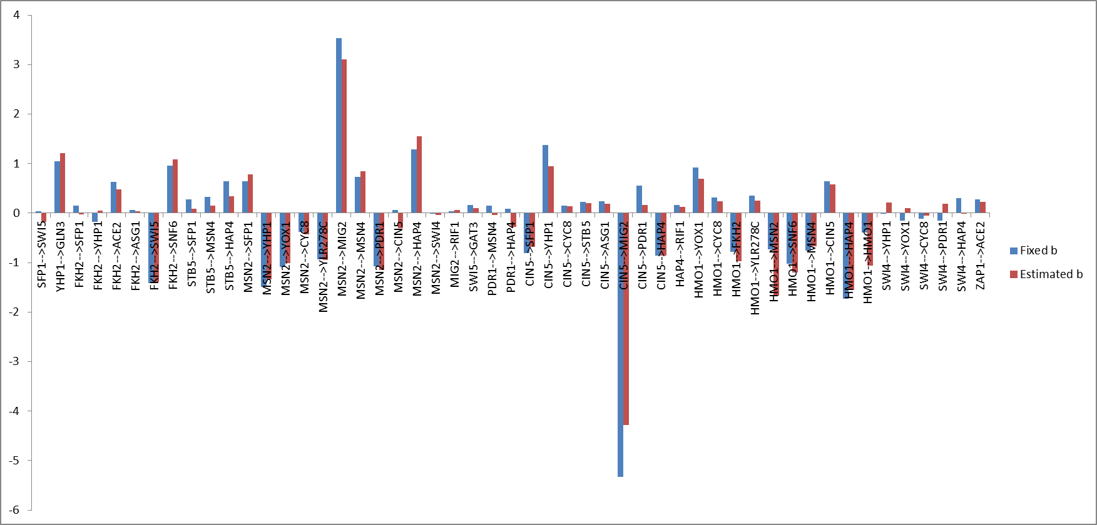

Slide 12
Summary
Estimation of b has a noticeable effect on this constructed GRN
The two strains have different behaviors, but the output graphs did not exemplify those divergences

