Slide 1
Networks in Engineering
A network consists of a set of interconnected components that deliver a predictable output to a given set of inputs.
Input
Function
Output

Slide 2
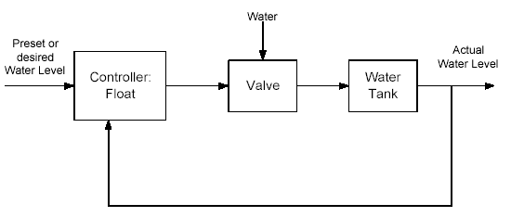
Control Systems
A control system is characterized by an input, controller and an output. Control systems could be open-loop or closed-loop.
Eg : Water level control (closed-loop)
- the objective of this system is to maintain a preset water level through a closed loop control system.

Slide 3
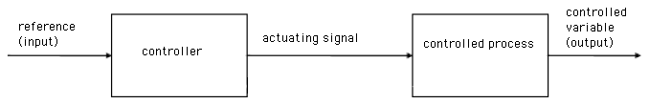
Open-loop Control Systems
The reference signal is directly used to compute the actuating signal.
There is no feedback.
Operating conditions are fixed and depends on calibration.
Not robust to perturbations.

Slide 4
Closed-loop Control Systems
The output is fed back into the system and compared with the reference signal (input).
The difference in signals is used to compute an error signal
An actuating signal is derived from the error signal to correct the error.
Robust to perturbations

Slide 5
Positive and Negative Feedback
Closed loop systems make use of positive and negative feedback.
Positive feedback
- eg: amplifiers
Negative feedback
- eg: blood pressure control
Input
Transfer Function
Output
Input
Transfer Function
Output

Slide 6
Transfer Functions
Control is achieved through the transfer function which determines the nature of the output.
Transfer functions govern the relationship between the input and output.
Input
Transfer Function
Output

Slide 7
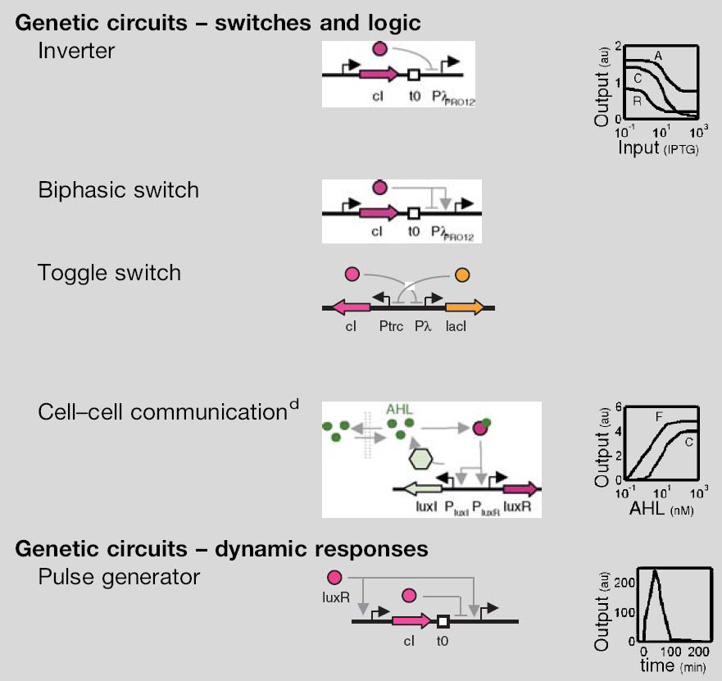
Some Basic Biological Circuits

