Slide 1
Mechanisms of Integrin Trafficking
Lauren Jansen
Department of Chemical Engineering
University of Massachusetts, Amherst
Group Meeting
September 21st 2015

Slide 2
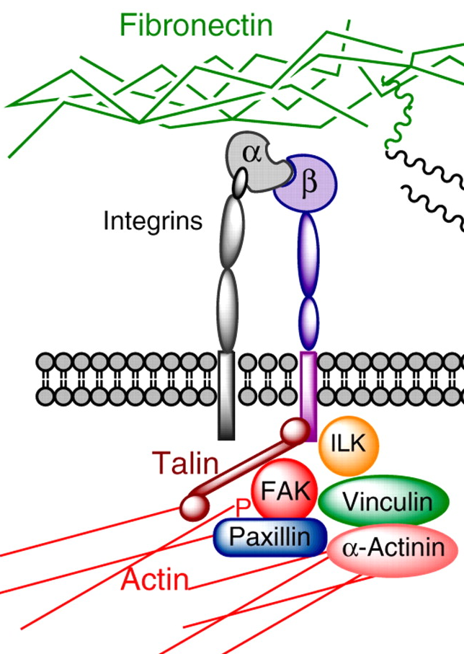
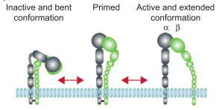
Integrin Background
Binding of extracellular
A conformational change making the cytosolic tail accessible
Recruitment of proteins that link integrins to the cytoskeleton
Mn2+ supports ligand binding
Mg2+ medium binding
Ca2+ does not support binding
Hammerschmidt, M and Wedlich, D, Development, 2008
Franceschi, ND, et al, J of Cell Sci, 2015
Tiwari, S, et al, J of Cell Sci, 2011
Notes:
Integrins are a family of adhesion molecules involved in interactions between the cell and the surrounding extracellular matrix (ECM).
The heterodimerization of 19 α-integrin and 8 β-integrin subunits is thought to yield 25 integrin αβ heterodimers.
The first step in focal adhesion assembly is the binding of transmembrane integrin heterodimers to extracellular matrix ligands such as fibronectin, vitronectin, laminin or collagen. Upon ligand binding, a conformational change occurs that renders the cytosolic tail of integrins accessible for intracellular interactors leading to the recruitment of diverse proteins such as talin, vinculin and a- actin in that link integrins to the actin cytoskeleton which in turn allows the generation of traction forces through actomyosin contraction.
The structural function is to connect actin stress fibers to the ECM by the association of integrins with linking proteins including talin, a-actinin, and vinculin. Signaling
and adaptor proteins (e.g., the Src tyrosine kinase, focal adhesion kinase [FAK], paxillin, and the integrin-linked kinase [ILK]).
Integrins can exist in either (1) an inactive, bent conformation with a closed head-piece and low affinity for ECM ligands, (2) a primed, extended conformation with a closed head-piece and low affinity for ligand, or (3) an active, extended conformation with an open head-piece and high affinity for ECM ligands
Integrins contain several cation-binding sites that regulate the ligand-binding affinity of the receptor. Different cations have markedly different effects on ligand affinity: in general, Mn2+ supports ligand binding, Mg2+ does so to a lesser extent, and Ca2+ does not support ligand binding at all.
ligand binding and cation binding are intimately linked because all of the regions implicated in ligand recognition lie at, or close to, cation-binding sites.

Slide 3
What is Integrin Trafficking?
Integrin trafficking is a mechanism employed by cells to regulate integrin presentation on the cell surface. This ultimately impacts–ECM interactions and cellular signaling.
Display integrins on plasma membrane
Cell migration
Invasion
Cytokinesis
FA disassembly
Matrix turnover
Integrin redistribution
Adhesion
Internalize
Recycle
Degradation
Margadant, C, et al, Curr Op in Cell Bio, 2011

Slide 4
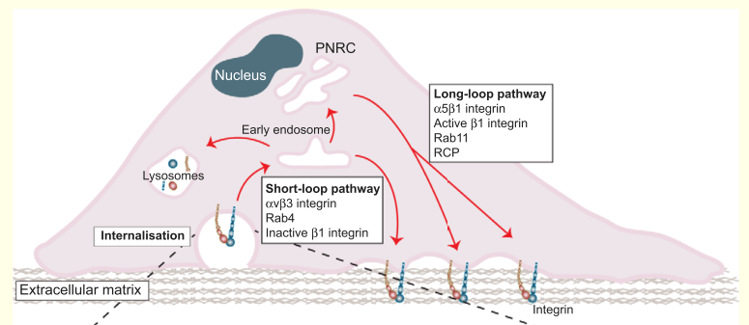
Recycling diagram
Franceschi, ND, et al, J of Cell Sci, 2015

Slide 5
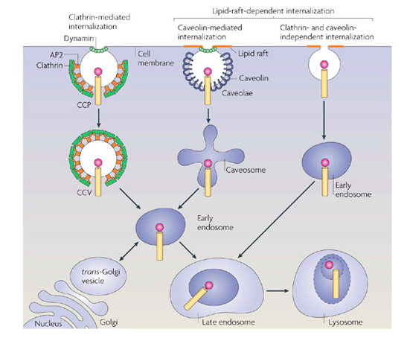
Integrin internalization through endocytosis
Schutze, et al, Nature Rev Mol Cell Biol, 2008
Notes:
A given integrin hetero- dimer can follow more than one internalization route.
DAB2 mediates clathrin-dependent endocytosis of integrins, there are still issues to be resolved regarding where this occurs (near focal adhesions or across the entire cell surface ) and whether the integrin heterodimer must be active to follow this route into the cell
CME of different types of integrins is often facilitated by cargo-specific adaptors like Dab2 [71], ARH [72] and Numb [49]. These endocytic adaptor proteins have been shown to interact with the NPxY motif in b-integrin cytoplasmic tails via their phosphotyrosine-binding domains.

Slide 6
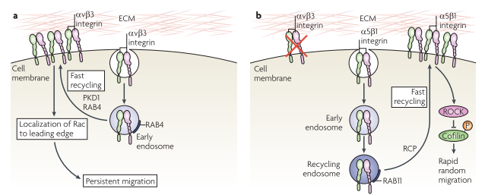
Short loop and long loop integrin recycling
Caswell, PT, et al, Nature Reviews, 2009
Notes:
Box 2. Rab and Arf GTPases control endocytic recyclingSmall GTPases are thought of as molecular switches that cycle between a GTP-bound ‘on’ state, and a GDP-bound ‘off’ state. There are more than 60 Rab proteins and six Arf proteins that localise to distinct membrane compartments, and these families of GTPases control most of the known intracellular trafficking events in eukaryotic cells
The short-loop recycling pathway is regulated by Rab4 and Rab35, and is characterised by cargoes that exit the early endosome to recycle to the plasma membrane. Long-loop recycling involves trafficking of cargo through the perinuclear recycling compartment (PNRC) and is thought to primarily require the activity of Rab11 and Arf6, but roles for Rab8, Rab10 and Rab22a have also been described (Grant

Slide 7
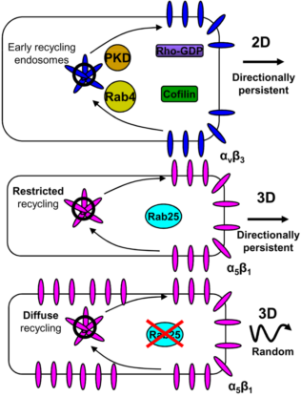
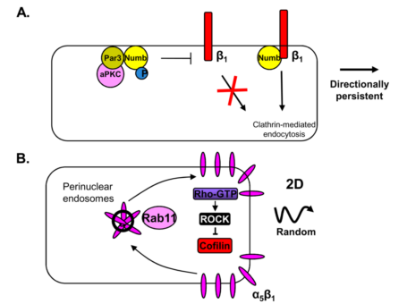
Integrin trafficking influences persistence in cell migration
Petrie, RJ, et al, Nat Rev Mol Cel Biol, 2009
Notes:
While a5b1 integrins promote focal adhesion turnover and thereby random cell motility, the heterodimer avb3 rather suppresses focal adhesion dynamics thereby promoting directionally per- sistent migration.
Integrin trafficking may contribute to directional migration by facilitating the formation of new adhesions at the leading edge
Par3 regulates Numb, an adaptor that couples specific cargo to clathrin-coated pits. Numb directs internalization of integrin β1 or β3 subunits behind the leading edge. Par3 binds directly to Numb and promotes its Ser phosphorylation by aPKC. Phosphorylation prevents interaction with the integrin and inhibits their internalization. Inhibiting either phosphorylation or dephosphorylation of Numb blocks the directed migration that occurs during wound healing of fibroblasts.
Integrin αVβ3 expression in wounded epithelial cell monolayers promotes stable centrosome re-orientation and directional migration compared to cells expressing integrin α5β. Integrin α5β1-mediated random migration in fibroblasts and epithelial cells is triggered by the ROCK-dependent phosphorylation and inactivation of cofilin. At the leading edge Cofilin severs F-actin filaments at the minus end to provide more free-barbed ends for actin polymerization. Rab11 controls integrin α5β1 recycling via a longer pathway from a perinuclear endosomal compartment.
Integrin αVβ3 suppresses RhoA–ROCK-mediated phosphorylation and inhibition of the actin-severing protein cofilin, thereby triggering broad lamellipodia, stable adhesions and increased directional migrationIn fibroblasts, PKD1 and Rab4 drive the rapid recycling of integrin αVβ3 from early endosomes to the cell surface. Perturbation of the rapid Rab4-dependent recycling of integrin αVβ3 increases the rate of integrin α5β1 recycling and promotes random fibroblast migration.
Matrix dimensionality influences Rab11-dependent recycling of integrin α5β1 and directional cell migration. Inhibition of integrin αVβ3 in an epithelial cancer cell line increases integrin α5β1 recycling by stimulating the Rab11-mediated return of integrin α5β1 to the plasma membrane. Integrin α5β1 recycling in epithelial cells driven by Rab25 promotes the directional migration of these cells within 3D environments without affecting their mode of migration on2D surfaces. Cell-derived matrix increases the association of Rab25 with β1 integrin and restricts its recycling to the tips of leading-edge protrusions in cell-derived matrix to promote directionally persistent migration. It is not known how matrix dimensionality regulates Rab25 activity or its association with integrin β1.

Slide 8
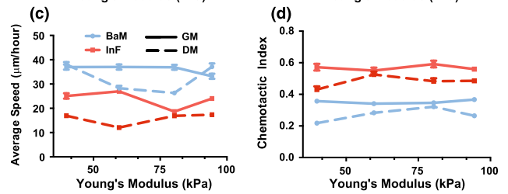
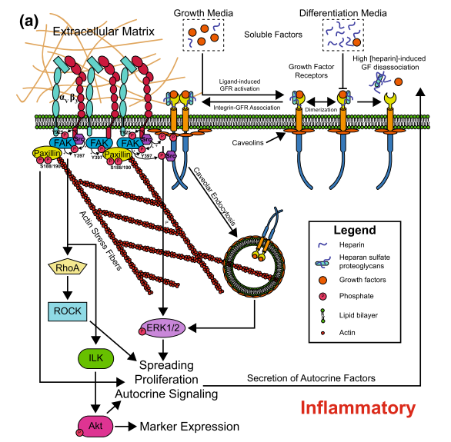
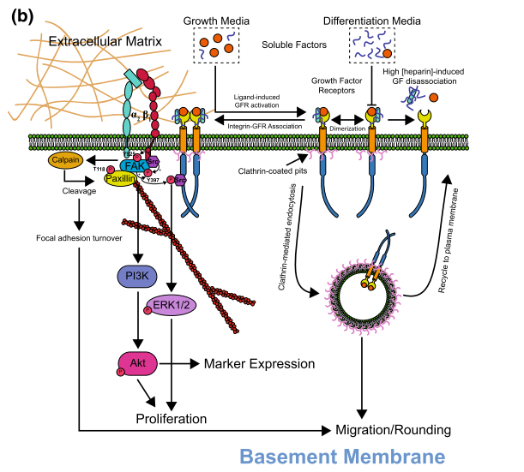
Endocytosis mechanisms may explain SMC phenotypes
Herrick, W, et al, Cell and Mol Bioengin, 2013
Notes:
ECM-controlled switch from a migratory to a proliferative phenotype.
Prior work with fibroblasts revealed that these cells are motile and proliferative at low and high concentrations of PDGF, respectively, a switchover mediated by clathrin-mediated endocytosis (CME) and raft/caveolin-mediated endocytosis (RME). We hypothesize that this switching of endocytic mechanisms could also be induced by changes in integrin activation. This proposal fits well with the finding that migration is random and non-directional on BaM, as CME is responsible for rapid, localized recycling of growth factor receptors at the plasma membrane, which enables a fast cellular response to transient microgradients of chemoattractants. BaM also suggest faster turn- over of FAs, which is likely to support rapid migration on soft substrates. This

Slide 9
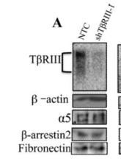
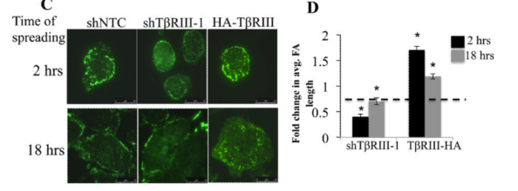
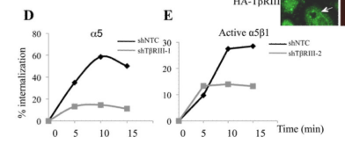
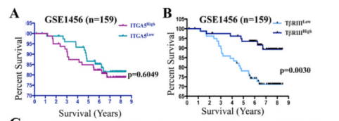
TβRIII controls trafficking of α5β1 and cell adhesion to fibronectin
TβRIII plays a general role in adhesion to FN
TβRIII does not alter alpha 5 levels
TβRIII regulates active alpha 5 internalization
TβRIII is a tumor supressor
Mythreye, K, et al, Oncogene, 2013
Notes:
The TGF-β superfamily co-receptor, the type III TGF-β receptor (TβRIII/betaglycan), is a transmembrane proteoglycan that serves as a co-receptor for multiple TGF-β superfamily members (10-12). TβRIII has essential, non-redundant roles in regulating signaling through TβRII and TβRI.
MCF10A cells adhering to FN
A5b1 Is the main FN receptor

Slide 10
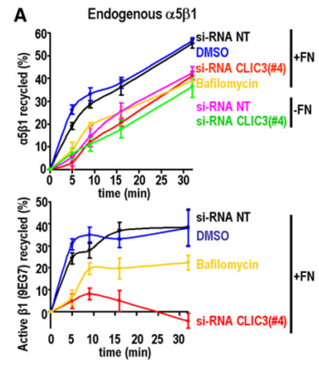
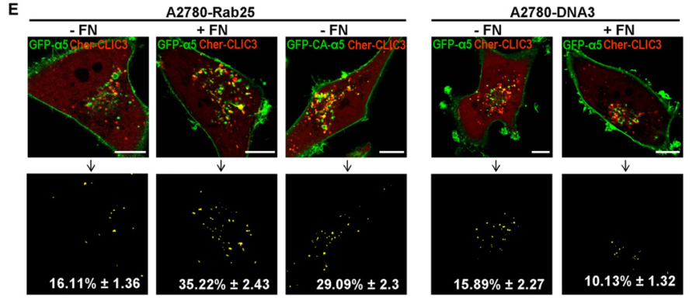
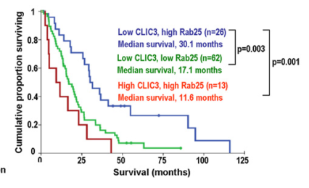
Rab25 recycling helps drive cancer progression
Soluble fibronectin on A2780-Rab25 cells promoted delivery of a5b1 to CLIC3-positive late endosomes/lysosomes
This trafficking controls the cell migration and increases invasion into 3D matrices
Fibronectin alters kinetics of a5b1 recycling, which is unaffected by knock- down of CLIC3 in absence of fibronectin
Dozynkiewicz, MA, et al, Developmental Cell, 2012
Notes:
CLIC3 is associated with late endosomes
in the absence of Rab25, fibronectin did not increase colocalization of a5b1 with CLIC3.

Slide 11
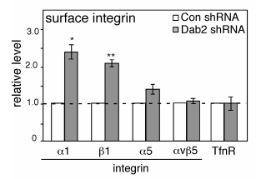
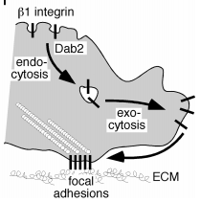
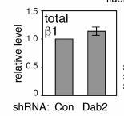
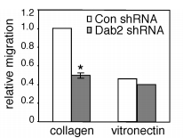
Exocytosis regulates migration speeds
Integrin surface levels increase in DAB2 deficient cells
DAB2 regulates endocytosis of inactive integrins
DAB2 regulates migration by maintaining internal pool
Teckchandani, A, et al, The J of Cell Biol, 2009
Notes:
Receptors that undergo clathrin-dependent endocytosis contain endocytosis signals that bind to adapter proteins, including the well-characterized tetramer AP2 and monomeric phosphotyrosine-binding domain proteins Dab2, Numb, and autosomal recessive hypercholesterolemia
By manipu- lating intracellular and surface integrin ?1 levels, we show that migration speed correlates with the intracellu- lar integrin pool but not the surface level. Together, these results suggest that Dab2 internalizes integrins freely diffusing on the cell surface and that Dab2 regulates migration, perhaps by maintaining an internal pool of integrins that can be recycled to create new adhesions at the leading edge.

Slide 12
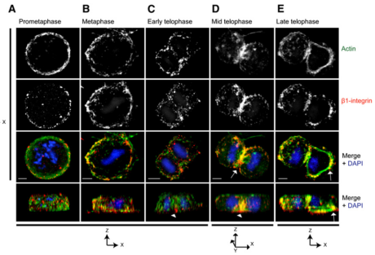
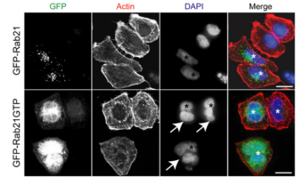
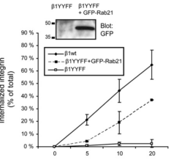
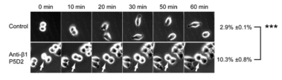
Mitosis is frozen when RAB21 is mutated
Rab21 causes multinucleated cells
Clathrin-mediated endocytosis
Blocking beta1 arrests cells in cytokinesis
Pellinen, et al, Developmental Cell, 2008
Notes:
In prometaphase and metaphase cells, b1-integrin localized diffusely at the membrane and in a few intracellular vesicles (Figures 1A and 1B). In early telophase, in- tegrin was detected mainly on the matrix-facing side of the cells (Figure 1C, z axis, arrowhead), and by mid-telophase, b1-integrin concentrated to the ingressing cleavage furrow (Figure 1D, arrow) and mainly to the basal side of the furrow, where it possibly anchors the cleavage furrow to the substrate (Figure 1D, side, arrowhead).
Cancer Cells Harboring a Rab21 Deletion Are Multinucleate
The cytoplasmic domains of b-integrins contain two conserved NXXY motifs required in other cell surface receptors for clathrin-mediated endocytosis (Le Roy and Wrana, 2005), suggesting that they also might be involved in the regulation of integrin endocytosis.
Weexploited this specificity to inves- tigate whether endocytosis-deficient b1YYFF MEFs are able to divide on laminin. We found that b1YYFF cells cultured on vitro- nectin were mainly mononuclear, whereas the same cells on laminin were significantly more frequently bi- and multinucleate

Slide 13
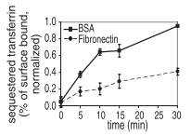
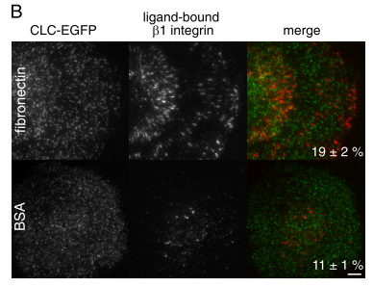
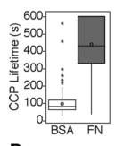
Endocytosis is reduced during epithelial cell adhesion
Endocytosis is slower on FN surface
Integrin B1 influences the uptake of clatherin coated pits on FN
Clatherin coated pits have shorter lifespans in less tightly adhered cells
Batchelder, EM, et al, Mol Bio of the Cell, 2010

Slide 14
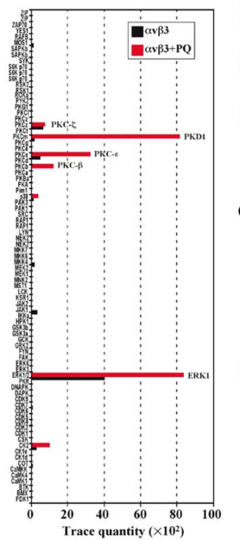
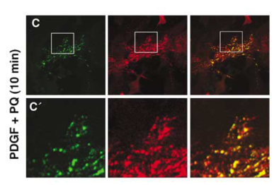
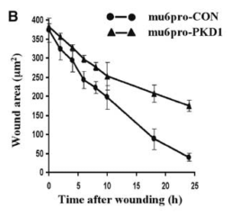
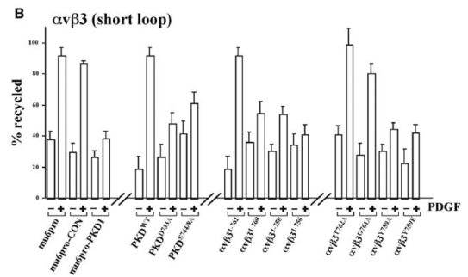
Kinases regulate growth factor mediated recycling of avb3
PKD1 associates with avb3 in the presence of PDGF and primaquine
Reduces fibroblast mobility because these cells are no longer able to form focal adhesions
Woods, AJ, et al, The EMBO J, 2004
Notes:
We have previously shown that the function of avb3 integrin is influenced by a growth factor-regulated recycling pathway directing the integrin to the plasma membrane
As the receptor recycling inhibitor primaquine causes cycling integrins to accumulate rapidly within endosomes, we have sought to identify kinases that associate with avb3 integrin on the cytoplasmic face of these endosomal vesicles
PKD1 causes short-loop recycling, which is regulated by PkD1, which must be active
Expression of a kinase inactive form of PKD1 has been recently shown to compromise fibroblast motility

Slide 15
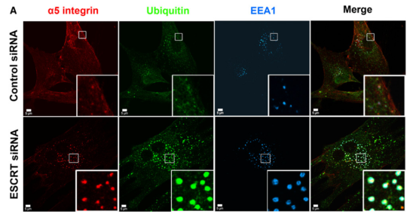
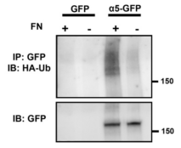
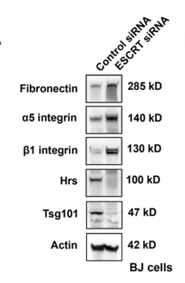
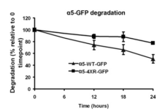
ECM can send integrins to lysosome for degradation
Binding fibronectin by a5 induces ubiquitination
Lack of ubiquitination decreases degradation
Protein accumulates in cells with less ESCRT
Lobert, et al, Developmental Cell, 2010
Notes:
Ubiquitination is a post-translational modification (an addition to a protein after it has been made) where ubiquitin is attached to a substrate protein.
a5b1 Integrin and Fibronectin Accumulate at Ubiquitin-Positive Early Endosomes in ESCRT-Depleted Cells and this is cell type specific

Slide 16
Overall Conclusions
Integrin trafficking is impacted by ECM proteins in the surrounding environment
Trafficking directs cell migration and adhesion to matrices
Many of these processes play large roles in cancer progression

Slide 17
Some things to consider
Are “fingerprint” phenotypes in cancer cells driven by common integrin trafficking mechanisms?
Can cross-communication between cells influence the deposition of matrix to control integrin trafficking?
Growth factors can strongly influence the recycling of integrin heterodimers

