Slide 1
Manual Tracking
An imagej plugin with cell tracking capabilities

Slide 2
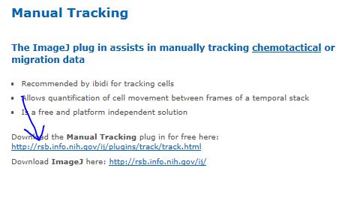
Acquiring Manual Tracking
              The first step to acquiring the manual tracking plugin is searching “imagej cell tracking” and clicking the first link.
Once on the ibidi page select “Manual Tracking” from the left menu containing Product Categories
From this page click the link shown below

Slide 3
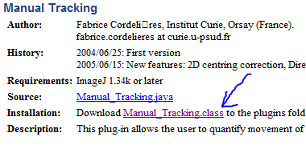
Acquiring Manual Tracking(cont.)
The next step is to download Manual Tracking from the purple link shown and move this file to the plugins folder of imagej

Slide 4
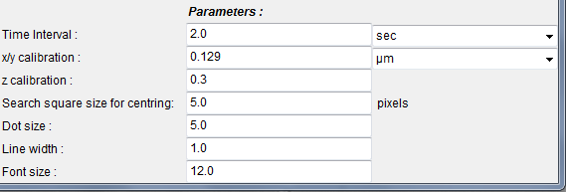
Using Manual Tracking
Once in imagej, open the zvi file you wish to track.
Click the Plugins button and select Manual Tracking in the drop down menu
A new window should open. This window allows you to set the parameters for the track you are about to make.
The time interval and x/y calibration values can be selected here. A z value can also be calibrated if 3D tracking is being done.

Slide 5
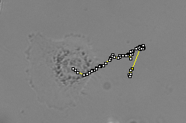
Using Manual Tracking
The Add track button in the top left should then be clicked.
Clicking on the nucleus will now produce xy points that pop up in a new window. If you continue to track the cell then the Manual Tracking program will produce distance and velocity values for the two points.

Slide 6
Further Information
The two following links offer guidelines to doing other operations with the manual tracking plugin
http://rsb.info.nih.gov/ij/plugins/track/track.html
http://rsb.info.nih.gov/ij/plugins/track/Manual%20Tracking%20plugin.pdf

