Slide 1
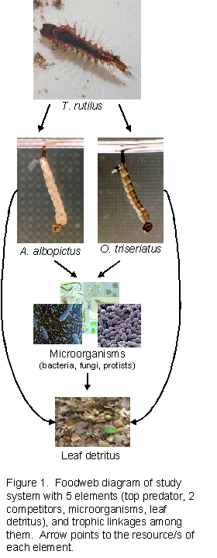
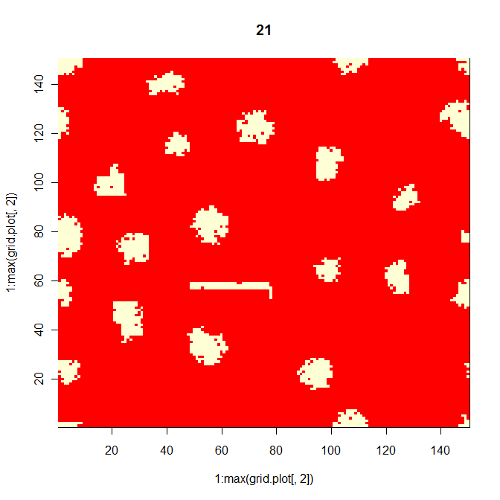
Modeling Metacommunities: A comparison of Markov matrix models and agent-based models with empirical data
Edmund M. Hart and Nicholas J. Gotelli
Department of Biology
The University of Vermont
F | S | R | F | R | R | Ѳ
S | F | F | F | S | Ѳ | S
F | R | Ѳ | R | R | R | R
S | D | D | D | S | F | S
R | D | D | F | D | S | S
Ѳ | F | Ѳ | F | F | F | Ѳ
S | S | S | R | Ѳ | S | F

Slide 2
Talk Overview
Objective
Background on metacommunities
Theoretical metacommunity
Natural system
Modeling methods
Markov matrix model methods
Agent based model (ABM) methods
Comparison of model results and empirical data, and different model types

Slide 3


Can simple community assembly rules be used to accurately model real systems?

Slide 4
Objective
To use community assembly rules to construct a Markov matrix model and an Agent based model (ABM) of a generalized metacommunity
Compare two different methods for modeling metacommunities to empirical data to assess their performance.

Slide 5
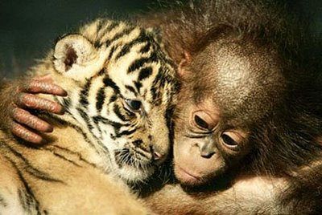
How do species coexist?

Slide 6
Classical models
and their multispecies expansions (eg Chesson 1994)
Lotka-Volterra Competition Model
N2
N1

Slide 7
Classical models
and their multispecies expansions (eg Chesson 1994)
Lotka-Volterra Predation Model
P
V

Slide 8
Mechanisms to Enhance Coexistence in Closed Communities
Environmental Complexity
Niche Dimensionality, Spatial Refuges
Multispecies Interactions
Indirect Effects
Complex Two-Species Interactions
Intra-Guild Predation
Neutral models

Slide 9

But what about space?

Slide 10
Levin’s Metapopulation

Slide 11
Metacommunity models
Coexistence in spatially homogenous environments
Patch-dynamic: Coexistence through trade-offs such as competition colonization, or other life history trade-offs
Neutral: Species are all equivalent life history (colonization, competition etc…) instead diversity arises through local extinction and speciation

Slide 12
Metacommunity models
Coexistence in spatially heterogenous environments
Species sorting: Similar to traditional niche ideas. Diversity is mostly controlled by spatial separation of niches along a resource gradient, and these local dynamics dominate spatial dynamics (e.g. colonization)
Mass effects: Source-sink dynamics are most important. Local niche differences allow for spatial storage effects, but immigration and emigration allow for persistence in sink communities.

Slide 13
A Minimalist Metacommunity
P
N₁
N₂

Slide 14
A Minimalist Metacommunity
P
Top Predator
N₁
N₂
Competing Prey

Slide 15
Metacommunity Species Combinations
Patch or local community
Ѳ
N₁
N₂
P
N₁N₂
N₁P
N₂P
N₁N₂P
N1
N2
N1
N1N2
N1N2
N2
N1N2P
N1
Metacommunity

Slide 16
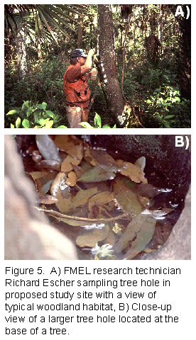
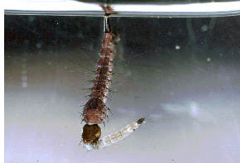
Actual data
Species occurrence records for tree hole #2 recorded biweekly from 1978-2003(!)

Slide 17
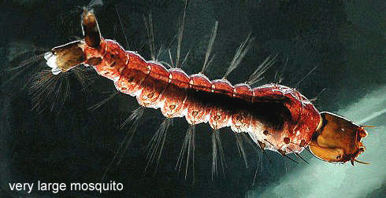
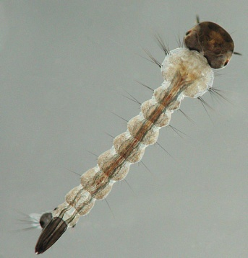
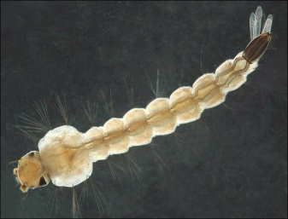
Actual data
Toxorhynchites rutilus
P
Ochlerotatus triseriatus
Aedes albopictus
N₁
N₂

Slide 18
Testing Model Predictions
 | S1 | S2 | S3 | S4 | S5 | S6 | S7 | S8 | S9 | S10 | S11 | S12 | S13 | S14
N₁ | 1 | 1 | 0 | 0 | 1 | 0 | 0 | 0 | 0 | 0 | 0 | 1 | 0 | 1
N₂ | 0 | 0 | 1 | 0 | 1 | 1 | 0 | 1 | 1 | 1 | 0 | 1 | 0 | 1
P | 0 | 0 | 1 | 1 | 0 | 0 | 0 | 0 | 0 | 0 | 0 | 0 | 1 | 1
Community State | Binary Sequence | Frequency
Ѳ | 000 | 2
N₁ | 100 | 2
N₂ | 010 | 4
P | 001 | 2
N₁N₂ | 110 | 2
N₁P | 101 | 0
N₂P | 011 | 1
N₁N₂P | 111 | 1

Slide 19
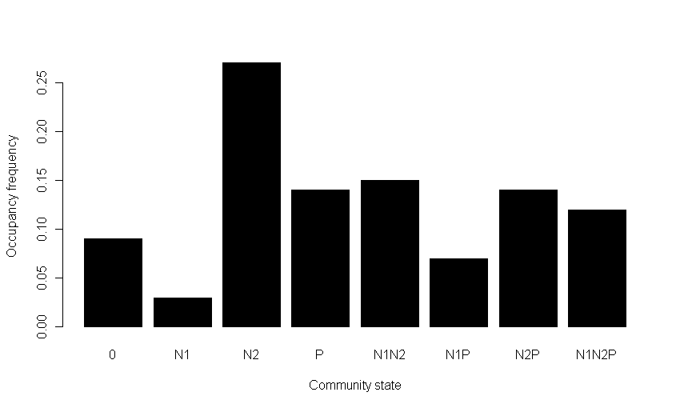
Empirical data

Slide 20
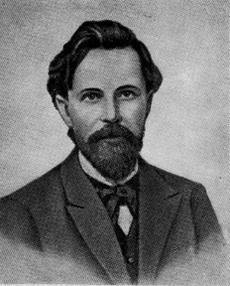

Markov matrix models

Slide 21
Stage at time (t)
•
=
Stage at time (t + 1)

Slide 22
Stage at time (t)
Ѳ
N₁
N₂
P
N₁N₂
N₁P
N₂P
N₁N₂P
Ѳ
N₁
N₂
P
N₁N₂
N₁P
N₂P
N₁N₂P
•
=
Stage at time (t + 1)

Slide 23
 | Community State at time (t)
Community State at time (t + 1) |  | Ѳ | N₁ | N₂ | P | N₁N₂ | N₁P | N₂P | N₁N₂P
 | Ѳ
 | N₁
 | N₂
 | P
 | N₁N₂
 | N₁P
 | N₂P
 | N₁N₂P

Slide 24
Community Assembly Rules
Single-step assembly & disassembly
Single-step disturbance & community collapse
Species-specific colonization potential
Community persistence (= resistance)
Forbidden Combinations & Competition Rules
Overexploitation & Predation Rules
Miscellaneous Assembly Rules

Slide 25
Competition Assembly Rules
N₁ is an inferior competitor to N₂
N₁ is a superior colonizer to N₂
N₁ N₂ is a “forbidden combination”
N₁ N₂ collapses to N₂ or to 0, or adds P
N₁ cannot invade in the presence of N₂
N₂ can invade in the presence of N₁

Slide 26
Predation Assembly Rules
P cannot persist alone
P will coexist with N₁ (inferior competitor)
P will overexploit N₂ (superior competitor)
N₁ can persist with N₂ in the presence of P

Slide 27
Miscellaneous Assembly Rules
Disturbances relatively infrequent (p = 0.1)
Colonization potential: N₁ > N₂ > P
Persistence potential: N₁ > PN₁ > N₂ > PN₂ > PN₁N₂
Matrix column sums = 1.0

Slide 28
 | Community State at time (t)
Community State at time (t + 1) |  | Ѳ | N₁ | N₂ | P | N₁N₂ | N₁P | N₂P | N₁N₂P
 | Ѳ | 0.1 | 0.1 | 0.1 | 0.1 | 0.1 | 0.1 | 0.1 | 0.1
 | N₁ | 0.5 | 0.6 | 0 | 0 | 0 | 0.4 | 0 | 0
 | N₂ | 0.3 | 0 | 0.4 | 0 | 0.8 | 0 | 0.6 | 0
 | P | 0.1 | 0 | 0 | 0 | 0 | 0 | 0.2 | 0
 | N₁N₂ | 0 | 0.2 | 0 | 0 | 0 | 0 | 0 | 0.4
 | N₁P | 0 | 0.1 | 0 | 0.9 | 0 | 0.5 | 0 | 0.1
 | N₂P | 0 | 0 | 0.5 | 0 | 0 | 0 | 0 | 0.1
 | N₁N₂P | 0 | 0 | 0 | 0 | 0.1 | 0 | 0.1 | 0.3
Complete Transition Matrix

Slide 29
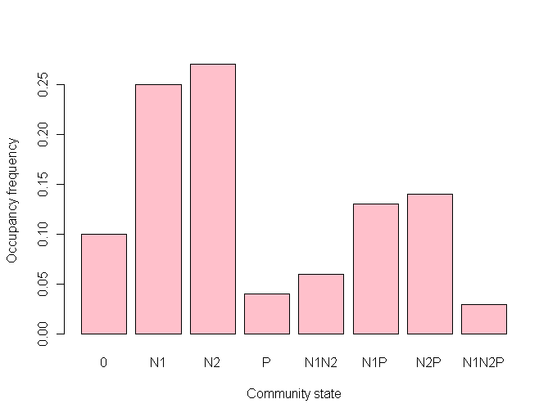
Markov matrix model output

Slide 30

Agent based modeling methods

Slide 31
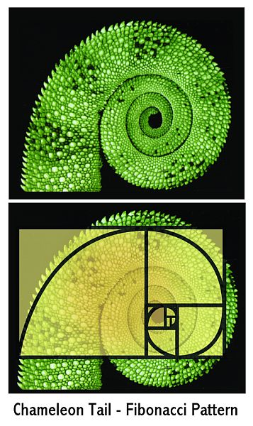
Pattern Oriented Modeling (from Grimm and Railsback 2005)
Use patterns in nature to guide model structure (scale, resolution, etc…)
Use multiple patterns to eliminate certain model versions
Use patterns to guide model parameterization

Slide 32
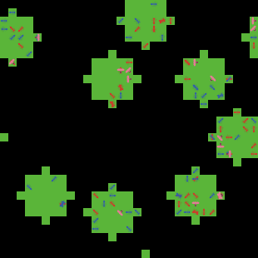
ABM example

Slide 33
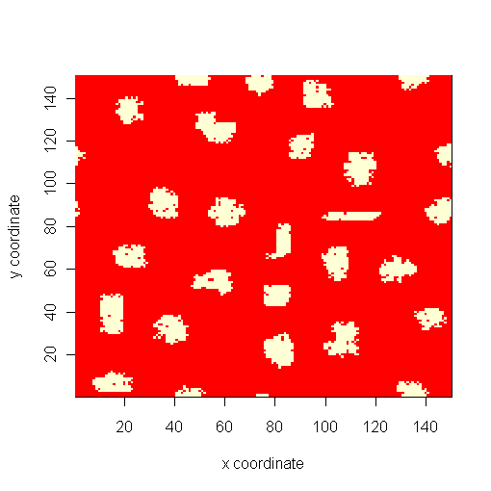
Randomly generated metacommunity patches by ABM
150 x 150 cell randomly generated
metacommunity, patches are
between 60 and 150 cells of a single resource (patch dynamic), with a minimum buffer of 15 cells.
Initial state of 200 N1 and N2 and 15 P
all randomly placed on habitat patches.
All models runs had to be 2000 time steps long in order to be analyzed.

Slide 34
Community Assembly Rules
Single-step assembly & disassembly
Single-step disturbance & community collapse
Species-specific colonization potential
Community persistence (= resistance)
Forbidden Combinations & Competition Rules
Overexploitation & Predation Rules
Miscellaneous Assembly Rules

Slide 35
Competition Assembly Rules
N₁ is an inferior competitor to N₂
N₁ is a superior colonizer to N₂
N₁ N₂ is a “forbidden combination”
N₁ N₂ collapses to N₂ or to 0, or adds P
N₁ cannot invade in the presence of N₂
N₂ can invade in the presence of N₁

Slide 36
Predation Assembly Rules
P cannot persist alone
P will coexist with N₁ (inferior competitor)
P will overexploit N₂ (superior competitor)
N₁ can persist with N₂ in the presence of P
P has a higher capture probability, lower handling time and gains more energy from N₂ than N₁

Slide 37
Miscellaneous Assembly Rules
Disturbances relatively infrequent (p = 0.006 per time step)
Colonization potential: N₁ > N₂ > P
Persistence potential: N₁ > PN₁ > N₂ > PN₂ > PN₁N₂
Matrix column sums = 1.0

Slide 38
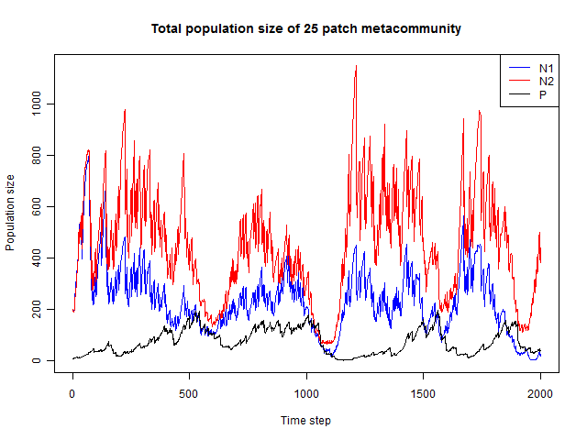
ABM Output

Slide 39
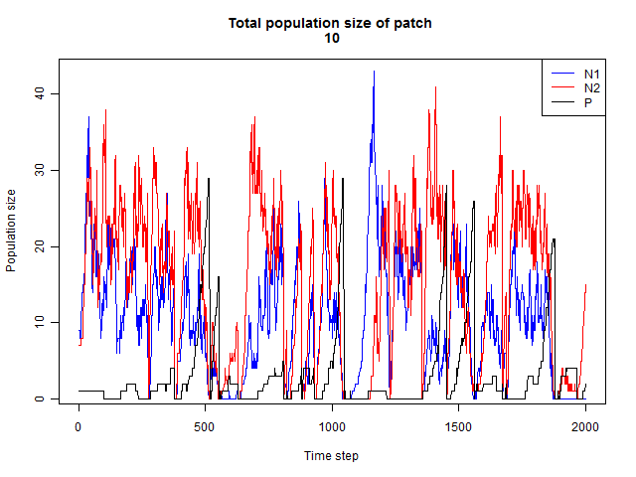
ABM Output

Slide 40
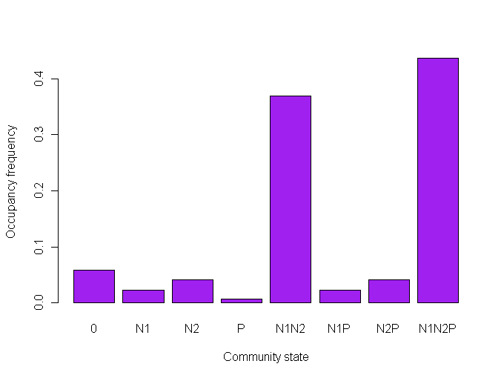
ABM community frequency output
The average occupancy for all patches of 12 runs of a 25 patch metacommunity for 2000 times-steps

Slide 41
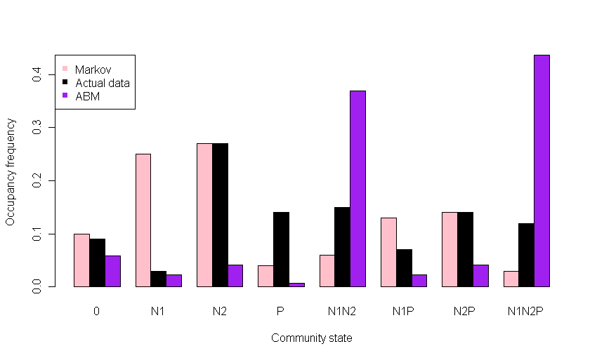
Testing Model Predictions

Slide 42
Why the poor fit? – Markov models
“Forbidden combinations”, and low predator colonization
High colonization and resistance probabilities
dictated by assembly rules

Slide 43
Why the poor fit? – ABM
Species constantly dispersing from predator free
source habitats allowing rapid colonization of habitats,
and rare occurence of single species patches
Predators disperse after a patch is totally exploited

Slide 44
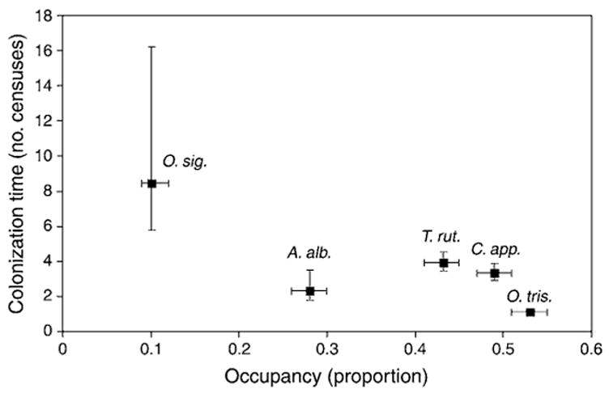
Metacommunity dynamics of tree hole mosquitos
Ellis et al found elements of life history trade offs, but also strong correlations between species and habitat, indicating species-sorting
Ellis, A. M., L. P. Lounibos, and M. Holyoak. 2006. Evaluating the long-term metacommunity dynamics of tree hole mosquitoes. Ecology 87: 2582-2590.

Slide 45
Advantages of each model
Markov matrix models | Agent based models
Easy to parameterize with empirical data because there are few parameters to be estimated | Can simulate very specific elements of ecological systems, species biology and spatial arrangements,
Easy to construct and don’t require very much computational power | Can be used to explicitly test mechanisms of coexistence such as metacommunity models (e.g. patch-dynamics)
Have well defined mathematical properties from stage based models (e. g. elasticity and sensitivity analysis ) | Allow for the emergence of unexpected system level behavior
Good at making predictions for simple future scenarios such as the introduction or extinction of a species to the metacommunity | Good at making predictions for both simple and complex future scenarios .

Slide 46
Disadvantages of each model
Markov matrix models | Agent based models
Models can be circular, using data to parameterize could be uninformative | Can be difficult to write, require a reasonable amount of programming background
Non-spatially explicit and assume only one method of colonization: island-mainland | Are computationally intensive, and cost money to be run on large computer clusters
Not mechanistically informative. All processes (fecundity, recruitment, competition etc…) compounded into a single transition probability. | Produce massive amounts of data that can be hard to interpret and process.
Difficult to parameretize for non-sessile organisms. | Require lots of in depth knowledge about the individual properties of all aspects of a community

Slide 47
Concluding thoughts…
Models constructed using simple assembly rules just don’t cut it.
Need to parameretized with actual data or have a more complicated set of assumptions built in.
Using similar assembly rules, Markov models and ABM’s produce different outcomes.
Differences in how space and time are treated
Differences in model assumptions (e.g. colonization)
Given model differences, modelers should choose the right method for their purpose

Slide 48
Acknowledgements
Markov matrix modeling
Nicholas J. Gotelli – University of Vermont
Mosquito data
Phil Lounibos – Florida Medical Entomology Lab
Alicia Ellis - University of California – Davis
Computing resources
James Vincent – University of Vermont
Vermont Advanced Computing Center
Funding
Vermont EPSCoR

Slide 49
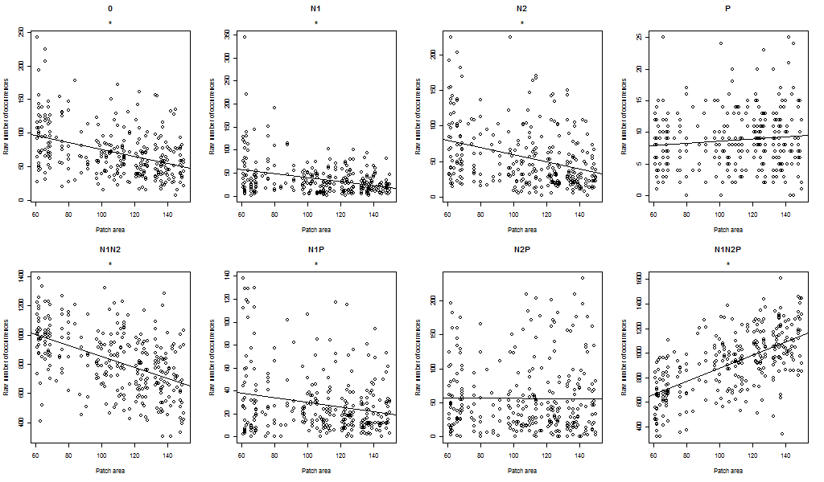
ABM Output
Influence of patch size on time spent in a community state

Slide 50
ABM Parameterization
Model Element | Parameter |  |  | Parameter Type | Parameter Value
Global | X-dimension |  |  | Scalar | 150
 | Y Dimension |  |  | Scalar | 150
Patch | Patch Number |  |  | Scalar | 25
 | Patch size |  |  | Uniform integer | (60,150)
 | Buffer distance |  |  | Scalar | 15
 | Maximum energy |  |  | Scalar | 20
 | Regrowth rate
 |  | Occupied |  | Fraction of Max. energy | 0.1
 |  | Empty |  | Fraction of occupied rate | 0.5
 | Catastrophe |  |  | Scalar probability | 0.008

Slide 51
ABM Parameterization
Model Element | Parameter |  | Parameter Type | Parameter Value
Animals |  |  |  | N1 | N2 | P
 | Body size |  | Scalar | 60 | 60 | 100
 | Capture failure cost |  | Uniform fraction of current energy | NA | NA | 0.9
 | Capture difficulty |  | Uniform probability | (0.5,0.53) | (0.6,0.63) | NA
 | Competition rate |  | Uniform fraction of feeding rate | (1,1) | (0,0.2) | NA
 | Conversion energy |  | Gamma | (37,3) | (63,3) | NA
 | Dispersal distance |  | Gamma | (20,1) | (27,2) | (20,1.6)
 | Dispersal penalty |  | Uniform fraction of current energy | 0.7 | 0.7 | 0.87
 | Feeding Rate |  | Uniform | (5,6) | (5,6) | NA
 | Handling time |  | Uniform integer | (8,10) | (4,7) | NA
 | Life span |  | Scalar | 60 | 60 | 100
 | Movement cost |  | Uniform fraction of current energy | .9 | .9 | .92
 | Reproduction cost |  | Scalar | 20 | 20 | 20
 | Reproduction energy |  | Scalar | 25 | 25 | 25

Slide 52
ABM Model Schedule
Time t | Individuals move on their patch
N1 and N2 Compete | Patches regrow
Predation | Individual death occurs
Extinction/Catastrophe | Reproduction
N1 and N2 Feed | Ageing
All individuals disperse | Time t + 1

