Slide 1
Review of Cell Biology
ChemEng 590B: Tissue Engineering
Lecture 2
January 24th, 2013

Slide 2
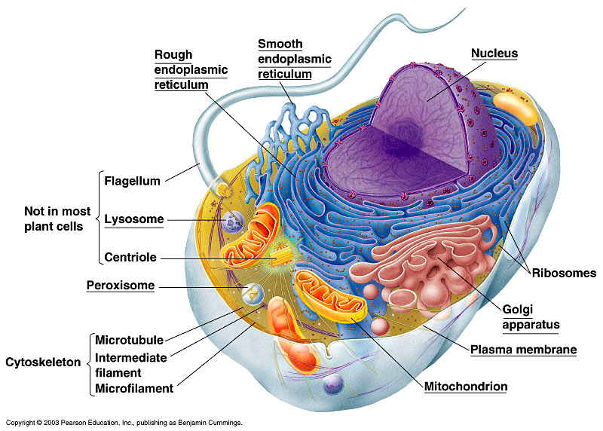
Animal Cell Structure

Slide 3
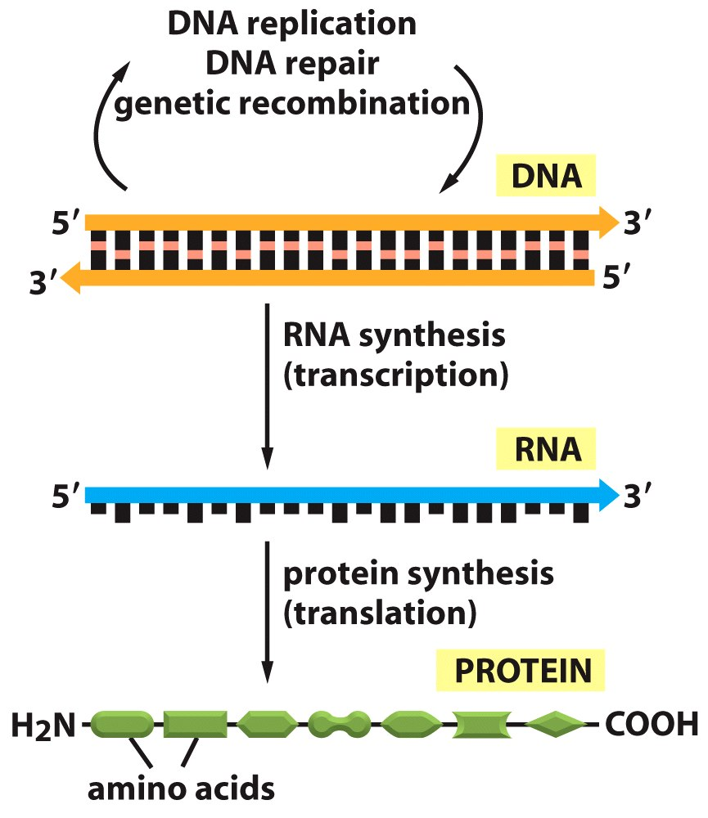
The Central Dogma of Molecular Biology
Figure 6-2 Molecular Biology of the Cell (© Garland Science 2008)

Slide 4
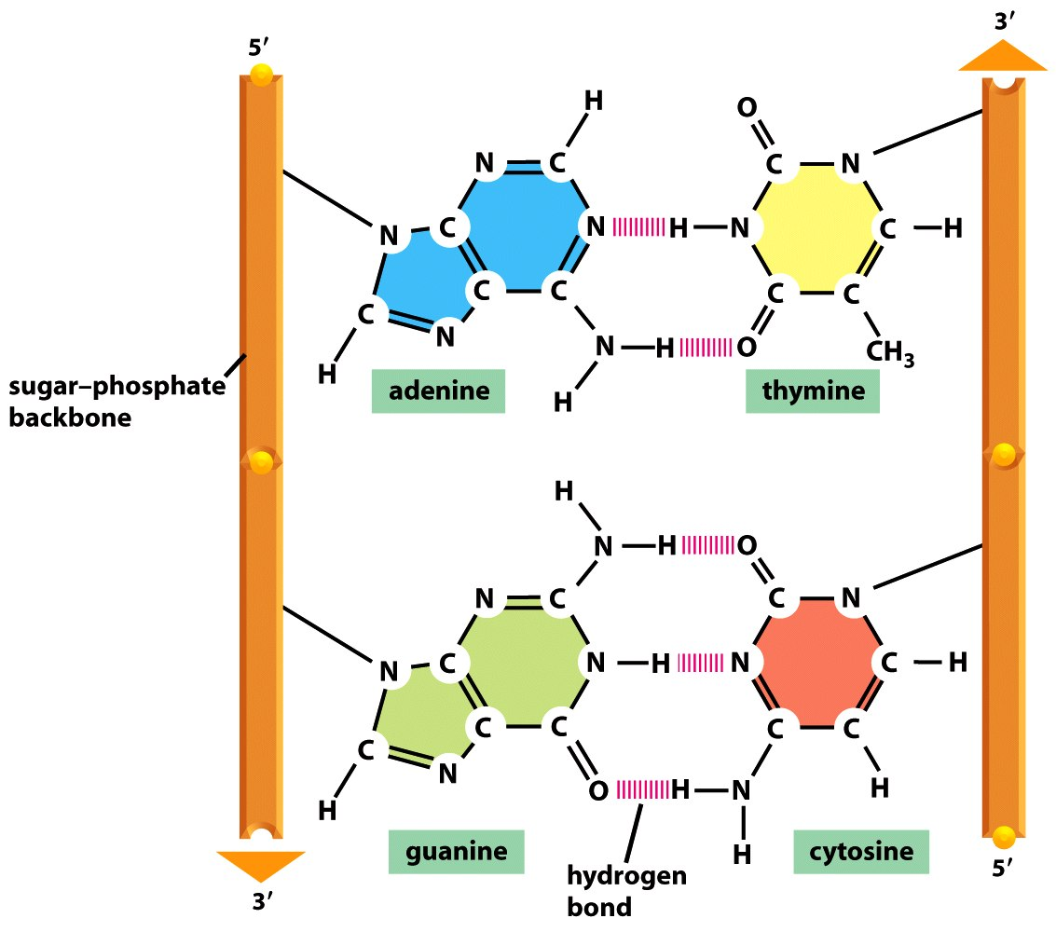
Figure 4-4 Molecular Biology of the Cell (© Garland Science 2008)

Slide 5
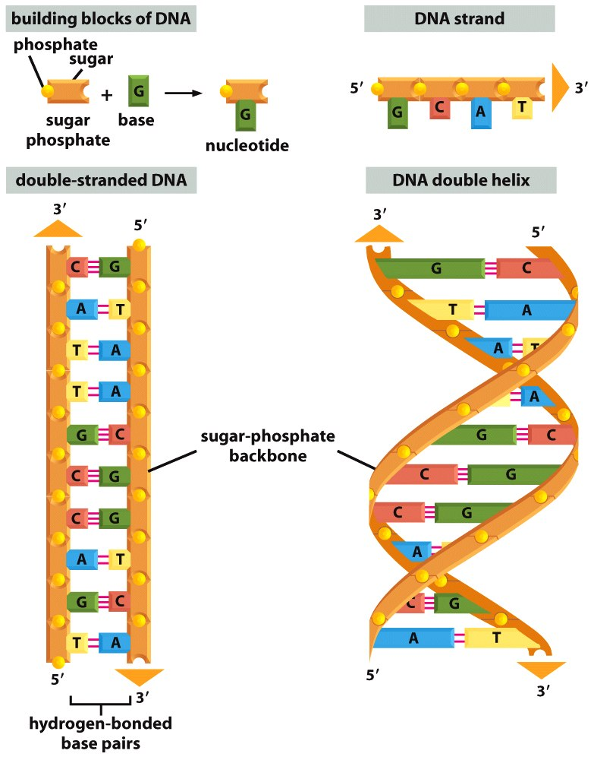
Figure 4-3 Molecular Biology of the Cell (© Garland Science 2008)

Slide 6
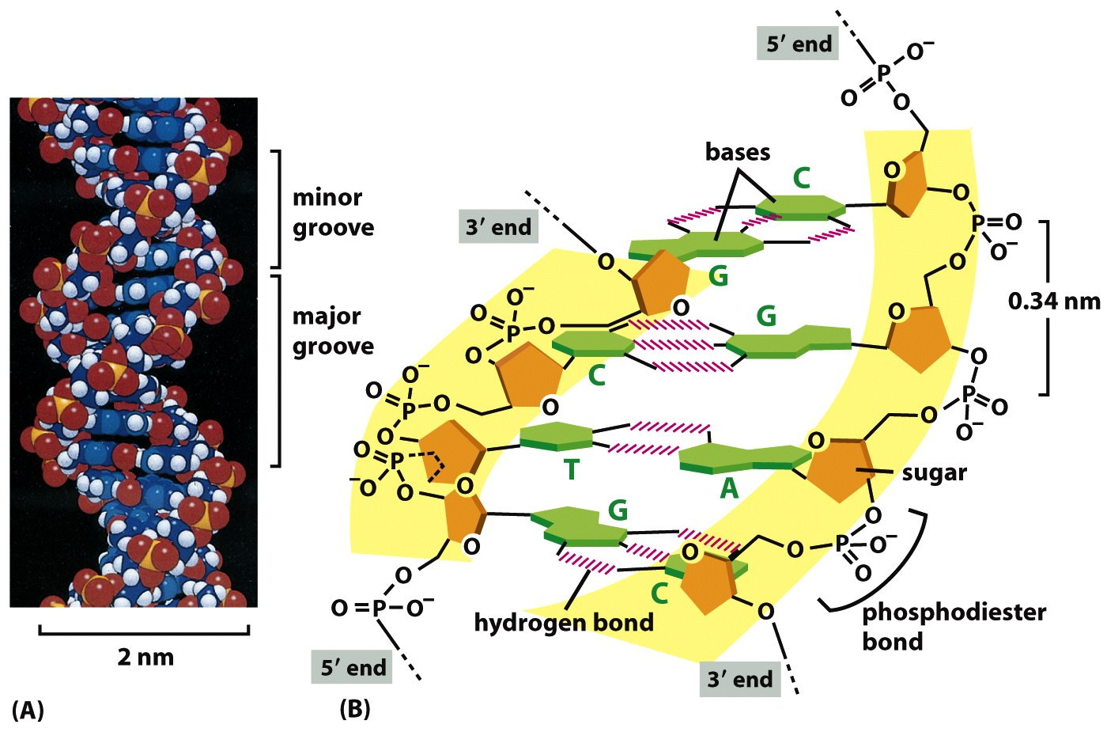
DNA forms double helix
G-C bonds are stronger than A-T bonds (3 hydrogen bonds versus 2)
Figure 4-5 Molecular Biology of the Cell (© Garland Science 2008)

Slide 7
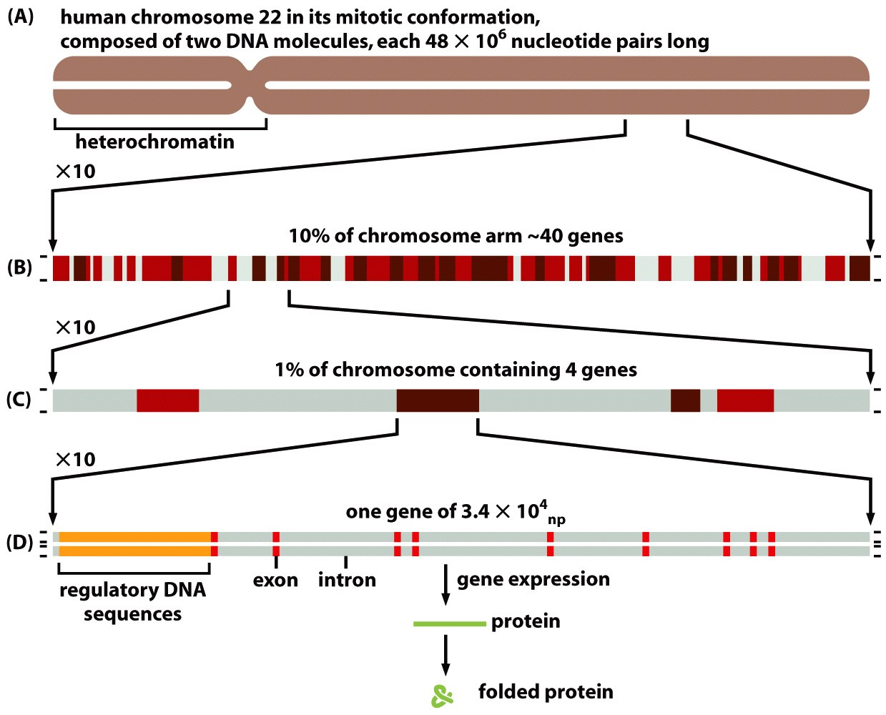
Not all DNA encodes for functional genes
Figure 4-15 Molecular Biology of the Cell (© Garland Science 2008)

Slide 8
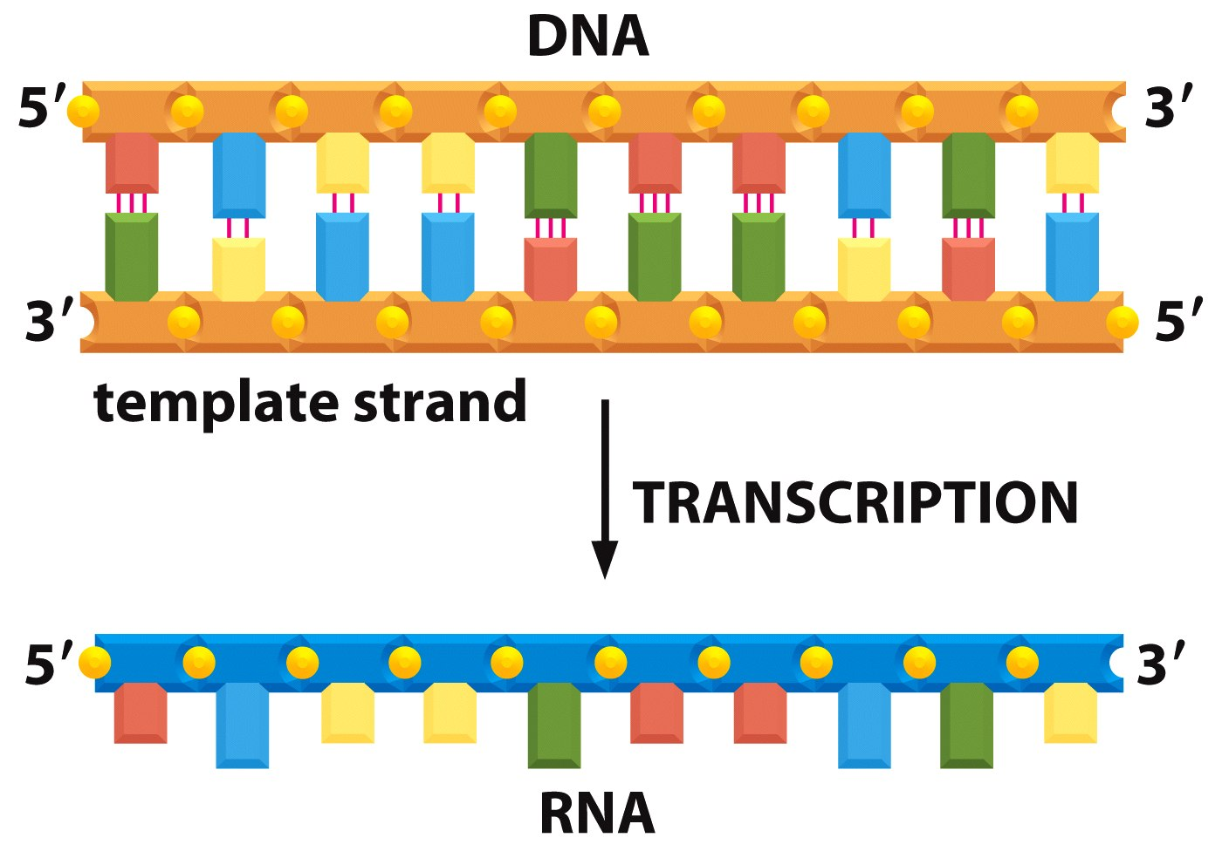
DNA-RNA Transcription
Figure 6-7 Molecular Biology of the Cell (© Garland Science 2008)

Slide 9
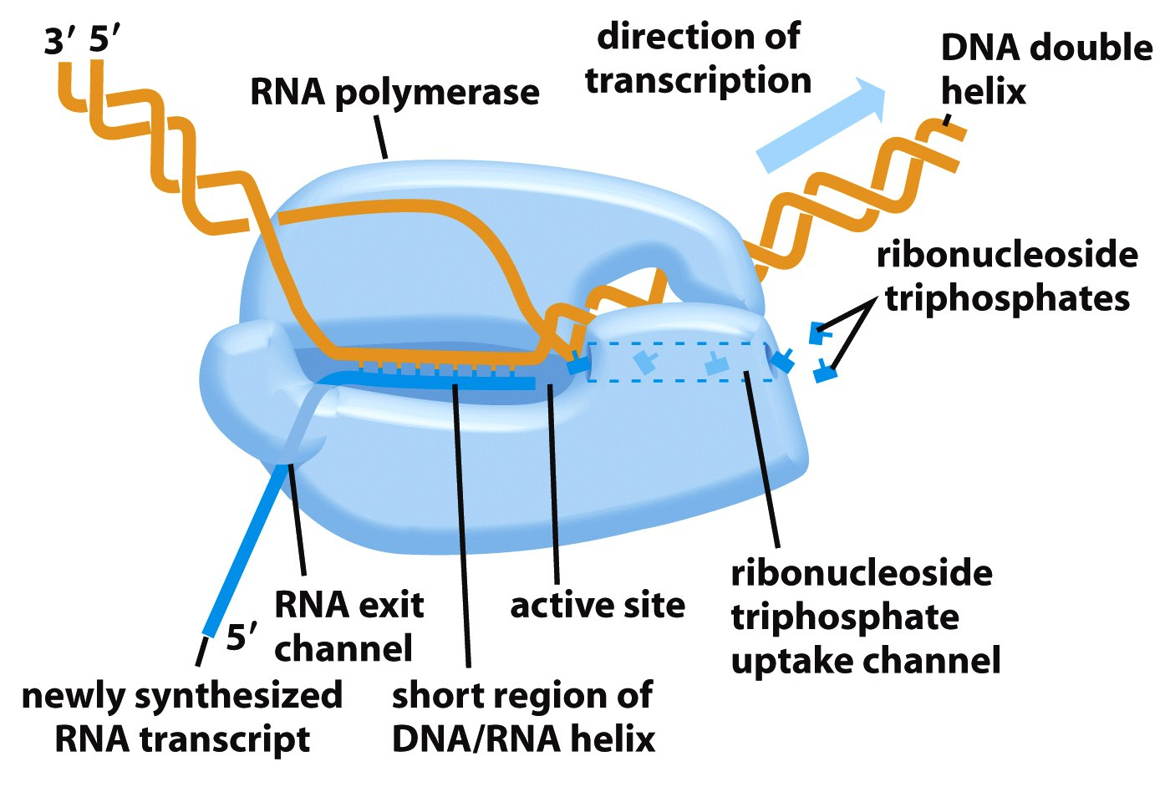
RNA Polymerase
Figure 6-8a Molecular Biology of the Cell (© Garland Science 2008)

Slide 10
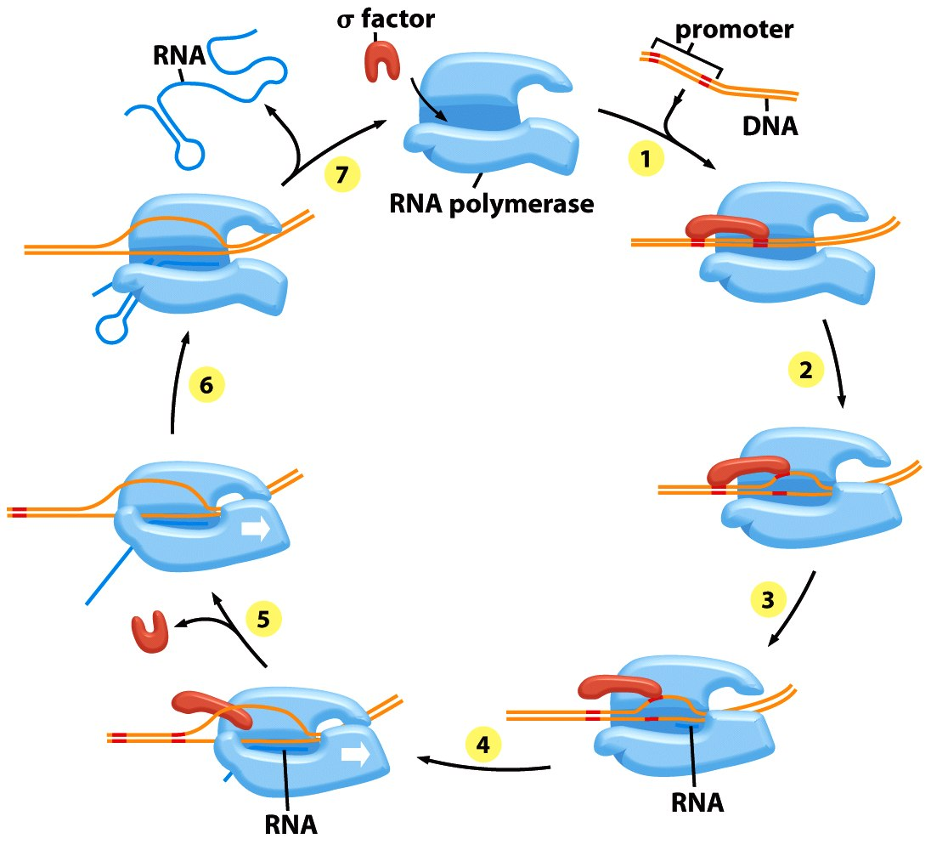
DNA Selectively Separated and Transcribed
Figure 6-11 Molecular Biology of the Cell (© Garland Science 2008)

Slide 11
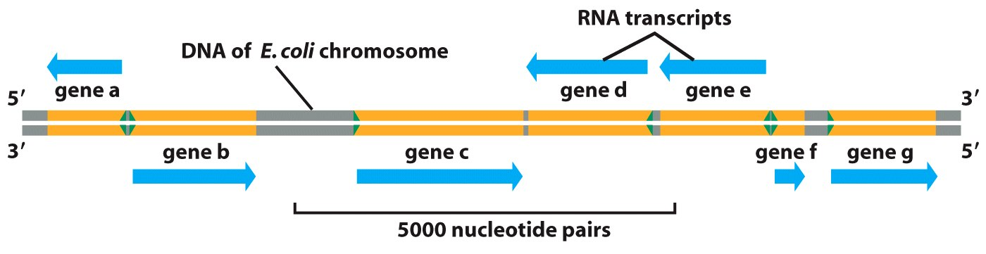
RNA polymerase can read in both directions
Figure 6-14 Molecular Biology of the Cell (© Garland Science 2008)

Slide 12
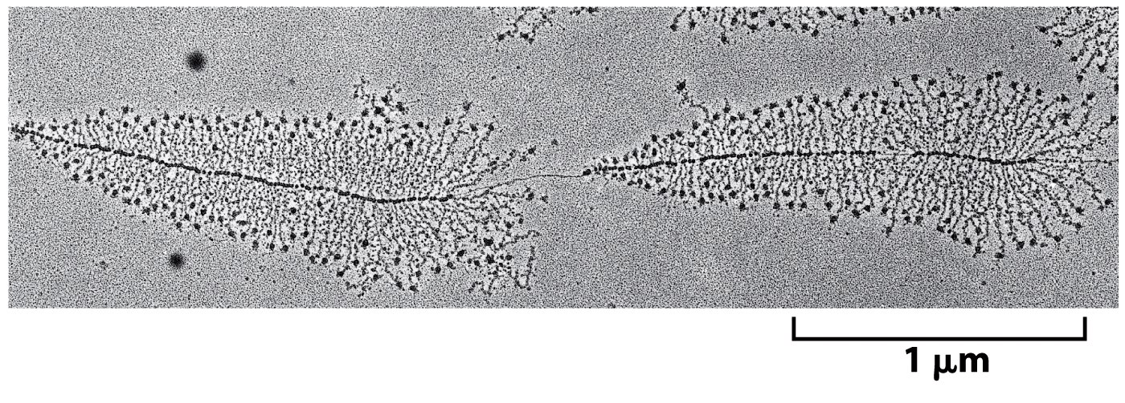
Many RNA Polymerases act at once
Figure 6-9 Molecular Biology of the Cell (© Garland Science 2008)

Slide 13
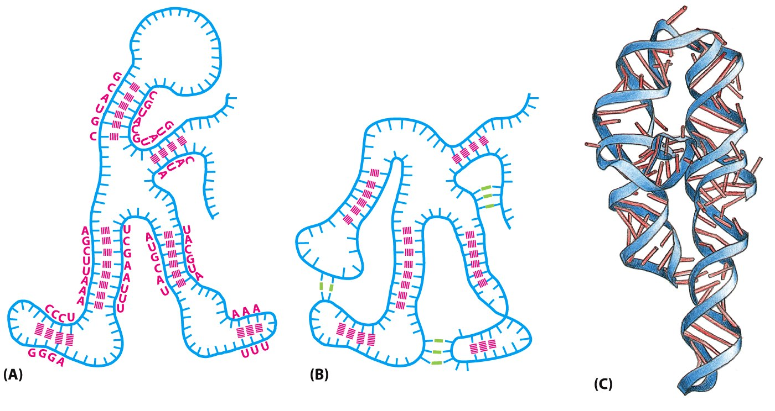
RNA forms functional secondary structures
Figure 6-6 Molecular Biology of the Cell (© Garland Science 2008)

Slide 14
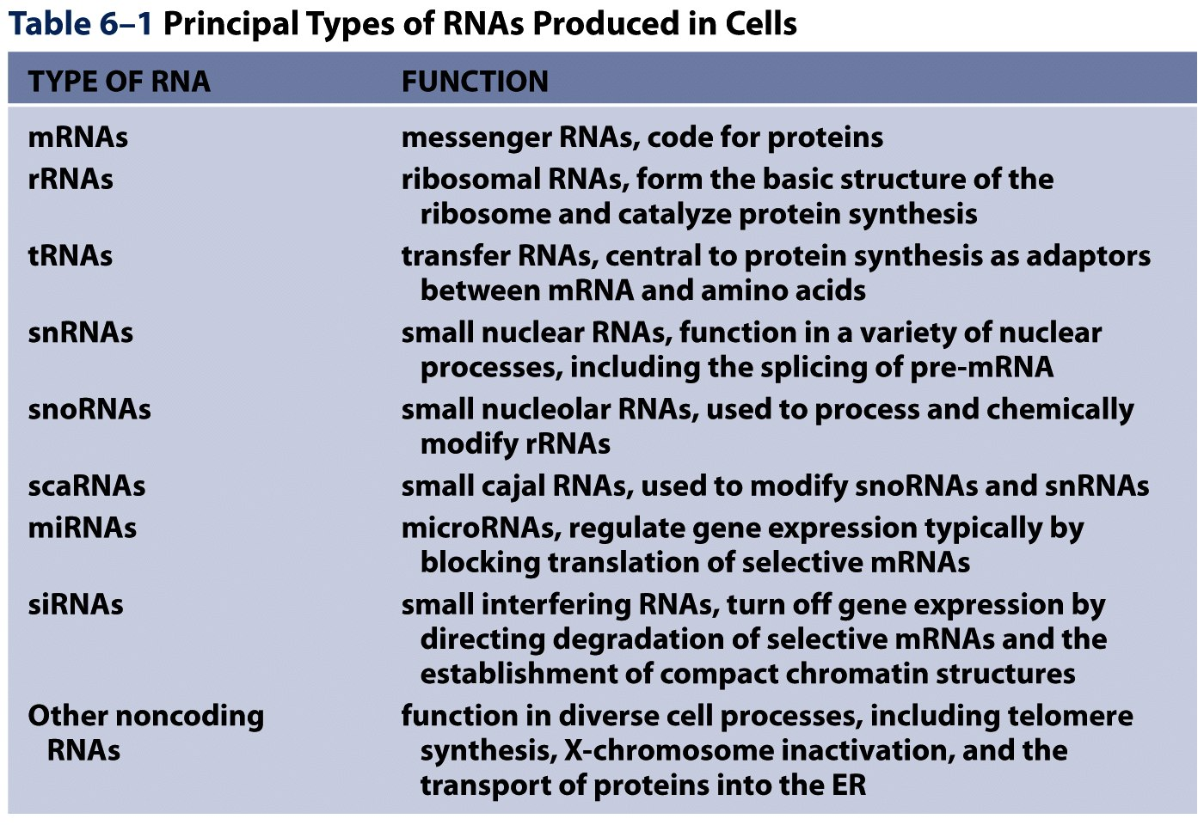
Table 6-1 Molecular Biology of the Cell (© Garland Science 2008)

Slide 15
The Central Dogma of Molecular Biology
Figure 6-2 Molecular Biology of the Cell (© Garland Science 2008)

Slide 16
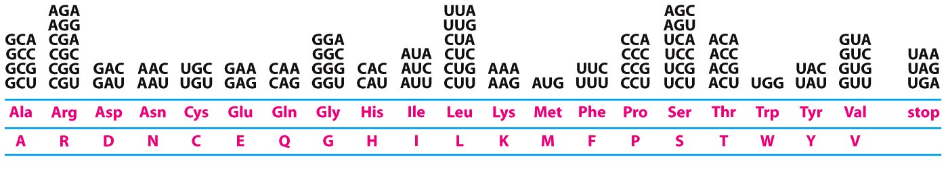
Multiple Codons for most Amino Acids
Figure 6-50 Molecular Biology of the Cell (© Garland Science 2008)

Slide 17
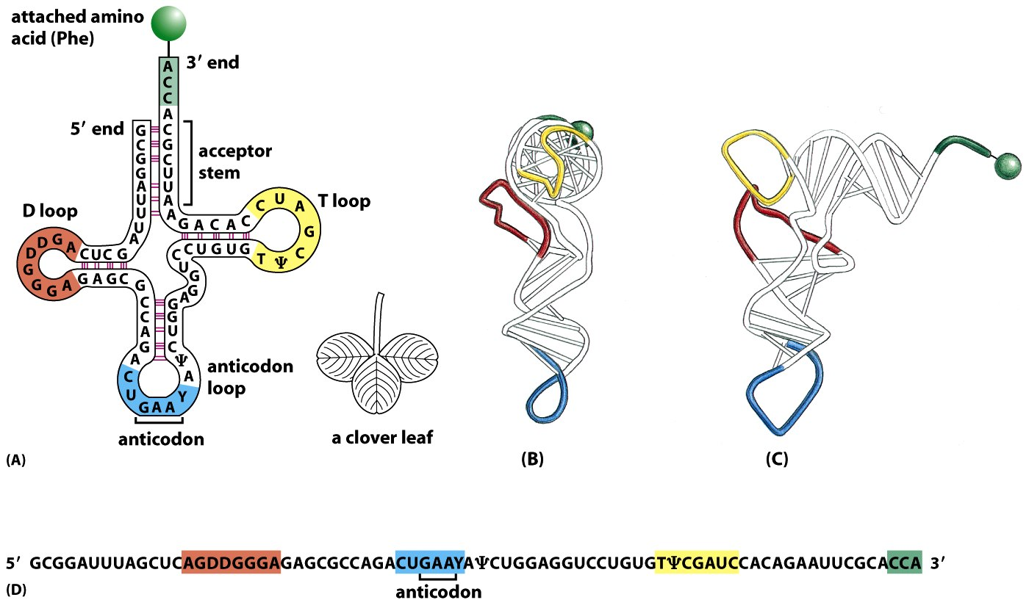
tRNA structure and codon translation
Figure 6-52 Molecular Biology of the Cell (© Garland Science 2008)

Slide 18
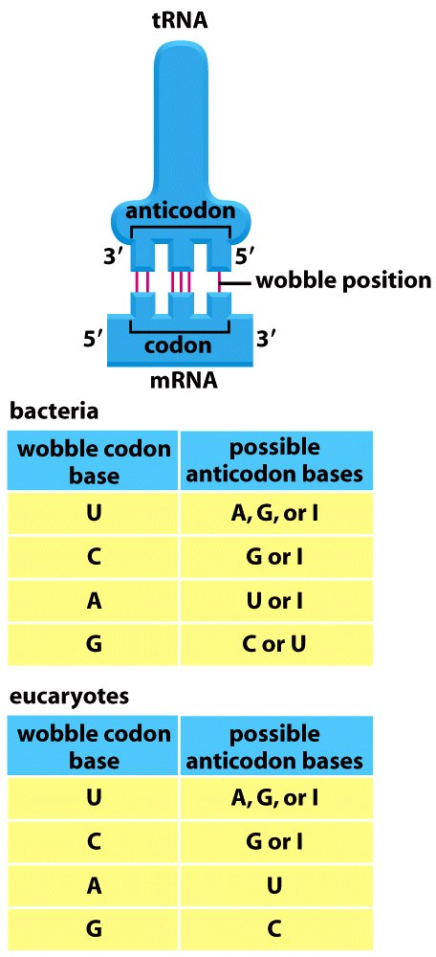
Codons, Anticodons, and Wobbles
Figure 6-53 Molecular Biology of the Cell (© Garland Science 2008)

Slide 19
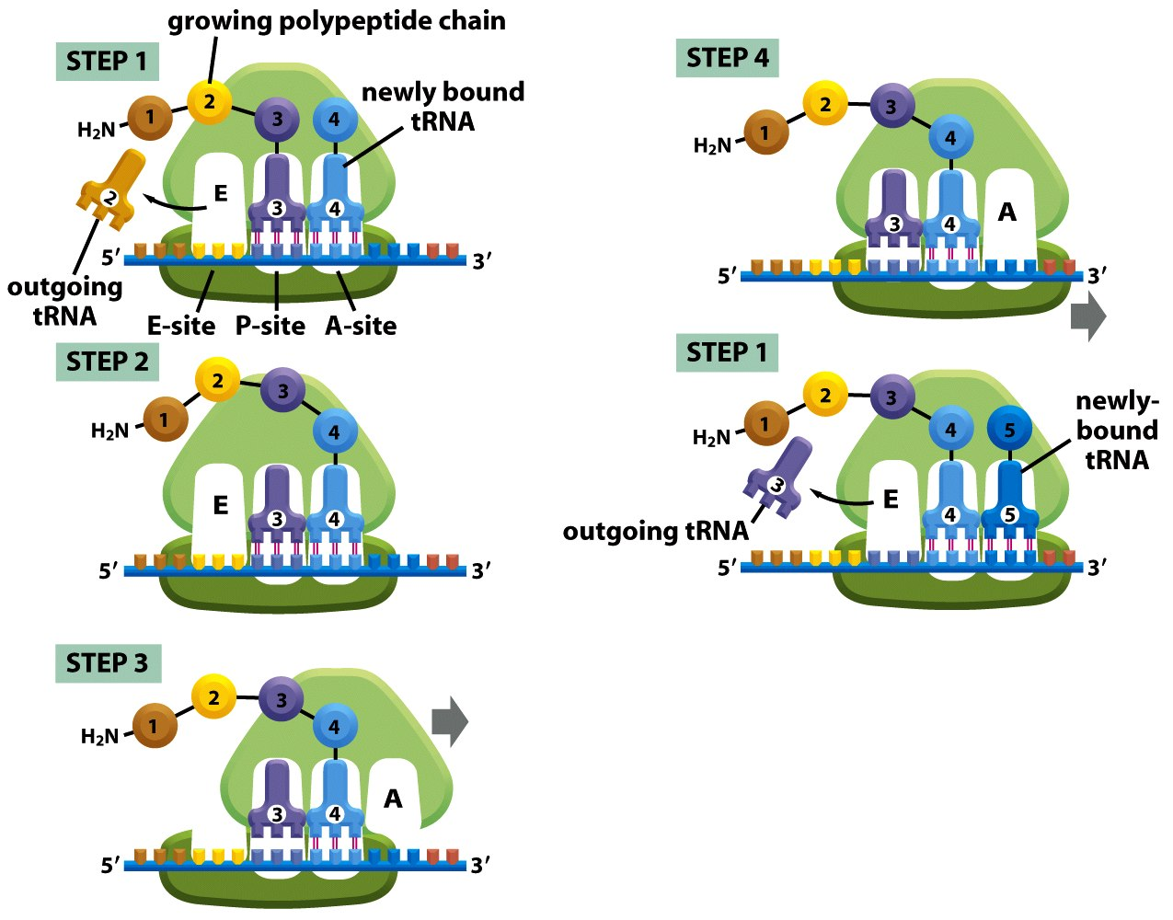
Translation movement from N-C term. inside ribosome
Figure 6-66 Molecular Biology of the Cell (© Garland Science 2008)

Slide 20
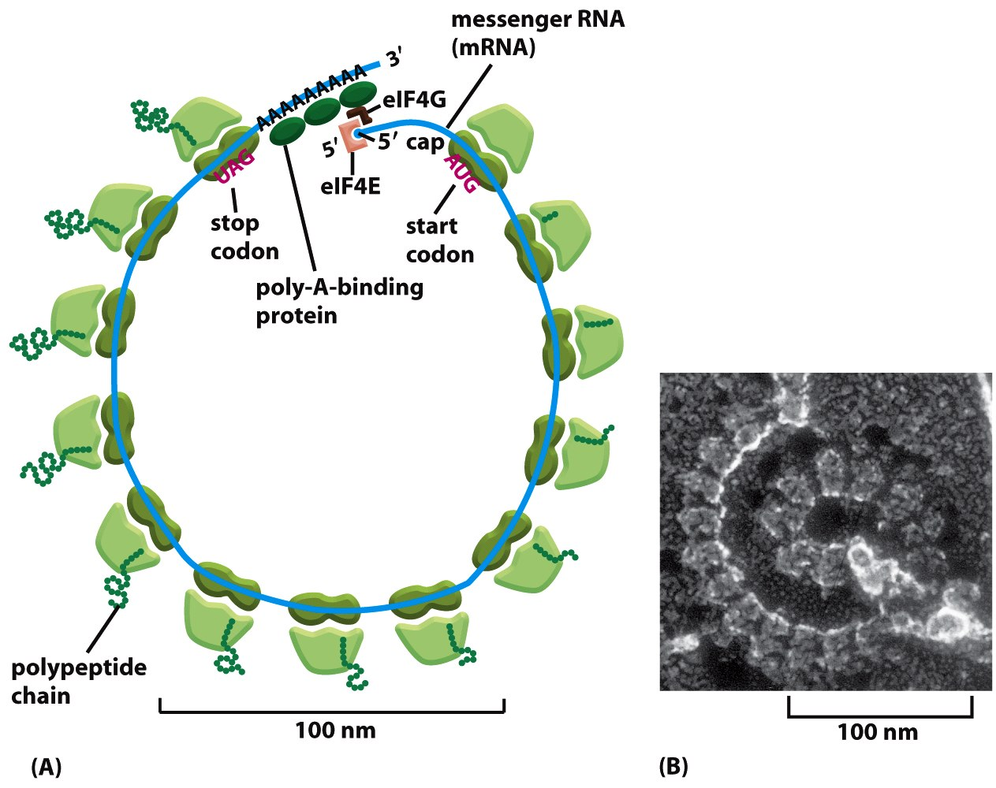
Multiple Ribosomes can be bound to RNA at once for rapid protein production
Figure 6-76 Molecular Biology of the Cell (© Garland Science 2008)

Slide 21
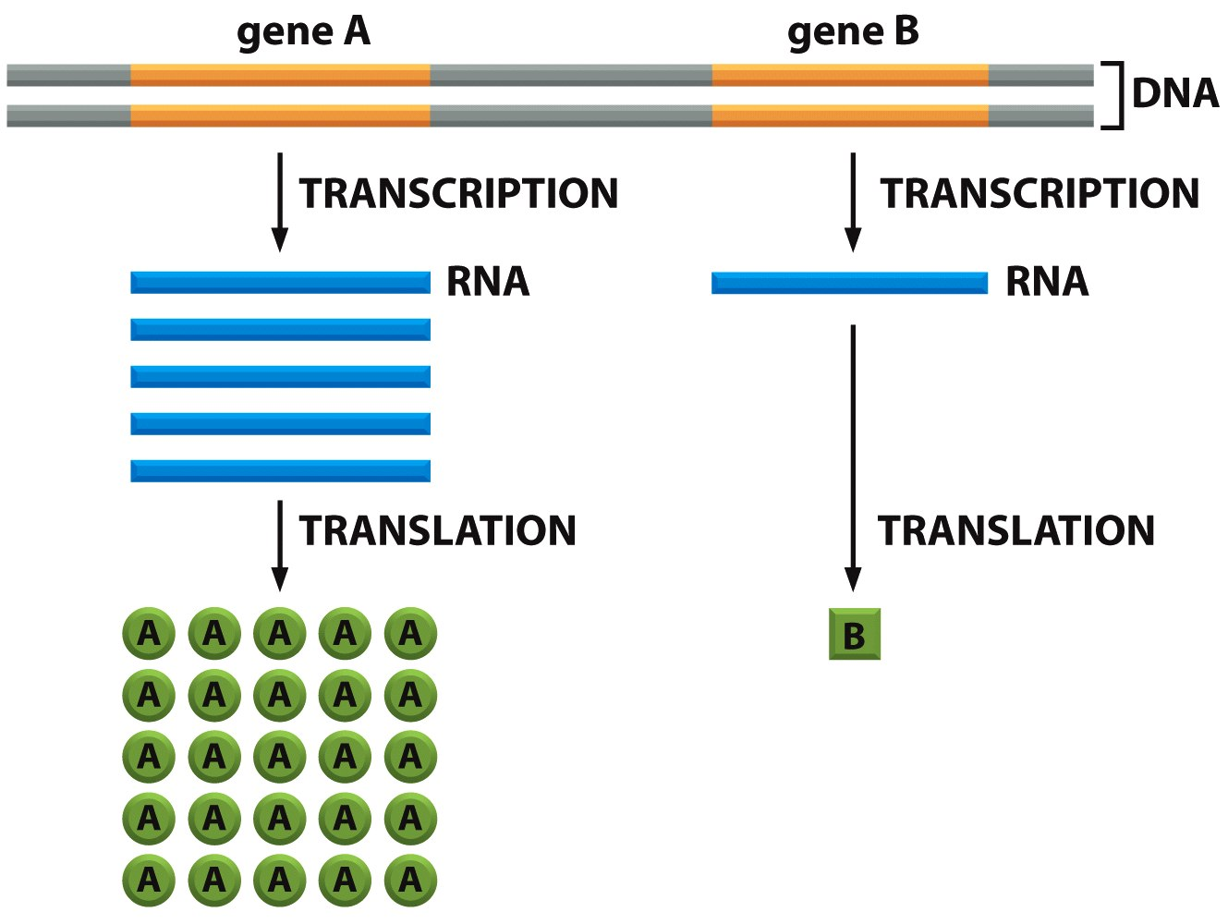
Transcription can be internally regulated
Figure 6-3 Molecular Biology of the Cell (© Garland Science 2008)

Slide 22
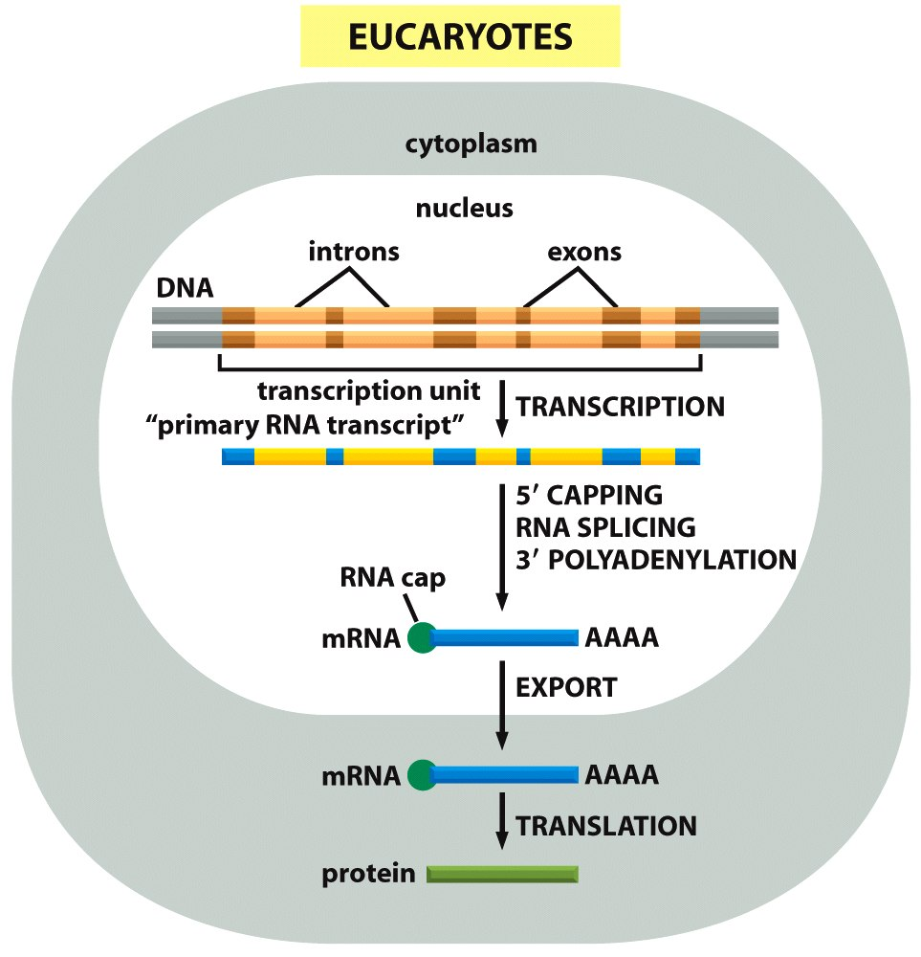
Transcription and Translation Compartmentalized
Figure 6-21a Molecular Biology of the Cell (© Garland Science 2008)

Slide 23
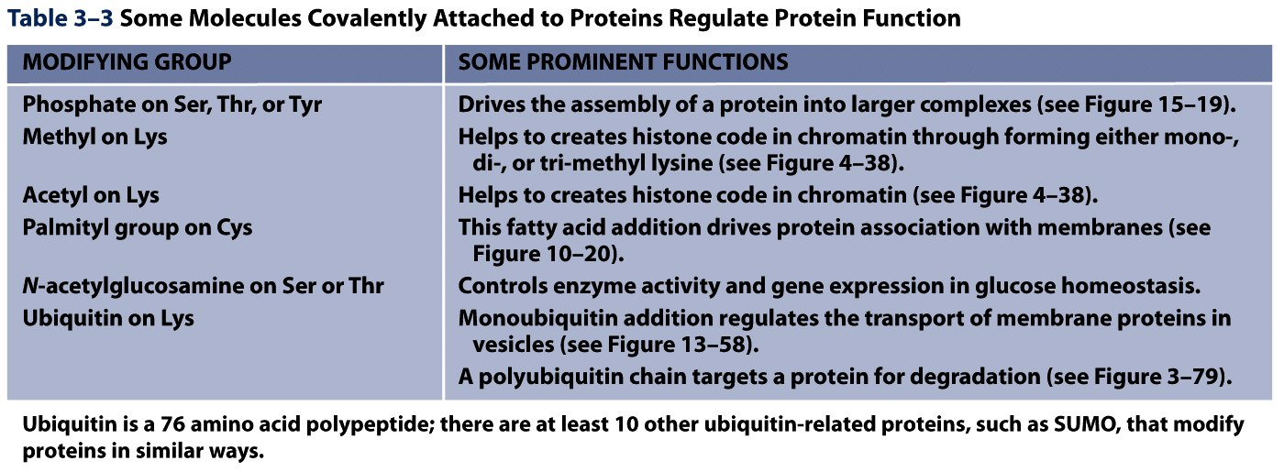
3rd layer of complexity: post-translational modifications
Table 3-3 Molecular Biology of the Cell (© Garland Science 2008)

Slide 24
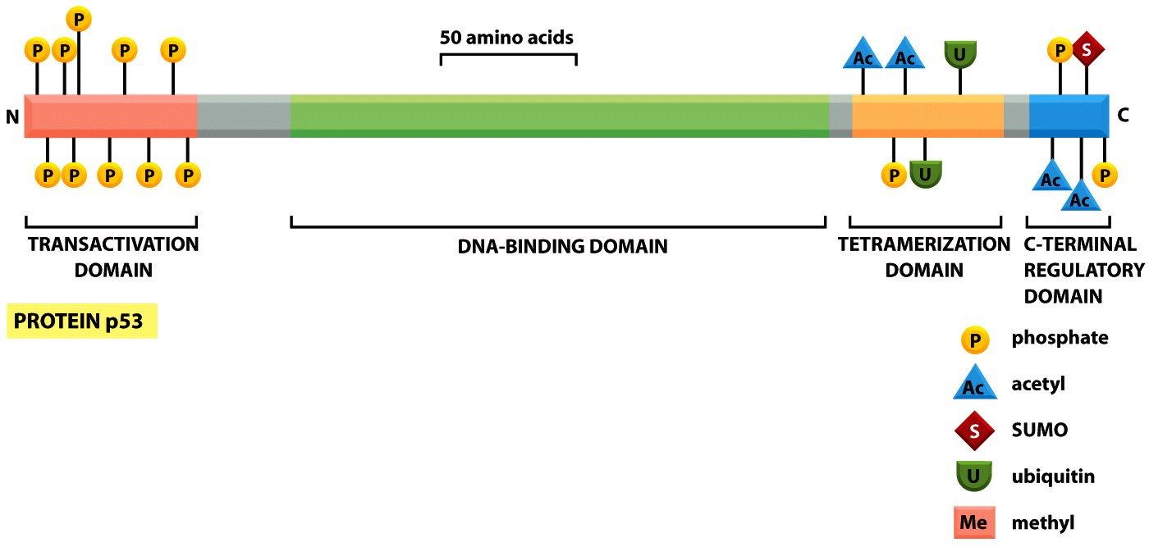
Figure 3-81a Molecular Biology of the Cell (© Garland Science 2008)

Slide 25
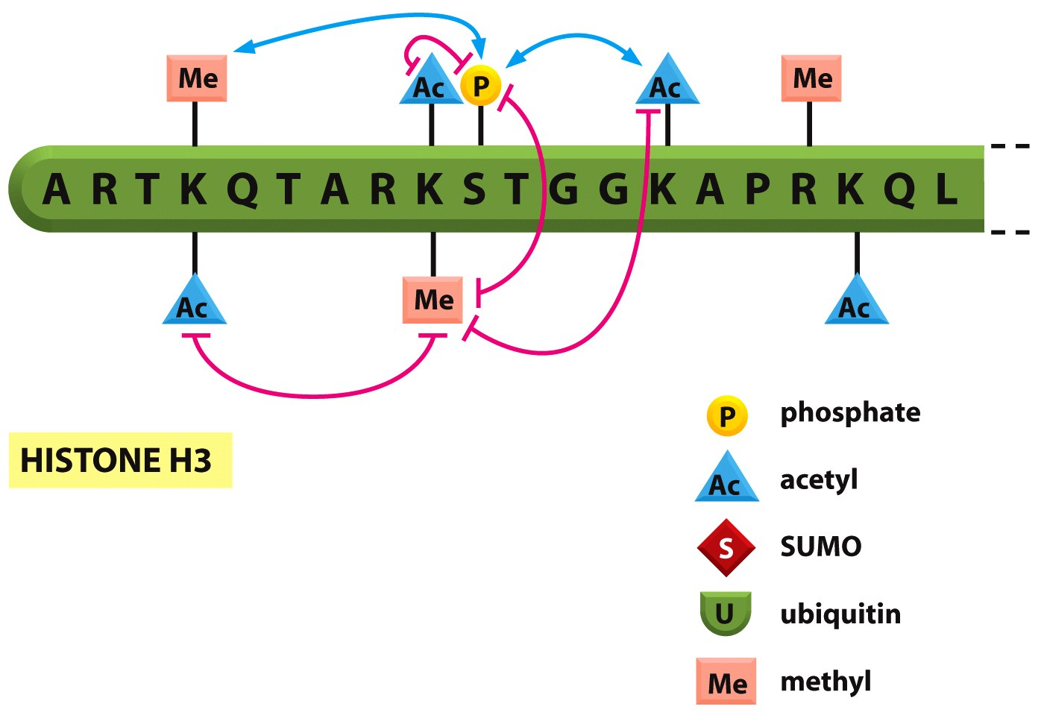
Figure 3-81b Molecular Biology of the Cell (© Garland Science 2008)

Slide 26
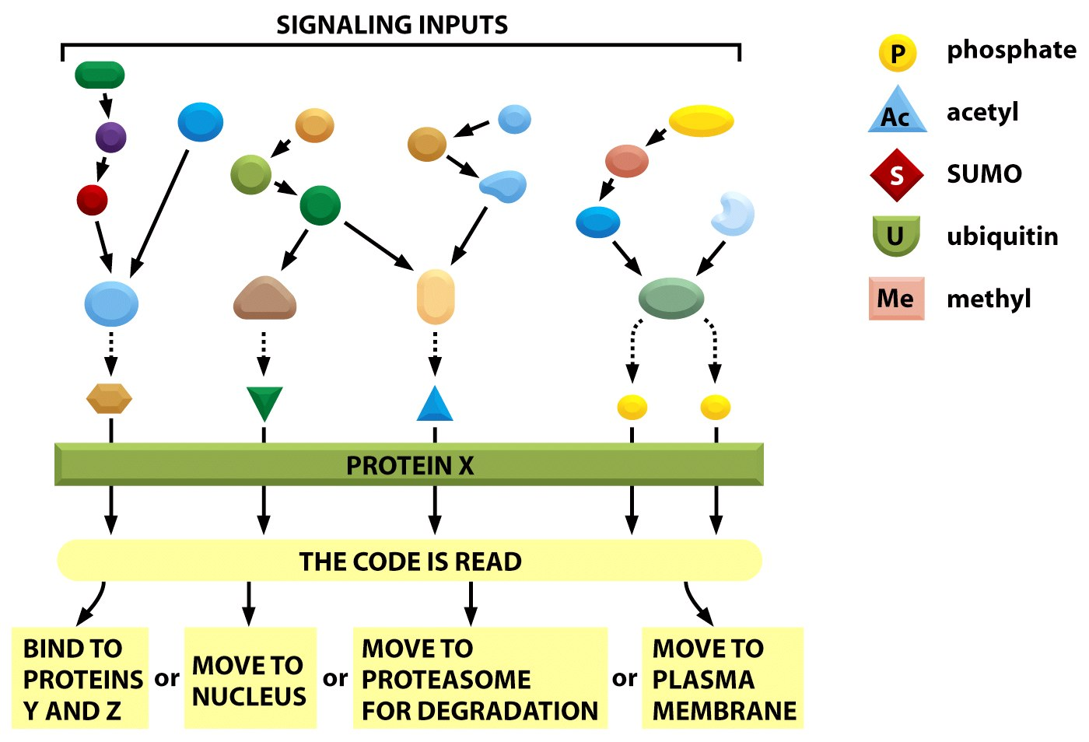
Figure 3-81c Molecular Biology of the Cell (© Garland Science 2008)

Slide 27
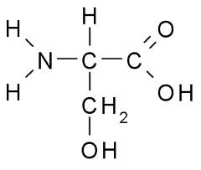
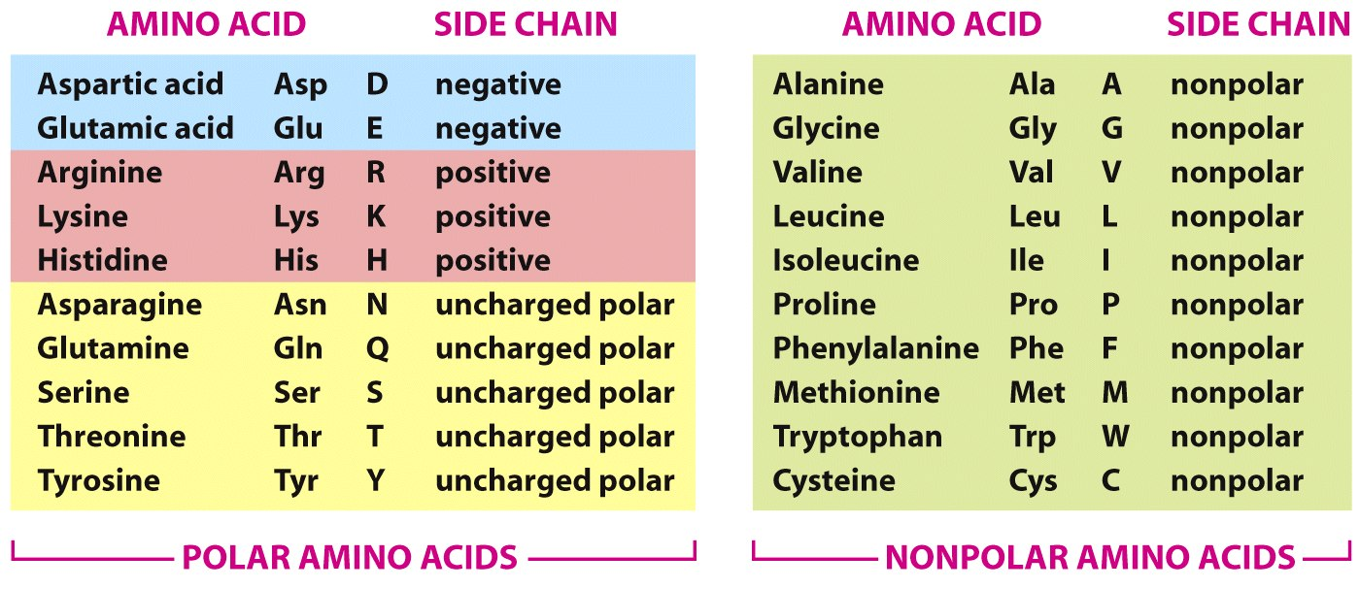
PROTEINS. Made from amino acid building blocks
R
Figure 3-2 Molecular Biology of the Cell (© Garland Science 2008)

Slide 28
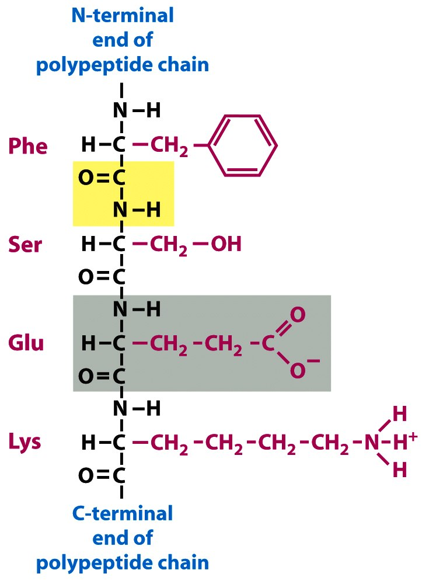
R
Small: peptide
Long: proteins
Single AA: monomer
Protein: polymer
Peptide Bond!
Figure 2-24 Molecular Biology of the Cell (© Garland Science 2008)

Slide 29
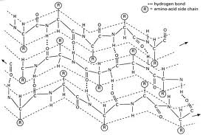
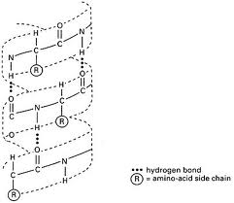
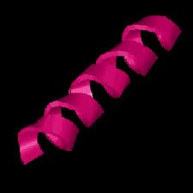
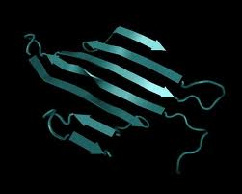
From amino acids to proteins
My favorite protein: RhoA (small GTPase)
www.ncbi.nlm.nih.gov/protein
Primary Structure
maairkklvi vgdgacgktc llivfskdqf pevyvptvfe nyvadievdg kqvelalwdt agqedydrlr plsypdtdvi lmcfsidspd slenipekwt pevkhfcpnv piilvgnkkd lrndehtrre lakmkqepvk peegrdmanr igafgymecs aktkdgvrev fematraalq arrgkkksgc lvl
Secondary Structure, α-helix and β-sheets
Dictated by primary sequence, hydrogen and disulfide bonds
Fully extended chains: NH-O interactions, aromatic residues
“MALEK”

Slide 30
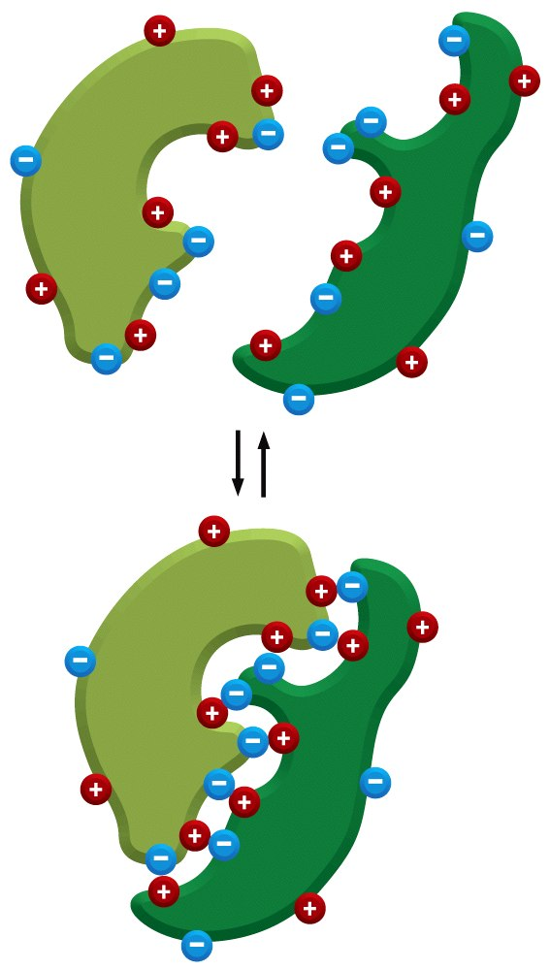
Protein structure, continued
Tertiary structure of RhoA
Final, folded protein conformation
Dictated by secondary structure and
remaining hydrogen, disulfide bonds
Quaternary Structure:
Dictated by tertiary and primary structure: What is the protein’s function?
Shimizu T et al. J. Biol. Chem. 2000;275:18311-18317

Slide 31
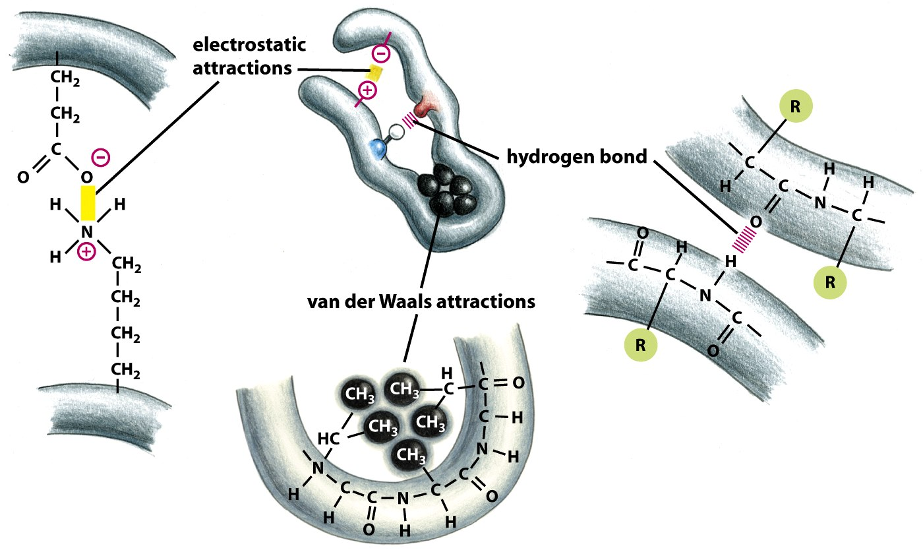
Types of amino acid interactions
Figure 3-4 Molecular Biology of the Cell (© Garland Science 2008)

Slide 32
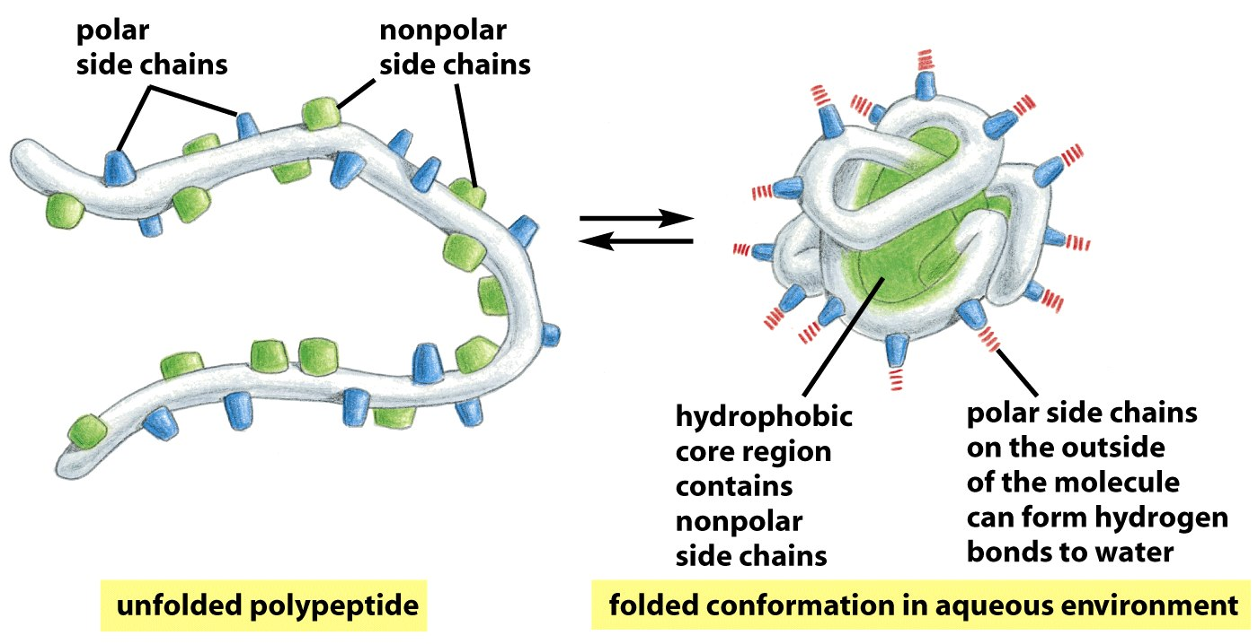
Hydrophobic “collapse”
This state is minimum Gibb’s energy in water
Figure 3-5 Molecular Biology of the Cell (© Garland Science 2008)

Slide 33
Animal Cell Structure

Slide 34
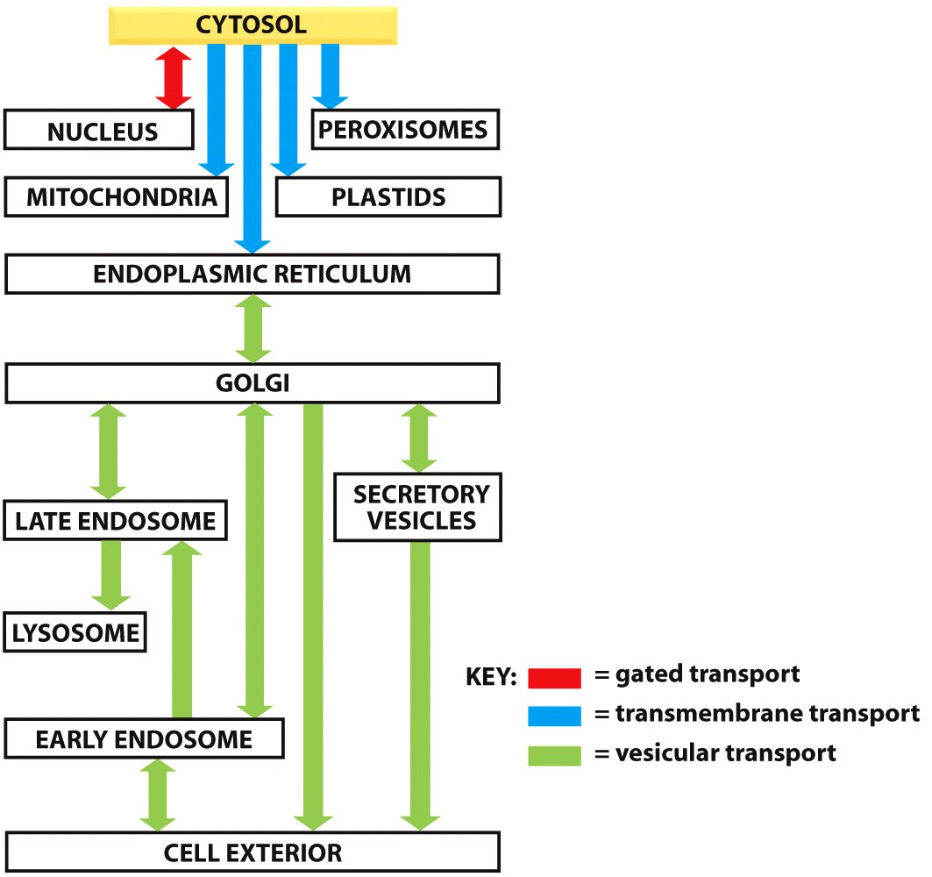
Movement of proteins between organelles is tightly controlled
Figure 12-6 Molecular Biology of the Cell (© Garland Science 2008)

Slide 35
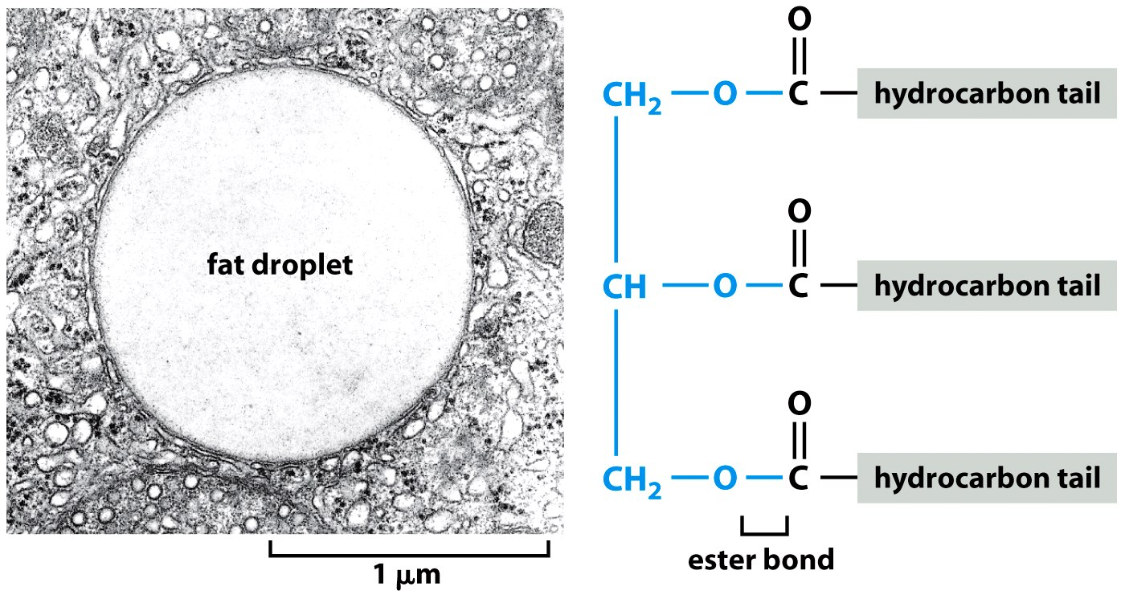
Lipid monolayers create fat vacuoles
Figure 2-81a Molecular Biology of the Cell (© Garland Science 2008)

Slide 36
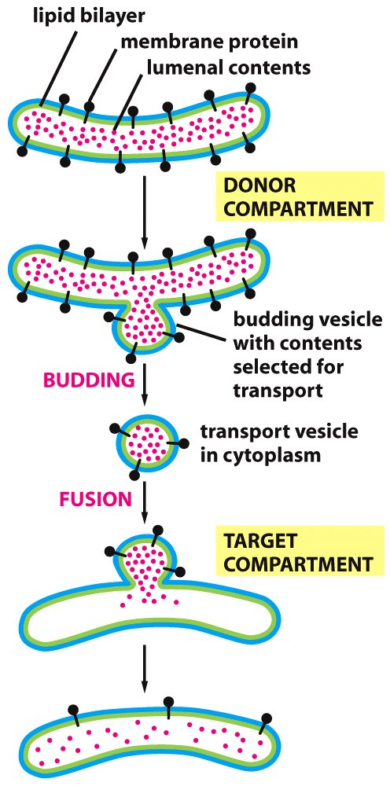
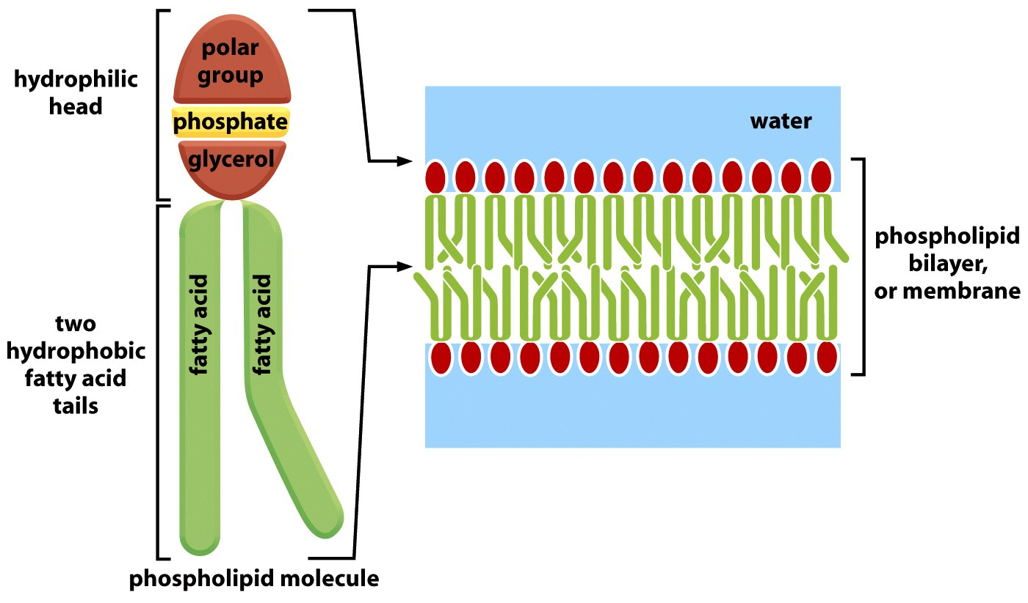
Since Organelle Membranes are Lipid Bilayers, Vesicular Transport via Budding
Figure 12-7 Molecular Biology of the Cell (© Garland Science 2008)

Slide 37
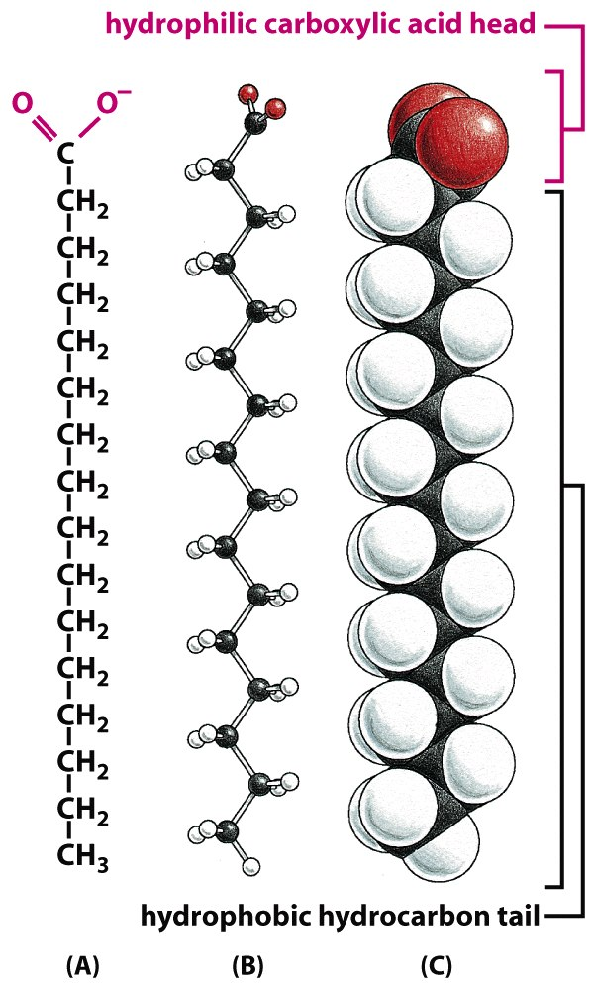
Lipids are long, saturated hydrocarbons
Figure 2-21 Molecular Biology of the Cell (© Garland Science 2008)

Slide 38
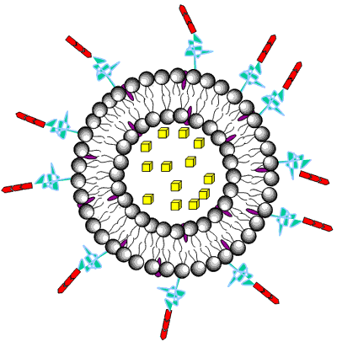
Bioengineering Micelles for drug delivery
Drug or molecule of interest
Antibody for cell specificity,
OR carrier to evade immune system
Lipid bilayer will fuse with cell membrane, emptying cargo into cell

Slide 39
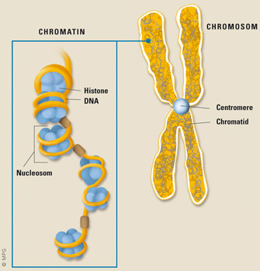
Nucleus
DNA storage, synthesis, replication
DNA tightly packed via histones into chromosomes (otw is 1.8m long!)
Connected to cytoplasm via endoplasmic reticulum

Slide 40
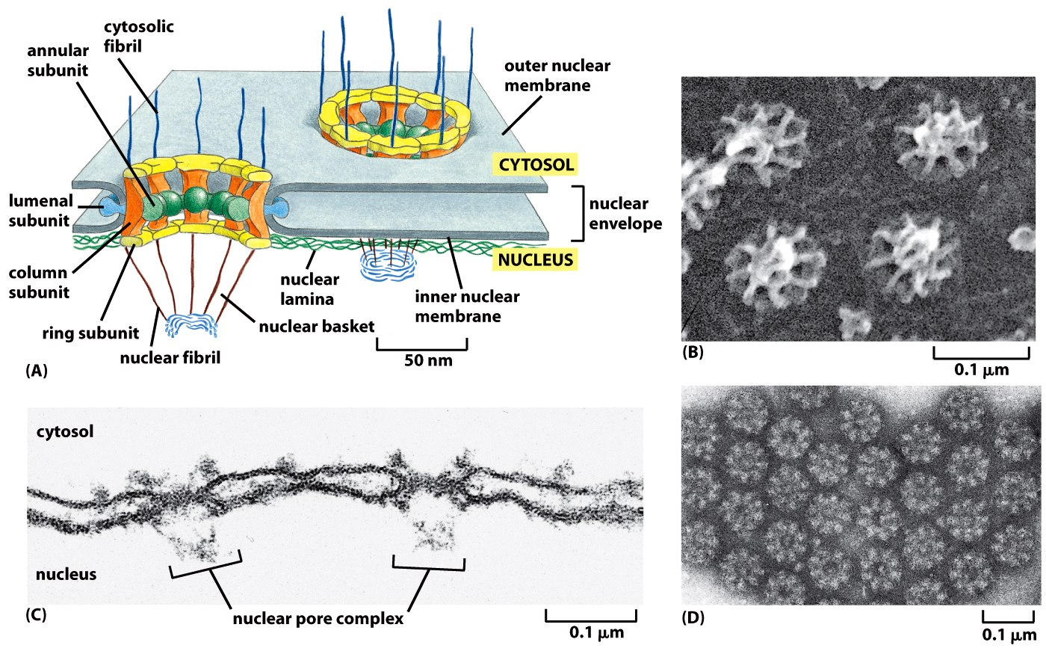
Nuclear Pore Complexes are Tightly Controlled
Figure 12-9 Molecular Biology of the Cell (© Garland Science 2008)

Slide 41
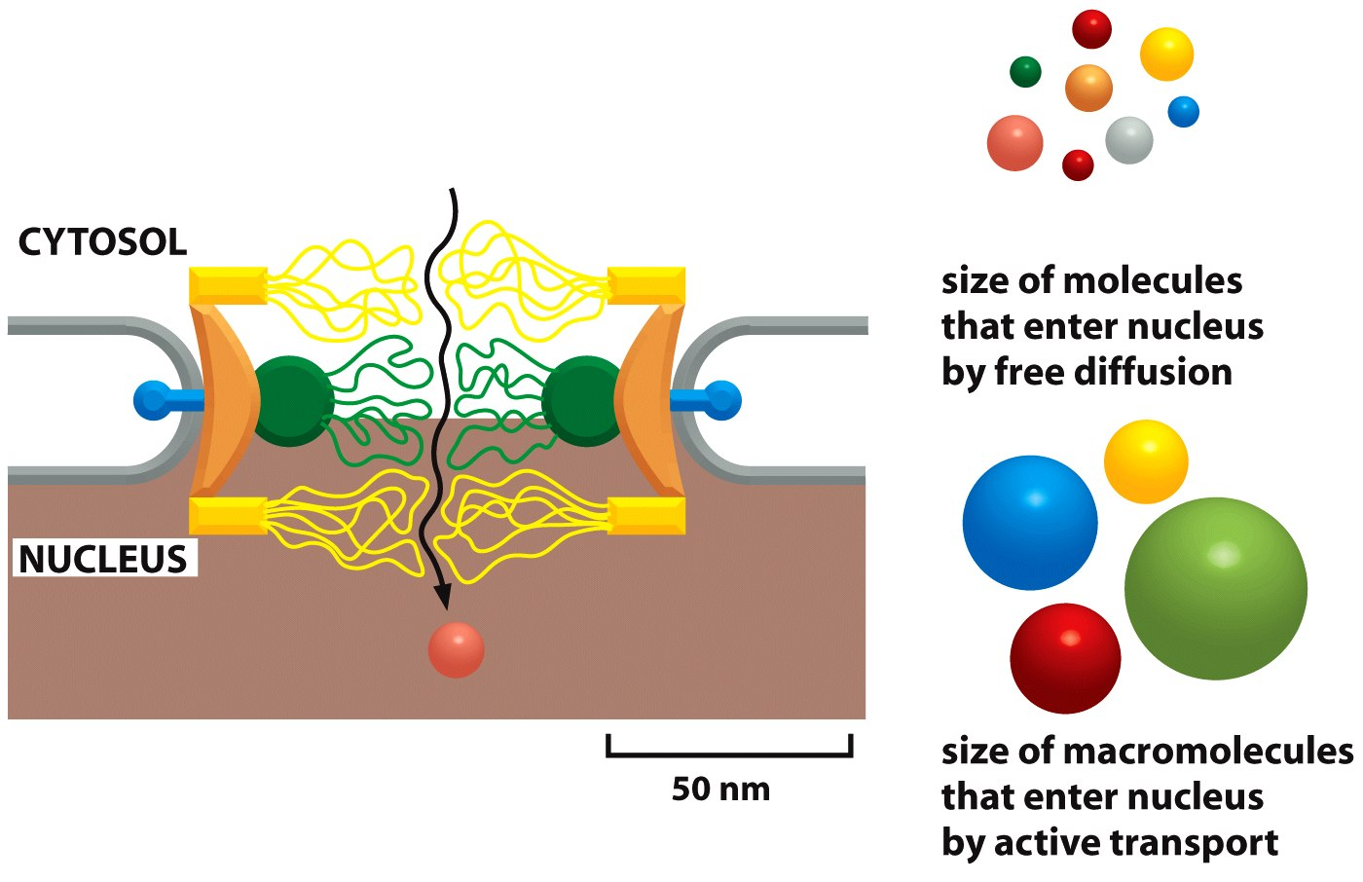
Very Small Molecules: Diffusion, Large Molecules are Shuttled
Figure 12-10 Molecular Biology of the Cell (© Garland Science 2008)

Slide 42
Endoplasmic Reticulum
RER: rough in appearance because ribosomes are attached to its membrane
Amino acids shuttle from RER via ribosomes, which then fold into proteins in cytoplasm
SER: not covered with ribosomes. Manufactures phospholipids and stores calcium ions – an important signaling activating ion.

Slide 43
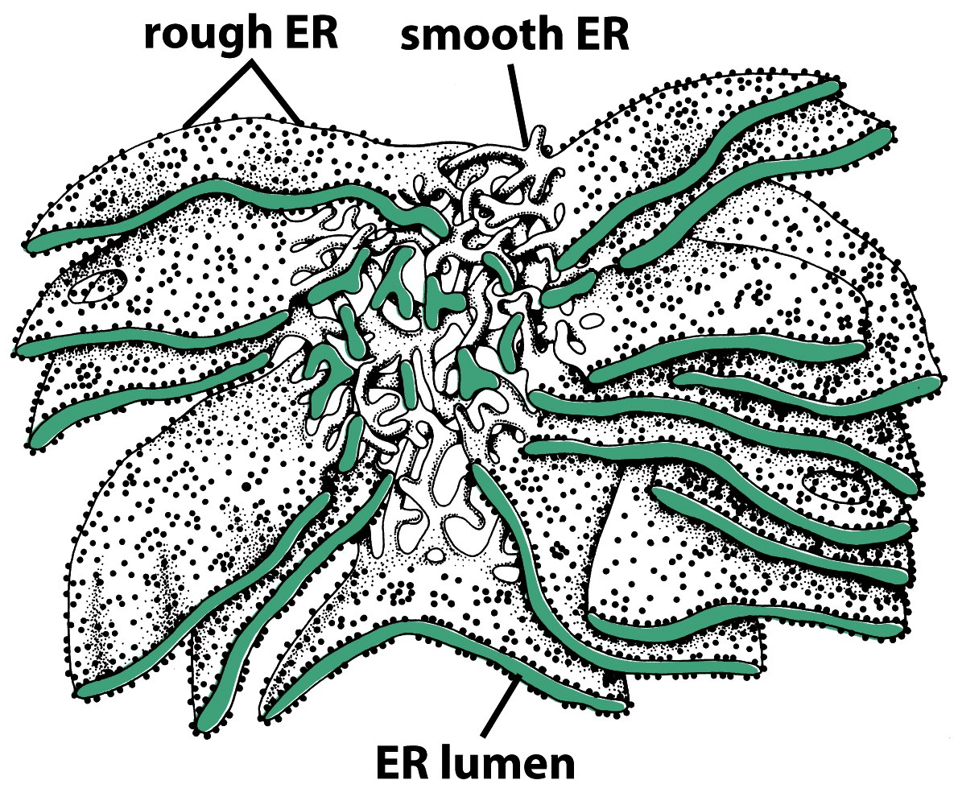
RER and SER Connected
Figure 12-36c Molecular Biology of the Cell (© Garland Science 2008)

Slide 44
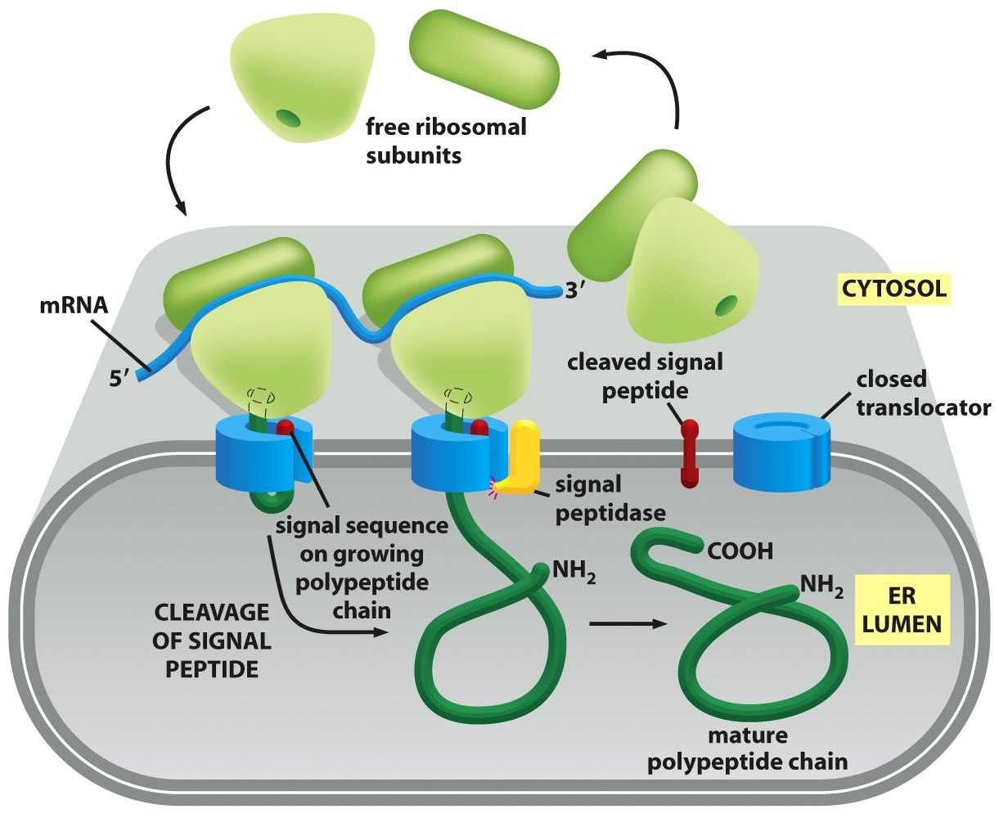
Ribosomes quickly move on and off RER surface
Figure 12-38 Molecular Biology of the Cell (© Garland Science 2008)

Slide 45
Golgi Apparatus
Many proteins, through made in the RER, will pass through Golgi before reaching final destination.
Has a Cis and Trans polarity. Cis faces the RER, and Trans faces cytoplasm.
The Golgi helps direct proteins to their final destination
Contains chaperone proteins, which help assemble proteins that don’t form tertiary structures on their own

Slide 46
Other small organelles
Peroxisomes: oxidation reactions (important for some enzymes)
Lysosomes: degrades damaged organelles, small organisms that have been phagocytosed, growth factors that bind to the cell surface and are endocytosed.
Helpful small molecules are released into cytosol.
Mitochondria: Produces ATP (the basis for all cell energy). Evolutionarily, the mitochondria was a bacteria, engulfed by an animal cell – now a symbiotic relationship. Mitochondria have their own DNA, organelles, and can replicate.

Slide 47
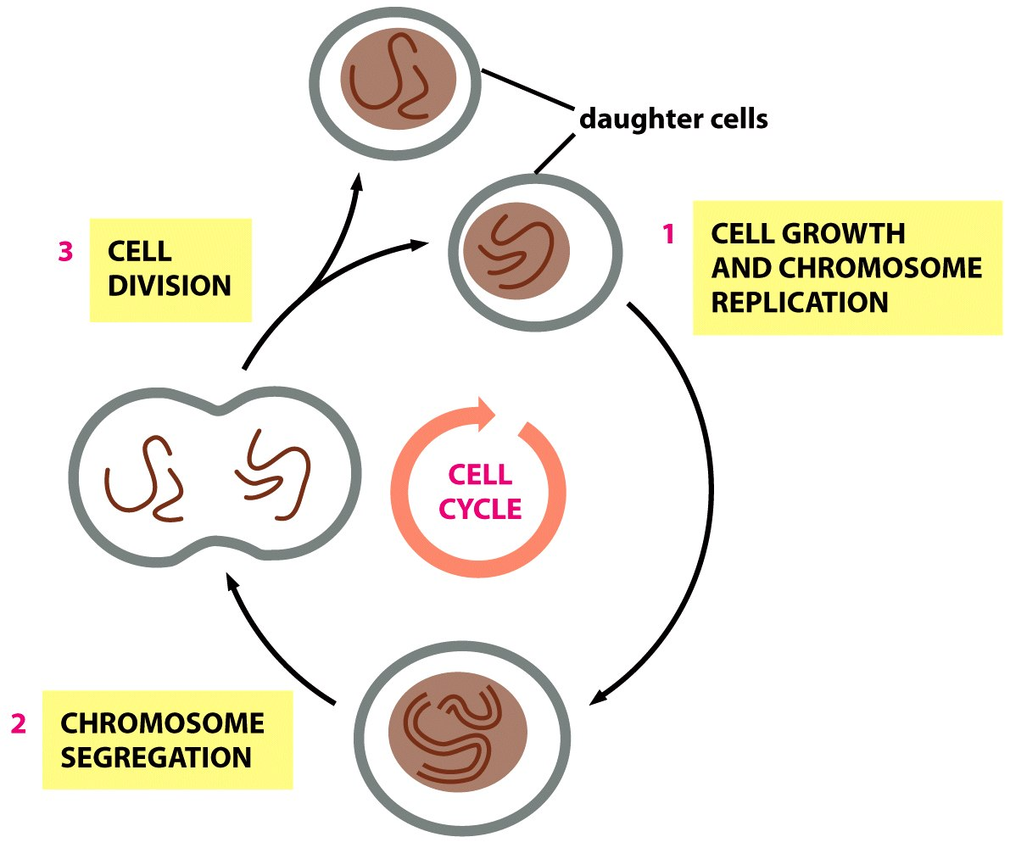
Cell Division: Overview
Figure 17-1 Molecular Biology of the Cell (© Garland Science 2008)

Slide 48
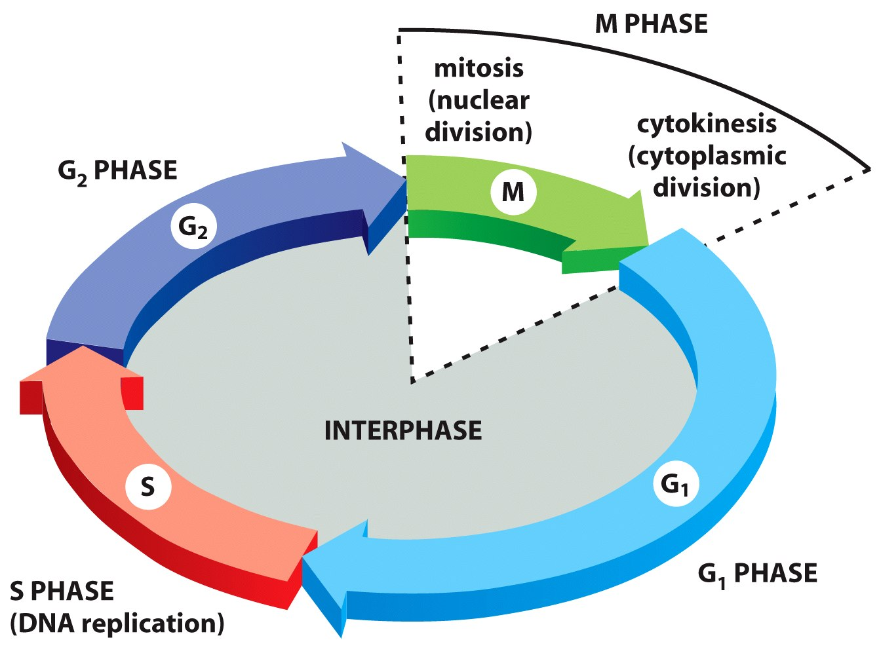
Cell Division Consists of Several Phases
Figure 17-4 Molecular Biology of the Cell (© Garland Science 2008)

Slide 49
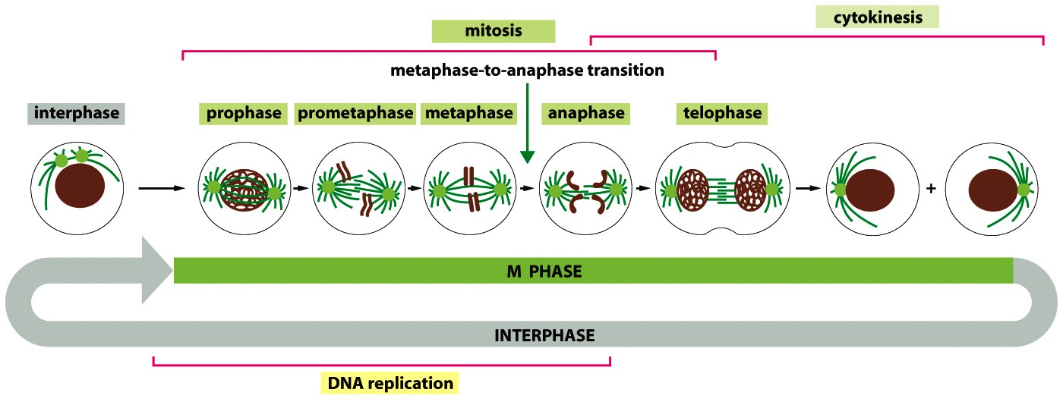
Cell Division: Mitosis and Cytokinesis
Figure 17-3 Molecular Biology of the Cell (© Garland Science 2008)

Slide 50
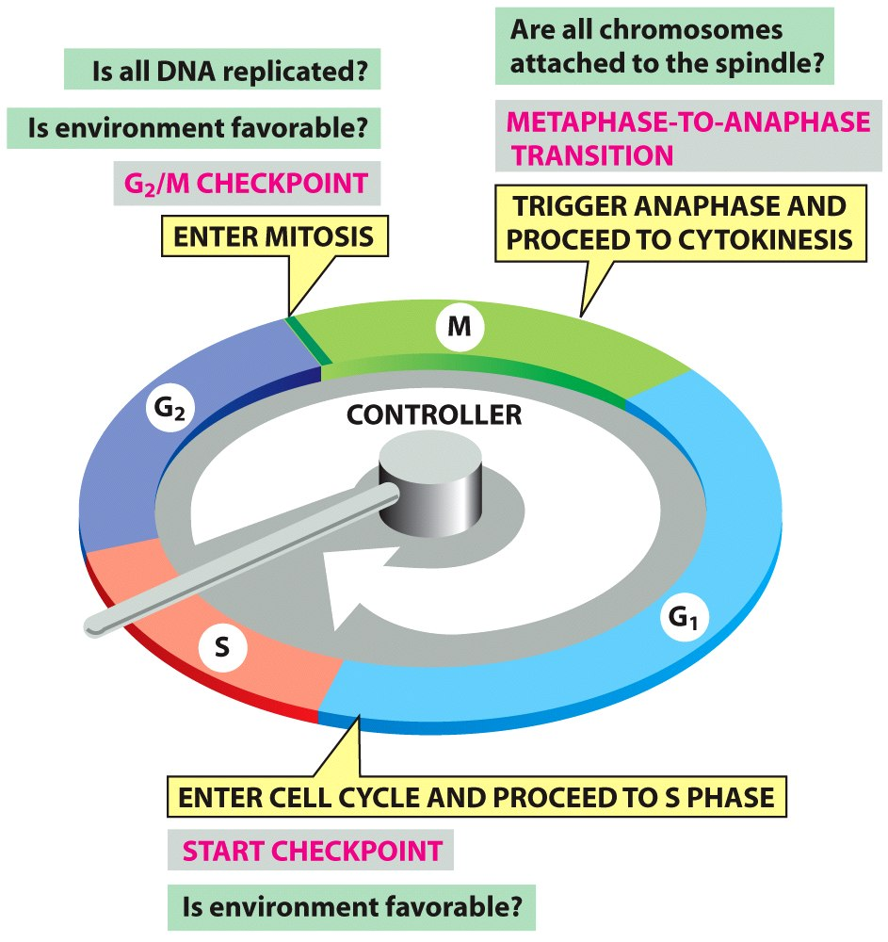
Progression through cell cycle governed by checkpoints
Figure 17-14 Molecular Biology of the Cell (© Garland Science 2008)

Slide 51
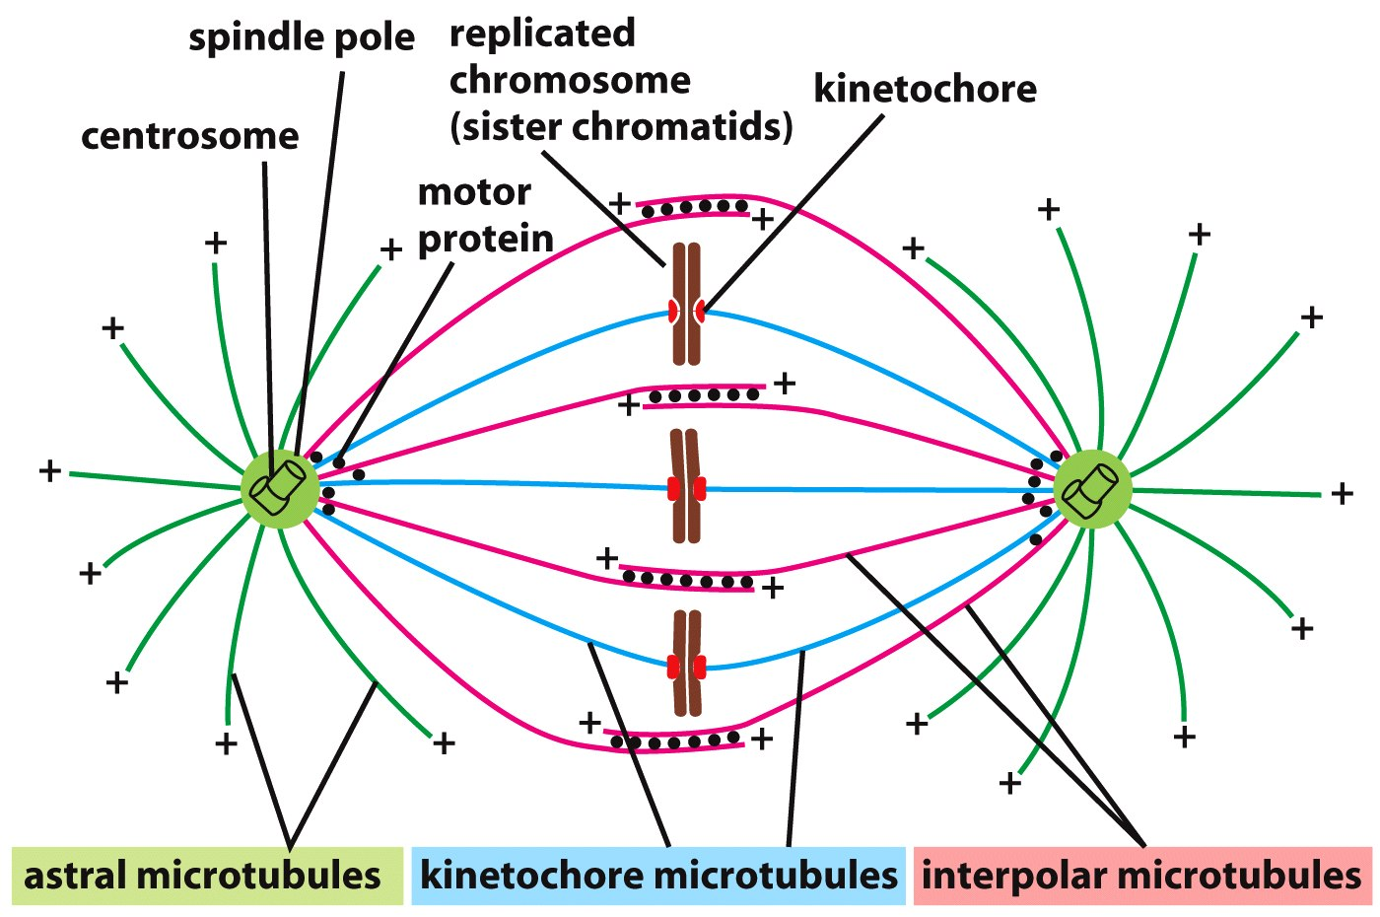
Cytokinesis: Microtubule-mediated chromosome division
Figure 17-28 Molecular Biology of the Cell (© Garland Science 2008)

Slide 52

Cytokinesis: Microtubule-mediated chromosome division
Figure 17-43 Molecular Biology of the Cell (© Garland Science 2008)

Slide 53

Mitosis Meiosis
Figure 17-47 Molecular Biology of the Cell (© Garland Science 2008)

Slide 54


Division Limitation: Telomeres

Slide 55



Telomeres: DNA Replication Limiters

Slide 56

Multiple cell divisions leads to cell specialization
Figure 17-67 Molecular Biology of the Cell (© Garland Science 2008)

Slide 57

EC signals transduced via signaling proteins – to – transcription factors, finally altering phenotype
Figure 15-1 Molecular Biology of the Cell (© Garland Science 2008)

Slide 58

Paracrine Signaling: um in distance
Figure 15-4b Molecular Biology of the Cell (© Garland Science 2008)

Slide 59

Endocrine signaling: very long distance paracrine signals (hormones)
Figure 15-4d Molecular Biology of the Cell (© Garland Science 2008)

Slide 60
Final Items to Consider Thoughts for your grant assignment?
Given spatial and temporal sensitivity of soluble signals, how do we deliver factors through a biomaterial to engineer proper cell and tissue function?
Can soluble signals themselves model paracrine signaling, or do we need multiple cell types?
Can we engineer growth factors with longer life times to reduce the total amount we need to deliver (or continue to deliver over time)?

