Slide 1
Widespread RNA and DNA Sequence Differences in the Human Transcriptome Mingyao Li, Isabel X. Wang, Yun Li, Alan Bruzel, Allison L. Richards, Jonathan M. Toung, Vivian G. Cheung
Mahnaz Janghorban
CANB610
1/26/2012

Slide 2
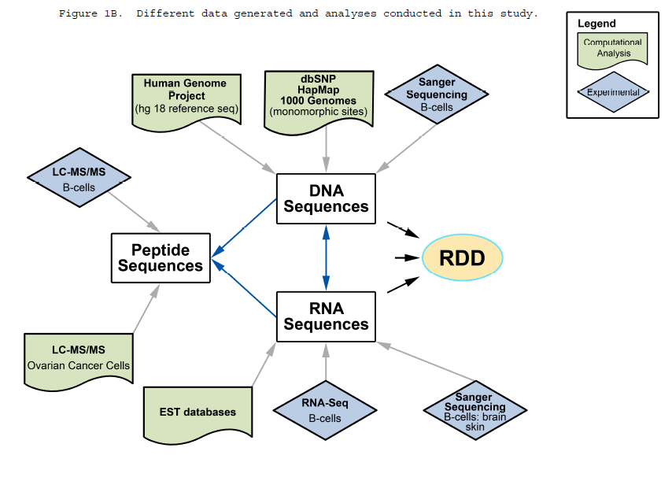
Data generation and analysis
RNA sequences + DNA sequences; human B cells of 27 individuals
RNA sequences of >10,000 exonic sites didn’t match that of DNA
RNA-DNA differences in
transcriptome:
Not through known
RNA editing mechanism
A new aspect of
genome variation
Notes:
Human genome project (HGP)
13-year project, completed in 2003
Goal:
1- determining the sequence DNA
2- identifying and mapping ~20,000–25,000 genes
of human genome
The HapMap project
develop a haplotype map (HapMap) of the human genome; 270 samples from 4 populations
genome-wide database for genome-wide association (GWA) studies
describe the common patterns of human genetic variation; SNPs, Copy number variants (CNV)
Use in genetic association studies of common disease
The 1000 Genomes Project
International research project
sequence the genomes of at least 1000 participants from a number of different ethnic groups
-In 2010, the project finished its pilot phase
-As of late 2010, the project is in its production phase with a target of sequencing upwards of 2000 individuals

Slide 3
Outlines
RNA editing
Mutagenesis
RNA seq

Slide 4
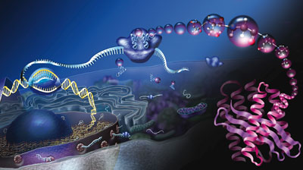
Central Dogma: DNA >> RNA >> Protein
RNA
DNA
Protein

Slide 5
Genetic integrity
DNA polymerases (DNAPs) generally exhibit high fidelity
RNA polymerases (RNAPs), operate with high fidelity; error rate of less than ~10^ 5
RNAP fidelity: substrate selection and proofreading
nucleotide misincorporation leads to slow addition of the next nucleotide;
stimulate the weak polymerase-intrinsic RNA 3’-cleavage activity
avoid mutant proteins with impaired function
Notes:
low-fidelity DNAPs ; accomplish special tasks such as translesion synthesis (DNA damage tolerance process that allows the DNA replication machinery to replicate past DNA lesions)

Slide 6
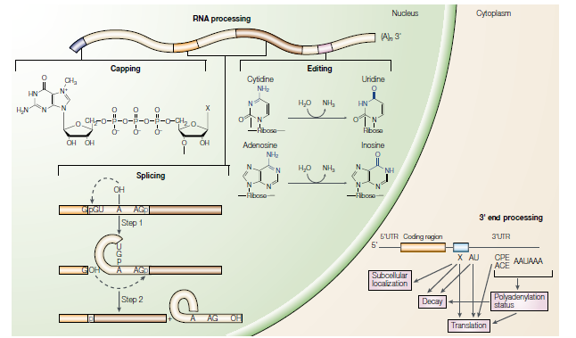
Genetic integrity vs. genetic diversity
Diversity at the DNA
Levels, or RNAs,
or Proteins?
RNA editing:
Insertion/deletion of (U) nucleotides
Modification: De-amination
C to U
A to I
Mary A. O’Connell, 2001
Notes:
Question:
At DNA levels:
1- polymorphism
2- SNPs
3- CNV
4- Transposons, micro sattelites
5-epigenetics
RNA processing:
RNA splicing
Capping
3’ processing

Slide 7
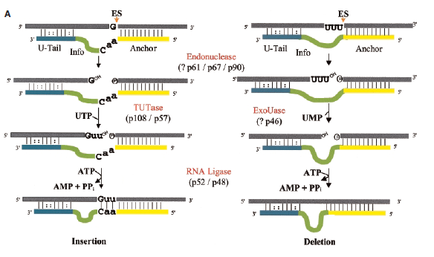
Post-transcriptional nucleotide insertion/deletion
Initially observed in kinetoplast (disk-shaped mass of circular DNA inside a large mitochondrion) of Trypanosoma brucei
Mitochondrial mRNA>>> extensive U insertion/deletion
Catalyzed by multiprotein editosome >20
Aswini K. Panigrahi, 2002
Notes:
The premRNA (upper bar) forms an anchor duplex with the gRNA (small guide RNA), which has anchor,
informational (info), and 3’ U-tail regions.
The premRNA is cleaved by an endonuclease
Us are added by TUTase or removed by 3’-ExoUase
processed fragment is rejoined to the 3’-fragment by an editing RNA ligase. The catalysts are components of the editosome.

Slide 8
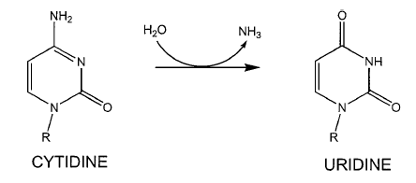
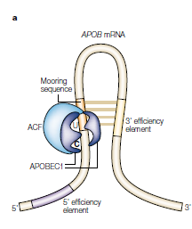
Mammalian C U editing
Are rare
Discovered in Apolipoprotein B (APOB) mRNA
Component of plasma lipoprotein, transport of Cholesterol and triglycerides in plasma
2 forms: APOB100 (in Liver) and APOB48 (in Intestine)
APOB48: from deamination of C U >>> translational stop
6666
11-nucleotide motif, located 3′ of the cytidine
Mary A. O’Connell, 2001

Slide 9
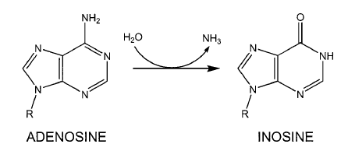
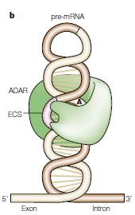
A I editing
Best described in glutamate receptor (GluR)
CAG (glutamine) to CIG (Arginine) located in channel-forming domain >>> decrease permeability for Ca 2+
ADAR evolved from ADAT (adenosine deaminases that act on tRNA)
dsRNA-binding domain(dsRBDs) + catalytic
deaminase domain (similar to that of APOBEC1)
Structure of duplex; between editing site
and editing site complementary sequence (ECS)
converting A•U base pairs in the RNA duplex
to an I•U mismatch >>> destabilizes it and
unwinds it
Mary A. O’Connell, 2001

Slide 10
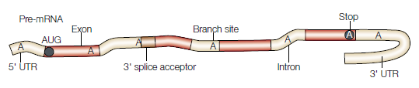
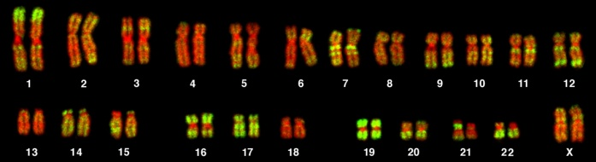
A I editing
The sequencing machinery reads I as G
Variation of RNA and genome: Polymorphism, random seq errors, mutation and inaccurate alignment of RNA
Conserved editing sites; to keep dsRNA structure intact
Almost all of these clusters occur in Alu elements
In mammals, Drosophila and squid; most of the ADAR edited transcripts expressed in the central nervous system
Alu element is a short stretch of DNA.
most abundant mobile elements in the human
genome
~10^6 copies of Alu in human genome; ~300bp
classified as short interspersed elements (SINEs); Retrotransposons
Mary A. O’Connell, 2001

Slide 11
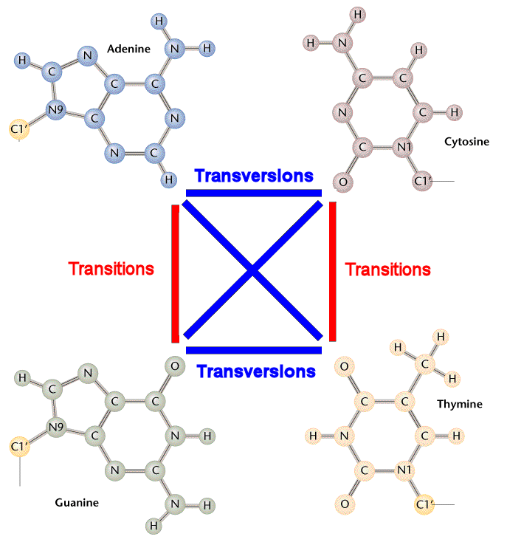
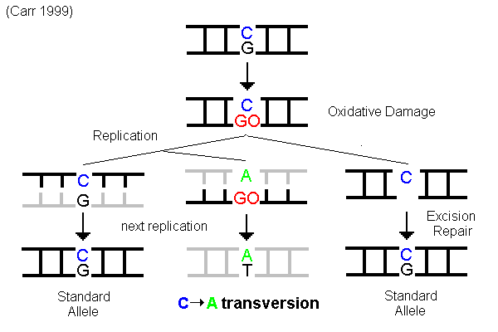
Mutagenesis
Transition:
purine nucleotide to another purine (A ↔ G)
pyrimidine nucleotide to another pyrimidine
(C ↔ T)
Transversion:
pyrimidine nucleotide to purine
(C ↔A)
oxidative damage

Slide 12
RNA sequencing
Expresses Sequence Tag (EST) data base
short sequence of a cDNA (500 to 800 nucleotides) from cDNA library
represent portions of expressed genes
Used to identify gene transcripts, gene discovery, gene sequence determination
2. Full length cDNA sequencing using Sanger seq
3. RNA seq using Next Generation Seq (NGS)
mRNA with fewer biases
Generates more data
Measure the level of gene expression
Can replace conventional microarray analysis; much higher resolution

Slide 13
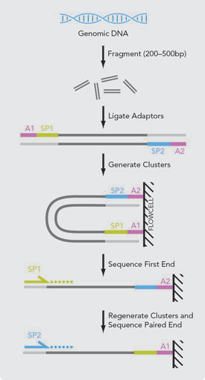
RNA seq
Rare transcripts, better base-pair-resolution compared to microarrays, higher dynamic range of expression level
Sequence reads obtained from NGS platform (Illumina, SOLiD, 454) are short (35-500bp)
Necessary to reconstruct the full-length transcript ; except in the case of small RNAs
Factor to consider:
choice of sequencing platform
Seq read length
Use pair-end protocol?

Slide 14
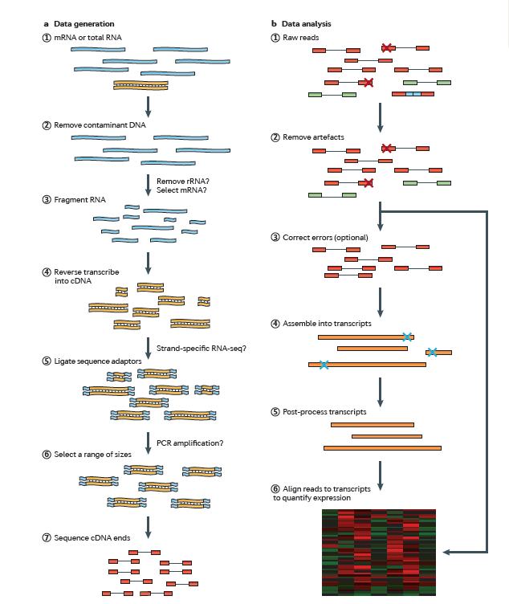
RNA seq
Seq adaptors,
Low-complexity reads
(homopolymers),
rRNAs
Zhong Wang , 2011
Notes:
Constructing libraries:
-To increased the # of assembled transcripts, especially for less abundant ones, rRNA and abundant transcripts are removed
- PCR amplification vs. Single molecule seq ?? PCR amplification results in low sequencing coverage for transcripts with high GC content
Single molecule seq >>> high error rate , more even and contiguous, easier for assembler to construct full-length across GC rich region

Slide 15
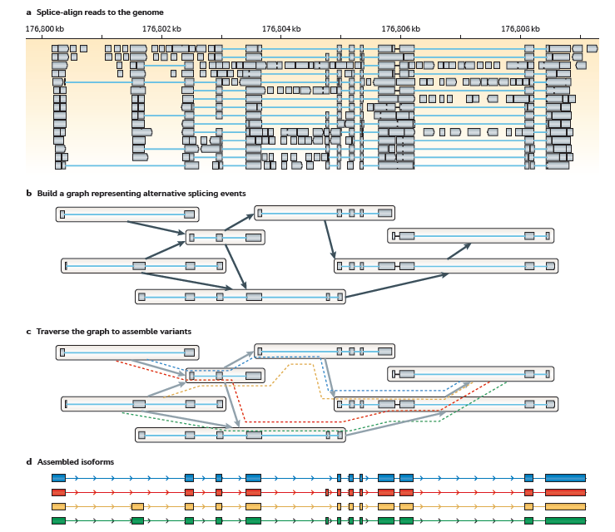
Reference-based assembly strategy
Current assembly
Strategies:
Reference-based
De novo
Combined
reference-based assembly >>> if high-quality reference genome already exists
Zhong Wang ,
2011
Notes:
1- RNA-seq reads are aligned to a reference genome using a splice-aware aligner, such as Blat45, TopHat46, SpliceMap47, MapSplice48 or GSNAP49
2- overlapping reads from each locus are clustered to build a graph representing all possible isoforms (FIG. 2b). The final step involves traversing the graph to resolve individual isoforms Examples of methods that use the reference-based strategy include Cufflinks , Scripture
3-Splice-aware aligners generally fall into two classes: seed-and-extend aligners and Burrows–Wheeler transform (BWT) aligners,
The seed-and-extend algorithms, such as BLAT and GSNAP, start by quickly finding a ‘seed’ — a substring of the read — that exactly matches the genome and then locally extending the match using Smith–Waterman alignment algorithms.
BWT aligners are optimized to align reads with few errors in them and are therefore generally faster than seed-and-extend aligners.
BWT aligners, such as TopHat, create a database of all possible combinations of splicing junctions within a locus and then align to this database the reads that failed to align to the genome.
Bowtie run on typical PC with 2G RAM, allign reads to human genome at a rate of 25 million read per hour. Doesnot support paired-end alignment.
After the reads are aligned to the genome, two methods are typically used for graph construction and traversal:
Cufflinks creates an overlap graph from all of the reads that align to a single locus and then traverses this graph to assemble isoforms by finding the minimum set of transcripts that ‘explain’ the intron junctions within the reads (that is, a minimum path cover of the graph).
Applications. Reference-based transcriptome assembly is easier to perform for the simple transcriptomes of bacterial, archaeal and lower eukaryotic organisms, as these organisms have few introns and little alternative splicing.
Cufflinks20 and Scripture16 have been developed for efficiently reconstructing transcripts from mammalian-sized data sets
Advantage:
Contamination or sequencing artefacts are not a major concern
very sensitive and can assemble transcripts of low abundance.
Disadvantages. :
1-The success of reference-based assemblers depends on the quality of the reference genome being used.
2-reference from a closely related species.
3- Errors introduced by short-read aligners are also carried over into the assembled transcripts.
4- Spliced reads that span large introns can be missed because aligners often only search for introns that are smaller than a fixed length to reduce the required computational power.
5-reference-based approaches cannot easily assemble trans-spliced genes…in some cancers , such as prostate cancer

Slide 16
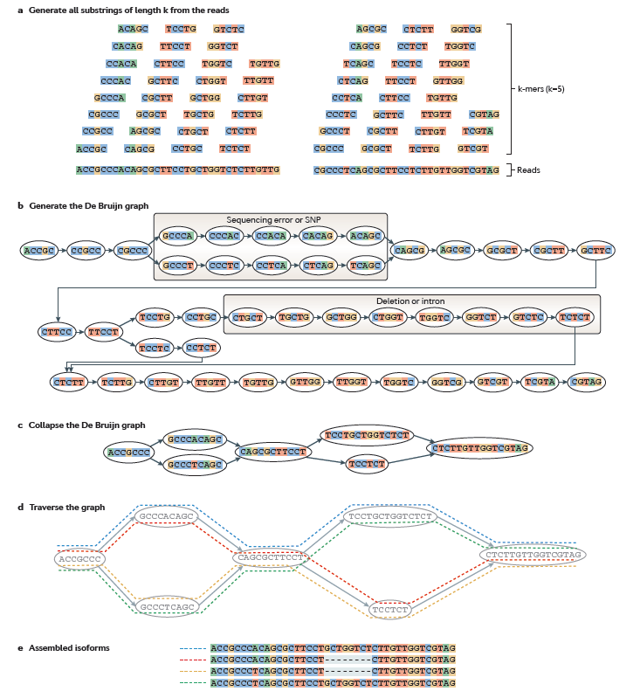
‘de novo’ transcriptome assembly strategy
does not use a reference genome
leverages the redundancy of short-read sequencing to find overlaps between the reads and assembles them into transcripts
Zhong Wang , 2011
Notes:
Advantages:
1-it does not depend on a reference genome.
2-it can recover transcripts that are transcribed from segments of the genome that are missing from the genome assembly, or it can detect transcripts from an unknown exogenous source.
3- is that it does not depend on the correct alignment of reads to known splice sitess or the prediction of novel splicing sites, as required by reference-based assemblers.
-long introns are not a concern for de novo assemblers.
trans-spliced transcripts and similar transcripts originating from chromosomal rearrangements can be assembled using the de novo approach.
Disadvantages:
De novo assembly of higher eukaryotic transcriptomes is much more challenging, not only because of the larger data set sizes but also because of the difficulties involved in identifying alternatively spliced variants
de novo transcriptome assembly requires a much higher sequencing depth for full-length transcript assembly than does the reference-based assembly strategy
very sensitive to sequencing errors and to the presence of chimeric molecules in the data set62

Slide 17
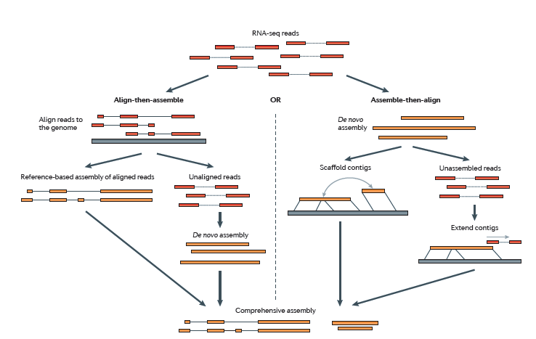
RNA seq, Analyzing Data
Zhong Wang , 2011

Slide 18
Summary
General transfers of biological sequential information
(replication, transcription, translation) vs.
Special/non-general transfers of biological information
(Reverse transcription, Methylation, RNA editing, …)
Human genome project, dbSNP, HapMap, 1000 genome
Diversity between individuals and across species
normal vs. cancer??

