Slide 1
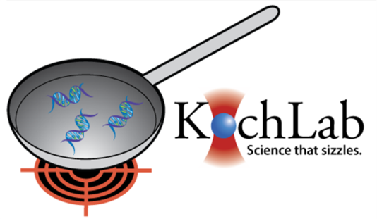

Biological things you should know when working in this lab…
…or Koch will cut off your big toe.
Presents:
By Anthony

Slide 2
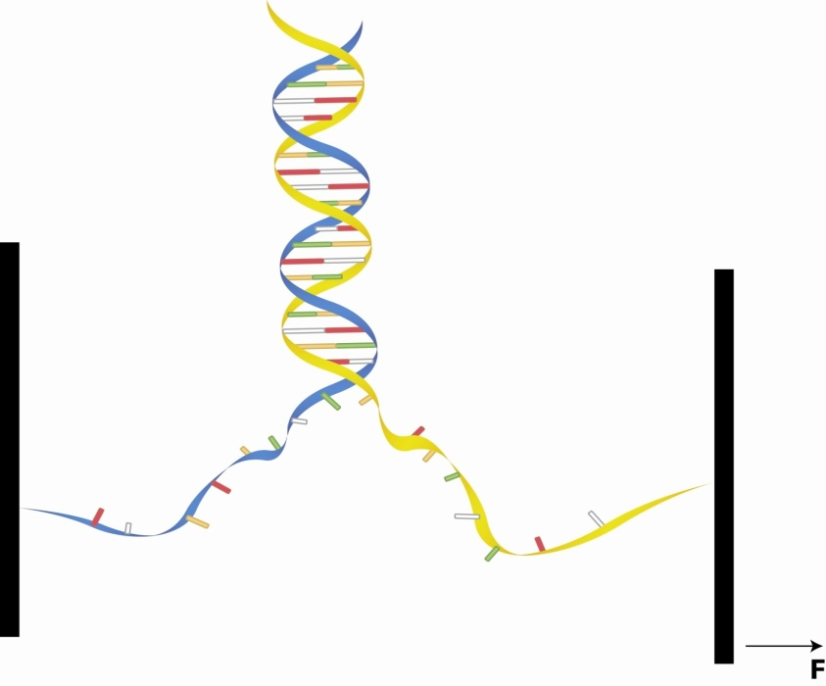


DNA
Can be double stranded and single stranded
Single stranded DNA (ssDNA) is really floppy compared to dsDNA
Determined by persistance length
This stuff is the reason people can look like this:
Or this:
This is a boring picture
No you’re not

Slide 3
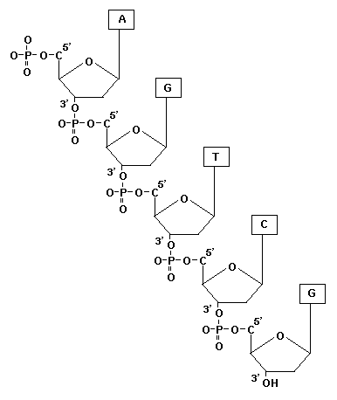
Read 3’ to 5’
Made of a sugar backbone
Joined by phosphate groups
Strands lined through 4 bases
  Adenine
  Guanine
  Cytosine
  Thymine
A binds with T
That’s called basepairing
G binds with C
Nothing creative here

Slide 4
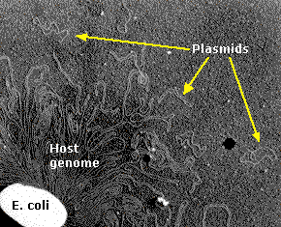
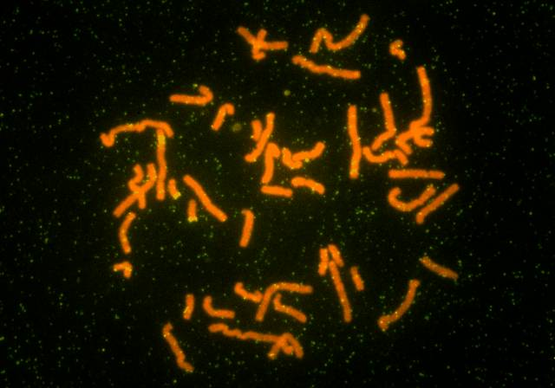
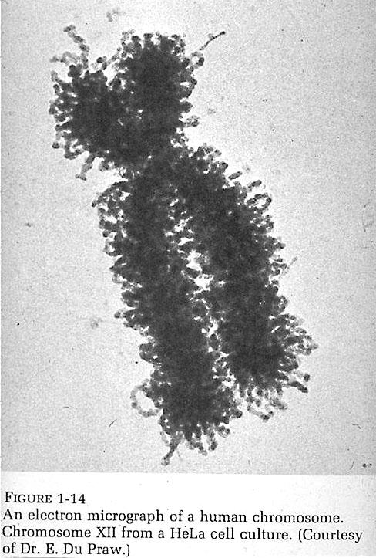
DNA in different organisms
Nope nothing interesting here

Slide 5
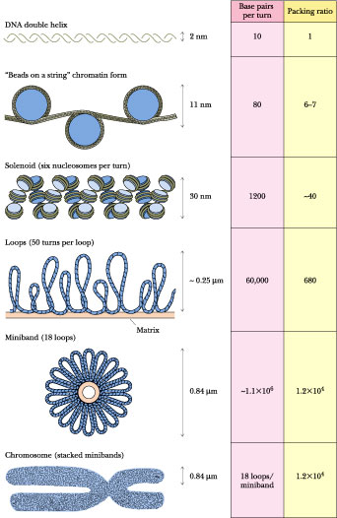
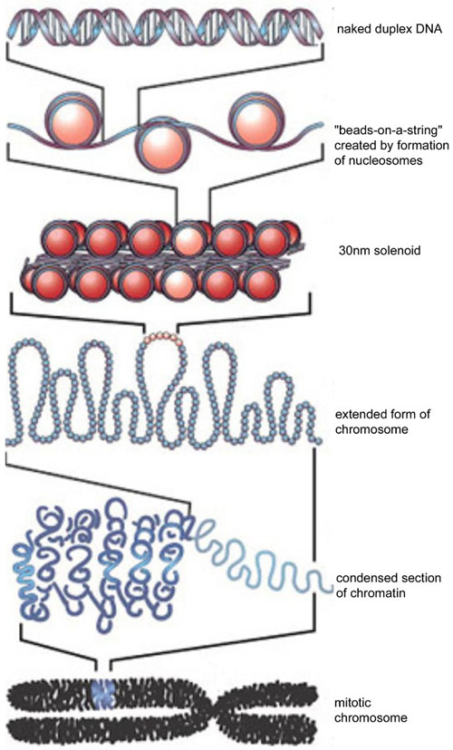
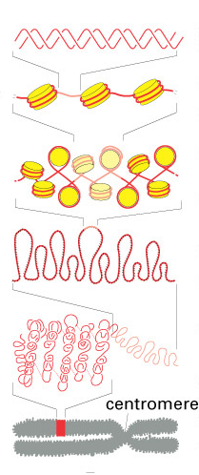
Why DNA looks like that
boring
boring
boring

Slide 6
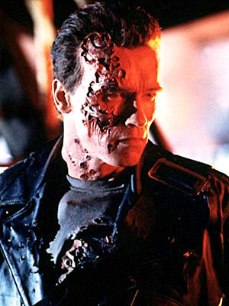
Why is it important
DNA contains all the genetic information of an organism
The entire genome is in every cell
It is important for:
  Cell Division
  Cell Metabolism
  Other Stuff
Nothing not boring about the terminator
Some of the other stuff

Slide 7
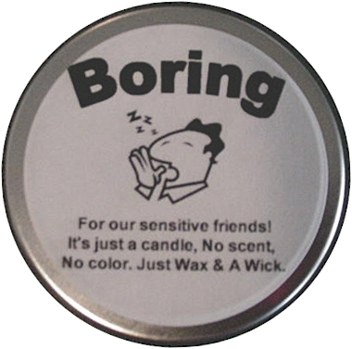
3 Main Mechanisms of DNA
Replication
  Making more DNA from DNA
  Think “Make a copy”
Transcription
  Making RNA from DNA
  Think “To write down”
Translation
  Making proteins from RNA
  Think “english to spanish”
Now this is actually a boring picture

Slide 8
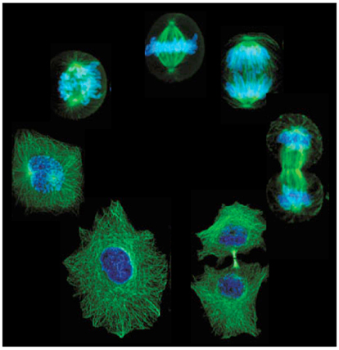
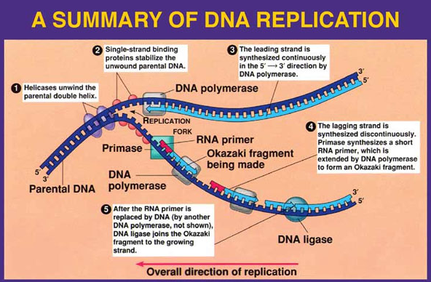
Cell Division
Even though this is one sweet ass picture
apparently it’s still boring as fuck

Slide 9
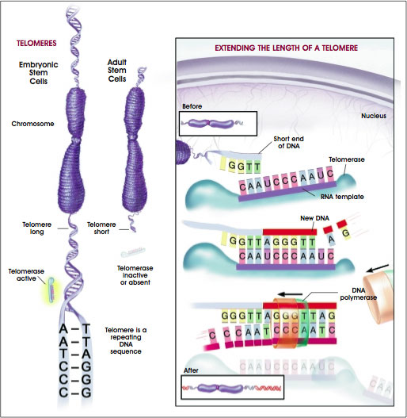
Cool Application
Protect ends of DNA
Prevents chromosomes from doing stupid shit
Made of repeating DNA sequence
Regulated by Telomerase
  Can build DNA strand from nothing
Determines age of cell
  Shorter telomeres indicate old age
Major role in cancer
  Cancer cells have fucked up telomeres
This is awfully busy… and boring

Slide 10
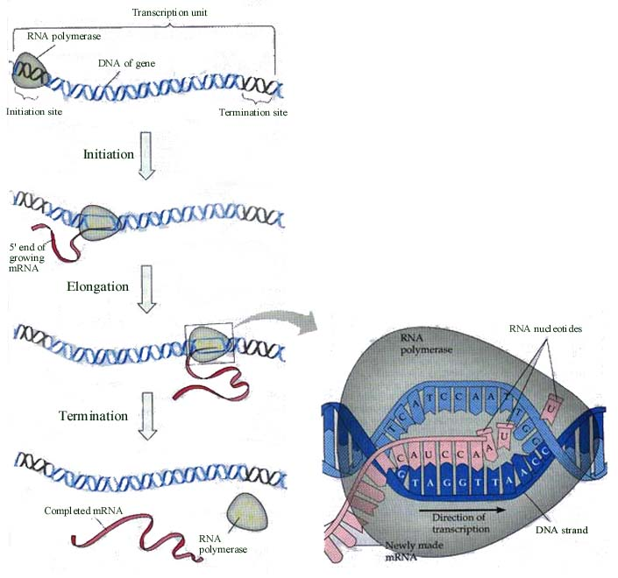
Transcription
Not even boring

Slide 11
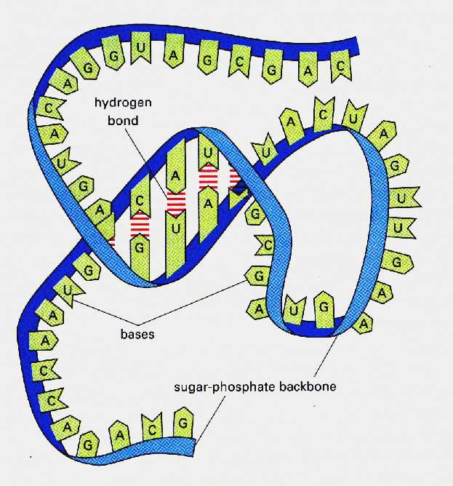
What is RNA?
Almost like DNA
Less Stable
Uses Uracil instead of Thymine
Can get some really cool structures if you try hard
Just like DNA but more boring

Slide 12
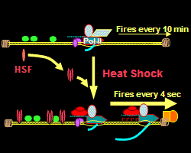
Cool Transcription-y Things
In the presence of environmental stress, cells can undergo transcription faster than under normal conditions due to the HEAT SHOCK RESPONSE
Transcription complex sits at elongation point
In presence of heat, transcription begins
Can make way more proteins this way
Good to fight infections
Black would be awesome anywhere
But here it is boring

Slide 13
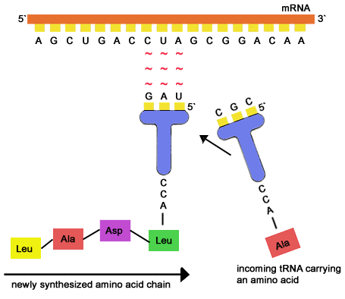
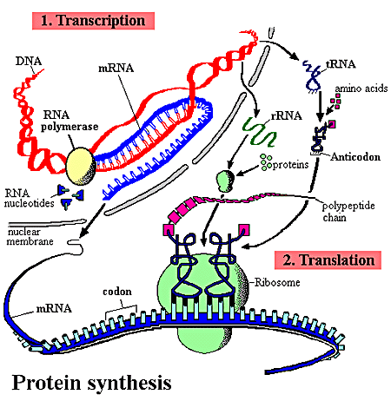
Translation
This is the step that makes proteins
mRNA (from transcription) gets translated into amino acids by tRNA
Ribosomes are the mechanism for this translation made by rRNA
tRNA… the most boring kind of RNA
Only slightly more boring than ribosomes

Slide 14
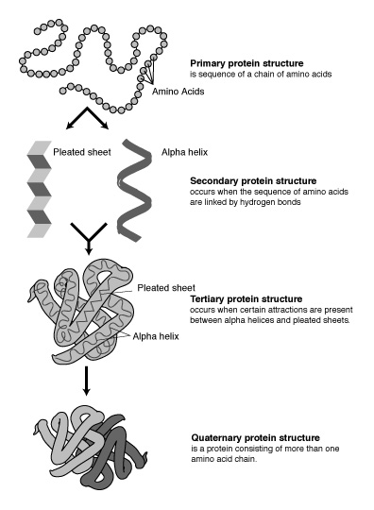
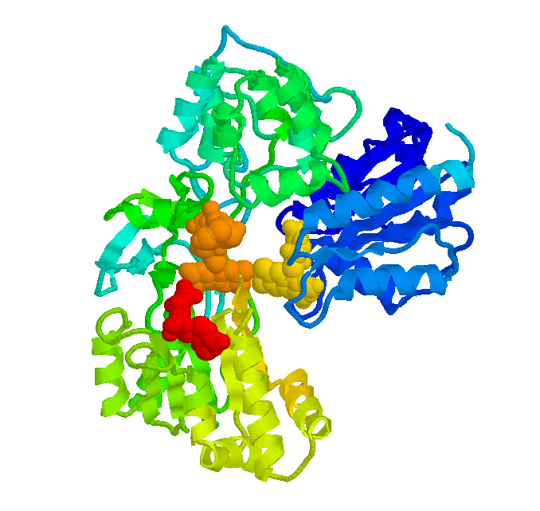
Proteins
Don’t ask me any questions about this.
Protein folding is boring… don’t believe me?
Go to the Biophysical Society Meeting.

Slide 15
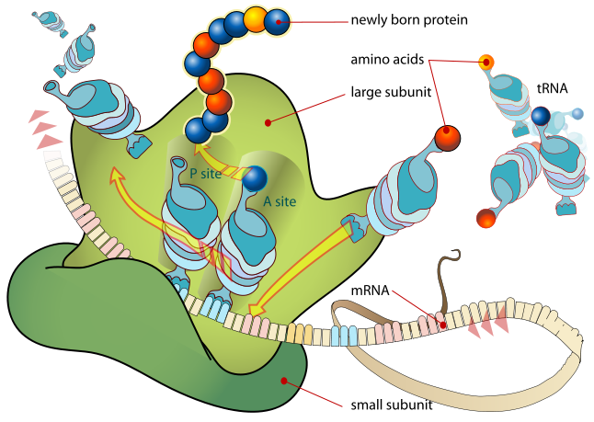
When Translation is Awesome… I mean boring.
Making proteins that regulate the making of proteins (think about it)
Different codons could code for the same amino acid
Cool Proteins:
  GFP
  HSP
  Whatever makes Red Heads
Alternative splicing (can’t show otherwise Larry will sue me)
Sweet!

Slide 16
Let’s Pause for a Moment
Pausing is boring

Slide 17
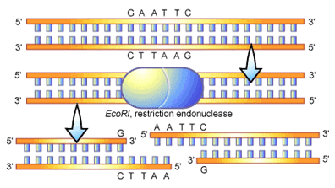
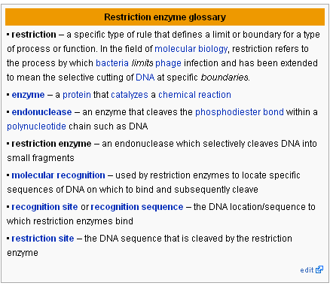
Restriction Enzymes
Restriction enzymes may have evolved as a defense mechanism against viruses.

Slide 18
Famous RE’s
NotI
SapI
EcoRI
XhoI
BstXI
GCGGCCGC
CGCCGGCG
GC GGCCGC
CGCCGG CG
GCTCTTCNNNNNN
CGAGAAGNNNNN
GCTCTTCN
CGAGAAGNNNN
GAATTC
CTTAAG
G AATTC
CTTAA G
CTCGAG
GAGCTC
C TCGAG
GAGCT C
CCANNNNNNTGG
GGTNNNNNNACC
CCANNNNN NTGG
GGTN NNNNNACC

Slide 19
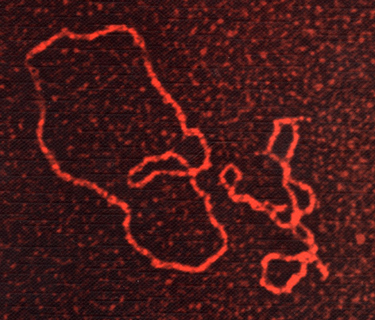
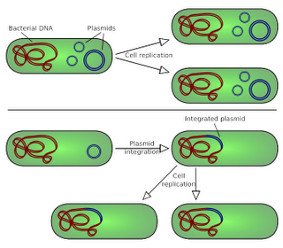
Plasmids
Circularized DNA
Separate from chromosomal DNA
Replicates on its own (in a cell)
Very useful in molecular biology

Slide 20
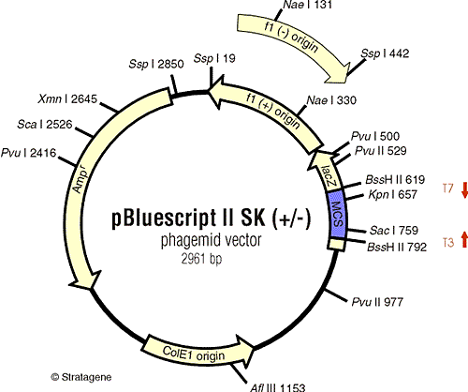
A famous plasmid
Things to note:
Resistance to Ampecilin
Multiple Cloning Site
lacZ gene

Slide 21
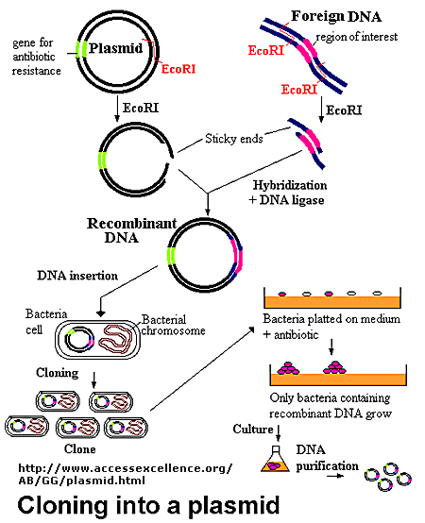
Combining the two

Slide 22
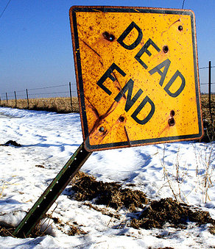
End

