Slide 1
GRNmap: a MATLAB Program for Gene Regulatory Network Modeling and Parameter Estimation
Student: Trixie Anne M. Roque, Tessa A. Morris
Faculty Mentors: Dr. Kam D. Dahlquist, Dr. Ben G. Fitzpatrick,
& Dr. John David N. Dionisio
SURP 2015 Final Joint Research Meeting
June 24, 2015

Slide 2
Outline
GRNmap models the dynamics of “medium-scale” gene regulatory networks using differential equations.
Trixie (GRNmap developer): design changes, new features, bug fixes, testing framework implementation, and documentation
Tessa (GRNmap tester): new test cases for the testing framework, discovered bugs using various test cases

Slide 3
Outline
GRNmap models the dynamics of “medium-scale” gene regulatory networks using differential equations.
Trixie (GRNmap developer): design changes, new features, bug fixes, testing framework implementation, and documentation
Tessa (GRNmap tester): new test cases for the testing framework, discovered bugs using various test cases

Slide 4
Systems Biology Workflow
DNA microarray data:
wet lab-generated or published
Statistical analysis,
clustering,
Gene Ontology, term enrichment
New experimental questions
Generate gene regulatory network
Visualizing the results
Modeling dynamics of the network

Slide 5
Systems Biology Workflow
DNA microarray data:
wet lab-generated or published
Statistical analysis,
clustering,
Gene Ontology, term enrichment
New experimental questions
Generate gene regulatory network
Visualizing the results
Modeling dynamics of the network

Slide 6
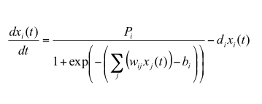
GRNmap: Gene Regulatory Network Modeling and Parameter Estimation
The user has a choice to model the dynamics based on a sigmoidal (shown) or Michaelis-Menten function.
Parameters are estimated from DNA microarray data from wild type and transcription factor deletion strains subjected to cold shock conditions.
Weight parameter, w, gives the direction (activation or repression) and magnitude of regulatory relationship.

Slide 7
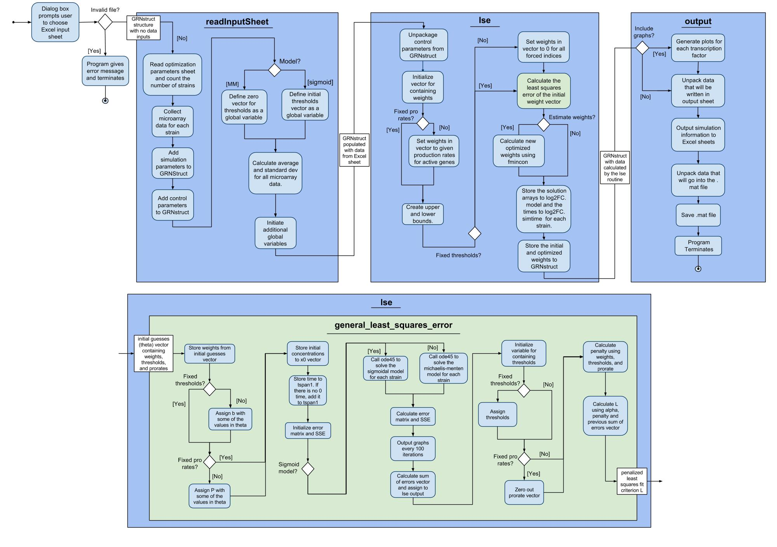
UML Activity Diagram Documents the Flow of the Program

Slide 8
UML Activity Diagram Documents the Flow the of Program

Slide 9
UML Activity Diagram Documents the Flow the of Program

Slide 10
UML Activity Diagram Documents the Flow the of Program

Slide 11
UML Activity Diagram Documents the Flow the of Program

Slide 12
Outline
GRNmap models the dynamics of “medium-scale” gene regulatory networks using differential equations.
Trixie (GRNmap developer): design changes, new features, bug fixes, testing framework implementation, and documentation
Tessa (GRNmap tester): new test cases for the testing framework, discovered bugs using various test cases

Slide 13
GRNmap v1.0.8 Includes the Following New Features and Bug Fixes
Changed Input/Output worksheet names
Deleted "concentration_sigmas" input worksheet from test_files folder because they are no longer used
Optimized threshold is now outputted when fix_b = 0
Optimized production rates are now outputted when fix_P = 0
Standard deviations of input expressions are now outputted
Updated the wiki with the documentation of input/output worksheets described above
Added 16 new test input sheets for each combination of optimization parameters Sigmoid, estimateParams, makeGraphs, fix_b, and fix_P

Slide 14
GRNmap v1.0.10 Includes the Following New Features and Bug Fixes
Created an optimization_diagnostics sheet with the LSE, Penalty term, min, and iteration count
  Added code functionality to compute min LSE and SSEs of individual genes
Reordered the strain sigma sheets
Renamed graph files to correspond to gene names.
Saved the diagnostic graph to a jpg named optimizationDiagnostic.jpg
Fixed a bug in the penalty computation of the production rates
2 demo files have been included with this release

Slide 15
Website and Wiki Updated to Reflect Changes with Code
Global variables listed in the wiki for future refactoring and testing development
GRNmap website now tracks page visits and downloads per version
Compatibility description has been included in the website
News page updated according to current changes to the website and new releases

Slide 16
Outline
GRNmap models the dynamics of “medium-scale” gene regulatory networks using differential equations.
Trixie (GRNmap developer): design changes, new features, bug fixes, testing framework implementation, and documentation
Tessa (GRNmap tester): new test cases for the testing framework, discovered bugs using various test cases

Slide 17
We Added New Features, Fixed Bugs, and Documented the Changes to GRNmap
New Features and Fix Bugs
Testing
Document
Update activity diagram, Github wiki, and GRNmap website
Testing Framework
Currently working to automate testing
Manual tests were performed to verify changes and check for bugs before releasing
Including changing names of worksheets, computing standard deviations, and creating optimization diagnostics output

Slide 18
There are Sixteen Different Combinations for the Test Inputs
Sigmoidal
Michaelis-Menten
Estimate + Forward
Forward Only
Fix p
Estimate p
Graph
No Graph
Graph
No Graph
Graph
No Graph
Estimate + Forward
Estimate b, Estimate p
Graph
No Graph
Estimate b, Fix p
Graph
No Graph
Fix b, Estimate p
Graph
No Graph
Fix b, Fix p
Graph
No Graph
Forward Only
Graph
No Graph

Slide 19
There was no notable difference between using .xlsx vs. xls input files
Tested using one MM and one Sigmoidal input from the original sixteen test files with 22 genes with 47 edges
The maximum of the MM difference matrix was 4.74681E-07 and the maximum of the Sigmoidal difference matrix was 4.51574E-06.
If a file is in the .xls format, the output will also be .xls.
GRNsight can only handle .xlsx files.

Slide 20
Using .xlsx vs. xls inputs Resulted in the Same Output with the Most Updated Version of GRNmap
Tested using one MM and one Sigmoidal input from the sixteen_tests
Zero difference between the LSE, Penalty term, and the counter
Zero difference between the w, P, and b values of two copies of the Sigmoidal input workbooks
Zero difference between w and P values of two copies of the MM input workbooks (no sheet for b for MM).
The w, P, b (for Sigmoidal), LSE, penalty term, and the counter are the same between the .xlsx and .xls versions and the copy-1 and copy-2 from the GRNmap Testing Report for Identical Runs with Same Code Version and Same Input Workbook

Slide 21
Identical Runs with Same Code Version and Same Input Workbook Resulted in the Same Output
Tested using one MM and one Sigmoidal input from the folder sixteen_tests files with 4 genes and 6 edges
Zero difference between the LSE, Penalty term, and the counter
Zero difference between the network_optimized_weights, optimized_production_rates, and optimized_threshold_b values of two copies of the Sigmoidal input workbooks
Zero difference between network_optimized_weights and optimized_production_rates values of two copies of the MM input workbooks (no sheet for optimized_threshold_b).

Slide 22
The Executable Functions Properly
The executable functions properly as long as the computer has administrator privileges and none of the directory names (folder name or administrator name) have any spaces.
Anti-virus software may be prevent download
The executable works even after the laptop has been shut off and the program was not reinstalled.
GRNmap will work on a non administrator account if it has been downloaded on an administrator account.
The executable is not compatible with OS X Yosemite.
The executable worked after being uninstalled and then reinstalled on a computer.
Running two at a time will produce the output sheets (.mat and .xlsx) as well as the plots, however the figures will overwrite if they are in the same folder

Slide 23
The GRNmap Output Sheet “Sigmas” Calculates the Correct Standard Deviation
One workbook containing all strains (wt, dcin5, dgln3, dhap4, dhmo1, and dzap1) for the network with 22 genes and 47 edges, no graphs, fixb = 1, and fixP = 1 was run
Manually calculated the standard deviations of the log2 fold expression and compared them to the sigmas that GRNmap calculated
The maximum difference between the manually calculated sigmas and the MATLAB calculated sigmas was E-15.

Slide 24
Setting estimateParams Equal to Zero Created an Error In MATLAB
Sixteen “large” test files were run with alpha set to 0.001; MaxIter and MaxFunEval set to 1.00E+06; and TolFun and TolX set to 1.00E-05
When estimateParams is set to zero the .xlsx does not output correctly and there is no .mat file produced
Also uncovered that if makeGraphs is set to zero, MATLAB will not automatically save the optimization_diagnostic image
Multiple runs were performed at once on the same computer for this experiment.
How to perform multiple runs at once on one computer is documented on the GRNmap Github

Slide 25
We Are Working To Automate GRNmap Tests
We are developing unit tests to automate the testing process
Compare output sheets a standard or to each other
Issues to think about is what constitutes no difference between output sheets

Slide 26
Acknowledgments
Dr. Kam Dahlquist
Dr. Ben Fitzpatrick
Dondi
Fellow members
Dr. Lily Khadjavi and Brandon

