Slide 1
First Draft/Information on Model dCIN5
William Gendron

Slide 2
P-Values and Percentages Comparison
ANOVA | WT | dCIN5 STRAIN
p < 0.05 | 2378 (38.4%) | 2034 (32.86%)
p < 0.01 | 1527 (24.7%) | 1198 (19.36%)
p < 0.001 | 860 (13.9%) | 576 (9.31%)
p < 0.0001 | 460 (7.4%) | 288 (4.65%)
B-H p < 0.05 | 1656 (26.8%) | 1177 (19.02%)
Bonferroni p < 0.05 | 228 (3.68%) | 119 (1.92%)

Slide 3
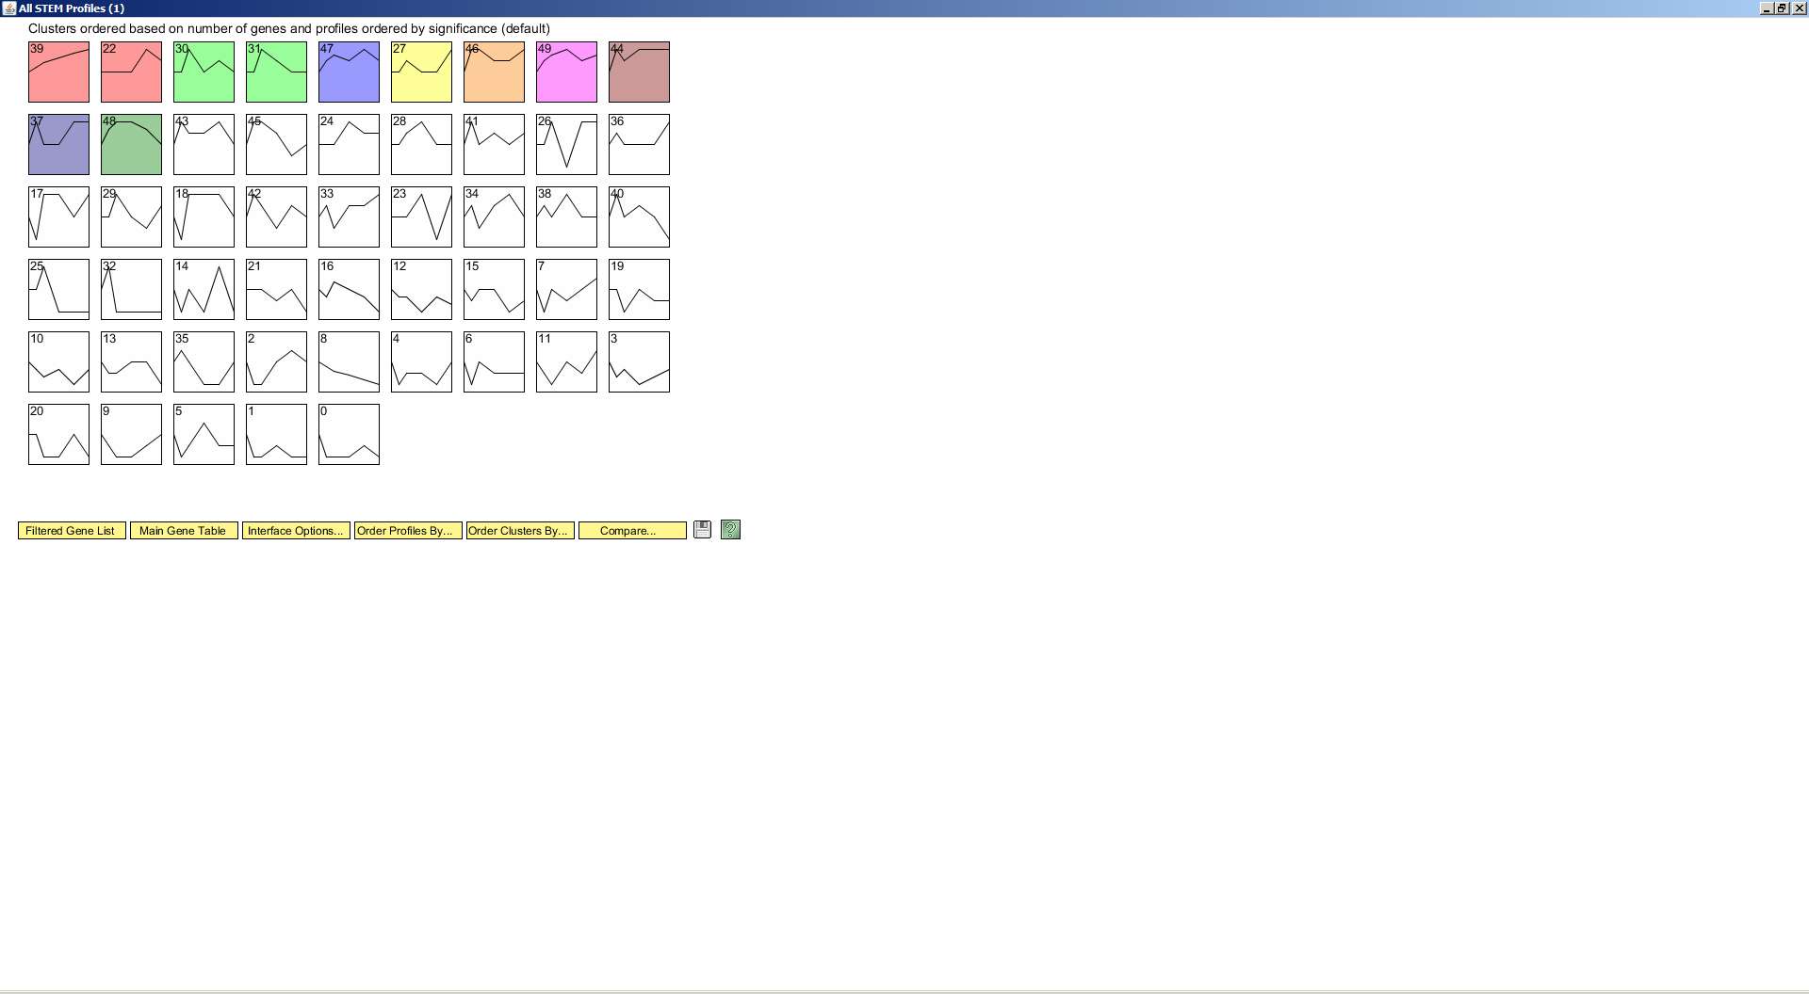
All STEM Profiles

Slide 4
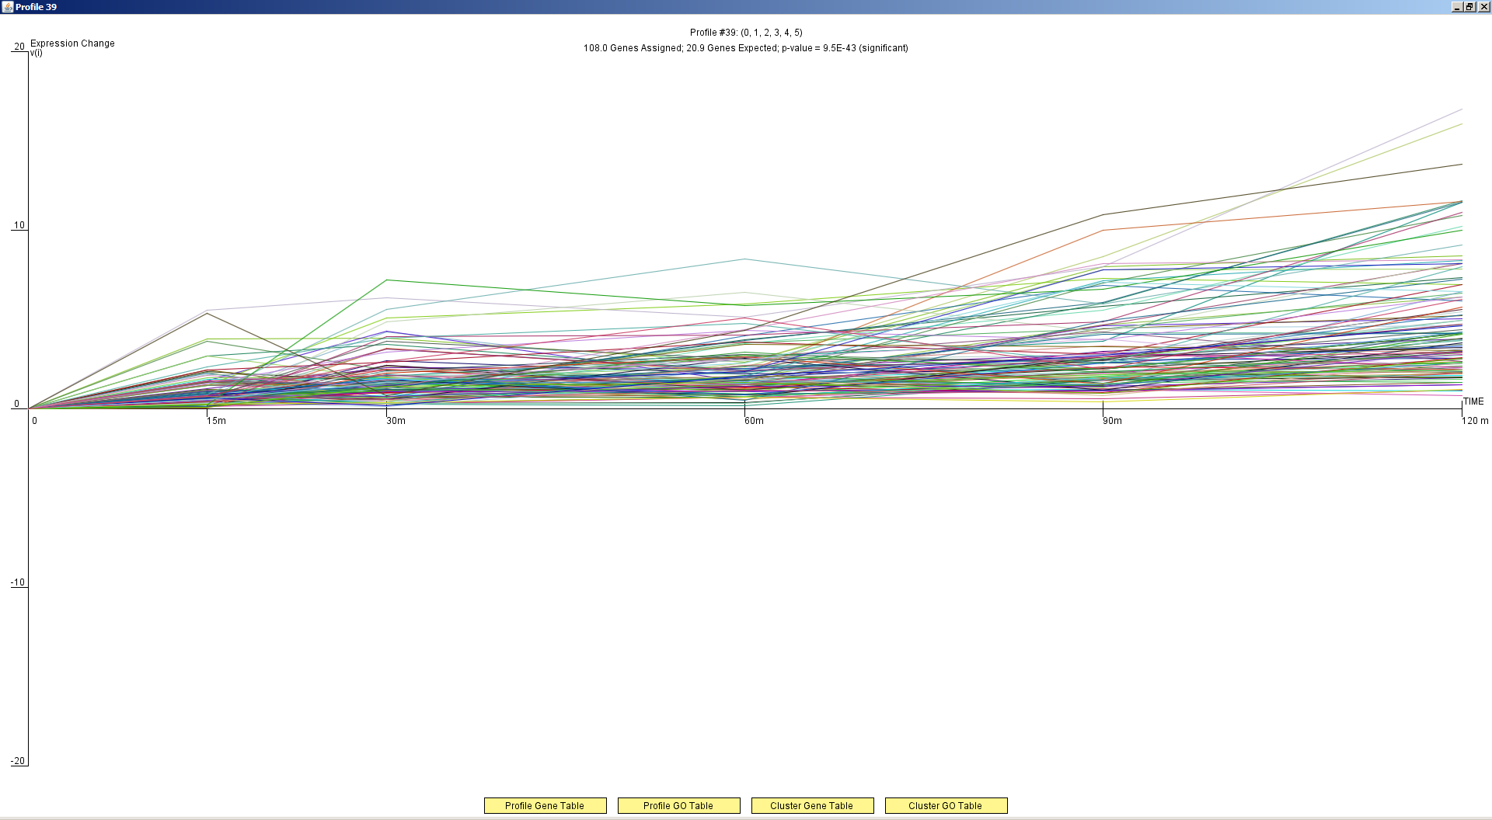
Profile 39

Slide 5
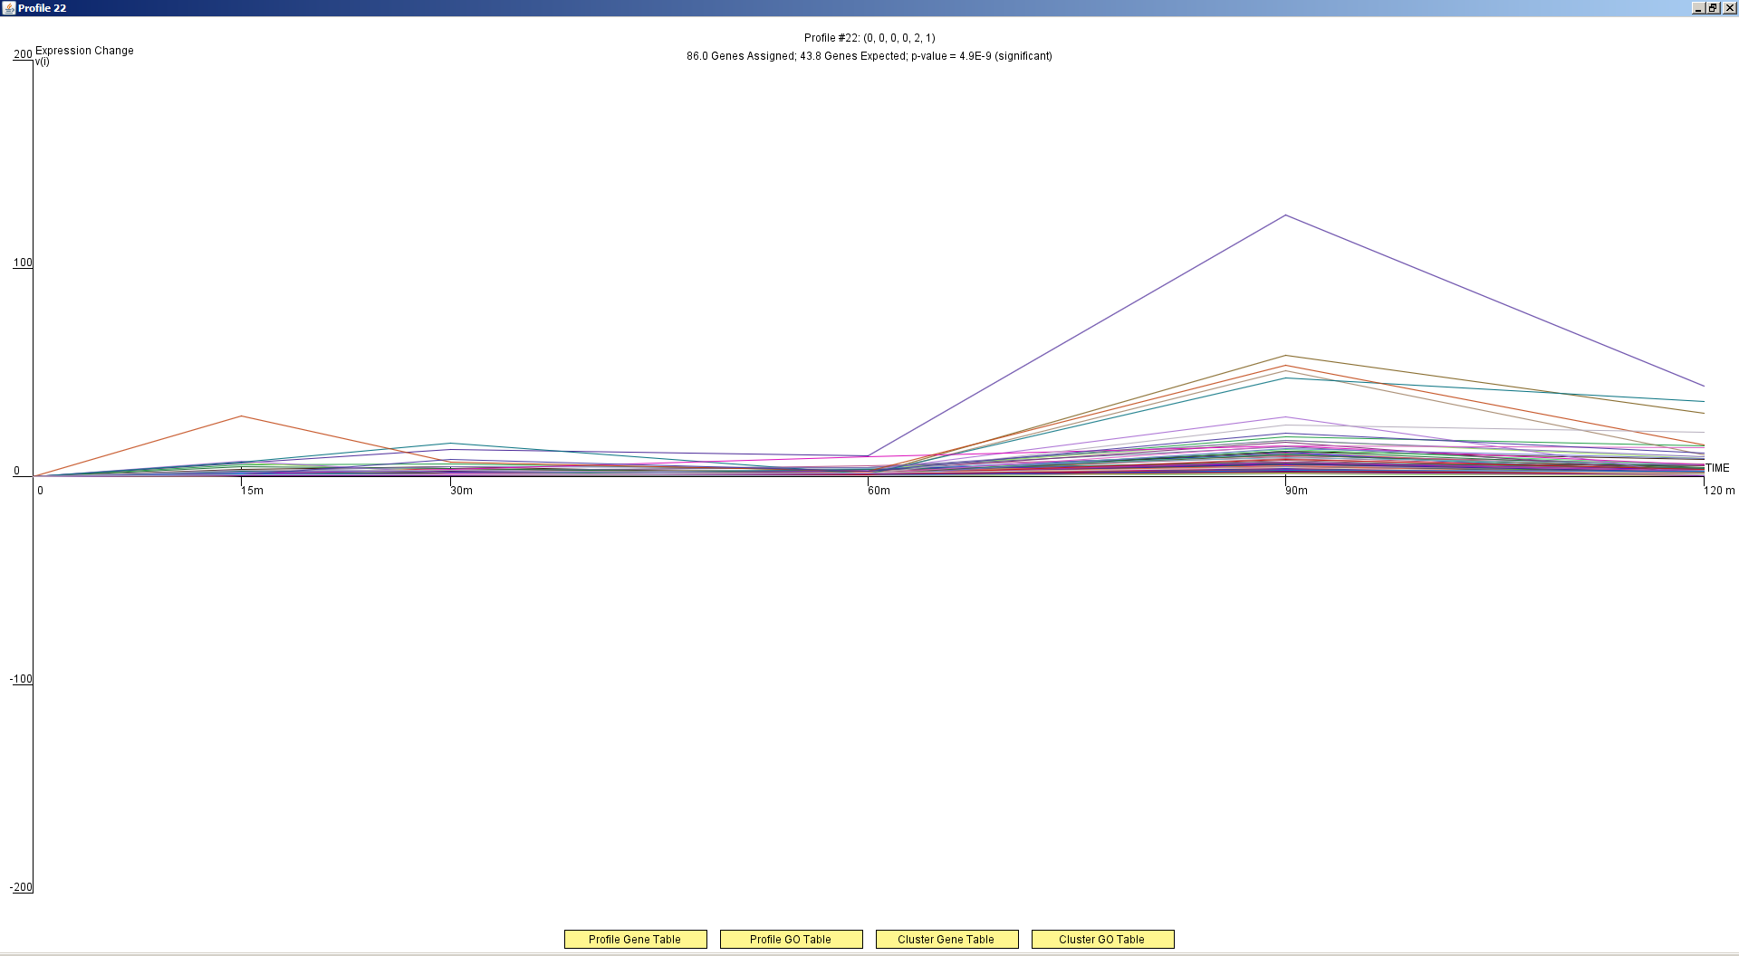
Profile 22

Slide 6
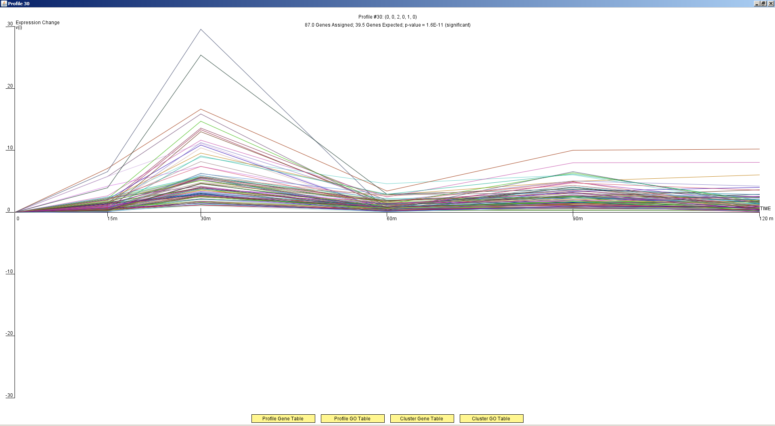
Profile 30

Slide 7
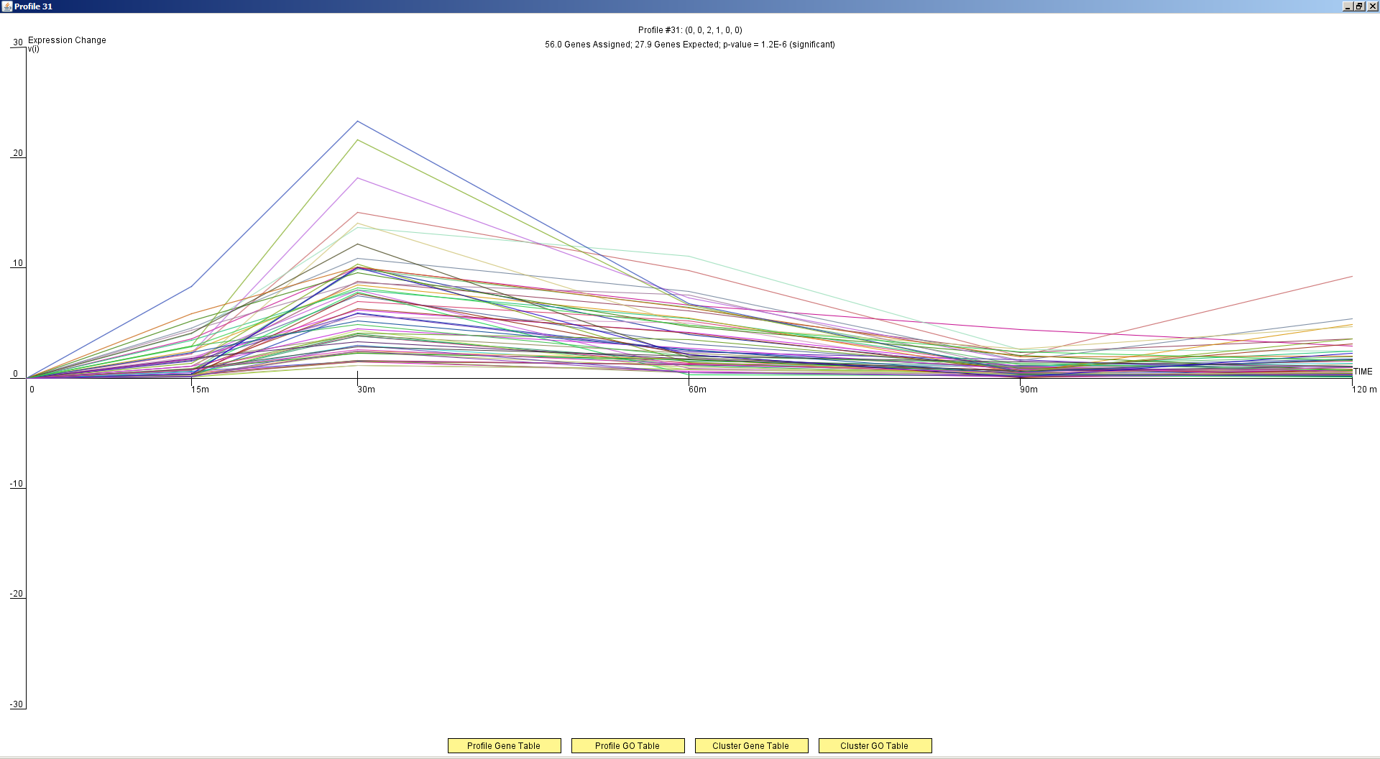
Profile 31

Slide 8
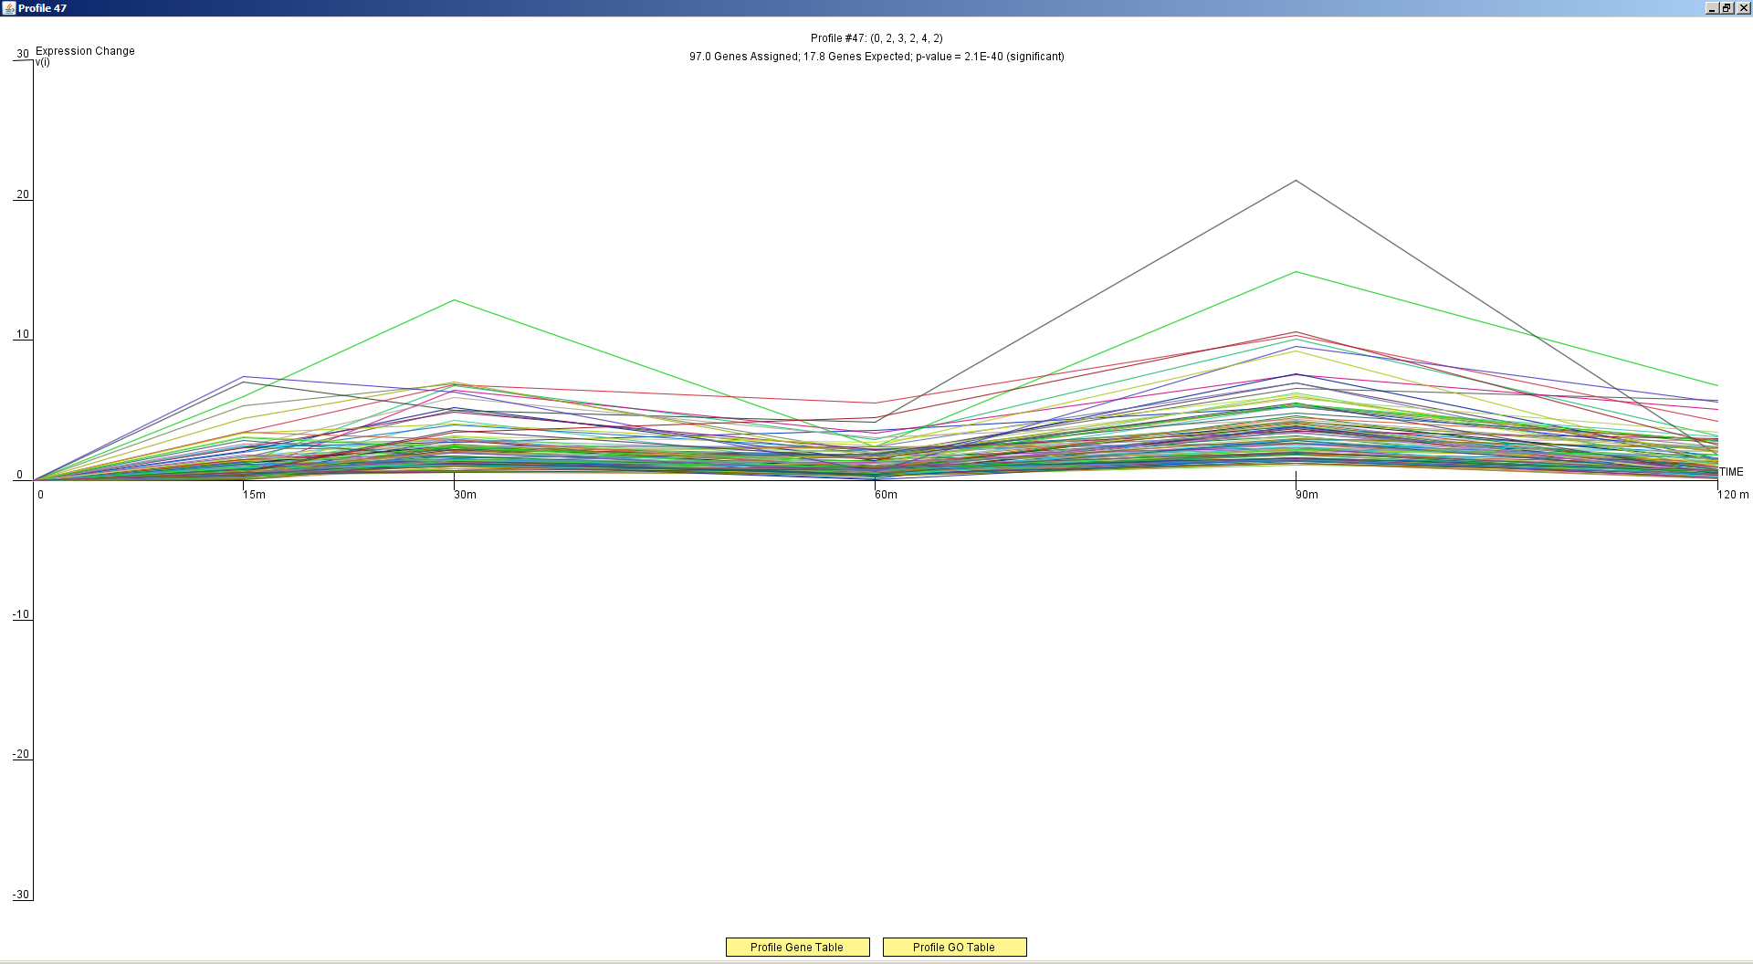
Profile 47

Slide 9
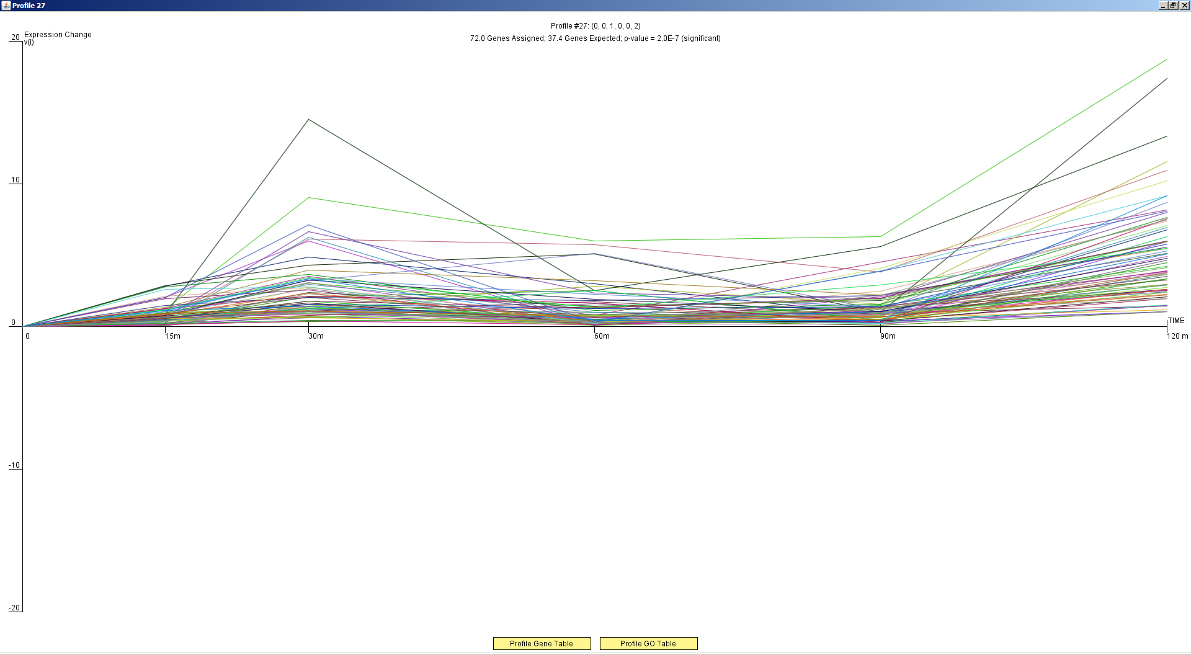
Profile 27

Slide 10
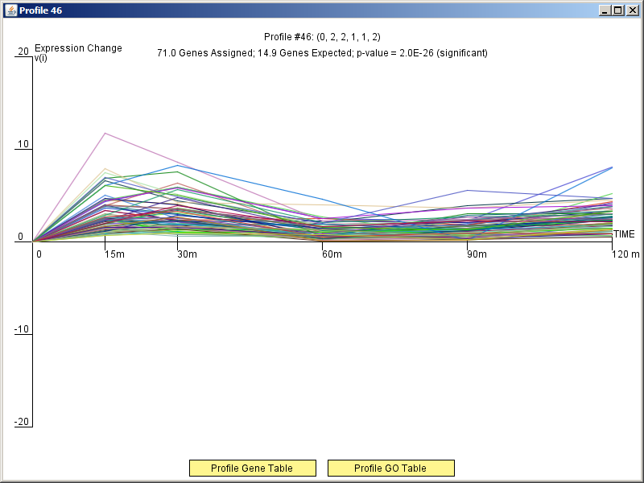
Profile 46

Slide 11
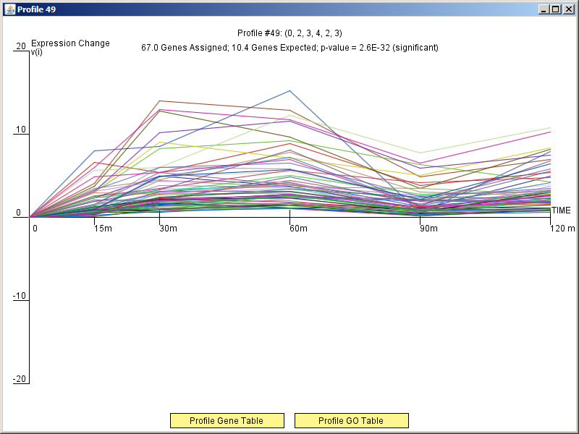
Profile 49

Slide 12
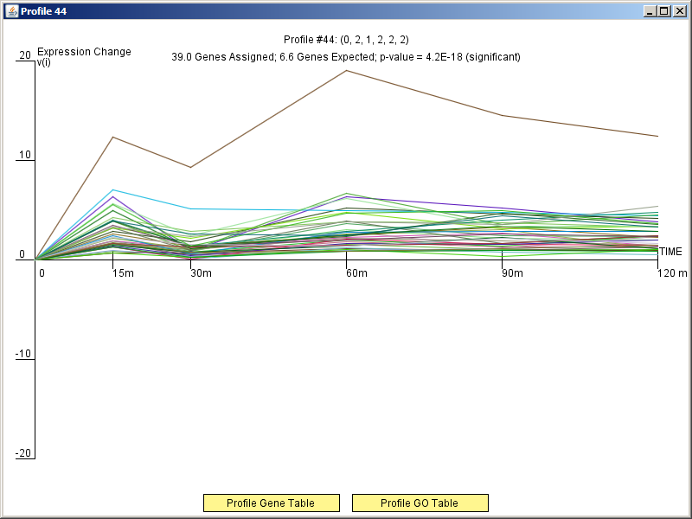
Profile 44

Slide 13
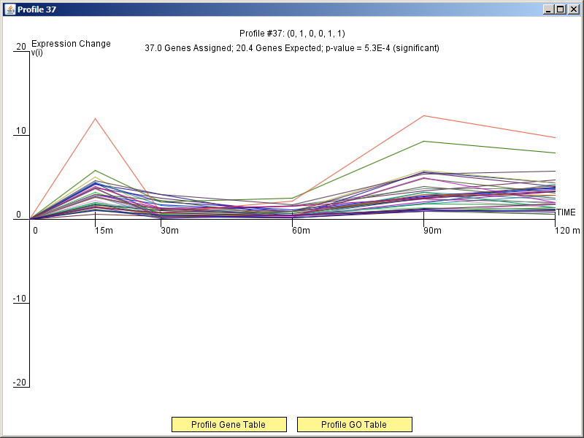
Profile 37

Slide 14
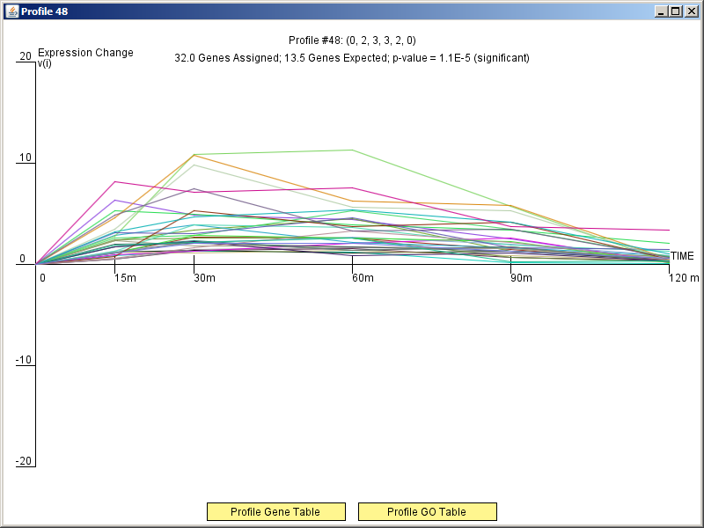
Profile 48

