Slide 1
Changes In Protein Sequences Of the HIV-1 gp120 V3 Region In Non-Progressor Types
Nicki S.Harmon
Samantha M. Hurndon

Slide 2
Outline
Markham’s non-progressors

Slide 3
The Amino Acid Sequence of the V3 Region Plays A Significant Role in CD4 Binding.
The V3 region of the gp 120 env protein is a variable loop with a high mutation rate.
V3 is what binds to the CD4 receptor sites on cell.
The amino acid sequence determines how the V3 region will function.
And therefore, how the CD4 will interact

Slide 4
HIV-1 Progresses at Different Rate
Markham observed 3 types of progressors
Non-progressors
Maintained CD4 T cell levels above 650 throughout the Observation period.
Moderate
CD4 T cell levels declined to 200-650 during the observation period
Rapid
Having attained a level of fewer than 200 CD4 T cells

Slide 5
The Non-Progressor Types Should Have Amino Acid Sequences that are Closely Related

Slide 6
Methods were Based off Markham’s Findings
The subjects that we selected for our study were subjects 2, 12, 13 and 8.
Subject 2, 12 and 13 are non progressor types
Subject 8 is a moderate progressor that will be used as a comparison to our non progressor subjects

Slide 7
Determination of Sequence were Randomly Selected
Due to the nature of the non-progressor type, sequence selection can be random.
Subject 8 showed a change over the course of the study.
Due to this change sequences from the first and last visits were chosen.

Slide 8
Amino Acid Sequences were Retrieved For Our Subjects
The program Bedrock was use to access our sequences.

Slide 9
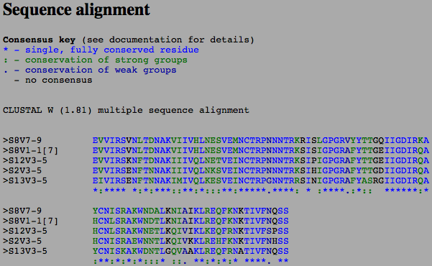
Analysis of Multiple Sequences Alignment Shows Conservation of Residues

Slide 10
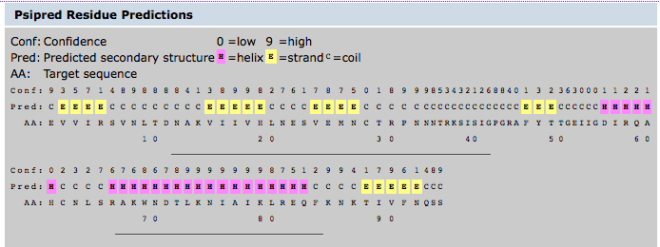
Secondary Structure Is Maintained Throughout The Subjects

Slide 11
Based Off Sequences From Subjects 2, 12, 13 & 8 We Can Conclude that
The Non-Progressor types had similar amino acid sequences.
There were changes between the non-progressors and subject 8 that could account for subject 8 being a moderate progressor.
Secondary structure was not affected by these changes in sequence.

Slide 12
References
Positive In Vivo Selection of the HIV-1 Envelope Protein gp120 Occurs at Surface-Exposed Regions
Beda Joos1,
Marek Fischer1,
Andreas Schweizer1,
Herbert Kuster1,
Jürg Böni2,
Joseph K. Wong3,
Rainer Weber1,
Alexandra Trkola1 and
Huldrych F. Günthard1

