Slide 1
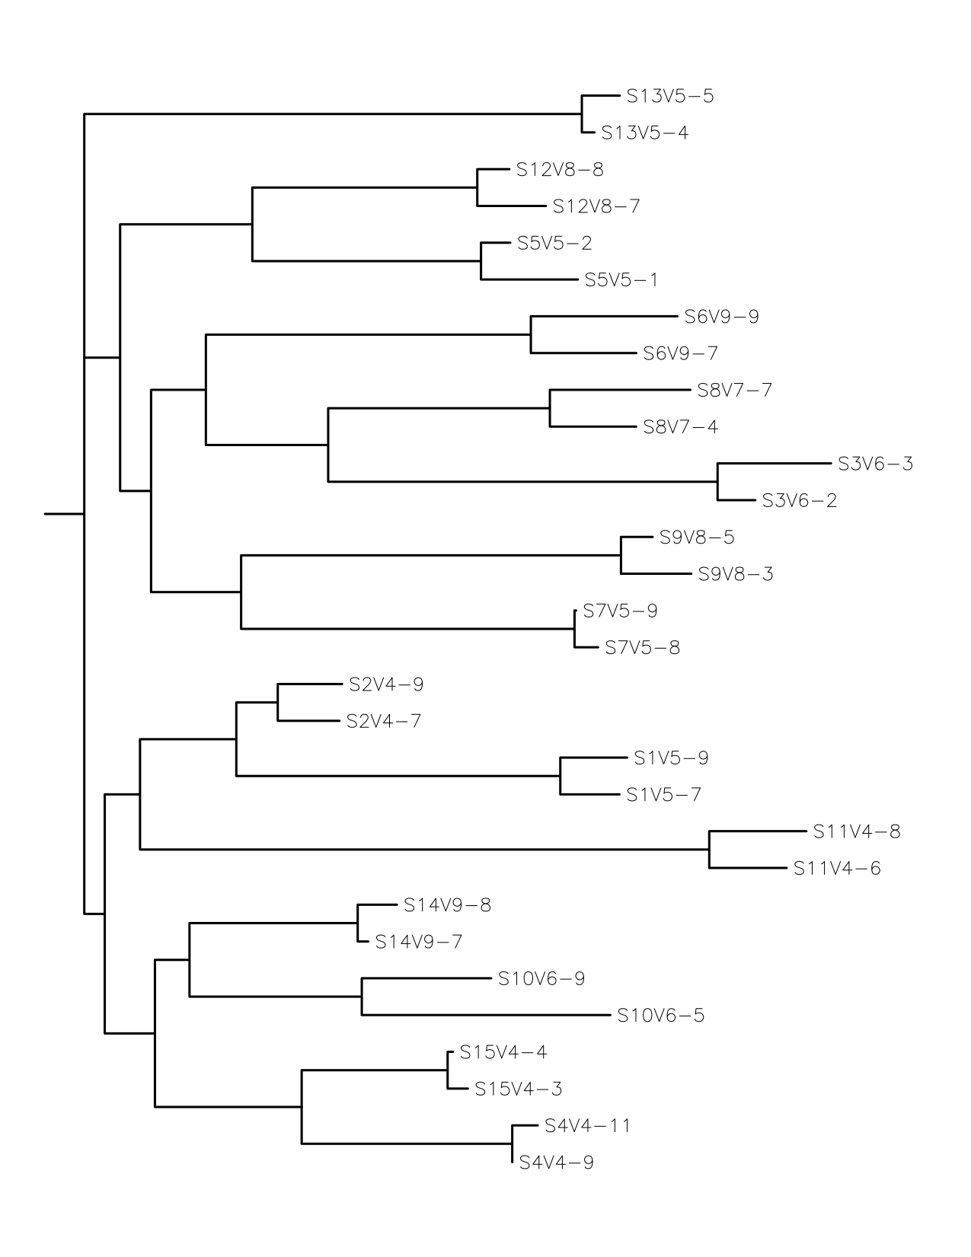
Not at Risk
At Risk
AIDS

