Slide 1
Engineering Living Functional Material Allen Y. Chen, Chao Zhong, Timothy K. Lu
Synthesis and patterning of tunable multiscale materials with engineered cells Allen Y. Chen, Chao Zhong, Timothy K. Lu
Presented by Gabriela Garcia
March 18th, 2015

Slide 2
Live systems have attractive foundational properties for improving of materials
Responsive to environment | Interfaces with inorganics
Sense damage & self heal Can lead to ‘smart’ materials | Multifunctional Introduce non biological properties
Evolvable | Self-organizing
Acted upon by selective pressure Adapted to optimize for material assembly | Material hierarchies Could translate to autonomous assembly

Slide 3
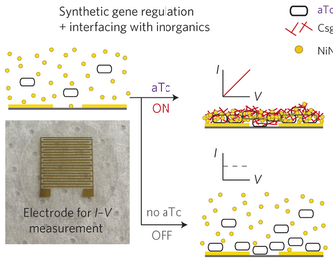
Combining synthetic and living components would add novel functionality to materials
Sense-and-response systems are attractive for use in material science
Can allow for self-healing materials, materials which remodel based on external signals, etc.
Proof of concept showed the assembly of a conductive biofilm from a biological system
Allen Y. Chen; Nature Materials 13, 515–523 (2014)

Slide 4
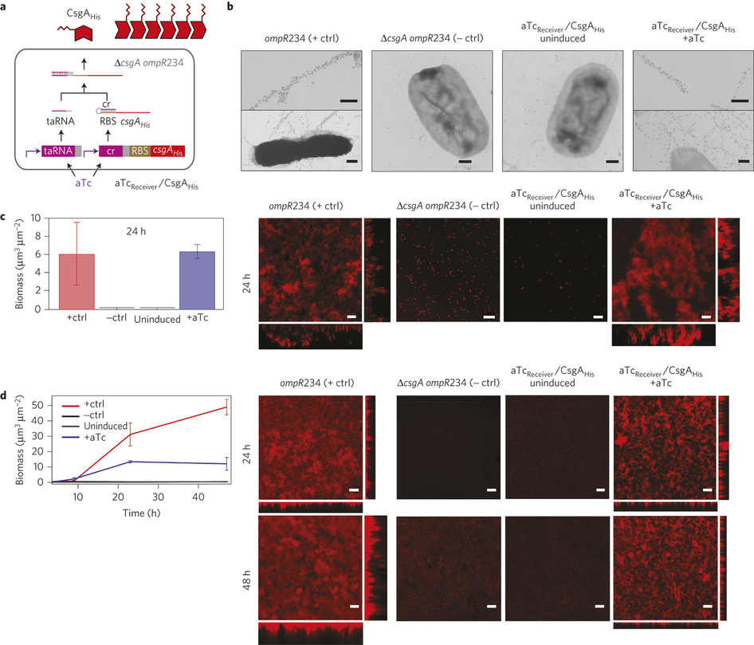
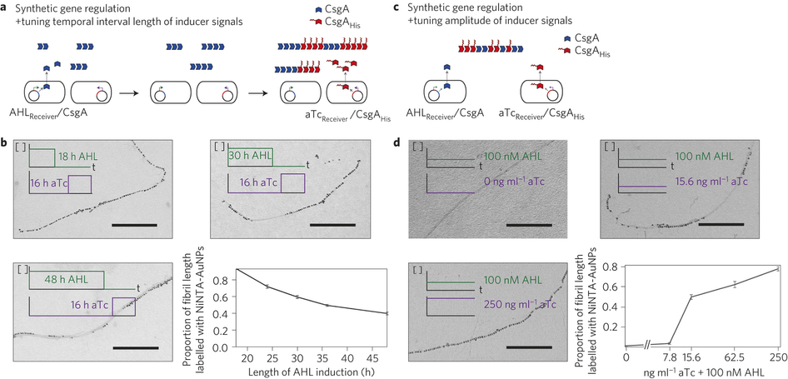
Four strains of E. coli were engineered to make a cellular consortia for materials patterning
ΔcsgA strains were modified for modulation of CsgA expression
CsgA and CsgA_{His} were used to allow for functionalization
Anhydrotetracycline (aTc) and acyl-homoserine lactone (AHL) were used in riboregulation
Tight control of CsgA subunit production was demonstrated
Notes:
Deletion of endogeneous csgA
Insertion of inducer-responsive bioregulated CsgA and CsgA_{His} protein
Exhibit tight regulation of csgA_{His} gene

Slide 5
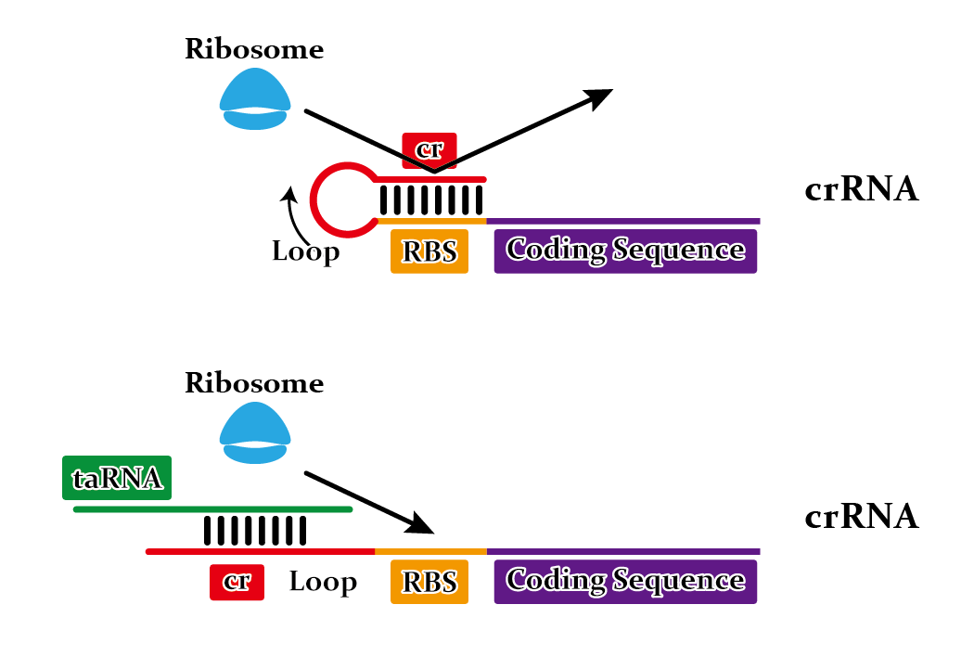
Stem-loop riboregulator
trans-activating RNA
cis-repressed mRNA

Slide 6
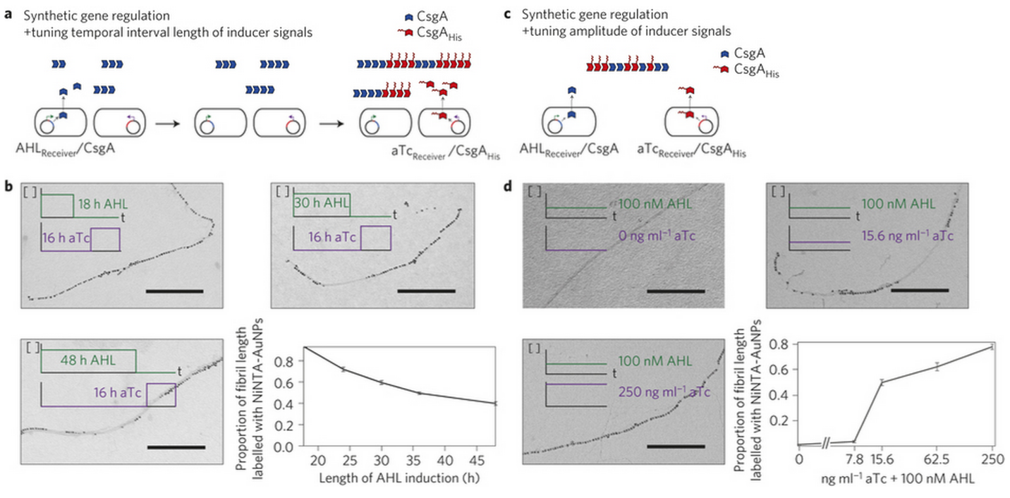
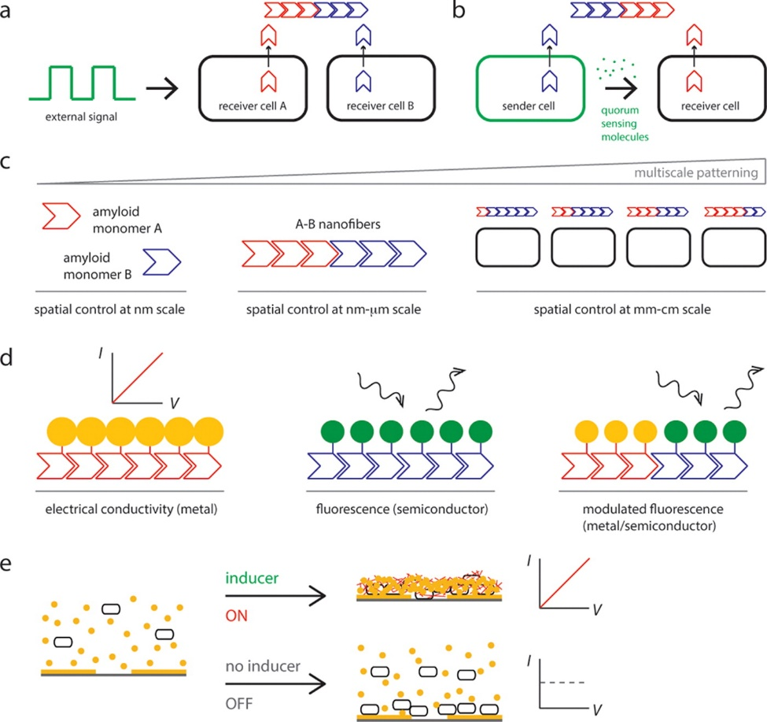
Induction modulation was explored to obtain means for different patterning techniques
Timescale of Inducer Signal
Amplitude of Inducer Signal
Notes:
Longer time corresponds to more of each type and longer blocks of that type
Amplitude corresponds to number of each type
Basically to show operational range

Slide 7
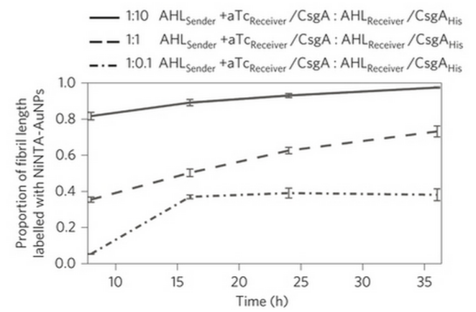
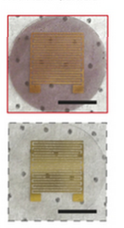
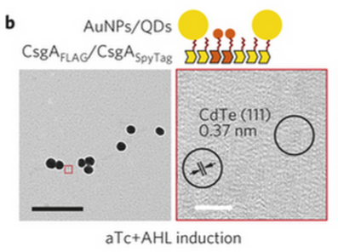
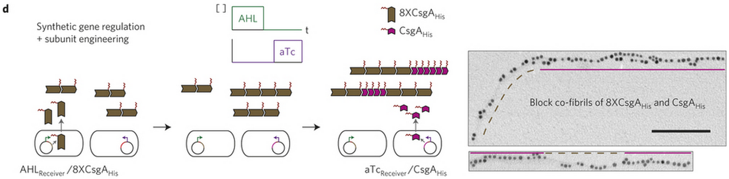
Four additional patterning schemes were explored using specialized cell cohorts
Autonomous Patterning
Multiscale Patterning
Inorganic Interfaces
Heterostructures

Slide 8
Assumptions and Concerns
Things I thought rested on assumptions
System would scale well
Use of other materials would be analogous
Concerns and Suggestions
Toxicity concerns with other materials
Experiment with other materials for possible use
Explore other excreted proteins/ other biofilm components

Slide 9
Conclusion and Significance
Cell circuitry behaved as expected and structures were well defined and characterized
Temporal, scale, appropriate signals
Applications for other fields and industries
Cell circuits demonstrate genetic programmability of biomaterials
Materials science and self-healing applications
Proof of concept
Interesting in theory, small impact in practice

