Slide 1
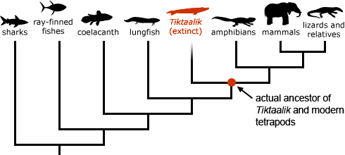

Slide 2
The Tree of Life
http://thumbnails.visually.netdna-cdn.com/the-great-tree-of-life_505ba0c07cda2.gif

Slide 3
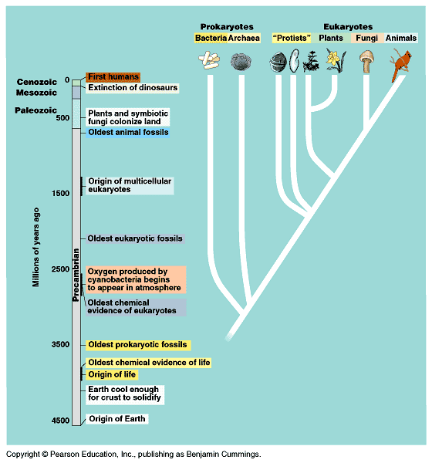
Figure 26.1 Some major episodes in the history of life

Slide 4
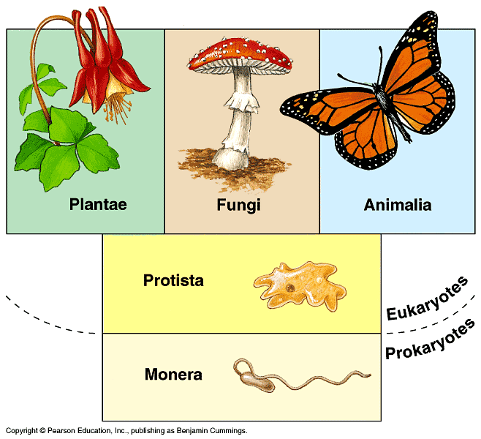
Figure 26.15 Whittaker’s five-kingdom system

Slide 5
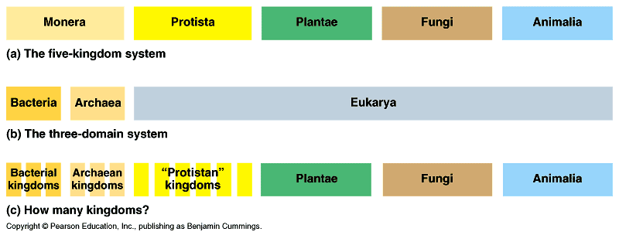
Figure 26.16 Our changing view of biological diversity

Slide 6
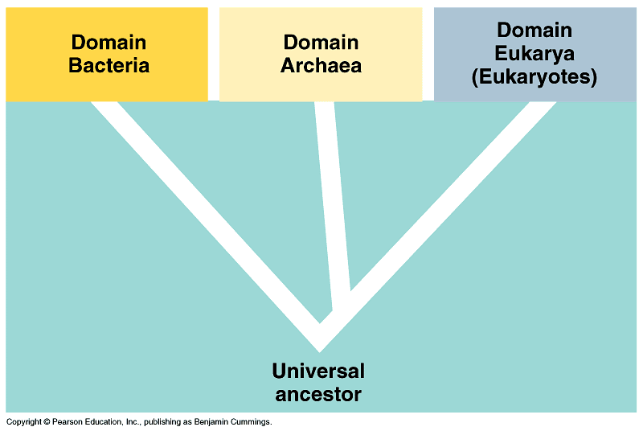
Figure 27.2 The three domains of life

Slide 7
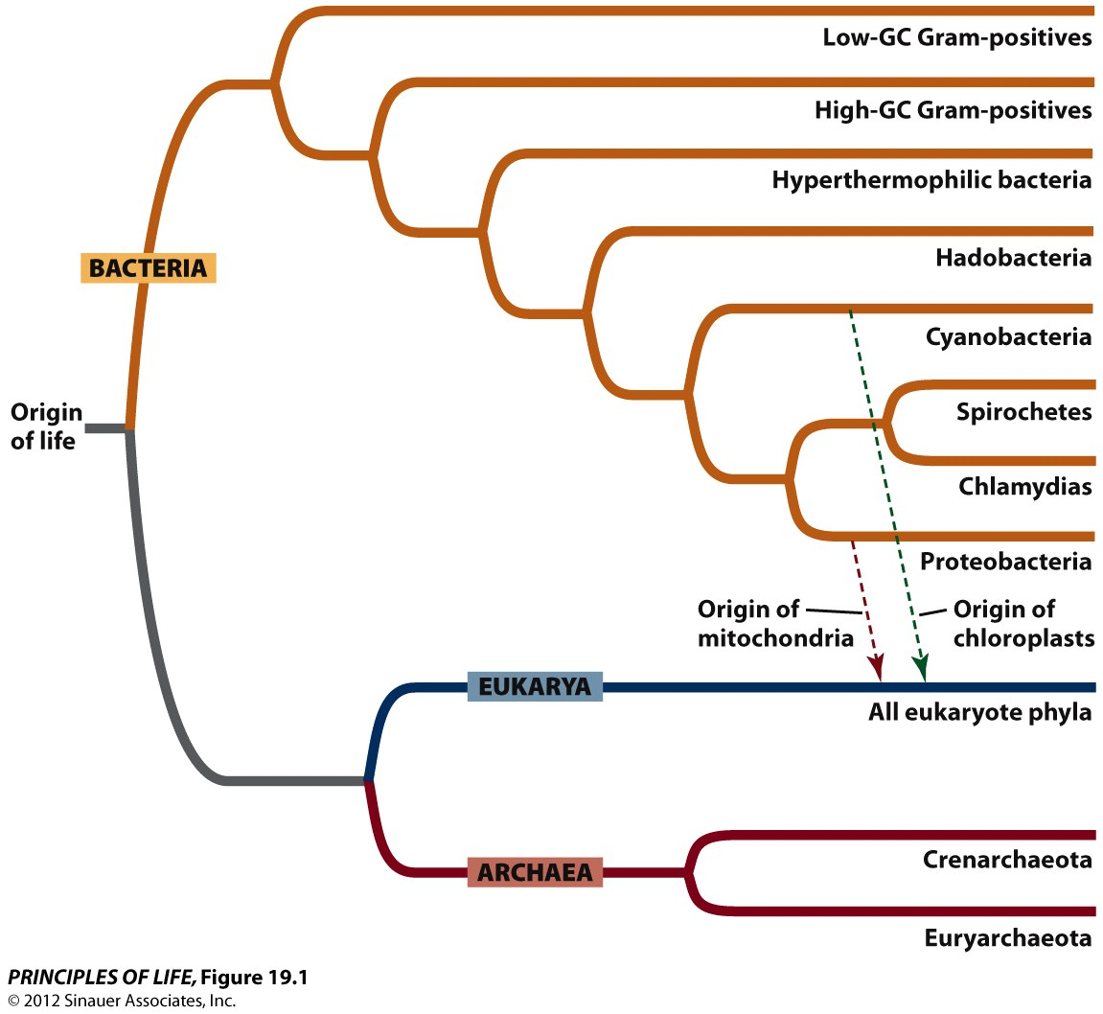
Figure 19.1 The Three Domains of the Living World

Slide 8
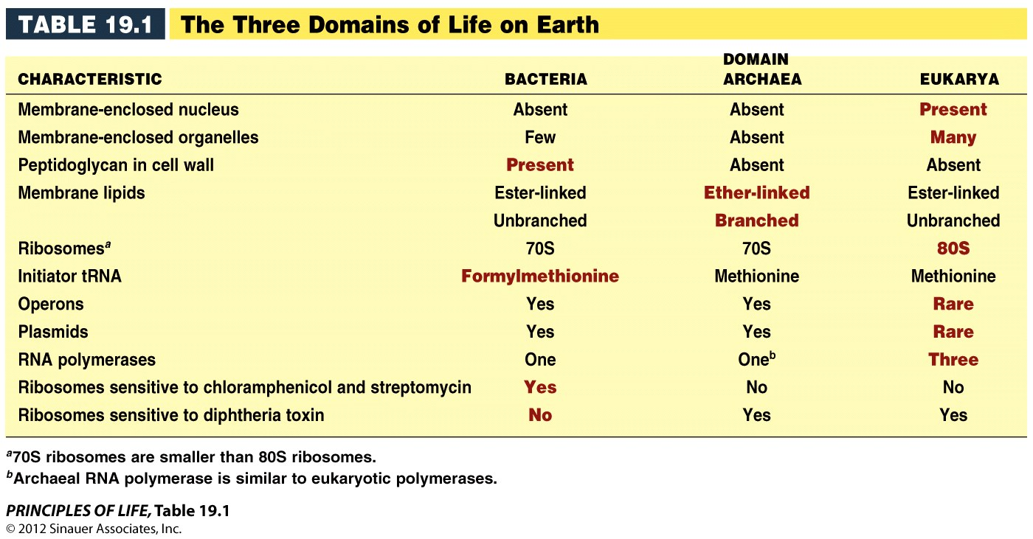
Table 19.1 The Three Domains of Life on Earth

Slide 9
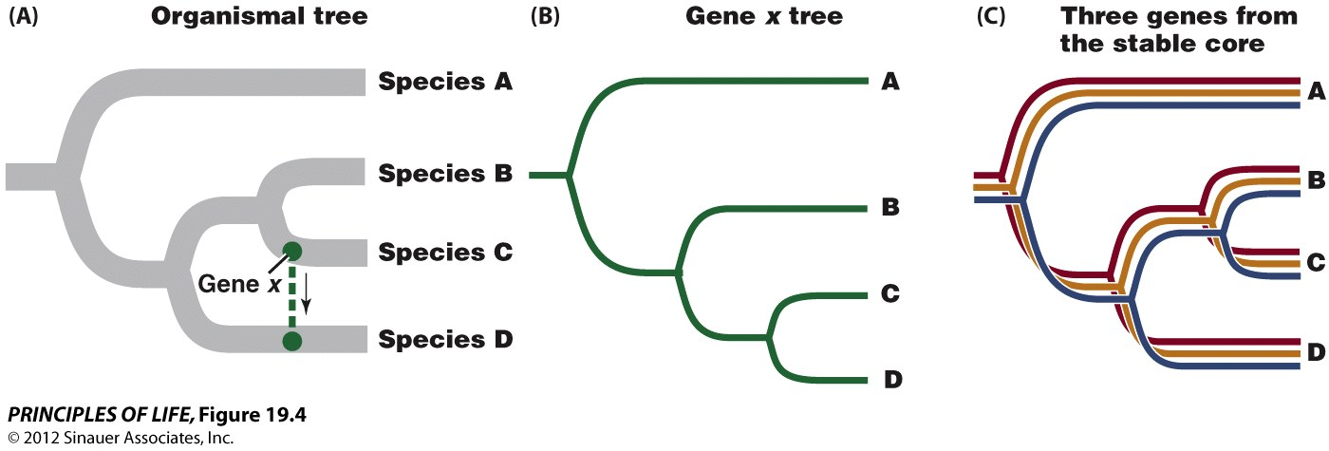
Figure 19.4 Lateral Gene Transfer Complicates Phylogenetic Relationships

Slide 10
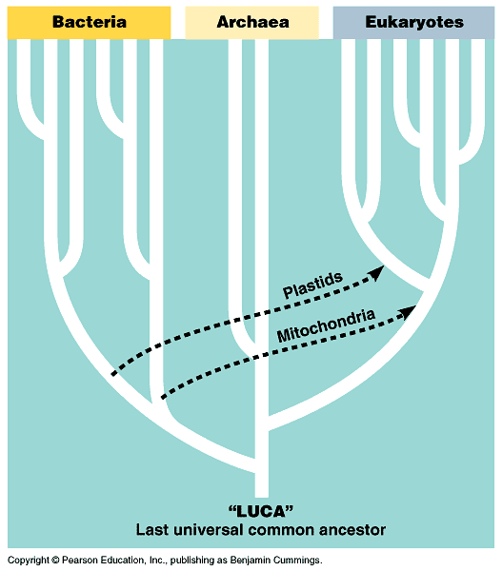
Figure 28.6 Traditional hypothesis for how the three domains of life are related

Slide 11
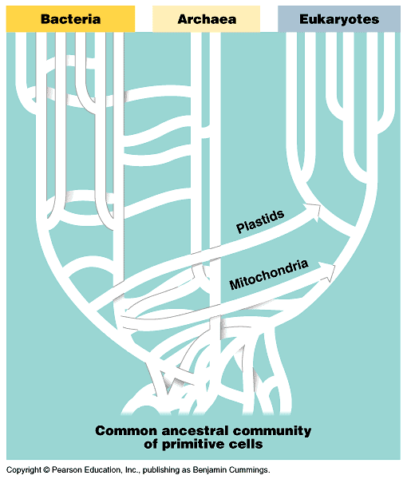
Figure 28.7 An alternative hypothesis for how the three domains of life are related

Slide 12
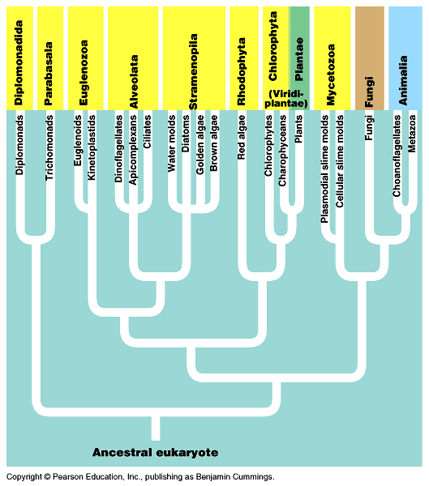
Figure 28.8 A tentative phylogeny of eukaryotes

Slide 13
Apply the concept p. 390
Eukaryotes acquired features from both archaea and bacteria
  Ribosomal RNA (rRNA) genes are present in the nuclear genome of eukaryotes. There are also rRNA genes in the genomes of mitochondria and chloroplasts. Therefore, photosynthetic eukaryotes have three different sets of rRNA genes, which encode the structural RNA of separate ribosomes in the nucleus, mitochondria, and chloroplasts, respectively. Translation of each genome takes place on its own set of ribosomes.
  The gene tree shows the evolutionary relationships of rRNA gene sequences isolated from the nuclear genomes of humans, yeast, and corn; from an archaeon (Halobacterium), a proteobacterium (E. coli), and a cynobacterium (Chlorobium); and from the mitochondrial and chloroplast genomes of corn. Use the gene tree to answer the following questions.

Slide 14
Why aren’t the three rRNA genes of corn one another’s closest relatives?
How would explain the closer relationship of the mitochondrial rRNA gene of corn to the rRNA gene of E. coli than to the nuclear rRNA genes of other eukaryotes? Can you explain the relationship of the rRNA gene from the chloroplast of corn to the rRNA gene of cyanobacterium?
If you were to sequence the rRNA genes from human and yeast mitochondrial genomes, where would you expect these two sequences to fit on the gene tree?

Slide 15
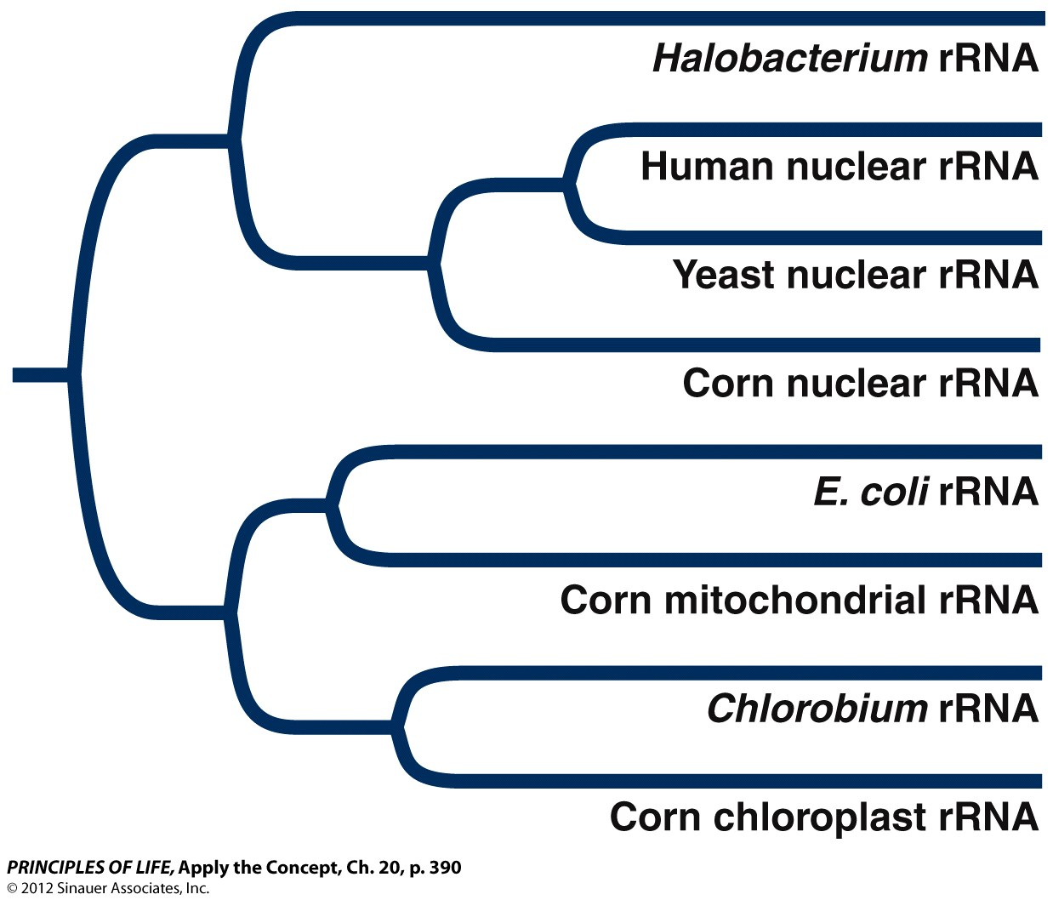
Apply the Concept, Ch. 20, p. 390

Slide 16
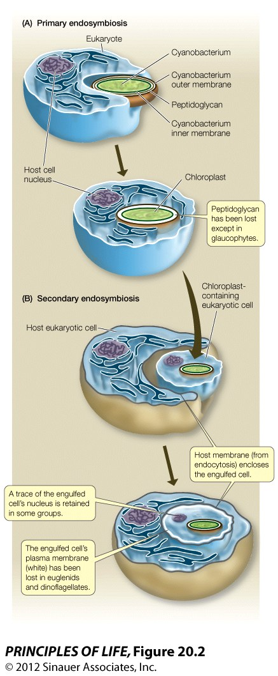
Figure 20.2 Endosymbiotic Events in the Evolution of Chloroplasts

Slide 17
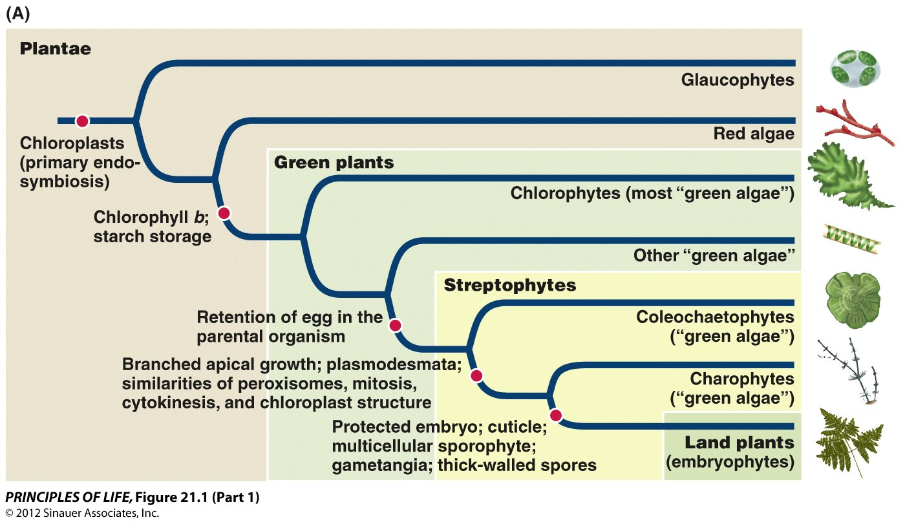
Figure 21.1 The Evolution of Plants (Part 1)

Slide 18
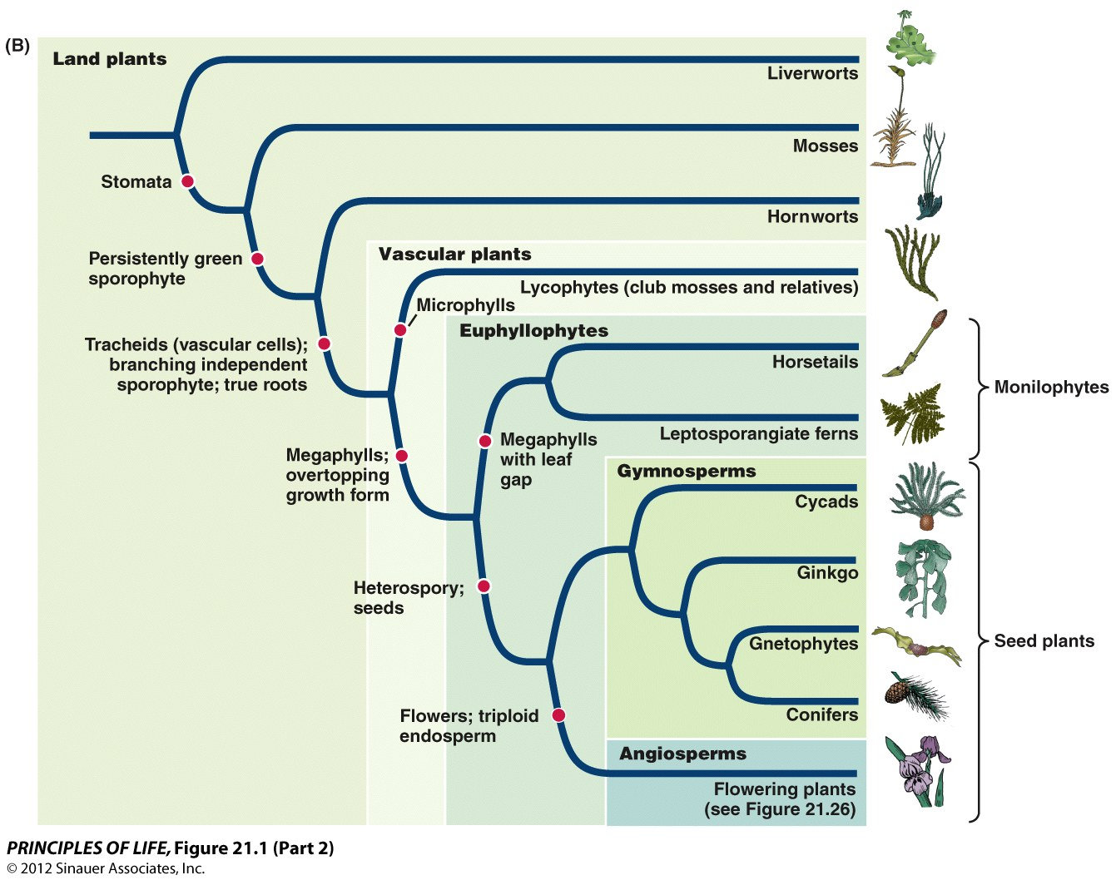

Slide 19
Concept 21.1 Primary Endosymbiosis Produced the First Photosynthetic Eukaryotes
Using the preceding phylogenies, answer the following:
  1. What are the key traits that separate green plants from glaucophytes and red algae?
  2. What is the key trait that separates streptophytes from green plants?
  3. Which two groups of green algae are most closely related to land plants?
  Name one trait that separates the land plants from green algae.
Compare your answers with your neighbors and discuss.
Notes:
19
Answers:
Chlorophyll b and starch storage
Retention of the egg in the parental organism
Coleochaetophytes and charophytes
Any of the following: protected embryo, cuticle, multicellular sporophyte, gametangia, thick-walled spores

Slide 20
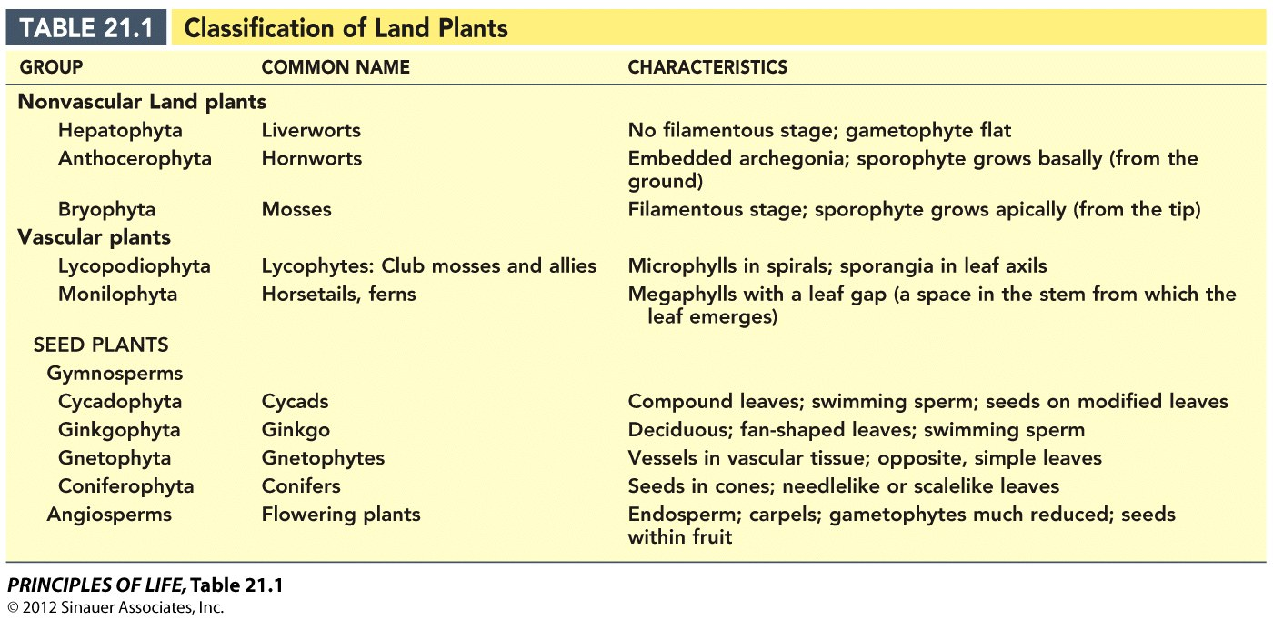
Table 21.1 Classification of Land Plants

Slide 21
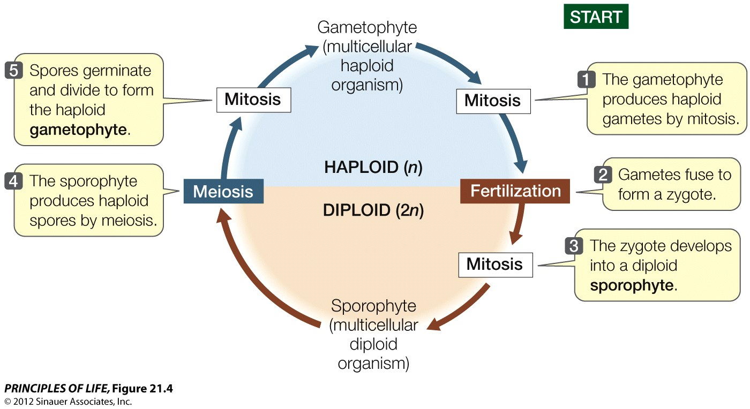
Figure 21.4 Alternation of Generations in Land Plants

Slide 22
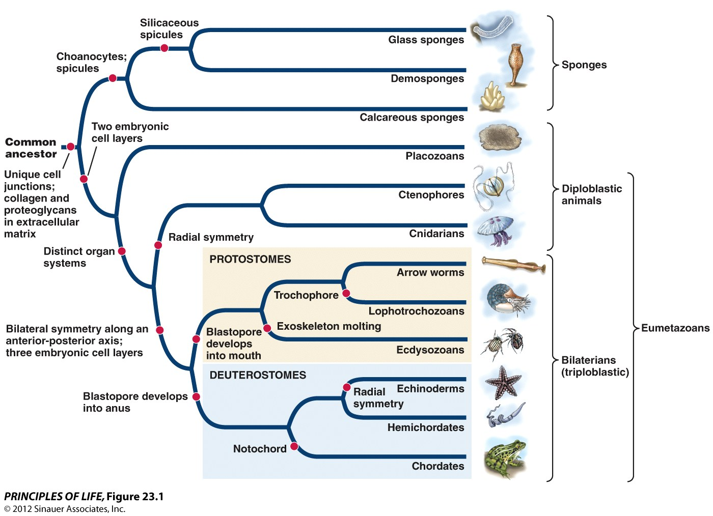
Figure 23.1 Animal Phylogeny

Slide 23
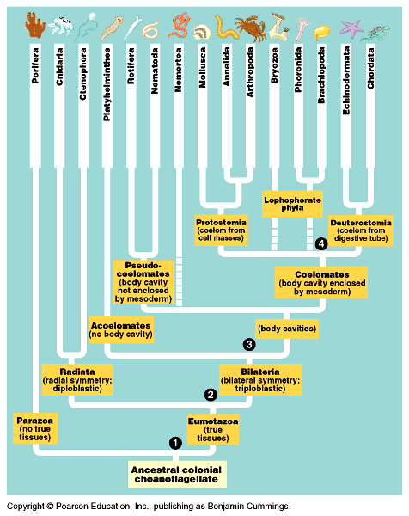
Figure 32.4 A traditional view of animal diversity based on body-plan grades

Slide 24
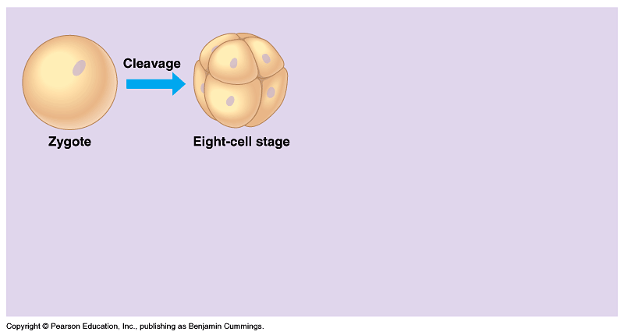
Figure 32.1 Early embryonic development (Layer 1)

Slide 25
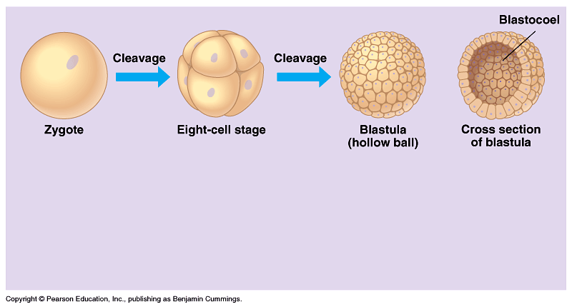
Figure 32.1 Early embryonic development (Layer 2)

Slide 26
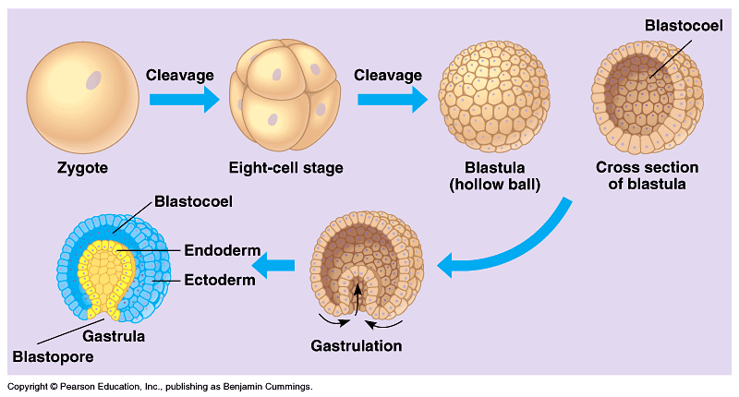
Figure 32.1 Early embryonic development (Layer 3)

Slide 27
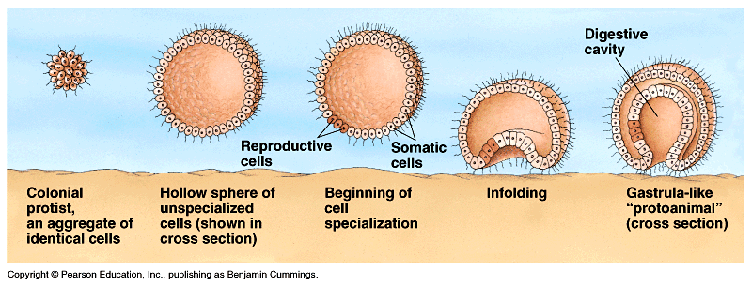
Figure 32.3 One hypothesis for the origin of animals from a flagellated protist

Slide 28
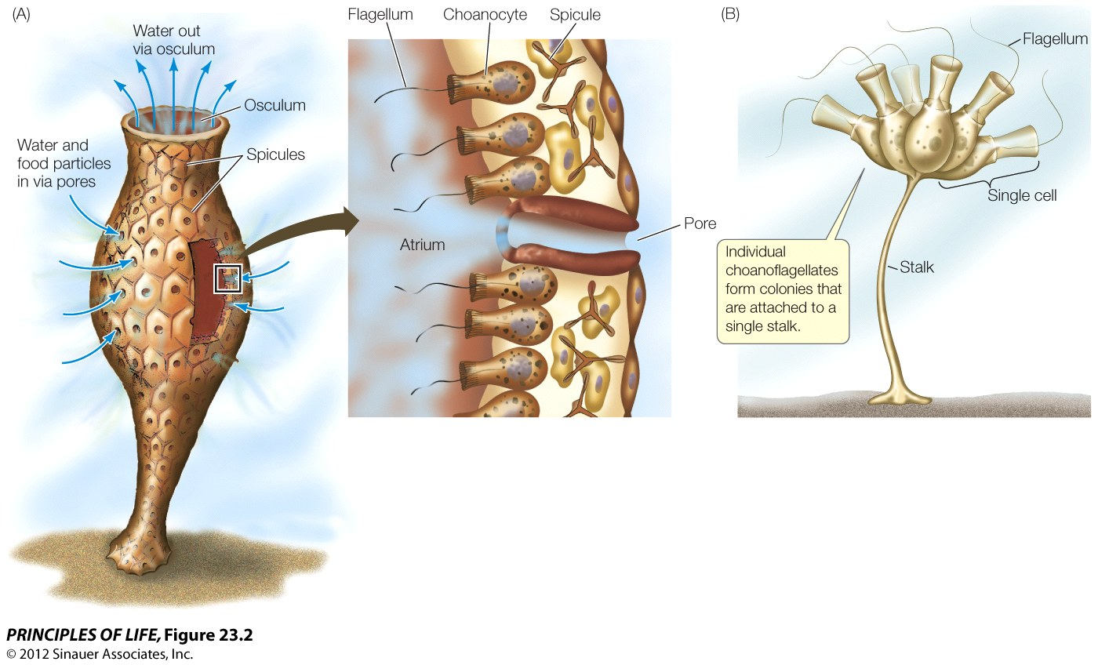
Figure 23.2 Choanocytes in Sponges Resemble Choanoflagellate Protists

Slide 29
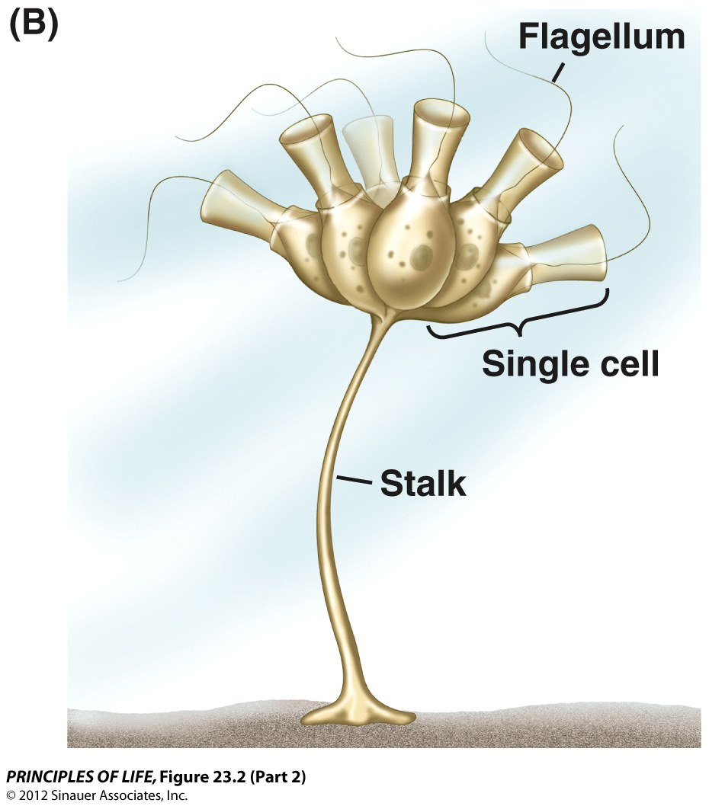
Figure 23.2 Choanocytes in Sponges Resemble Choanoflagellate Protists (Part 2)

Slide 30
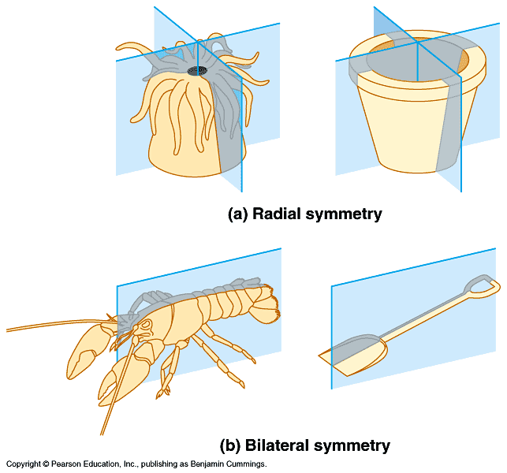
Figure 32.5 Body symmetry

Slide 31
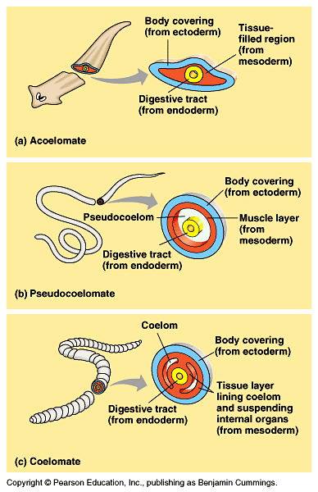
Figure 32.6 Body plans of the bilateria

Slide 32
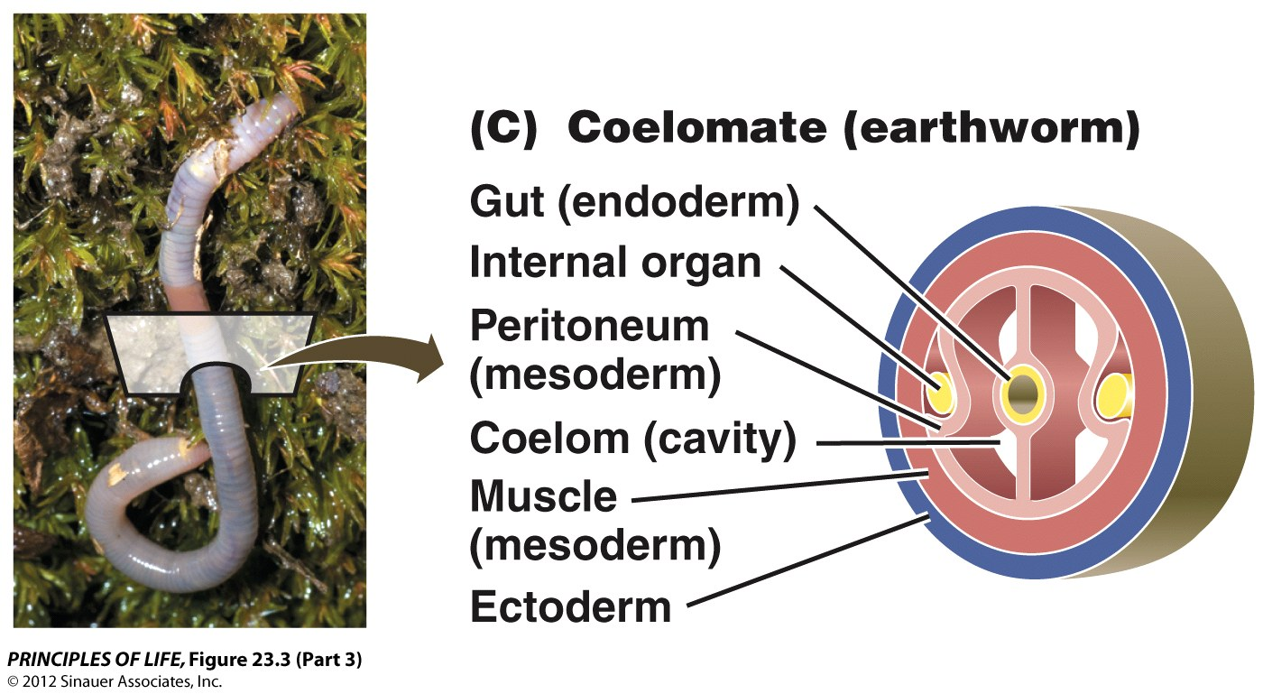
Figure 23.3 Animal Body Cavities (Part 3)

Slide 33
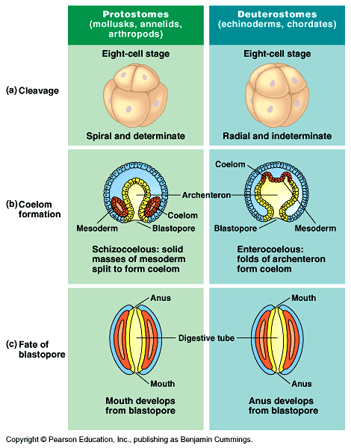
Figure 32.7 A comparison of early development in protostomes and deuterostomes

Slide 34
Concept 23.1 Distinct Body Plans Evolved among the Animals
Examine the following animal phylogeny and focus on the major patterns in animal evolution in terms of body plan.
Discuss in particular the evolution of different types of body symmetry. As organisms diverge at the point shown by the arrow on this phylogenetic tree, does symmetry remain fixed as evolution proceeds?
Notes:
34
INSTRUCTOR NOTE:
Use Figure 23.1 from the textbook for reference.

Slide 35
Concept 23.1 Distinct Body Plans Evolved among the Animals
As organisms diverge at the point shown by the arrow on this phylogenetic tree, symmetry remain fixed as evolution proceeds.
  a. True
  b. False
  c. I don’t know.
Notes:
35
Answer: b
(In fact, radial symmetry evolves in radiate animals, but then evolves again independently, from bilateral symmetry, in echinoderms.)
[NOTE TO THE INSTRUCTOR: It can be useful to include an “I don’t know” choice with clickers, because it can help you discover how many students really haven’t understood the concept at all. Use of this option may depend on whether you assign participation-only points or performance points (or some combination) to clicker questions in your course. If you only assign participation points, it may be useful to leave the “I don't know” choice in the question, as it gives students a penalty-free way of indicating that more time may be needed on this concept.]

Slide 36
Concept 23.2 Some Animal Groups Fall Outside the Bilateria
Referring to the phylogeny illustrated below, is radial symmetry common to all organisms not included as bilaterians?
Consulting your textbook, do sponges and placozoans share any common features apart from not being part of the Bilateria?
Bilateria
Notes:
36
INSTRUCTOR NOTE:
This question requires students to consult their textbook.

Slide 37
Concept 23.2 Some Animal Groups Fall Outside the Bilateria
Which of the following statements is true?
  a. All animals that fall outside of the Bilateria group are radially symmetrical.
  b. Sponges and placozoans share the trait of having differentiated tissue types.
  c. Sponges and placozoans can reproduce both sexually and asexually.
  d. Sponges and placozoans have a gut.
  e. Sponges and placozoans have a nervous system.
Notes:
37
Answer: c
(Answer A is not true because some of the organisms, like sponges, are asymmetrical. Answer B is not true because sponges have no distinct tissue types, whereas placozoans have four tissue types. Answers D and E are not true because these organisms have no guts and no nervous system.)
INSTRUCTOR NOTE:
This question requires students to consult their text.

Slide 38
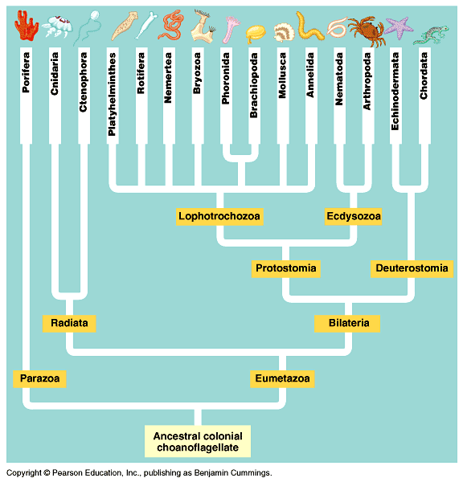
Figure 32.8 Animal phylogeny based on sequencing of SSU-rRNA

Slide 39
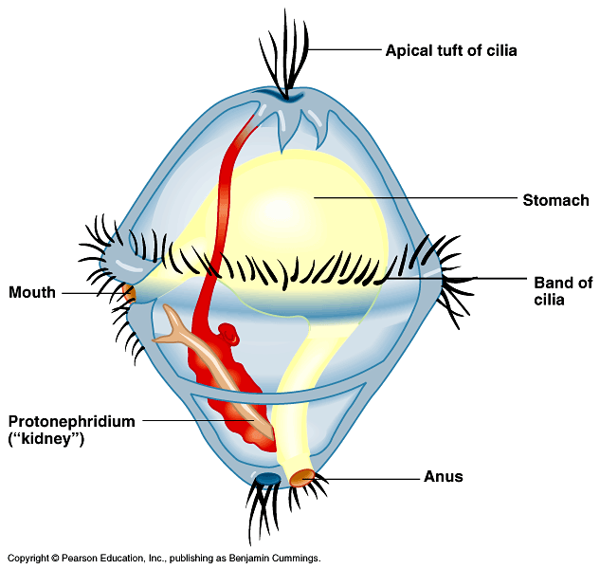
Figure 32.9 A trochophore larva

Slide 40
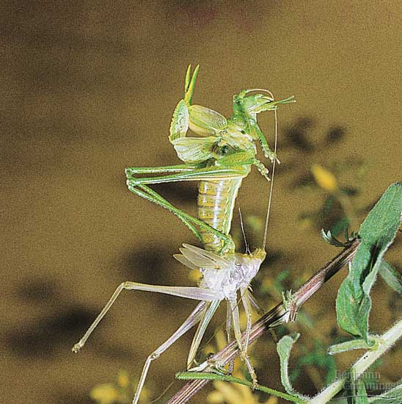
Figure 32.10 Ecdysis

Slide 41
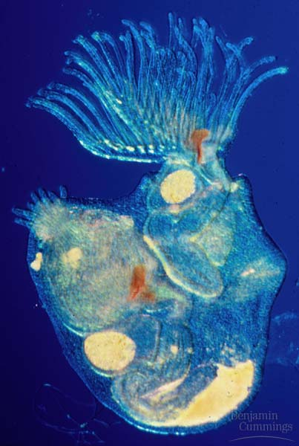
Figure 32.11 A lophophorate

Slide 42
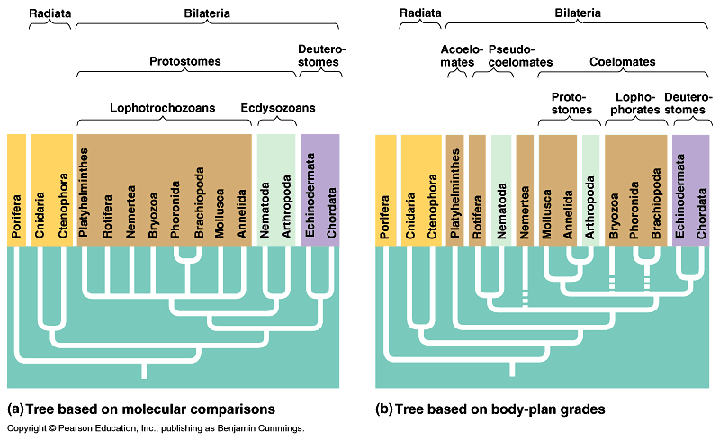
Figure 32.12 Comparing the molecular based and grade-based trees of animal phylogeny

Slide 43
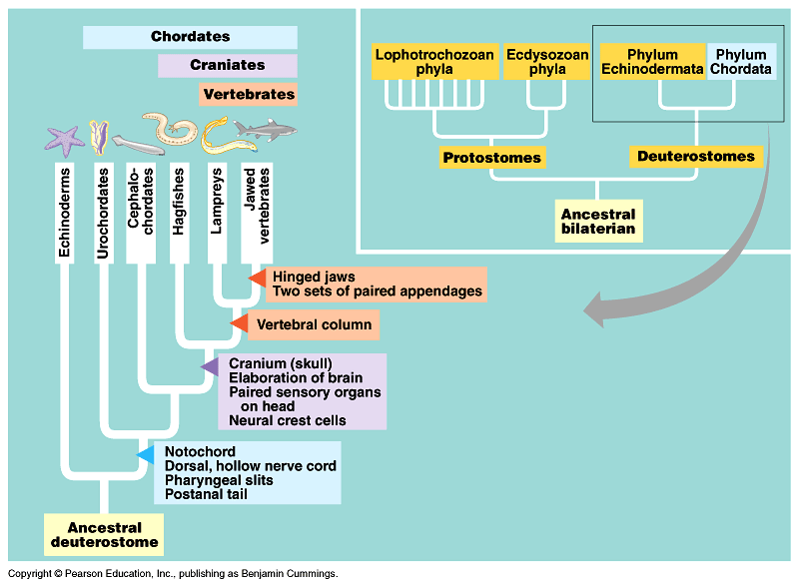
Figure 34.1 Clades of extant chordates

Slide 44
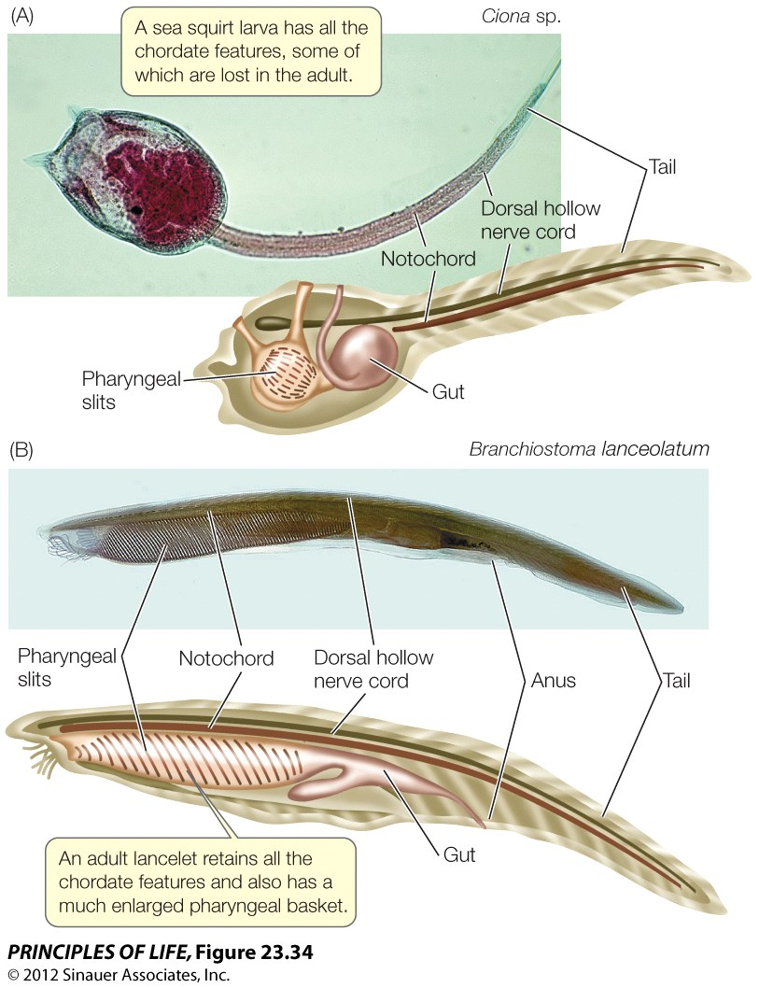

Slide 45
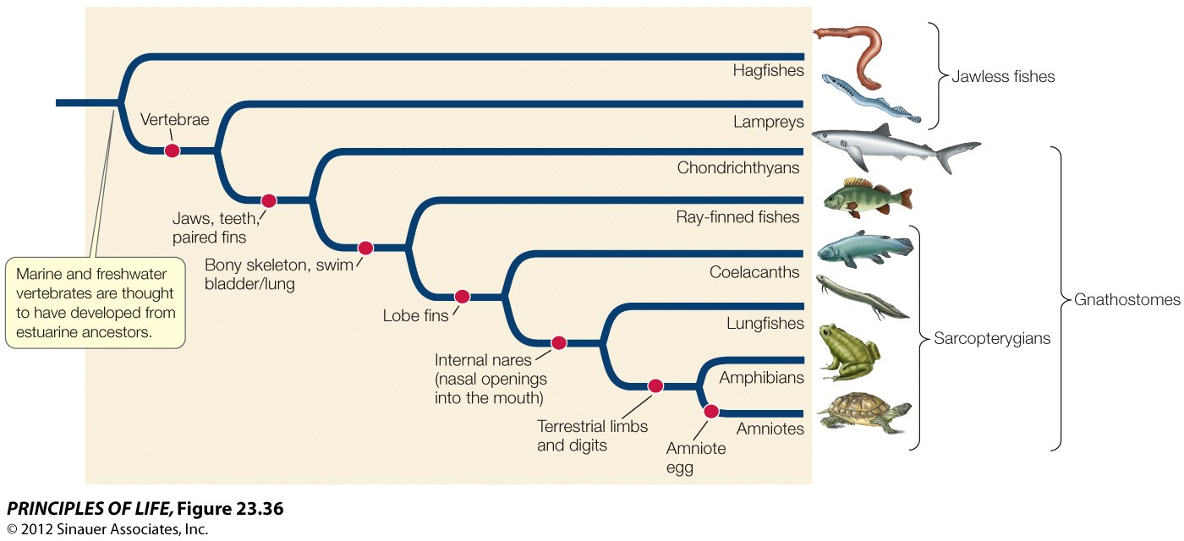
Figure 23.36 Phylogeny of the Living Vertebrates

Slide 46
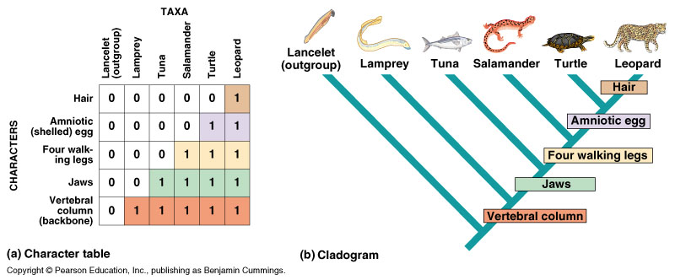

Slide 47
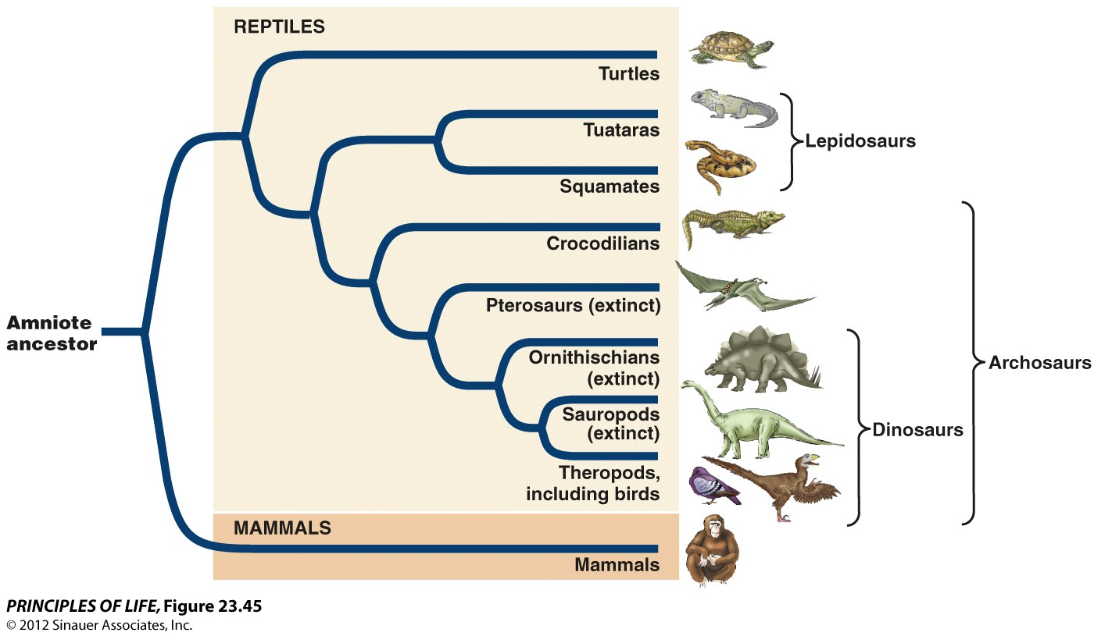
Figure 23.45 Phylogeny of Amniotes

Slide 48
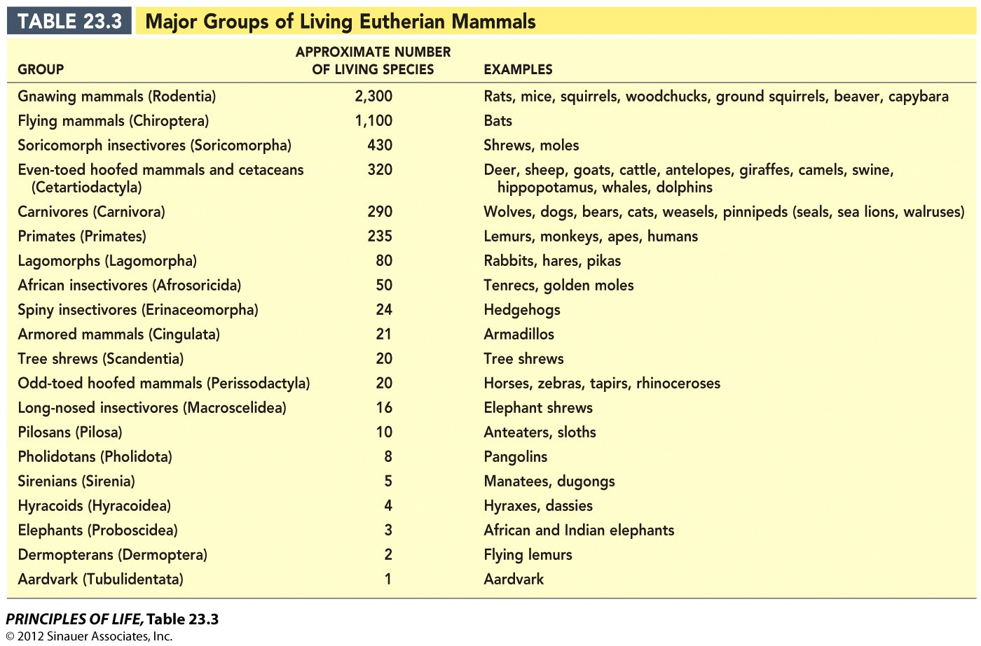

Slide 49
