Slide 1
Changes in Gene Regulation in ΔZap1 Strain of Saccharomyces cerevisiae due to Cold Shock
Jim McDonald and Paul Magnano

Slide 2
Outline
Introduction to Gene Regulation, Cold Shock, and DNA Microarrays
Steps required for Analysis and Model
Results of Running the Model
Discussion of our Results

Slide 3
What is Gene Regulation?
Mechanism by which cells increase or decrease specific gene products.
All organisms react to changes in the external environment using gene regulation.
Due to its relatively small genome and the readily available genome datasets, Saccharomyces cerevisiae is a great model organism for studying gene regulation in response to environmental change.
Notes:
jim

Slide 4
The Effects of Cold Shock
Heat shock responses are well characterized for yeast but cold shock is much less characterized.
Cold shock triggers a stress response from yeast cells, altering gene regulation.
To fully understand the cell as a whole we want to see the effects of cold shock at 13ºC on gene regulation and transcription factors.
Notes:
jim

Slide 5
What are DNA Microarrays?
DNA microarrays allow us to measure the expression of many genes at the same time.
Using green/red ratios the microarrays shows whether a gene is up-regulated or down-regulated due to cold shock.
We can then use this data to analyze the role of transcription factors in the up and down regulation of genes.

Slide 6
Our Microarray Dataset
Our dataset was the ΔZap1 strain of the yeast.
ΔZap1 is a zinc-regulated transcription factor.
Provided with a data sheet that input data using scanner software.
4 replicates at each time point (15, 30, 60, 90, 120 minutes) with the log fold changes included.
Log fold changes was the log₂ ratio of green/red fluorescence for each gene at each time point.

Slide 7
Statistical Analysis Done in Excel
Normalized the data to decrease variation.
  The average log fold change computed for each column of data.
  The standard deviation computed for each column of data.
  The data was scaled and centered by subtracting each data point by the average and dividing by the standard deviation
The t-statistic and p-value were then computed to indicate the significance of the fold changes.
Notes:
jim

Slide 8
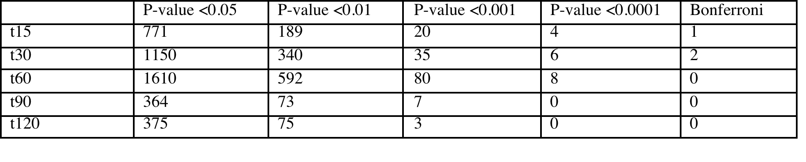
P-values of genes increased or decreased significantly
P-value indicate significant log-fold changes in the genes.
The smaller the p-value, the less likely a gene changed due to random chance.
Bonferroni correction further increases stringency, greatly reducing the likelihood that the expression change was a rare event.
Notes:
jim

Slide 9
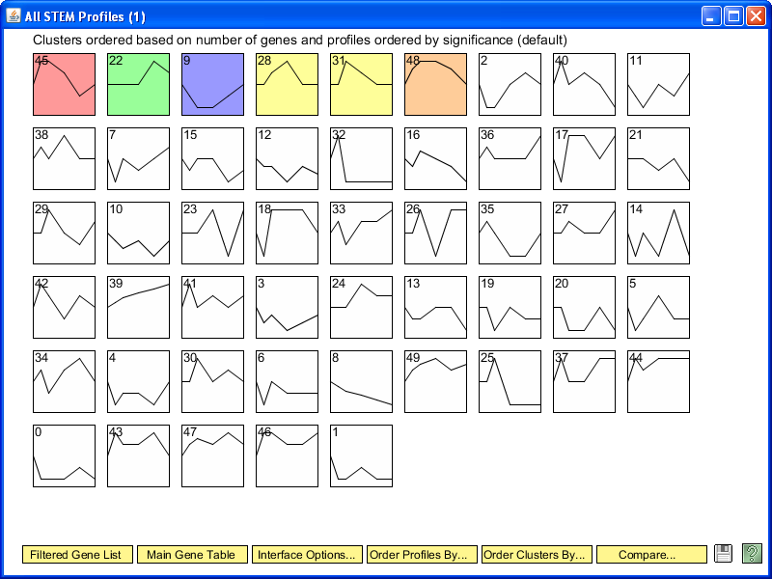
ΔZap1 STEM Profiles
Biological Analysis done in STEM
Average Log Fold Change data put into the STEM software.
Colored profiles have a statistically significant number of genes in the profile having the most significant p-value.

Slide 10
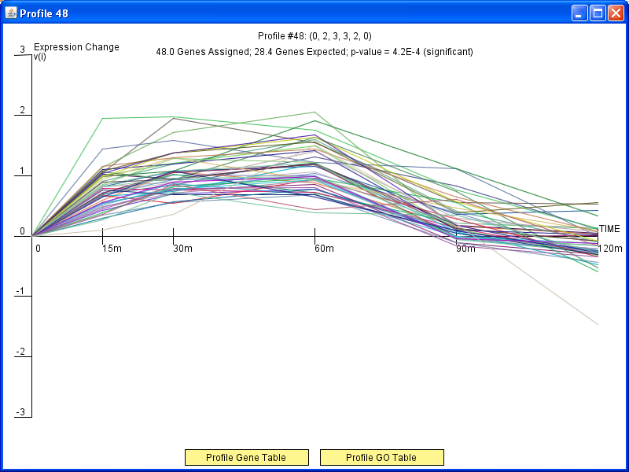
Cluster: Profile 48
The majority of genes are up-regulated

Slide 11
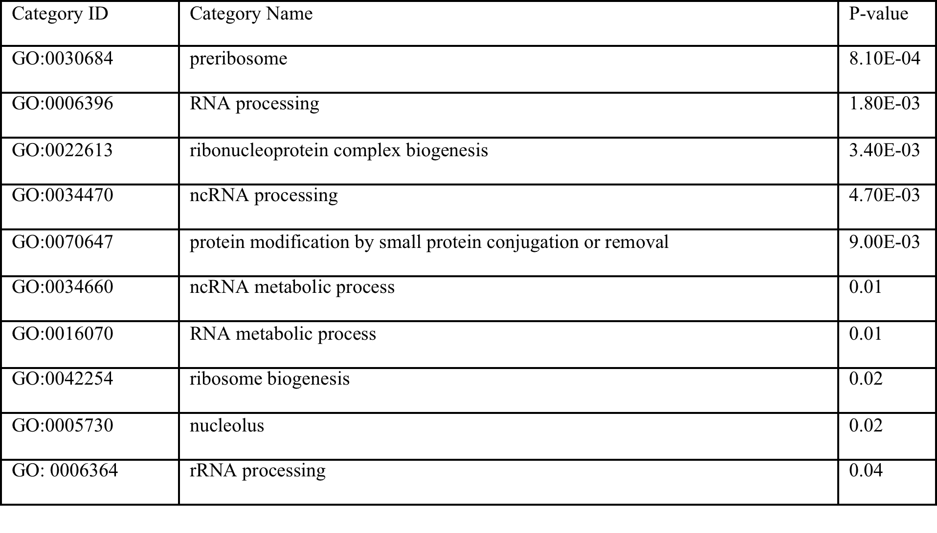
Gene Ontology Terms from STEM
These GO terms showed significant changes in expression. They are involved in ribosome biosynthesis, assembly of ribosomes, RNA molecule synthesis, and transcription processes

Slide 12
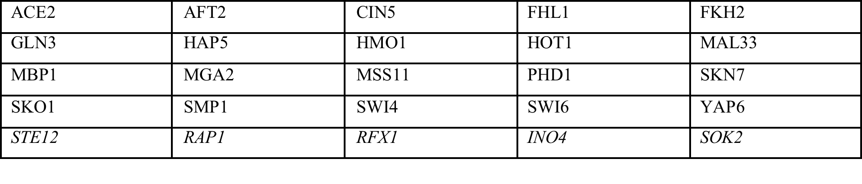
Transcription Factors used in Model
Used YEASTRACT to choose the 5 transcription factors that had the highest percentage of genes they regulated in the profile, increasing the likelihood they would be apart of the transcription factor network.
Notes:
jim

Slide 13
YEASTRACT Transcription Factor Network
All of our transcription factors, including the five we added, had connections to other transcription factors in the network.
Notes:
jim

Slide 14
Transcription factors that have the closest fit to the model data
Ran the model using the 25 transcription factors in the network.
Ran three models: Sigmoidal; where fix_b=1, Sigmoidal; where fix_b=0, and Michaelis-Menten
Found that Ace2 and Yap6 had the closest fit to the model data.
There were slight differences in the log fold changes for each different model we ran.
Notes:
jim

Slide 15
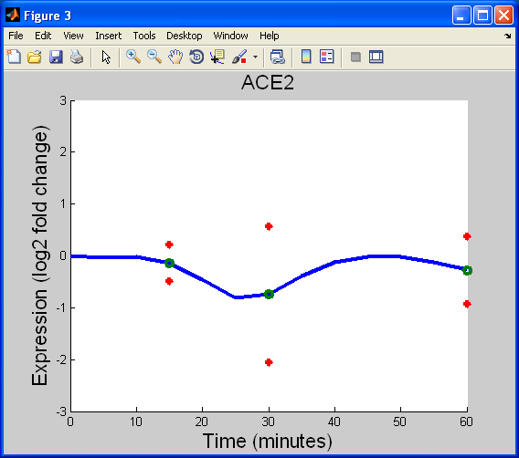
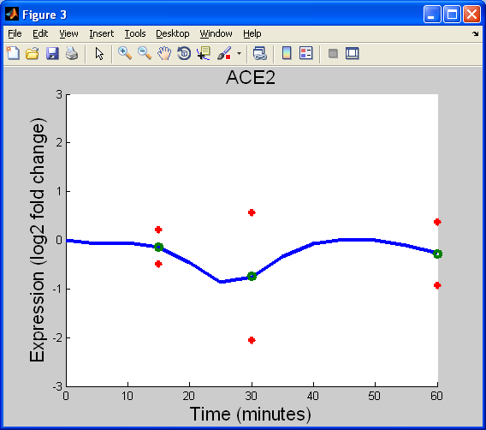
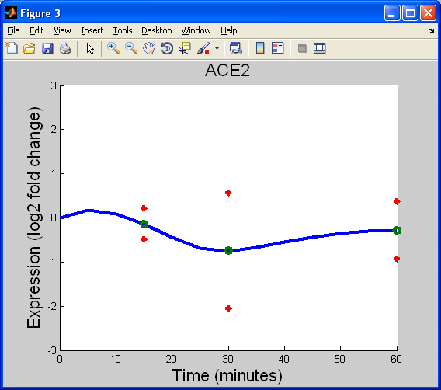
Sigmoidal fix_b = 1
Sigmoidal fix_b = 0
Michaelis-Menten
Notes:
jim

Slide 16
Ace2 is regulated by multiple other transcription factors.
Ace2 is mainly responsible for septum destruction during cytokinesis.
During cold shock it is down-regulated as the cell is not dividing and does not need Ace2 to be available to be activated.
Notes:
jim

Slide 17
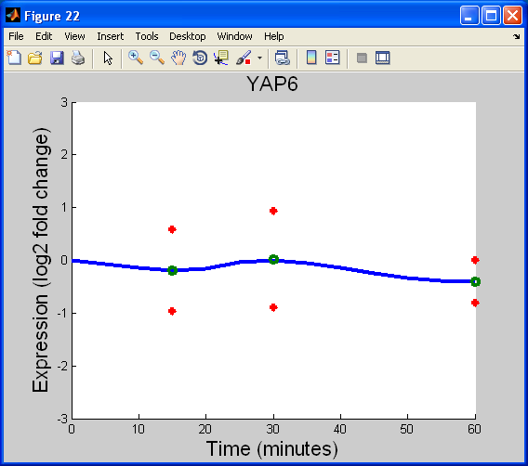
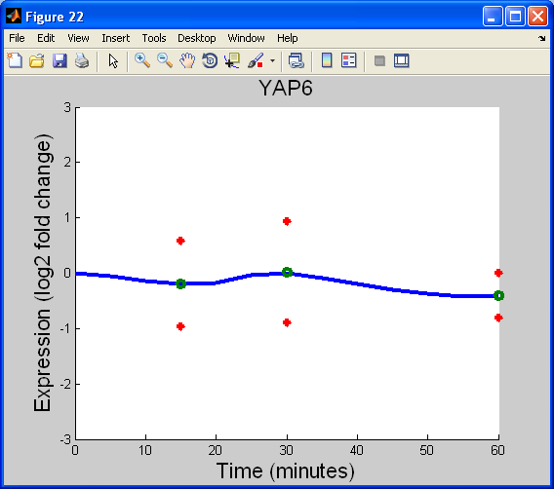
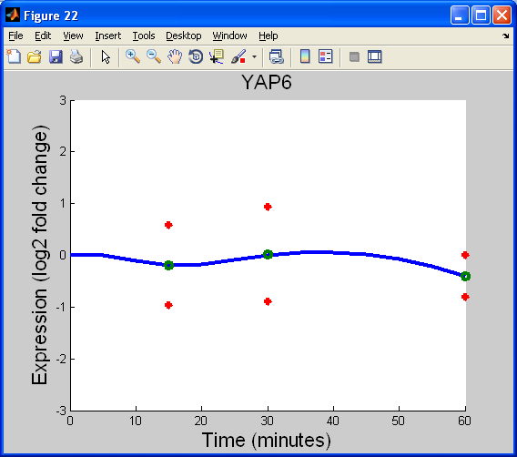
Sigmoidal fix_b = 1
Sigmoidal fix_b = 0
Michaelis-Menten

Slide 18
Yap6 is also regulated by multiple other transcription factors.
Yap6 shows a slight repression followed by a slight activation but doesn’t move far from from 0 expression.
Yap6 is a leucine zipper that holds parallel alpha helices together.
This process is neither up or down regulated during cold shock.

Slide 19
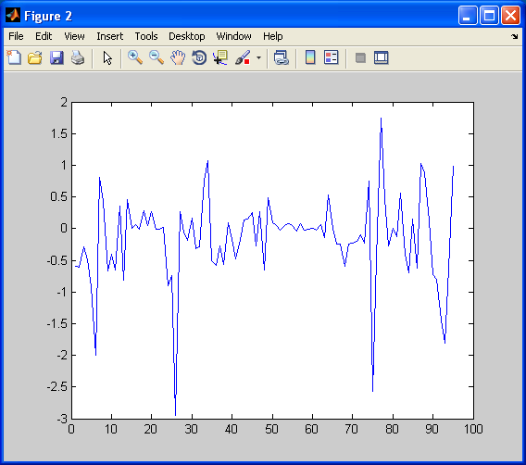
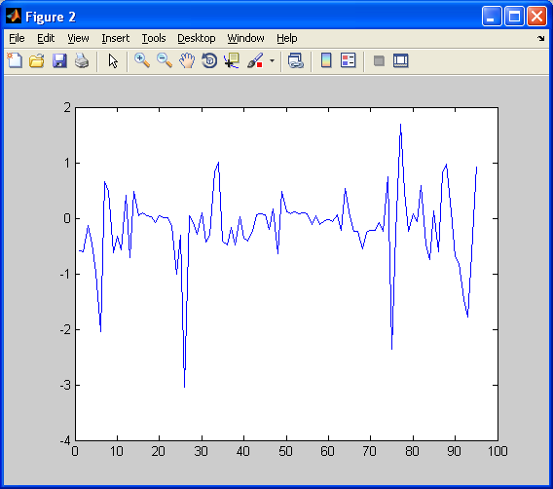
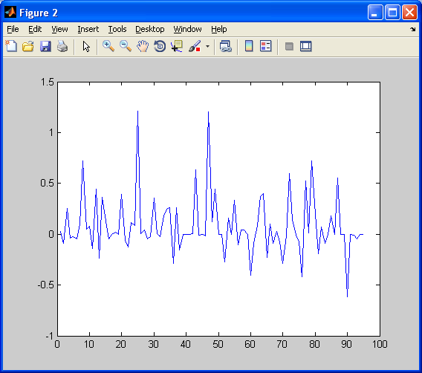
Sigmoidal fix_b = 1
Sigmoidal fix_b = 0
Michaelis-Menten
Notes:
jim

Slide 20
Optimized Output Graphs
The sigmoidal graphs show similar gene expression levels although there is a larger amount of down-regulation in some transcription factors.
The michaelis-menten graph has many differences from the other two. There are many more transcription factors up-regulating.
This suggests that if a cell responds to cold shock according to the michaelis-menten model, more transcription factors will be up-regulated than the sigmoidal model of response.
Notes:
jim

Slide 21
Optimized Weights of Regulation
Optimized Weights | Sig 0 | Sig 1 | M-M
PDH1 -> CIN5 | -3.04 | -2.95 | 0.01
MBP1 -> SWI4 | -0.30 | -0.73 | 1.21
PDH1 has the strongest regulation of CIN5 in both sigmoidal models. MBP1 had the strongest regulation of SWI4 in the michaelis-menten. The models did not agree in most transcription factors, showing that a large difference between the responses in the different models.

Slide 22
Possible Future Direction
We are only modeling the cold shock portion of the data.
We are not using the final two time points during the recovery stage.
In the future we could use the recovery time data to see how gene regulation changes during the recovery period.
However this would probably require another model.

Slide 23
Acknowledgements
Dr. Dahlquist and Dr. Fitzpatrick
Dr. Dahlquist’s lab for supplying the microarray data

