Slide 1
The Frequency Dependence of Osmo-Adaptation in Saccharomyces cerevisiae
Jerome T. Mettetal, et al.
Science 319, 482 (2008);
William J. Gibson

Slide 2
Overview
Background and Goals
Experimental Setup
Results
Conclusion

Slide 3
Background and Goals
Systems Biology
Attempt to gain insight into biology by viewing biological responses as a system
Holistic vs. Reductionist approach
Biological processes take place over a variety of timescales <1 second to >10^3 seconds
Pathways can involve hundreds of reactions
This level of complexity is difficult to model explicitly

Slide 4
Background and Goals
Solution:
Use oscillating input to gain insight into system dynamics / biological mechanism.
Compare WT and mutant cells to identify which proteins drive response at different time scales.

Slide 5
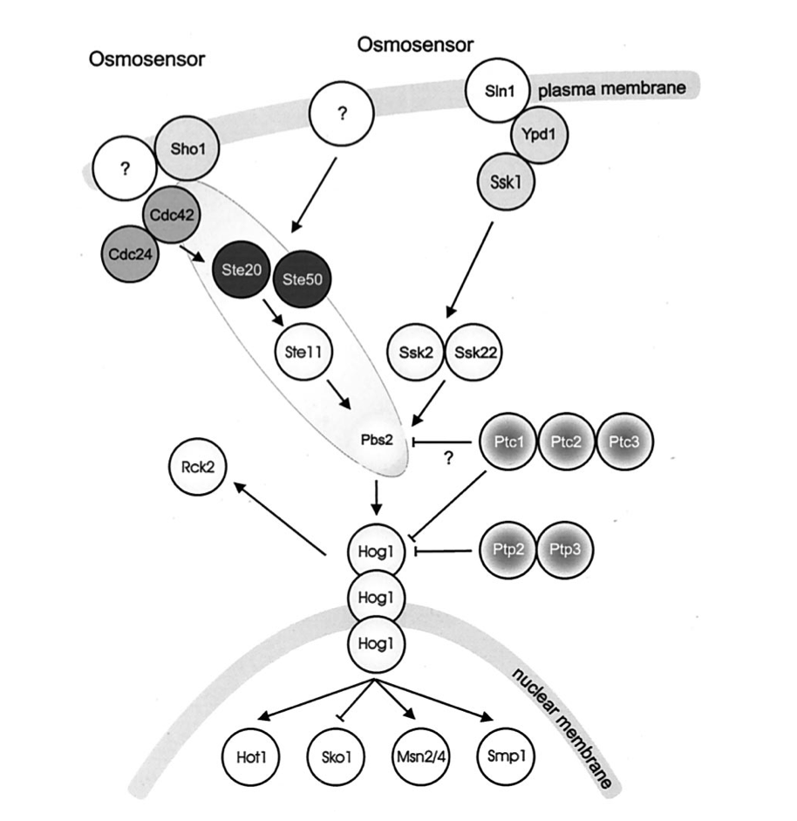
Background and Goals
Use well-characterized Hog1 osmosensory pathway to test input oscillation approach to studying pathways.
(Hohmann, Micro Mol Bio Rev 2002)

Slide 6
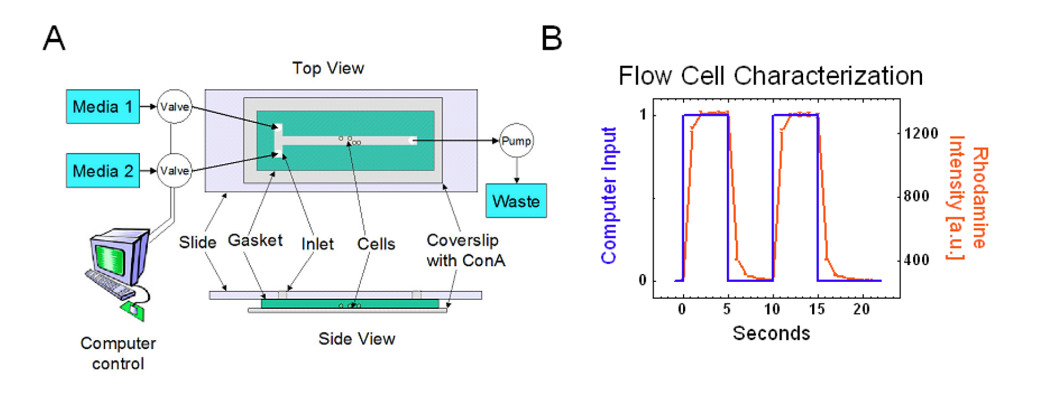
Experimental Setup
(Mettetal et al. , Science 2008)
Notes:
Fig. S1. (A) Schematic diagram of the flow-cell setup. A pump removes media from the flow chamber while a valve constantly selects from one of two fresh media sources. (B) Flow cell characterization indicates that the time-constant for complete media replacement in the flow chamber is significantly less than 10 seconds.

Slide 7
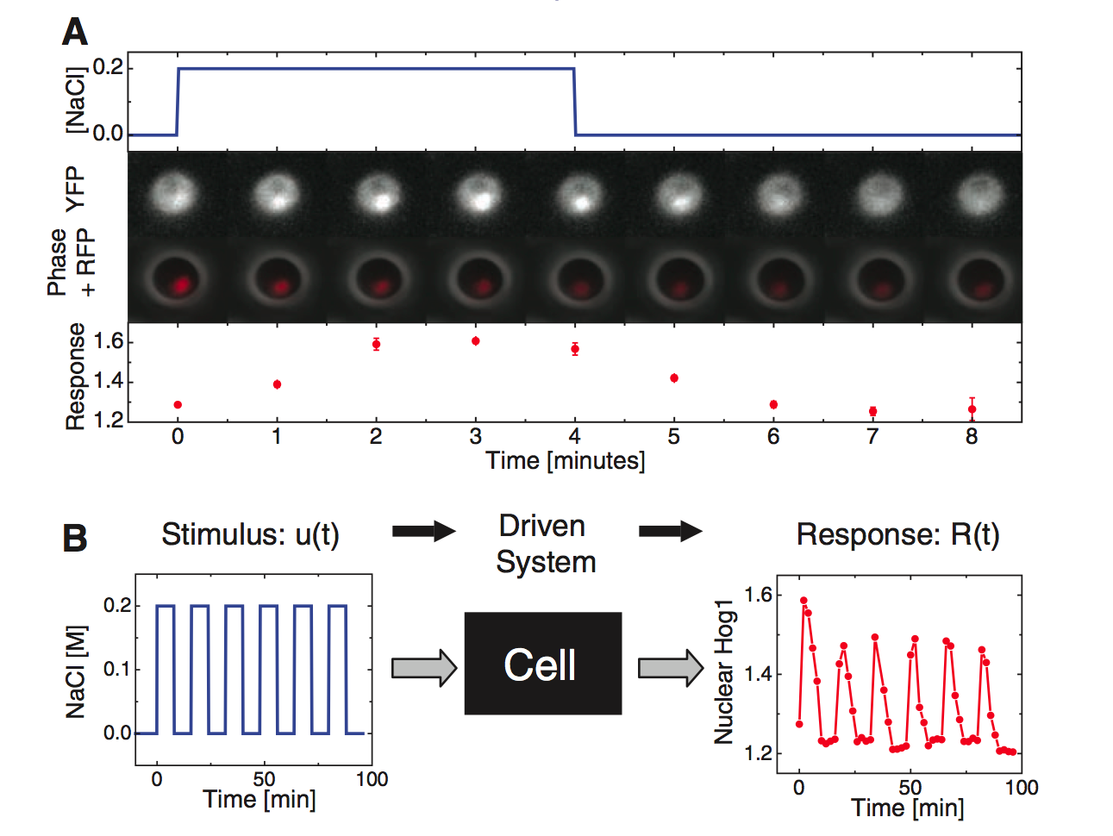
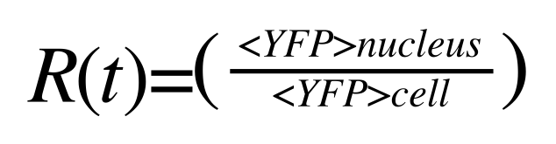
Experimental Setup
YFP nuclear localization→HOG1 nuclear localization
HOG1 fused to YFP
NRD-RFP identifies nucleus
(Mettetal et al. , Science 2008)

Slide 8
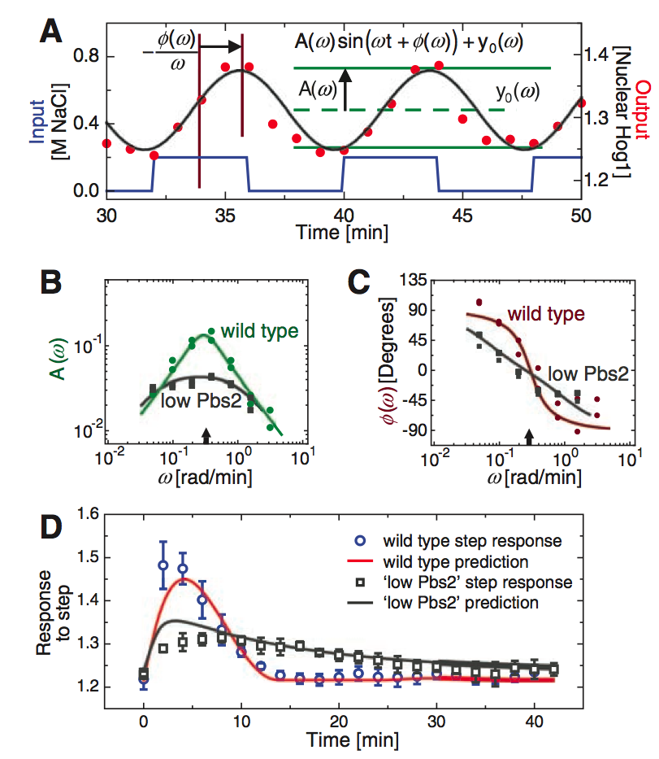
Results Fourier Analysis
Fourier analysis was used to approximate the input as a sine wave and the output as a sine wave at the corresponding frequency.
A second-order linear time–invariant (LTI) model was used to fit the data in B and the parameters were used to predict the response to a step input of 0.2 M NaCl (D)
(Mettetal et al. , Science 2008)

Slide 9


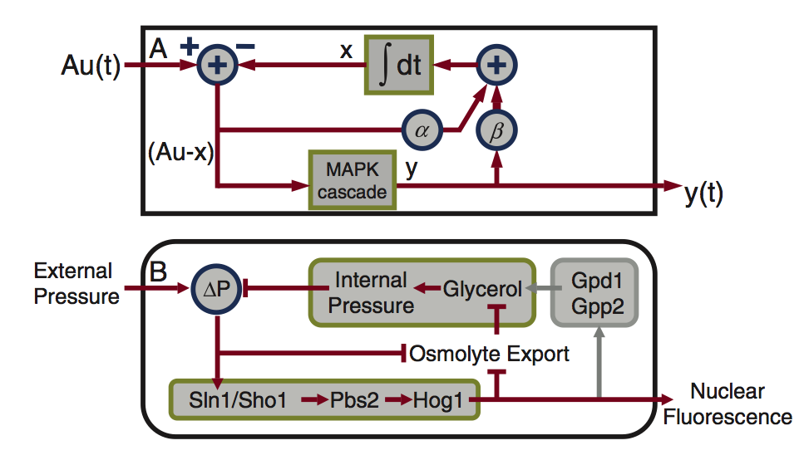
Results System Model
x = the intracellular osmolyte concentration
y = enrichment of phosphorylated Hog1 above its baseline level
Hog1 dependent contribution and independent contribution (Fps1)
(Mettetal et al. , Science 2008)
Notes:
Network topology im- plied by pulsed-input anal- ysis corresponds to biological network. (A) Diagrammatic representation of the mecha- nistic model shows two linear negative-feedback responses: one dependent on Hog1 ac- tivity with strength b and a second independent of Hog1 activity with strength a. The intracellular osmotic pressure was modeled as an integra- tor, whereas the MAPK signal transduction pathway was modeled by the linear impulse–response function. The output of circumscribed- plus-sign symbols is simply the sum of its inputs. (B) The osmo-adaptation network structure. With the inducement of osmotic stress, cells increase or decrease their export rate of glycerol through the transmembrane protein Fps1, which is modified by Hog1-independent and Hog1-dependent mechanisms. In addition, under high osmotic stresses, active nuclear Hog1 is known to modify the expression of glycerol-producing proteins over longer time scales. DP represents the difference between internal and external pressure relative to its optimal value.

Slide 10
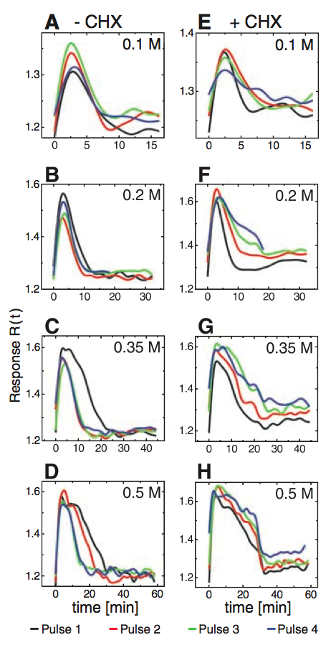
Results - Osmoadaptation
16 Min .1M NaCl
With short pulses of NaCl, cyclohexamide makes no difference.
As duration of pulse increases cells normally respond more quickly
Cyclohexamide treated cells fail to adapt
Implies that gene expression drives an adaptive response
32 Min .2M NaCl
45 Min .35M NaCl
60 Min .5M NaCl
(Mettetal et al. , Science 2008)
Notes:
Fig. 4. Gene expression facilitates response to subsequent pulses. Consecutive-pulse responses were compared for cells treated with (A) 0.1 M NaCl, 16-min period (i.e., 8 min at 0.1 M followed by 8 min at 0.0 M); (B) 0.2 M NaCl, 32-min period; (C) 0.35 M NaCl, 45-min period; and (D) 0.5 M NaCl, 60-min period. (E to H) Similarly treated cells also exposed to cycloheximide.

Slide 11
Conclusion
Oscillating inputs accurately identifies known cell network dynamics
Engineering principles can be applied to biological systems to gain new insight into system dynamics.

Slide 12
References
Mettetal, et al., "The Frequency Dependence of Osmo-Adaptation in Saccharomyces cerevisiae" Science 2008.
Stefan Hohmann, “Osmotic Stress Signaling and Osmoadaptation in Yeasts” Microbiology and Molecular Biology Reviews, June 2002, p. 300–372

