Slide 1
Analysis of a Fluctuating Dilution Rate
Salman Ahmad
Helena Olivieri
Notes:
Salman

Slide 2
Purpose
To see how changing chemostat conditions affects cell growth
To identify a dilution rate that maximizes cell growth in relation to nutrient use in a chemostat
Notes:
Salman

Slide 3
Outline
Defining Terms and Variables
Modeling Chemostat
Results and Discussion

Slide 4
Outline
Defining Terms and Variables
Modeling Chemostat
Results and Discussion

Slide 5
State Variables
At the steady state, the temperature, pH, flow rate, and feed substrate concentration will all remain stable.
Notes:
Helena

Slide 6
Terms
q=dilution rate
un=feed rate of nitrogen
uc=feed rate of carbon
r=conversion rate
V=reaction rate
Kn= Nitrogen reaction constant
Kc= Carbon reaction constant
Notes:
Helena

Slide 7
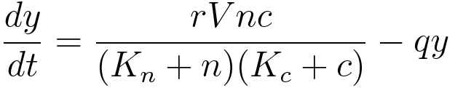
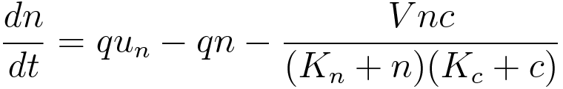
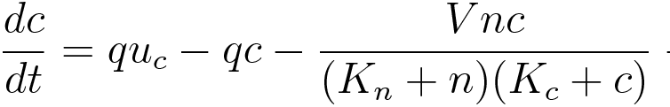
Differential Equations/ Terms
Rate of change of nutrient
= inflow rate – outflow rate – rate consumed in the tank.
Notes:
Helena

Slide 8
Outline
Defining Terms and Variables
Modeling Chemostat
Results and Discussion

Slide 9
Parameters
Dilution rate, q
q= volumetric inflow rate (volume/time)/ volume of mixture of tank
Feed of nitrogen, u=30
Net growth, r=1.25
Nutrient saturation, K=5
Nutrient consumption, V=0.5
Feed carbon, u2=60
Notes:
Salman

Slide 10
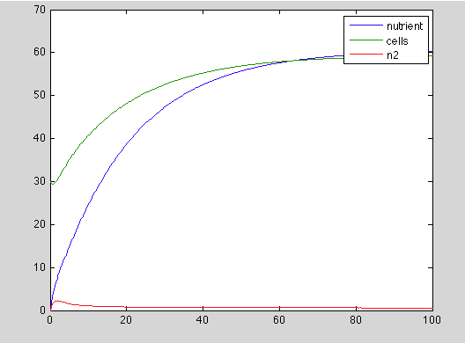
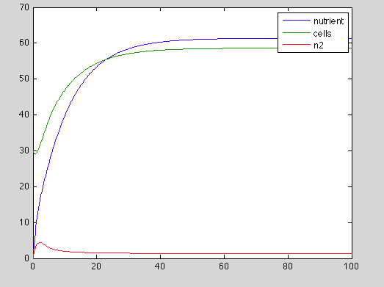
Graphs
q=0.05
q=0.1
Concentration (mg/cc)
Concentration (mg/cc)
Time (hours)
Time (hours)
Notes:
Helena

Slide 11
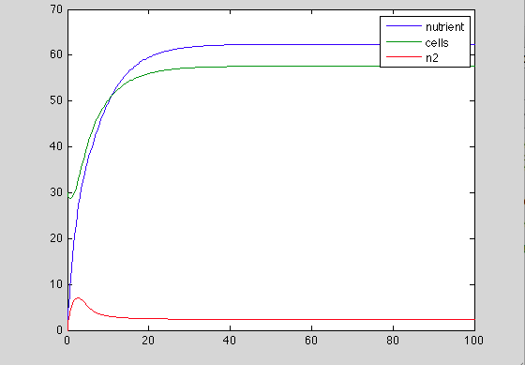
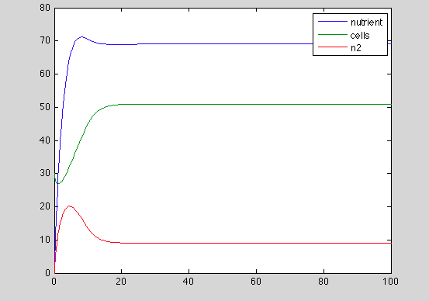
Graphs
Standard Conditions q=0.15
q=0.30
Concentration (mg/cc)
Concentration (mg/cc)
Time (hours)
Time (hours)
Notes:
Helena

Slide 12
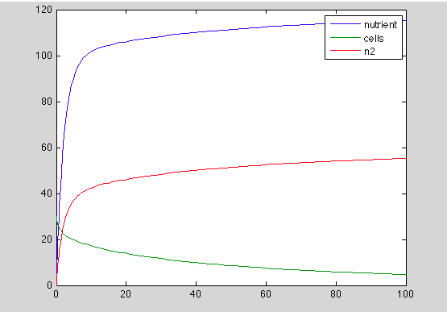
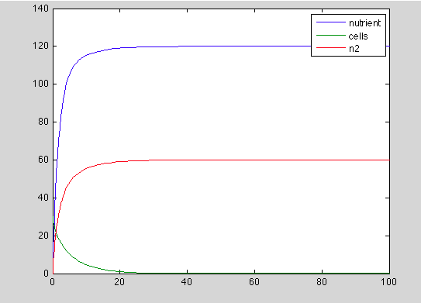
Graphs
q=0.45
q=0.60
Concentration (mg/cc)
Concentration (mg/cc)
Time (hours)
Time (hours)
Notes:
Salman

Slide 13
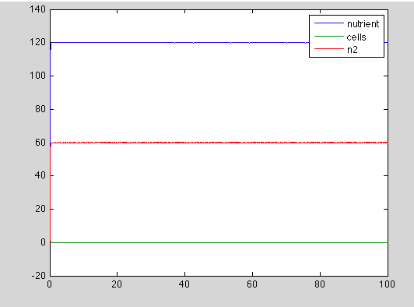
Graph: q=15
Concentration (mg/cc)
Time (hours)
Notes:
Helena

Slide 14
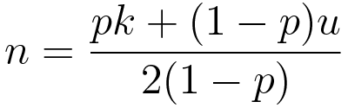

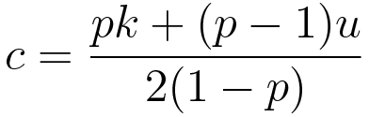

Discussion: Dilution Relationship to concentration of yeast and nutrient in chemostat

Slide 15
Outline
Defining Terms and Variables
Modeling Chemostat
Results and Discussion

Slide 16
Discussion
Each microorganism growing in a chemostat and thriving on a specific nutrient has a maximum specific growth rate (μ_{max}) (the rate of growth observed if none of the nutrients are limiting).
When dilution rate becomes higher than μ_{max}, the culture will not be able to sustain itself in the chemostat, and will, thus, “wash out.”
Notes:
Salman

Slide 17
Discussion (cont.)
Cell production rate will, initially, increase as dilution rate increases. The rate of cell production is at a maximum at q_{max}.
q = μ (dilution rate = specific growth rate) is established at this point, where the steady-state equilibrium is reached.
When dilution rate goes beyond q_{max,} the concentration of cells decreases. Biomass will, thus, continue to decrease, until all cells are “washed out.”
Substrate concentration will, therefore, be significantly larger in value because there are less cells to use the nutrients.
Notes:
Salman

Slide 18
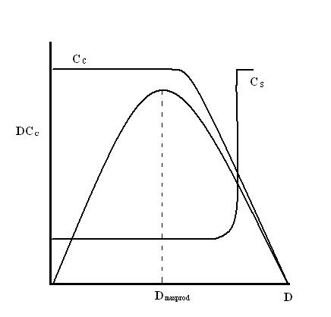
The figure below shows how the dilution rate affects cell production rate(DC_{C}), cell concentration (C_{C}), and substrate concentration (C_{S}).
Notes:
Salman

Slide 19
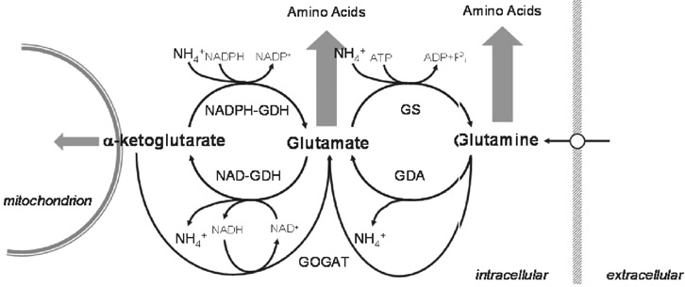
In relation to terSchure Papers

Slide 20
Future Directions
We can look at how changing the different parameters affects the concentrations of biomass, nitrogen, and carbon.
Notes:
Salman

Slide 21
Works Cited
https://controls.engin.umich.edu/wiki/index.php/Bacterial_Chemostat_Model
ter Schure, E. G., H. H. W. Sillj ́e, L. J. R. M. Raeven, J. Boonstra, A. J. Verkleij, and C. T. Verrips. 1995. Nitrogen-regulated transcription and en- zyme activities in continuous cultures of Saccharomyces cerevisiae. Microbi- ology 141:1101–1108.
ter Schure E. G., Silljé H. H., Verkleij A. J., Boonstra J., Verrips C. T. The concentration of ammonia regulates nitrogen metabolism in Saccharomyces cerevisiae. (1995) J. Bacteriol. 177, 6672–6675
Notes:
Helena

