Slide 1

Geometric Control of Cell Life and Death Christopher S. Chen, Milan Mrksich, Sui Huang, George M. Whitesides, and Donald E. Ingber Science, 1997
Michael Batista^{1,2}
Brian Carvalho^{1,3}
Department of Biological Engineering, MIT
Department of Material Science Engineering, MIT
Department of Physics, MIT

Slide 2
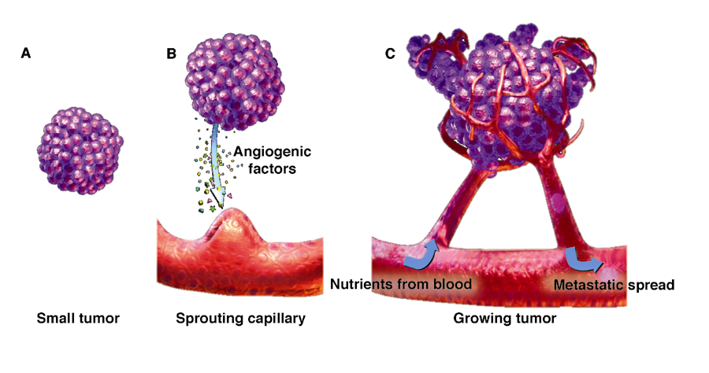
The Capabilities of Cancer
Hanahan and Weinberg, Cell, Vol. 100, 57-70, 2000
Siemann DW., Vascular targeting agents. Horizons in Cancer Therapeutics: From Beach to Bedside. 2002;3(2):4-15
Notes:
To begin, I’d like to put this paper in the frame of its application to disease. I’m sure we’re all aware that cancer cells, in order to sustain their growth, have to acquire several unique abilities. Among these are an insensitivity to anti-growth and apoptotic signals, constitutive activation of growth pathways, and most importantly for this paper the ability to continuously stimulate the growth of blood vessels. Angiogensis is essential to a ensuring that a tumor will receive the nutrients and oxygen it will need to continue to proliferate. It also gives a tumor a path into the circulation once it is able to metastasize. So given the important role angiogenesis plays in ensuring tumor survival there stands a lot to be gained from understanding what controls the apoptosis of vascular endothelial cells.

Slide 3
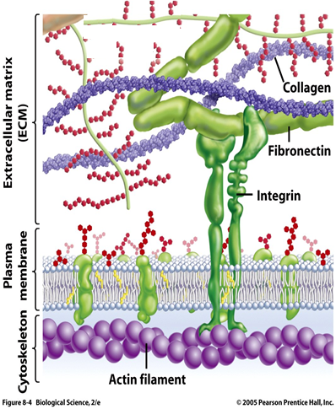
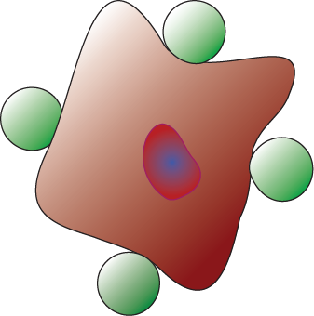
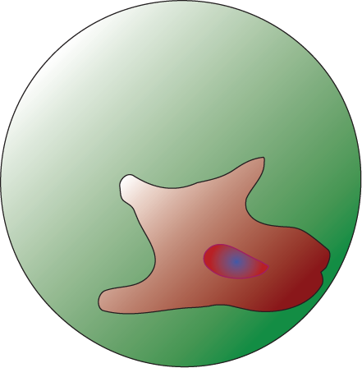
Apoptosis: ECM Adhesion vs. Cell Geometry
Integrins:
Transduce mechanical stimuli into/out of the cell
Cell Shape:
Implicated in triggering apoptosis independent of ECM
Apoptosis
4.5µm
Proliferation
Differentiation
Survival
Apoptosis
100µm
Notes:
Now, its been shown throughout the literature that breaking or blocking integrin mediated attachments to the ECM leads to the apoptosis of a variety of cell types including vascular endothelial cells. Integrins, as you know, help form the bridge that connects the cytoskeleton (and by extension the entire interior of a cell) to the ECM outside the cell. As a part of this bridge integrins act to transduce information about the environment outside the cell into the cytosol and vice versa are at the heart of many cellular processes ranging from differentiation to migration and proliferation to apoptosis. But interactions with the ECM don’t give the full story on the triggering of apoptosis in vascular endothelial cells. Instead the shape and size of the cells seems to also play a role. This correlation between size and death is supported by bead adhesion studies done before this paper in which capillary cells in suspension are attached to small 4.5 micron beads coated with ECM ligands. Bead binding still stimulated integrin signaling, but the cells nevertheless quickly underwent apoptosis whereas cells adhered to beads larger than 100 microns were able to survive.
Here the authors used both human and bovine capillary cells to try to understand these observations by parsing apart the effects of cell geometry and integrin binding on the triggering of apoptosis.
REPLACE ARROW WITH A LIGHTNING BOLT???

Slide 4
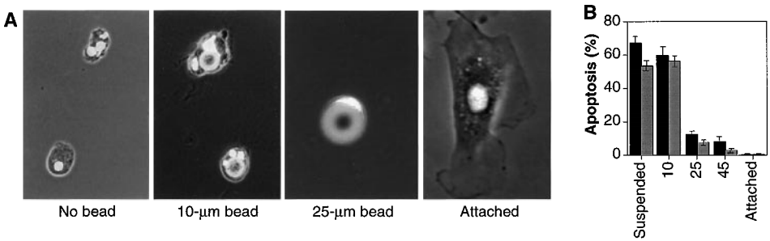
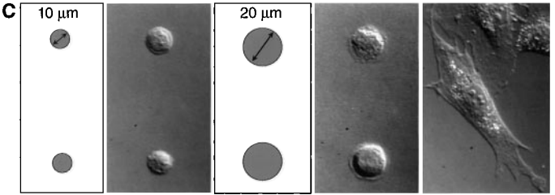
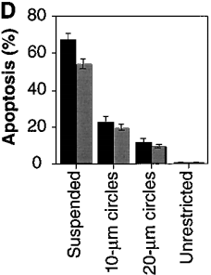
Cell Spreading and ECM Exposure Inhibits Apoptosis
Nuclei
Differences in cell curvature, bead engulfment, and ECM contact area confound the trend in B
Restricting cells to flat pads eliminates these complications
Notes:
They began by demonstrating that they could get around the problems of past bead adhesion studies CLICK where even though there is a clear correlation between increasing cell death and decreasing bead size it’s unclear if this trend is caused by the changes in cell shape allowed for when the cell is on a larger surface, the bending of a cell as it engulfs a bead, or degree of ECM contact. POINT WITH LASER POINTER
They did this CLICK by creating variously sized Fibronectin coated pads that allowed for better control of cell shape and degree of ECM attachment. Attachment studies using these islands showed the same trend toward increased apoptosis with decreasing cell size.
SAVE FOR SUPPLEMENTAL SLIDES: but also demonstrated that increased cell spreading could trigger progression through the cell cycle and growth. FIG 2B

Slide 5
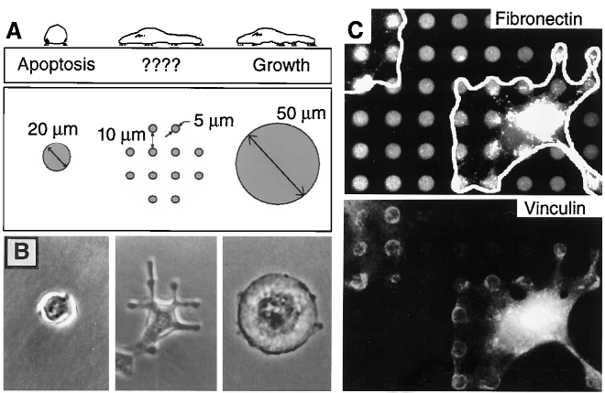
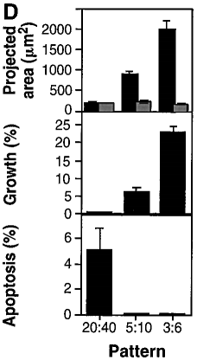
Apoptosis: Effect of Cell Surface Area
Pad Size: Pad Spacing
Holding ECM contact area constant does not change survival effect of increasing cell surface area.
Notes:
However the authors noted that in all their cell attachments studies thus far both cell geometry and ECM contact area had been varying together because to change a cells shape required changing how much ECM the cell was attached to. To separate the effect of these two variables the authors created grids of the same ECM coated pads seen before. By manipulating the size and spacing between these pads the authors were able to increase the spreading of a cell while keeping its ECM contact area constant.
Examples of this system can be seen here POINT where each circle represents a pad coated with fluorescent Fibronectin. Here POINT the fluorescently tagged Vinculin, a component of the focal adhesions that attach cells to ECM, traces out the pads showing that the cell is stuck onto the grid.
As you can see CLICK even by keeping the ECM contact area constant while increasing cell surface area, where the pattern here POINT means pad diameter vs spacing between pads all in microns, you get the same trend as before: increasing cell surface area both inhibits apoptosis and stimulates growth.

Slide 6
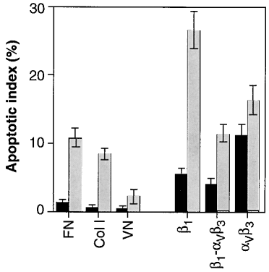
Apoptosis: Effect of Integrin Binding
β-1 Ligand
β-3 Ligand
Notes:
However its been well established in the literature that integrin binding also has anti-apoptotic effects. To probe this effect the authors adhered cells to 20 micron circular pads indicated by the gray bars, each coated with a different integrin ligand.
While apoptosis was greatly reduced for all cases in which the cells were adhered to patterned substrates compared to unpatterned substrates indicated by the black bars, there were differences in the magnitude of the anti-apoptotic effect between the different ligands CLICK. For example when moving from a flat plane to the 20 micron pads apoptosis increased much more when cells were adhered to ligands of the Beta-1 isoform of integrin (which include anti-B1 antibodies, Fibronectin, Collagen I, and B-1 Ab mixed with B3-Ab) relative to ligands of the Beta-3 isoform (which includes Vinculin and B-3 Ab).
POSSIBLE QUESTION: Could this be due to low levels of apoptosis on such large pads.
ANSWER: No. This experiment was repeated on 10 micron pads, thereby promoting apoptosis by cell constriction, and the same relative trend was observed.

Slide 7
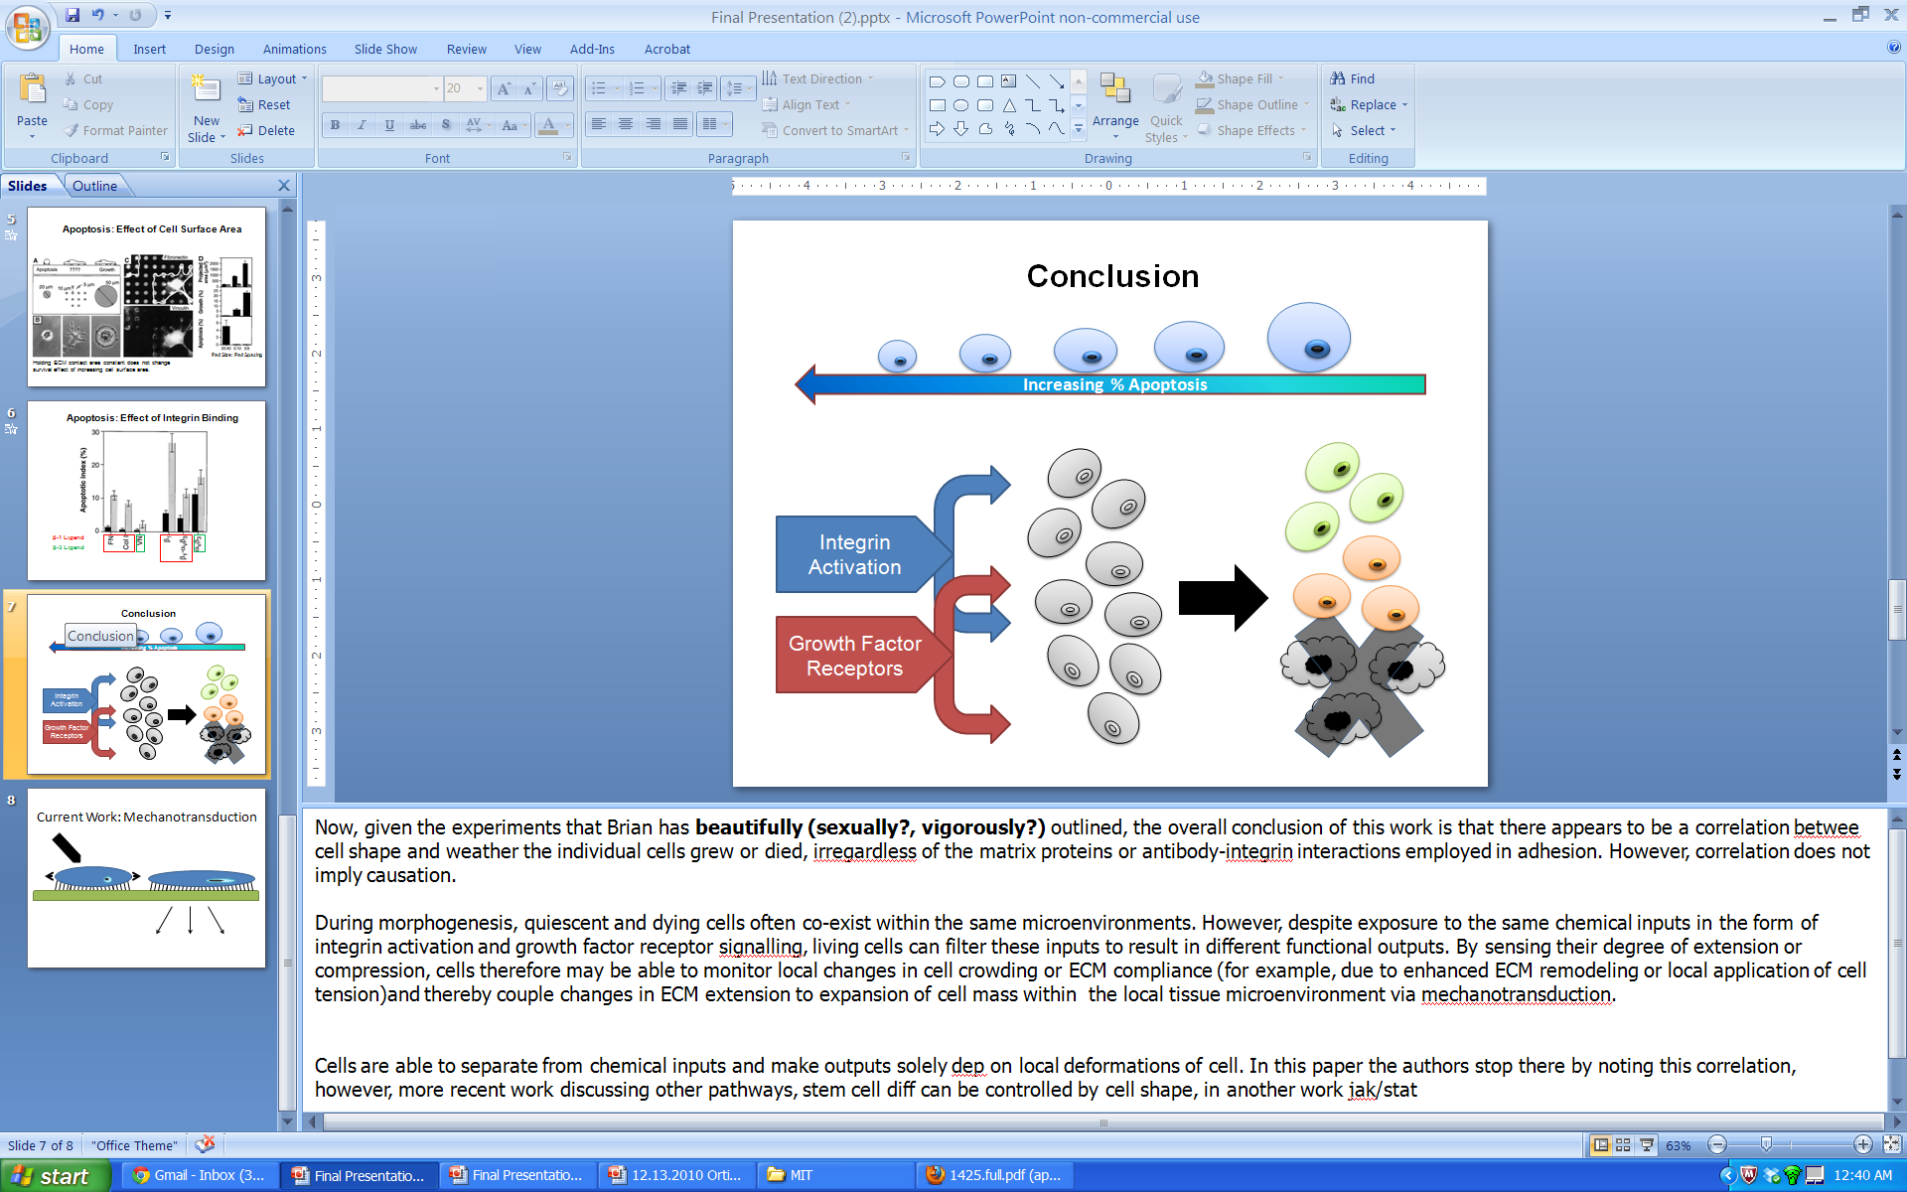
Conclusions
Notes:
Now, given these experiments, the overall conclusion of this work is that there appears to be a correlation between cell shape and whether the individual cells grew or died, irregardless of the matrix proteins or antibody-integrin interactions employed in adhesion. However, this correlation does not directly indicate the mechanism at work and the authors clearly note that the mechanism by which cells transduce changes in cell geometry into different biochemical responses remains unclear to them.
During morphogenesis, quiescent and dying cells often co-exist within the same microenvironments. However, despite exposure to the same chemical inputs in the form of integrin activation and growth factor receptor signalling, living cells can filter these inputs to result in different functional outputs including apoptosis. The authors hypothesized that since the cells can differentiate the chemical from the mechanical signaling, it is the mechanical signals that result from a given geometry which govern cell fate. For example, by sensing their degree of extension or compression, cells may be able to monitor local changes in cell crowding or ECM compliance (for example, due to enhanced ECM remodeling or local application of cell tension)and thereby couple changes in ECM extension to expansion of cell mass within the local tissue microenvironment via mechanotransduction.

Slide 8
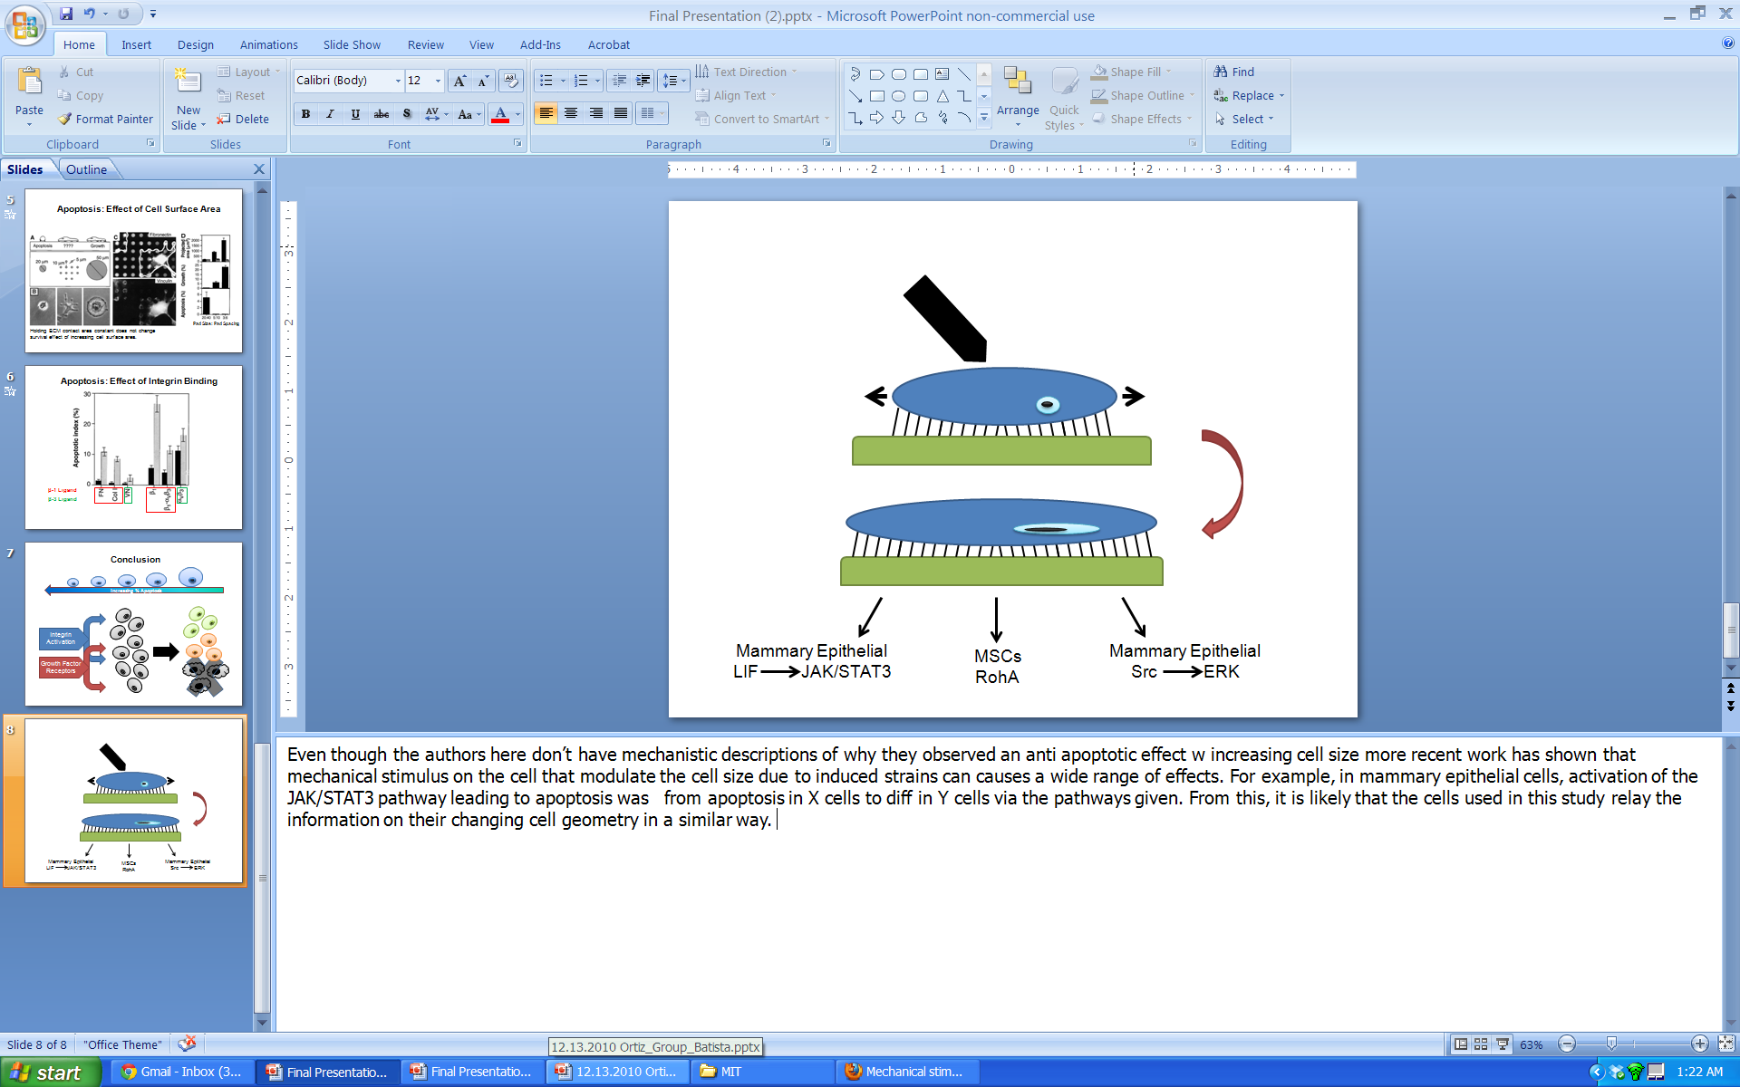
Current Work: Mechanotransduction
Mammary Epithelial
LIF JAK/STAT3
MSCs
RhoA ROCK
Osteocytes
Src ERK
Apoptosis
Differentiation
Anti-Apoptosis
Notes:
Now, again the authors do not present a mechanistic descriptions of why they observed an anti apoptotic effect with increasing cell size. However, this paper was published in 1997 and since then, recent work has shown that mechanical stimulus on the cells resulting in induced strains can causes a wide range of effects. For example, in mammary epithelial cells, activation of the JAK/STAT3 pathway leading to apoptosis was initiated by an up-regulation of lif cytokine expression due to radially applied stress. In mesenchymal stem cells, presence of contractile forces and cytoskeletal tension stimulates the RhoA pathway activation of the downstream effector Rho Kinase (or ROCK) to direct commitment of MSCs to osteogenic rather than adipogenic fates. Finally, one last example is fount in osteocytes where biaxial stretching led to Src activation of ERKs which promote anti-apoptotic effects by phosphorylating transcription factors that regulate the expression of apoptosis-related genes
Therefore, in conclusion, given that the work since this paper we’ve been presenting does indicate that mechanotransduction is a mechanism in other types of cells for initiation and prevention specifically of apoptosis since this is what the original paper investigated, the claim that mechanical signals resulting from a given geometry are what ultimately govern cell fate, is a reasonable claim.

Slide 9

Questions
Notes:
Thank you for listening and we will be taking any questions at this time.

