Slide 1
Change in Expression after modifying fix_b?
Fixed b = fix_b set to 1
Estimated b = fix_b set to 0

Slide 2
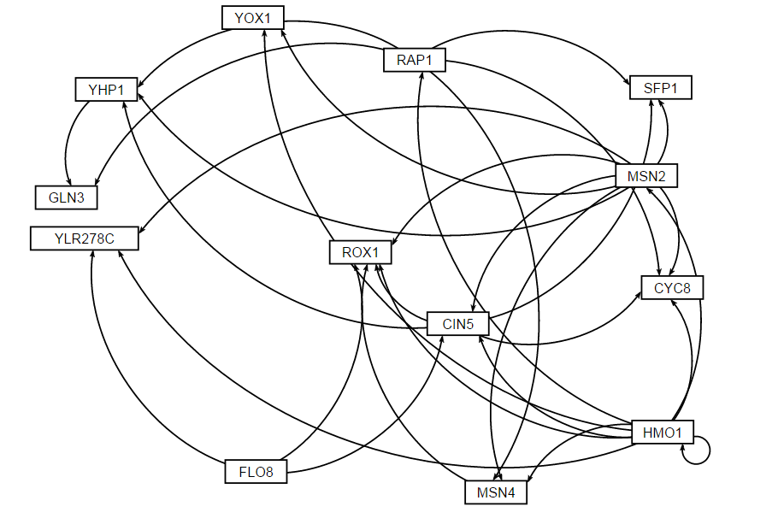
Gene regulatory Network HMO1_profile43

Slide 3
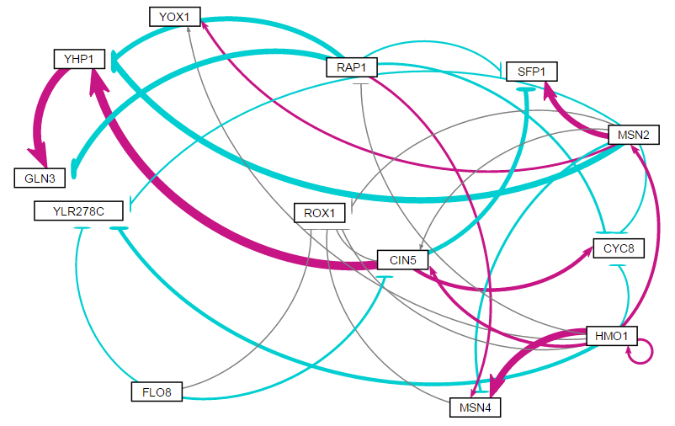
Estimated b: weighted network

Slide 4
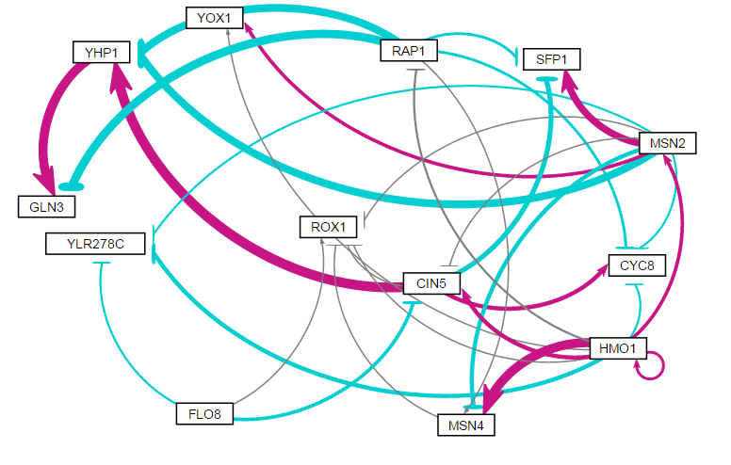
Fixed b: weighted network

Slide 5
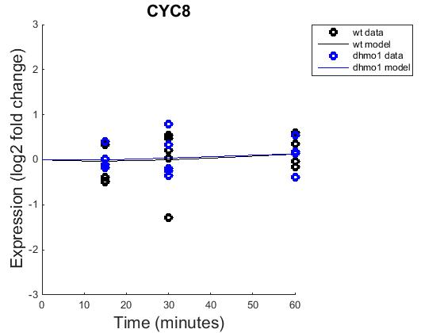
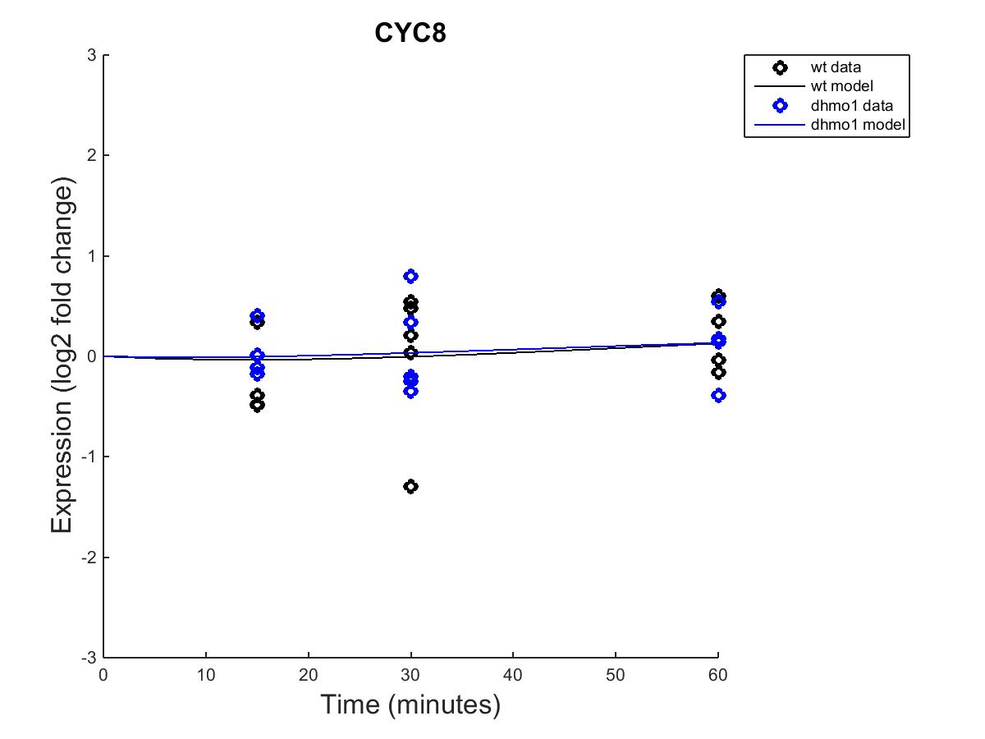
GRNmap model
Fixed b
Estimated b

Slide 6
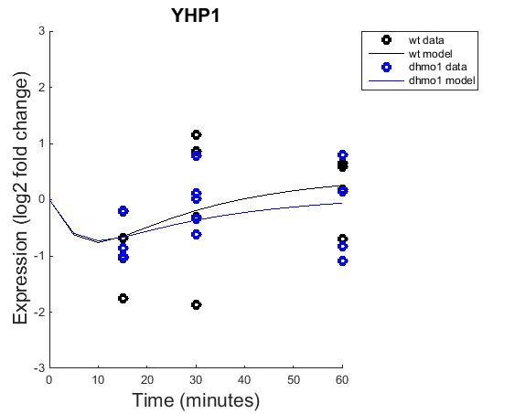
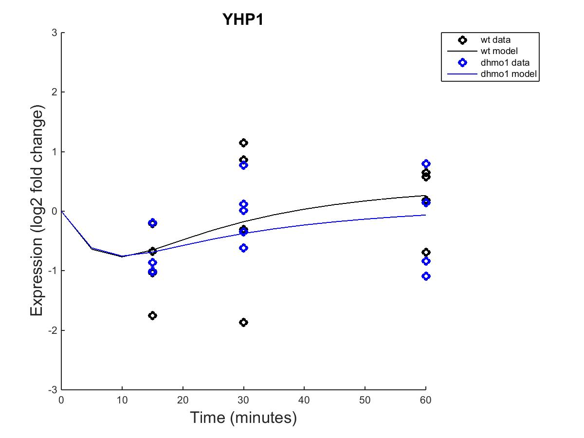
GRNmap model
Fixed b
Estimated b

Slide 7
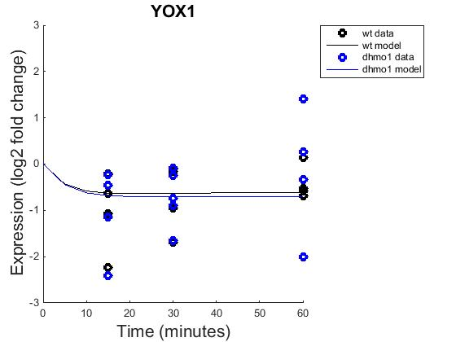
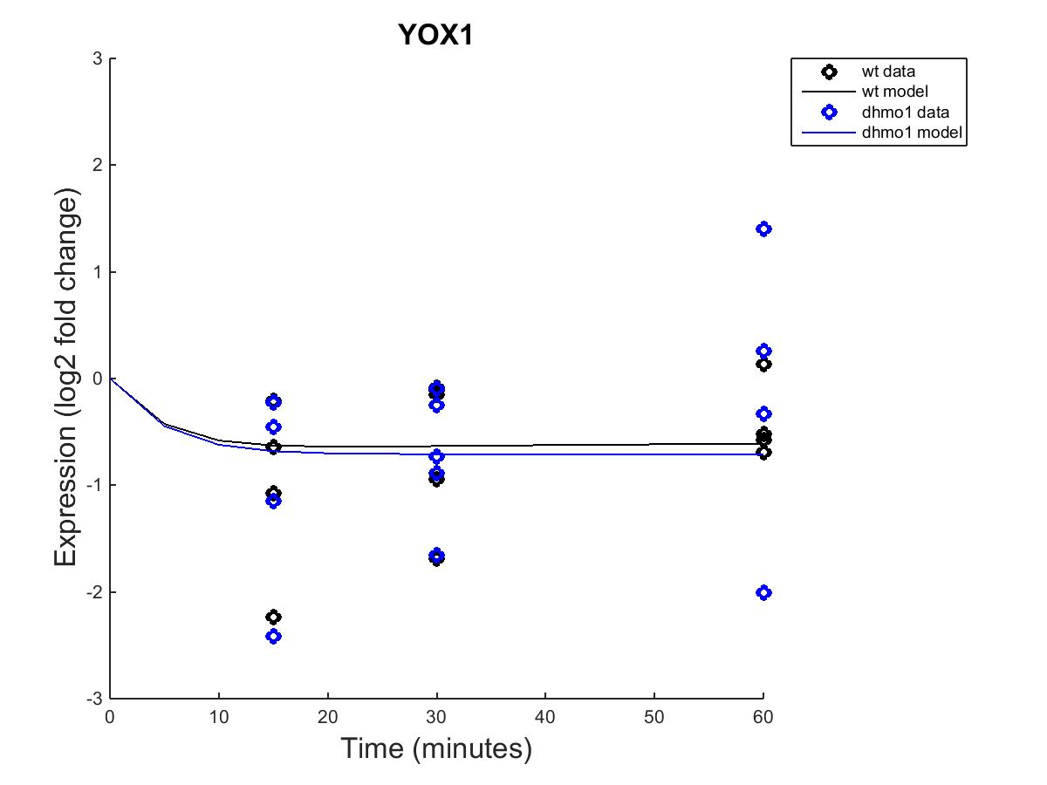
GRNmap model
Fixed b
Estimated b

Slide 8
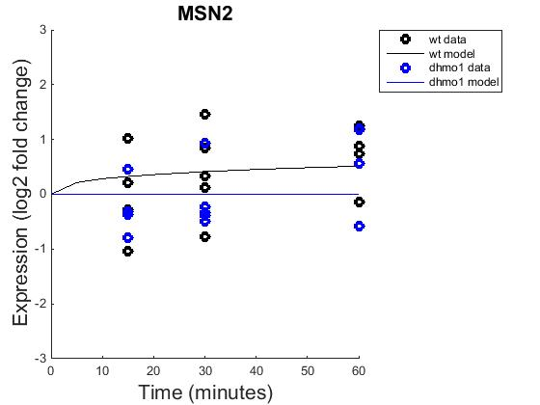
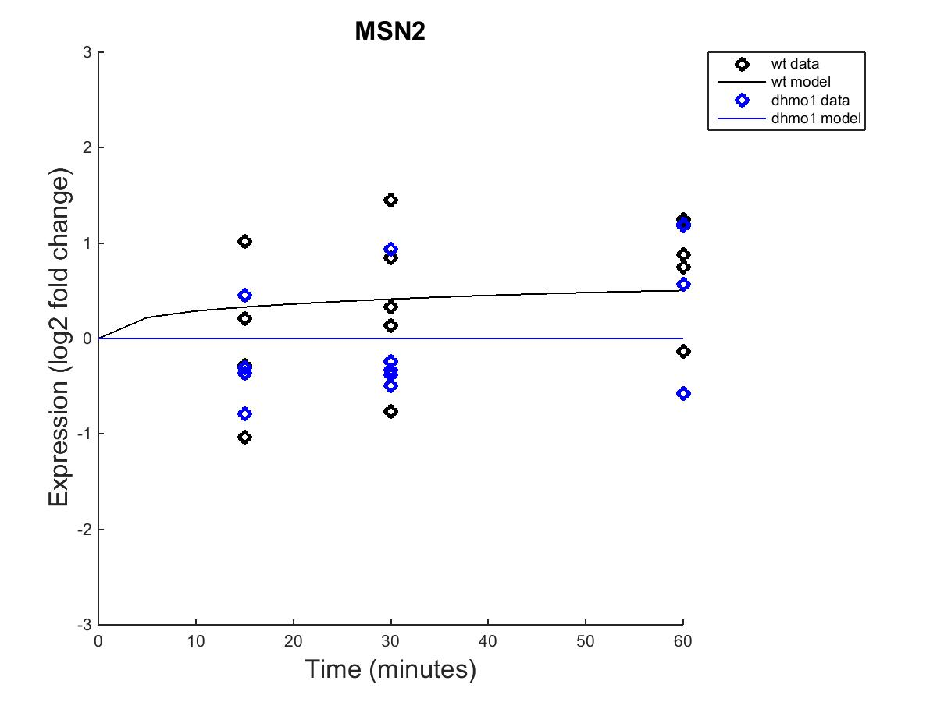
GRNmap model
Fixed b
Estimated b

Slide 9
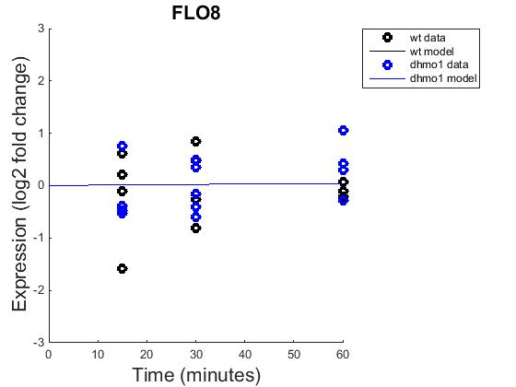
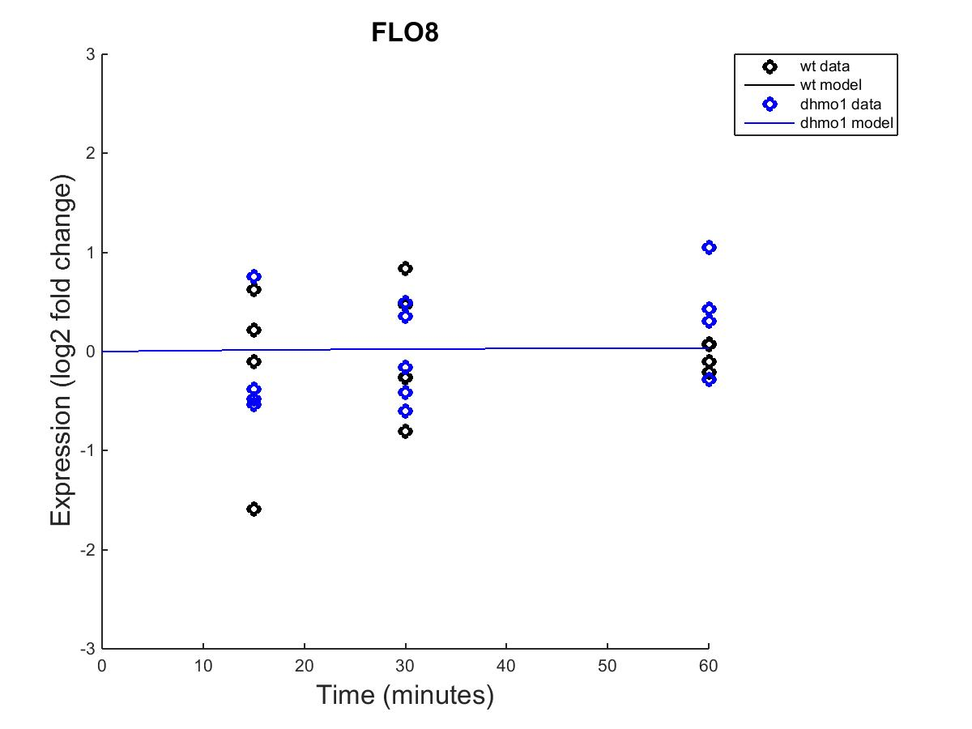
GRNmap model
Fixed b
Estimated b

Slide 10
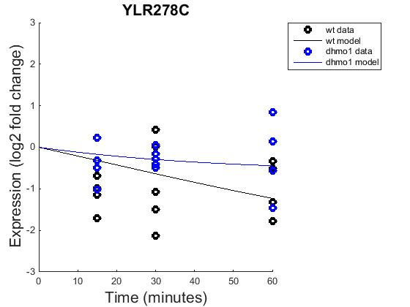
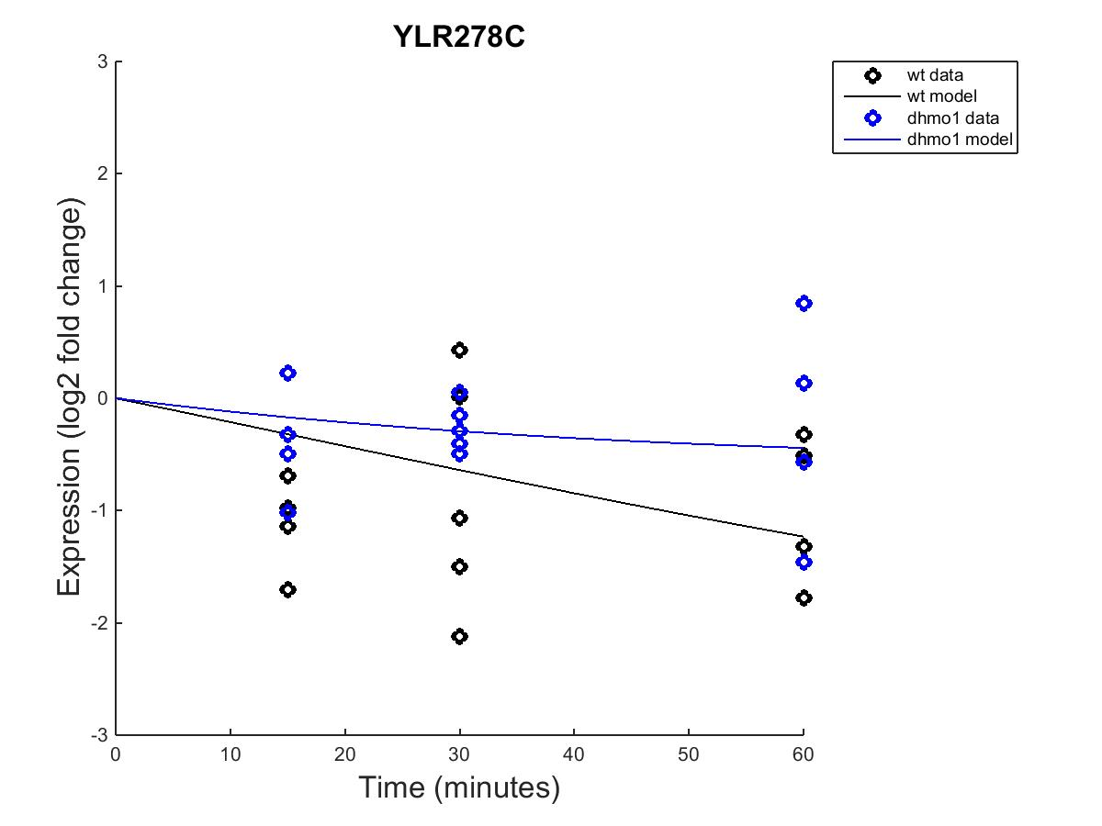
GRNmap model
Fixed b
Estimated b

Slide 11
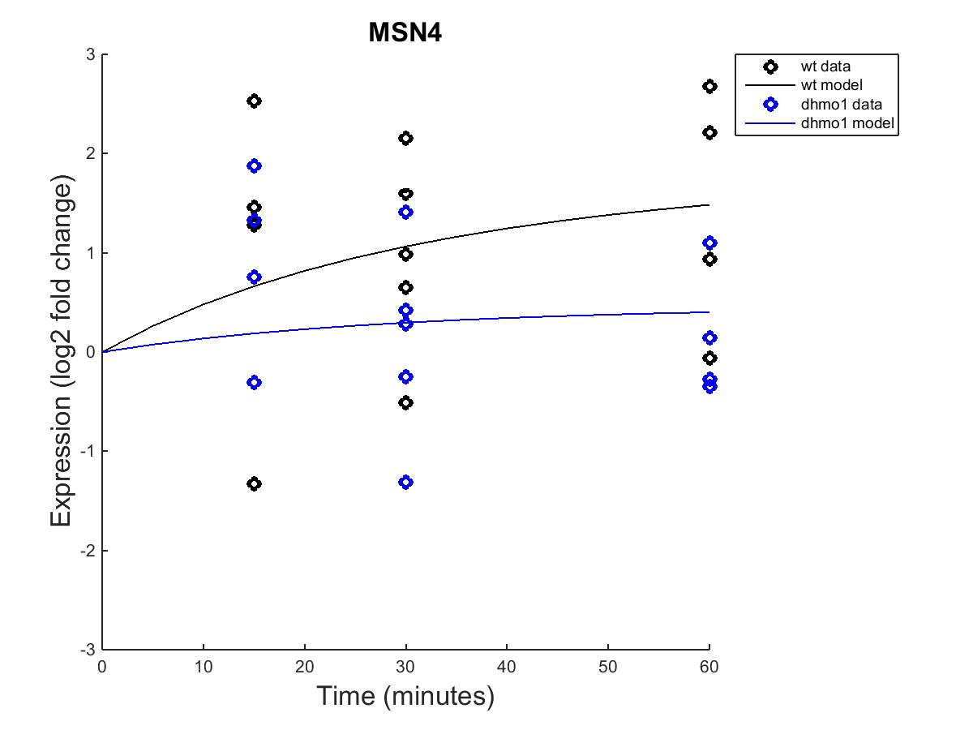
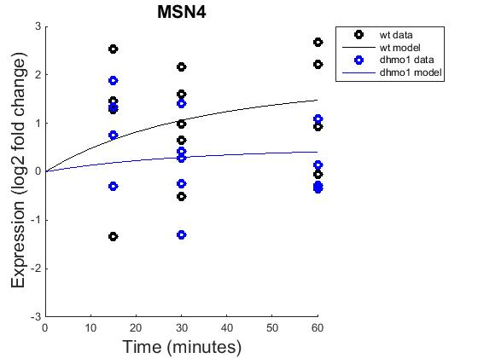
GRNmap model
Fixed b
Estimated b

Slide 12
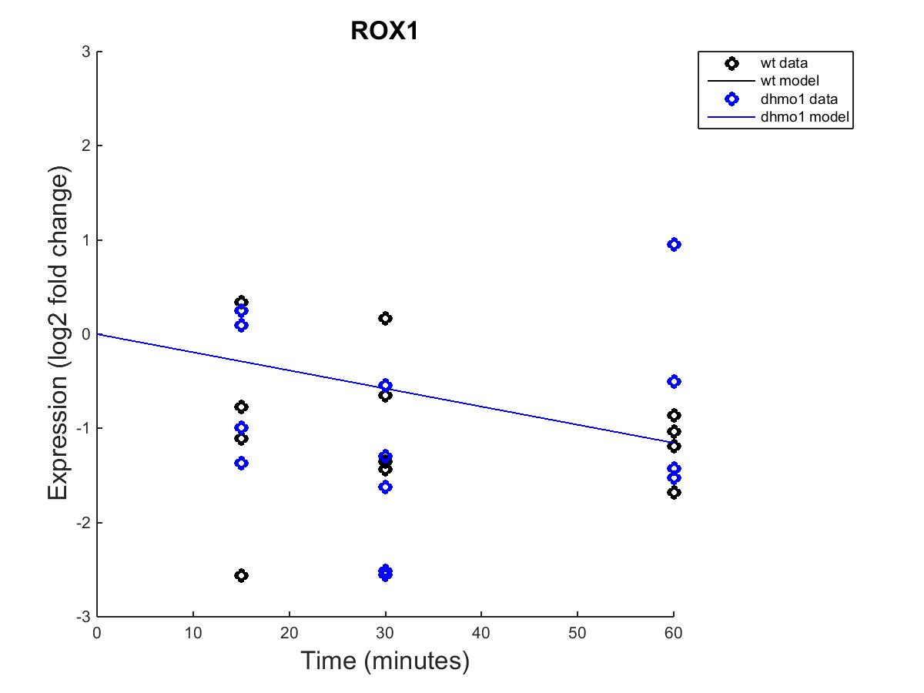
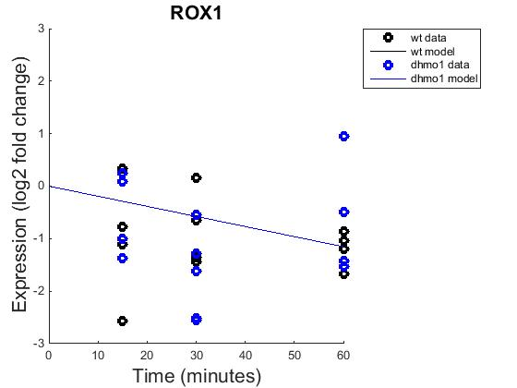
GRNmap model
Fixed b
Estimated b

Slide 13
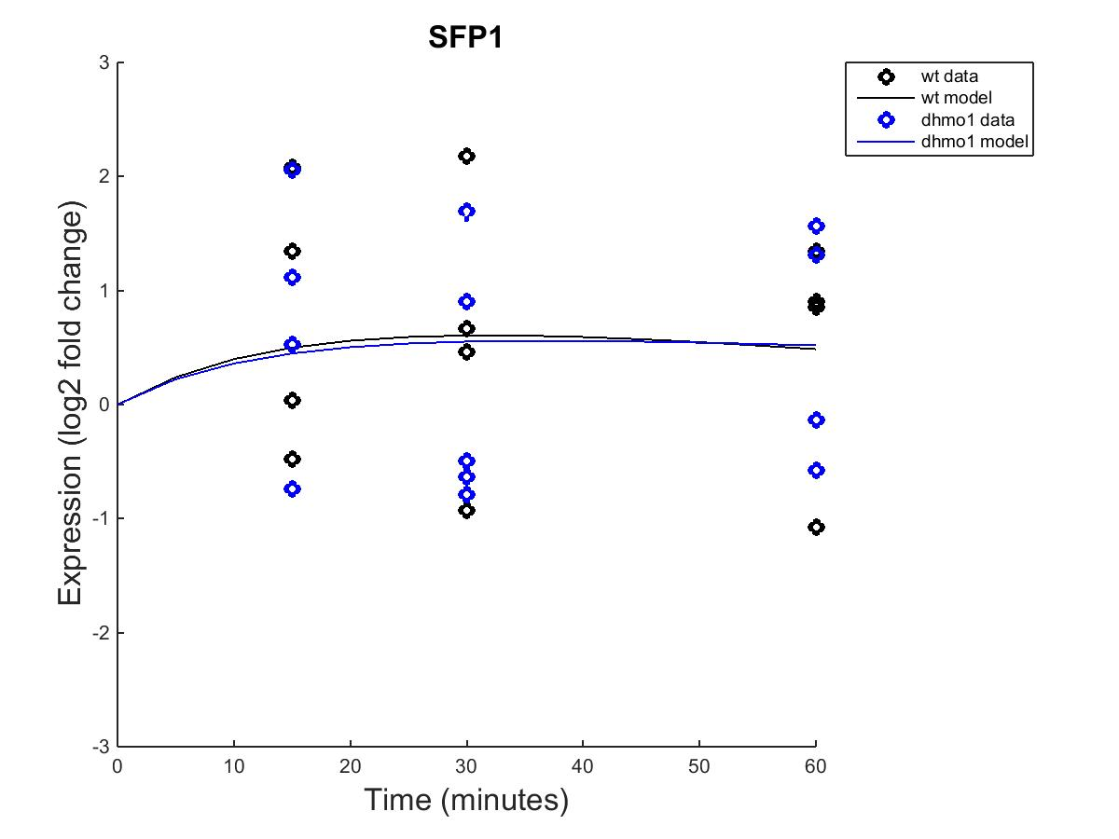
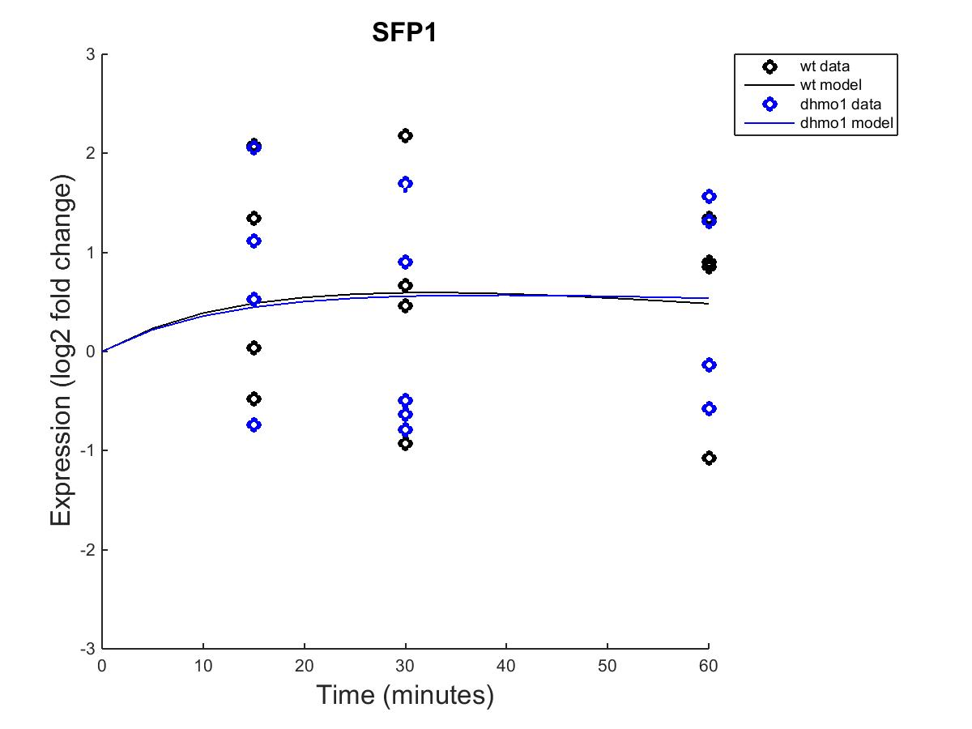
GRNmap model
Fixed b
Estimated b

Slide 14
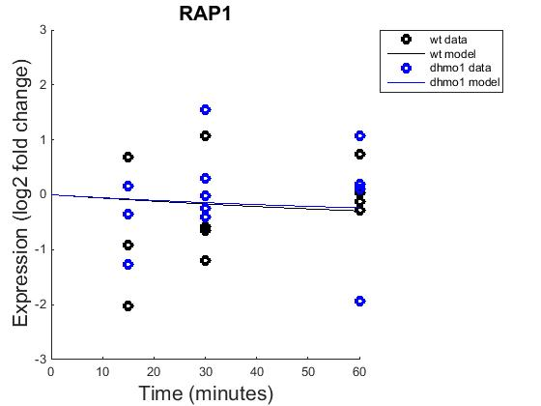
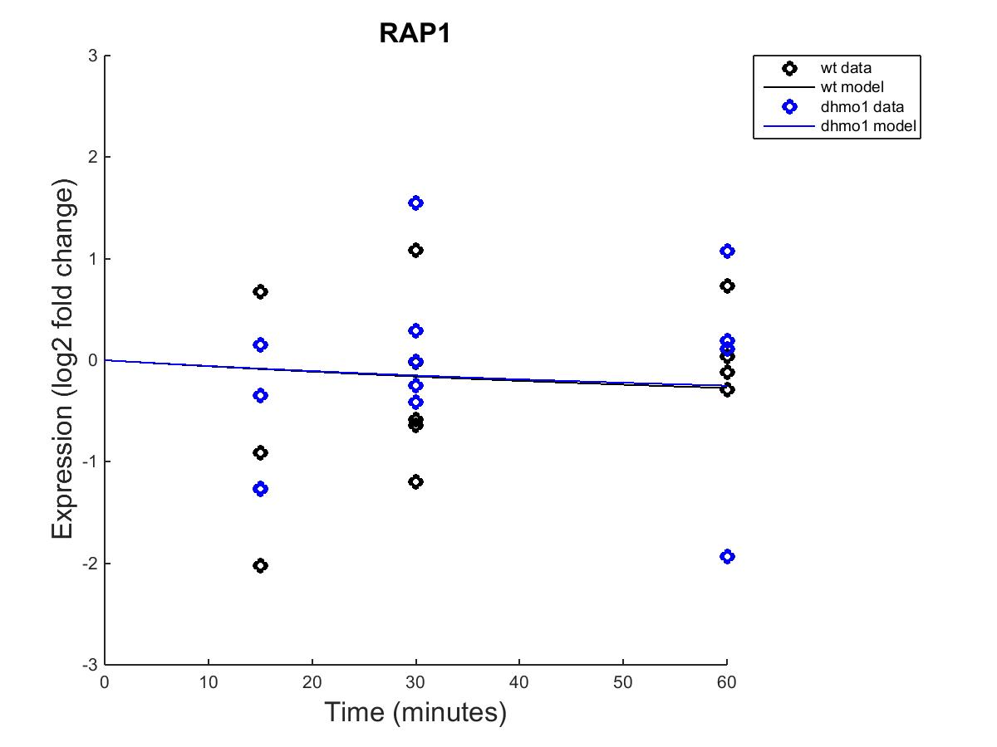
GRNmap model
Fixed b
Estimated b

Slide 15
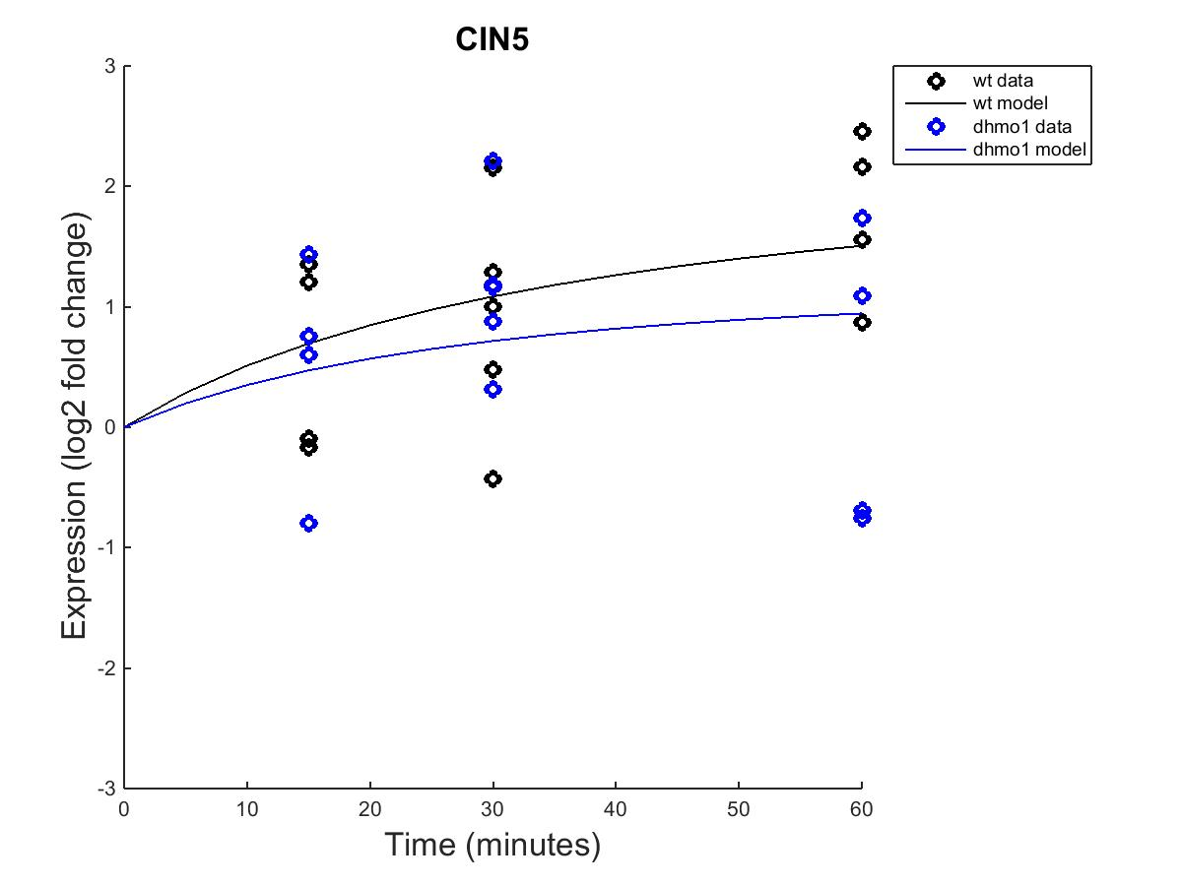
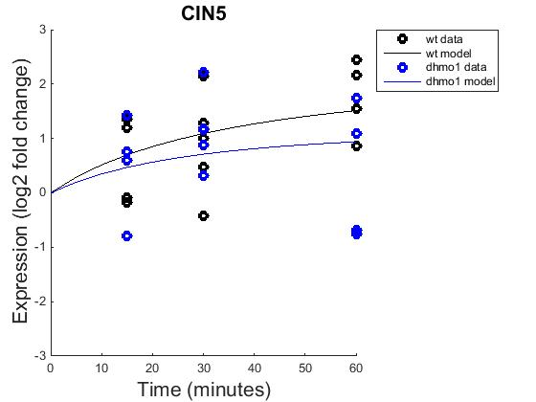
GRNmap model
Fixed b
Estimated b

Slide 16
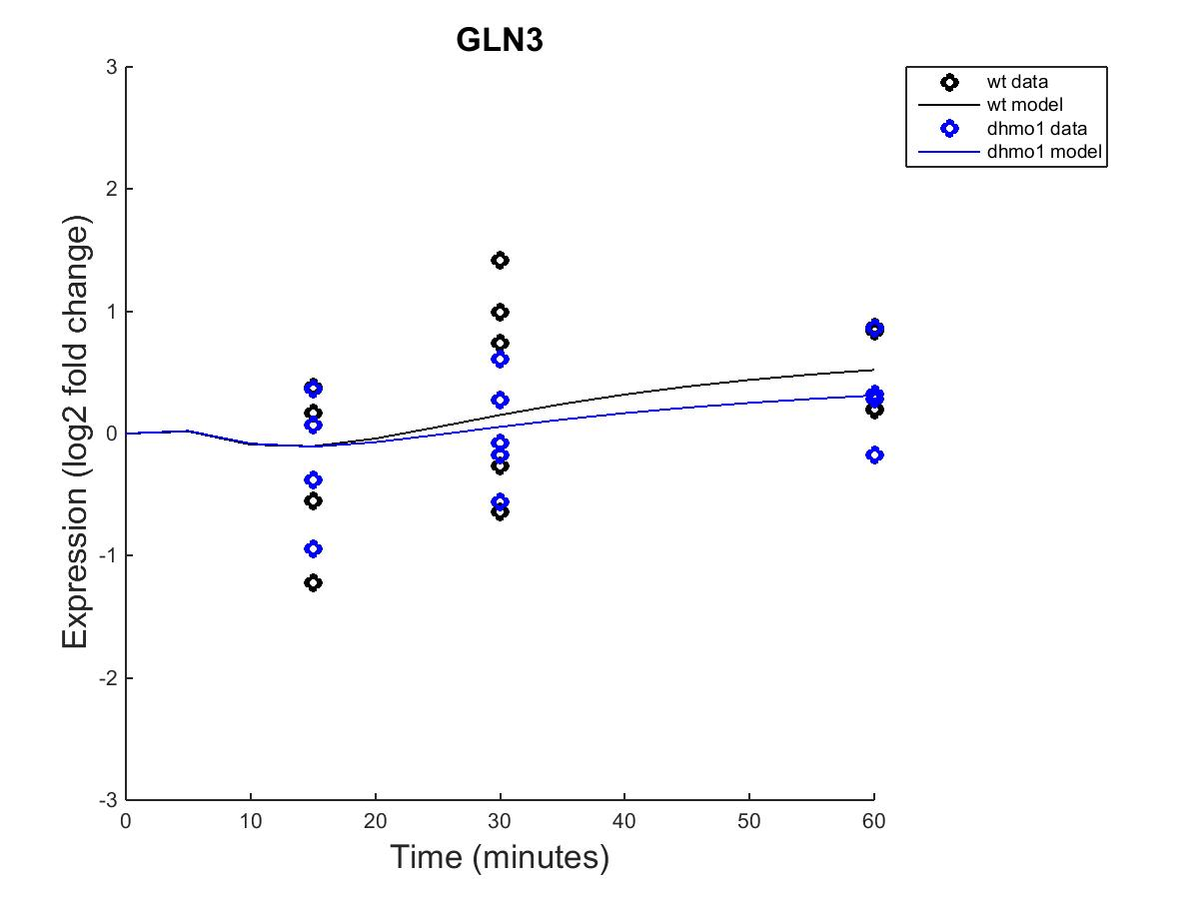
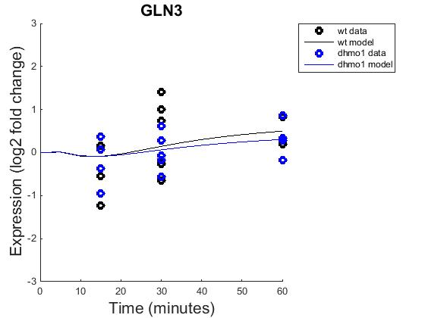
GRNmap model
Fixed b
Estimated b

Slide 17
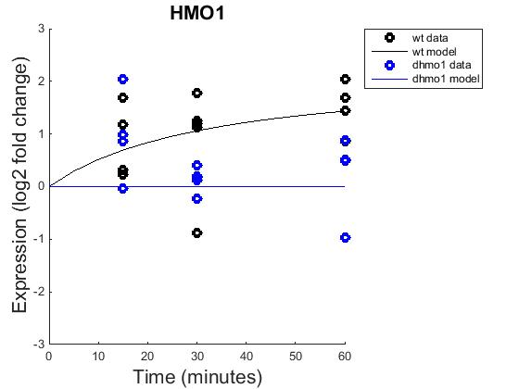

GRNmap model
Fixed b
Estimated b

Slide 18
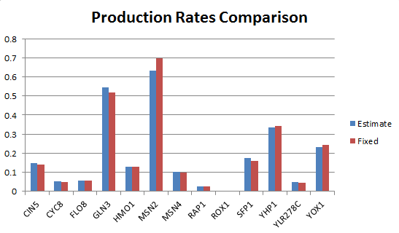
Estimated vs. fixed b

Slide 19
