Slide 1
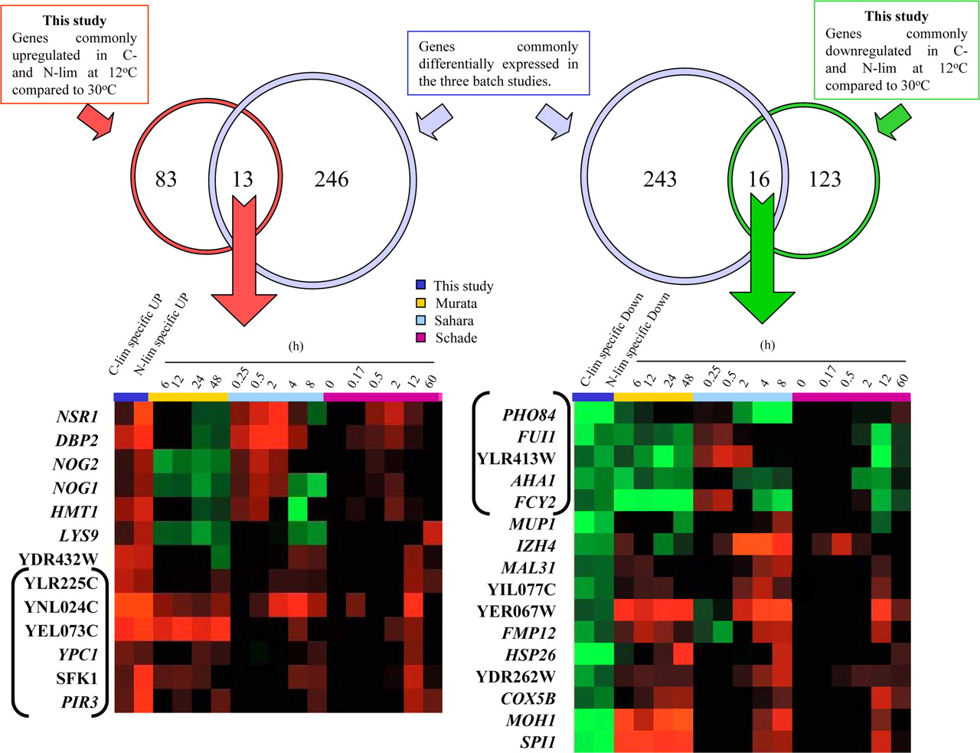
Comparison of the genes common to three batch-culture low-temperature transcriptome datasets with the genes in the chemostat cultures
- Set of 259 low-temperature adaptation genes was compared with the 235 genes that exhibited a consistently transcription changes in acclimation.
- 29 genes were transcriptionally regulated during both the adaptation and acclimations to low temperatures.
- Only 11 genes (bracketed) showed a consistent pattern of regulation in all four situations in all datasets..
- 3 of the genes that were consistently up-regulated at low temperature (SFK1, YPC1, YEL073C) are involved in lipid metabolism.
Tai S L et al. Mol. Biol. Cell 2007;18:5100-5112

