Slide 1


Microbial Ecology of Endophytic Bacteria in Zea as Influenced by Plant Genotype, Seed Origin, and Soil Environment
David Morris Johnston Monje
Plant Agriculture, University of Guelph
Advisor: Manish Raizada
Committee: Jack Trevors, George Lazarovits, Kari Dunfield, Paul Goodwin

Slide 2
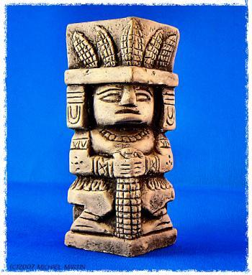
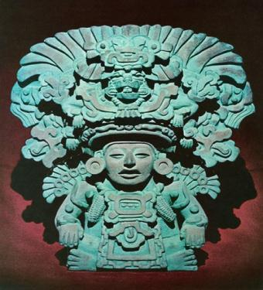
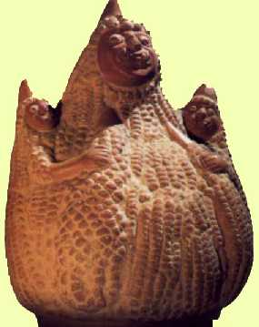



Maize has been important all over the Americas for thousands of years...
Mayan maize god
Yumil Kaxob
Zapotec maize god
Pitao Cozobi
Moche culture
Peru
Mitchell Corn Palace, USA

Slide 3
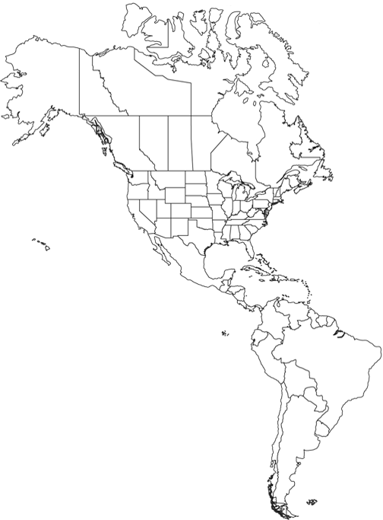
Where does maize come from?
9,000 years ago
Oaxaca, Mexico

Slide 4
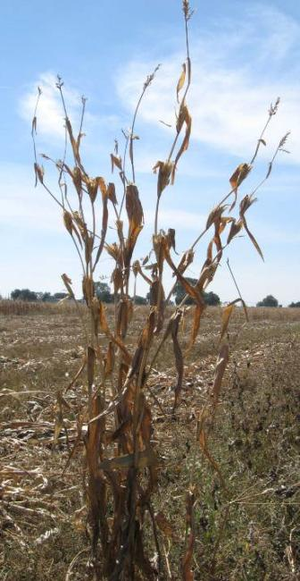
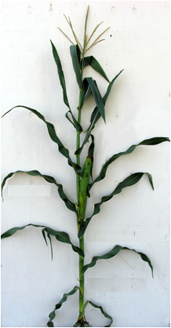
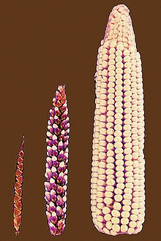

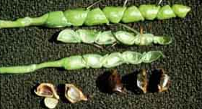
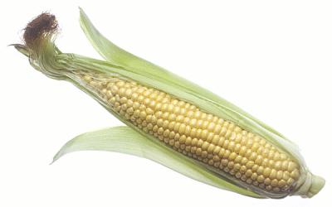
How has the plant been changed?
Domestication, breeding, and migration have altered plant and seed architecture while forcing maize to grow in different environments and to be completely dependent on humans.

Slide 5
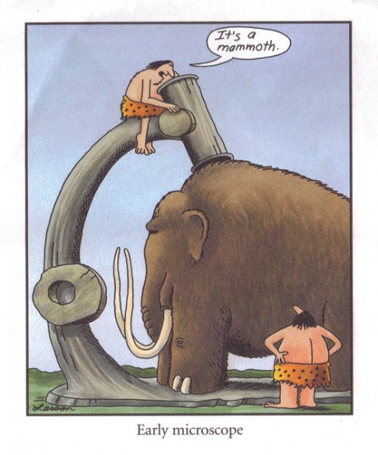
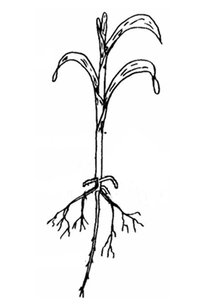


Obvious structural differences may coincide with microscopic changes

Slide 6
What are endophytic bacteria and why study their ecology in Zea plants?
Endophytes are bacteria or fungi that can live within a plant without causing obvious disease
The inside of plants is an agriculturally important niche where microbes can help the host plant grow and survive
Endophytes are likely enriched for botanically significant genes and metabolic pathways as a result of co-evolution
There is fossil evidence that plants had endophytes at least 400 million years ago (Krings et al 2008)
Which are typical maize endophytes, what do they do and have any been lost during domestication/breeding/migration?

Slide 7
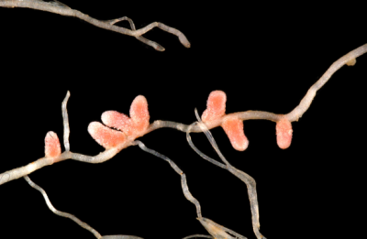
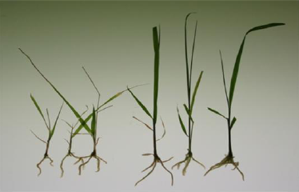
New Strains May Help Agricuture
Rhizobial endophytes first patented and sold as ‘Nitragin’ in the United States in 1895
Burkholderia phytofirmans PsJN from rotting onions can promote plant growth.
High levels of nitrogen fixation found in sugarcane thanks to Gluconacetobacter diazotrophicus.
Nitrogen fixing Klebsiella pneumonii isolated from Zea luxurians shown to improve wheat growth.
(Dalton and Kramer 2006)

Slide 8
Previous Research on Maize Endophytes?
99% microbes in the world are believed to have not yet been cultured.
Chelius and Triplett (2001) studied 16S rDNA from endophytes in Wisconsin grown maize roots of Pioneer 3751.
74 phylotypes in 6 bacterial divisions including were found by culture-independent analysis, as opposed to 27 cultured phylotypes in 4 divisions.
It is impossible to accurately use only culturing to study endophytes in corn!!!

Slide 9
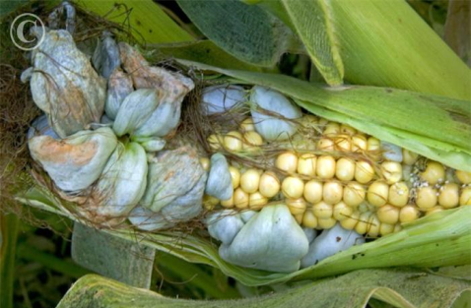
Previous Research on Maize Endophytes?
At least 20 publications exist about maize endophytes, mostly focusing on culture based isolation of novel strains.
For example, Bacillus mojavensis from Italian maize seed was patented as a biocontrol agent against fungal infections (Hinton et al. 1995 ).
An exception shows the pathogen Ustilago maydis underwent a genetic bottleneck about 9,000 years ago in concert with maize domestication (Munkacsi et al. 2008).
No study directly addresses the influence of domestication, breeding, and migration of Zea plants on the ecology of their bacterial endophytes.

Slide 10

My PhD Research
Hypothesis: Domestication, breeding, and movement of maize to new environments has altered the community of bacterial endophytes associated with these plants.
Objective 1: Characterize bacterial endophytes in a diverse panel of Zea seed. (Published with 516 views so far)
Objective 2: Study the importance of soil as a source of bacterial endophytes to Zea plants.
(Submitted – BMC Biology)

Slide 11
Outline
Methodology used
Objective 1: Surveying seed endophytes
DNA (culture independent) based survey of bacteria
Culture based survey of bacteria
Objective 2: Surveying soil derived endophytes
DNA (culture independent) based survey of bacteria
Culture based survey of bacteria
Major conclusions

Slide 12
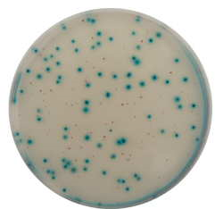



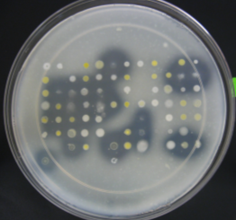
Methodology Employed
Clone library
Molecular fingerprinting
Parviglumis
B73
DNA extraction
Surface sterilization: bleach and ethanol
Multivariate
Statistics
OR
Maceration in buffer
Culture Characterization
Culturing on different media

Slide 13
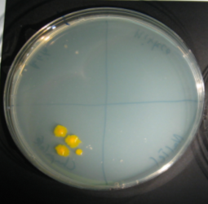
Surface Sterilization
Maceration in buffer
Sterility check
10 min
3% bleach
10 min
3% bleach
10 min
95% ethanol
OR

Slide 14
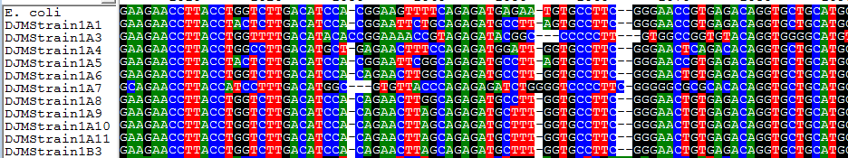
How can DNA identify bacteria?
All life contains ribosomes: protein/RNA complexes responsible for production of protein using information coded in DNA
A ribosomal gene called 16S is found in all bacteria, although it has accumulated diagnostic mutations in different species over evolutionary time
Each sequence can be compared bioinformatically to reference sequences to predict what species it is from

Slide 15
TRFLP is one way to comprehensively view a microbial community using DNA
Outline of the terminal restriction fragment length polymorphism method
Extract DNA from the community
PCR label with a fluorescently labelled rRNA forward primer
Restriction Digest of PCR Product
Relative fluorescence
Recognition of labelled fragments
Fragment separation in sequencing gel

Slide 16
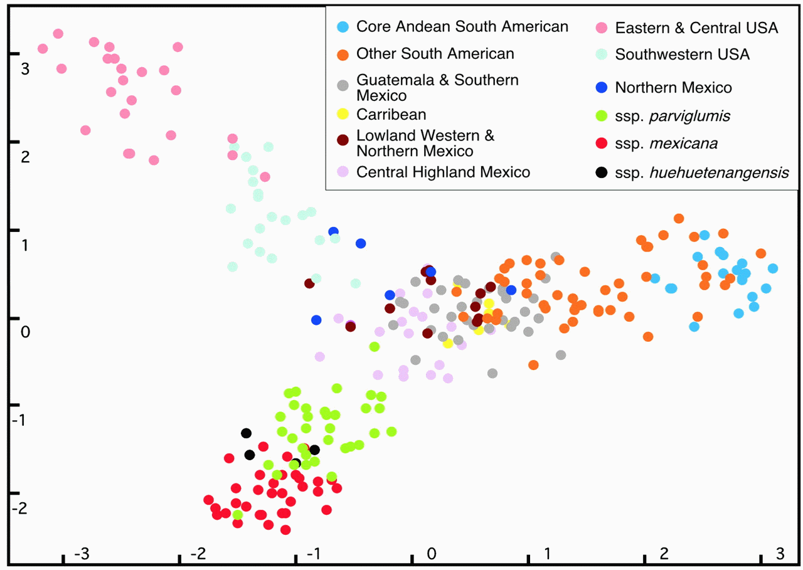
How can a DNA fingerprint like TRFLP be interpreted statistically?
Based on 99 microsatellites
Principle Component 2
Principle Component 1
Matsuoka et al. (2002)

Slide 17
Objective 1: Seed Endophyte Survey
Seed selected with CIMMYT on phylogenetic, geographic, and environmental parameters

Slide 18
Objective 1: Sampling Strategy
Canadian field grown plants
Growth Room Seedlings
Generation 2 Seed
Generation 1 Seed
15 Seeds/Genotype
Surveyed
15 Seeds/Genotype
Pooled
Random block planting,
10 Stems/Genotype
Pooled

Slide 19
Objective 1: TRFLP – Generation 1 Seed

Slide 20
Objective 1: TRFLP – Generation 2 Seed

Slide 21
Objective 1: TRFLP – Stems

Slide 22
Objective 1: TRFLP – Comparisons
Conserved in Seed
Conserved in Stems
Generation 1 Seed
Generation 2 Seed
Stems

Slide 23
Objective 1: TRFLP – Comparisons
Conserved in stems and seeds across genotypes
Abundant in teosinte seeds and all stems
Generation 1 Seed
Generation 2 Seed
Stems

Slide 24
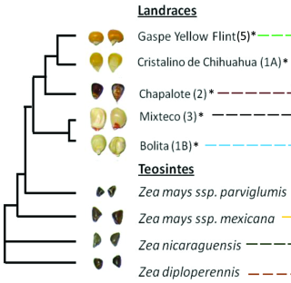
Objective 1: How related are bacterial endophytic communities? (principle component analysis)
Generation 1 Seed
Stems
Generation 2 Seed
(no coherant pattern)

Slide 25
Objective 1: Phylogenetics of 16S clones and cultures

Slide 26
Objective 1: Summary of TRFLP
Four TRFLP signals including two predicted to represent Clostridium and Paenibacillus species were conserved across all Zea genotypes.
Loss of the fruitcase in maize may explain reduction of populations of seed endophytes, such as Enterobacter/Pantoea .
Phylogenetic change, but not external environment correlates to changes in Zea seed endophytic populations.
Endophyte populations in seed are regulated by plant genotype, but in stems there is no clear pattern.

Slide 27
Objective 1: Culturing Seed Endophytes

Slide 28
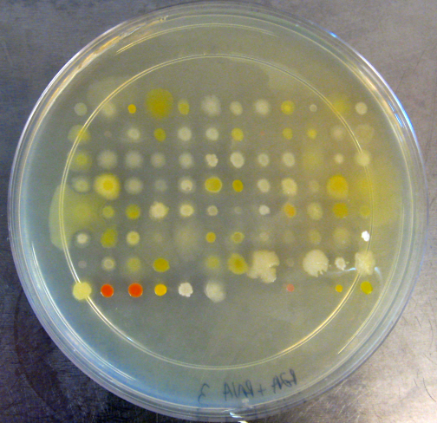
Objective 1: Organizing and testing functions of isolates
A total of 124 bacteria were isolated from agar plates; identified by sequencing of the 16S; and 94 unique isolates put into a 96 well plate.

Slide 29
Objective 1: Culturing from Seed
Generation 1 Seed
Generation 2 Seed
Both Seed Generations

Slide 30
Objective 1: Organizing and testing functions of isolates
Antibiosis
ACC Deaminase
Phosphate
Solubilization
Acetoin/Butanediol
Pectinase
Also tested nitrogen free growth, cellulase, RNAse, auxin production,
siderophore production

Slide 31
Objective 1: Do isolates from different seed have specialized functions?

Slide 32
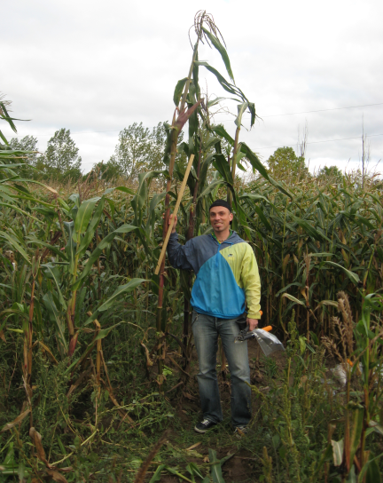
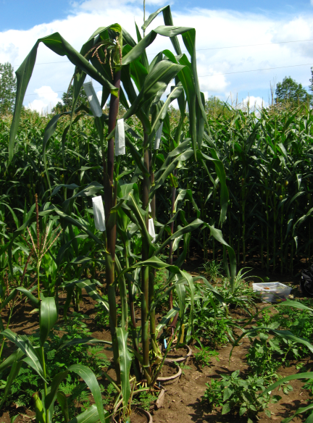
Objective 1: Mexican landrace Mixteco: a source of growth promoting endophytes?
Mixteco comes from nutrient poor soils at 2,500 m in Oaxaca, near the proposed site of maize domestication.
The only cultivated endophyte from Mixteco seeds was the growth promoting Burkholderia phytofirmans – this may contribute to the plant’s large height and biomass.

Slide 33
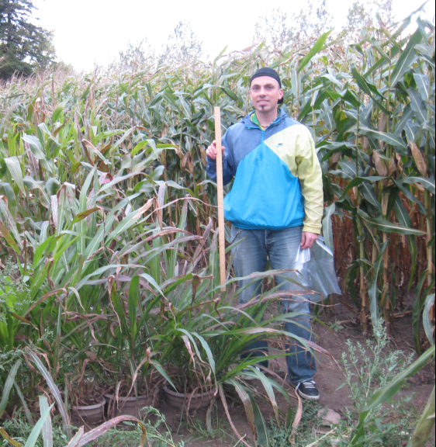
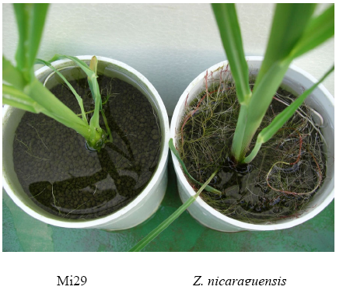
Objective 1: Zea nicaraguensis a source for root promoting endophytes?
4 isolates of Enterobacter from Zea nicaraguensis had auxin production potential.
A critically endangered species surviving as approx. 6,000 plants in 0.03 square km of Nicaraguan swamp.
Auxin producing endophytes may help root development.
Maize Z. nicaraguensis

Slide 34
Objective 1: What are different species of endophytes doing?

Slide 35
Objective 1: Why would these microbes have this activity?
Inside the plant acetoin production by endophytes may stimulate cytokinin production, cellulase/pectinase could aid movement, and nitrogen fixation could aid plant nutrition
Spermosphere is the soil around the germinating seed, rhizosphere is the soil around roots. Microbial activity here might stimulate germination/growth, protect against pathogens, and help make minerals available for developing roots.
If endophytes can colonize these niches from inside, they could help solubilize phosphate for uptake by the growing plant.

Slide 36
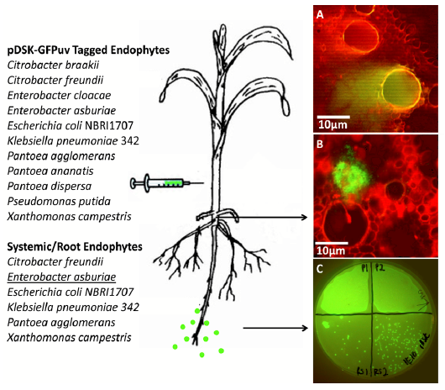
Objective 1: Are these seed endophytes able to live and move inside a plant?

Slide 37
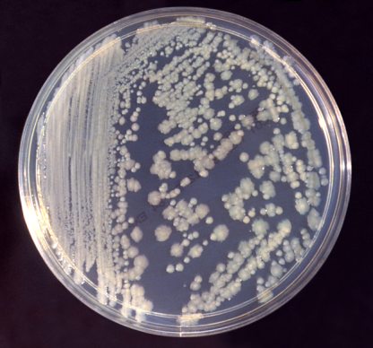
Objective 1: Enterobacter asburiae
E. asburiae had cellulase activity, strong auxin production, nitrogen fixation, and phosphate solubilization.
These traits have all been previously reported in rhizosphere isolates of E. asburiae
A previous study in cotton reported this bacteria as able to bore holes in cotton to facilitate endophytic colonization (Quadt-Hallmann et al. 1997).
This bacteria may use cellulase to “dig” its way out of the root, colonizing rhizosphere where it helps solubilize phosphate

Slide 38
Objective 1: Seed Endophyte Culturing Summary
26 genera of bacteria were cultured with Enterobacter, Methylobacteria, Pantoea and Pseudomonas species being most common.
Phosphate solubilization and production of acetoin/butanediol were the most commonly observed traits.
An isolate from the giant Mexican landrace Mixteco, with 100% identity to Burkholderia phytofirmans, significantly promoted shoot potato biomass.
Enterobacter asburiae was shown to be able to exit the root and colonize the rhizosphere.

Slide 39
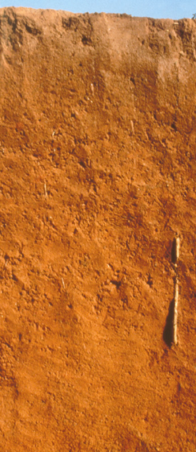
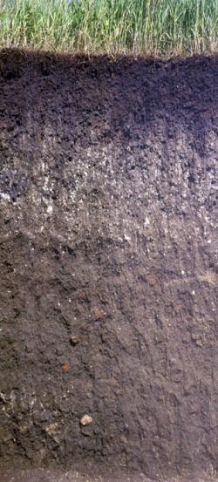
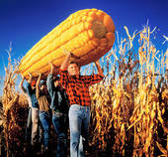
Objective 2: What happens to endophyte communities as maize is moved around the world?

Slide 40
Objective 2: What happens to endophyte communities as maize is moved around the world?
Modern plant breeding moves seed all over the world, including wild relatives, exotics, and modern varieties
Soils are the most diverse ecosystem on earth and geographically distinct soils have distinct microbiota.
4 different soils across the Americas shows only 4% similarity between samples (Fulthorpe et al. 2008).
Plants are assumed to act as “traps” taking up a lot of bacteria from the soil, as if soil is a marketplace.
Thus, maize growing on geographically isolated soils should have dramatically different maize endophytes!

Slide 41
Objective 2: Experimental Design
Grew wild, exotic, and modern varieties side by side on two extreme soils and a heat sterilized sand
3 pools of 5 plants grown side by side in a common growth chamber, receiving equal amounts of sterile water
Plants sampled at the juvenile stage to examine founder populations of endophytes
Sterile sand
Canadian soil
Mexican soil

Slide 42
Objective 2: PCA of TRFLP shows soils have little influence
Shoots
Pioneer
Roots
Mixteco
Parviglumis

Slide 43
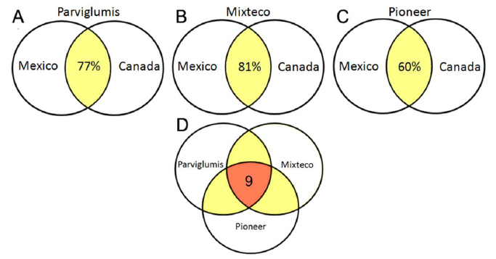
Objective 2: Comparing Soil Treatments Using Sᴓrensen’s Similarity Index
QS = 2c / (S1 +S2)
27 bp, 32 bp (Acidobacteria), 53 bp (Pediococcus), 91 bp (uncultured compost bacterium), 187/188 bp (Chloroflexi), 225/226 bp (Enterobacter or Pantoea), and 229 bp (Burkholderia or Azospirillum).

Slide 44
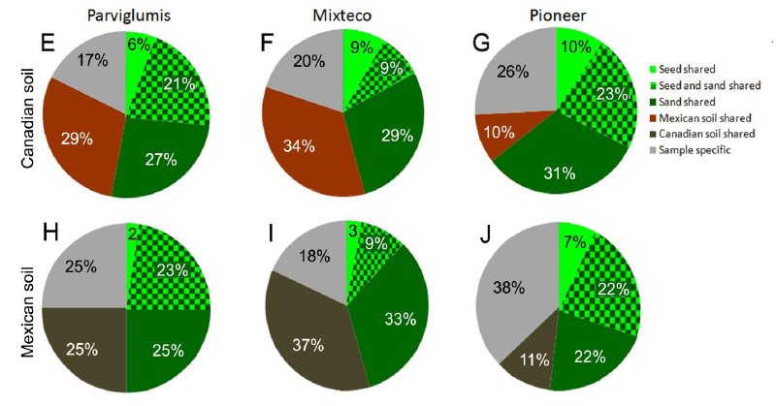
Objective 2: What is the origin of TRFLP peaks: inherited or soil derived?
Seed shared
Seed & sand shared
Sand shared
Mexican soil shared
Canadian soil shared
Sample specific

Slide 45
Objective 2: Soil Endophyte TRFLP Survey Summary
45-64% of TRFLP peaks could be explained as being inherited, while 10-37% of TRFLP peaks appeared to have a soil origin.
Plant genotype (and thus microbial inheritance) is a more significant factor for root endophytes than soil.
Plants growing on Mexican soil were up to 81% endophytically similar on Canadian soil – different soils may contain a common set of maize endophytes.
The elite modern maize Pioneer 3751 appears better suited to regulate uptake of bacteria than its unimproved relatives.

Slide 46
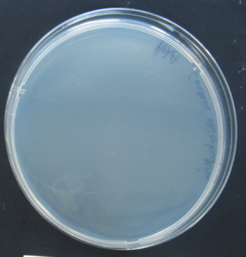
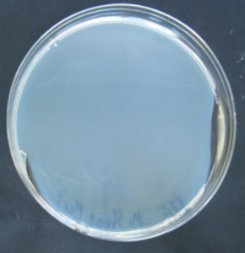
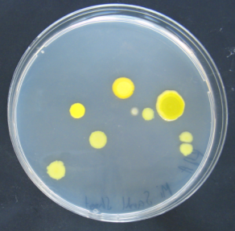
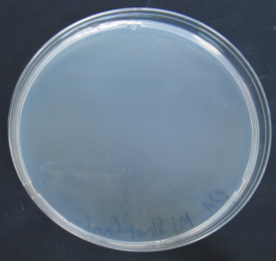
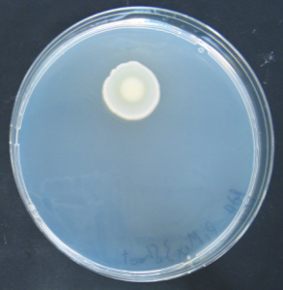
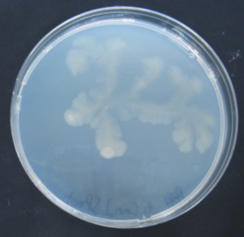
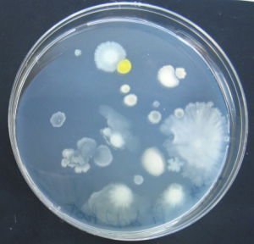
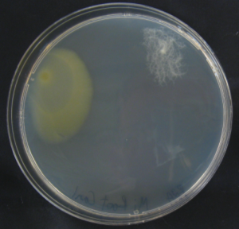
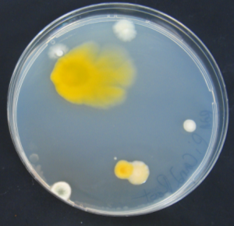
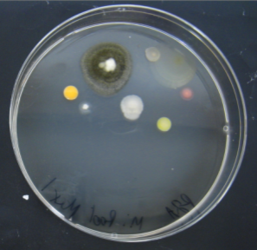
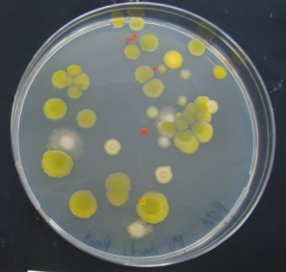
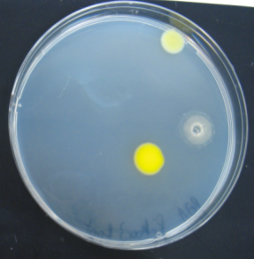
Objective 2: Culturing bacteria from surface sterilized plants
Parviglumis
Mixteco
Pioneer

Slide 47
Objective 2: PCA of cultured isolate functions
Unpooled
Pooled by Genotype
Pooled by Soil

Slide 48
Major Conclusions
As humans have domesticated and bred maize we have altered seed endophyte communities.
Some bacterial species have not been changed in seed by domestication and breeding.
The majority of Zea endophytes are inherited from generation to generation through seed.
Geographically different soils are not a major source of Zea endophytes, although they can serve as a source of similar endophytes.

Slide 49
Can I refute or support my hypothesis?
Hypothesis: Domestication, breeding, and movement of maize to new environments has altered the community of bacterial endophytes associated with these plants.
There is support for the idea that domestication and breeding have affected bacterial endophytic populations in seeds and roots.
Movement of maize to a new soil does not appear to dramatically alter bacterial endophytes associated with these plants.

Slide 50
Future Directions
Check South American seed for differences in seed endophyte populations
Increase sequencing effort to more completely define the endophytic community
Increase efforts to find utility of novel bacterial isolates; field testing as biofertilizers
Mine Zea plants and their endophytic communities for novel plant-microbe interactions and the associated and genes
Extend soil impact study to rhizosphere and phyllosphere – to be done in Brazil this summer

Slide 51
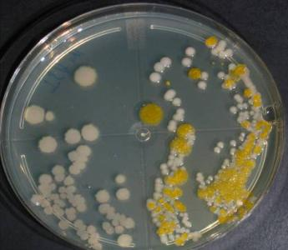
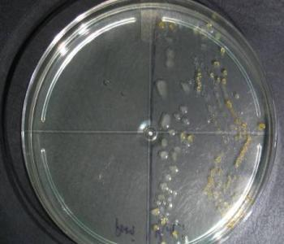

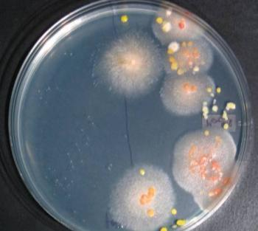
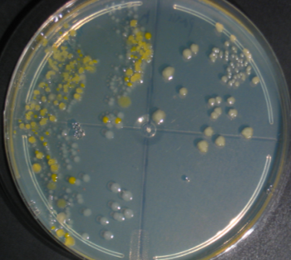


Thank you!
Ontario Research Fund for funding
Dr. Manish Raizada for wonderful supervision
My committee Dr. George Lazarovits, Dr. Jack Trevors, Dr. Kari Dunfield, and Dr. Paul Goodwin
Dr. Suketoshi Taba, Dr. Garrison Wilkes, CIMMYT, Pioneer, and NCPRIS for seed
My labmates and colleagues, especially Sameh Soliman for collaboration on endophytes & Jamie Larsen for consultation on statistics
Gerald R. Stephenson Scholarship, Sophia Hungerford and Taffy Davison Memorial Travel Grants
My family: Dr. David Johnston Sr. and Mrs. Gloria Monje de Johnston

