Slide 1
Isolation of rare circulating tumor cells in cancer patients by microchip technology
Nagrath & Sequist et al. (2007)
Journal Presentation
Brigitte Morales & Leanna Morinishi
December 8th, 2011
Nagrath, S., Sequist, L. et al. Nature 450.7173 (2007):1235-239. Print.
Notes:
Hi everyone, I’m Leanna Morinishi and this is Brigitte Morales, and we’re going to talk today about the isolation of rare circulating tumour cells in cancer patients by microchip technology, a paper published in nature in 2007 by Nagrath and Sequist of Mass General Hospital.

Slide 2
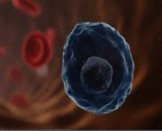
Circulating Tumor Cells
Viable cancer cells detached from the primary tumor and circulating through bloodstream
May “seed” additional tumors (metastasis)
Very rare (1 in 10⁹)
http://cdn2-b.examiner.com/sites/default/files/styles/large/hash/df/20/df20e52fb60caa56c75fbf5463efb422.jpg
Notes:
Circulating tumor cells are viable cancer cells detached from the primary tumor and circulating through the bloodstream. They are probably the origin of intractable metastatic disease. CTCs can be found in the blood of non-haemotologic cancer patients, but are very rare at about 1 CTC per 10^9 haematologic cells.

Slide 3
Previous research
CTC studies potential in cancer research
  Circumvent invasive biopsies
  Further cancer marker studies
  Study metastasis
Previous methods of CTC isolation
  Requires pre-processing of blood
  Identification after fixed cells
  Poor yield and purity
Notes:
CTCs are a point of interest, however, because their identification, isolation, and characterization have great potential to contribute to the greater understanding of cancer. For example, isolating CTCs for tumor samples would circumvent invasive biopsies, and characterization of their phenotype would inform cancer marker studies and possibly the mechanism of metastasis. Prior to this paper, methods of CTC isolation required complex analytic approaches with low yield and purity. Some required pre-processing of the blood, possibly affecting results, and some could only identify the cells after fixing and killing them.

Slide 4
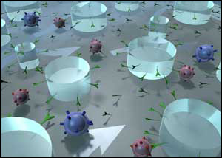
Microchip for high-quality isolation
http://www.aacc.org/publications/cln/2008/november/PublishingImages/Nov08SeriesImage.jpg
Notes:
Therefore, Nagrath and Sequist proposed a microfluidic chip for the isolation of viable circulating tumor cells to enable further study of these rare but useful cells. I’ll hand it off to Brigitte.

Slide 5
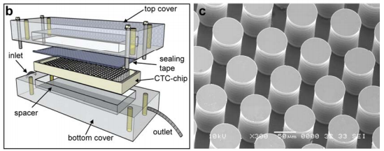
Design considerations
Micro-post placement maximizes probability of contact
Optimize flow velocity
Minimize shear force
Notes:
The authors decided to maximize rare cell capture by flowing the sample through a series of chemically functional microposts spaced 50 microns apart. The flow velocity was then optimized to have maximum contact between cells and microposts, and to minimize shear force on the captured cells so that they stayed on the posts and didn’t die.

Slide 6
CTC capture
Cancer cells of interest overexpress EpCAM
Haematologic cells do not
Coated microposts with anti-EpCAM antibodies capture CTCs
Non-specifically bound
cells are washed out
after initial flow
http://www.aacc.org/publications/cln/2008/november/PublishingImages/Nov08SeriesImage.jpg
Notes:
In order to capture the CTCs, the authors focused on the epithelial cell adhesion molecule (EpCAM) that is frequently overexpressed in carcinomas and would differentiate the cancer cells from haemotologic cells. They took anti-EpCAM antibodies and attached them to the microposts via avidin-biotin chemistry. The coated microposts would then capture CTCs and let blood cells flow through.

Slide 7
Controls
Non-small-cell lung cancer cells spiked into buffer
  Capture efficiency: 65%
3 cell lines with varying antigen expression
  Capture efficiency: >65%
    Density of antigens/cell doesn’t affect the number of cells captured
NSCLC cells spiked into whole and lysed blood from healthy donors
  CTC-chip doesn’t require blood sample pre-processing
Examined blood samples from 20 healthy individuals
Notes:
Ran 3 chips. Non-small cell lung cancer; prostate cancer pc3-9 cells and bladder cancer cells, with >50000, 50000 and 2000 antigens per cell at equal cell concentrations
Possible steric hindrance of red blood cells in the flow path

Slide 8
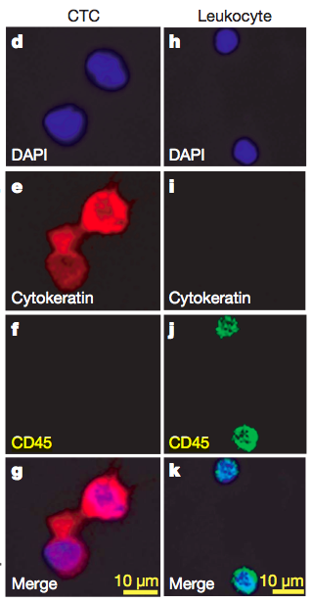
Visual confirmation
CTCs - rhodamine-conjugated anti-cytokeratin
Haematologic cells – fluorescein-conjugated anti-CD45 antibodies
Both – DAPI staining for DNA
Notes:
To get a sense of the purity of the captured sample and to make sure they were actually capturing epithelial CTCs, the authors fixed and stained the cells. First with DAPI, for DNA content, to visualize all cells, then rhodamine-conjugated anti-cytokeratin antibody that targets epithelial cells and fluorescein-conjugated anti-CD45 antibody that targets leukocytes.
Here you can see the stains, the top are CTCs and the bottom row are non-specifically bound leukocytes
They were able to see that their chip was in fact capturing cancer cells, and that their captured samples were about 50% CTCs, 2x the previous rates of purity

Slide 9
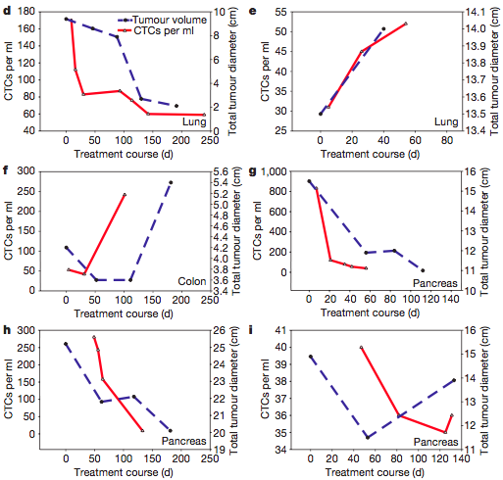
Longitudinal tumor study
Notes:
Lung, lung, colorectal, pancreatic, pancreatic, pancreatic

Slide 10
Major Conclusions
Efficient - CTC isolation, high purity and yield
Simple - Analyzes whole blood, in one-step
Gentle - Isolates viable cells
Powerful - Useful for early diagnosis and longitudinal monitoring of cancer
Future Potential for expansion into other disease studies
Notes:
The CTC-chip was a great improvement upon existing technologies for the isolation and study of circulating tumor cells. It was efficient, capable of analyzing milliliter volumes of sample with high purity and yield of isolated cells. Simple, as it required no pre-processing of the blood samples, and analyzed it in one step. Gentle, optimized to limit shear stress and cell capture of VIABLE CTCs for future characterization and analysis. Powerful, proven to be useful in early diagnosis and the longitudinal monitoring of cancer patients and their response to therapy.
Lastly, the generalizable format of the CTC-chip means that it has the potential to be altered to detect other rare cells from the blood, for use in other disease studies.

Slide 11
Advances and Significance
Improvements
  Recovering the live cells
  Using this device for capture of other rare cells
Post-2007, cited in >400 articles
  Span topics from metastasis to lab-on-a-chip
As of Oct., antibody-based capture still the purest yield technique

Slide 12
Questions?

Slide 13
Nagrath, S., Sequist, L., Maheswaran, S., Bell, D., Irimia, D., Ulkus, L., Smith, M., Kwak, E., Digumarthy, S., Muzikansky, A., Ryan, P., Balis, U., Tompkins, R., Haber, D., Toner, M. “Isolation of Rare Circulating Tumour Cells in Cancer Patients by Microchip Technology.” Nature 450.7173 (2007):1235-239. Print.

