Slide 1
Microarray Cold Shock Analysis of Wild type Saccharomyces cerevisiae
Salman Ahmad & Helena Olivieri
Department of Biology
Loyola Marymount University
May 9th, 2013

Slide 2
Outline
Significance of cold shock in relation to the functions of yeast metabolic processes
Data derived from DNA microarray experimentation
Methods and Results regarding:
Statistical analysis
Clustering and GO term analysis
YEASTTRACT transcription factors
Modeling of Equations to determine up and down regulation

Slide 3
Why study gene regulation and cold shock?
Temperatures below optimum range for growth (25–35°C) slow down enzyme kinetics and cellular processes
Cold shock, sudden exposure to environmental changes is likely to trigger rapid, highly dynamic stress-response phenomena (adaptation)
Yeast responds to colds shock via transcription regulation
Little is known about which transcription factors regulate the early response to cold shock
Notes:
suboptimal temperatures affect a variety of cellular characteristics and processes, including growth phase
,respiration, lipid composition of membranes, and trehalose content
QUESTION:
How do cold temperatures affect transcriptional response in S. cerevisiae?
This study looks at mechanisms responsible for growth and survival at low temperatures

Slide 4
Data derived from DNA microarray experimentation
Microarray time series gene expression experiments are widely used to study a range of biological processes such as the cell cycle, development, and immune response
Studied over short time periods
GREEN: repressed
RED: induced
Log fold changes of time periods 15-120 min derived from lab trials
60 min cold shock
60 min recovery
Notes:
EARLY COLD RESPONSE

Slide 5
Statistical Analysis
Data normalize in order to standardize variables
Calculated average log fold of transformed ratios
Calculated standard deviations of each time period
Determined p-value via t-test
Notes:
P-value= signficance of t-test

Slide 6
Wildtype P-values
Filtering methods displayed statistical significance of log fold changes
 |  |  | P-values
Time (minutes) |  |  | < .05 | < .01 | < .001 | < .0001
 |  | 15 | 803 | 203 | 24 | 2
 |  | 30 | 1213 | 415 | 69 | 8
 |  | 60 | 1042 | 273 | 33 | 4
 |  | 90 | 672 | 162 | 14 | 0
 |  | 120 | 288 | 36 | 5 | 2
Notes:
Rather than random chance
Indicated significant genes

Slide 7
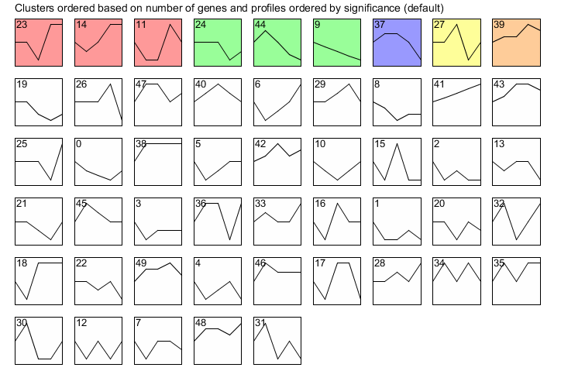
Wildtype Profile Overview
Top colored row indicates profiles with statistically significant genes
Same color represent profiles grouped into a single cluster

Slide 8
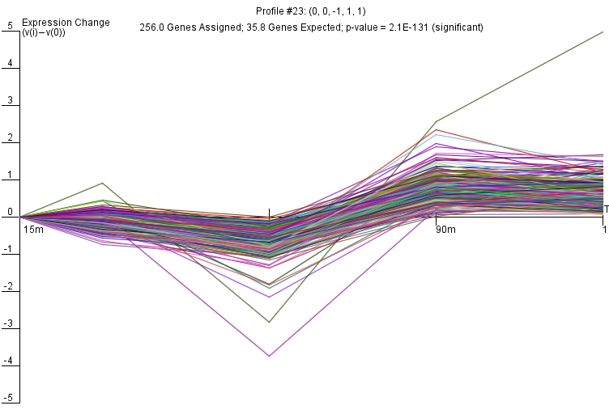
STEM Profile 23
Profile down-regulated at first three time periods

Slide 9
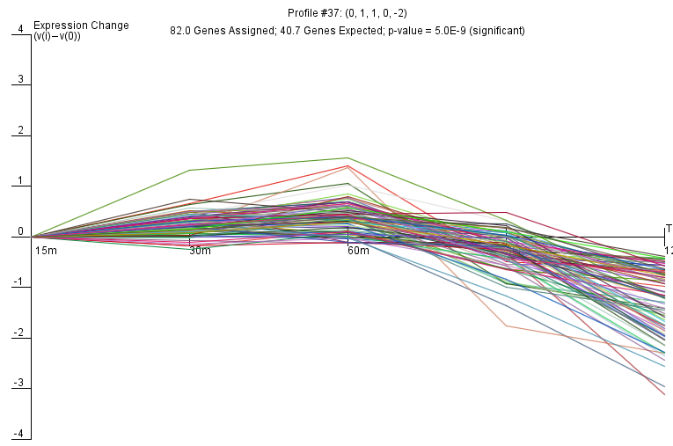
STEM Profile 37
Profile up-regulated at first three time periods

Slide 10
YEASTRACT Transcription Factors
Profile 23
Profile 37
Ste12: 34.4 %
Rap1: 33.2 %
Fhl1: 19.5 %
Sok2: 16.0 %
Sko1: 15.6 %
Yap6: 14.1 %
Skn7: 13.7 %
Msn2: 12.9 %
Cin5: 12.9 %
Yap5: 11.7 %
Ste12: 26.8 %
Rap1: 20.7%
Phd1: 13.4%
Aft1: 12.2%
Gcn4: 11%
Cin5: 11%
Abf1: 11%
Nrg1: 11%
Yap6: 9.8%
Reb1: 9.8%
Ste12: Transcription factor that is activated by a MAPK signaling cascade
Rap1: Essential DNA-binding transcription regulator that binds at many loci
Aft1: Transcription factor involved in iron utilization and homeostasis
Notes:
MAPK: Mitogen-activated protein kinases- protein chain moves extra-cellular signal to DNA expression

Slide 11
Regulation Networks
Profile 23:
Profile 37:
Notes:
Ste 1 regulates Ste 12 & Rap1

Slide 12


Michaelis Menten & Sigmoidal Modeling
MatLab used to run
Sigmoidal model with fix_b=1
Sigmoidal model with fix_b=0
Michaelis-Menten model
MSS11 as seen in Profile 23 most closely matches the models
as seen in Profile 37 most closely matches the models

Slide 13
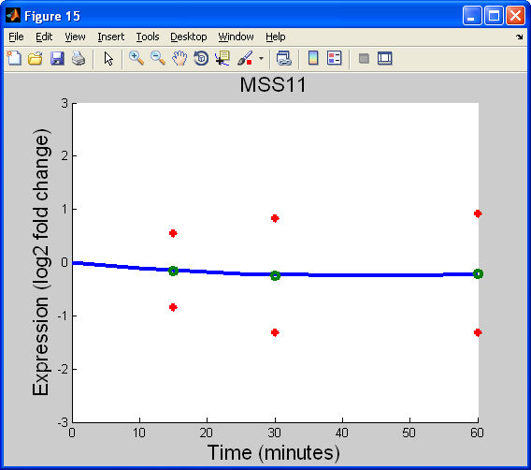

MSS11 as modeled by Sigmoidal and Michaelis-Menten in Profile 23
Sigmoidal where fixed_b=0
Michaelis-Menten
Identified as general transcriptional activator
Upregulated by Cin5, SKO1,
STE12
Does not act as a regulator
Sigmoidal where fixed_b=1

Slide 14
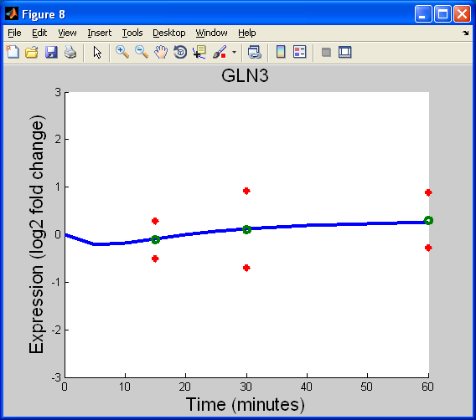

GLN3 as modeled by Sigmoidal and Michaelis-Menten in Profile 37
Sigmoidal where fixed_b=0
Sigmoidal where fixed_b=1
Identified as general transcriptional activator
Down regulates itself, upregulates MGA2
Upregulated by MAL33, AFT1, RAP1
Michaelis-Menten

Slide 15
Future Possibilities
Comparison of cold shock and heat shock
Differences between Early Cold Response and Late Cold Response

Slide 16
Acknowledgements
Loyola Marymount University
Department of Biology:
Dr. Dahlquist
Loyola Marymount University
Department of Mathematics:
Dr. Fitzpatrick

