Slide 1
Enumeration of Bacteriophage and Prokaryotic Populations in an Urban Coastal Wetland, the Ballona Wetlands, by Confocal Microscopy.

Slide 2
Methods

Slide 3
Collection
1 sample collection from the Ballona Wetlands during the ebb flow
1 sample collection during the flood flow
Determination of salinity, turbidity, oxygen level, water temperature

Slide 4
Filtration
Dilutions
  Using 0.02 um and 0.4 um filtered water
  Water contamination most common contamination
1 ml of each dilution through 0.02 um filter

Slide 5
Staining
SYBR Green I
  Binds to double stranded DNA and RNA
  “Virus particles were distinctly shaped ‘pinpricks’ and fluoresced bright green, and bacterial cells could easily be distinguished from viruses because of their relative size and brightness” [Noble, R.T. & Fuhrman, J.A “Use of SYBR Green I for rapid epifluorescence counts…”
Anti-fade/ glycerol mix

Slide 6
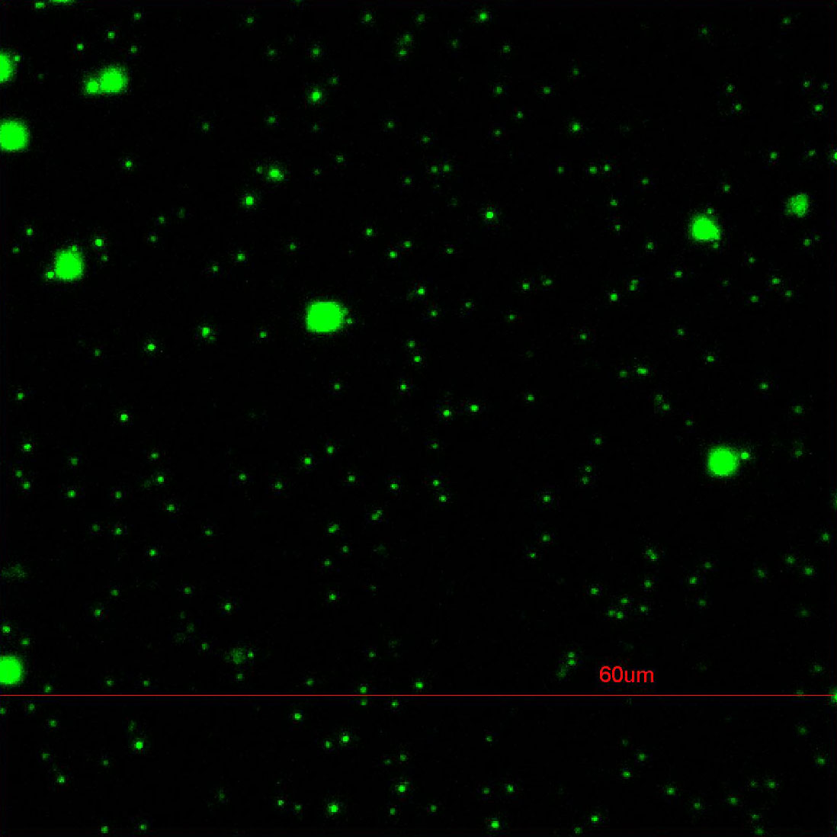
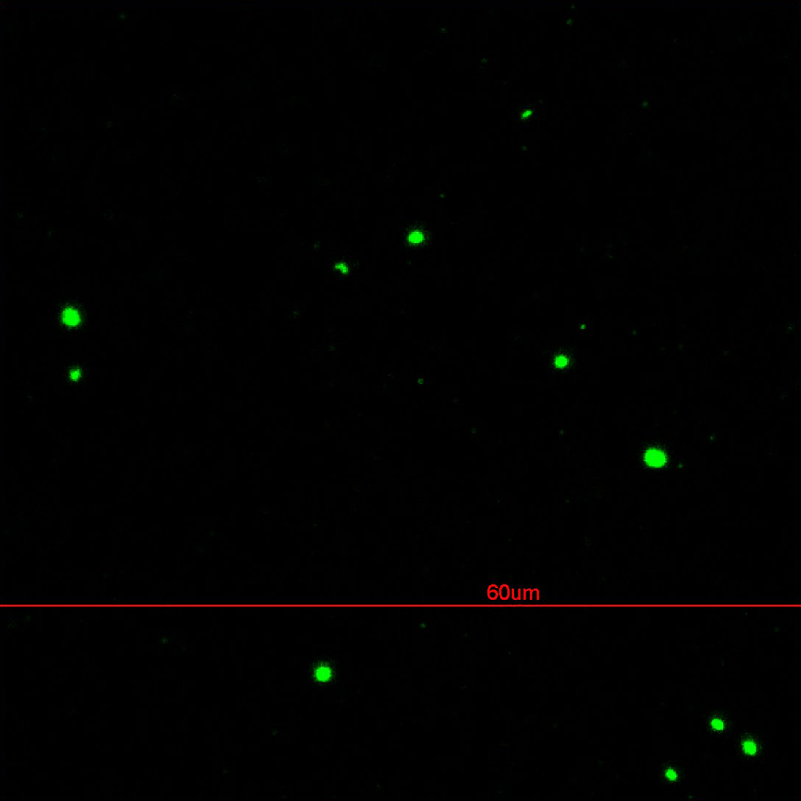
Confocal Microscopy
Ebb
Flood
6/21/12 EBB 3 10⁻¹ (g)
6/21/12 FLD 2 10⁻¹ (i)

Slide 7
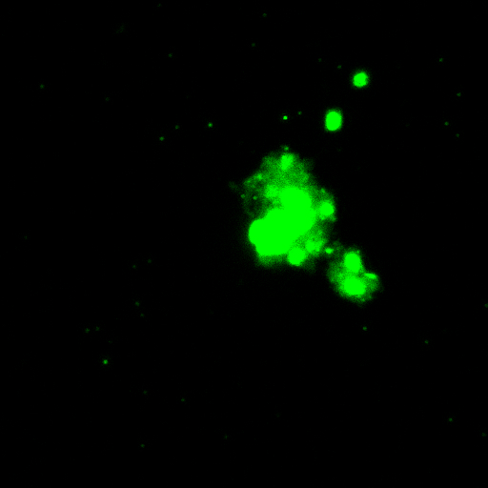
Protist
6/21/12 EBB 2 10⁻² (b)

Slide 8
Data: Average Bacteria per 10 images
 | EBB 1 (-1) | EBB 2 (-1) | EBB 3 (-1) | AVERAGE | FLD 1 (-1) | FLD 2 (-1) | FLD 3 (-1) | AVERAGE
21-May | 25.7 | 18 | 26.6 | 23.43 | N/A | N/A | N/A
30-May | 24.8 | 15.5 | 4.6 | 14.97 | 23.1 | 8 | 34.6 | 21.90
4-Jun | 24.8 | 10.6 | 10.3 | 15.23 | 4 | 8 | 1.1 | 4.37
19-Jun | 10.5 | 12.8 | 8.2 | 10.50 | 7.9 | 5.8 | 4.1 | 5.93
21-Jun | 8.3 | 12.8 | 8.2 | 9.77 | 7.8 | 7.3 | 9.4 | 8.17
 |  |  |  | 14.78 |  |  |  | 10.09
 | EBB 1 (-2) | EBB 2 (-2) | EBB 3 (-2) | AVERAGE | FLD 1 (-2) | FLD 2 (-2) | FLD 3 (-2) | AVERAGE
21-May | 22.7 | 15.5 | 8.1 | 15.43 | N/A | N/A | N/A
30-May | 22.4 | 2.9 | 14.2 | 13.17 | 33.8 | 30.3 | 16 | 26.70
4-Jun | 22.4 | 6.9 | 2.3 | 10.53 | 4.3 | 7.1 | 2.3 | 4.57
19-Jun | 0.5 | 0.3 | 1.2 | 0.67 | 0.6 | 1.1 | 1.1 | 0.93
21-Jun | 1.1 | 1.9 | 2.9 | 1.97 | 1.8 | 1.6 | 1.1 | 1.50
 |  |  |  | 8.35 |  |  |  | 8.43

Slide 9
Data: Average Bacteria per mL
 | EBB 1 (-1) | EBB 2 (-1) | EBB 3 (-1) | AVERAGE | FLD 1 (-1) | FLD 2 (-1) | FLD 3 (-1) | AVERAGE
21-May | 3.50E+09 | 2.45E+09 | 3.62E+09 | 3.19E+09 | N/A | N/A | N/A
30-May | 3.37E+09 | 2.11E+09 | 6.26E+08 | 2.04E+09 | 3.14E+09 | 3.54E+09 | 4.71E+09 | 3.80E+09
4-Jun | 3.37E+09 | 1.44E+09 | 1.40E+09 | 2.07E+09 | 5.44E+08 | 1.09E+09 | 1.50E+08 | 5.95E+08
19-Jun | 1.43E+09 | 1.10E+09 | 1.20E+09 | 1.24E+09 | 1.07E+09 | 7.89E+08 | 5.58E+08 | 8.06E+08
21-Jun | 1.13E+09 | 1.74E+09 | 1.12E+09 | 1.33E+09 | 1.06E+09 | 9.93E+08 | 1.28E+09 | 1.11E+09
 |  |  |  | 1.97E+09 |  |  |  | 1.58E+09
 | EBB 1 (-2) | EBB 2 (-2) | EBB 3 (-2) | AVERAGE | FLD 1 (-2) | FLD 2 (-2) | FLD 3 (-2) | AVERAGE
21-May | 3.09E+10 | 2.11E+10 | 1.10E+10 | 2.10E+10 | N/A | N/A | N/A
30-May | 3.05E+10 | 3.94E+09 | 1.93E+10 | 1.79E+10 | 4.60E+10 | 4.12E+10 | 2.18E+10 | 3.63E+10
4-Jun | 3.05E+10 | 9.38E+09 | 3.12E+09 | 1.43E+10 | 5.85E+09 | 9.66E+09 | 3.13E+09 | 6.21E+09
19-Jun | 6.80E+08 | 4.08E+08 | 1.63E+09 | 9.06E+08 | 8.16E+08 | 1.50E+09 | 1.50E+09 | 1.27E+09
21-Jun | 1.50E+09 | 2.58E+09 | 3.94E+09 | 2.67E+09 | 2.45E+09 | 2.18E+09 | 1.50E+09 | 2.04E+09
 |  |  |  | 1.14E+10 |  |  |  | 1.15E+10

Slide 10
Data: Average Bacteriophage per 10 images
 | EBB 1 (-1) | EBB 2 (-1) | EBB 3 (-1) | AVERAGE | FLD 1 (-1) | FLD 2 (-1) | FLD 3 (-1) | AVERAGE
21-May | 323.2 | 290.1 | 168.4 | 260.57 | N/A | N/A | N/A
30-May | 245.4 | 214.1 | 65.4 | 174.97 | 203.3 | 232.1 | 293.5 | 242.97
4-Jun | 245.4 | 127.3 | 215 | 195.90 | 83.4 | 57.8 | 10.5 | 50.57
19-Jun | 232.1 | 216.9 | 204.1 | 217.70 | 253 | 58 | 33.2 | 114.73
21-Jun | 164.8 | 232.7 | 217 | 204.83 | 49.2 | 33.9 | 136.8 | 73.30
 |  |  |  | 210.79 |  |  |  | 120.39
 | EBB 1 (-2) | EBB 2 (-2) | EBB 3 (-2) | AVERAGE | FLD 1 (-2) | FLD 2 (-2) | FLD 3 (-2) | AVERAGE
21-May | 11.1 | 14.7 | 21.8 | 15.87 | N/A | N/A | N/A
30-May | 13.3 | 41.8 | 32.8 | 29.30 | 46.9 | 21.8 | 33.4 | 34.03
4-Jun | 22.4 | 23.1 | 2.3 | 15.93 | 11.7 | 154.7 | 13.1 | 59.83
19-Jun | 6.5 | 4.5 | 3.3 | 4.77 | 6.6 | 8.8 | 22.6 | 12.67
21-Jun | 6.8 | 2.5 | 3.3 | 4.20 | 2.8 | 1.3 | 5.2 | 3.10
 |  |  |  | 14.01 |  |  |  | 27.41

Slide 11
Data: Average Bacteriophage per mL
 | EBB 1 (-1) | EBB 2 (-1) | EBB 3 (-1) | AVERAGE | FLD 1 (-1) | FLD 2 (-1) | FLD 3 (-1) | AVERAGE
21-May | 4.40E+10 | 3.95E+10 | 2.29E+10 | 3.55E+10 | N/A | N/A | N/A
30-May | 3.43E+10 | 2.91E+10 | 8.89E+09 | 2.41E+10 | 2.76E+10 | 3.16E+10 | 3.99E+10 | 3.30E+10
4-Jun | 3.34E+10 | 1.73E+10 | 2.92E+10 | 2.66E+10 | 1.13E+10 | 7.86E+09 | 1.43E+09 | 6.86E+09
19-Jun | 3.16E+10 | 2.95E+10 | 2.78E+10 | 2.96E+10 | 3.44E+10 | 7.89E+09 | 4.52E+09 | 1.56E+10
21-Jun | 2.24E+10 | 3.16E+10 | 2.95E+10 | 2.78E+10 | 6.69E+09 | 4.61E+09 | 1.86E+10 | 9.97E+09
 |  |  |  | 2.87E+10 |  |  |  | 1.64E+10
 | EBB 1 (-2) | EBB 2 (-2) | EBB 3 (-2) | AVERAGE | FLD 1 (-2) | FLD 2 (-2) | FLD 3 (-2) | AVERAGE
21-May | 1.51E+10 | 2.00E+10 | 2.96E+10 | 2.16E+10 | N/A | N/A | N/A
30-May | 1.81E+10 | 5.68E+10 | 4.46E+10 | 3.98E+10 | 6.38E+10 | 2.96E+10 | 4.54E+10 | 4.63E+10
4-Jun | 1.81E+10 | 3.12E+10 | 3.60E+10 | 2.84E+10 | 1.59E+10 | 2.10E+11 | 1.78E+10 | 8.12E+10
19-Jun | 8.84E+09 | 6.12E+09 | 4.49E+09 | 6.48E+09 | 8.98E+09 | 1.20E+10 | 3.07E+10 | 1.72E+10
21-Jun | 9.25E+09 | 3.20E+09 | 4.49E+09 | 5.65E+09 | 3.81E+09 | 1.77E+09 | 7.07E+09 | 4.22E+09
 |  |  |  | 2.04E+10 |  |  |  | 3.72E+10

Slide 12
Data: Average Protists per 10 images
 | EBB 1 (-1) | EBB 2 (-1) | EBB 3 (-1) | AVERAGE | FLD 1 (-1) | FLD 2 (-1) | FLD 3 (-1) | AVERAGE
21-May | 0.1 | 0 | 0 | 0.03 | 0 | 0 | 0 | 0.00
30-May | 0.2 | 0 | 0 | 0.07 | 0 | 0 | 0 | 0.00
4-Jun | 0.2 | 0 | 0 | 0.07 | 0 | 0.1 | 0 | 0.03
19-Jun | 0.2 | 0.1 | 0 | 0.10 | 0 | 0 | 0 | 0.00
21-Jun | 0.1 | 0.1 | 0 | 0.07 | 0 | 0 | 0 | 0.00
 |  |  |  | 0.07 |  |  |  | 0.01
 | EBB 1 (-2) | EBB 2 (-2) | EBB 3 (-2) | AVERAGE | FLD 1 (-2) | FLD 2 (-2) | FLD 3 (-2) | AVERAGE
21-May | 0 | 0 | 0 | 0.00 | 0 | 0 | 0 | 0.00
30-May | 0 | 0 | 0 | 0.00 | 0 | 0 | 0 | 0.00
4-Jun | 0 | 0.4 | 0 | 0.13 | 0 | 0 | 0.1 | 0.03
19-Jun | 0 | 0 | 0 | 0.00 | 0 | 0 | 0 | 0.00
21-Jun | 0.1 | 0 | 0 | 0.03 | 0 | 0 | 0 | 0.00
 |  |  |  | 0.03 |  |  |  | 0.01

Slide 13
Data: Average Protists per mL
 | EBB 1 (-1) | EBB 2 (-1) | EBB 3 (-1) | AVERAGE | FLD 1 (-1) | FLD 2 (-1) | FLD 3 (-1) | AVERAGE
21-May | 1.36E+07 | 0 | 0 | 4.53E+06 | 0 | 0 | 0 | 0
30-May | 2.72E+07 | 0 | 0 | 9.07E+06 | 0 | 0 | 0 | 0
4-Jun | 2.72E+07 | 0 | 0 | 9.07E+06 | 0 | 1.36E+07 | 0 | 4.53E+06
19-Jun | 2.72E+07 | 1.36E+07 | 0 | 1.36E+07 | 0 | 0 | 0 | 0
21-Jun | 1.36E+07 | 1.36E+07 | 0 | 9.07E+06 | 0 | 0 | 0 | 0
 |  |  |  | 9.07E+06 |  |  |  | 9.07E+05
 | EBB 1 (-2) | EBB 2 (-2) | EBB 3 (-2) | AVERAGE | FLD 1 (-2) | FLD 2 (-2) | FLD 3 (-2) | AVERAGE
21-May | 0 | 0 | 0 | 0 | 0 | 0 | 0 | 0
30-May | 0 | 0 | 0 | 0 | 0 | 0 | 0 | 0
4-Jun | 0 | 5.44E+08 | 0 | 1.81E+08 | 0 | 0 | 2.72E+08 | 9.07E+07
19-Jun | 0 | 0 | 0 | 0 | 0 | 0 | 0 | 0
21-Jun | 1.36E+08 | 0 | 0 | 4.53E+07 | 0 | 0 | 0 | 0
 |  |  |  | 4.53E+07 |  |  |  | 2.27E+07

Slide 14
Data: Turbidity
 | 5/30/2012 EBB [NTU] | 5/30/2012 FLD [NTU] | 6/4/12 EBB [NTU] | 6/4/12 FLD [NTU]
Turbidity 1: | 5.97 | 1.58 | 1.52 | 1.04
Turbidity 2: | 2.52 | 1.43 | 2.06 | 1.01
Turbidity 3: | 2.41 | 1.6 | 1.36 | 1.03

