Slide 1
Statistics & Biology
Shelly’s Super Happy Fun Times
February 7, 2012
Will Herrick

Slide 2
A Statistician’s ‘Scientific Method’
Define your problem/question
Design an experiment to answer the question
  Collect the correct data
  Choose an unbiased sample that is large enough to approximate the population
  Quantify random variation with biological and technical replication
Perform experiments
Conduct hypothesis testing
Display the data/results
  Balance clutter vs. information

Slide 3


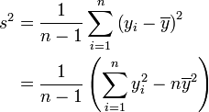
Important Terms
Categorical vs Quantitative Variables/Data
Random Variable
Mean:
Median
Percentiles
Variance:
Standard Deviation:
Range
Interquartile Range IQR = Q₃ – Q₁
Outliers:
Q₁ – 1.5 x IQR > Outliers > Q₃ + 1.5 x IQR

Slide 4
Normal Distribution
Frequently arises in nature
  Does not always apply to a set of data
  But many statistical methods require the data to be normally distributed!
μ = Mean
σ = Standard Deviation
Probability of a random variable falling between x₁ and x₂ =
the area under the curve from x₁ to x₂
“Tail” Probabilities = Probability from –∞ to x or from x to +∞

Slide 5
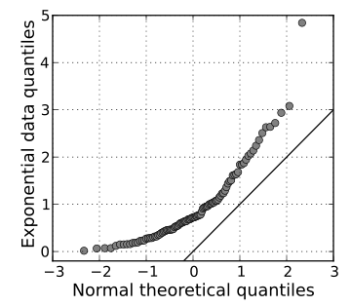
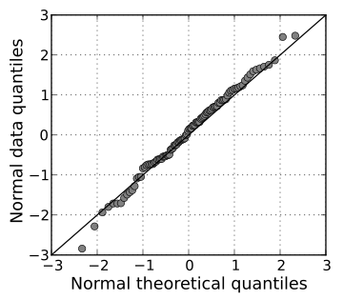
Assessing Normality: Q-Q Plots
Many statistical tools require normally distributed data.
How to assess normality of your data?
‘Quantile’ or Q-Q plot: Quantiles of data vs quantiles of normal distribution with same mean and SD as data

Slide 6
The Central Limit Theorem
Population vs Sample
  Sample mean and standard deviation are random variables!
Central Limit Theorem for Sample Proportions:
p% of a population has a certain characteristic – NOT a random variable
From a sample size n, p% of the sample has the characteristic
As n gets large, μ_{p} = p and
Central Limit Theorem for Sample Means:
A characteristic is distributed in a population with mean μ and standard deviation σ – but not necessarily normally
A sample of size n is randomly chosen and the characteristic measured on each individual
The average of the characteristic, , is a random variable!
If n is sufficiently large, is approximately normally distributed, μ_{x} = μ and σ_{x} = σ/sqrt(n)
^

Slide 7
Error Bars: Standard Deviation vs Standard Error
Standard Deviation: The variation of a characteristic within a population.
  Independent of n!
  More informative
Standard Error: AKA the ‘standard deviation of the mean,’ this is how the sample mean varies with different samples.
  Remember sample means are random variables subject to experimental error
  It equals SD/sqrt(n)

Slide 8
Error Bars: Confidence Intervals
“95% Confidence Interval:” the range of values that the population mean could be within with 95% confidence:
This is the 95% confidence interval for large n (> 40)
For smaller n or different %, the equation is modified slightly. Versions for population proportions exist too.
When to Use:
Standard Deviation: When n is very large and/or you wish to emphasize the spread within the population.
Standard Error: When comparing means between populations and have moderate n.
Confidence Intervals: When comparing between populations; frequently used in medicine for ease of interpretation.
Range: Almost never.

Slide 9
Design of Experiments:
Statistical Models
Mathematical models are deterministic, but statistical models are random.
Given a set of data, fit it to a model so that dependent variables can be predicted from independent variables.
  But never exactly!
Ex: Suppose it’s known that x (independent) and y (dependent) have a linear relationship:
Here, the β’s are parameters and ε is an error term of known distribution.
Find the parameters → make predictions

Slide 10
Design of Experiments:
Choosing Statistical Models
Quantitative vs Quantitative: Regression Model (curve fitting)
Categorical (dependent) vs Quantitative (independent): Logistic Regression, Multivariate Logistic Regression
Quantitative (dependent) vs Categorical (independent): ANOVA Model
Categorical vs Categorical: Contingency Tables

Slide 11
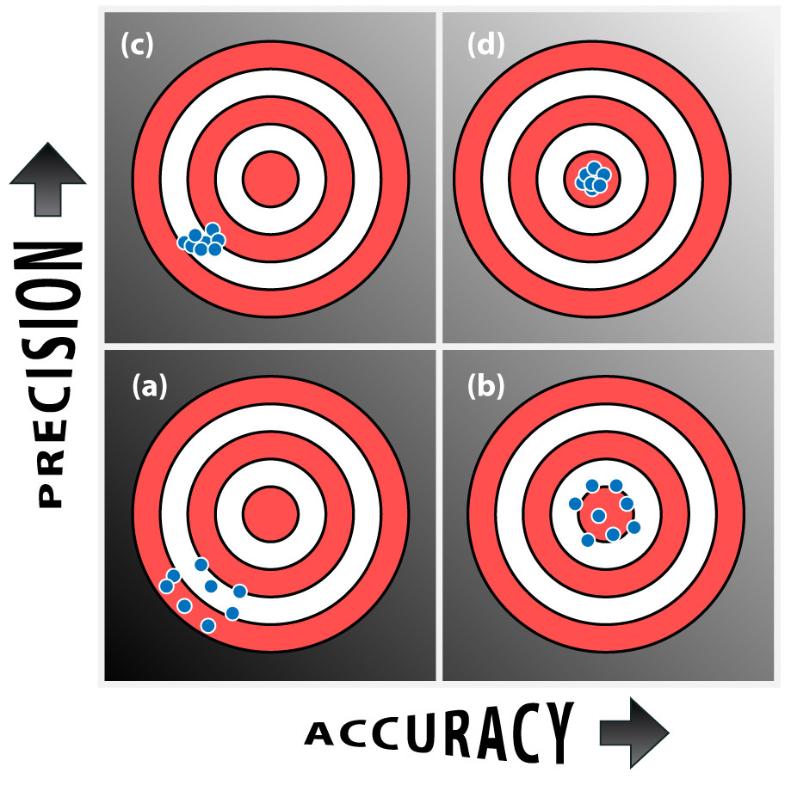
Design of Experiments:
Sampling Problems
Bias: Systematic over- or under-representation of a particular characteristic.
Accuracy: a measure of bias. Unbiased samples are more accurate.
Precision: measure of variability in the measurements
Adjust sampling techniques to solve accuracy problems
Increase the sample size to improve precision

Slide 12
Hypothesis Testing
Null Hypothesis, H₀:
  A claim about the population parameter being measured
  Formulated as an equality
  The less exciting outcome i.e. “No difference between groups”
Alternative Hypothesis, H_{a}:
  The opposite of the null hypothesis
  What the scientist typically expects to be true
  Formulated as <, > or ≠ relation

Slide 13
Hypothesis Testing: Example
Example: Comparing HASMC proliferation on collagen I and collagen III.
The null hypothesis: the proliferation on both collagens is the same.
The alternative hypothesis: the proliferation on collagens I and III is not the same.
H₀ : μ_{collagen I} = μ_{collagen III}
H_{a} : μ_{collagen I} ≠ μ_{collagen III}

Slide 14
5 Steps to Hypothesis Testing
Pick a significance level, α
Formulate the null and alternative hypotheses
Choose an appropriate test statistic
  A test statistic is a function computed from the data that fits a known distribution when the null hypothesis is true.
Compute a p-value for the test and compare with α
Formulate a conclusion

Slide 15
First… what is a p-value?
A p-value is the probability of observing data that does not match the null hypothesis by random chance.
If p = 0.05, there is a 5% chance that the observed data is due to random chance and a 95% chance that the observed data is a real effect.
Test Decision | H₀ True | H₀ False
Fail to reject H₀ | Correct decision | ERROR
Reject H₀ | ERROR | Correct decision

Slide 16
Hypothesis Tests for Normally Distributed Data
t-tests:
  1 sample t-test: Compare a single population mean to a fixed constant.
  2 sample t-test: Compare 2 independent population means.
  Paired t-test: Compare 2 dependent population means
z-tests: Like t-tests, except for population proportions instead of means.
F-tests: Decides whether the means of k populations are all equal.

Slide 17
Non-Parametric Tests for Abnormally Distributed Data
Wilcoxon-Mann-Whitney Rank Sum Test: Comparable to the 2-sample t-test.
Non-parametric tests are more versatile, but less powerful.
Still have assumptions to satisfy!

Slide 18
Displaying Data
Bar chart: Categorical vs Quantitative, Small # of Sample Types
Pie chart: Bar chart alternative when dealing with population proportions.
Histogram: Observation frequency, use with large # of observations
Dot plot: Like a histogram with fewer observations
Scatter: Quantitative vs quantitative
Box plot: Quantitative vs categorical. Describes the data with median, range, 1st and 3rd quartiles for easy comparison between many groups.
Data Characteristic | Statistical Measure | When to Use
Center/”Typical” value | Mean Median | No outliers, large sample Possible outliers
Variability | Standard deviation IQR Range | No outliers, large sample Possible outliers Almost never

Slide 19
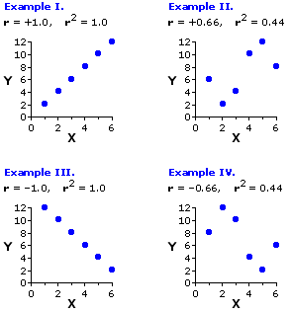

Correlation vs Causation
Correlation describes the relationship between 2 random variables.
Correlation coefficient:

Slide 20
Biological vs Technical Replicates
All the cells in 1 flask are considered 1 biological source
Therefore, replicate wells of cells seeded for an experiment are technical replicates.
They only measure variability due to experimental error!
To increase n, the number of samples, we must repeat experiments with different flasks of cells!
It is not appropriate to use error bars if you have not repeated the experiment with biological replicates.

Slide 21


Binomial Distribution
n independent trials
p probability of success of each trial
  (1 – p) probability of failure
What is the probability that there will be k successes in n independent trials?
where

