Slide 1
Direct and specific chemical control of eukaryotic translation with a synthetic RNA-protein interaction
Stephen J. Goldfless, Brian A. Belmont, Alexandra M. de Paz, Jessica F. Liu and Jacquin Niles
presented by Alfred Ramirez and Lauren Berry
20.385: February 29, 2012

Slide 2
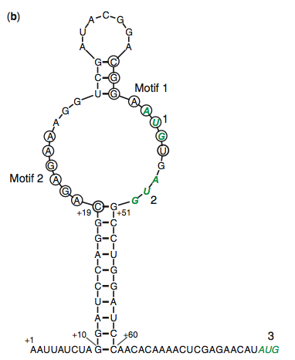
Background: Aptamer Selection
Previously screened aptamers for binding to TetR
Secondary structure involves two conserved motifs
Mutation of conserved sequences affects TetR binding
Notes:
motifs are circled
potential start codons in green - one included in a motif

Slide 3
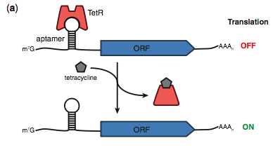
Background: Design Overview
Notes:
the aptamer shown before is included in the 5'-UTR of the desired ORF
binding of TetR to the aptamer region inhibits translation of downstream protein
tetracycline analogs aTc and Dox prevent binding, allowing translation to occur

Slide 4
Design Principles and Approach
Screen a library of known TetR-aptamer interactions for those that regulate translation
Modify the selected aptamer to maximize translation efficiency
Validate the translation regulation
Optimize for modularity and streamlining

Slide 5
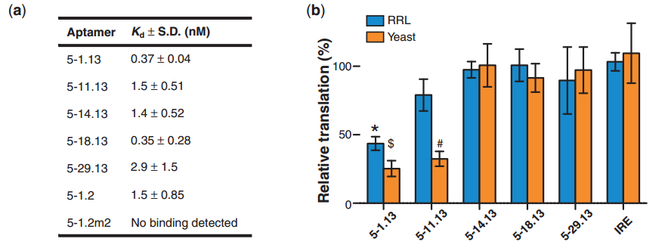
Screen: Aptamer Selection

Slide 6
Modification: Aptamer Minimization
Aptamers 5-1.13 and 5-11.13 exhibited desired translation regulation.
Modified aptamer 5-1.13 to minimize stability, creating aptamer 5-1.2 and 5-1.2m2

Slide 7
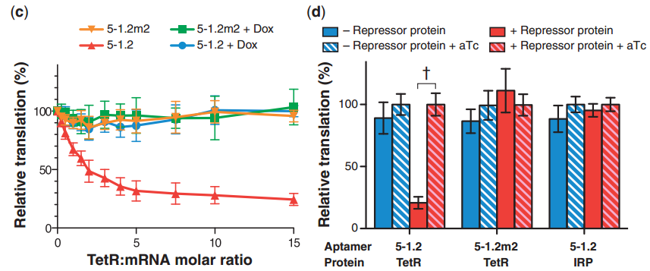
Validation: Translation Repression

Slide 8
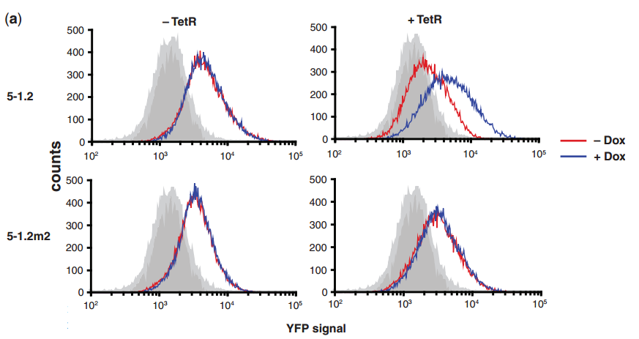
Validation: Episomal Inducible
Gene Expression

Slide 9
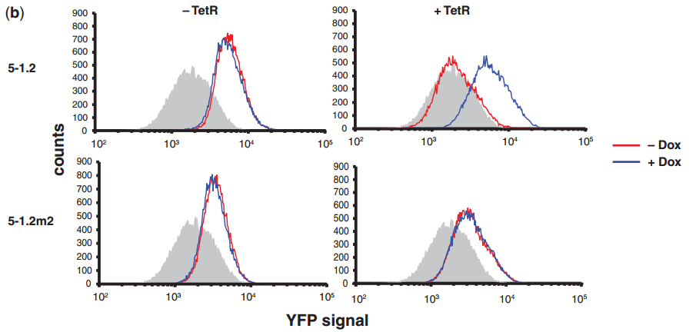
Validation: TRP1 Integrated
Inducible Gene Expression

Slide 10
Optimization: Expanding Regulatory Potential
Goal: Expand the scope of regulatory behavior while maintaining the aptamer as a validated, defined component.

Slide 11
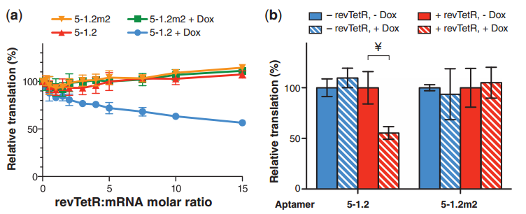
Optimization: Logic Inversion

Slide 12
Optimization: Reduction of Translation Impact
Authors observed that aptamer 5-1.2 had a significant impact in gene expression levels compared to no aptamer.
Goal: Minimize impact of the maximum protein output while preserving the regulatory function of the aptamer.

Slide 13
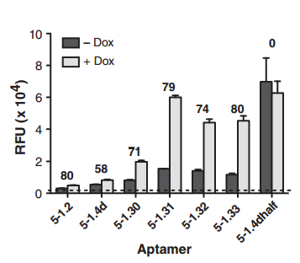
Optimization: Reduction of Translation Impact

Slide 14
Optimization: Modularity
Goal: Assess the modularity of the aptamer in the context of different 5'-UTR.

Slide 15
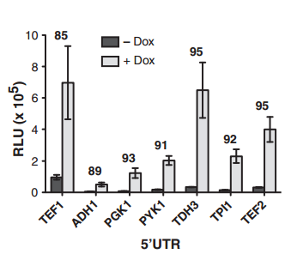
Optimization: Modularity

Slide 16
Optimization: Streamlining the Selection of Functional Interactions
Goal: Define strategy to rapidly identify new functional aptamer variants
Notes:
possible future implementations of the system may need TetR aptamers with different binding capabilities

Slide 17
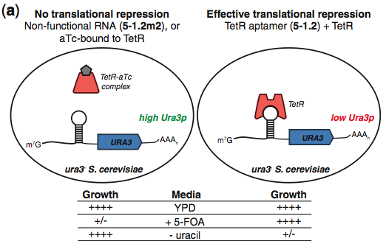
Optimization: Streamlining the Selection of Functional Interactions
Ura3p allows growth in -uracil media and causes cell death in +5-FOA media
Notes:
RHS: binding of TetR to the aptamer represses translation of Ura3p
LHS: aTc inhibits TetR from binding to the aptamer, allowing translation of Ura3p

Slide 18
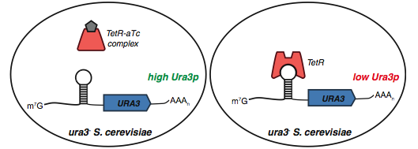
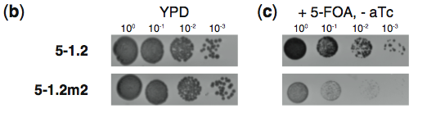
Optimization: Streamlining the Selection of Functional Interactions
Notes:
both strains viable in normal media
inclusion of 5-FOA causes death to cells expressing Ura3p: 5-1.2m2 strain can't repress translation

Slide 19
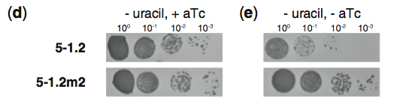
Optimization: Streamlining the Selection of Functional Interactions
Notes:
aTc inhibits TetR from binding to the aptamer and repressing translation
both strains grow because both are expressing Ura3p to live in the -uracil, +aTc media
the 5-1.2 strain cannot grow on the -uracil, -aTc media because expression of Ura3p is repressed by TetR binding to the aptamer

Slide 20
Conclusions
Apatmer used to regulate protein expression at the RNA level
Optimization of aptamer can change max expression and repression levels
System is modular: able to use with different 5'-UTRs

Slide 21
Significance of System
Future Work
Host cell independent
Biologically robust
Modular
Successful in vivo
Organisms with poorly understood transcriptional regulation
Further regulation of circuits
Notes:
also: possibility of creating similar mechanisms with other aptamers for complex systems?
limitations:
different graph profile for the inversion case
somewhat decreases overall expression

