Slide 1


Slide 2
Synthetic Biology

Slide 3
About Synthetic Biology
“The application of engineering design principles to do construction, characterization, and design of biological systems” C. Smolke
Engineering design principles such as:
Standardization
Grammar implementation
Design Implementation (CAD)

Slide 4
iGEM & Registry
Registry of Standarized Biological Parts: repositorium of BioBrick compliant parts.
iGEM: the primary international competition on synthetic biology aimed at enriching and curating the Registry of Biological Parts.
Focus at undergraduate programs around the world, with support from recognized advisors

Slide 5
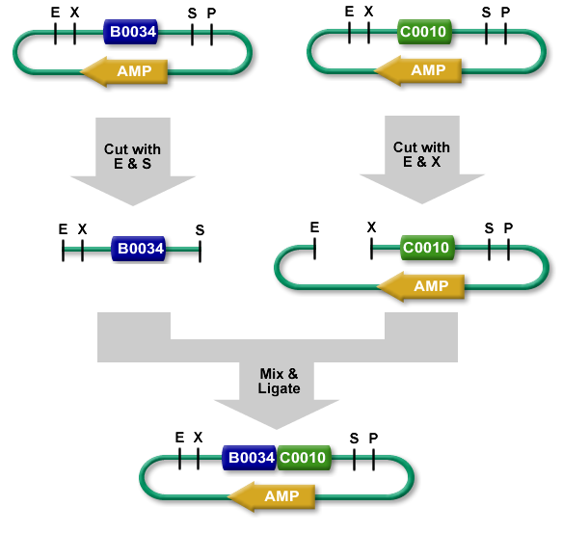
Standards
The BioBrick Standard:
Prefix
Suffix
Scalability

Slide 6
WiFi Coli

Slide 7
Goal & Approach
Goal: communication while deprecating chemical / spatial barrier
Approach: use a non-chemical messenger, i.e. photons
Encoding: have wavelength encoding
Parts: use existing available machinery

Slide 8
Platform
Use BioBrick standard to:
assemble BioParts into modules,
organize modules into devices,
express devices within systems.
BBa_I15008
BBa_I15009
BBa_I15008
BBa_I15009
BBa_I15010
BBa_I15010

Slide 9
Platform
Use BioBrick standard to:
assemble BioParts into modules,
organize modules into devices,
express devices within systems.
BBa_I15008
BBa_I15009
BBa_I15008
BBa_I15009
BBa_I15010
BBa_I15010
Regulator
BBa_I15008
BBa_I15009
BBa_I15010
Terminator

Slide 10
Platform
Use BioBrick standard to:
assemble BioParts into modules,
organize modules into devices,
express devices within systems.
BBa_I15008
BBa_I15009
BBa_I15008
BBa_I15009
BBa_I15010
BBa_I15010
Regulator
BBa_I15008
BBa_I15009
BBa_I15010
Terminator

Slide 11
Organization
Emission
Transmission
Reception
Reception Module
Emission
Module

Slide 12
Constructions

Slide 13
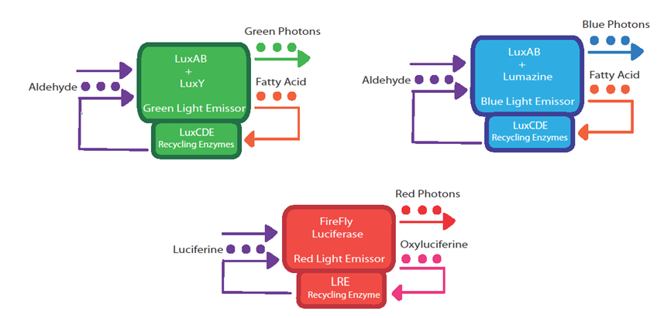
Expanded Behavior
Recycling pathway for substrate
Inducible expression of enzyme, ergo light

Slide 14
Characterization
Photons
Reception Module
PoPs
Transfer Function
PoPs
Emission Module
Photons
Transfer Function

Slide 15
Applications

Slide 16
Trinary Cycle
Red Emit.
Blue Recep.
Red Recep.
Green Emit.
Blue Emit.
Green Recep.

Slide 17
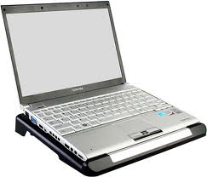
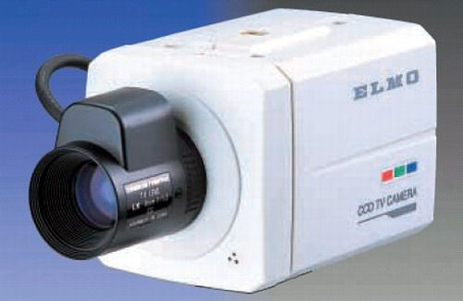
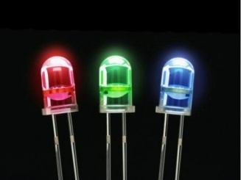
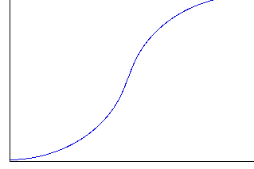
Control Cycle
Rec. Module
Emis. Module
X

Slide 18
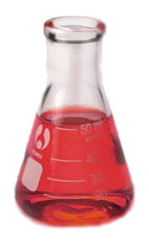







Logic Gates & Processor
Input
Output

Slide 20
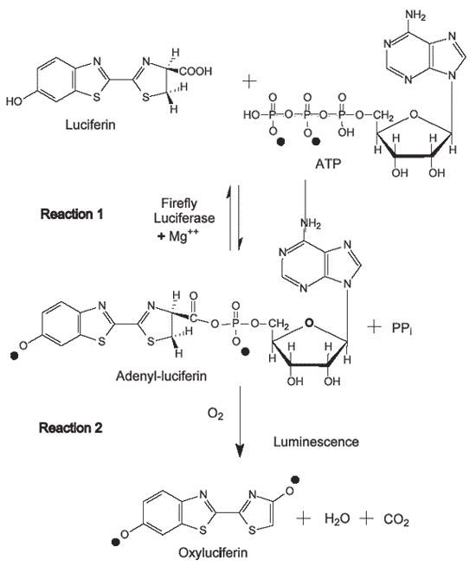
FireFly Luciferase
Bacterial
Luciferase

Slide 21
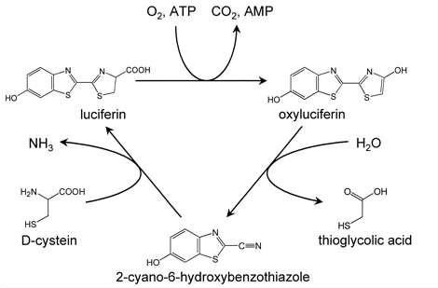
LRE Recycling Enzyme

Slide 22
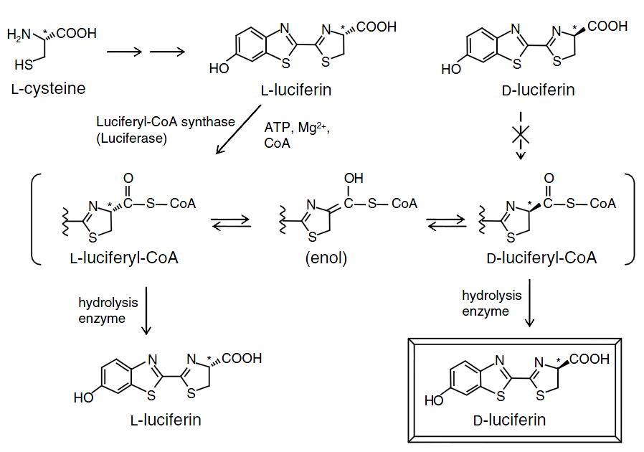
Magic Quirality Conversion

