Slide 1
Site-Directed mutagenesis

Slide 2
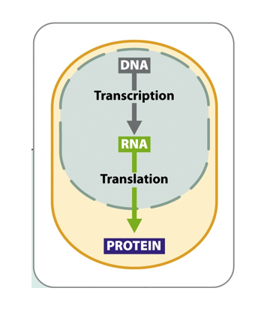
Site-directed mutagenesis
Make a specific desired mutation (or mutations) at a particular position within a gene (DNA)
What is the relationship
between DNA and
protein?
Changes in the DNA
will result in changes in
the protein (which
creates the properties
of the cell)
X
X
X

Slide 3
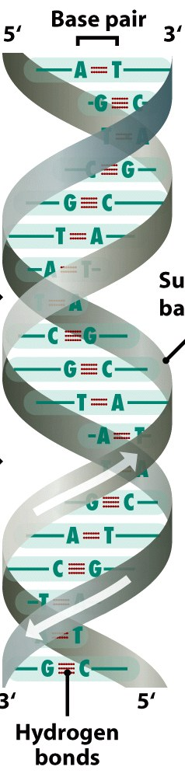
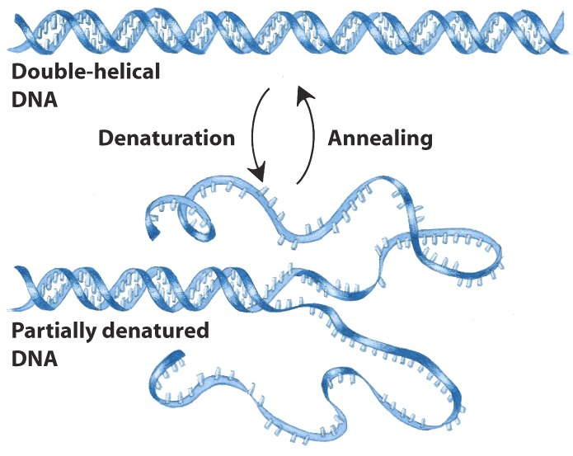
The structure of dna
The two DNA strands can be separated and rejoined either together or with other DNA strands

Slide 4

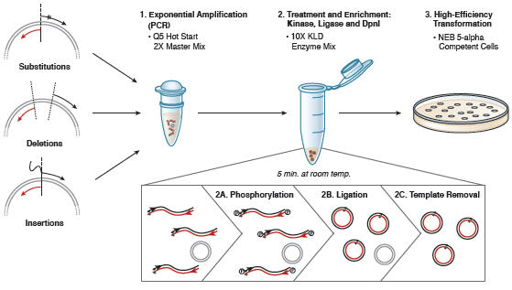
The process of site-directed mutagenesis
P
When DNA is normally made in cells:
  it contains methyl groups
  it contains phosphate groups at the ends-this is necessary for joining DNAs together
When DNA is made in the lab:
  It does not contain methyl groups
  It does not contain a phosphate group at the end
M
M
M
M
M
P
Step 1: Amplify the entire plasmid by using primers to start DNA synthesis; these primers also contain the mutation we are creating
Step 2: Use three enzymes to convert DNA back into a circle: Kinase (add phosphate groups), Ligase (seals DNA strands that have phosphate groups), DpnI (degrades DNA that has methyl groups, but not DNA without methyl groups)
Step 3: Introduce the circular DNA back into bacteria
M
M
M

Slide 5
What gene are we mutating?

Slide 6
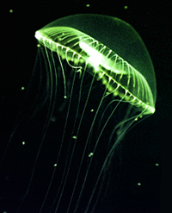
Fluorescent proteins
Green fluorescent protein discovered
in 1960’s from jellyfish
Emits fluorescence when illuminated
with specific wavelengths of light
Started being used in the lab in early 1990’s
Fluorescence is dependent on the structure of the proteins
This means that alterations to the structure can affect fluorescence

Slide 7
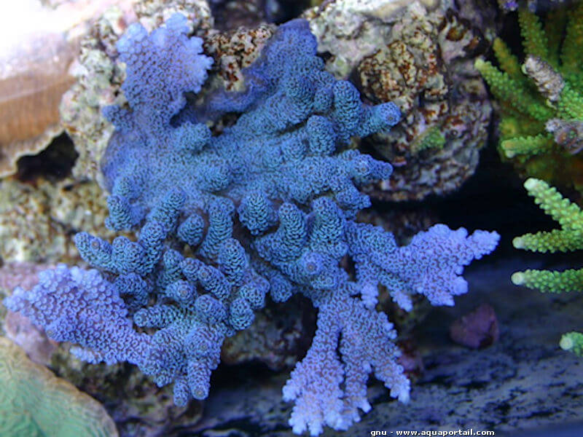
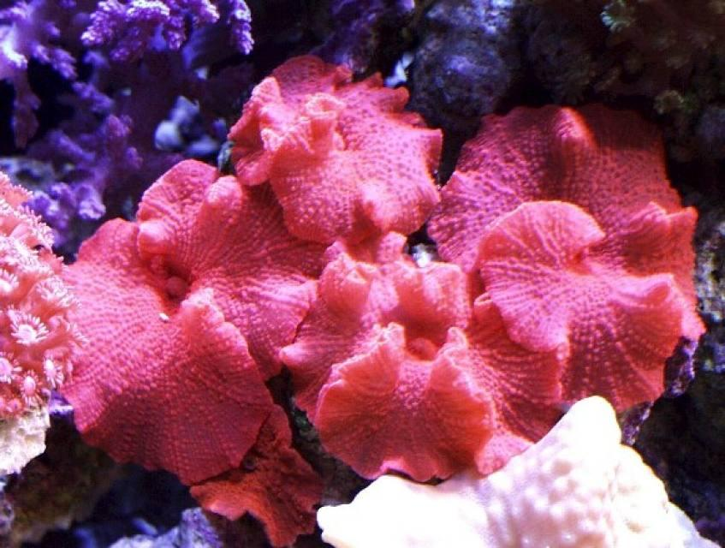
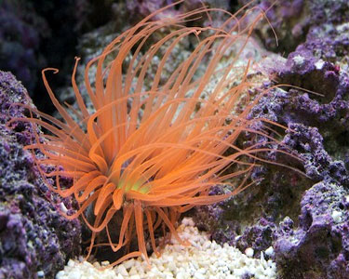
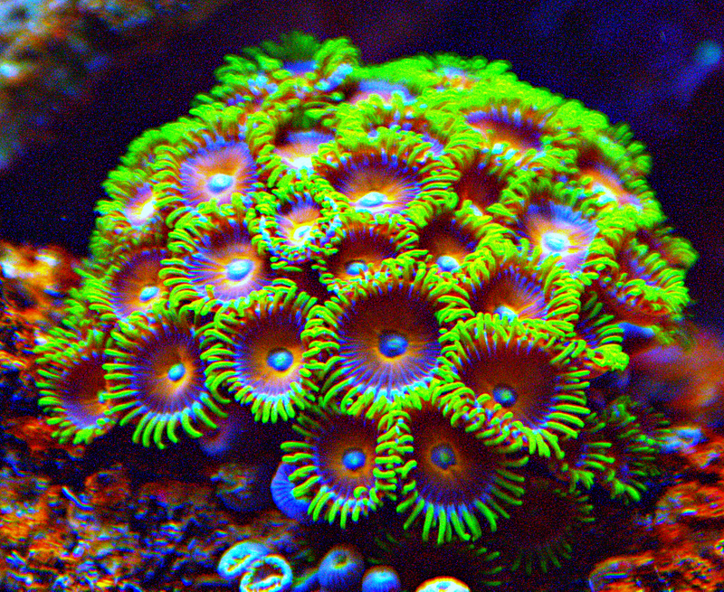
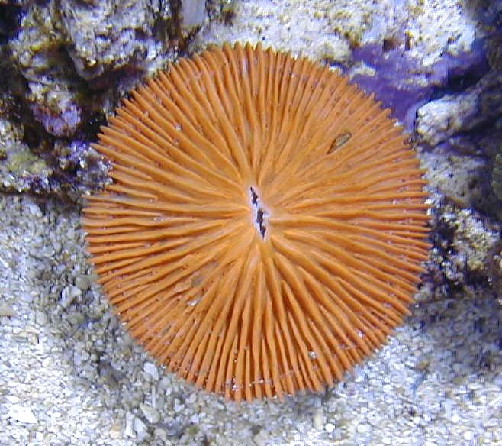
Discovery of fluorescent proteins from other species
Fluorescent proteins isolated from marine anemone and reef corals expand the colors available

Slide 8
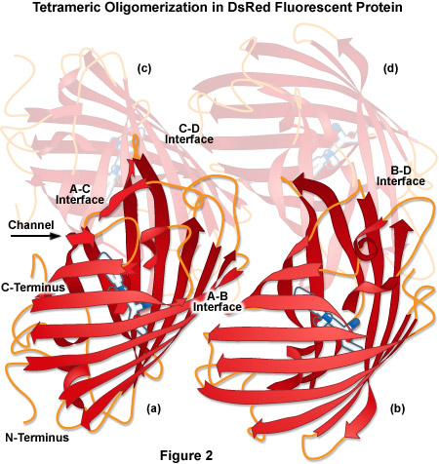
Red fluorescent proteins
In nature, they exist as tetramers (groups of 4 proteins)
Problems:
  The tetramers may clump up and may cause toxicity
  The functional form is produced slowly in cells

Slide 9
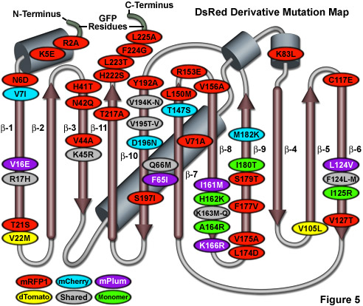
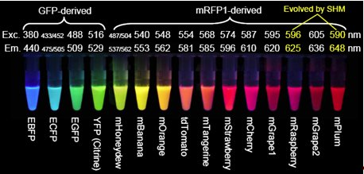
The palette of fluorescent proteins
Mutations can overcome some of the problems, but often reduce fluorescence
Isolating genes from new species plus mutating known fluorescent proteins has led to a diverse palette of proteins

Slide 10
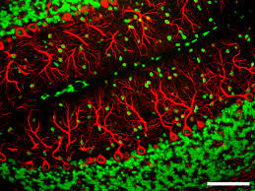
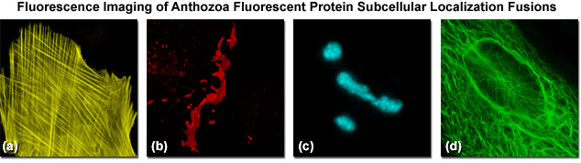
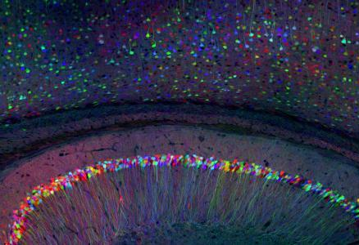
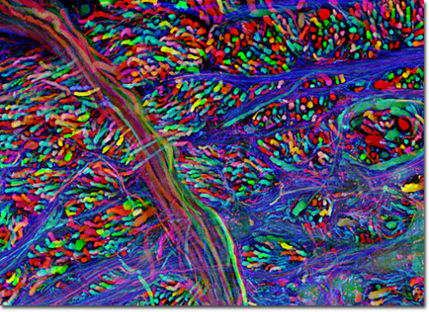
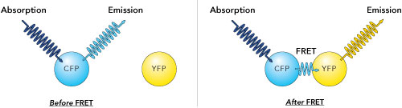
How do scientists use fluorescent proteins?
Tag a protein of interest by attaching a fluorescent protein so we can see where the protein is or how much there is
Send fluorescent protein to different compartments in the cells so that we can visualize them
Attach different fluorescent proteins to >1 protein so we can see how close they are in the cell
Mark different cells in the same tissue so we can follow them over time

Slide 11
Our goal
A2A
S4T
Mutations can overcome some of the problems, but often reduce fluorescence
We want to make mutations that increase the fluorescence of red fluorescence protein (RFP)
We will introduce two mutations that may affect the efficiency at which the protein is produced (Sorensen et al, FEBS Letters 552:110, 2003)

Slide 12
How do we design primers for mutagenesis?

Slide 13
Some more about dna structure
DNA has direction- a 5’ end and a 3’ end
The two strands of DNA always face opposite directions
DNA can only be synthesized by moving from the 5’ direction toward the 3’ direction

Slide 14
Designing primers
The starting sequence of DNA:
5’-CGCGGCCGCTTCTAGATGGCTTCCTCCGAAGACGTTATCAAAGAGTTCATGCG-3’
3’-GCGCCGGCGAAGATCTACCGAAGGAGGCTTCTGCAATAGTTTCTCAAGTACGC-5’
The desired sequence of DNA after mutagenesis:
5’-CGCGGCCGCTTCTAGATGGCATCCACCGAAGACGTTATCAAAGAGTTCATGCG-3’
3’-GCGCCGGCGAAGATCTACCGTAGGTGGCTTCTGCAATAGTTTCTCAAGTACGC-5’

Slide 15
Designing primers
The starting sequence of DNA:
5’-CGCGGCCGCTTCTAGATGGCTTCCTCCGAAGACGTTATCAAAGAGTTCATGCG-3’
3’-GCGCCGGCGAAGATCTACCGAAGGAGGCTTCTGCAATAGTTTCTCAAGTACGC-5’
’

Slide 16
Designing primers
The starting sequence of DNA:
5’-CGCGGCCGCTTCTAGATGGCTTCCTCCGAAGACGTTATCAAAGAGTTCATGCG-3’
3’ 5’
3’-GCGCCGGCGAAGATCTACCGAAGGAGGCTTCTGCAATAGTTTCTCAAGTACGC-5’
5’ 3’

Slide 17
Designing primers
The starting sequence of DNA:
5’-CGCGGCCGCTTCTAGATGGCTTCCTCCGAAGACGTTATCAAAGAGTTCATGCG-3’
GCGCCGGGCAAGATCTACCGAAG Creating our new bottom strand
3’ 5’
3’-GCGCCGGCGAAGATCTACCGAAGGAGGCTTCTGCAATAGTTTCTCAAGTACGC-5’
Creating our new top strand CTCCGAAGACGTTATCAAAGAGTTCATGCG
5’ 3’

Slide 18
Designing primers
The starting sequence of DNA:
5’-CGCGGCCGCTTCTAGATGGCTTCCTCCGAAGACGTTATCAAAGAGTTCATGCG-3’
3’-GCGCCGGCGAAGATCTACCGAAGGAGGCTTCTGCAATAGTTTCTCAAGTACGC-5’
The desired sequence of DNA after mutagenesis:
5’-CGCGGCCGCTTCTAGATGGCATCCACCGAAGACGTTATCAAAGAGTTCATGCG-3’
3’-GCGCCGGCGAAGATCTACCGTAGGTGGCTTCTGCAATAGTTTCTCAAGTACGC-5’

Slide 19
Designing primers
Making the desired mutations:
5’-CGCGGCCGCTTCTAGATGGCTTCCTCCGAAGACGTTATCAAAGAGTTCATGCG-3’
GCGCCGGGCAAGATCTACCGTAG Creating our new bottom strand
3’ 5’
3’-GCGCCGGCGAAGATCTACCGAAGGAGGCTTCTGCAATAGTTTCTCAAGTACGC-5’
Creating our new top strand CACCGAAGACGTTATCAAAGAGTTCATGCG
5’ 3’

Slide 20
Bacterial transformation

Slide 21
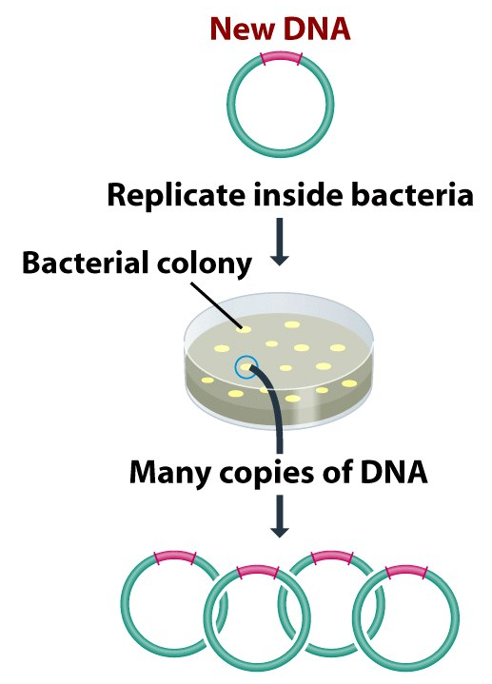
transformation
Goal is to insert the DNA back into bacteria
Bacteria grows into a colony of cells
As they grow, the bacteria copy the DNA and make many copies

