Slide 1
Field Focusing Nuclear Magnetic Resonance (FONAR): Visualization of a Tumor in a Live Animal
Raymond Damadian, Lawrence Minkoff, Michael Goldsmith, Michael Stanford, Jason Koutcher.
Dana Braff & Lisa Foo |20.309 Fall 2011| 13 December 2011

Slide 2
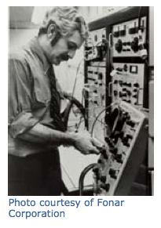
Background on R. Damadian
Inventor of the Magnetic Resonance (MR) scanning machine
Published his 1971 paper “Tumor Detection by Magnetic Resonance” a year prior to filing a patent for a MRI scanner
Formed FONAR Corporation which produced the first commercial scanner in 1980.
Earned the a Lemelson-MIT Program’s Lifetime Achievement Award, National Medal of Technology and was inducted into the National Inventors Hall of Fame.

Slide 3
Brief History of Nuclear Magnetic Resonance
Application in health care was developed in the early 1970’s
Non-invasive technique and safe alternative to X-rays. Findings could be easily and quickly obtained from a single system.
Application of NMR imaging stayed in research and experimental phase through the 70’s and 80’s
Field focusing Nuclear Magnetic Resonance (FONAR) enabled one to externally direct the NMR spot to a anatomic site of interest for continuously monitored inspection.

Slide 4
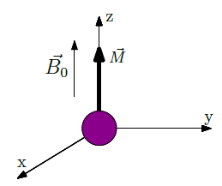
Nuclear Spin
Source: Zimmerman, 20.309 Stellar Website
Notes:
-Going to give a brief overview of how NMR works
-Nuclear spin is the intrinsic angular momentum of a hydrogen nucleus. This angular momentum leads to a rotating charge, which generates a magnetic moment.
-When you apply an external B field, magnetic moment aligns with that B field.
The hydrogen nucleus has an intrinsic angular momentum, which can be referred to as the nuclear spin. The angular momentum leads to a rotating charge, or tiny current loop, which generates a magnetic moment.
At thermal equilibrium, in the presence of a large static field, B0, M aligns with Bo

Slide 5
Precession
Source: Zimmerman, 20.309 Stellar Website
Notes:
Another property called Precession.
When another magnetic field, orthogonal to B0 (call this field B1), is applied, it perturbs the magnetic moment. Apply brief pulse of B1, and observe that magnetic moment M begins to realign with B0 while precessing. This precession is most obviously right after a pulse that is 90 degrees from B0 (precession becomes less obvious as Mxy component of M decreases).
At thermal equilibrium, M is aligned with B0.
Therefore Mz=Meq, Mxy=0, and precession is not visible.
Figure 1-3: Demonstration that precession is most obvious directly after a 90 degree pulse, and that precession becomes less obvious as the M_xy component of M decreases.
From NMR_System_Thesis: NMR is the response of nuclear magnetic moments to external magnetic fields. NMR technology is based on the relationship between the magnetic moments of atomic nuclei and external magnetic fields and the ability to observe that interaction.

Slide 6
NMR: how it works
NMR experiments can be thought of as having two stages: excitation and acquisition
Critical components of NMR:
Large static homogeneous magnetic field, B0
Coil to generate the resonant excitation field, B1
A coil used to measure the precession of the spins
A sample that has “spin” property
Source: Zimmerman, 20.309 Stellar Website
Notes:
External field, B0 is applied. Then, two stages: excitation and acquisition.
During the excitation stage, the nuclear spins are perturbed form alignment with the static field, B0. This is done by applying a magnetic pulse, B1 with the transmit coil. (The word “resonance” in NMR corresponds to the necessity of matching the excitation field frequency with the frequency of nuclear precession.) When B1 is at the Larmor frequency and applied perpendicular to B0, it rotates M. The amount M is rotated is referred to as the tip angle, theta, which depends on the duration and amplitude of the RF pulse. This process can be seen as an energy transfer. At equilibrium, M is aligned with B0, which is the lowest energy state. When energy is transferred with the RF pulse, the magnetization vector M is perturbed.
The data acquisition stage of NMR involves observing the precession of the nuclear spins. The orientation of M can be measured by the interaction of the magnetization with a receive coil. Although the magnetic moment of each spin is infintesimal, a significant magnetization can be measured from the sum of the magnetic moments in a small volume. From Faraday’s law, we know that a changing magnetic field in a coil (produced by the precessing magnetic moments) induces an electromotive force. This corresponds to a voltage that may be measured and recorded.
-------
Note: amplitude of voltage generated across the coil correspond sto the magnitude of the transverse component of the magnetization vector, Mxy. It is essential to understand that only the transverse component of M can be directly measured. This is because precession is a rotational motion in the transverse place. This means that the maximum NMR signal is observed when Mxy is maximized,which is when the tip angle is 90 degrees.
The precession is measured by orienting the receive coil in the transverse plane (perpendicular to B0)
---------
Imaging: the fundamental concept that allows us to form images is the fact that the frequency of precession is linearly dependent on field strength. Therefore if we vary the field strength of B0 spatially, we can differentiate signals that correspond to different points in the sample.

Slide 7
FONAR
Field Focusing Nuclear Magnetic Resonance
Resonant Window (aperture)
Scanning
Notes:
-FONAR accomplished by field regulation of spatial boundaries of a signal-producing region inside a sample; shape magnetic fields B0 and B1 to construct resonant window
-everywhere inside the Resonant Window, alignment of magnetic moments to applied B field (B0) occurs; outside of this window, doesn’t occur
-Resonant Window, aka Resonance Aperture
-Scan to develop image: move resonance aperture through an anatomic cross section, or move the animal with respect to the aperture; provides visible proton signal, without signal processing, from scanning apertures that are approximately spherical and estimated as slightly less than 1mm;
-ie: focus magnetic field onto a window of space within the sample, image it, and keep going
The televised output is a stored video record of proton signal intensities at various xy coordinates, generated by the resonance aperture as it was swept through a cross section of the animal’s torso.

Slide 8
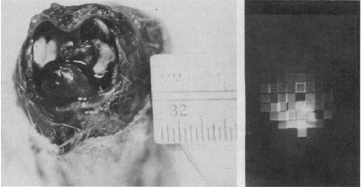
Results
Notes:
These are the results.
Image on the right: FONAR image
Image on left: shown for comparison; what you see from the FONAR image
To get the FONAR image, mouse was immobilized in the probe for 4 hours. (The animal was successfully immobilized in the probe for 4 hours with .2ml of valium injected intraperiotoneally.)
Fig 2. Cross-sectional video FONAR image of a live mouse, obtained with a 3-mm exploring spot. At the left is a photograph of the anatomical section for comparison. The heart is anterior in the photo, and the lungs seen as collapsed white structures, fill the remainder of the thorax. The most intense proton signal in the FONAR image occurs in the region of the blood-filled heart. The dark fields in the upper half of the photo were generated by the hydrogen-poor air filled lungs. The television raster is seen coursing through the image. Overlap artifacts appear in the image as bright, vertical and horizontal lines are due to imperfect positioning of adjacent mapping squares.
----------
Video FONAR images were obtained…with variable frequency pulse spectrometer operating at 10 Mhz.
Figure 2 is a direct televised image of a section through the thorax of a live mouse at the level of the mediastinum. A photo of the postmortem anatomic section at the level of the cross-sectional image is in the left of the figure for direct comparison.
A 3mm scanning aperture was used.

Slide 9

Notes:
These are the more impressive results….
Their work was on the cover of Science (in color in the 70’s..). This is a FONAR image of a cross section of a tumor (color video FONAR image of a cross section through the upper thorax, above the mediastinum, of a mouse that had a solid Ehrlich ascites tumor surgically implanted in the anterior chest wall)
Each colored area designates a different range of signal amplitude. The anterior orange-pink and red region (at the bottom of the image), not present in normal control mice and indicative of a signal-producing mass, corresponds with the location of the tumor. In the normal animal, the anterior half of the thorax appears as a blue signal-poor region representing the lung cavities.
Last sentence: “Having originally introduced the NMR method chiefly for the purpose of noninvasively detecting internal tumors in humans, we have succeeded in obtaining the first images of a tumor in a live animal.”
(The resolving limitation of a 1mm scanning aperture in a 13mm sample (thorax diameter) overestimates the tumor size partially obscuring the underlying lung fields)

Slide 10
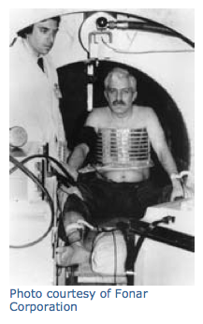
Significance
This research was extended towards developing the NMR method as a way of noninvasively detecting chemical abnormalities in human internal organs.
Imaging a human chest
when the exploring n.m.r sample is at the plateau of the conic section a signal is produced.
The signal vanishes when moved off-center along either axis because H0 departs from the value of resonance and because the field is too steeply graded.

Slide 11
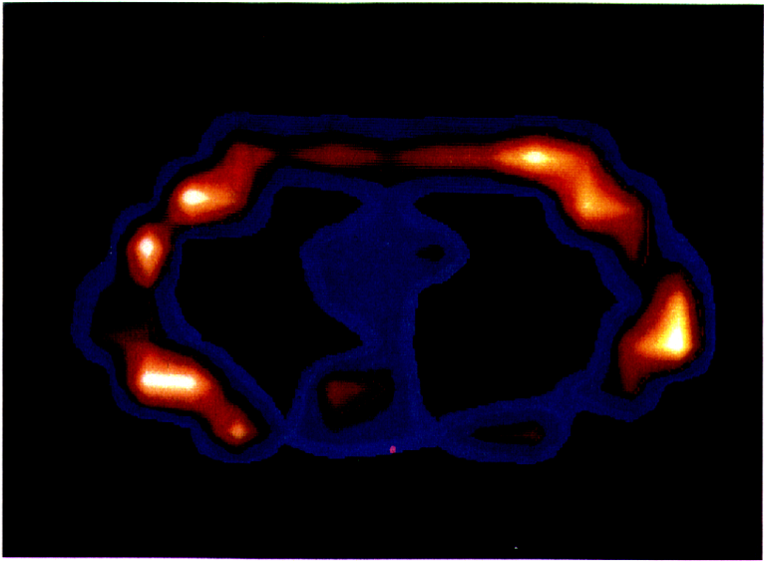
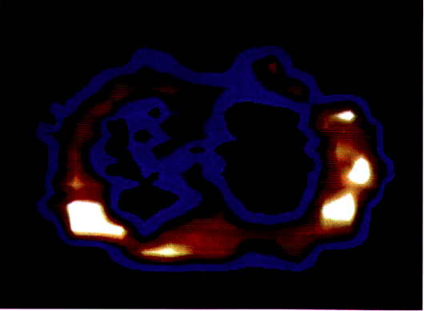
Formation of Chemical Images in Man
Figure 1. Fonar cross-section of the live human chest at the level of the 8th thoracic vertebra
Figure 2. Fonar scan of man with pulmonary oat cell carcinoma. Tumor indicated by blue infiltrate in left lung field.
Source: Damadian 1980

Slide 12
Thank you!

