Slide 1
Diffusion Models of Cell Migration and Chemotaxis
3/7/13
Lecture 10, ChE 590B

Slide 2
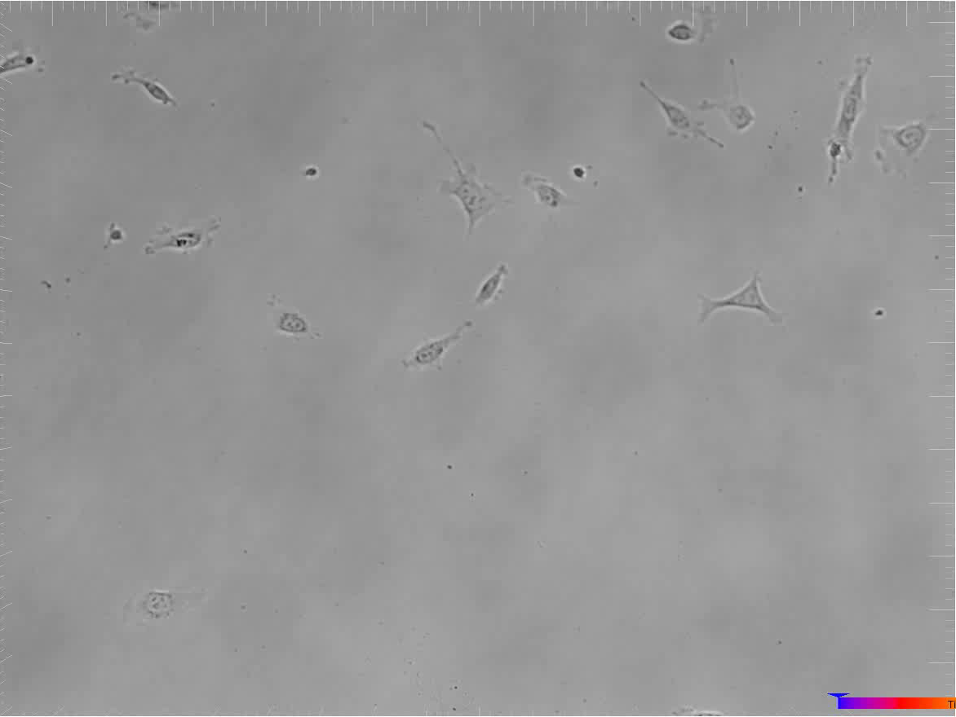
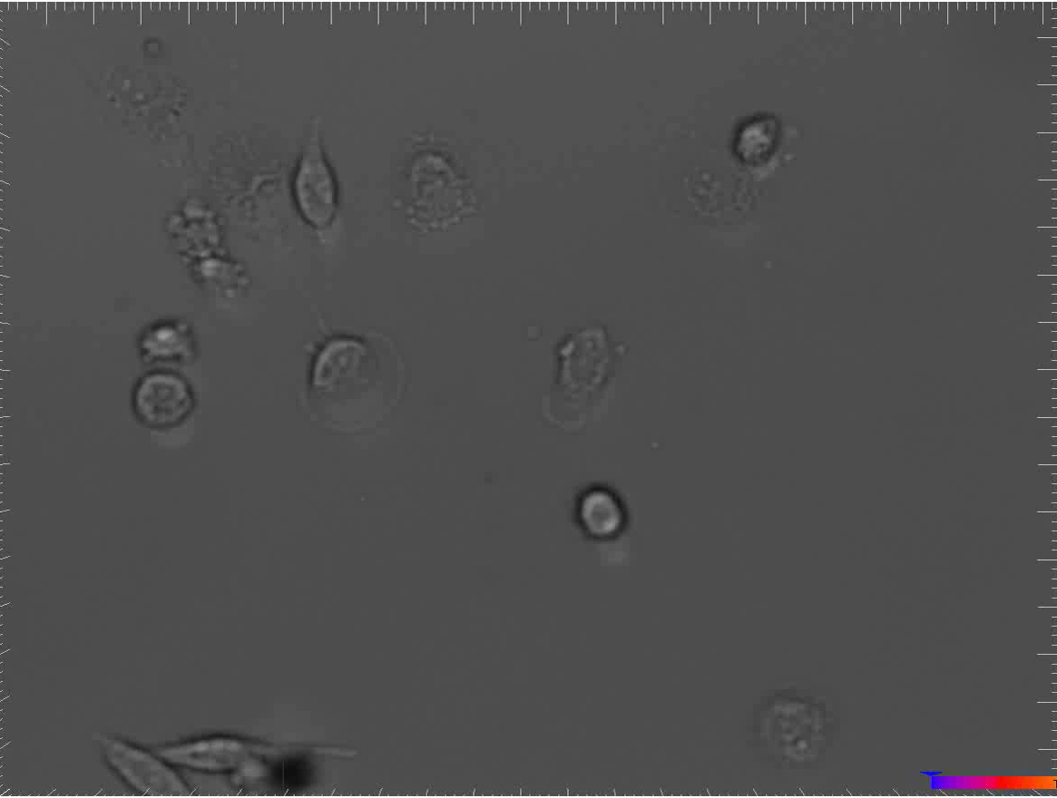
Sample Movies from Peyton Lab
Breast Cancer Cells migrating on a biomaterial
Courtesy S. Peyton

Slide 3
How does one quantify this movement?
Speed
Displacement
Path Length
finish
y
t=3
x
t=2
t=1
start

Slide 4
MSD analysis
Free diffusion
Dimension (1, 2 or 3)
Diffusion coefficient
<r²> (µm)
Time (min)
=> You need a minimum of 20 time points for a decent MSD analysis

Slide 5
Migration is Random at Long Time points, but persistent at short intervals
Longer timepoints (min-hr):
Cell locomotion observed
Breast Cancer Cells migrating on a biomaterial
Courtesy S. Peyton

Slide 6
MSD analysis
Persistent Random Walk

Slide 7
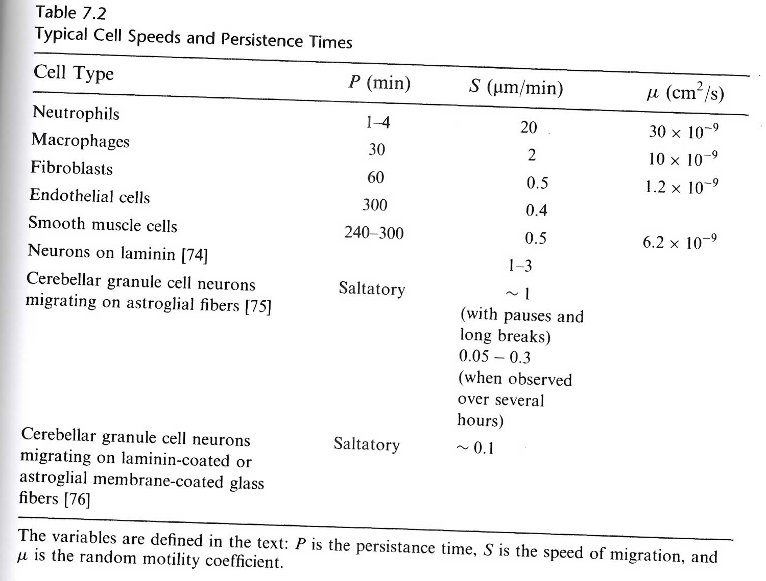

Slide 8
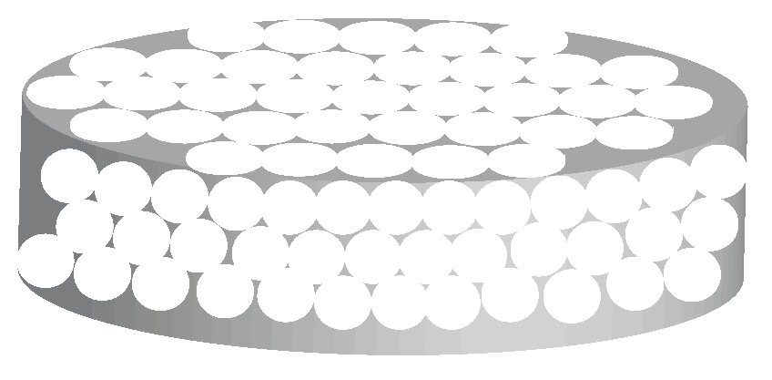
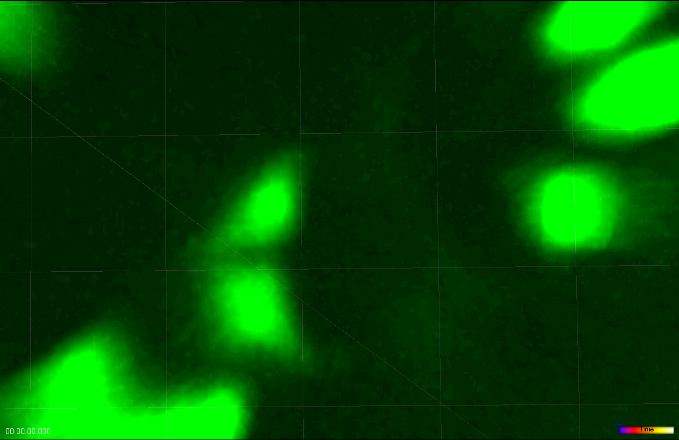
Anomalous diffusion:
Often confined
If there are obstacles or traps in the way, diffusion might be anomalous (depends on obstacle concentration).
Anomalous diffusion exponent
<r²> (µm)
Time (min)
Saxton 1994

Slide 9
Anomalous diffusion model yields superior fit of total cell population
Persistent Random Walk
Anomalous Diffusion
n ≅ 2500 cells; π_{Superdiffusive} = 0.54; π_{Subdiffusive} = 0.46
Superdiffusive Condition
Mean R2: 0.9900
Subdiffusive Condition
Mean R2: 0.8887
Superdiffusive Condition
Mean R2: 0.9959
Subdiffusive Condition
Mean R2: 0.227
Notes:
In our migration experiments, we tracked approximately 2500 cells which were roughly evenly split between superdiffusive and subdiffusive subpopulations.
Plotted here is alpha—the scaling index and determines the type of migration—vs. the R^2 statistic. In the PRW, note that the mean R2 value of the superdiffusive subpopulation is roughly 1. In contrast the subdiffusive subpopulation R^2 statistic is approximately 0.2.
For the anomalous diffusion model, the mean R^2 value of the superdiffusive subpopulation is approximately 1, like in the PRW model. However, in contrast, the ADM is able to capture the subdiffusive population with an R^2 of approximately 0.9.
To truly appreciate this difference, we can overlay the two plots.

Slide 10
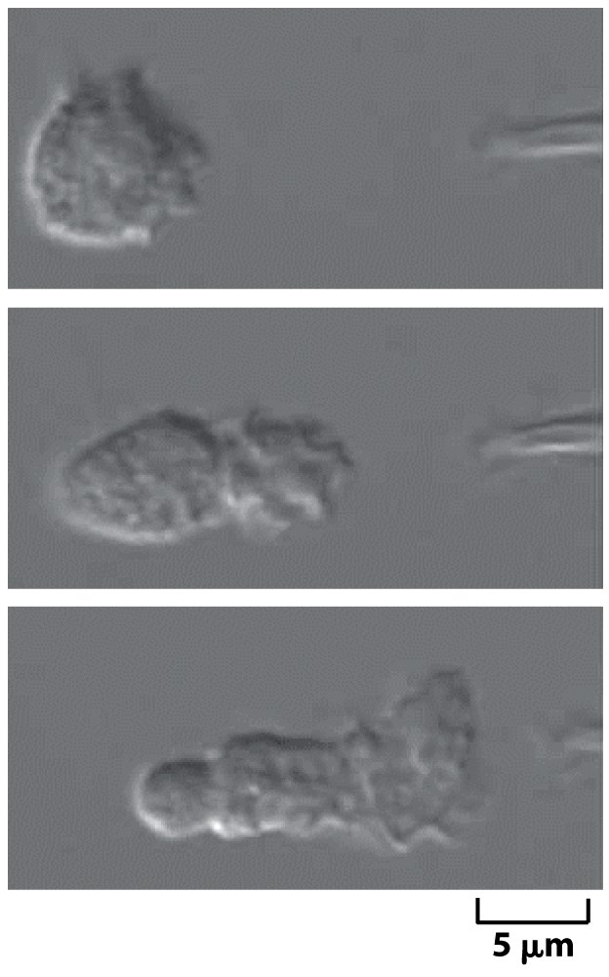
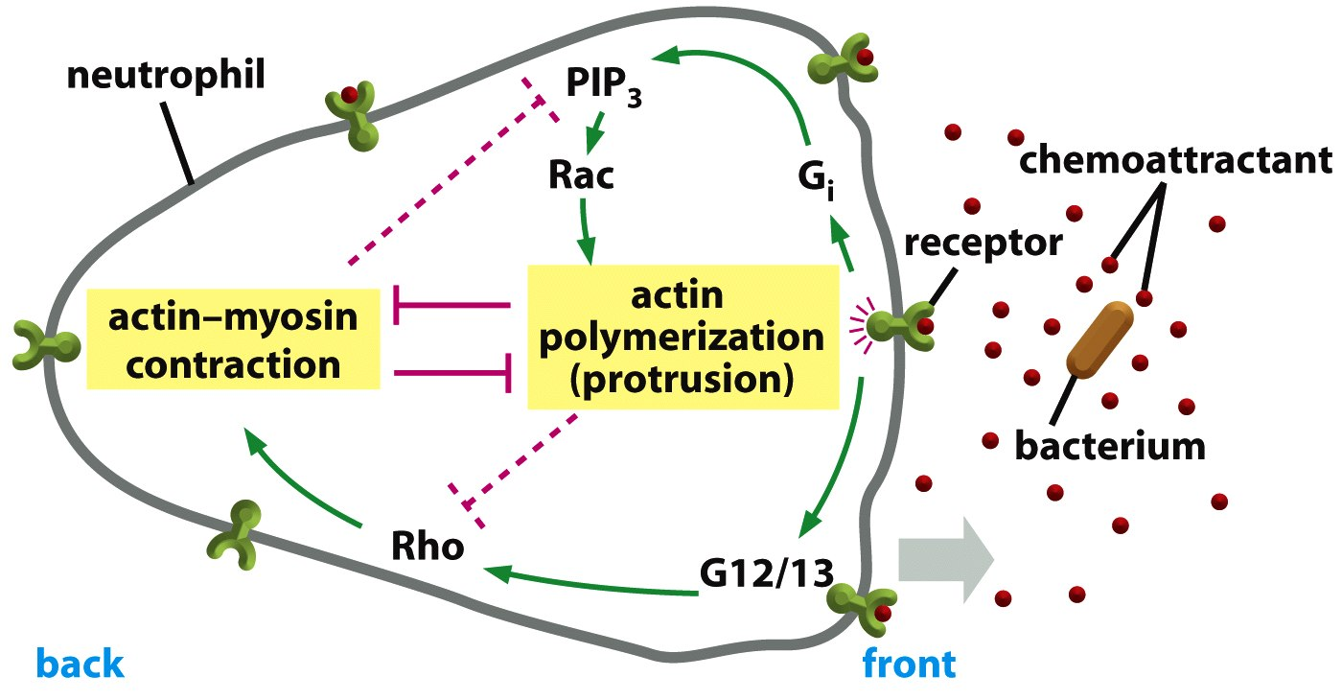
Chemotaxis: Controlling Direction of Motility via Soluble Chemical Cues

Slide 11
Chemotactic Index is a measure of how efficiently a cell follows a chemical gradient

Slide 12
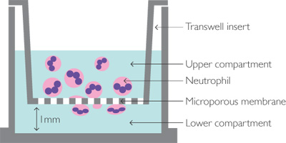
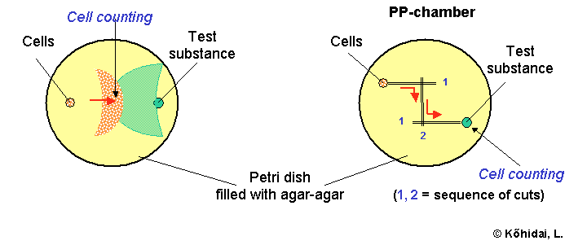
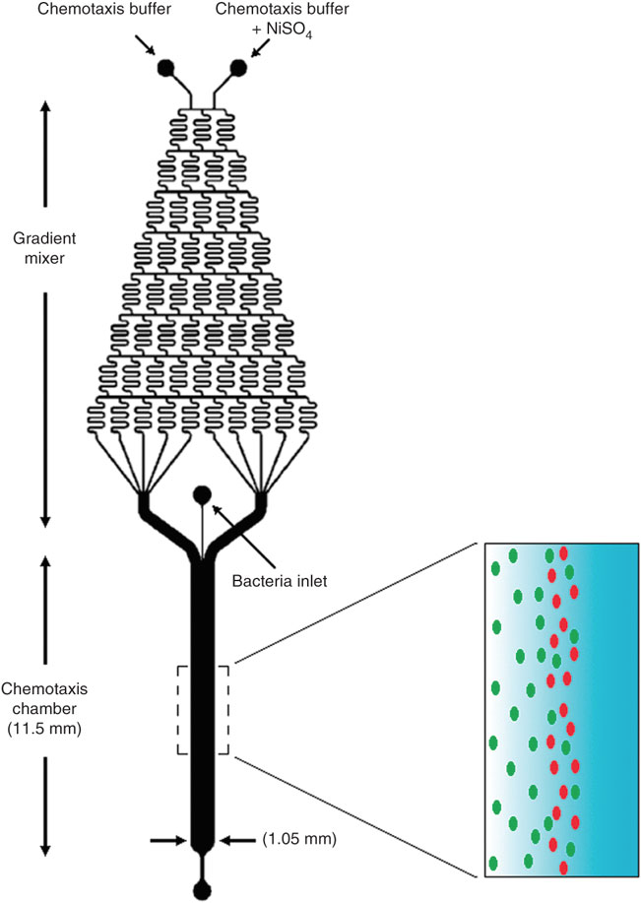
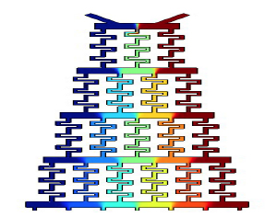
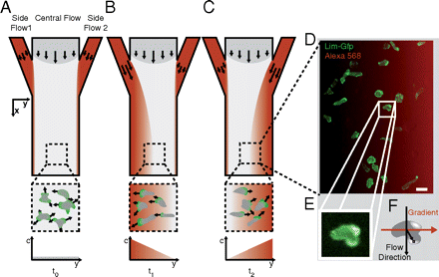
In vitro Chemotaxis
Boyden Chamber
Under-Agarose Assay
Microfluidics

