Slide 1
A modular positive feedback-based gene amplifier
Goutam J Nistala, Kang Wu, Christopher V Rao, Kaustbh D. Bhalerao
Presented by
Raven Reddy and Colin Reisterer
March 9, 2011
Notes:
Impedence mismatch—amplifier vs. mutation deisgn
Remind people of quorum sensing (what is it??)
Protein concentrations were different
How useful is this without a deeper understanding? Is this engineering approach useful?
Strength of PompC affects sensitivity of the system. 2 components make it more robust
Different amounts of transcription based on where the gene is in the operon
Discuss relative fluorescence

Slide 2
Positive Feedback
Gene product enhances its own production
Amplification
Bistability
Hysteresis
Oscillation

Slide 3
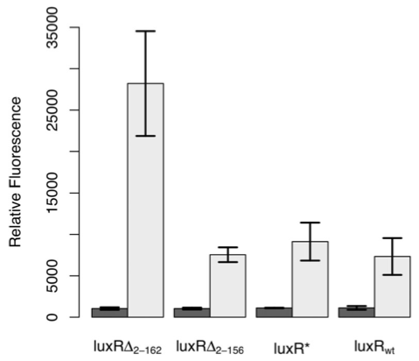
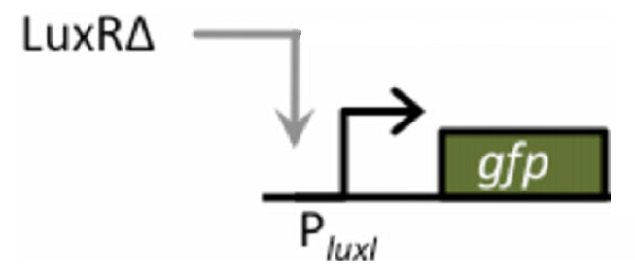
Constitutively Active LuxR

Slide 4
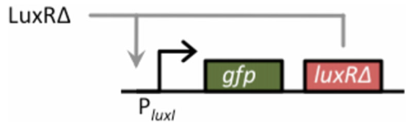
Positive Feedback Amplifier
Input: LuxRΔ
Output: LuxRΔ, GFP

Slide 5
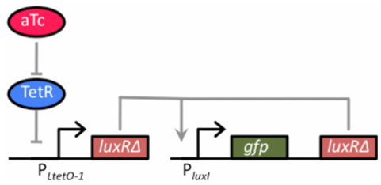
One Component System
Input: aTc
Output: LuxRΔ, GFP

Slide 6
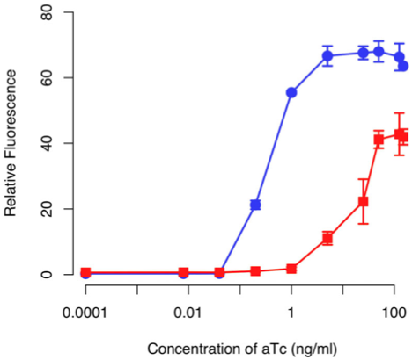

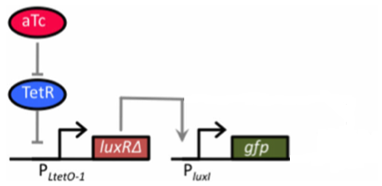
One Component System

Slide 7
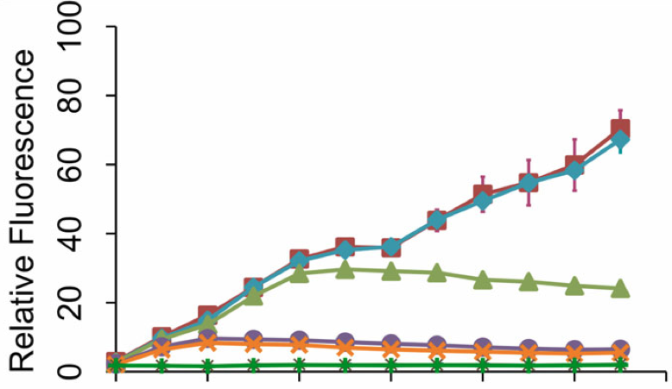
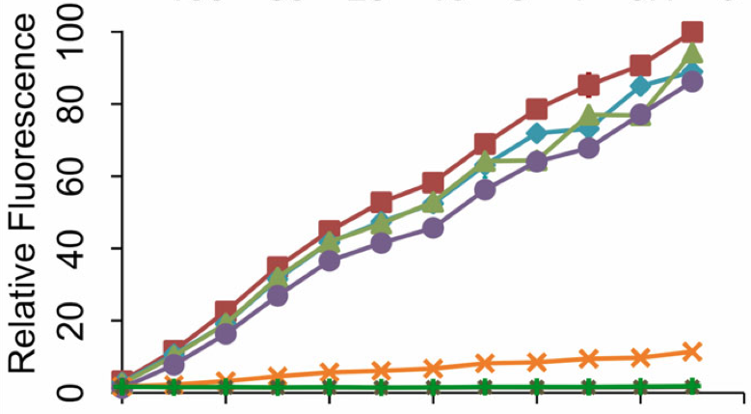

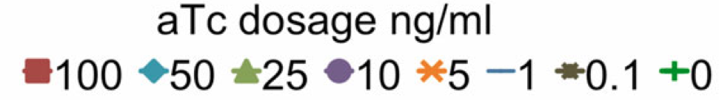
One Component System
Time Dependent Dosing Conditions
With Postive Feedback
Without Postive Feedback

Slide 8
One Component System
Tried to create “memory”

Slide 9
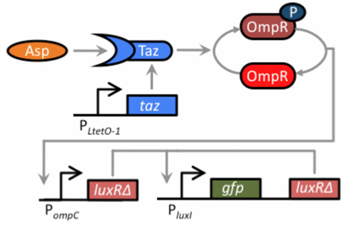
Two Component System
Input: Aspartate
Output: LuxRΔ, GFP

Slide 10
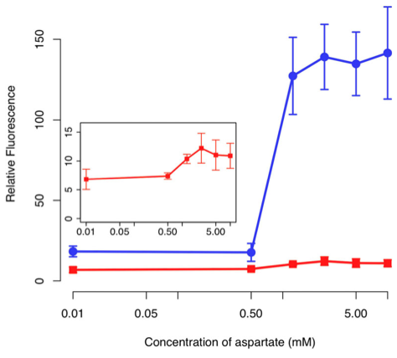
Two Component System
Sensor output

Slide 11
Conclusions
Proved modularity of LuxRΔ positive feedback system
Application to impedance matching?
Future goal: better predictability
Transient signal?

